Slide 1
Setting a SMART Goal for Your Club

Slide 2
How many of us have club meetings that go something like this?

Slide 3
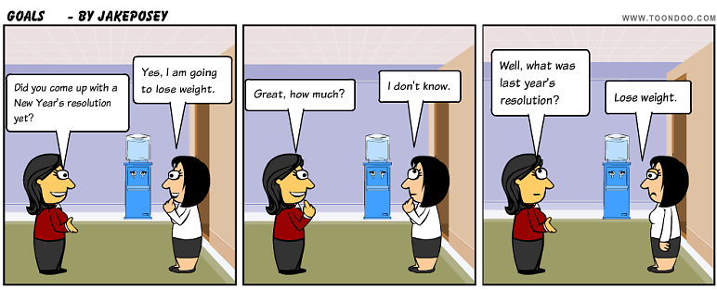

Slide 4
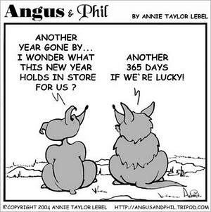
Why does this happen to us, meeting after meeting, year after year?

Slide 5
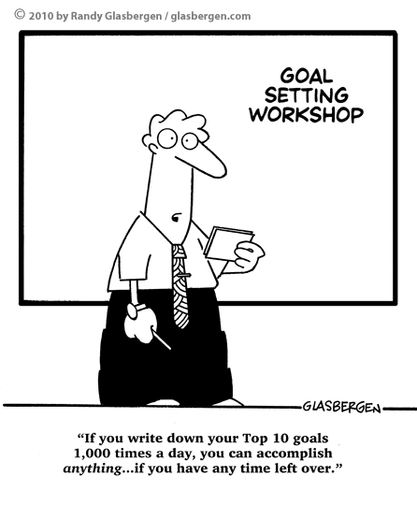
How do we set the goals for our club?

Slide 6
If we change HOW we set our goals, we can change what happens with our goals.

Slide 7
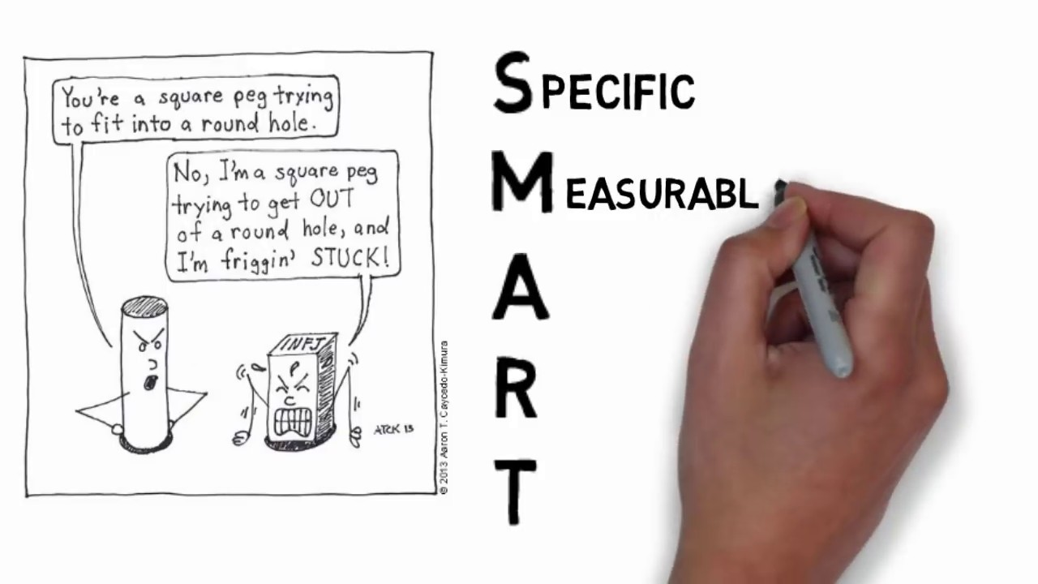
SMART goals give us a focus, a timeframe, and a measure of success.

Slide 8
S
SPECIFIC
Who will do it?
What will we do?
Where will we do it?
How will we do it?

Slide 9
M
MEASURABLE
What numbers are we going to use to track our success?
How will we know when we met our goal?

Slide 10
A
ATTAINABLE
Double check—Do we have the skills, knowledge, and resources to achieve our goal?
  IF YES, move on.
  IF NO, go back to the brainstorming stage.
What help do you need to meet your goal?

Slide 11
R
RELEVANT
Why do you want to do this project?
Why is this important to your club?
Why is this important to your community?

Slide 12
T
TIME-BASED
When will you complete your project?
When will you debrief to plan for next time?

Slide 13
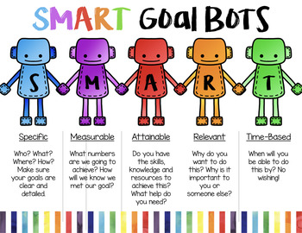

Slide 14

What new thoughts do you have now?

Slide 15

Now go out there and

