Slide 1
So, You Want to Be A Governor?
Follow-Up
Adapted from original presentations by Paul Lucas, Gerri Barnette, and Marguerite Fesheke
Notes:
After this session, we are wanting those who are TRULY interested to put your name on a list. This will help us determine timelines and ways to nurture those who would like to be Governor. We are here to help you!

Slide 2
Or how to enjoy leadership at every level!

Slide 3
Notes:
Everyone comes to the President / Lt. Governor / Governor role on their own path. No two are exactly the same. But one reason that some Districts, such as the Iowa District, are successful is because of the unofficial prepping that is given to people to be Governors. The same could apply to Club Presidents and Lt. Governors. Such as an unofficial checklist. Perhaps this unofficial training should become formal so that we, as a group, are more consistent. It would be beneficial for the Governor position to flow from one year to the next.
Remember, all educational sessions at all levels are geared to helping us all be better volunteers in support of youth!

Slide 6
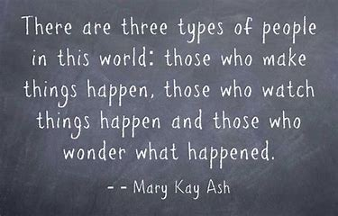

Slide 7
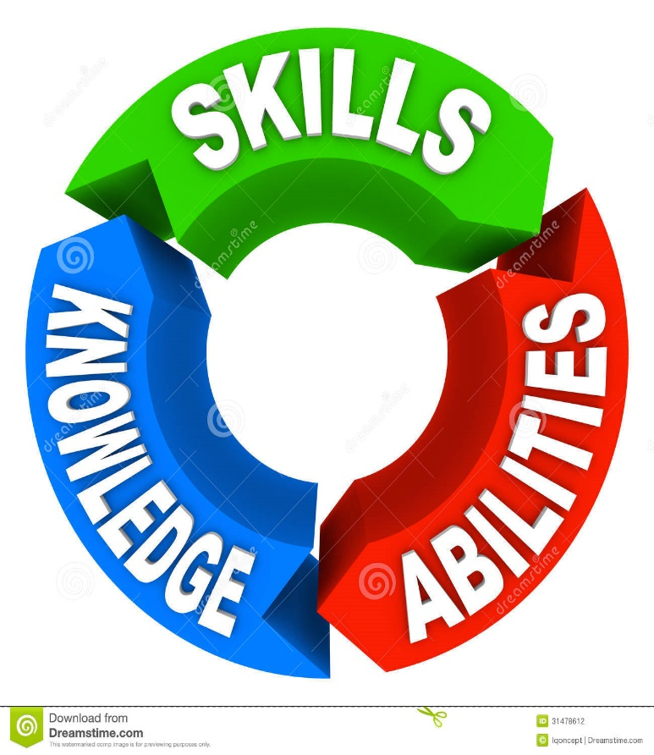
-Desire
-Passion
-Leadership Qualities
-Be a Motivator
-Organizational Skills
-Enthusiasm
-Knowledge
Qualifications:
Notes:
Qualifications: you should have the desire, the passion, and leadership qualities, be a motivating factor, and have organizational skills, enthusiasm, and knowledge of the OI Organization. From this list you know what attributes you have and what YOU need to work on. I would tell you that knowledge of Optimist International, its history, programs and who/what can offer support is a huge factor. And know you can count on me or any of your predecessors to help you! We are your support system.

Slide 8
Membership-New Club Building-Foundation-CCC
Notes:
Think about your Goals. This is part of the unofficial check list, thinking about them now gives you a basis to build on. Do you have some changes you would like to see in the your club or our District? This is a way to be effective in making changes. Without change, our clubs and our District will stagnate.

Slide 9
CLUB PRESIDENT
ZONE LT. GOVERNOR
Notes:
Of course, to be a District Governor, you must have been or will be a President and Lt. Governor. It’s in the OI and East Missouri Policies.
If you have not been a Club President or Lt. Governor, these are positions to put on your checklist of things To Do. Not sure? Take small steps starting with club committee chair and District committee chair. These are ways to get going.

Slide 10
Theme
Motto
Notes:
No matter what position you are aspiring too, you will probably need these. Whether it’s a committee selling beer at your town’s festival [Pints to benefit ½ pints (meaning kids)] or as District Governor incorporating the Optimist International President’s theme.

Slide 11
Thinking about your Goals, Theme, and Motto gives you
Direction and Focus.
Notes:
What will be the theme for my year as Club President? What do I want to change from past years? What do I want to retain from past years?

Slide 12
Spousal Support
Club Members Support
Club Support
Predecessor Support
Past Governor Support
We’re all here for YOU!
Notes:
OI committee chairs are available. OI Regional Vice President – call him or her. And for Governor, your employer’s support.

Slide 13
Communication is key. Seek advice
And give it. Listen. State clearly
what you expect. Respond to others.

Slide 14
Don’t be this guy
As a Lt. Governor, he turns in nothing and had no report from his Zone, and chose to stay at breakfast for almost two hours instead of coming to the meeting when it started.
Successful leaders have a zeal for completing things timely and maybe with a bit of flair!
Report
Page 1 of 10
Notes:
Some things are just required. Period. From club committee chair to Governor, do them to your best and let your enthusiasm shine through! When you put your heart in it, everyone will feel your passion.

Slide 15
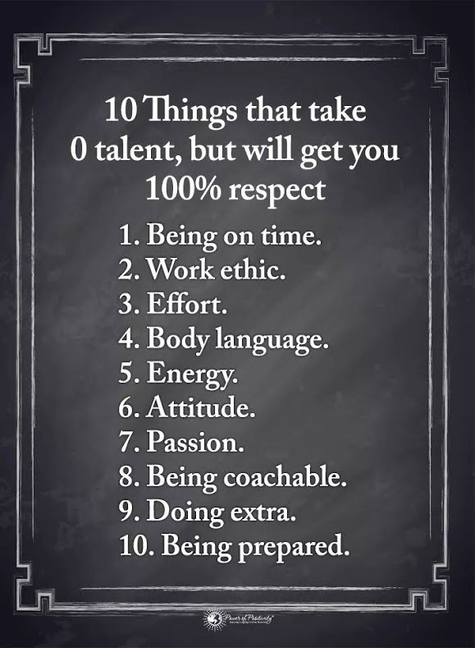

Slide 16
Notes:
No matter what position you are considering, there is already a team in place – above you at a higher level in OI and your predecessors. Plus you will be creating your OWN team.

Slide 17
Notes:
These are some of the factors to look at when choosing your team. What is the job or position? Who might be good at it and why? Are they readily available to do that task? As you start contemplating these factors, your team will shape up.

Slide 18
GROWTH
Strategies and Tactics…to achieve that Objective
-Strong District Chairs for
Membership
Retention
New Club Building
Club Fitness
-Develop a strategic plan
Notes:
Goals for growth are important. BUT think of the BIG picture…what will be YOUR plans for the District or your club?

Slide 19
-Membership Chair
-New Club Building
Chair
-Help Your
Club Build a
New Club
-Bring in New
Members
Notes:
You should have experience on the District Growth Team. So, add Membership or New Club Building Chair to your checklist. When you chair your club’s membership committee, think of new ways to entice new members. Can’t think of anything? Attend Conferences and OI Convention for ideas. Have you participated in Building a New Club?
Start there and get yourself on a Building Team for your local Club. It is not necessary to being a President or Governor but it helps you when you are Governor as you are responsible for Growing your District. Bring in New Members —that is VERY important.

Slide 20
Oratorical Chair
Childhood Cancer Campaign Chair
Convention Chair
JOI Chair
Notes:
Continuing with the unofficial checklist: Some District Chairs it is suggested that you have held….again, not necessary to be Governor but incredibly helpful.
A Scholarship Chair: Essay, Oratorical (especially), CCDHH. The Childhood Cancer Campaign Chair. Experience putting on a Convention so District Convention Chair or JOI Chair because as JOI Chair you put on the JOI Convention. If not the Chair at least get on a Convention Committee and get hands-on experience. We already talked about a Growth Chair (Membership or New Club Building) and lastly I would add Club Fitness. This Chair explores the health and well-being of Clubs and would be good education. Any questions or discussion about these Chairs. Another point: these are committees that need members and mentors for future chairs!

Slide 21
Essay Chair
OIF Chair
PDP / PGI Chair
Activities Chair
Notes:
Continuing with the unofficial checklist: Some club or District Chairs it is suggested that you have held….again, not necessary to be President or Governor but incredibly helpful.
If not the Chair at least get on a Committee and get hands-on experience. We already talked about a Growth Chair or Membership position. Another point: these are committees that need members and mentors for future chairs! Additionally for club level, set your fund raiser chairs and service project chairs even before your year starts so you can hit the ground running!

Slide 22
Attend Meetings, Conferences,
& Conventions!
Groundwork

Slide 23
Notes:
Getting all the training that is offered to you. Definitely! Sometimes we feel that at the end of our year as _____[you fill in the blank]______ is when we finally understand the job. Here’s a thought: teach a workshop on a District Chair topic! It is great training for you. You learn about your subject and you get practice speaking in front of a group. Teaching also introduces you to the District’s Membership. And the same applies at your club level. It’s a win-win!

Slide 24
Attend International Conventions
June 27-30, 2020
Renaissance Schaumburg Convention Center Hotel
Schaumburg, IL (Chicago Northwest)
Notes:
Speaking of Training…Put this on your Check list: Plan to Attend Optimist International Conventions! It is a great way to gain a lot of knowledge and perspective on various District Chair and even club positions. You meet others and gain knowledge and ideas from them! Remember my earlier comment about where to get ideas? It’s also a great way to network and hear lots of ideas that you can incorporate into planning your Governorship or your year as President or even as a committee chair.

Slide 25
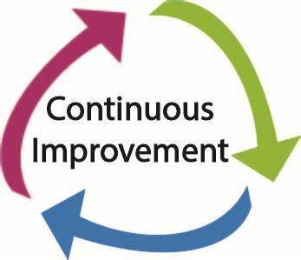

Slide 26
Qualifications: (desire, passion, leadership qualities, be a motivating factor, organization skills, and enthusiasm)
Knowledge of the OI Organization

Slide 27
Attend Conferences: (meet the people, collect the bulletins, take notes)
Do the Paperwork: (File those reports timely)

Slide 28
Humm, what’s in it for me?
Notes:
There are many benefits of being a leader whether club president, Lt. Governor, or Governor. You get to work with fellow members in new capacities. You get to learn their hidden talents. You get to visit new clubs and learn what they are doing and how they are doing it. You really get to know many new friends! You learn new ways of improving yourself and then you are better prepared to help others. You receive as much as you give.

Slide 29
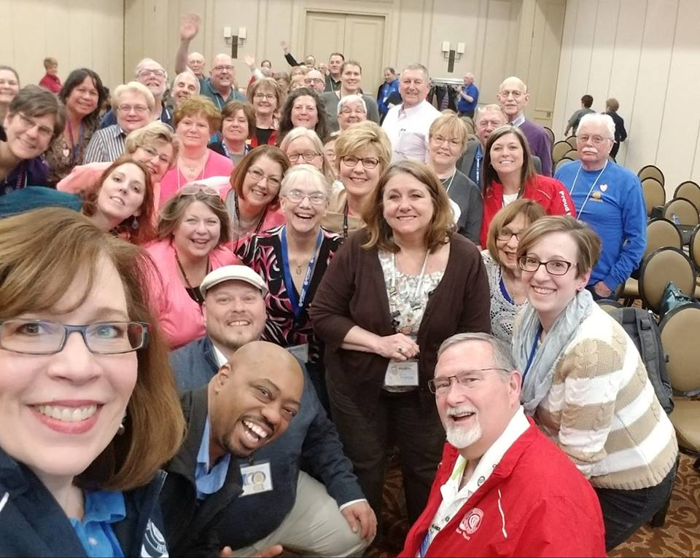
You are not alone!

Slide 30
Notes:
Thank you for coming to this session today. [The plan will be to have a session for the Pre Governor Group at each of the upcoming quarter conference] WHAT ARE YOUR QUESTIONS???

Slide 32
Notes:
What are YOUR goals?

