Slide 1

Inclusion
A Strategy for Advocacy in
the Community

Slide 2
The ArC Community Advocates
We exist as an advocacy organization to make it possible for each person with a developmental disability to participate fully in all aspects of community and to support the effort of each individual to determine their own future.

Slide 3
Inclusion definition
The action or state of including or of being included within a group or structure
The practice or policy of providing equal access to opportunities and resources for people who might otherwise be excluded or marginalizes, such as those who have disabilities and members of other minority and/or marginalized groups

Slide 4
Definitions
Advocacy
Publicly supporting a particular cause or proposal, actions that speak on behalf of others
Allyship
The active, consistent and lifelong practice of using one’s privilege and power to support, amplify, and advocate for marginalized individuals or groups.
Allyship involves listening, self-education, and taking action to challenge systemic inequality, rather than offering passive support.
Accomplice
Individual who actively works to dismantle systems of oppression.
They have worked through initial phase of allyship and done the work of learning and understanding their roles in upholding unjust structures.

Slide 5
Diversity is the presence of differences, inclusion is the deliberate practice of ensuring those differences are valued, heard and integrated
Inclusion is an act of advocacy because it moves beyond passive acceptance to actively dismantling the structural, social, and cultural barriers that exclude marginalized groups.

Slide 6


Slide 7
Champions of Inclusion as Advocacy
Martin King Jr
Injustice anywhere is a threat to justice everywhere (or, exclusion anywhere
is a threat to inclusion everywhere)
People fail to get along because they fear each other; they fear each other because
they don’t know each other; they don’t know each other because
they have not communicated with each other.

Slide 8
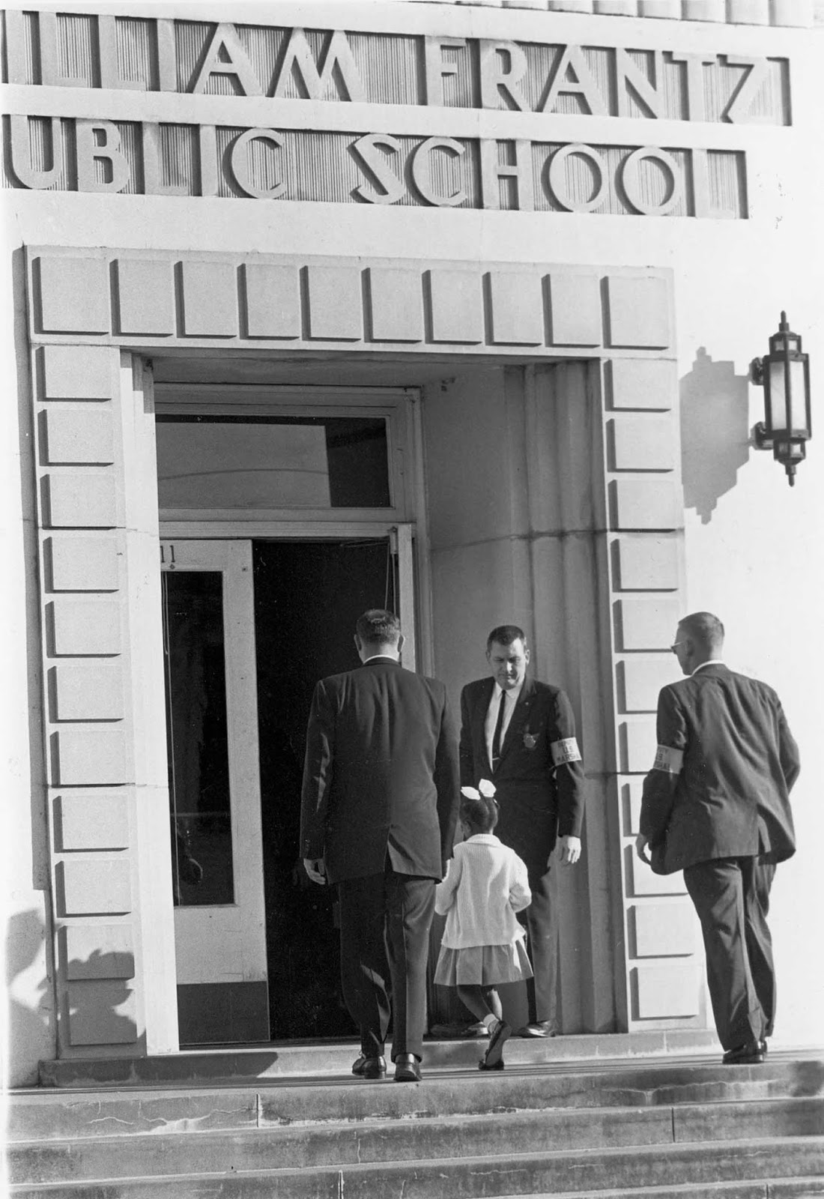

Slide 9
Champions of Inclusion as Advocacy
Ruby Bridges
6 years old
Federal Marshalls and family held her up
Only student in her class for the first year
No 6 year old does this on her own---her family, friends and
the federal government supported her

Slide 10
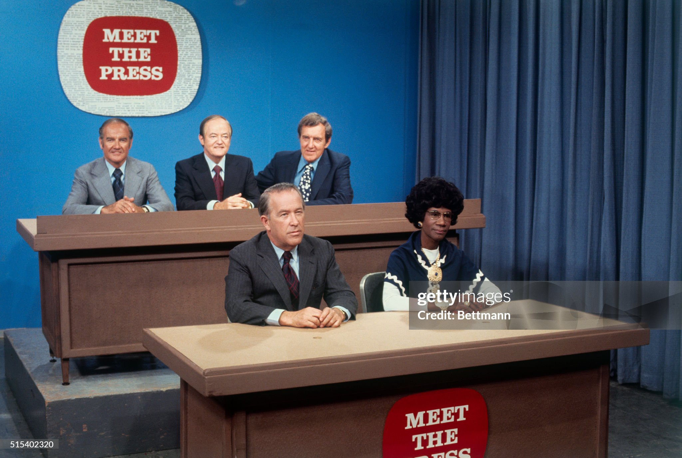

Slide 11
Champions of Inclusion as Advocacy
Shirley Chisholm
“If they don’t give you a seat at the table, bring a folding chair”
First black woman elected to the US Congress
First black candidate for a major party nomination for President of the US
In congress Expanded Food Assistance program
Brought people along---prioritized hiring women and African Americans

Slide 12
How Inclusion Functions as Advocacy
Systemic Restructuring:
Inclusion advocacy involves challenging and changing the blueprint of a community or an organization.
This means pushing for laws, regulations and/or policies like inclusive hiring practices and accessible infrastructure that fix the systems that cause exclusion (rather than just treating the systems)

Slide 13
How inclusion functions as advocacy
Amplifying Unheard Voices
It is an act of advocacy to step back and create space for marginalized individuals to tell their own stories.
This shifts the power dynamic, ensuring that those most impacted
by a decision are the ones leading the conversation

Slide 14
How inclusion functions as advocacy
Challenging Everyday Biases
Advocacy happens in small, daily choices, such as redirecting a meeting’s attention to someone who was interrupted or calling out a microaggression. These acts signal that exclusionary behavior is unacceptable and set a new cultural standard.

Slide 15
How inclusion functions as advocacy
Fostering Equitable Outcomes
Unlike equality (treating everyone the same),
inclusion advocacy focuses on equity—providing specific supports
or accommodations so that every individual
has an equal opportunity to succeed

Slide 16
Presence as advocacy
How to reduce discrimination and promote radical inclusion by your presence
Presence as education, although not the responsibility of the oppressed to educate the majority
People won’t do or say things when they are face-to-face as readily as on social media

Slide 17
Presence as advocacy
Presence changes the minds and hearts of those around you:
President Lyndon Johnson supported the Civil Rights act based on his experience teaching in an Elementary School with predominantly African–American students who were impoverished. He also initiated the “War on Poverty”, establishing Medicare and expanding Social Security benefits as well as signing the bill creating federal Food Assistance program
Autism benefit for Medicaid happened due to Lt. Governor Calley who has family member with ASD, he cared about somebody with Autism Spectrum Disorder

Slide 18
In our community
Build bridges when in community with individuals with I/DD:
Make eye contact
Talk with everyone
Notice everything---identify commonalities, interests
Say hello, chit-chat
Live--Model including all marginalized communities:
See everyone, make eye contact, smile, use “Friendly eyes”
Value and respect all marginalized communities, build bridges with them. Lift them up

Slide 19
importance
Executive Order 14151 Ending Radical and Wasteful Government DEI Programs and Preferencing
Seeks to end DEI programs throughout the federal government
Ending Illegal Discrimination and Restoring Merit-Based Opportunity revokes DEI initiatives from previous administrations, including
Advancing Racial Equity and Support for Underserved Communities throughout the federal government

Slide 20
Why DEI or DEIB
Pete Buttigieg explains the purpose of DEI to regular folks. | John Smith Marketing | Facebook

Slide 21
Inclusion
Means
Everyone

