Slide 1
What makes WM Different?
Wealth Management as A Career

Slide 2
Wealth Management
Wealth management is a broad topic that is often used to describe investment and financial sector areas such as:
Preferred Banking
Private Banking
Independent Financial Advisory
Family Offices
Insurance Brokers
Stock Brokers, etc

Slide 3
Evolution of WM in Personal Banking
What is Wealth Management:
Is it Private Banking?
Is it Financial Planning?
Is it Banc assurance?
Is it Retail Financial Services?
Is it the Financial Services “Supermarket”?
The definition of Wealth Management has evolved over time & over markets…

Slide 4
What is Wealth Management?

Slide 5
Wealth Management Formula

Slide 6
What does a Wealth Manager Advise On?

Slide 7
How Wealth Management is Different?

Slide 8
What does a Wealth Management Client Want?

Slide 9
Wealth Management in India

Slide 10
Wealth Management In India
Wealth Management is the new buzzword in Financial Services Sector
Increased Demand for Private Bankers due to increased Wealth.
There are more than 2,500 established private bankers in India, with 200 of them managing over Rs 1,000 crore, according to estimates by Vito India, a leading executive search firm.
Most wealth management firms increased their headcount last year, anticipating larger business volumes in the future.
IIFL added 250, Centrum Wealth added 135, while Edelweiss, Aditya Birla and Kotak Wealth beefed up their wealth desks by 50 each.

Slide 11
Wealth Management In India
Leading Wealth Managers believe the opportunity for growth is significantly bigger from a longer-term career perspective in Wealth Management than in Investment Banking, with its larger market size and revenue pool. Plus, compensation is more attractive due to the dearth of quality talent.
However, the amount of wealth being managed by institutional players is less than 25%, leading to robust demand.
Indian wealth managers earn as much or even more than global counterparts — as much as 20-25% of revenue generated against 12-18% internationally, according to Vito data.

Slide 12
Wealth Management In India
The increasing demand for wealth managers is also because many outfits are looking to penetrate newer territories by opening offices in tier two cities.
Indian wealth managers are addressing a market with Rs 100 lakh crore ($1.5 trillion) of investible wealth, expected to double in the next five years.

Slide 14
Economic Times

Slide 15
What is Chartered Wealth Management Designation?
#1 Designation in Wealth Management

Slide 16
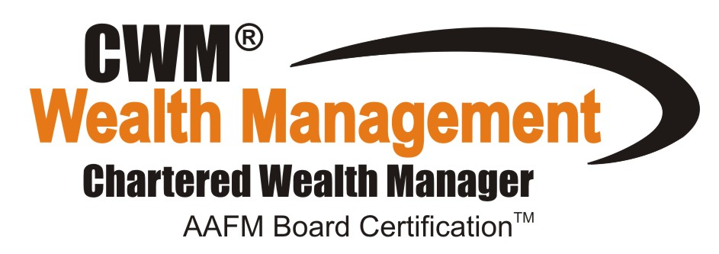
"Highest Paying Top Ranked Internationally Accepted Certification, Valid in 151+ Countries."

Slide 17
Chartered Wealth Management® A Symbol of Integrity and Professional Excellence

Slide 18
Chartered Wealth Management® (CWM®) is an international certification in the field of Wealth Management, Financial Planning, and Financial Advisory Services.
50000+ CWM® Certificants Worldwide.
The AAFM CWM® program is a TUV Accredited and ISO certified 9001 and ISO certified 29990 training program.

Slide 19
What will I learn in Chartered Wealth Management Certification?

Slide 20
Wealth Management
Wealth Enhancement Strategies
Wealth Protection Strategies
Wealth Transfer Strategies

Slide 21
Wealth Management
Onshore Wealth Management
Offshore Wealth Management

Slide 22
Asset Classes
Equity
Debt
Real Estate
Alternate Investments
Commodities

Slide 23
Specialized Topics
Fundamental & Technical Analysis
Behavioral Finance
Portfolio Management Strategies
International Taxation
Will & Trust Planning

Slide 24
CWM Academic Requirements
CWM®
Level 1
Level 2
Project Work

Slide 25
CWM Curriculum
CWM® Level 1
Concept of Wealth Management
Indian & Global Financial System
Investment Vehicles in Wealth Management
Measuring Investment Risk & Returns
Concept of Insurance & Risk Management
Role of Wealth Management in Banking
Legalities in Wealth Management
Tax Laws in Wealth Management
Life Cycle Management
Intergenerational Wealth Transfer & Tax Planning

Slide 26
CWM Curriculum
CWM® Level 2
Equity Analysis
Alternative Products in Wealth Management
Real Estate Valuation & Analysis
Behavioral Finance in Wealth Management
Relationship Management by a Wealth Manager
Loan and Debt Management
Portfolio Management Strategies
International Tax & Trust Planning
Wealth Management Planning
Advanced Wealth Management

Slide 27
Benefits of CWM® Designation
Higher Compensation
International Recognition
Knowledge with Global Perspective
Valid in 151+ Countries
Certification Directly from AAFM USA
Access to Global Network

Slide 28
Career Opportunities
Chartered Wealth Manager Career Opportunities

Slide 29
HUGE DEMAND SUPPLY GAP FOR CWM® IN INDIA :

Slide 30
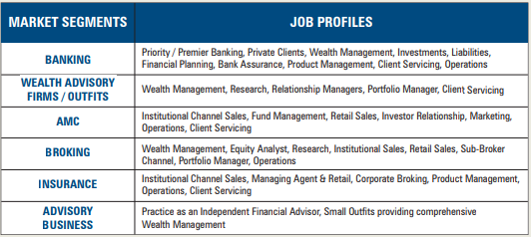
Job Profiles :

Slide 31
Employers Respect the Value of CWM® Certification
Valued and recognized by CEOs/Senior Executives in Wealth
Advisory and Private Banking and leading corporations as a
differentiator among current staff and potential new hires.
82% of Top 500 Banks/ Wealth Management Organizations employ CWMs
Wealth Advisory/Private Banking jobs require or prefer CWM
Online job boards tracked include:
Monster, eFinancialCareers.com, FINS, JobsintheMoney,
CareerBuilder, AAFM Global Career Center

Slide 33
Career Opportunities

Slide 34
AAFM as a Global Body

Slide 35
AAFM® as a Global Body
Background
Founded in Year 1996 – 18 Years Old Organization
Offices in 17 Countries like USA, UK, China, Hong Kong, Singapore, Taiwan, Dubai, Europe, India and more…….
Approx. 3,00,000 Certificants Globally and 50,000 CWM®
Members Present in 151+ Countries
Top 800 Business Schools Globally are now recognized and registered educational programs that qualify for educational credit for AAFM™ Membership

Slide 36
AAFM® as a Global Body
Credentials of the Institution
AACSB Accreditation (http://www.aacsb.edu/membership/MemberListings/corplist.asp)
ACBSP Accreditation (http://www.acbsp.org/p/cm/ld/fid=15)
Prof. G Mentz, Global CEO is a Distinguished Fellow of Royal Society of Fellows (http://royalfellows.org/id12.html)
Contributory Recognition by US Dept. of Labor in their Occupational Handbook (http://books.google.co.in/books?id=5oxGNtegbzsC&pg=PA105&dq=%22american+academy+of+financial+management%22+occupational+outlook&hl=en&ei=T9n7TPW8PIKsQPRnND2DQ&sa=X&oi=book_result&ct=result&redir_esc=y#v=onepage&q=%22american%20academy%20of%20financial%20management%22%20occupational%20outlook&f=false)
Top Designations in the USA in Forbes News (http://www.forbes.com/sites/investor/2011/07/05/how-to-check-out-your-stock-broker/3/)
AAFM India Tie-Up with BSE INDIA for conducting Financial Literacy Programs all across India
CWM Designation Recognized in WiseAdvisor.com http://www.wiseradvisor.com/designations-detail~id~45~des~chartered-wealth-manager-cwm.asp

Slide 37
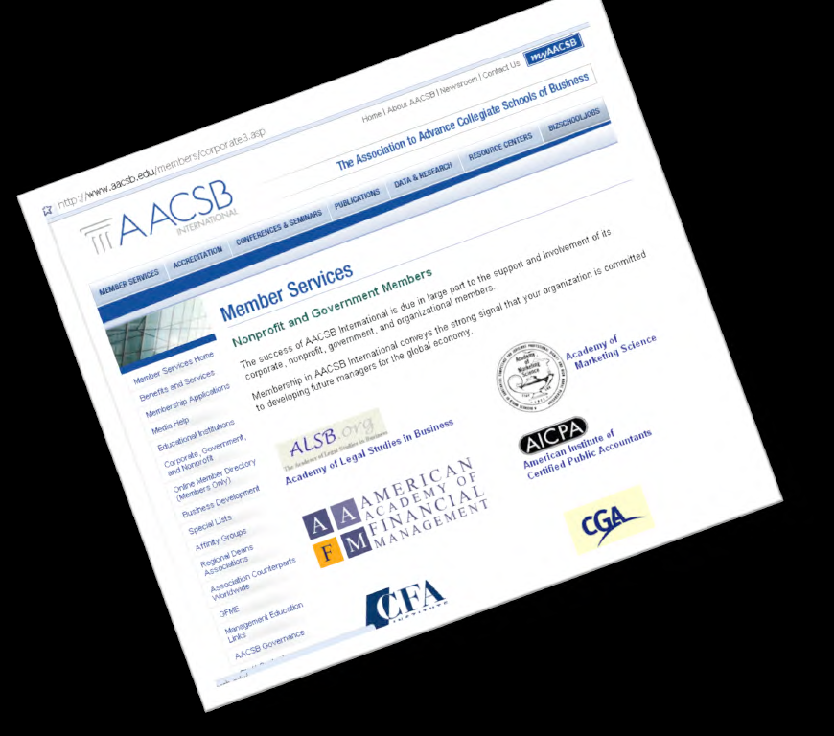
AACSB Accreditation

Slide 38
AAFM® as a Global Body
Credentials of the Institution
Top 10 Designations by WSG Include CWM® (http://www.wallstreetglobe.com/news.html)
NOCA ,National Organization for Competency Assurance - ICE - AAFM - IBS International Board of Standards is a: Certifying Organizational Member (http://www.credentialingexcellence.org/GeneralCertificationInfomation/MemberOrganizations/ICEOrganizationalMembers/tabid/68/Default.aspx)
Middle East Presence - AABFS Arab Academy of Banking and Financial Sciences (http://web.archive.org/web/20100204225548/http://www.aabfs.org/English/EnShowNews.asp?NewsID=749)
Financial Planning Standards Council (CFP Board of Canada) recognizes CWM® for CE Points (https://www.fpsc.ca/ce-course-providers)
ANSI American National Standards Institute - AAFM IBS International Board of Standards is a: Prof. Member (https://eseries.ansi.org/Source/directory/Search.cfm)
Many More Accreditations and Credential…

Slide 39
Global Presence
50,000+ Certificants across the Globe

Slide 40
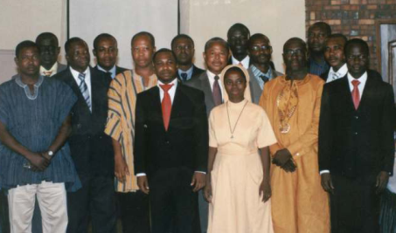
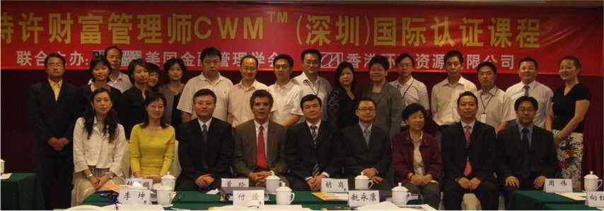
Global Presence - 150+ Countries & Truly
Global Since 1996…
Ghana, Africa
USA
Athens, Greece
Kuwait City
Hong Kong (SAR)
Doha, Qatar
Taipei, Taiwan
Dubai, UAE
Mainland - China

Slide 41
AAFM @ Asian Financial Industry
AAFM® Asia has conducted In-house & Offsite Training for the following corporates
AIA Singapore – Life Insurance
ANZ Bank
ACE Insurance
Am Bank Group
American Chamber of Commerce
BNP Paribas
Bank Julius Baer
Bank of China
Bank of East Asia
Bank of New York
Bank of Singapore
Barclays Wealth
CIMB
China Everbright Bank
China Merchant Bank
Citibank
DBS
Goldman Sachs
Gulf Bank
HSBC
Hong Leong Bank
ING Fund Management
Prudential Asset Management Prudential Assurance
Royal Bank of Scotland
Shanghai Pudong Development Bank
Singapore Exchange Standard Chartered Bank
UBS
United Oversees Bank
Many More ……………

Slide 42
AAFM @ China Financial Industry
AIG
Bank of America
Citibank
HSBC
ING Life Insurance
Standard Chartered Bank
ABN Amro Bank
Bank BNP Paribas
Paris, France
CIGNA Group
American Healthy Life
Bank of America
Merrill Lynch
Morgan Stanley Securities
City commercial banks
New York Life International
The Bank of Communications (China)
Agricultural Bank (China)
Chinese Farmers Bank of Abu Dhabi
Commercial Bank India
Abu Dhabi Commercial Bank
Commercial Bank of Kuwait
Central Bank of the UAE United Arab Emirates
Central bank Everbright Bank
Huaxia Bank
CITIC Bank
Joint-stock banks

Slide 43
GET WEALTH MANAGEMENT’S HIGHEST DESIGNATION
BUILDING WEALTH MANAGERS OF TOMORROW

