Slide 1
Roseville Youth Soccer Club
2019 Coaches Meeting – U6-U14
July 25, 2018
Maidu Community Center

Slide 2
U6-U14 Coaches
Welcome and Introductions
Opening remarks

Slide 3
Agenda
Collect signed page 22 from each coach
RYSC Coaching Manual Overview
First Practice
2016 Changes
Age Matrix
Small Sided Games
Rules on Headers/Concussion Protocol
Zero Tolerance Policy
Uniforms
Team Equipment Distribution
Team Managers Open House
Field Usage and Field Permits
Practice Scheduling
New Coaches Licensing Protocols
Field Equipment
Weather
Questions
The Registrar
Notes:
Tony

Slide 4
RYSC Coaching Manual
Setting up an introductory meeting
Finding Team Manager
Finding Assistant Coaches: Get the live scanned to get coaching card
Communication: Consider using apps such as team snap or shutter fly
Player Passes
Downloads available through Rosevillesoccer.com
Notes:
Tony

Slide 5
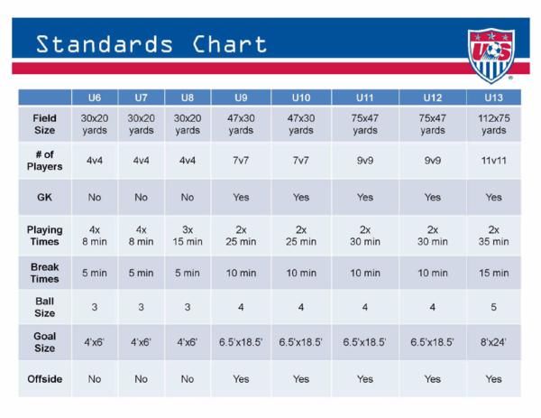
Age Matrix: U8 is 4X10

Slide 6
FIRST PRACTICE
Be Prepared: Have equipment set up and ready, show up 15 – 20 mins early
Make sure players are prepared: Cleats, shin guards, socks, soccer ball, and water
Warm Up:
Stretches, try to incorporate soccer ball in warm up and run. More touches the better
Introduce a Drill -
Play A Game
Cool down and reinforce learning objective

Slide 7
Small Sided Games
Fewer players on the field means more touches on the ball and greater involvement in game for each player.
As players become more involved, skill and confidence improve.
As confidence improves, players make faster and better decisions.
Less emphasis on positions; all players attack and defend.
NO CAMPING – Do not place a player to “sit” in front of the goal – essentially defensive players should be “marking” offensive players.
Parents should be on a sideline away from opposing players and coaches – they should NEVER be behind the goal.
Coaches will referee their own games. The dynamic/rotation can be decided upon by the coaches.

Slide 8
Small Sided Games in General Cont.
U6 – U8 USE A SIZE “3” BALL
4 V 4 FORMAT - EITHER ALL ATTACKING OR ALL DEFENDING
Substitutions should take place at the end of the quarter, unless an injury occurs or a player needs to leave the field.
Quarter Breaks – should allow just enough time for the coach to allow a quick water break and a brief talk with the team – no more than 2 minutes please, it’s important to keep the games moving.
Halftime Break – again, please limit this break to 4 minutes, no more than 5 minutes. Just enough time for all of the players to get some water.
After the game is the time to have a brief talk with the team and parents regarding gameplay, attitude, effort and focus.

Slide 9
SMALL SIDED GAME RULES
4 V 4
STANDARDS OF PLAY
KICK OFFS, FREE KICKS, THROW-INS, GOAL KICKS AND CORNER KICKS ARE USED TO START OR RESTART PLAY
KICK-INS AND/ OR DRIBBLE-INS ARE ALSO ACCEPTABLE
GOAL KICKS AND CORNER KICKS SHOULD BE TAKEN IN THE GENERAL VICINITY OF THE RESPECTIVE GOAL OR CORNER
IF USED, ALL FREE KICKS ARE INDIRECT
OPPONENTS SHOULD BE 10 FEET AWAY FROM THE BALL ON ALL RESTARTS
NO PENALTY KICKS
NO OFFSIDES
**IMPORTANT** Before every game, please talk to the opposing coach as to how you both intend to call the game. These rules are more of a guideline, and are ABSOLUTELY NOT intended to slow down or stop the game.

Slide 10
Rules on Headers (U6-U14)
No heading for any players participating at U14 or below.
When a player deliberately heads the ball in a game, an indirect free kick should be awarded to the opposing team from the spot of the offense.
If a player deliberately heads a ball within their goal area, the indirect free kick by the attacking team should be taken on the goal area line parallel to the goal line at the point nearest to where the infringement occurred.
Notes:
Jim

Slide 11
Concussion Protocol
Concussion Protocol & Procedures
Notes:
Jim

Slide 12
District VI Zero Tolerance Policy
Each coach, player, and spectator shall at all times support the Referee and assistant Referees. Negative or critical comments directed to any member of the Referee crew will not be tolerated.
No one is to address a Referee in a negative manner immediately before, during, or after the game.
It is the responsibility of ALL coaches to maintain the highest standards of conduct for themselves, their players, and supporters in all matches.
Abusive and obscene language, violent play, violent conduct, fighting, and other behavior detrimental to the game will not be tolerated.
A coach’s responsibility for Referee support and spectator control includes the times prior to, during, and after the game at the field and surrounding areas.

Slide 13
District VI Zero Tolerance Policy
Coaches, players, and sideline spectators may NOT address any member of the Referee crew during play except for:
Responding to a Referee-initiated communication.
Making a request for substitutions.
Pointing out emergencies or safety issues, such as an injured player on the field.
To request clarification of any call, provided the request is courteous and non-argumentative.
A Referee may caution any coach for his/her failure to abide by this Zero-Tolerance Policy. Any coach who continues to violate this Policy may thereafter be dismissed from the game by the Referee.
A Referee may dismiss a coach for any egregious action, including, but not limited to, abusive language or any implied or actual threat of physical abuse. A prior warning is not required.

Slide 14
2019/20 Laws of the Game MODIFICATIONS Summary
LAW 3: THE PLAYERS
Subs must leave the field at the nearest point on the boundary line, unless otherwise directed by the referee.
LAW 5: THE REFEREE
Team Officials (coaches) guilty of misconduct can be shown a YC/RC
If an offender cannot be identified, the senior coach in the technical area receives the YC/RC.
If a PK is awarded, the team’s PK taker can receive assessment or treatment and then stay on the field and take
the kick
LAW 7: THE DURATION OF THE MATCH
Hydration Breaks (water/drink breaks) not to exceed 1 minute
Cooling Breaks (to cool down the body) from 90 seconds to 3 minutes
LAW 8: THE START AND RESTART
Coin toss - winner of coin toss may select kick-off (ball) or goal to attack/defend (side). According to their
selection, the other team takes the other option.
Drop Ball – all drop balls are uncontested. The ball is in play when it is dropped and it touches the ground
* If play is stopped in the Penalty Area (for a non-misconduct call), the ball is dropped for the Keeper
* If play is stopped anywhere else on the field (non-misconduct call), the ball is dropped for the
team/player who last touched the ball at the location of the last touch.
* All other players (of both teams) MUST be at least 4.5 yards away.

Slide 15
2019/20 Laws of the Game MODIFICATIONS Summary
LAW 12: FOULS AND MISCONDUCTS
HANDBALL - It’s an offence if the hand/arm has made the player’s body unnaturally bigger or if the hand/arm is
above/beyond their shoulder level.
HANDBALL - It is NOT usually an offence if the ball touches the player’s hand/arm directly from a player’s own
head or body (including foot), or if the ball touches the player’s hand/arm if the hand is close to the body and
does not make the body bigger or when the player falls and the hand/arm is between the body and the ground
to support the body, but is not extended laterally or vertically away from the body.
HANDBALL - An ‘illegal’ handball offence by the Keeper in their own Penalty Area is not sanctioned with YC/RC.
HANDBALL - If, after a throw-in or deliberate pass from a team-mate, the Keeper UNSUCCESSFULLY kicks or tries
to kick the ball to release it into play, the Keeper can then handle the ball
LAW 13: FREE KICKS
From a DFK, the ball is in play once it is kicked and clearly moves; it does NOT have to leave the Penalty Area
WALL – When there is a defensive ‘wall’ of at least 3 players, all attacking team players must be at least 3 feet from the wall; an IDFK if they encroach.
LAW 14: THE PENALTY KICK
Keeper must have at least part of one foot on, or in line with, the goal line when a PK is taken; cannot stand
behind the line
LAW 16: THE GOAL KICK
GOAL KICKS - At goal kicks, the ball is in play once it is kicked and clearly moves; it does not have to leave the
Penalty Area.

Slide 16
RUN AWAY SCORING
Run away scoring by definition is any victory where the scoring differential is greater than 6.
This continues to be a big issue across all of PYSL Rec leagues
Steps to curtail blow outs
Identify early in game if the teams are unbalanced
Rotate your strong players to defense and vice versa
Emphasize passing and set minimums before a shot on goal should be take

Slide 17
AT THE BREAK TOURNAMENT
This will be the 17th year for our tournament. Come join the fun and participate in the longest running recreational soccer tournament in Northern California!
October 12th and 13th, 2019
• Open to girls and boys teams Under 9 through Under 14
• All teams will play at least three games with
Championship and Consolation games on Sunday
• Pins for all participants and trophies/medals 1st through 4th place
• Registration open mid-August to October 1, 2019.
Cost: U11 to U14 teams-$325.00 per team (3 guest players allowed)
U9 and U10 Teams-$250 per team (3 guest players allowed)
Proceeds from this tournament help to fund the annual RYSC Jo Meza Memorial Scholarships
for graduating high school seniors
Please go the tournament link on www.rosevillesoccer.com for the application and entry information!

Slide 18
Uniforms
Uniforms for U6-U8 Recreational Teams: For teams in the U6 to U8 age groups, the RYSC uniform consists of a reversible green/white jersey, black shorts, and black socks. The cost of the U6-U8 package is $28.00 before tax.
Uniforms for U9 and Older Recreational Teams : For teams in the U9 and older age groups, the RYSC uniform consists of a pair of jerseys (one white, one green), black shorts, and black socks. The cost of the U9 and older package is $35.00 before tax.
Purchasing Recreational Uniforms: Uniforms may be purchased through:
Kombat Soccer, the official provider of uniforms for the Roseville Youth Soccer Club, which is located at: 1230 Sunset Blvd., Suite 300 Rocklin, CA 95765. (Corner of Sunset Blvd. and West Oaks Blvd. next to Mongolian BBQ Sizzle)
RYSC has adopted the rule that when you are home wear white, on the road wear green. Please contact the opposing coach ahead of time to confirm

Slide 19
Team Equipment Distribution
Team Equipment Distribution: Saturday 8/3
SOMEONE from your team MUST come and pick up the equipment on 8/3. If you are out of town that day you must send a parent.
Location: Maidu park near the soccer fields (same as last year)
Time:
U6 - U7: 9 AM
U8 - U10: 10 AM
U11 - U19: 11 AM
If you are a multi-team coach you can come at any of these times.
New this year: Practice shirts were ordered based on the shirt size parents requested at registration. On 8/3, the team representative who picks up equipment will receive a list of the players on their team and the shirt sizes they ordered. Shirts will be on a table for you to add to your equipment kit bag. Collect only the sizes your players ordered or we may run out of shirts in a given size. This new distribution method better ensures that players receive the correct shirt sizes.
Exchanging practice shirt sizes: Kids have growth spurts, so at the Team Manager meeting we will allow Team Managers to exchange player shirts for different sizes while supplies last.

Slide 20
Field Equipment
On the schedule you will see either an up arrow or a down arrow beside your team’s name. This represents whether or not you have field set up or tear down.
Field equipment pick up location is at Maidu at the very back near the soccer fields.
Pick up time is 6 – 7 pm on Fridays
Drop off time is 6 – 7 pm on Sunday
Implemented last year: If your team fails to pickup or drop off field Equipment at the allotted time, the head coach will be suspended from coaching the following game.
Notes:
Jerome

Slide 21
Team Managers Open House
Team Manager Open House: When: Tuesday, August 27th
Location: Woodcreek Oaks Golf Club Banquet Room located at 5880 Woodcreek Oaks Blvd, Roseville.
ALL teams should send a representative. It does not have to be the Coach or Team Manager. U9 and older teams will pick up their player passes. ALL teams will pick up their team packet (including Comp. Teams) which will include Team Photo Information/Order Forms, Game Cards, Trophy and Banner flyers. There will be a representative from Wilson Trophy and TopFlight Fundraising present to obtain information and/or view their products.
All Coaches should have their Team Manager register on the RYSC site so that they can receive notifications.
We will also have player tees at the Open House as well so that sizes can be swapped out if necessary.
This is an Open House format which means the representative can come in ANYTIME between 6-8 and stay as little or as long as they would like.

Slide 22
Field Usage and Field Permits
City of Roseville provides permits by Aug 1
Permit will be made available electronically
Practice starts Aug 5 – not earlier
Our 1st Game will be September 7th
ONLY PRACTICE AT ASSIGNED FIELDS
Practice time slots and locations are assigned through our scheduler. You should have received an email asking for your practice time/location preferences. Once schedules are set, if you need to make a change please reach out to: scheduling@rosevillesoccer.com
Be aware of how the weather conditions effect field conditions. If fields are open, but there are muddy areas present, please avoid during practices, even if that means staying out of the goals.
The goal structures are not intended for climbing, please keep your players safe by discouraging climbing on goals.
No dogs on all City fields during games and practices; please relay this to your players' families.
Notes:
George

Slide 23
Practice Scheduling
Thank you! We are ahead of schedule and will have the full practice spreadsheet out soon!
Coaches may start with their team earlier than their time or continue past their time, as long as they are not on another team’s designated practice area.
As we lose daylight, coaches at each site will work with each other to work out the best way for their teams to continue practicing."
Coaches will also be able to request field space for Saturday morning practices/scrimmages before the regular season starts.

Slide 24
U.S. Soccer Coaching Licenses
Beginning in 2018, U.S. Soccer implemented changes to its coaching curriculum that impact the license requirements of RYSC.
The Grassroots Licensing Courses consist of four (4) in-person experiences and four (4) online experiences. Coaches have the option to engage in any of these new courses—in any sequence—after completing a free introductory module provided by U.S. Soccer.
The current F and E courses are transitioning out of the U.S. Soccer Coaching Pathway. These licenses are still recognized by U.S. Soccer, and both certifications remain relevant as a means to advance within the pathway, but the specific courses are no longer be available.

Slide 25
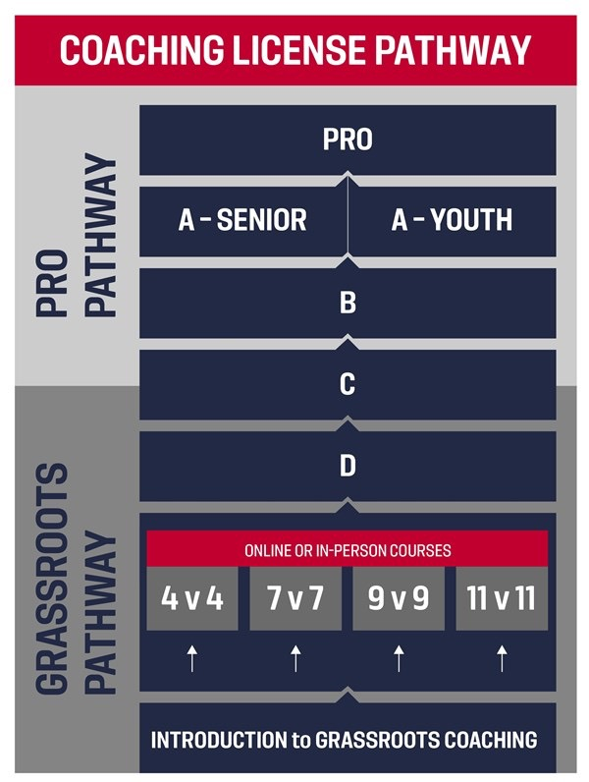

Slide 26
The Introduction to Grassroots Coaching Module serves as the first step in obtaining any one of the eight new Grassroots Licenses across four grassroots levels: 4v4, 7v7, 9v9, 11v11.
After completing the Introduction to Grassroots Coaching Module, candidates can progress to any of the eight grassroots license course opportunities through the U.S. Soccer Digital Coaching Center.
All recreational coaches must complete the Introduction to Grassroots Coaching and one online course (4v4, 7v7, 9v9, or 11v11) by the start of their second year of coaching.
Completion of the Introduction to Grassroots Coaching and one online course equals the previous F License requirement.

Slide 27
Introduction to Grassroots Coaching
Free introductory module
First step in the newly revised coaching license pathway
Required prerequisite to undergo any of U.S. Soccer's Grassroots Licensing Courses.
Coaches who complete the module will also be provided with four complimentary Play-Practice-Play training sessions.
The module takes approximately 20 minutes to complete.

Slide 28
Online Courses
Two-hour courses
Cost: $25 - includes access to training sessions and planning tools in the Digital Coaching Center (reimbursable by RYSC)
Build on the principles covered in U.S. Soccer's Introduction to Grassroots Coaching Module
Must complete U.S. Soccer's Introduction to Grassroots Coaching module
Candidates will learn more about U.S. Soccer's Grassroots Coaching Education Philosophy, Play-Practice-Play Methodology, the Six Tasks of a Coach, and the characteristics of players at specific age groups.
The course will also ask each candidate to reflect on their experiences to develop action steps for personal growth.
Must be 16 years old to register. Due to online privacy laws, individuals under the age of 16 cannot create DCC profiles, and thus are unable to take Grassroots Courses.
4v4 Online Course - Focuses on the characteristics of players aged 6-8.
7v7 Online Course - Focuses on the characteristics of players aged 9-10.
9v9 Online Course - Focuses on the characteristics of players aged 11-12.
11v11 Online Course - Focuses on the characteristics of players aged 13 and older.

Slide 29
In-Person Courses
Four-hour courses
Cost: Courses range from $25-$100 (which is reimbursable by RYSC)
Build on the principles covered in U.S. Soccer’s Introduction to Grassroots Coaching Module.
Must complete U.S. Soccer's Introduction to Grassroots Coaching module
Candidates will learn more about U.S. Soccer's Grassroots Coaching Education Philosophy, Play-Practice-Play Methodology, the Six Tasks of a Coach, and the characteristics of players at specific age groups.
The course will also ask each candidate to reflect on their experiences to develop action steps for personal growth.
Must be 16 years old to register. Due to online privacy laws, individuals under the age of 16 cannot create DCC profiles, and thus are unable to take Grassroots Courses.
4v4 Online Course - Focuses on the characteristics of players aged 6-8.
7v7 Online Course - Focuses on the characteristics of players aged 9-10.
9v9 Online Course - Focuses on the characteristics of players aged 11-12.
11v11 Online Course - Focuses on the characteristics of players aged 13 and older.

Slide 30
Weather
If the weather is above 100 degrees, you should seriously consider canceling practice. If you should choose to hold practice then please exercise good judgement. Reduce physical activities and attempt to keep the kids in the shade.
If the weather exceeds 105, you must cancel practice. There is no exception to this rule.
If the Air Quality Index is between 101 to 150 range, coaches are encouraged to cancel practice, or at least hold a light workout focusing on elements that do not include heavy exertion, such as set plays. If the Air Quality Index exceeds 150 coaches should cancel. Please visit sparetheair.com for updates
If we experience excessive rain, please visit our website for updates on whether our fields have been shut down. This is determined by the city and will be usually updated by Friday Evening for Saturdays Games.

Slide 31
Roster Distribution
Stephanie

