Slide 1
MONTHLY
PROGRESS REPORT
ROSWALT REALTY
29.05.2026
“ROSWALT SUJATA NIWAS ”

Slide 2
SUJATA NIWAS

Slide 3
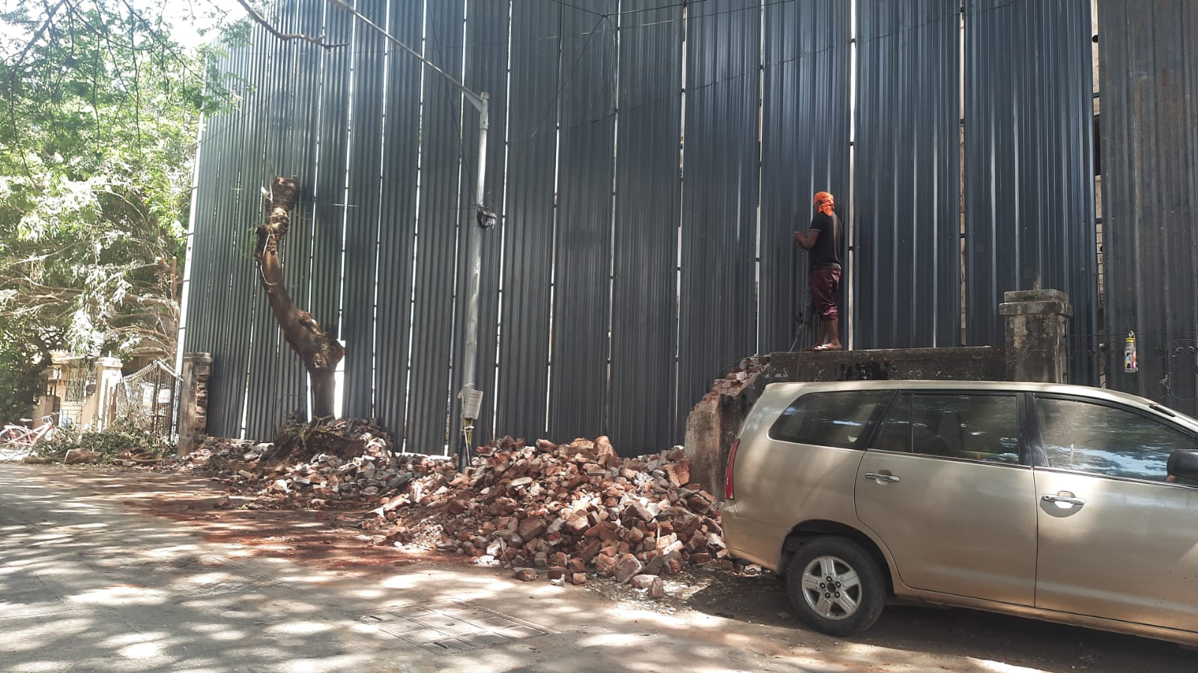
Compound Wall breaking work

Slide 4
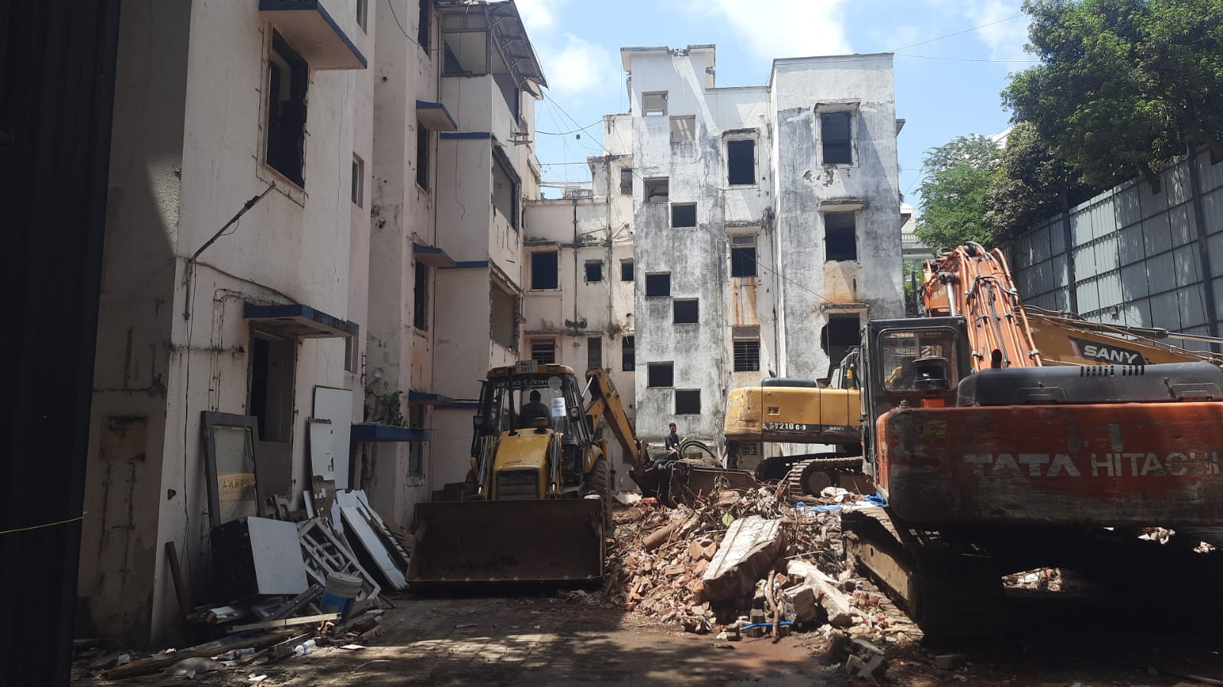
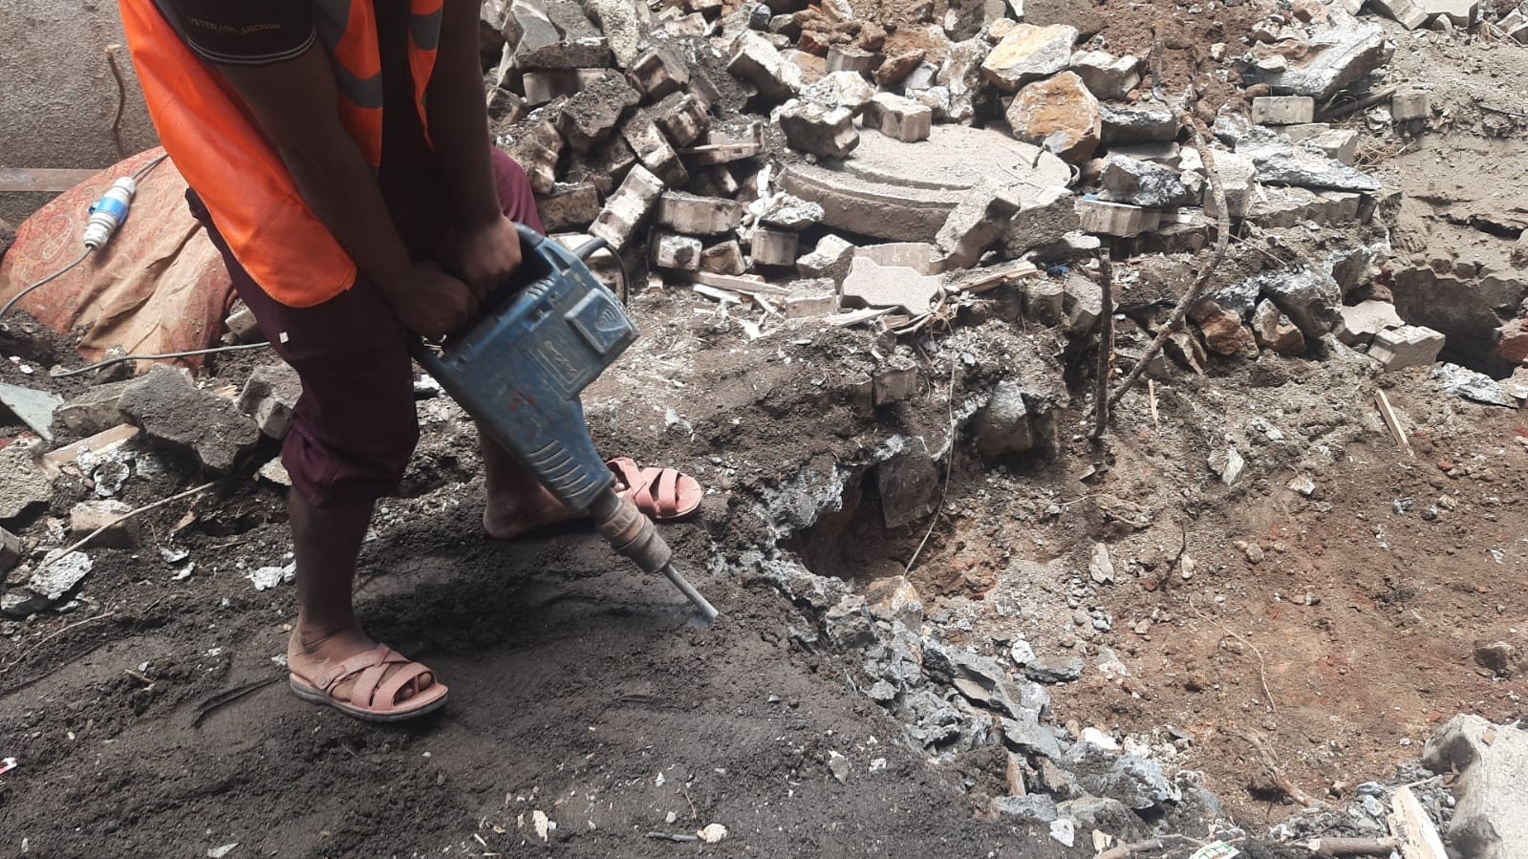
Gas pipe trench work

Slide 5
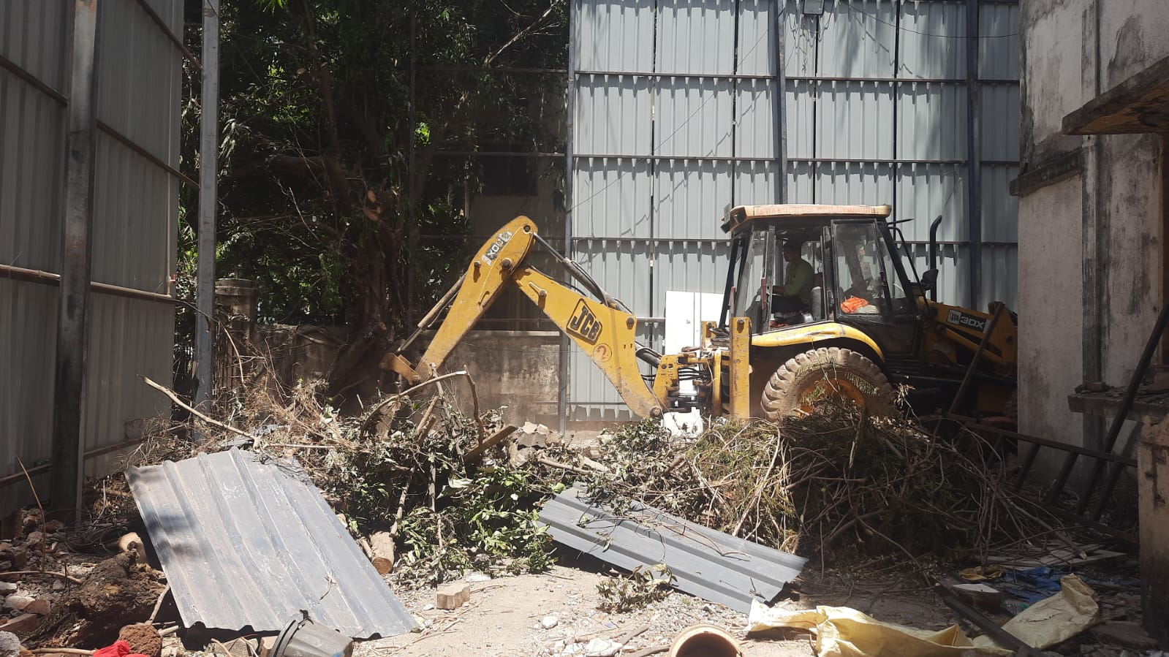
Work is in progress to disconnect the gas pipe.

Slide 6
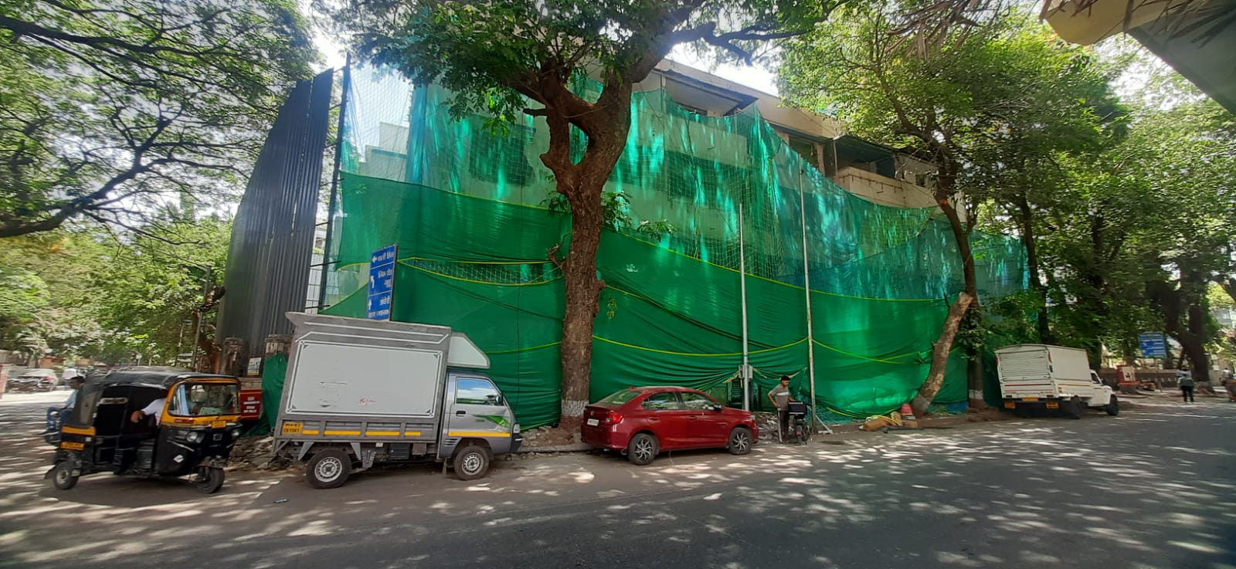
Side View

