Slide 1
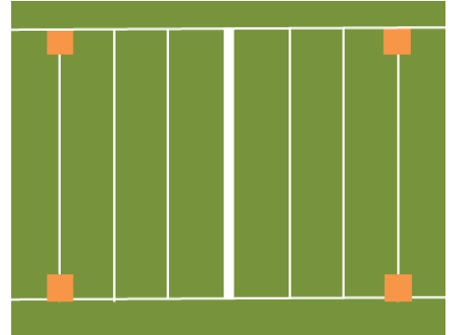

Game Day – Field Set Up & Mentor Tip
PARENTS
PARENTS
Practice & Game
Place your two orange foam pylons on each side of the touchdown line
Mentor Tip of the Week
gather your players and give them the tip of the week
Practice – 30 minutes
1st Half – 30 minutes
Half – 3 minutes
2nd Half – 30 minutes
  Seating
Teams should sit on one side of the field
Parents (one per player) can sit on the other
Each should respect COVID distancing requirements of 2 metres and MUST be 1 metre away from sideline
TEAM
TEAM

Slide 2
The Game
Plays
Plays must be called….go get open is not enough!
Playing Time
Equal playing time is so important
Coaches need to monitor play to ensure all players are being thrown to
We provide a tool to help you with that (see next page)
Quarterbacks play one full half and will be changed at half
Coaches can be on the field to select play. Best to print out your plays and place them in a binder.

Slide 3
Shifts & Play Equity
Player Name | On-Field |  |  |  | Passed To
James | 1 | 2 |  |  | X
Frank | 1 | 2 |  |  | X
Gerry | 1 |  | 3 |  | X
Don | QB | QB | QB
Tony | 1 |  | 3 |  | XX
Kevin |  | 2 | 3 |  | X
Mel |  | 2 | 3
Comment:
You will find a copy of this at document MFFL Coaching Resources
Each column represents a “shift”. “X” indicates that a player is on the field. Move to the next column for the next shift and place “X” for those players on the field. Start at the top of the column and go down.

Slide 4
Past Issues
Unequal Playing Time
Unequal Ball Distribution
Not wanting to play QB – place them closer to the end of the season
Coaches are too Competitive and take it out on refs or team
Incompatible objectives between Coach and Team – team wants to have fun / coach wants to improve
Comment:
Here is a list of issues we have seen in the past. Let’s try to avoid them.
One more – encounters with referees – if you want to address the ref you need to call them over to the bench.

Slide 5
Other Information
Contact with Families
Coach’s email will be available on the web site.
Contact and activities outside of league game days are NOT allowed and not covered by league insurance.
Refs
They will try their best!
As long as they are trying, give them the benefit of the doubt.
DO NOT REQUEST FAMILY EMAILS
If you want to address them – call them over to the bench.

Slide 6
Injuries
All injuries should be reported to the tent where there is first aid available.
Hydration
Athletes often arrive dehydrated.
Urge parents and players to monitor hydration level before they arrive.
Monitor Urine
Dark = Dehydrate
Light = Hydrated
Remind parents and players to bring their own bottles with water or a sports drink.
Urge players to drink when they arrive and throughout the game.

Slide 7

COVID Protocols
Session COVID Screening Protocols
Each participant and spectator must complete a screening protocol prior to participating in each session.
Staggered Starts
To manage the flow of people at Brenner Field, we will stagger the starts for each division. Starts will be at 6:30pm, 6:45pm and 7:00pm. Arrival will be followed by a 30 minute practice and 60 minute.
Maximum of 10 Players per Team
Each team will have a maximum of 10 players per team.
Players Are Not Required to Wear Masks
We will begin the season without players having to wear masks, but it is dependent on government directives.
One Parent Allowed to Stay with Child (not required to wear mask)
Only one parent per child is allowed to come and stay at the field. At this time they are not required to wear face masks.
2 Meter Physical Distancing
Physical distancing of 2 meters for players, coaches and parents will be imposed.

Slide 8
COVID Protocols
No Close Huddles
Traditional huddles will not be allowed and physical distancing will be enforced by referees and coaches for huddles.
Players to Use Hand Sanitizer
Coaches will be provided with hand sanitizer. Players are to use hand sanitizer throughout the game.
Bring Your Own Marked Water Bottles
Players will need to bring their own water bottle that is identified with their name.
Clean Footballs and Equipment
Each team will have a set of their own footballs and flags. Mentor Flag Football will use Microban 24 on footballs after each possession. Microban is a disinfectant spray that gives surfaces long-lasting protection and prevents the spread and growth of bacteria for 24 hours, even after multiple touches.
No Handshakes Before or After Game
Handshakes will not be allowed.
First Aid Personnel to Wear Gloves and Mask
All first aid personnel are to wear gloves and masks when interacting with players, coaches or parents.

Slide 9





Thank You!
Thanks for coaching this season. It’s a lot of work. We’ll try and assist to make it easier for you.
Remember to make sure the kids have fun and that you do too!
CONTACT: 905-830-7774 / mentorflagfootball@rogers.com

