Slide 1
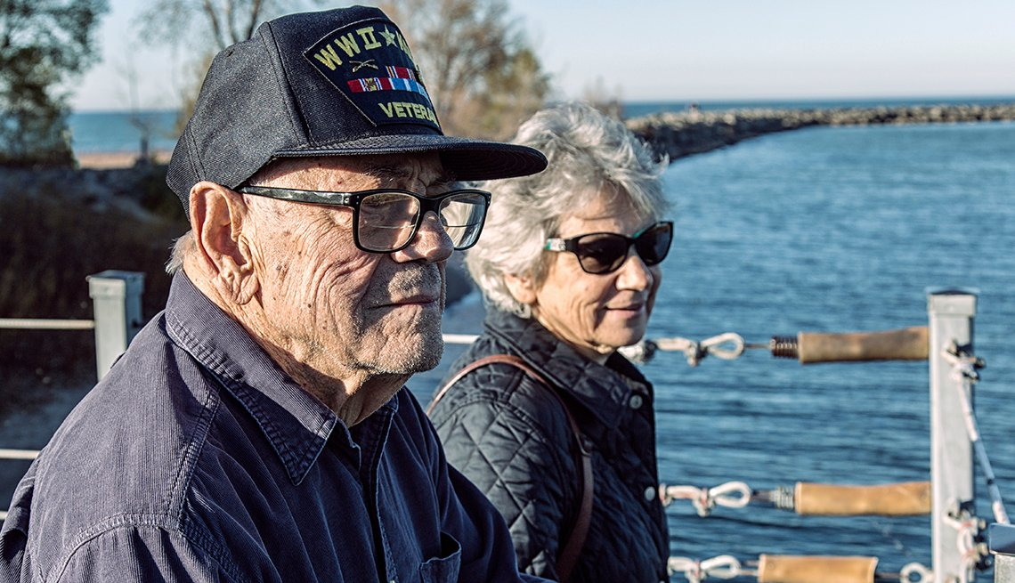
VA Survivor and Widow Benefits
Survivors of a Veteran or service members may qualify for benefits, including help with burial costs and survivor compensation
Winston-Salem VA Regional Office Virtual Outreach
March 4, 2021

Slide 2
Here to Learn – What’s available?
This outreach event is focused on providing awareness and information regarding VA survivor or widow benefit programs such as:
Burial Plot/Allowance – Monetary benefit to help cover burial, funeral, and transportation costs
Burial Flag – U.S. flag is provided to drape the casket or accompany they urn
Presidential Memorial Certificate - An engraved paper certificate signed by the current president
Headstone/Marker – Provided for privately purchased headstones or unmarked
VA Life Insurance – Types of insurance and how to submit a claim
VA Survivors or Widow Pension – Monthly monetary benefit based on income
Dependency Indemnity Compensation Benefits – Monthly monetary benefit for service-connected deaths
Accrued Benefits and Substitution Claims – Deceased Veteran’s pending claim may be paid to survivors
CHAMPVA – Health benefits program providing coverage to the widower and children
Dependent Education Allowance – Monthly monetary benefit to help cover education or job training costs

Slide 3
Burial and Plot Allowance
What Are VA Burial Allowances?
Flat-rate monetary benefits that help cover eligible Veterans’ burial and funeral costs to include plot or interment allowance and transportation allowance.
Who Is Eligible?
If the surviving spouse has not been automatically paid, VA will pay whoever files a claim first of the following:
Veteran’s surviving spouse
Veteran’s children, regardless of age
Veteran’s parents
Executor or administrator of the estate
The survivor of a legal union with the Veteran. This applies to formal relationships that continued up until the Veteran’s death. The couple needs to have formalized the relationship under the law of the state. There should be state-issued documentation of the relationship.

Slide 4
Burial and Plot Continued
Who Is Eligible? (continued)
The Veteran must have a discharge other than dishonorable. The Veteran must also have met one of the following conditions:
Receiving VA pension or disability service-connected compensation at time of death
Entitled to receive VA pension or compensation at time of death, but instead received full military retirement or disability pay
Died while hospitalized by VA or while receiving care under VA contract
Died while traveling under proper authorization and at VA expense for the purpose of examination, treatment or care
Had an original or reopened claim for VA compensation or pension pending at the time of death (Only if the Veteran would have been entitled to benefits from a date prior to the death date)
Died while a patient at a VA-approved state nursing home

Slide 5
Burial and Plot Continued
How Much Does VA Pay?
Service-connected deaths:
Up to $2,000
Veteran is buried in a VA national cemetery: some or all costs of transporting remains
Non-service-connected deaths:
VA will pay up to $807 toward burial and funeral expenses (if hospitalized by VA at time of death),
$300 toward burial and funeral expenses (if not hospitalized by VA at time of death)
$807 plot-interment allowance (if not buried in a national cemetery)

Slide 6
Burial Flags to Honor Veterans and Reservists
What is it?
VA provides a United States flag to drape on a casket
or place with an urn in honor of the military service
of a Veteran or Reservist.
Who is Eligible?
You may be eligible for a burial flag if you’re the next of kin or a close friend of the Veteran or Reservist and one of the descriptions below is true for that person. They:
Served in wartime, or
Died while serving on active duty after May 27, 1941, or
Served after January 31, 1955, or
Served in peacetime and left military service before June 27, 1950, after serving at least 1 enlistment, or because of a disability that was caused—or made worse—by their active military service, or
Served in the Selected Reserves (in certain cases)

Slide 7
Presidential Memorial Certificates
What is it?
A Presidential Memorial Certificate (PMC) is an engraved
paper certificate signed by the current president.
Who is Eligible?
The Veteran or Reservist who didn’t receive a dishonorable discharge or a service member who died while on active duty, and
You’re the next of kin, family member, or close friend of the Veteran or Reservist (or an authorized service representative for a family member or friend of the Veteran or Reservist)
If the Veteran is eligible for burial in a national cemetery, but is instead buried in a private cemetery, the family member or close friend can still apply to get a PMC. Fill out the VA Form 40-0247. To speed up the processing of the claim, submit the Veteran's military discharge documents and death certificate. Don’t send original documents, as they won’t be returned.
Note: If the family or close friends would like to request more than one PMC, they can apply using VA Form 40-0247.

Slide 8
Headstones and Grave Markers
Who is Eligible?
A Veteran who didn’t receive a dishonorable discharge or a service member who died while on active duty may be eligible for a headstone or marker if they meet the requirements listed below.
Enlisted personnel who served before September 7, 1980, and officers who served before October 16, 1981. At least one of these must be true. The Veteran or service member:
Died on or after November 1, 1990, and their grave is currently marked with a privately purchased headstone, or
Was buried in an unmarked grave, anywhere in the world
Enlisted personnel who served after September 7, 1980, and officers who served after October 16, 1981. In addition to the above requirement, at least one of these must also be true. The Veteran or service member:
Served for a minimum of 24 months of continuous active duty, or
Died while serving on active duty

Slide 9
Headstones and Grave Markers Continued
Who Can Apply?
One of these must describe your relationship to the deceased:
A family member, or
A personal representative (someone who officially represents the deceased), or
A representative of an accredited Veterans Service Organization, or
An employee of a state or local government whose official responsibilities include serving Veterans, or
Any person who's legally responsible for arrangements for unclaimed remains or details having to do with the deceased’s interment or memorialization, or
Any individual representing the deceased, if the Veteran’s service ended before April 6, 1917
You must be a member of the deceased’s family if the deceased’s remains:
Haven’t been recovered or identified, or
Were buried at sea, or
Were donated to science, or
Were cremated and scattered

Slide 10
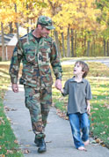
VA Life Insurance
Types of Life Insurance and How to Apply or Inquire
VA life insurance can offer financial security for Veterans, service members, and their spouses and dependent children. Explore your options, manage your policy, and file claims to get the insurance benefits you've earned.
Servicemembers' Group Life Insurance (SGLI): All Servicemembers with full-time coverage
should use the SGLI Online Enrollment System (SOES) to designate beneficiaries, or reduce,
decline or restore SGLI coverage. To access SOES, go to www.dmdc.osd.mil/milconnect.
Veterans' Group Life Insurance (VGLI): Complete and file form SGLV 8714 or apply online.
Family Servicemembers' Group Life Insurance (FSGLI): All Servicemembers should use
SOES to decline, reduce, or restore FSGLI coverage. To access SOES, go to
www.dmdc.osd.mil/milconnect.
Servicemembers' Group Life Insurance Traumatic Injury Protection (TSGLI): Coverage is
automatic for all Servicemembers covered by SGLI. To file claim for the TSGLI benefit,
complete and file SGLV 8600.
Service-Disabled Veterans' Life Insurance (S-DVI): apply for S-DVI online or complete and
file form VA 29-4364.

Slide 11
VA Survivors Pension
What is Survivors or Widow’s Pension?
A needs-based program with monthly payments to surviving spouses and unmarried dependent children of wartime Veterans who meet certain countable income and net worth limits.
From December 1, 2020, to November 30, 2021, the net worth limit to be eligible for Survivors Pension benefits is $130,773.
On October 18, 2018, we changed the way we assess net worth to make the pension entitlement rules clearer. Net worth includes your assets and annual income. Your countable income is how much you earn, including your salary, investment and retirement payments, and any income you may have from your dependents.
Some expenses, like non-reimbursable medical expenses (paid medical expenses not covered by your insurance provider), may reduce your countable income.
You may qualify for extra Housebound or Aid and Attendance benefits

Slide 12
VA Survivors Pension Continued
Who is Eligible?
The Veteran didn’t receive a dishonorable discharge and their service meets at least one of the requirements listed below.
At least one of these must be true. The Veteran:
Entered active duty on or before September 7, 1980, and served at least 90 days on active military service, with at least 1 day during a covered wartime period, or
Entered active duty after September 7, 1980, and served at least 24 months or the full period for which they were called or ordered to active duty (with some exceptions), with at least 1 day during a covered wartime period or
Was an officer and started on active duty after October 16, 1981, and hadn’t previously served on active duty for at least 24 months
AND
Surviving Spouse: You haven’t remarried after the Veteran’s death, and yearly family income and net worth meet certain limits. Your net worth equals the value of everything you own (except your house, your car, and most home furnishings), minus any debt.

Slide 13
VA Survivors Pension Continued
Who is Eligible? (continued)
Child of a Deceased Wartime Veteran: You may be eligible for this benefit if you’re unmarried and you meet at least one of the requirements listed below.
At least one of these must be true:
You’re under age 18, or
You’re under age 23 and attending a VA-approved school, or
You’re unable to care for yourself due to a disability that happened before age 18
What are Wartime Periods?
World War I April 6, 1917, to November 11, 1918
World War II December 7, 1941, to December 31, 1946
Korean conflict June 27, 1950, to January 31, 1955
Vietnam War era November 1, 1955 to May 7, 1975, for Veterans who served in the Republic of Vietnam during that period. August 5, 1964, to May 7, 1975, for Veterans who served outside of the Republic of Vietnam.
Gulf War to current August 2, 1990, through a future date to be set by law or presidential proclamation

Slide 14
Dependency and Indemnity Compensation
What is Dependency and Indemnity Compensation (DIC)?
A tax-free monetary benefit for the surviving spouse, child, or parent of a service member who died in the line of duty, or the survivor of a Veteran who died:
while on active duty, active duty for training, or inactive-duty training, or
from a service-connected illness or injury, or
didn’t die from a service-connected illness or injury, but was eligible to receive VA compensation for a service-connected disability rated as totally or 100% disabling for a certain period
If the Veteran’s eligibility was due to a rating of totally or 100% disabling, they must have had this rating:
For at least 10 years before their death, or
Since their release from active duty and for at least 5 years immediately before their death, or
For at least 1 year before their death if they were a former prisoner of war who died after September 30, 1999

Slide 15
Dependency and Indemnity Compensation Continued
Who Is Eligible?
Surviving Spouse (widow)
One must be true. You:
Were married to the Veteran or service member for at least 1 year, or
Had a child with the Veteran or service member, aren’t currently remarried, and either lived with the Veteran or service member without a break until their death or, if separated, weren’t at fault for the separation, or
Married the Veteran or service member before January 1, 1957, or
Married the Veteran or service member within 15 years of their discharge from the period of military service during which the qualifying illness or injury started or got worse
Note: If you remarried on or after December 16, 2003, and you were 57 years of age or older at the time you remarried, you can continue to receive compensation.

Slide 16
Dependency and Indemnity Compensation Continued
Who Is Eligible? (continued)
Surviving Child
All must be true. You:
Aren’t married, and
Aren’t included on the surviving spouse’s compensation, and
Are under the age of 18 (or under the age of 23 if attending school)
Note: If you were adopted out of the Veteran’s or service member’s family, but meet all other eligibility criteria, you still qualify for compensation.
Surviving Parent
Both must be true:
You’re the biological, adoptive, or foster parent of the Veteran or service member, and
Your income is below a certain amount Parents DIC Rate Table
Note: We define a foster parent as someone who served in the role of a parent to the Veteran or service member before their last entry into active service.

Slide 17
Accrued Benefits and Substitution
What are Accrued Benefits?
Accrued benefits are benefits that are due, but not paid prior to a Veteran’s death.
Examples include:
A service-connected disability claim or appeal for a recurring benefit was pending at the time of death, but all evidence needed for a favorable decision was in VA’s possession.
A claim for a recurring VA benefit had been granted, but the beneficiary died before the award was completed.
At the time of death, one or more VA benefit checks were not deposited or received.
What Is Substitution?
Substitution is a type of accrued benefit. If a claimant dies during a pending claim or appeal, someone eligible to receive accrued benefits can act as substitute to complete the claim.

Slide 18
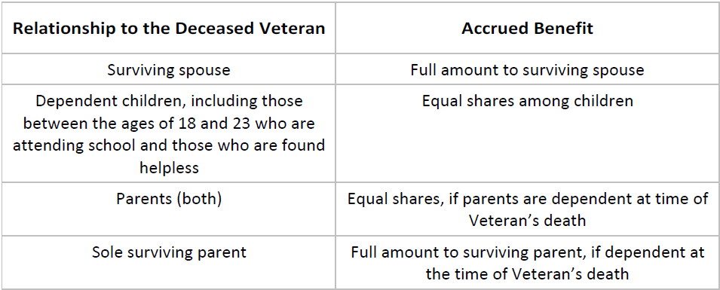
Accrued Benefits and Substitution Continued
Who Is Eligible?
VA pays accrued benefits based on the claimant’s relationship to the deceased Veteran. If there is no eligible living person, VA pays accrued benefits based on reimbursement.

Slide 19
Accrued Benefits and Substitution Continued
What is Reimbursement?
If there is no entitled living person based on relationship, VA will reimburse the person who paid for or was responsible for the Veterans last illness and burial expenses. If payments were made from the deceased beneficiary’s estate, the executor of the estate should file the claim.
The amount payable as reimbursement is limited to the actual expenses paid. It is also limited to the accrued benefits available.
When to Apply?
VA must receive an accrued benefits claim within one year of:
• The Veteran’s death and/or
• The date of notification to the Veteran
VA must receive a substitution claim within one year of the original claimant’s death. If the substitute dies, the next substitute has one year from the original substitute’s death to file a claim.

Slide 20
Civilian Health and Medical Program of the Department of Veterans Affairs (CHAMPVA)
What is CHAMPVA?
Civilian Health and Medical Program of the Department of Veterans Affairs (CHAMPVA) is a comprehensive health care program in which the VA shares the cost of covered health care services and supplies with eligible beneficiaries.
CHAMPVA is a Department of Veterans Affairs program while TRICARE is a regionally managed health care program for active duty and retired members of the uniformed services, their families, and survivors.
To be eligible for CHAMPVA, the beneficiary cannot be eligible for TRICARE.

Slide 21
CHAMPVA Continued
What does CHAMPVA pay?
CHAMPVA has an outpatient deductible ($50 per beneficiary per calendar year or a maximum of $100 per family per calendar year) and a patient cost share of 25% of our allowable amount up to the catastrophic cap ($3,000 per calendar year).
If your provider accepts CHAMPVA, the provider agrees to accept our allowable amount as payment in full. A provider cannot bill you for the difference between our allowable amount and their normally billed amount.
If the patient has other health insurance, then CHAMPVA pays the lesser of either 75% of the allowable amount after the $50 calendar year deductible is satisfied, or the remainder of the charges and the beneficiary will normally have no cost share.
Click here for more information or visit www.va.gov

Slide 22
CHAMPVA Continued
Who Is Eligible?
The spouse or widow(er) and to the children of a Veteran who:
is permanently and totally disabled (100% P&T service-connected) because of a service-connected disability, or
died as a result of an adjudicated service-connected disability or who at the time of death was rated P&T due to service-connected conditions, or
died while in an active-duty status and in the line of duty, not due to misconduct. The term “active duty” may include periods of inactive duty for training.
died on active duty and the dependents are not otherwise eligible for Department of Defense TRICARE benefits.

Slide 23
VA Education Benefits for Dependents and Survivors (Dependents Educational Assistance)
What is Dependents Educational Assistance?
The Survivors’ and Dependents’ Educational Assistance (DEA) program offers monthly benefit payments for education and training related expenses to qualified dependents of Veterans who are permanently and totally disabled because of a service-connected condition or who died while on active duty or as a result of a service-related condition.
Who Is Eligible?
To be eligible for DEA, you must be the son, daughter or spouse of:
Veteran who died or is permanently and totally disabled (100% P&T service-connected) because of a service-connected disability
Died while on active duty or as a result of a service-connected disability
If you’re a dependent who doesn’t meet the above criteria, you may still qualify for VA education benefits if the Veteran or service member transferred some or all of their Post-9/11 GI Bill entitlement to you while they were on active duty.
Click here to learn about transferred benefits or visit www.va.gov

Slide 24
Dependents Educational Allowance Continued
When Can This Benefit Be Used?
Spouses and surviving spouses have 10 years to use benefit, beginning on the date VA establishes DEA eligibility.
Remain eligible for 20 years if VA rates the Veteran permanently and totally disabled with an effective date of three years from discharge.
Surviving spouses of Service members who died while on active duty have 20 years from the date of the Service member’s death.
Children can use the benefit between the ages of 18 and 26.
How Much and When Does VA Pay?
Amount paid is based on type of training and part-time or full-time attendance. The current monthly payment for full-time training is $1,224 per month.
Benefits are paid monthly.
How Can You Apply or need more info?
Call 888-GI-BILL-1 or visit: https://www.va.gov/education/survivor-dependent-benefits/

Slide 25
How Do I Apply to these VA Benefits?
Online
Visit www.va.gov for information on all VA programs, access VA forms,
submit online applications, how to contact us, and FAQs
In person
Contact the Winston-Salem VA Regional Office and speak with a local representative. Click here to request a virtual or in-person appointment, or visit https://v2.waitwhile.com/lists/winston-salemvaregio/join to self-schedule an appointment or visit our website at https://www.benefits.va.gov/winstonsalem/
Mail
Visit www.va.gov to select the benefit and specific mailing information
Consult with the many (no-cost) Veteran Service Organizations (VSO) for help
Click here for the North Carolina County VSO List or visit www.milvets.nc.gov
Click here for the VA Directory of Veterans Service Organizations or visit https://www.va.gov/vso/

