Slide 1




Slide 2
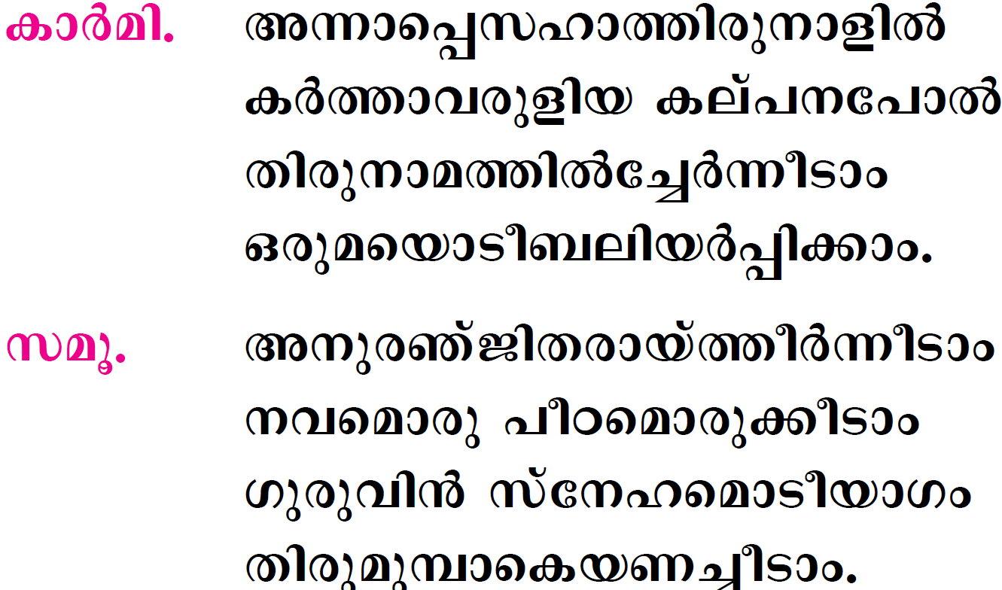

Slide 3
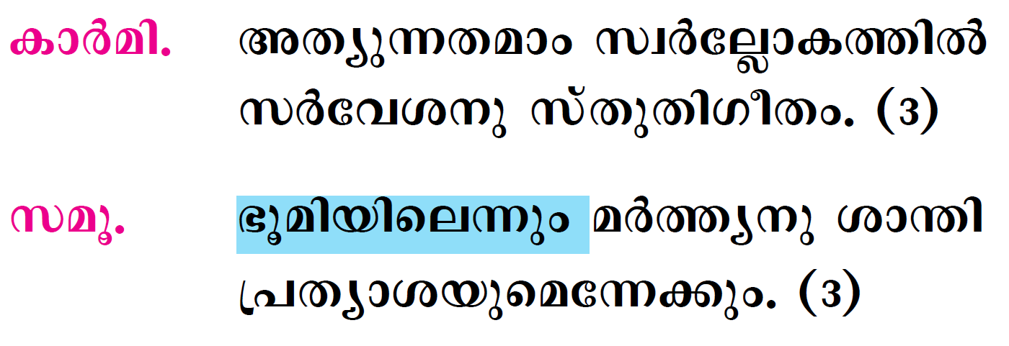

Slide 4
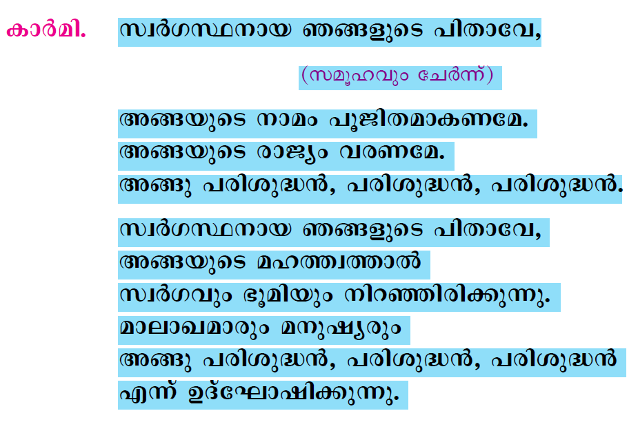

Slide 5
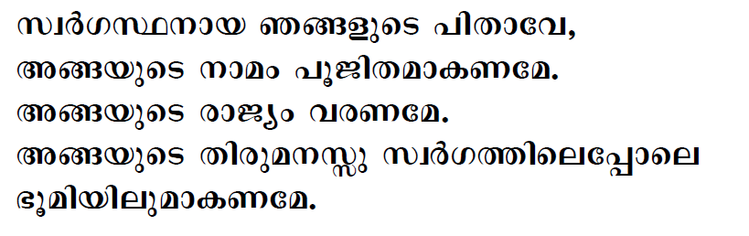
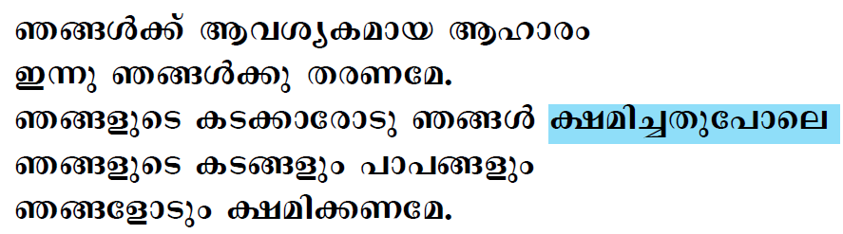

Slide 6
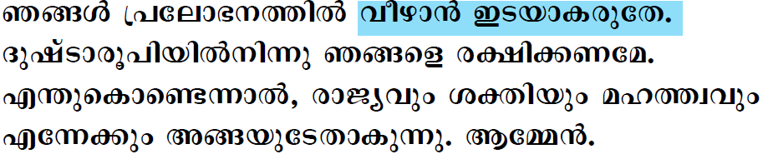

Slide 7

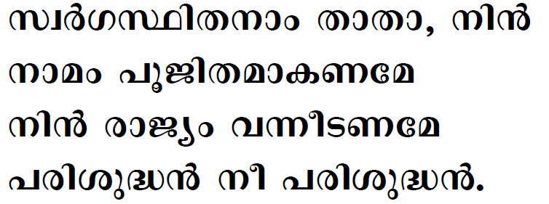

Slide 8

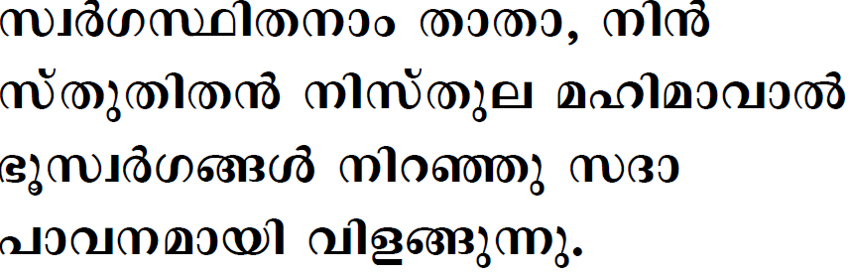
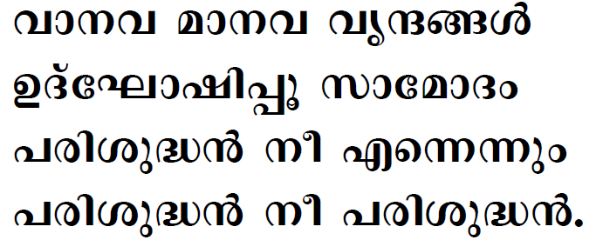

Slide 9
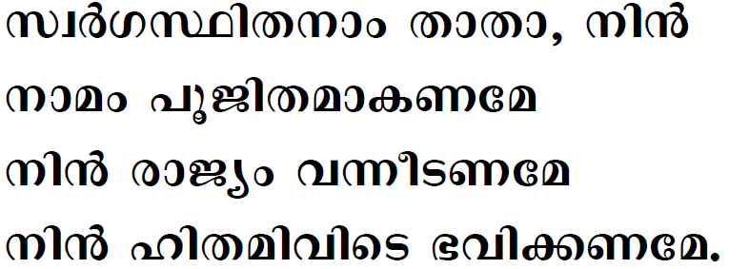
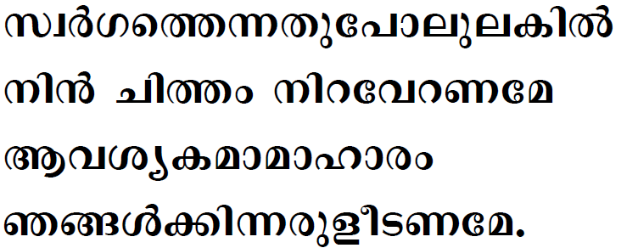

Slide 10
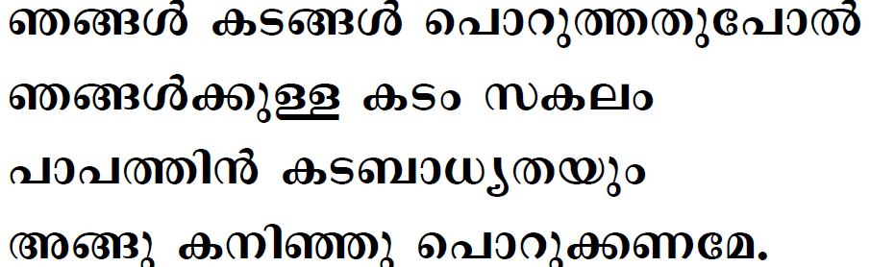
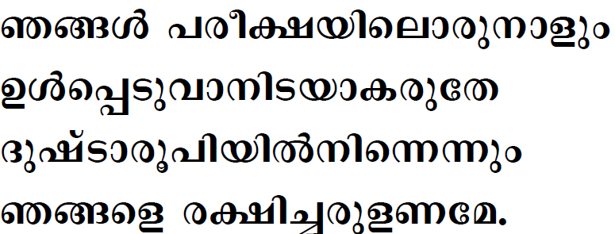

Slide 11
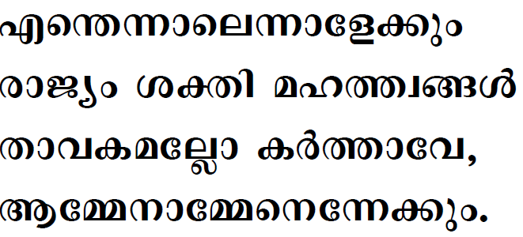

Slide 12

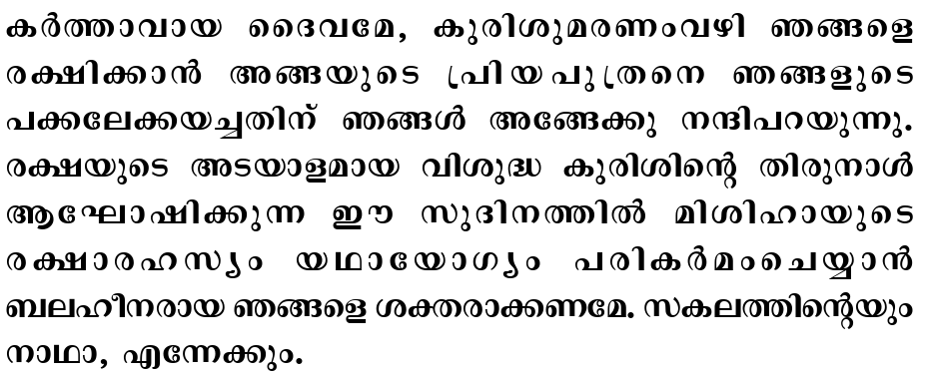


Slide 13

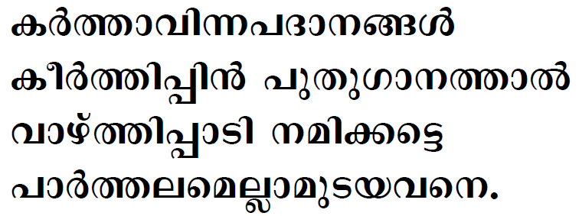

Slide 14
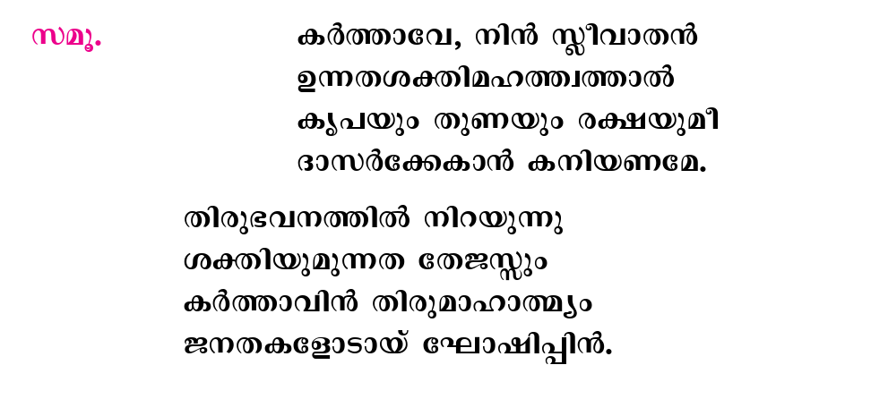

Slide 15
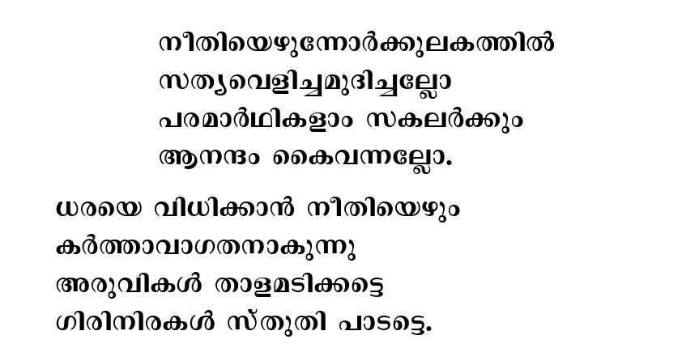

Slide 16
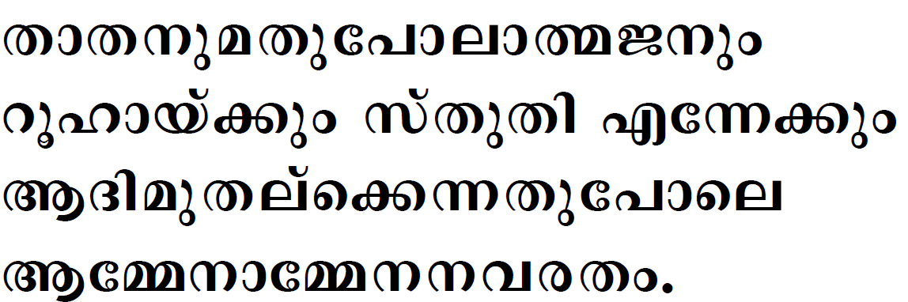

Slide 17

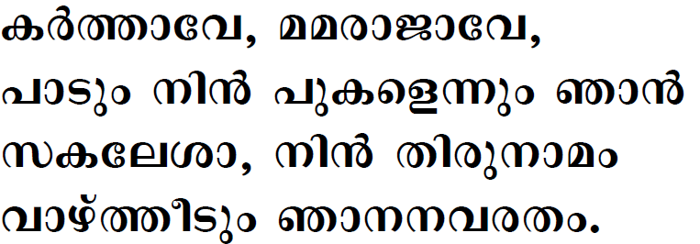

Slide 18

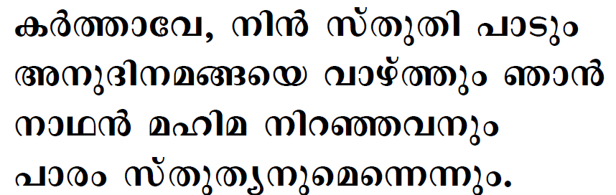
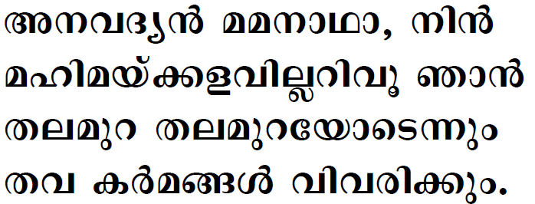

Slide 19
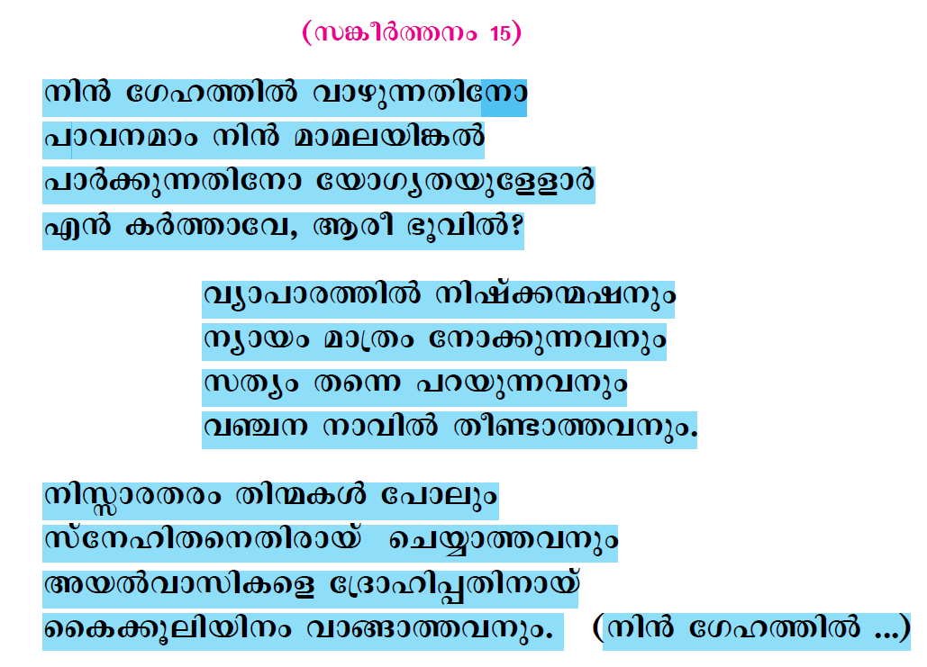

Slide 20

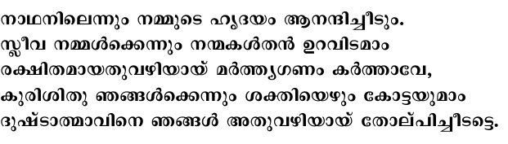

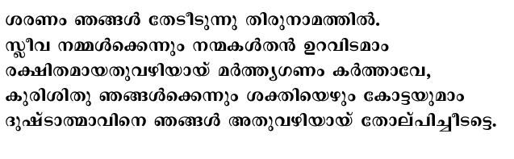

Slide 21
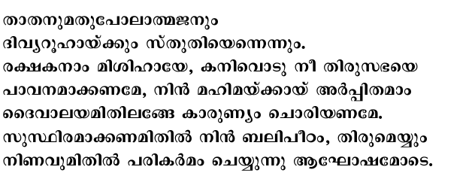
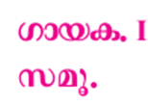
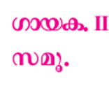
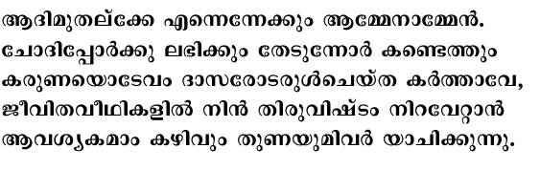

Slide 22

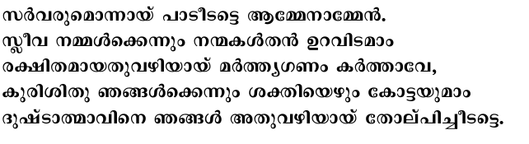

Slide 23
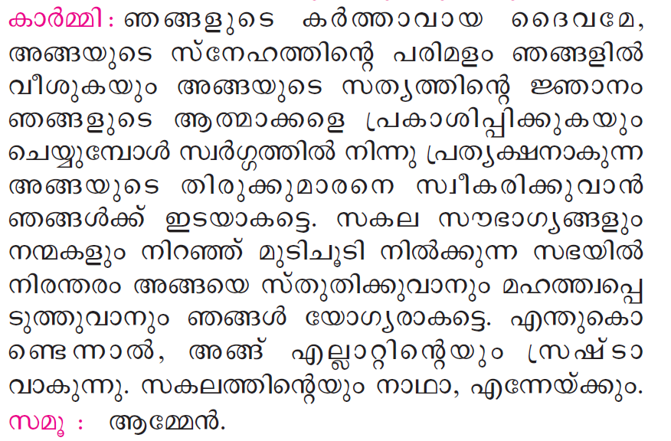

Slide 24
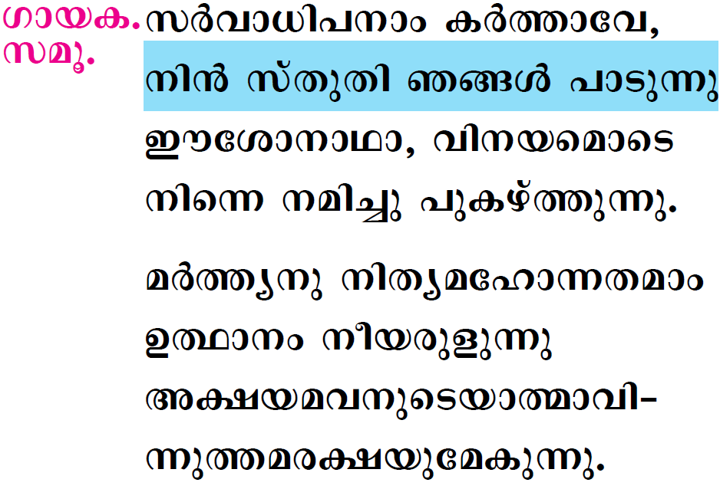

Slide 25

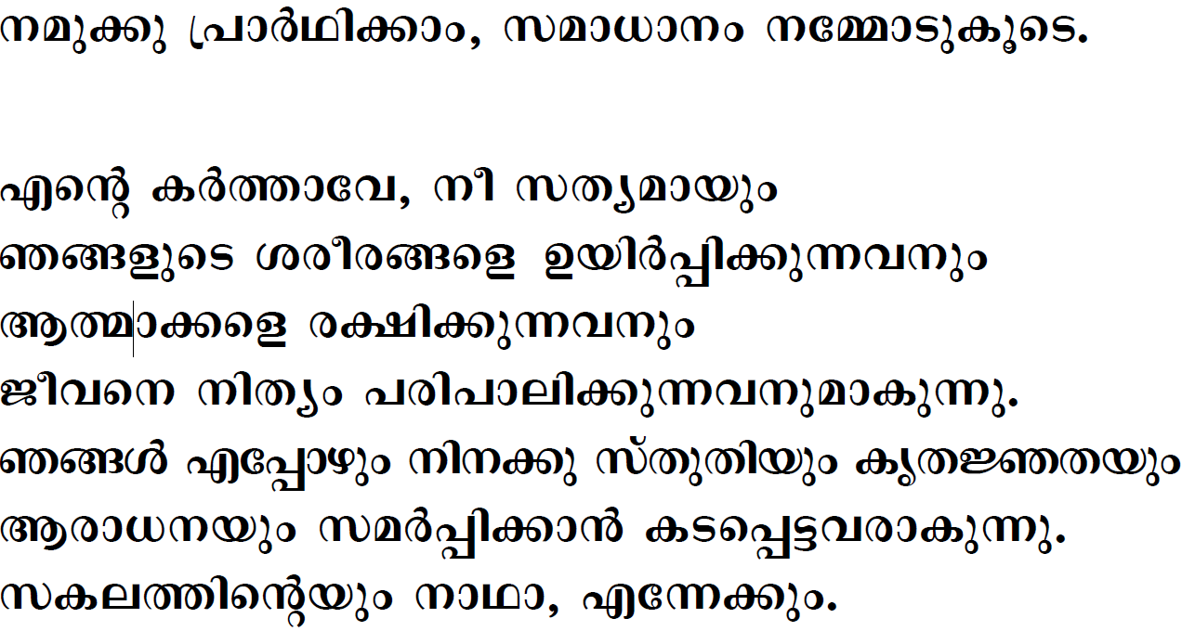



Slide 26
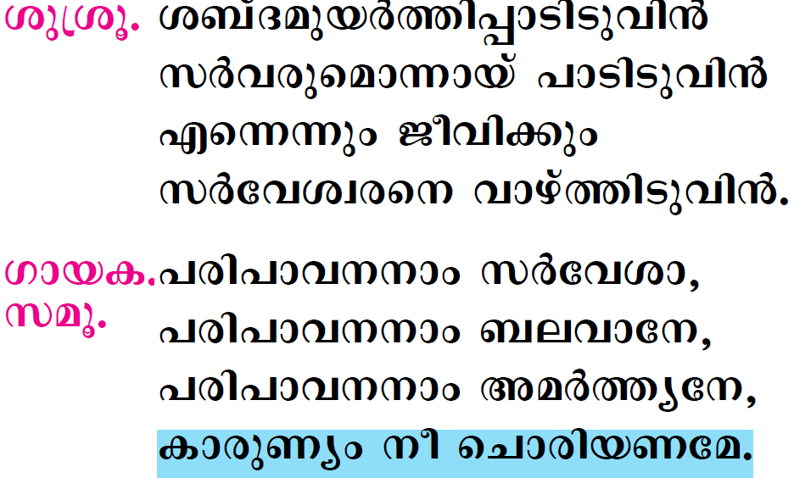

Slide 27

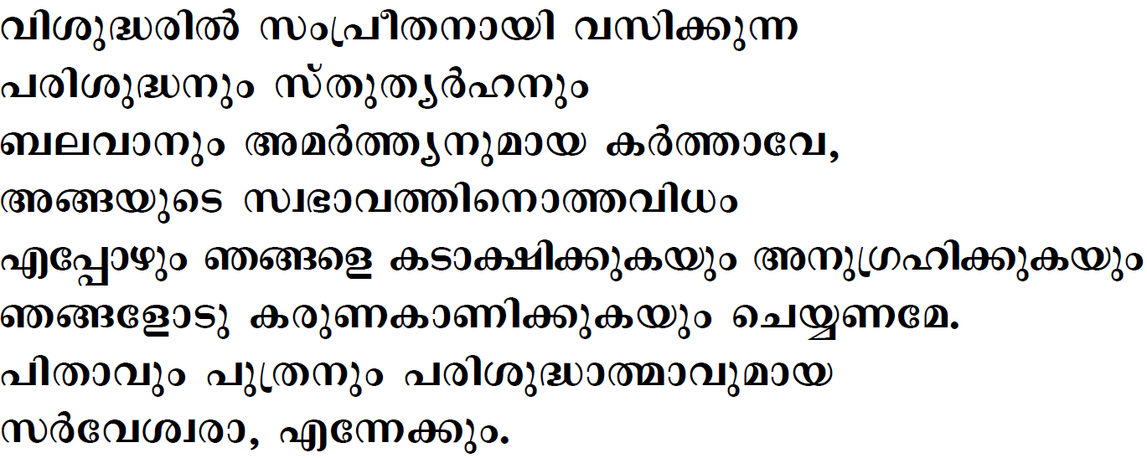


Slide 28
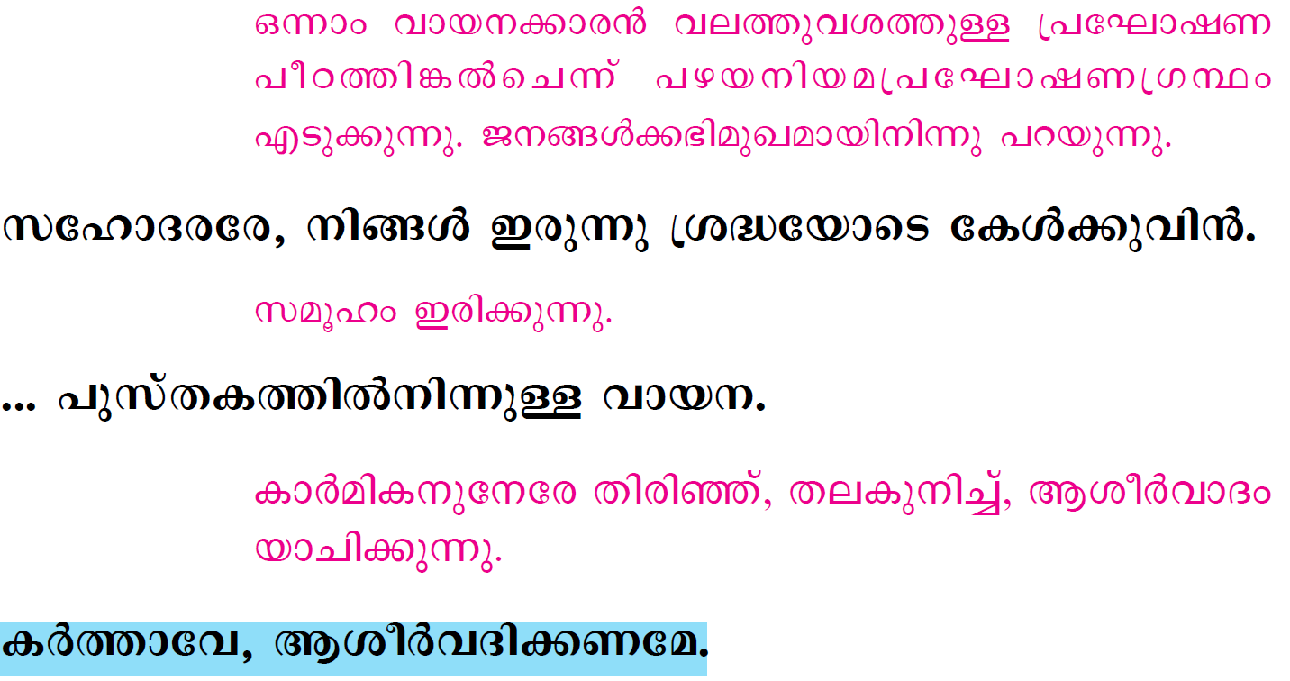

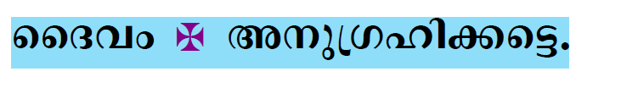

Slide 29
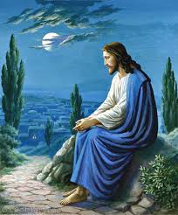
Please be Seated…

Slide 30
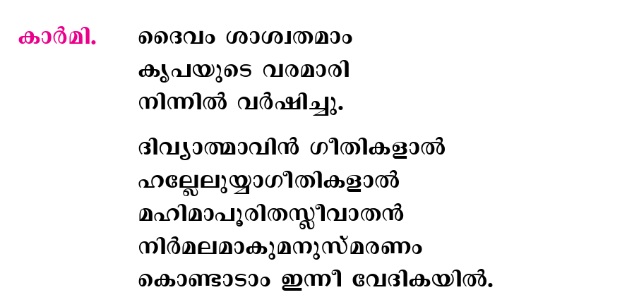

Slide 31

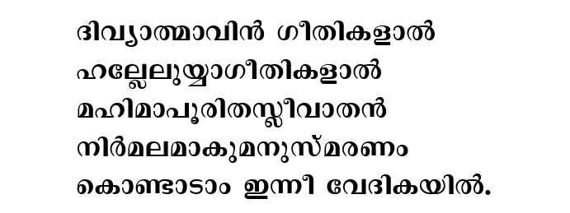

Slide 32
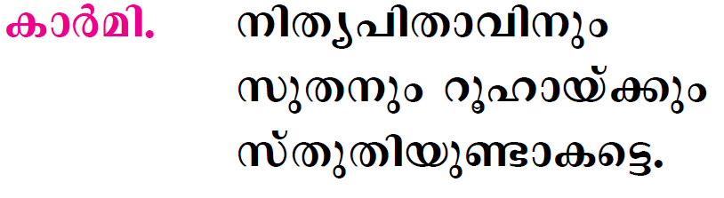


Slide 33
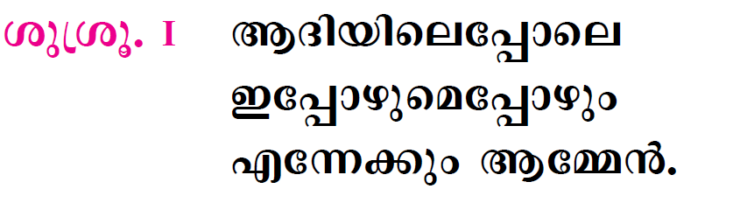


Slide 34

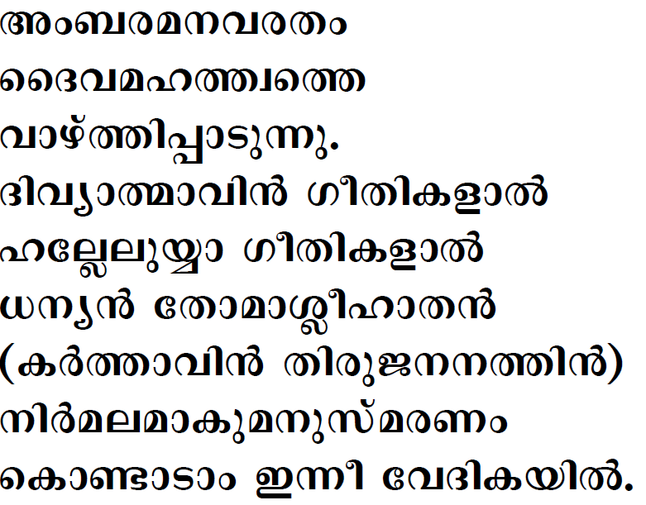

Slide 35

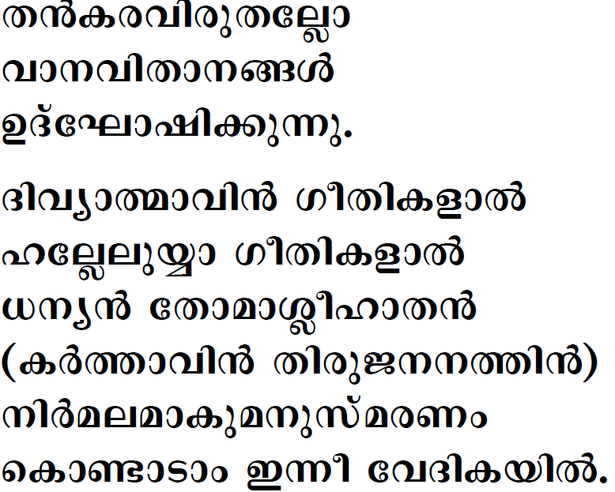


Slide 36

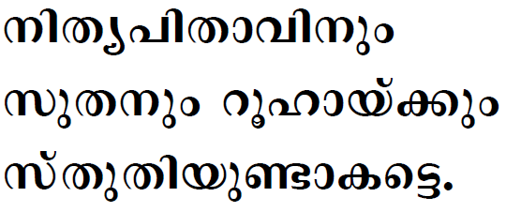

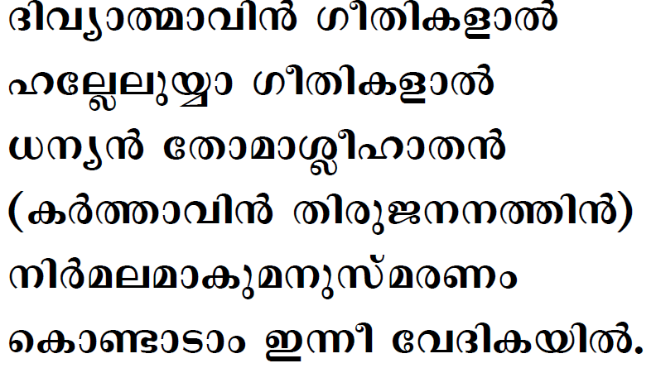

Slide 37

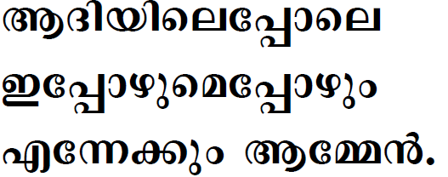

Slide 38
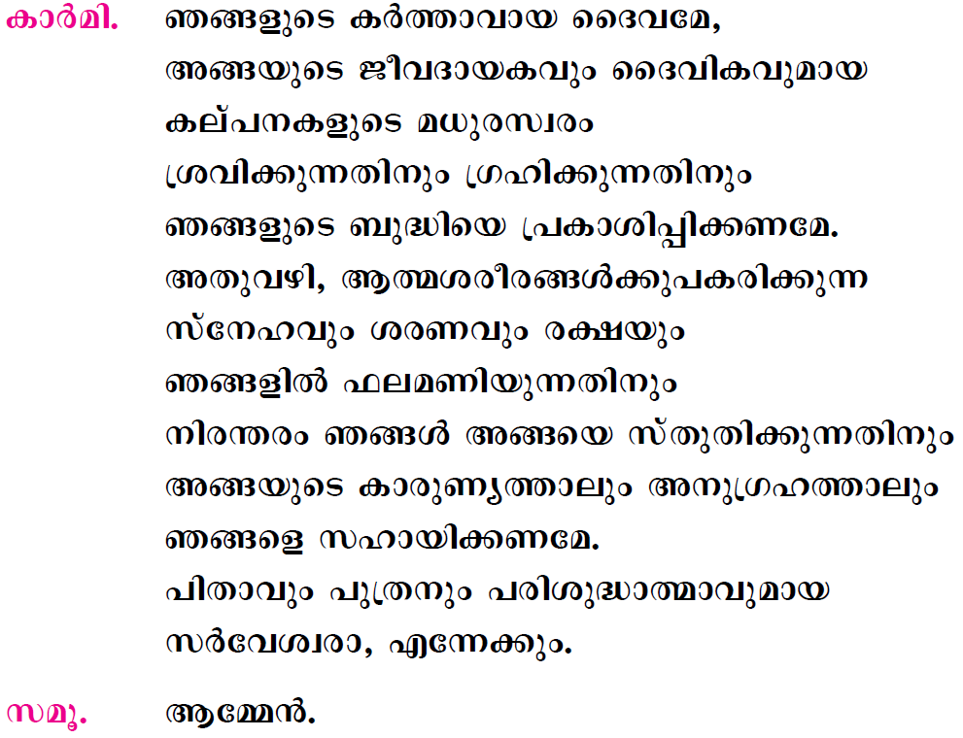

Slide 39
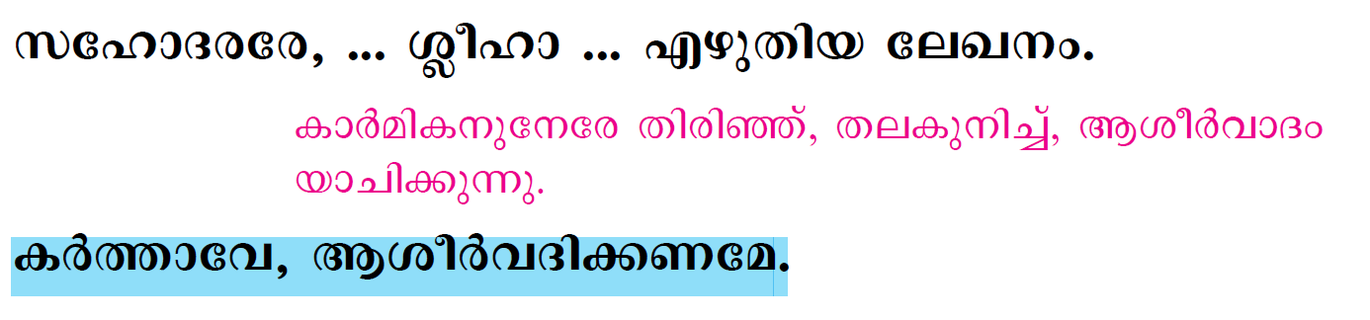
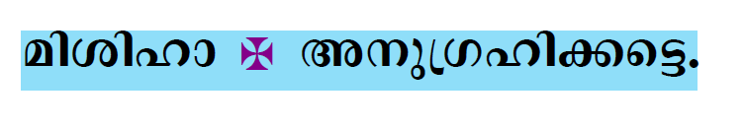


Slide 40

Please Stand…

Slide 41



Slide 42


Slide 43


Slide 44


Slide 45


Slide 46




Slide 47
Please be Seated…

Slide 48


Slide 49
Please Stand…

Slide 50



Slide 51



Slide 52


Slide 53


Slide 54




Slide 55



Slide 56





Slide 57





Slide 58





Slide 59



Slide 60



Slide 61


Slide 62


Slide 63


Slide 64


Slide 65




Slide 66


Slide 67


Slide 68


Slide 69





Slide 70


Slide 71



Slide 72


Slide 73



Slide 74




Slide 75



Slide 76




Slide 77



Slide 78




Slide 79



Slide 80




Slide 81





Slide 82




Slide 83



Slide 84


Slide 85




Slide 86


Slide 87





Slide 88


Slide 89


Slide 90



Slide 91



Slide 92


Slide 93


Slide 94


Slide 95



Slide 96



Slide 97



Slide 98



Slide 99


Slide 100



Slide 101



Slide 102




Slide 103


Slide 104





Slide 105



Slide 106


Slide 107


Slide 108


Slide 109





Slide 110





Slide 111



Slide 112




Slide 113




Slide 114




Slide 115




Slide 116


Slide 117


Slide 118


Slide 119



Slide 120



Slide 121




Slide 122




Slide 123


Slide 124


Slide 125


Slide 126




Slide 127



Slide 128





Slide 129


Slide 130



Slide 131


Slide 132


Slide 133


Slide 134


