Slide 1



Slide 2
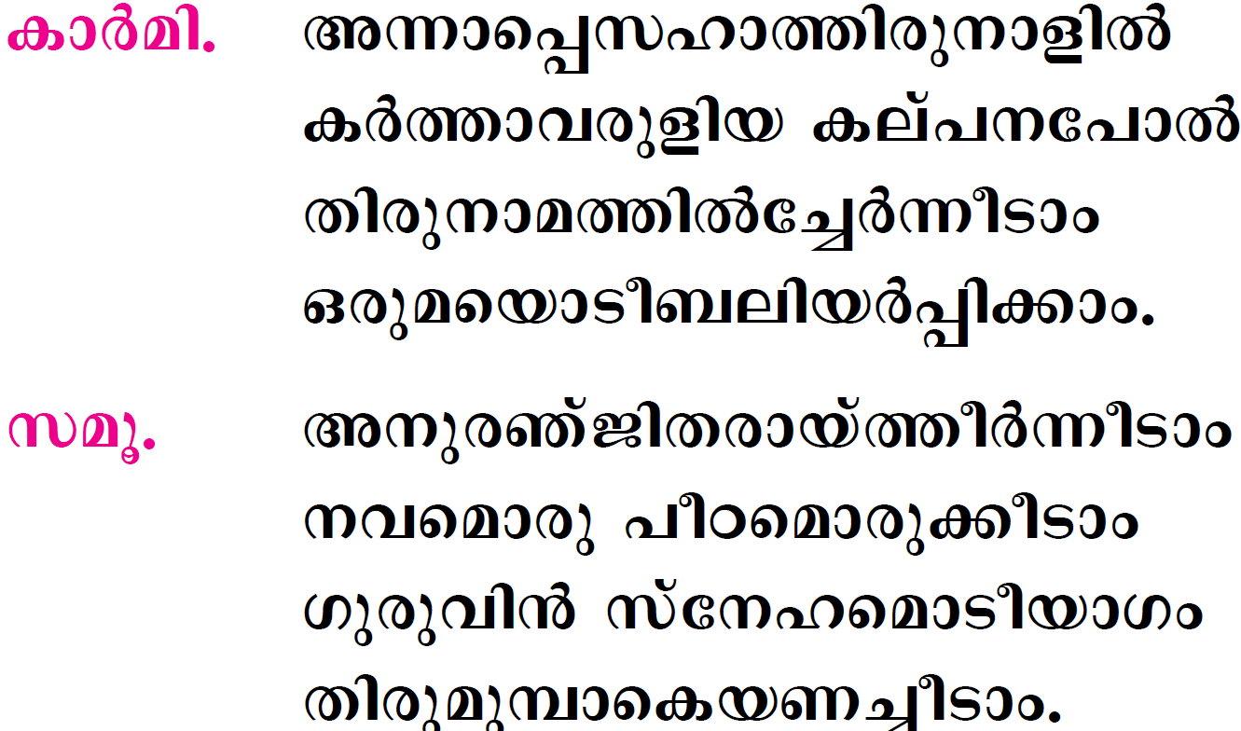

Slide 3
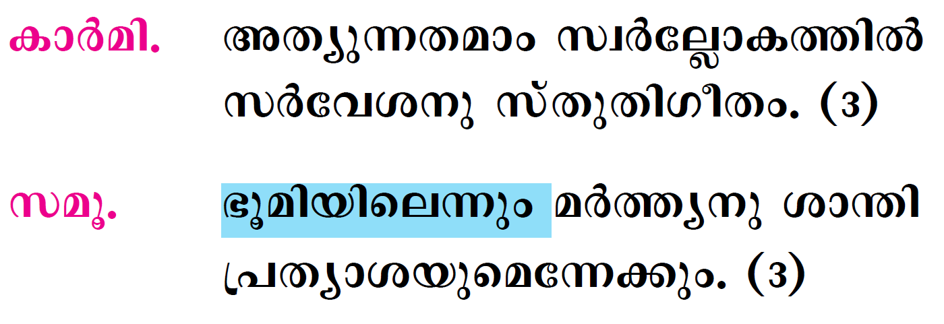

Slide 4
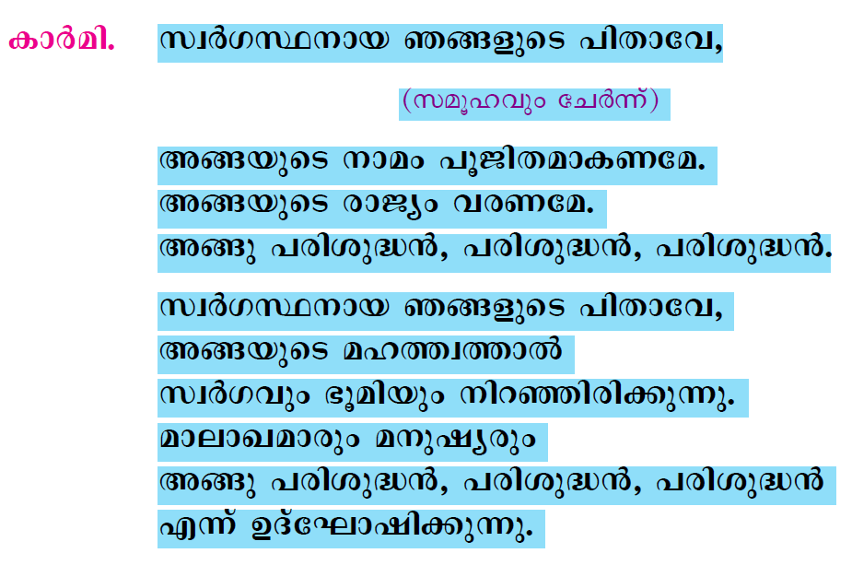

Slide 5
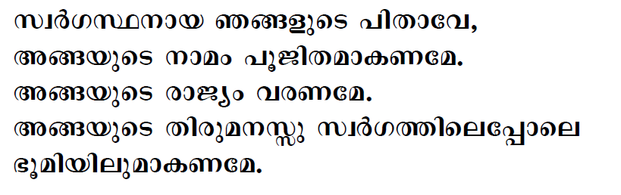
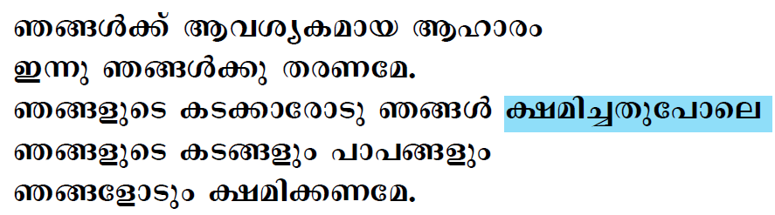

Slide 6
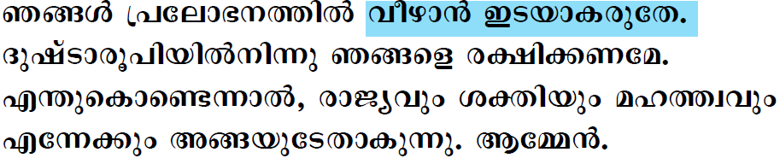

Slide 7

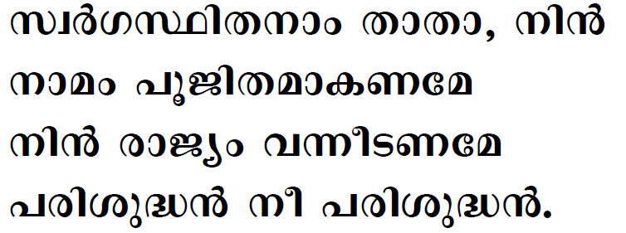

Slide 8

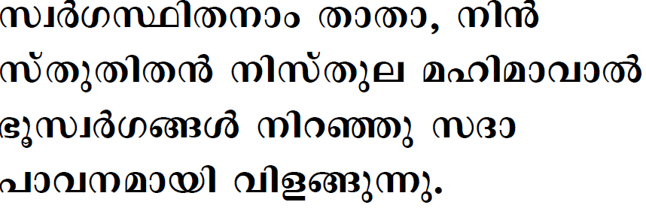
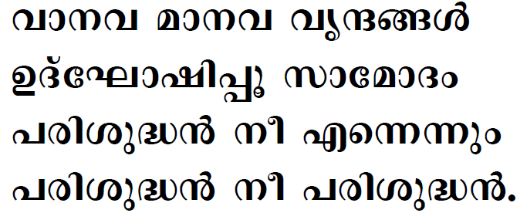

Slide 9
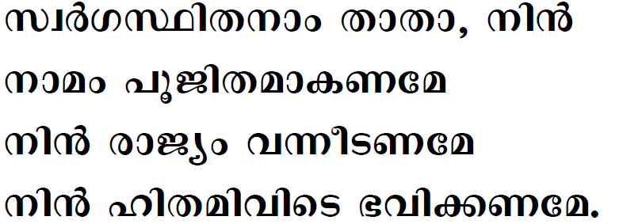
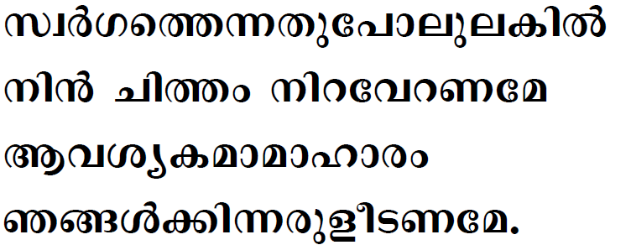

Slide 10
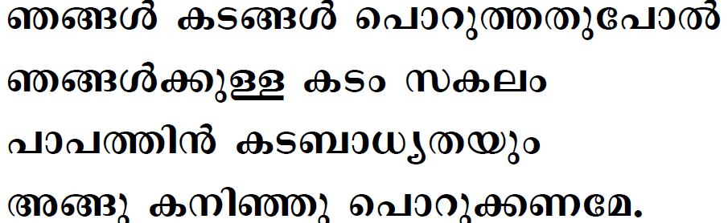
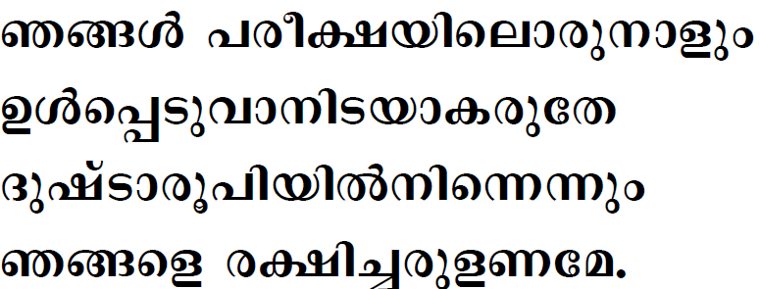

Slide 11
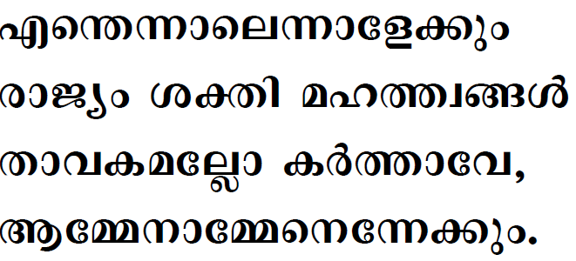

Slide 12
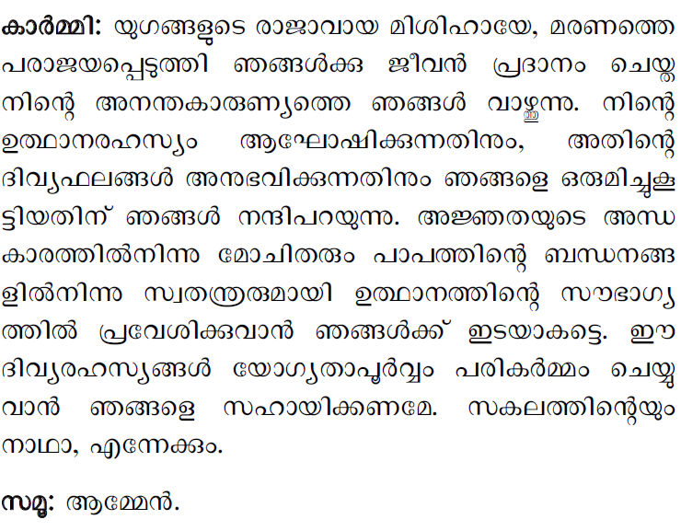

Slide 13


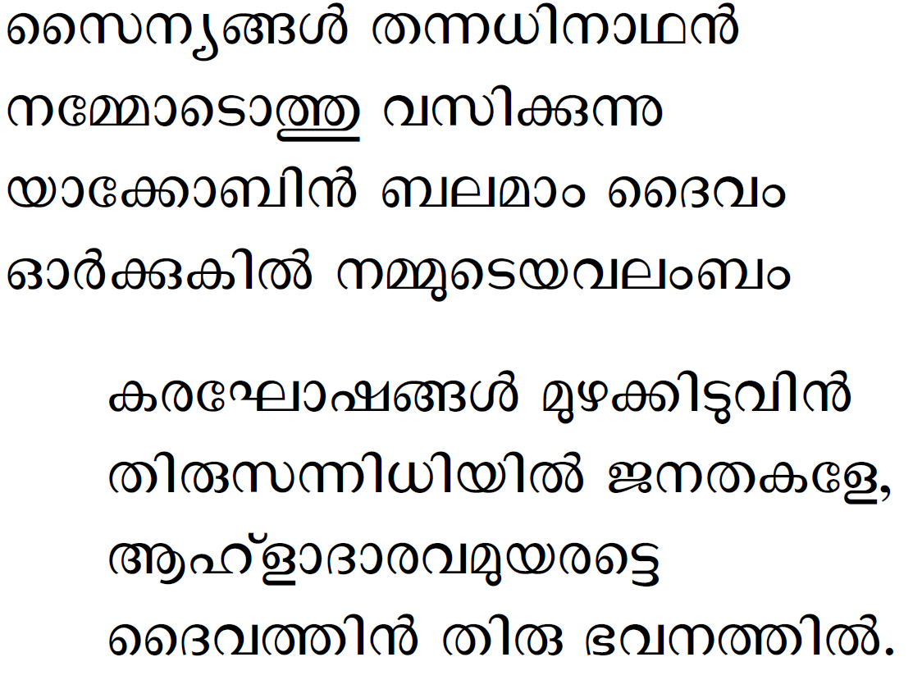

Slide 14
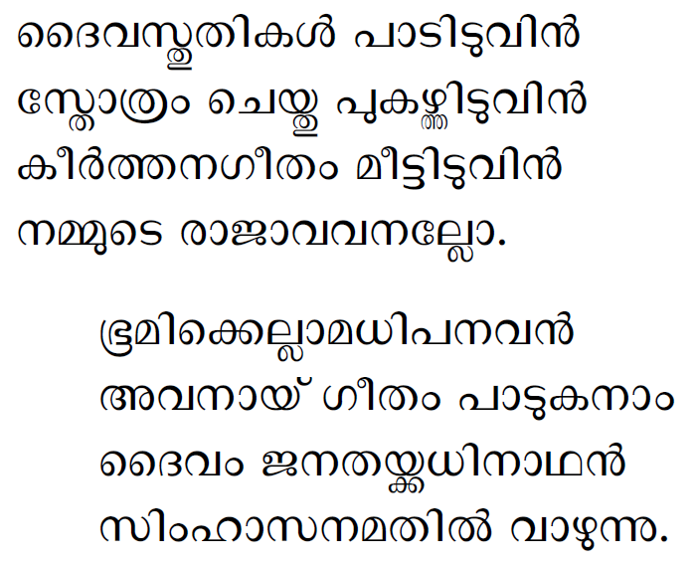

Slide 15
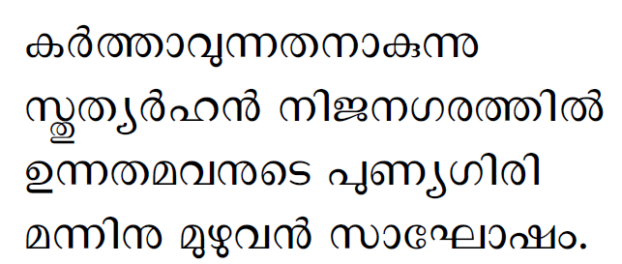
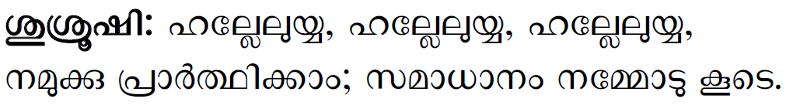

Slide 16
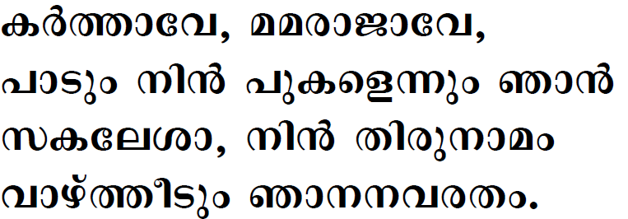

Slide 17

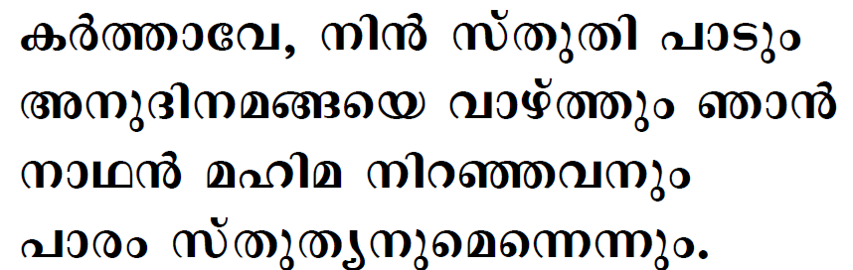
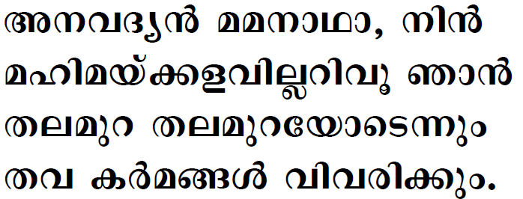

Slide 18
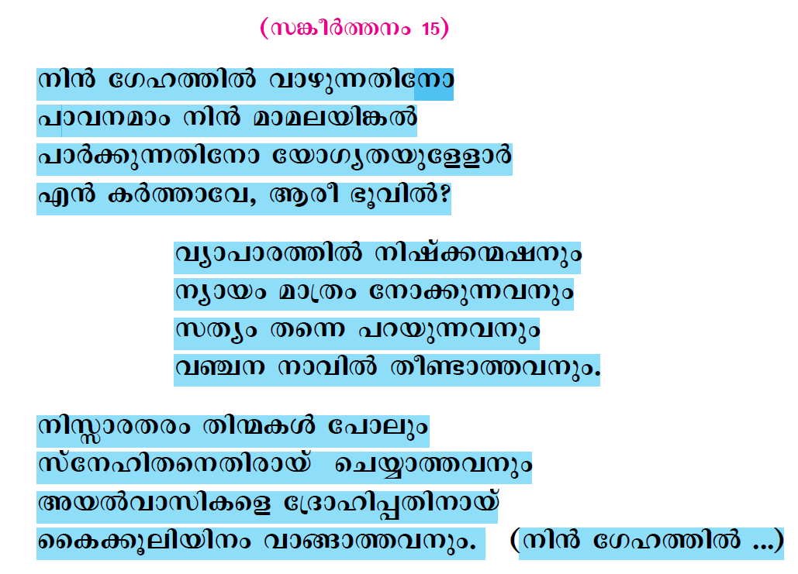

Slide 19
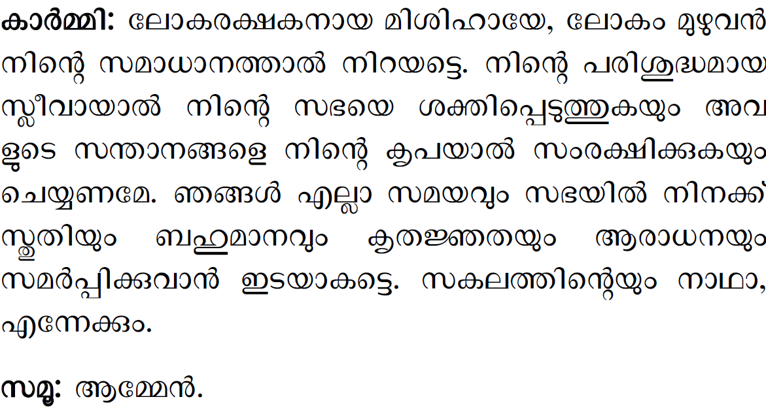

Slide 20
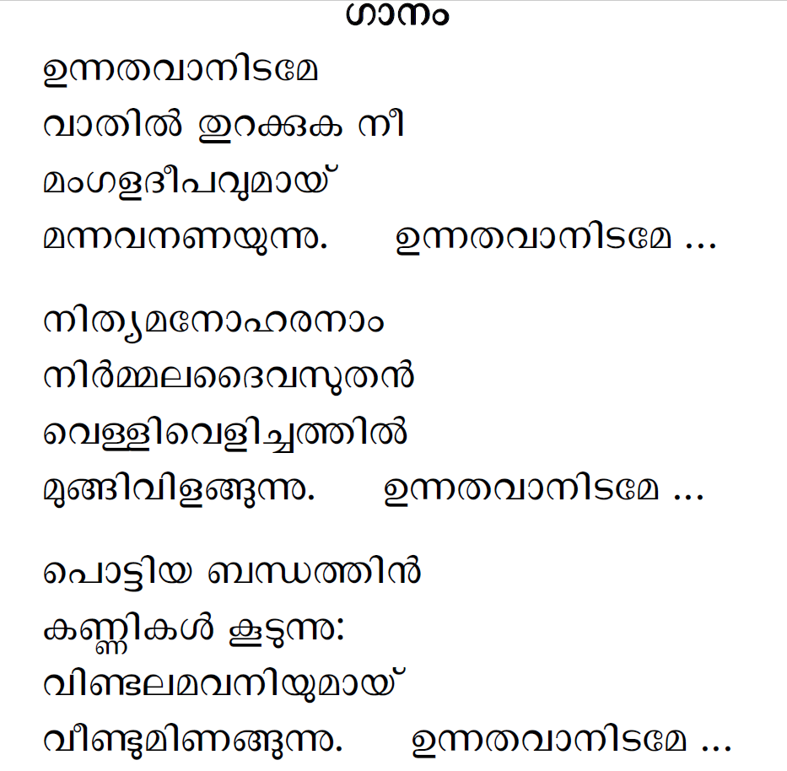

Slide 21
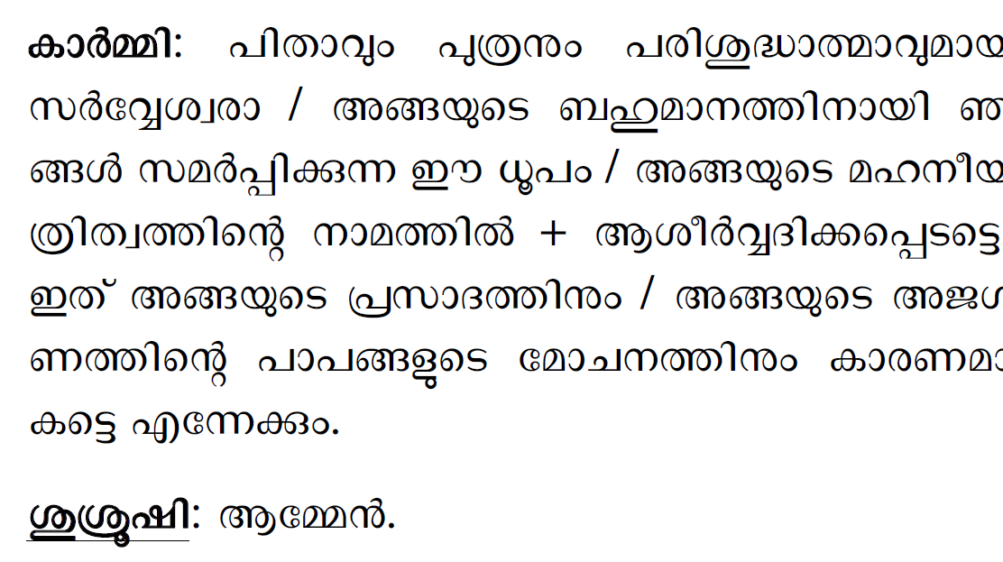

Slide 22
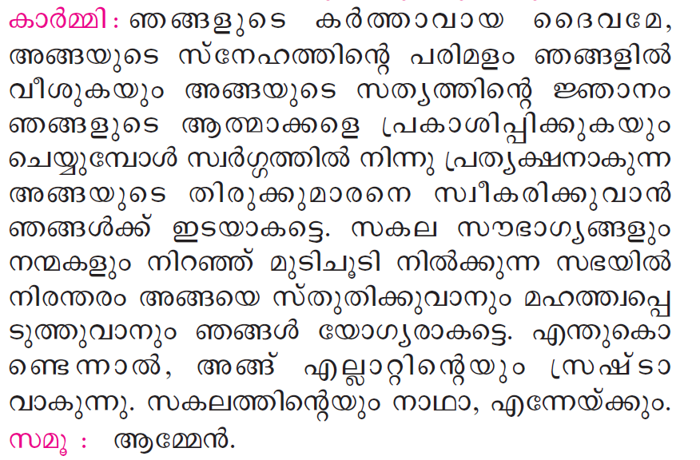

Slide 23
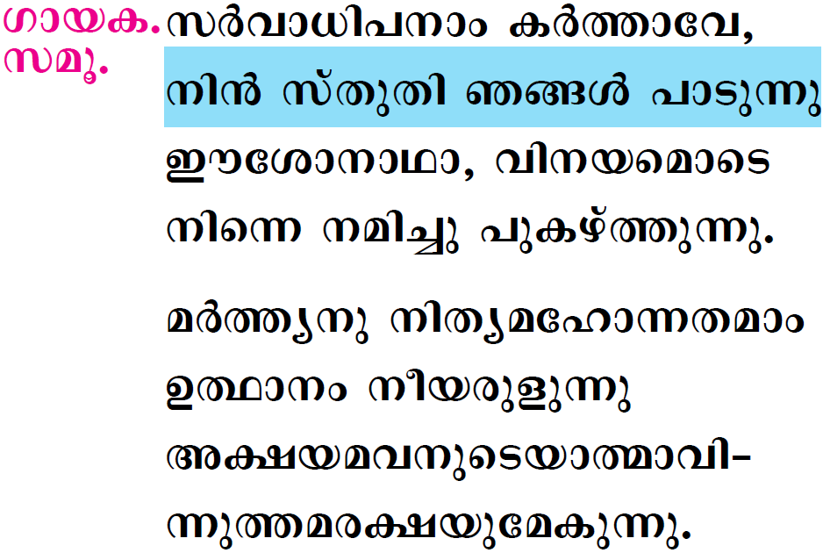

Slide 24

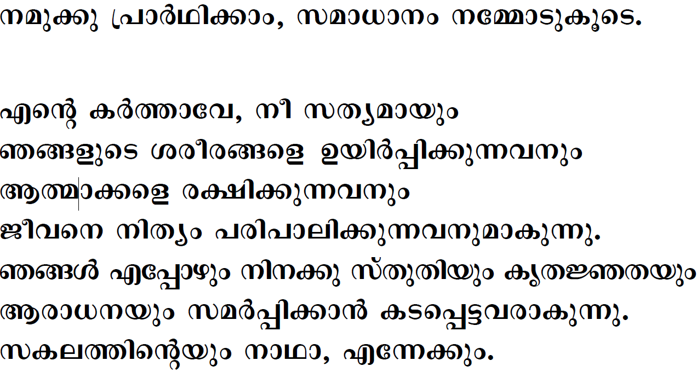



Slide 25
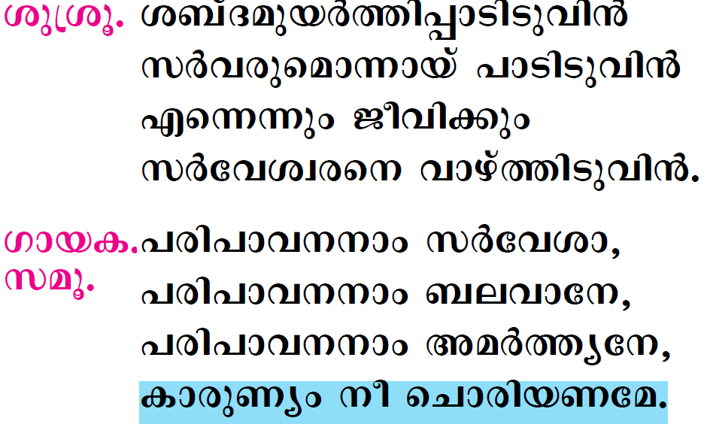

Slide 26

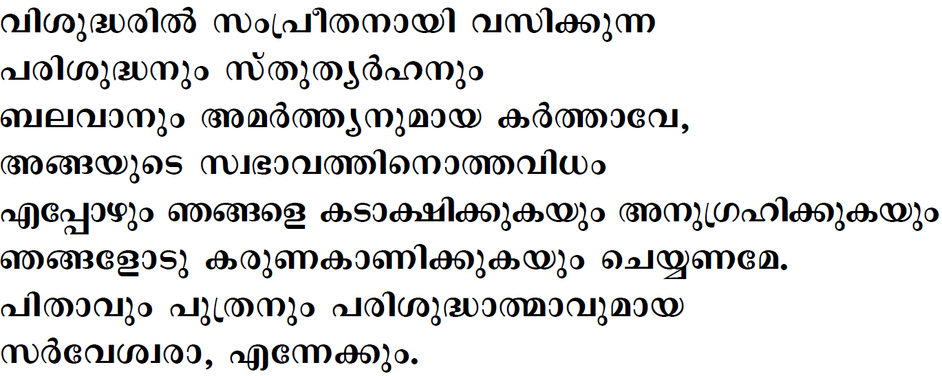


Slide 27
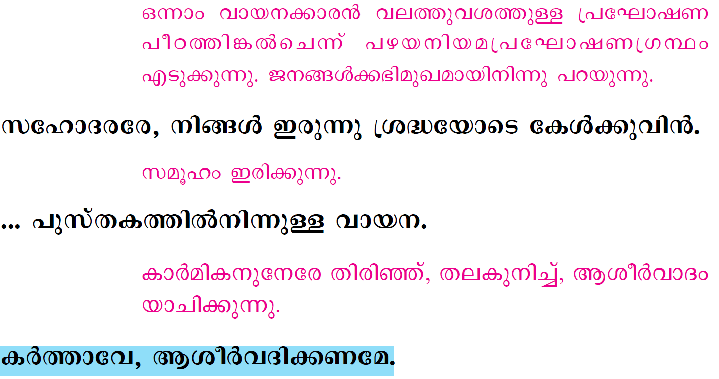

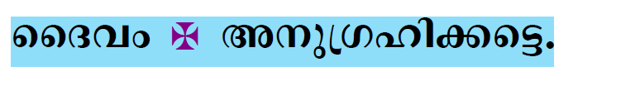

Slide 28
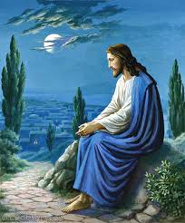
Please be Seated…

Slide 29
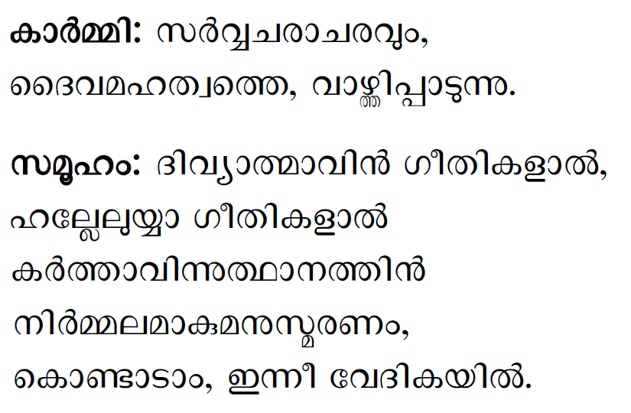

Slide 30
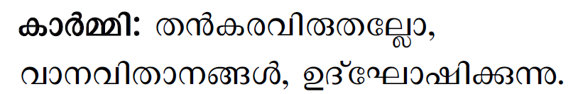
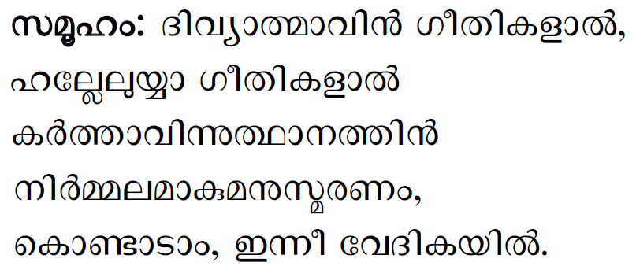

Slide 31
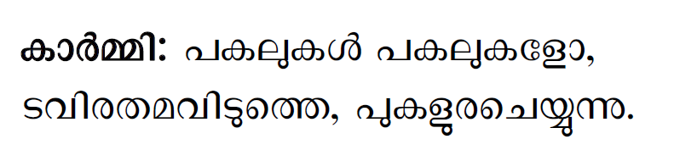

Slide 32
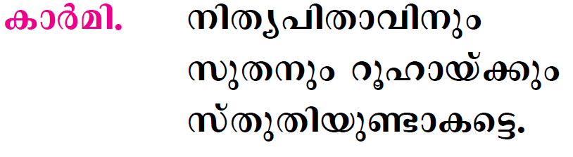

Slide 33
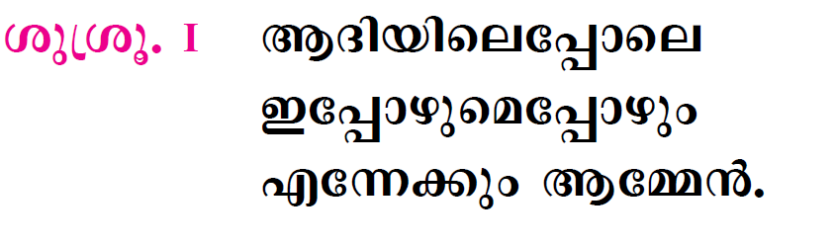

Slide 34

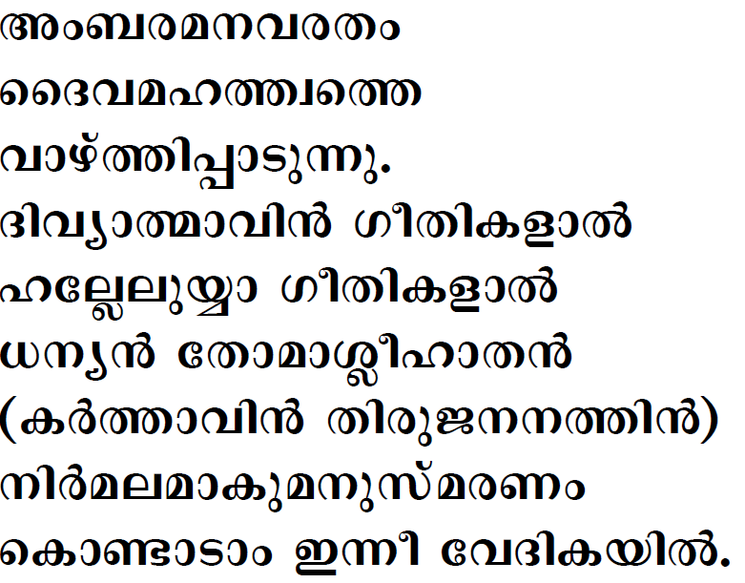

Slide 35

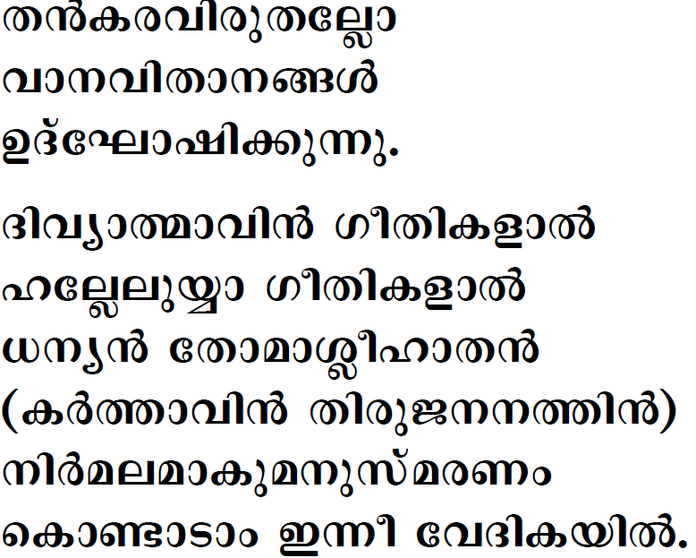


Slide 36

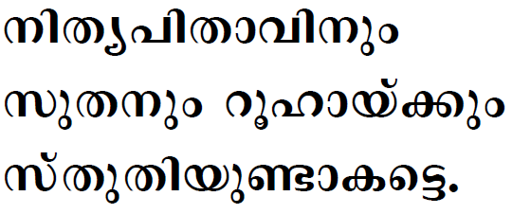

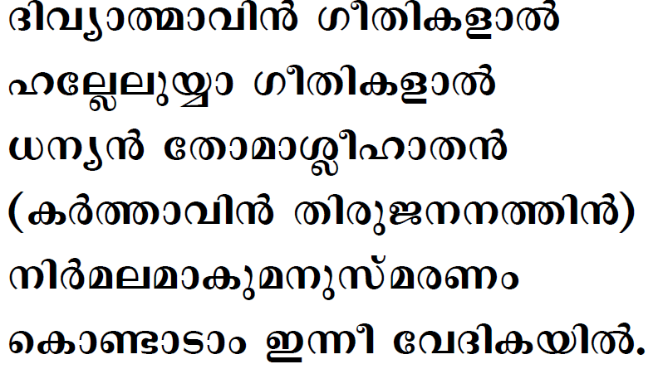

Slide 37

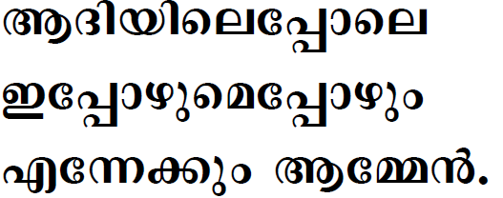

Slide 38
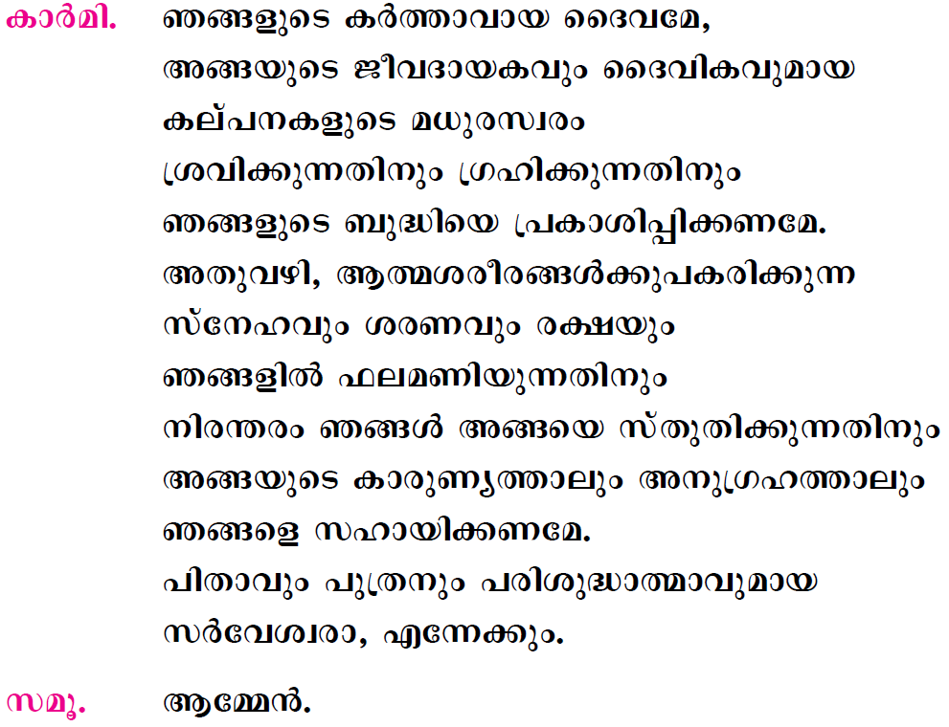

Slide 39
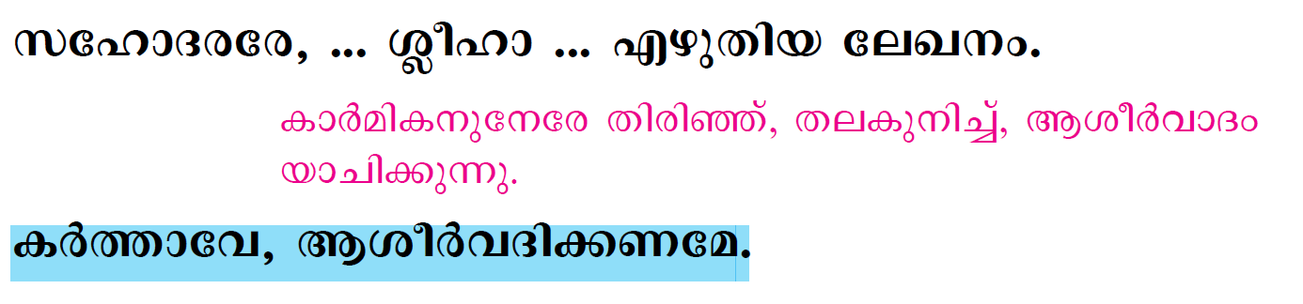
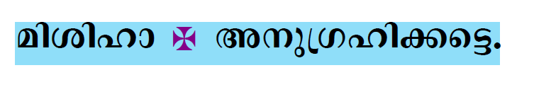


Slide 40
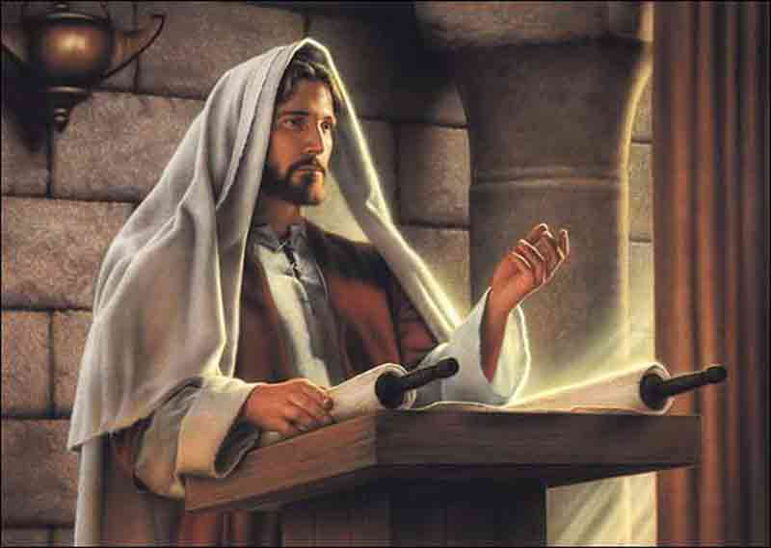
Please Stand…

Slide 41
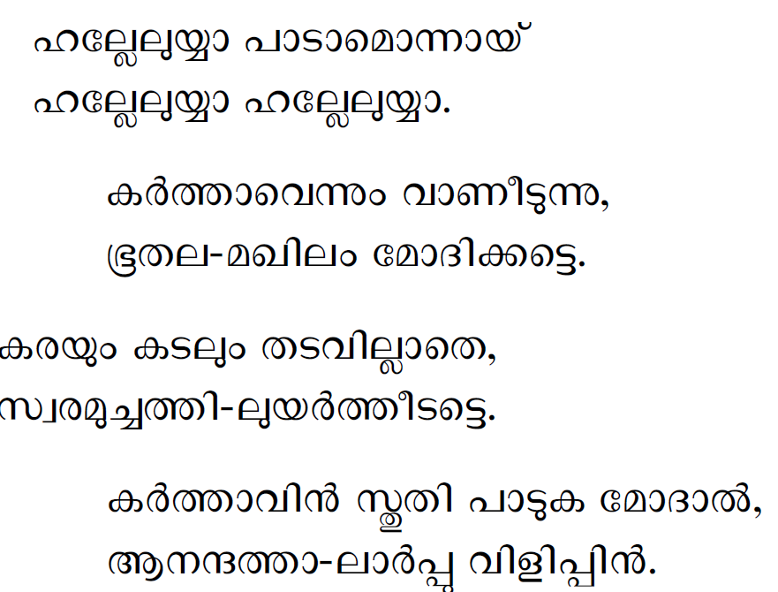

Slide 42


Slide 43


Slide 44


Slide 45


Slide 46




Slide 47


Slide 48



Slide 49


Slide 50


Slide 51


Slide 52



Slide 53


Slide 54


Slide 55


Slide 56


Slide 57


Slide 58


Slide 59



Slide 60


Slide 61



Slide 62


Slide 63


Slide 64
Please be Seated…

Slide 65


Slide 66
Please Stand…

Slide 67


Slide 68






Slide 69





Slide 70



Slide 71



Slide 72





Slide 73





Slide 74





Slide 75



Slide 76



Slide 77


Slide 78


Slide 79


Slide 80


Slide 81




Slide 82


Slide 83


Slide 84


Slide 85





Slide 86


Slide 87



Slide 88


Slide 89



Slide 90




Slide 91



Slide 92




Slide 93



Slide 94




Slide 95



Slide 96




Slide 97





Slide 98




Slide 99



Slide 100


Slide 101




Slide 102


Slide 103





Slide 104


Slide 105


Slide 106



Slide 107



Slide 108


Slide 109


Slide 110


Slide 111



Slide 112



Slide 113



Slide 114



Slide 115


Slide 116



Slide 117



Slide 118




Slide 119


Slide 120





Slide 121



Slide 122


Slide 123


Slide 124


Slide 125





Slide 126



Slide 127




Slide 128




Slide 129




Slide 130




Slide 131


Slide 132


Slide 133


Slide 134



Slide 135



Slide 136




Slide 137


Slide 139


Slide 140


Slide 141



Slide 142



Slide 143






Slide 144


Slide 145



Slide 146


Slide 147


Slide 148


Slide 149


