Slide 1
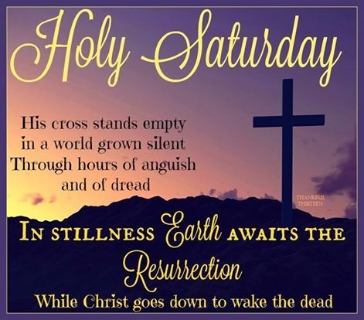


Slide 2
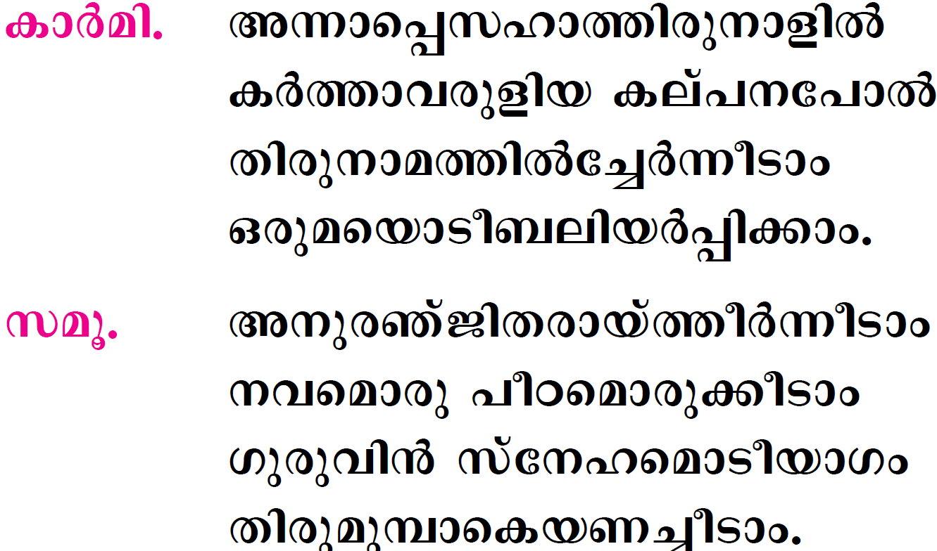

Slide 3
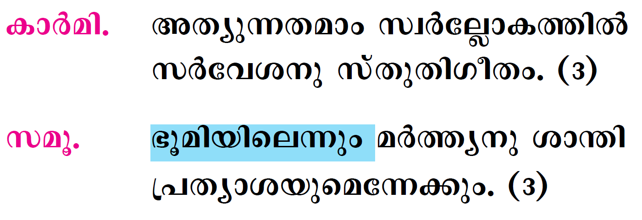

Slide 4
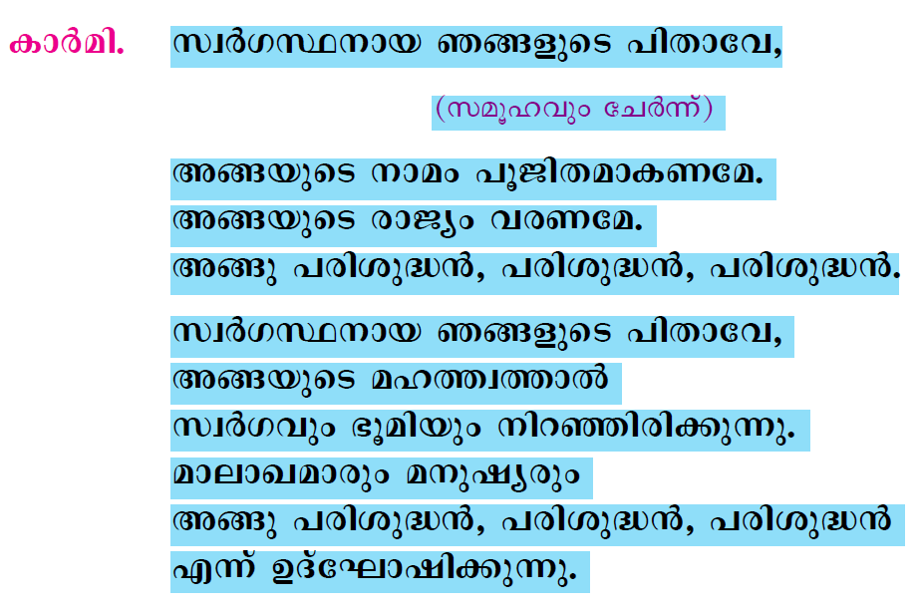

Slide 5
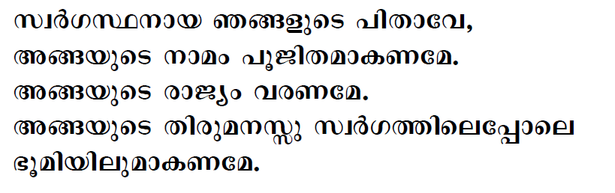
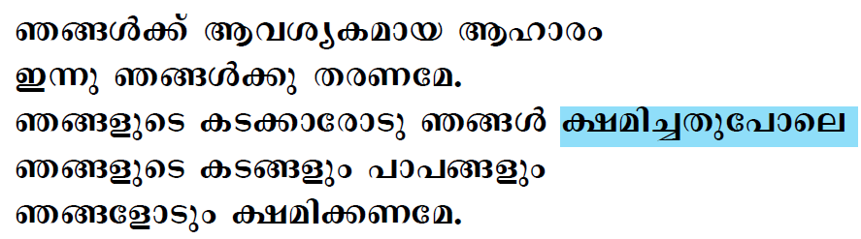

Slide 6
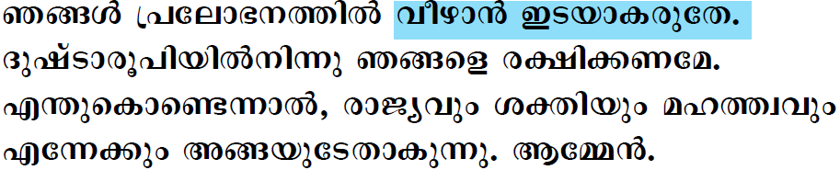

Slide 7

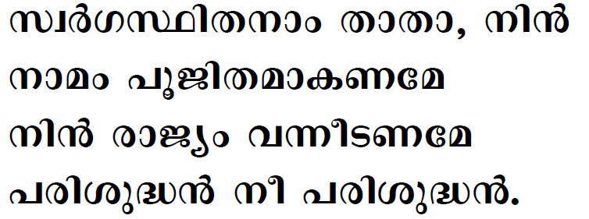

Slide 8

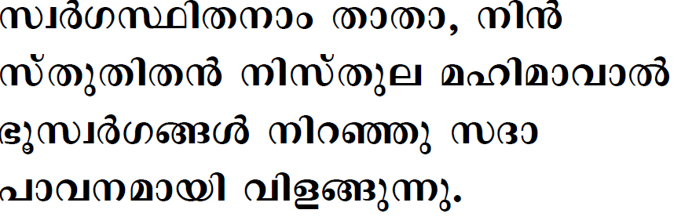
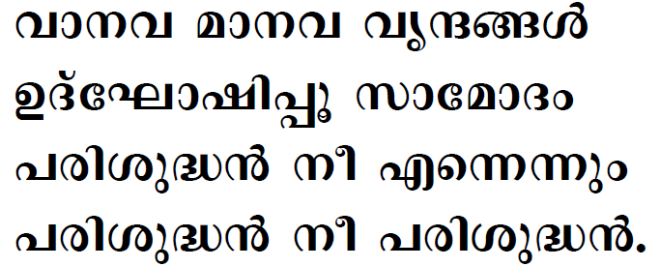

Slide 9
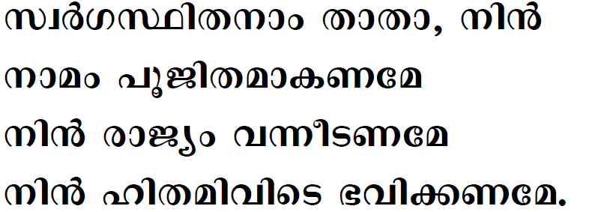
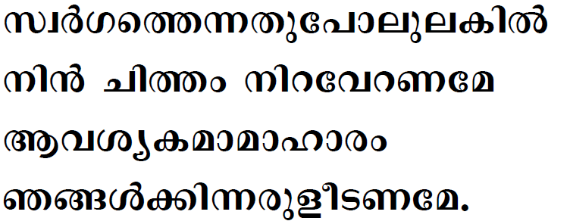

Slide 10
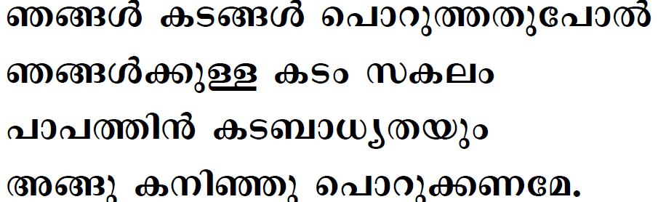
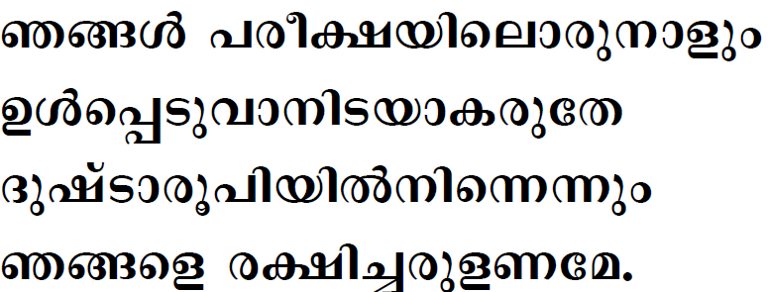

Slide 11
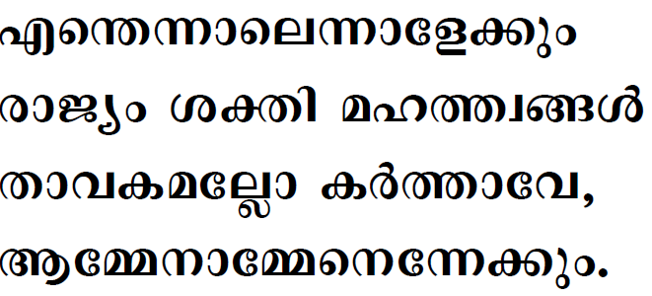

Slide 12
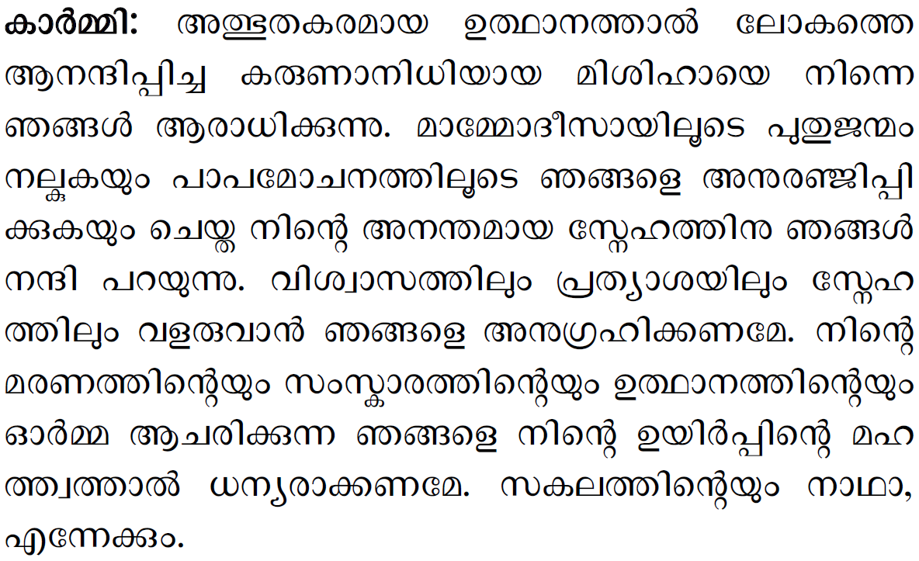


Slide 13
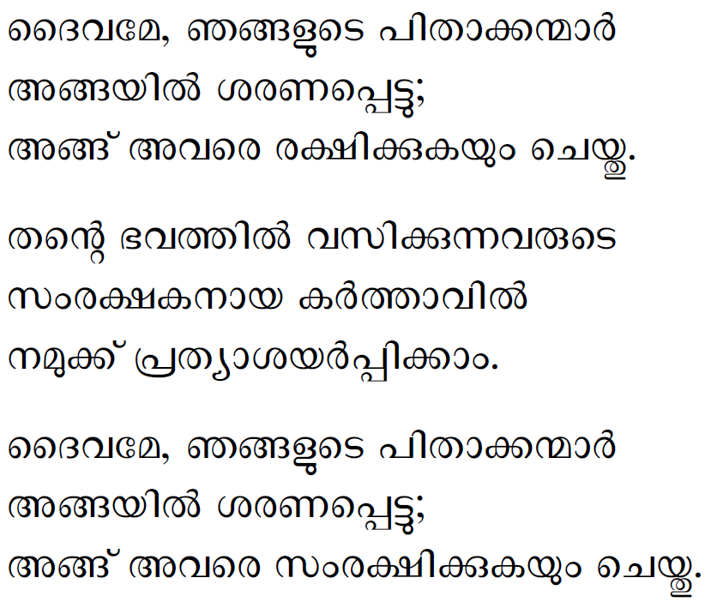

Slide 14
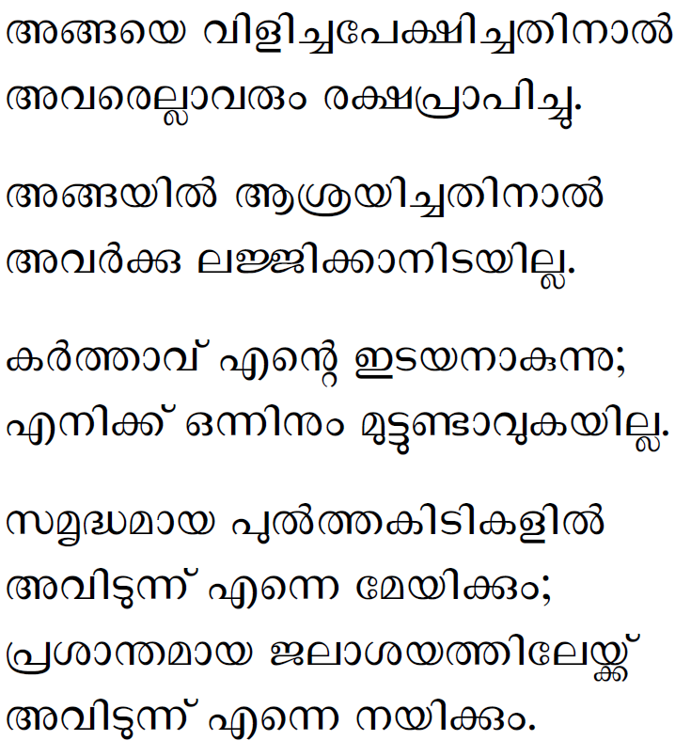

Slide 15
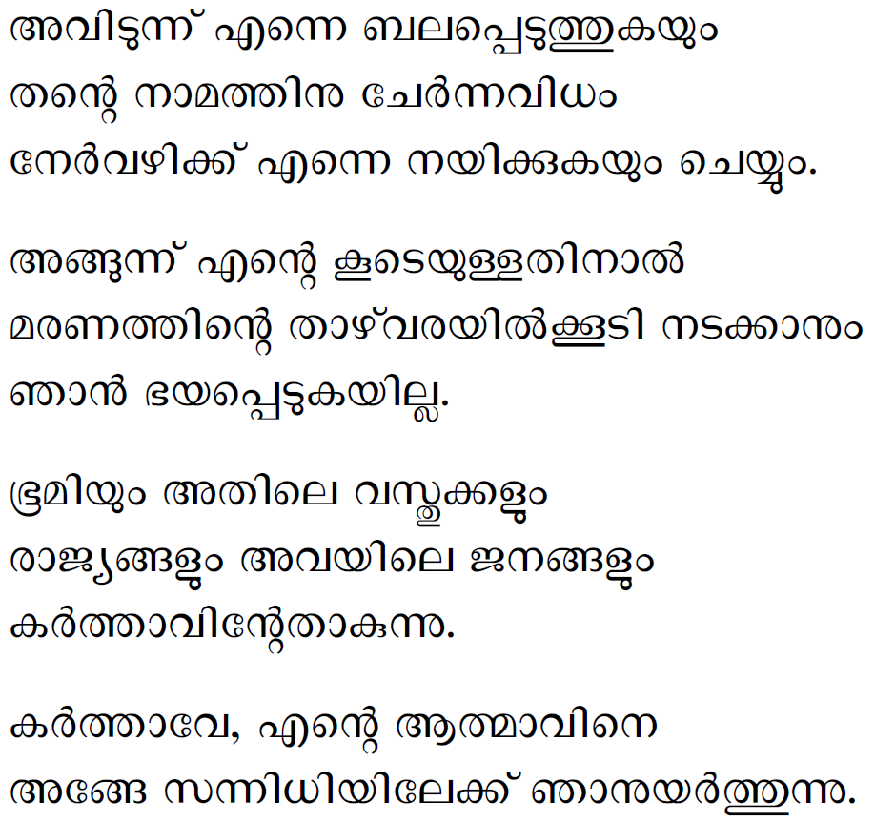

Slide 16
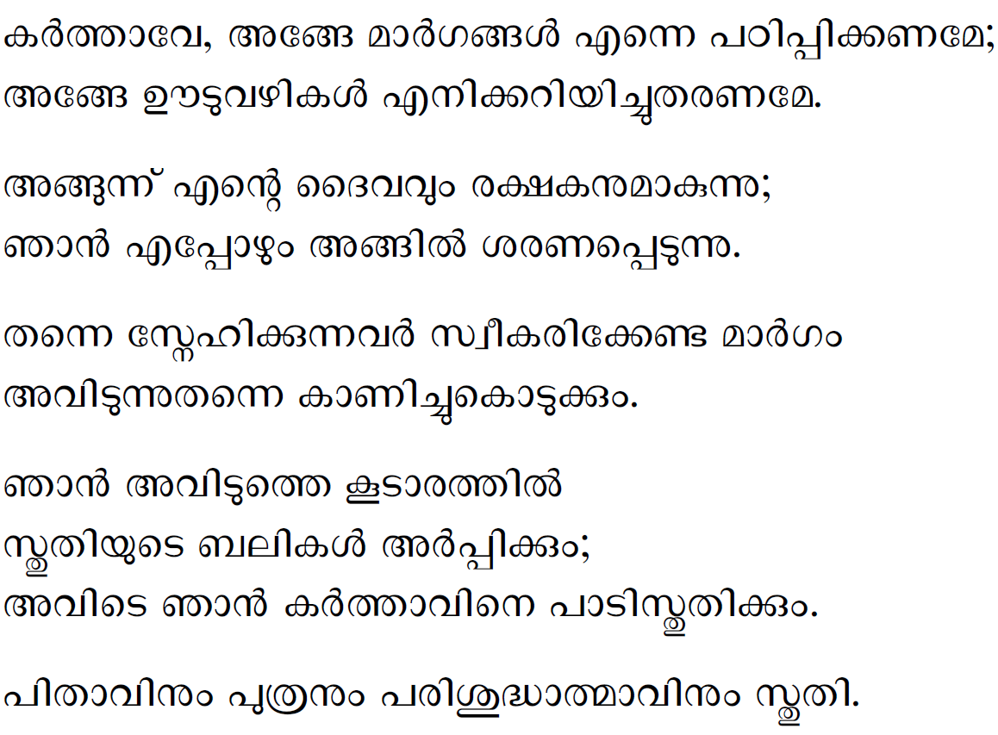

Slide 17
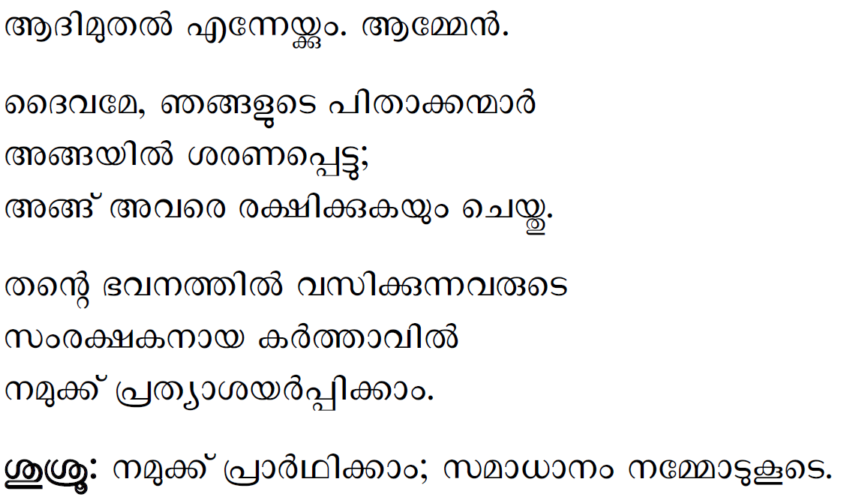

Slide 18

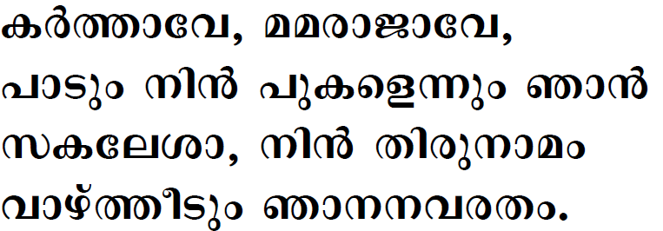

Slide 19

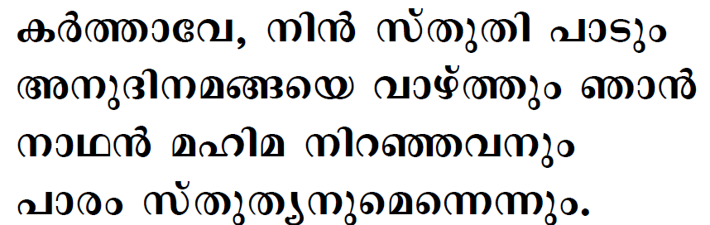
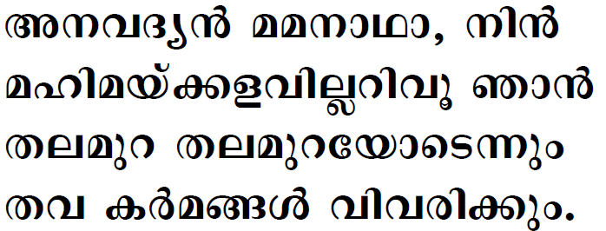

Slide 20
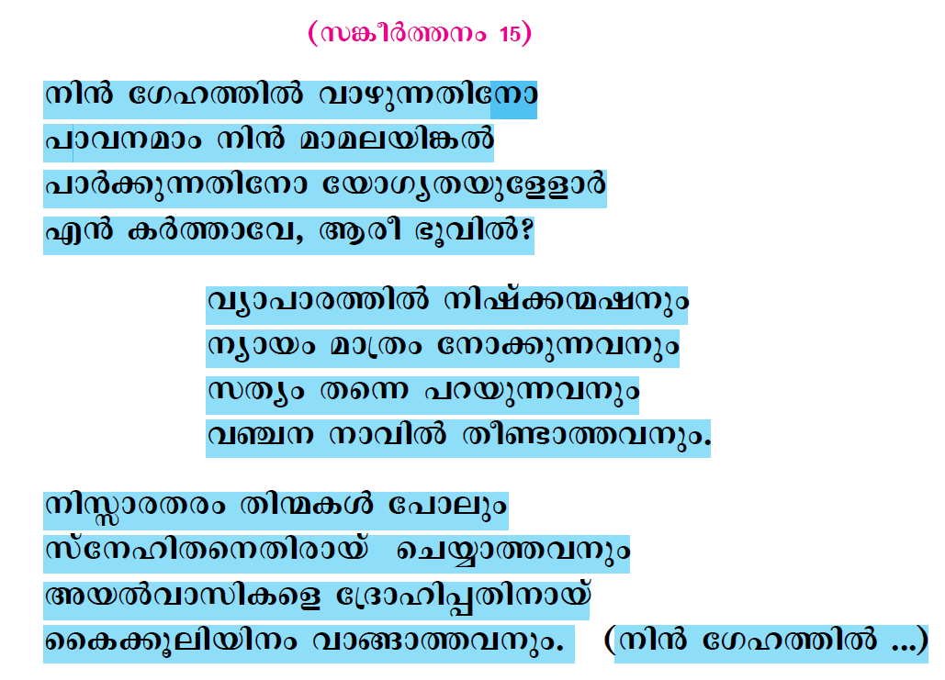

Slide 21
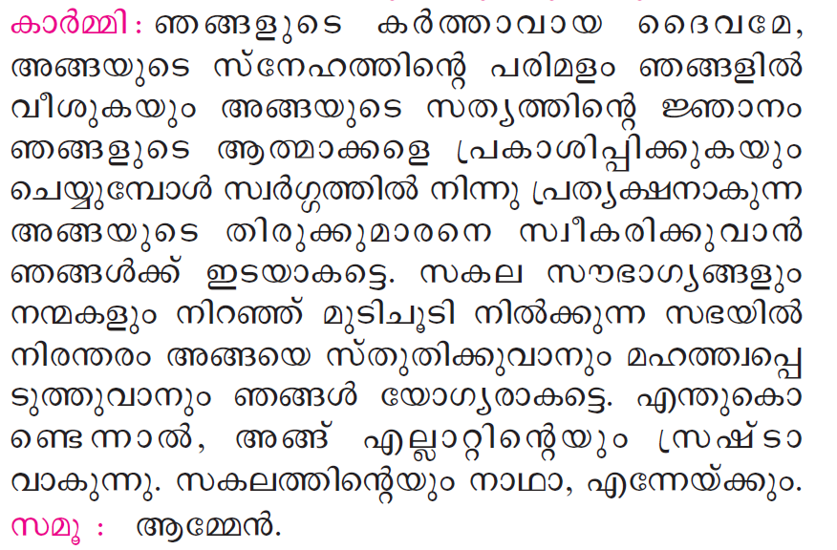

Slide 22
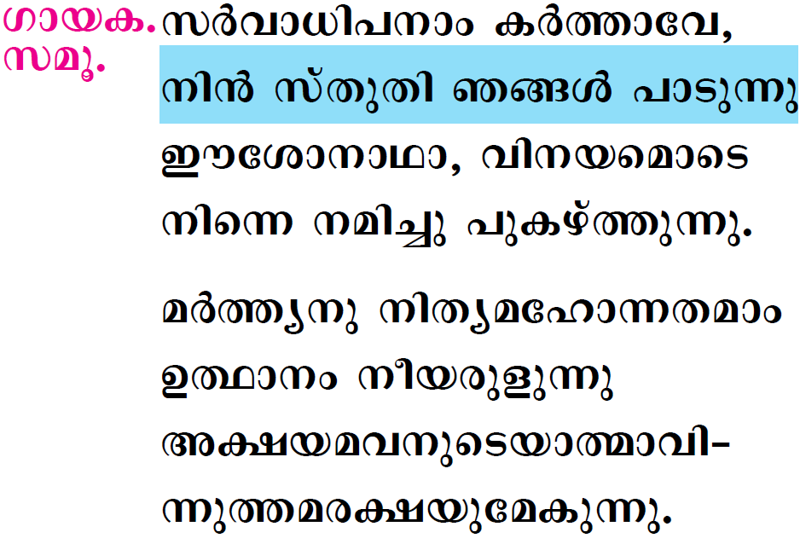

Slide 23

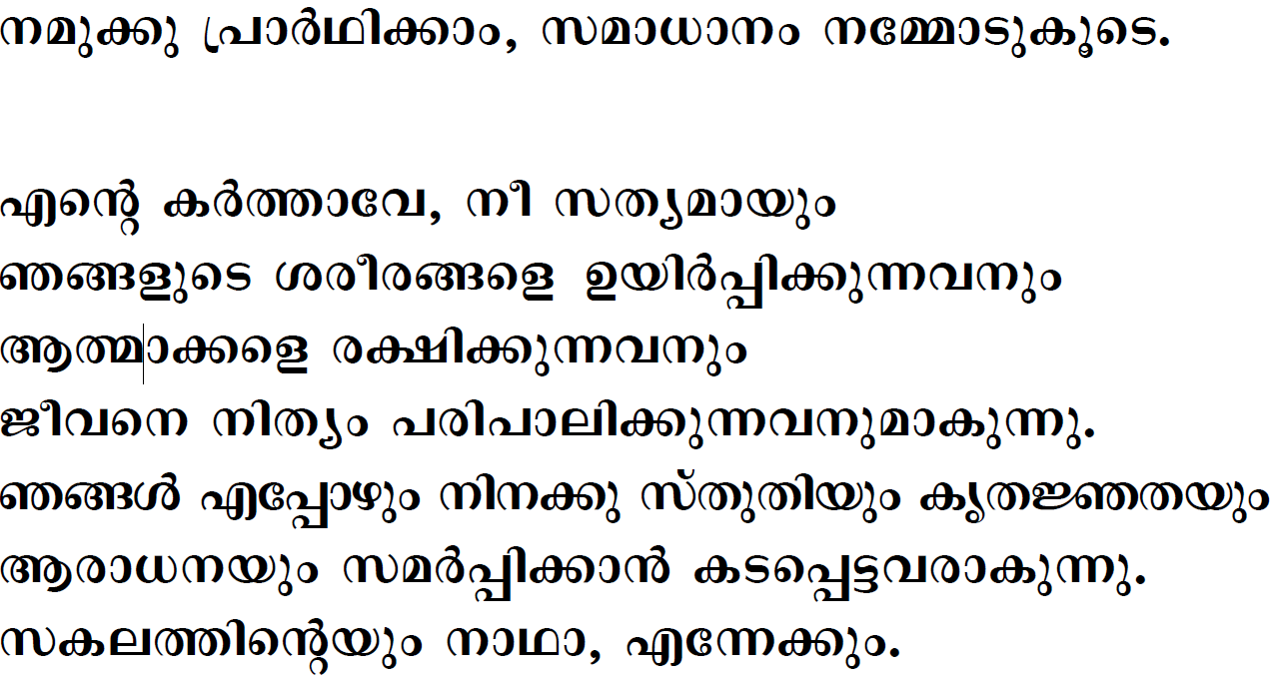



Slide 24
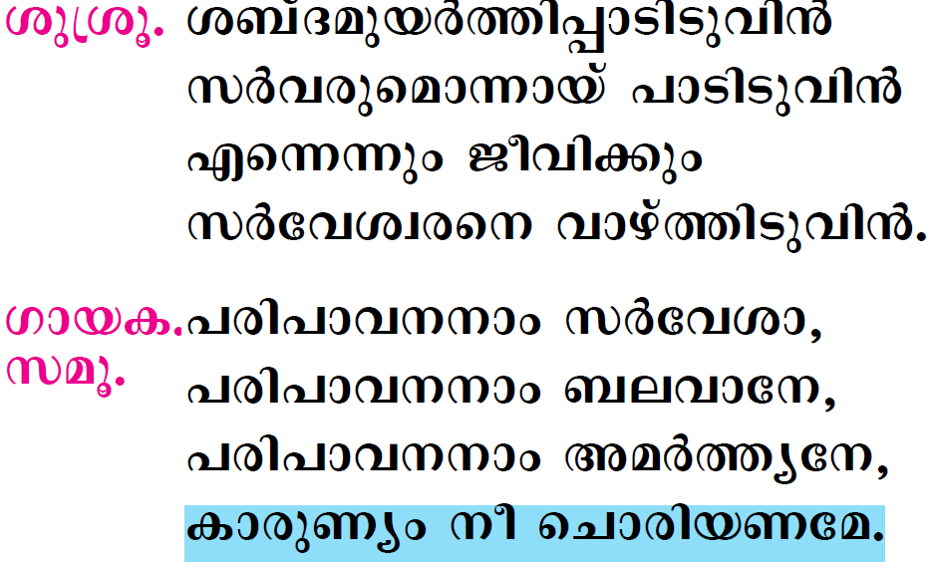

Slide 25

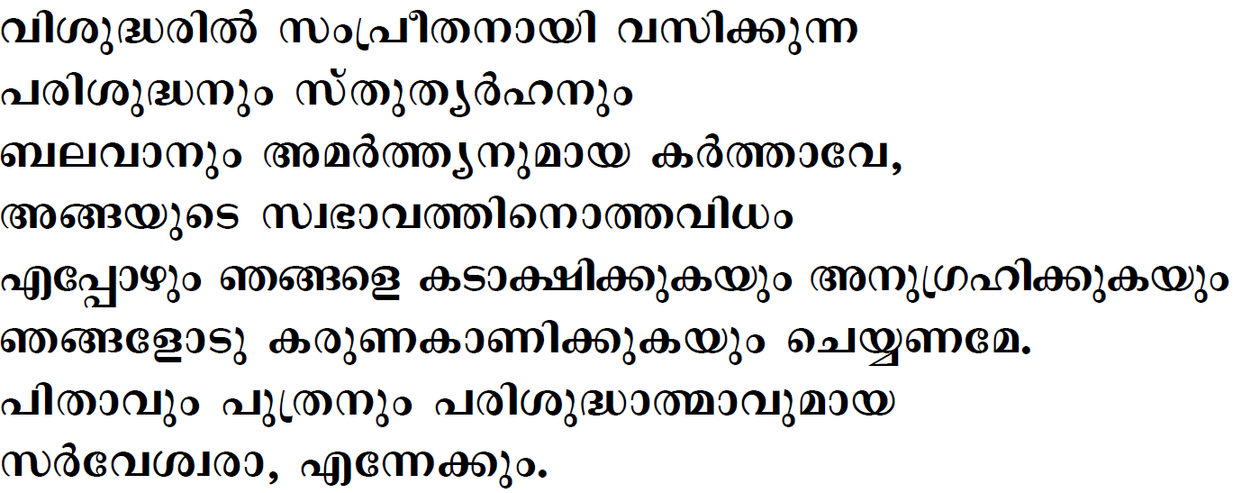


Slide 26
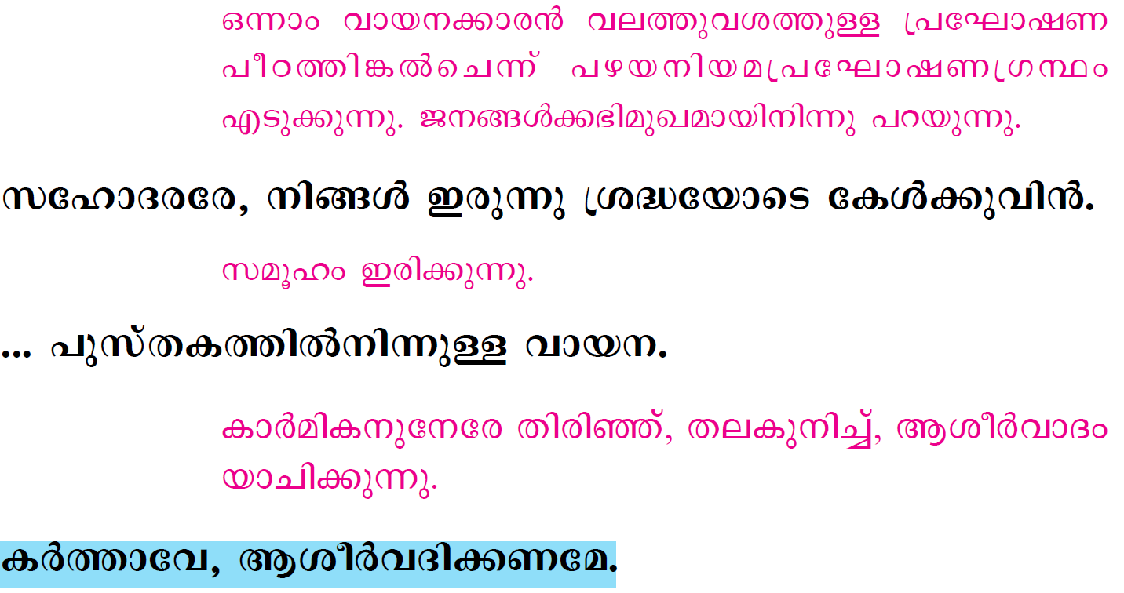

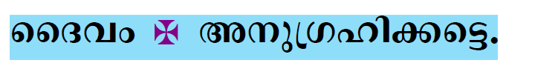

Slide 27
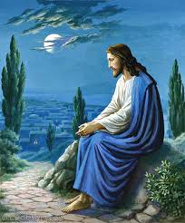
Please be Seated…

Slide 28
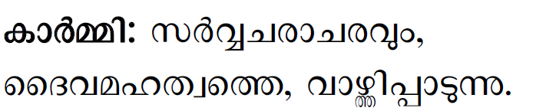
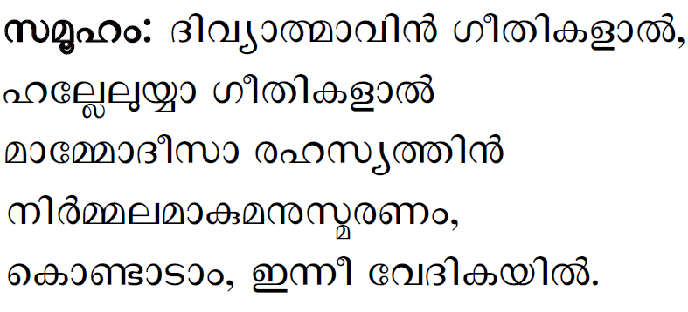

Slide 29
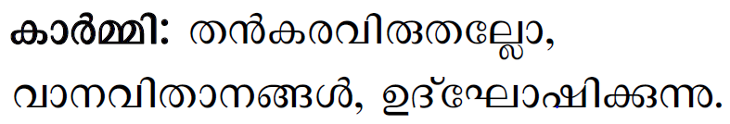

Slide 30
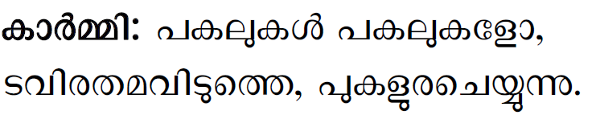

Slide 31
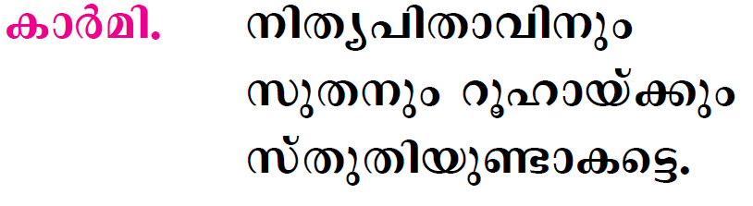

Slide 32
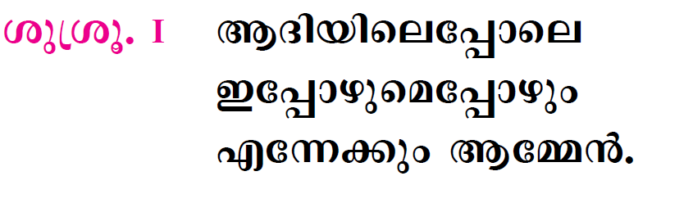

Slide 33

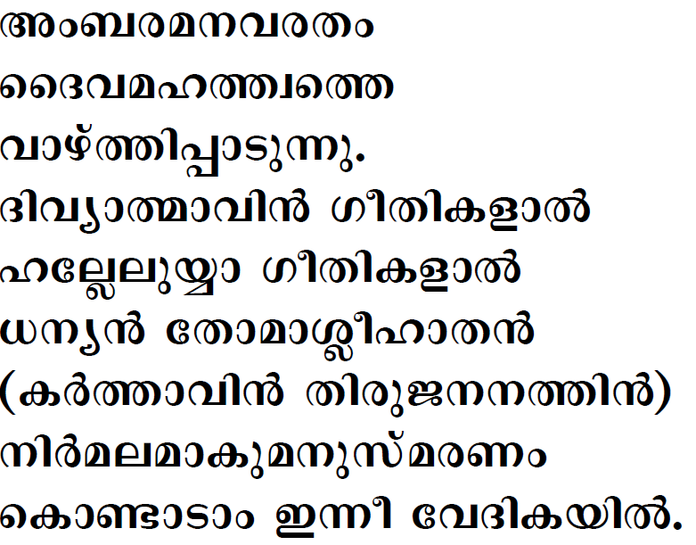

Slide 34

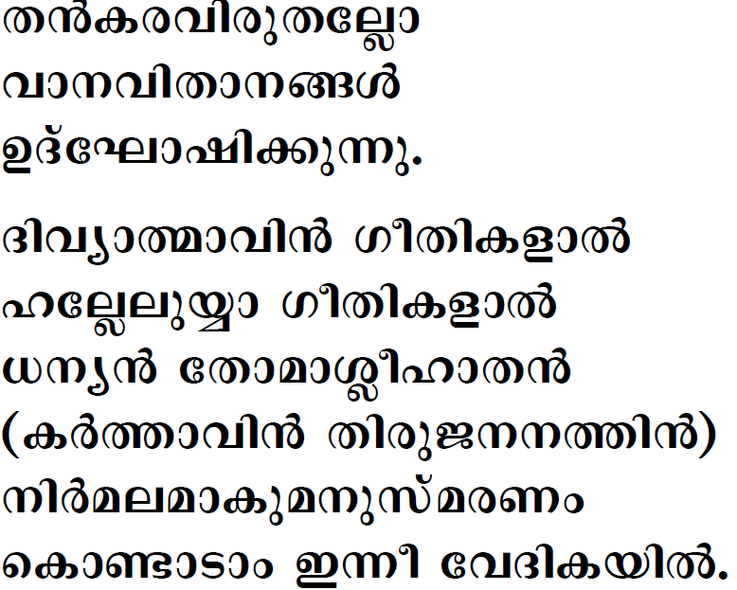


Slide 35

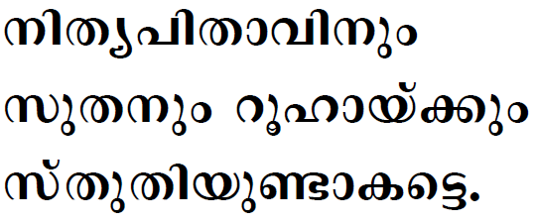

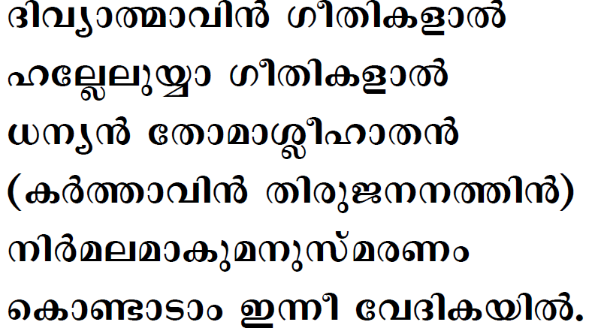

Slide 36

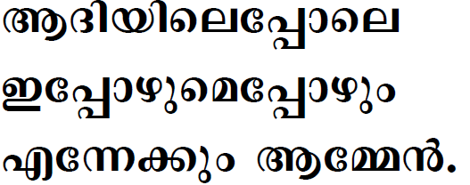

Slide 37
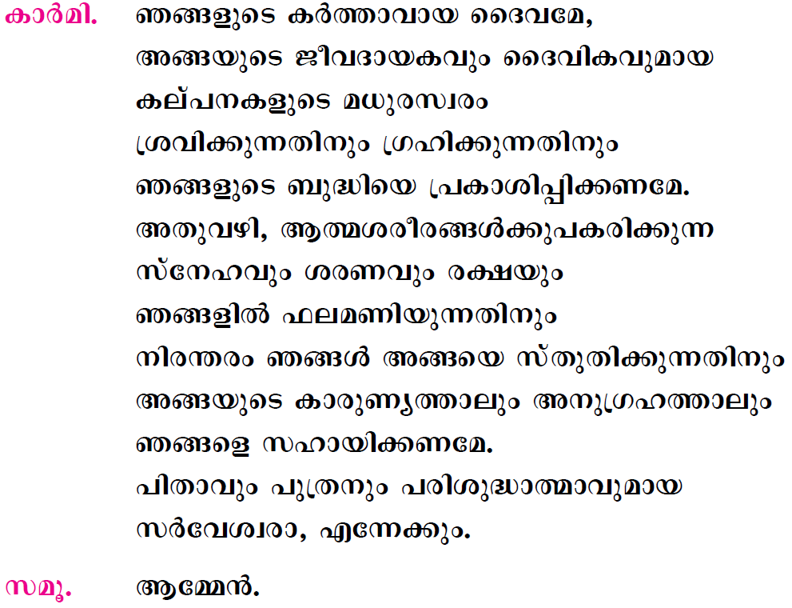

Slide 38
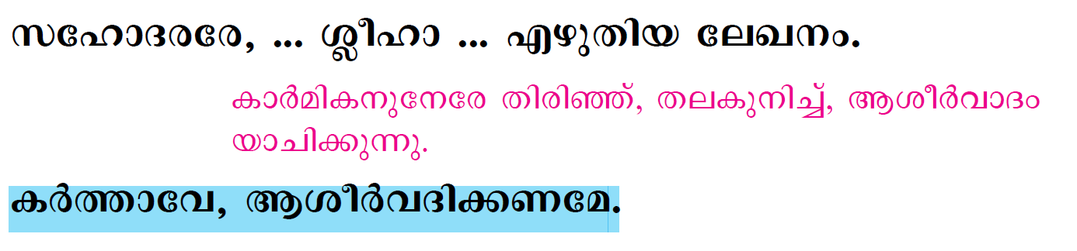
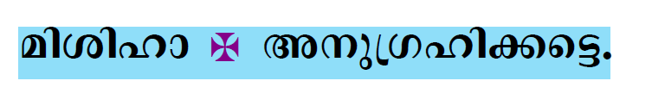


Slide 39
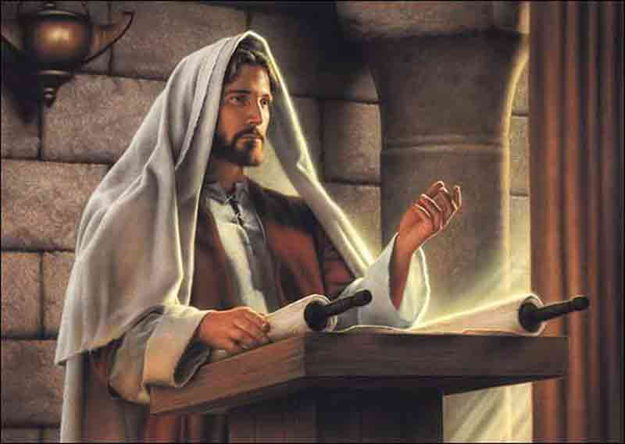
Please Stand…

Slide 40
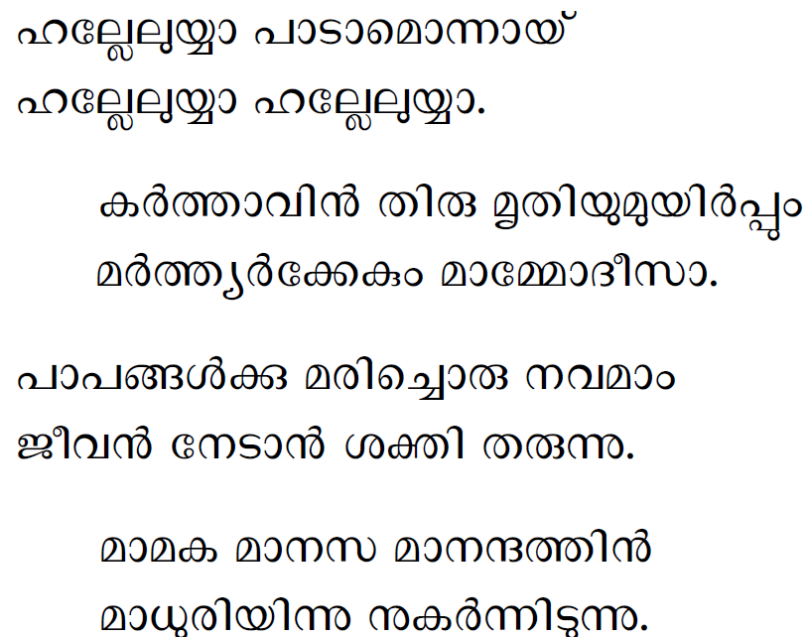

Slide 41
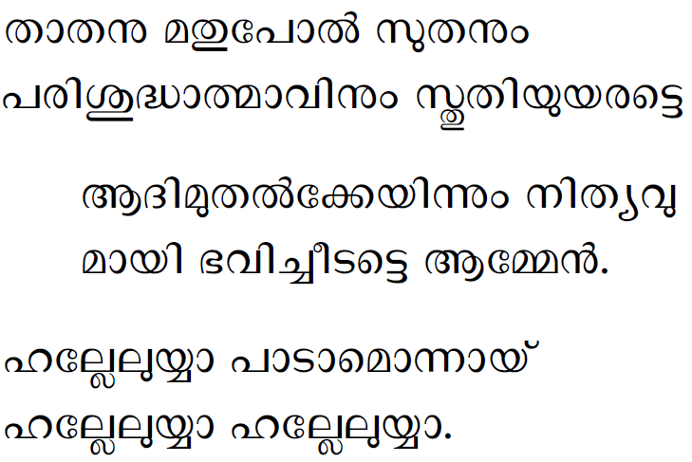

Slide 42


Slide 43


Slide 44


Slide 45




Slide 46
Please be Seated…

Slide 47


Slide 48
Please Stand…

Slide 49


Slide 50


Slide 51



Slide 52


Slide 53


Slide 54



Slide 55


Slide 56


Slide 57



Slide 58


Slide 59



Slide 60


Slide 61



Slide 62


Slide 63


Slide 64


Slide 65


Slide 66





Slide 67





Slide 68


Slide 69



Slide 70





Slide 71





Slide 72





Slide 73



Slide 74



Slide 75


Slide 76


Slide 77


Slide 78


Slide 79



Slide 80




Slide 81



Slide 82




Slide 83



Slide 84




Slide 85



Slide 86




Slide 87





Slide 88




Slide 89



Slide 90


Slide 91




Slide 92


Slide 93





Slide 94


Slide 95


Slide 96



Slide 97



Slide 98


Slide 99


Slide 100


Slide 101



Slide 102



Slide 103



Slide 104



Slide 105


Slide 106



Slide 107



Slide 108




Slide 109


Slide 110





Slide 111



Slide 112


Slide 113


Slide 114


Slide 115





Slide 116



Slide 117




Slide 118




Slide 119




Slide 120




Slide 121


Slide 122


Slide 123


Slide 124



Slide 125



Slide 126



Slide 127


Slide 129


Slide 130


Slide 131




Slide 132



Slide 133






Slide 134


Slide 135



Slide 136


Slide 137


Slide 138


Slide 139


