Slide 1





Slide 2
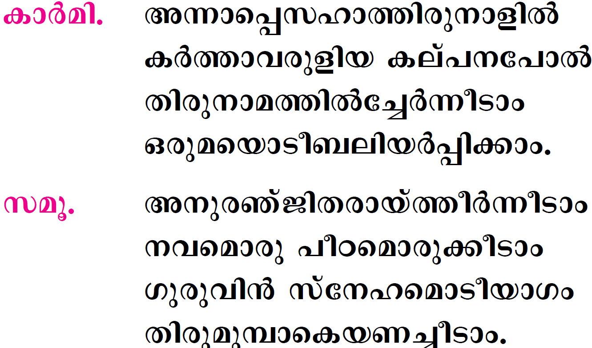

Slide 3
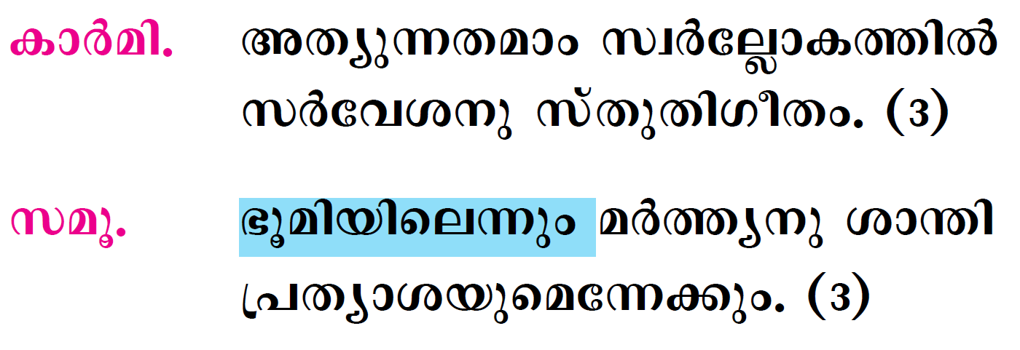

Slide 4
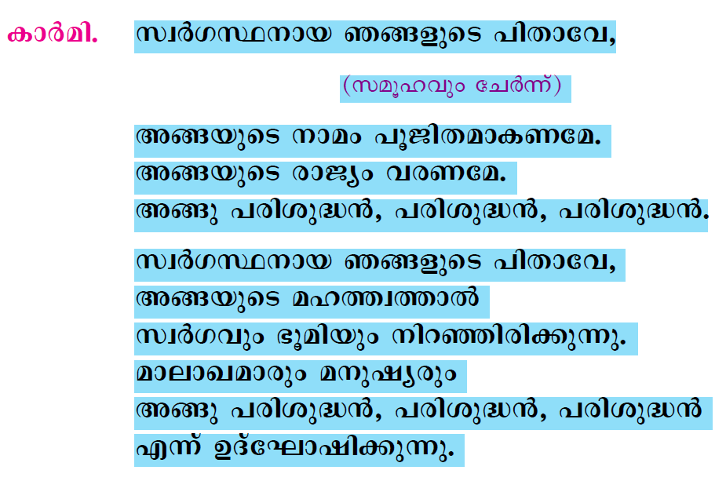

Slide 5
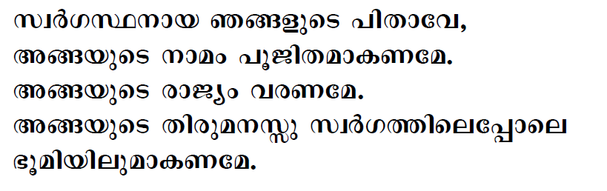
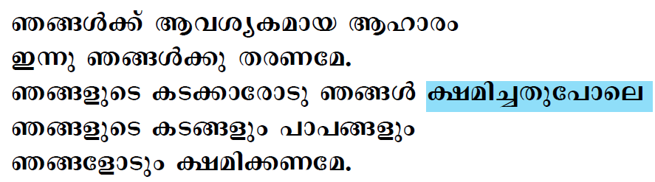

Slide 6
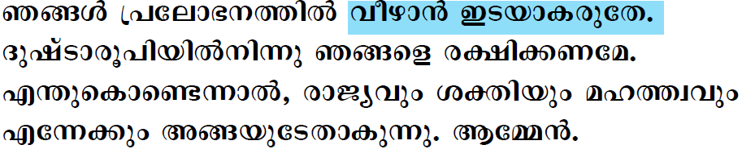

Slide 7

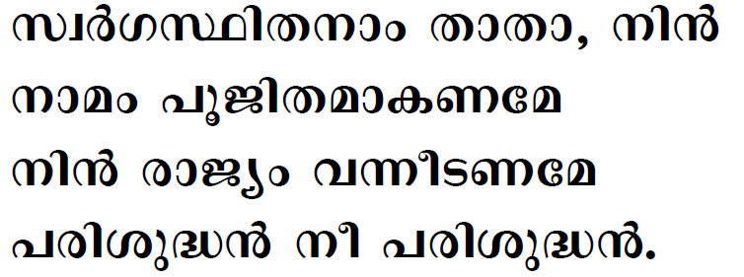

Slide 8

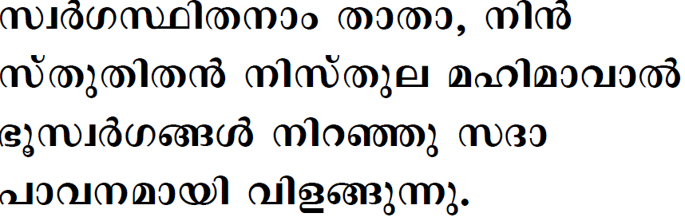
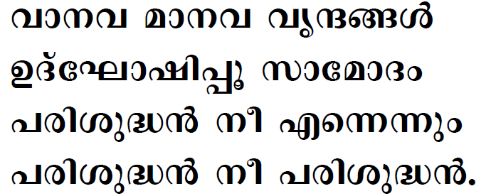

Slide 9
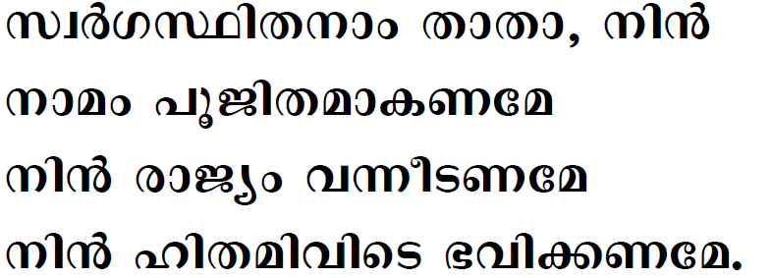
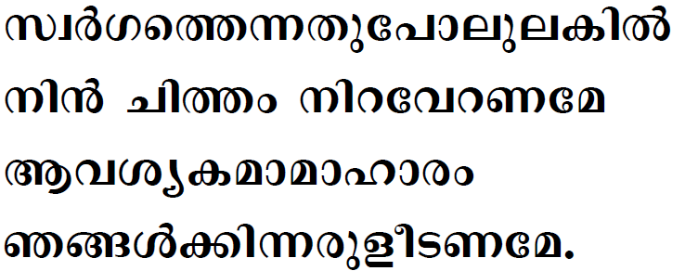

Slide 10
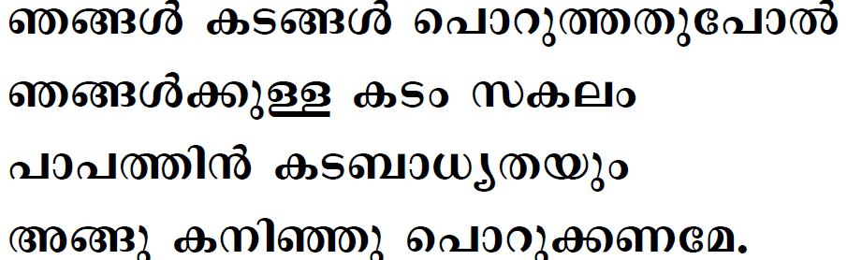
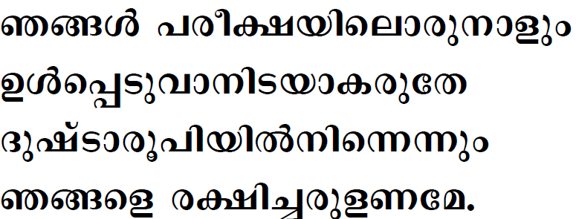

Slide 11
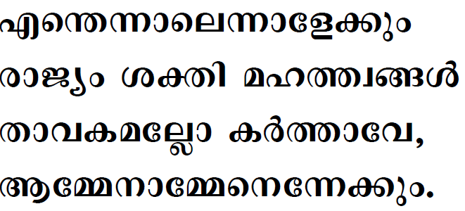

Slide 12

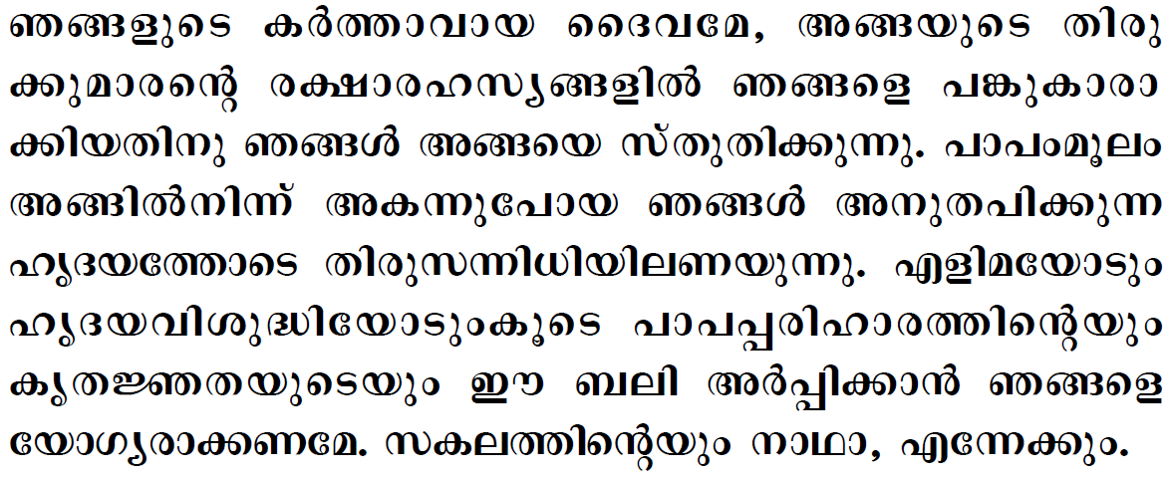


Slide 13

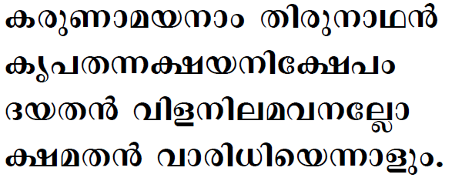

Slide 14

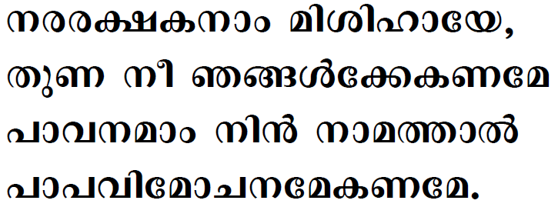
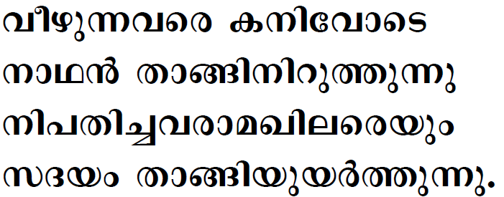

Slide 15
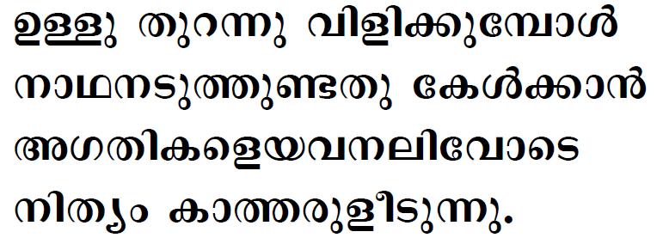
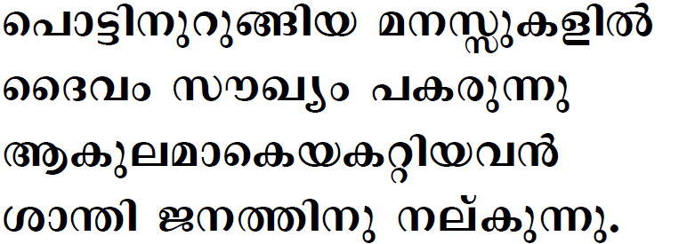

Slide 16
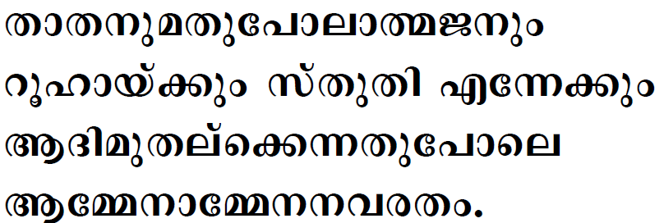

Slide 17

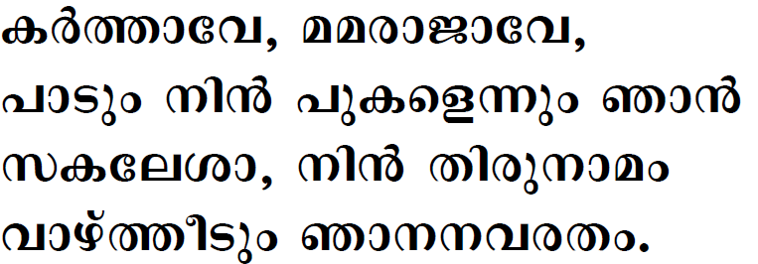

Slide 18

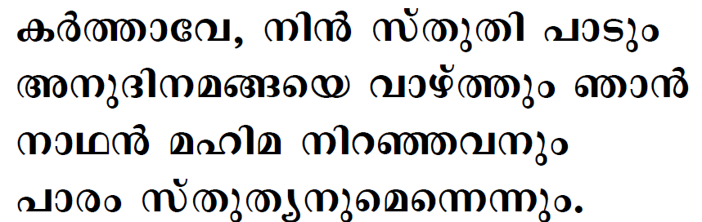
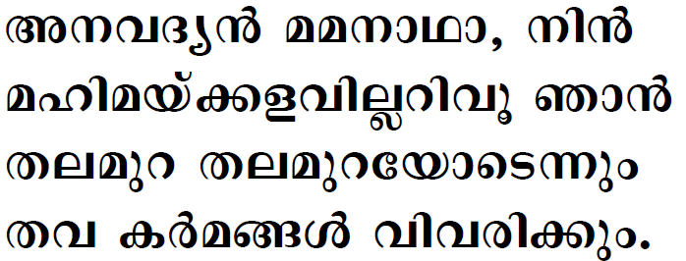

Slide 19
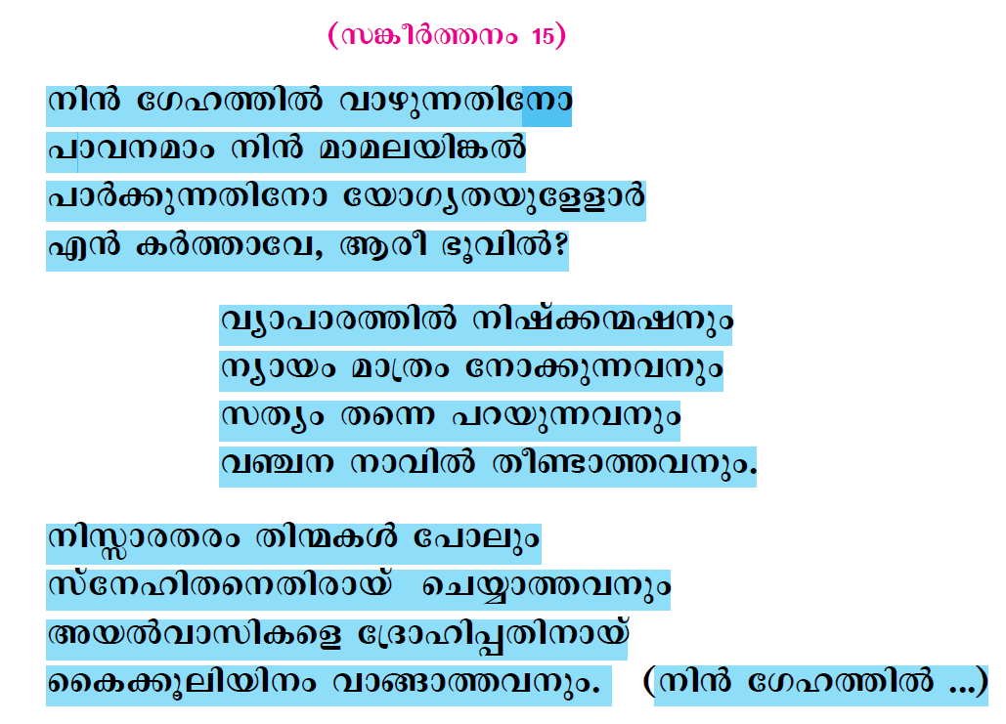

Slide 20
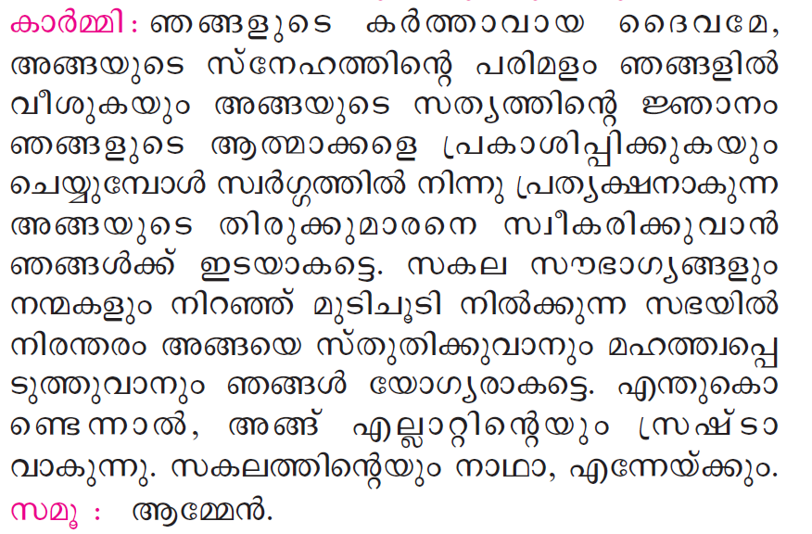

Slide 21
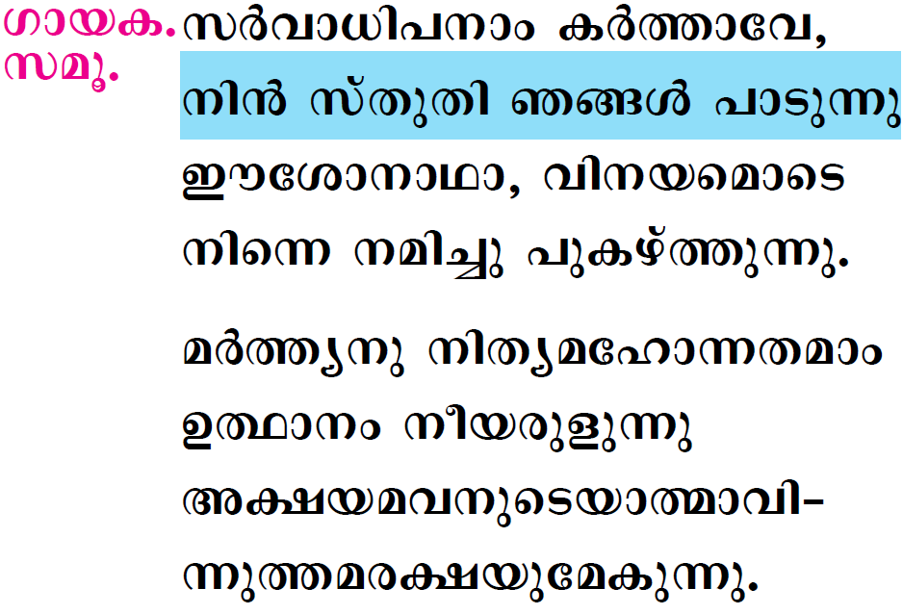

Slide 22

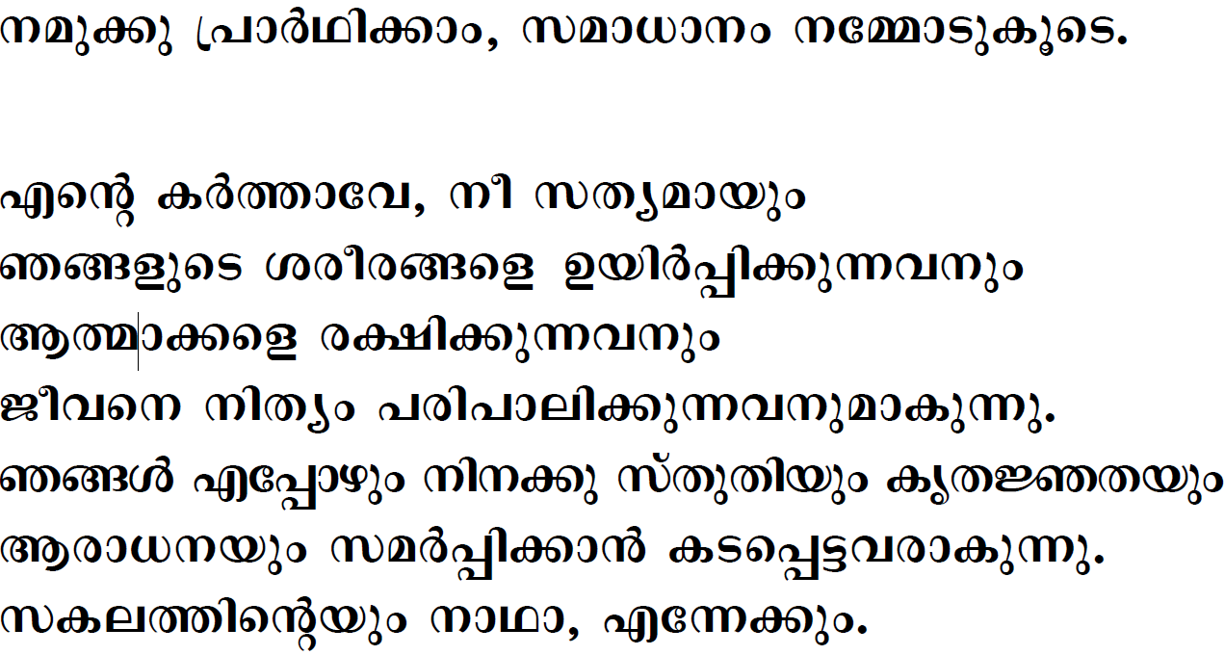



Slide 23
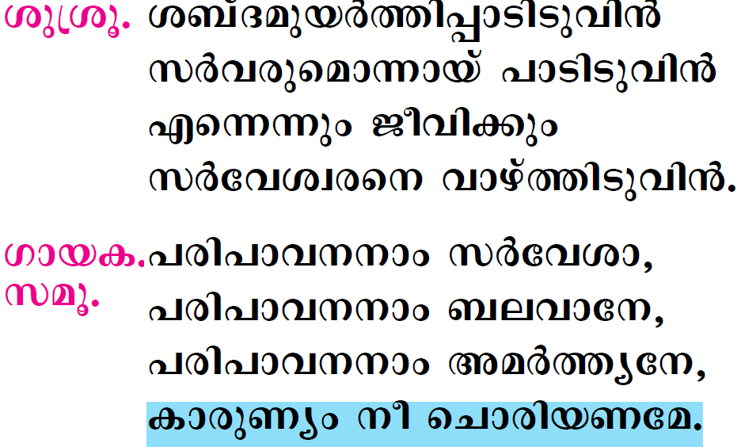

Slide 24

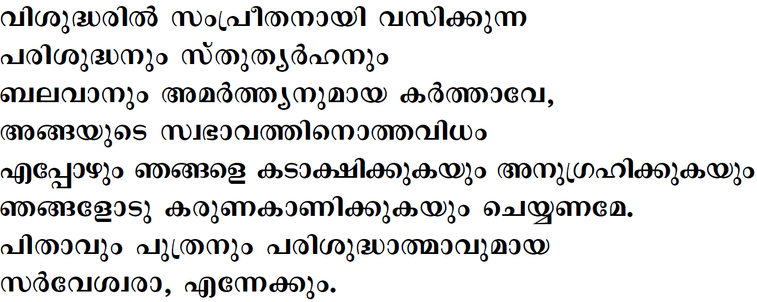


Slide 25
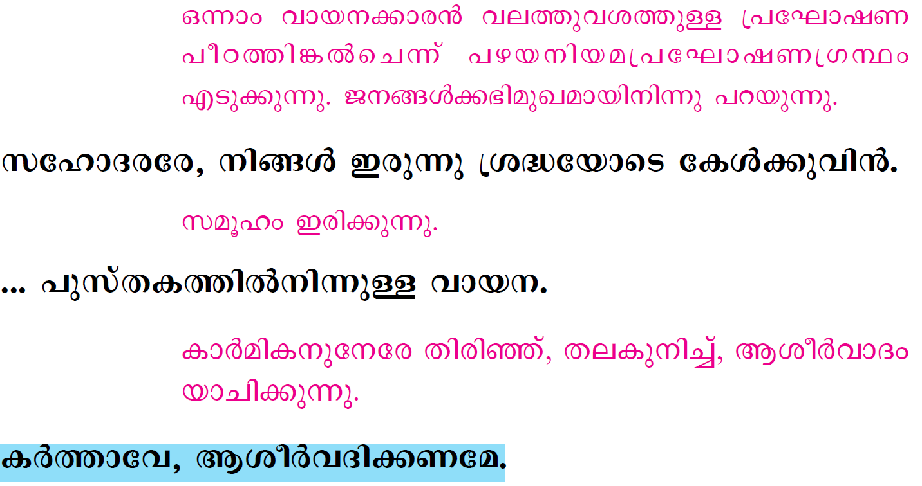

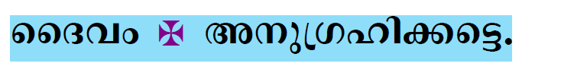

Slide 26
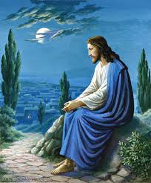
Please be Seated…

Slide 27
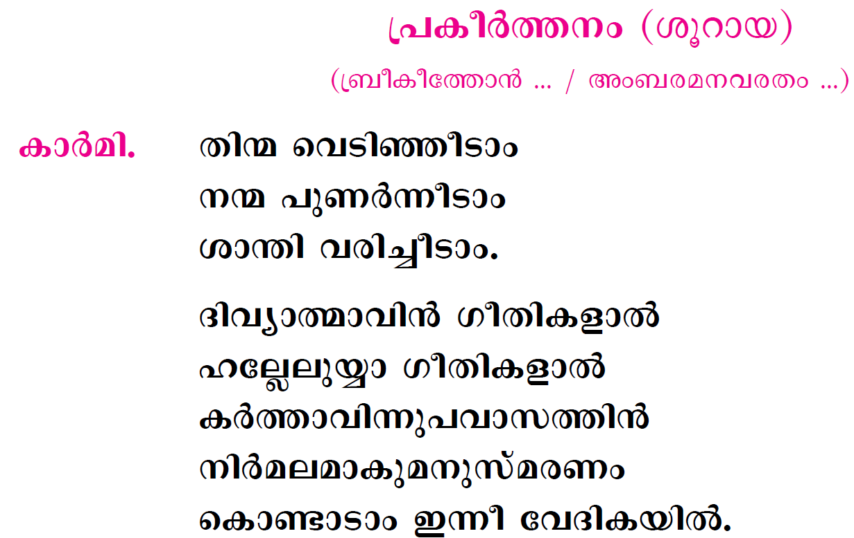

Slide 28
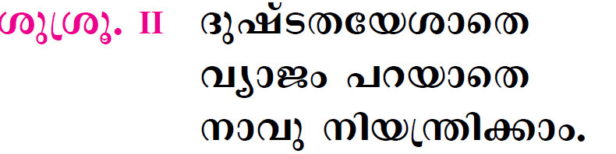
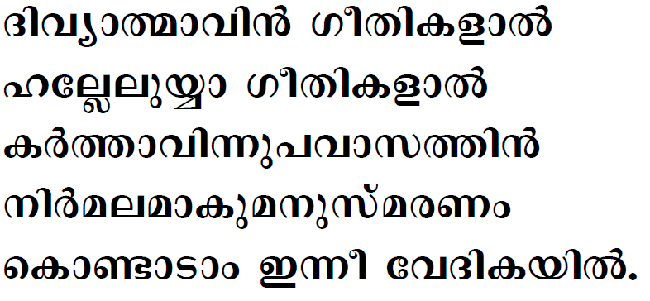

Slide 29
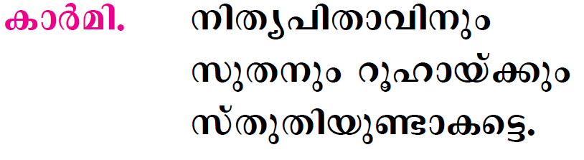

Slide 30
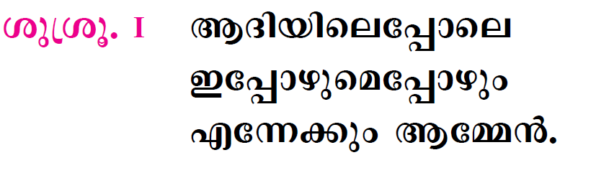

Slide 31

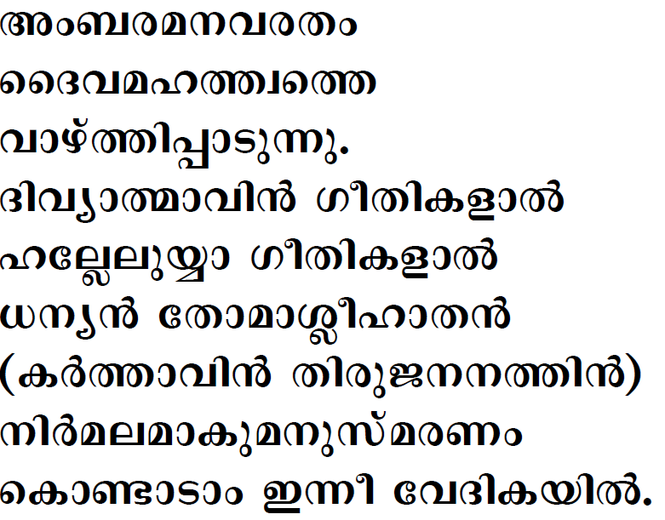

Slide 32

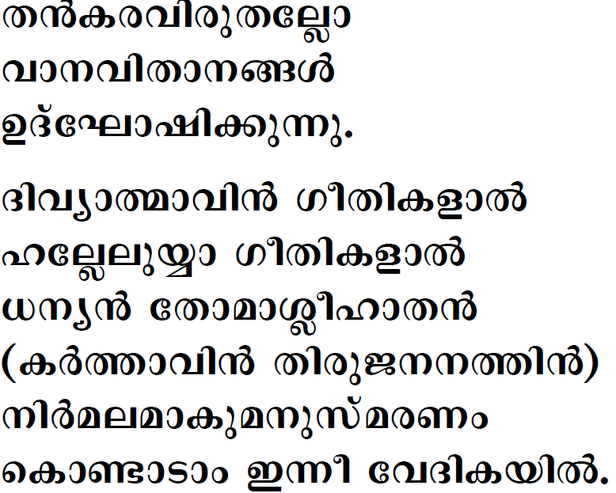


Slide 33

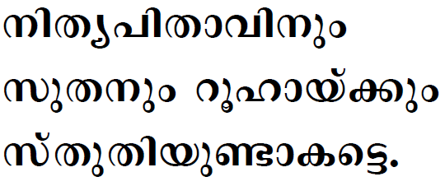

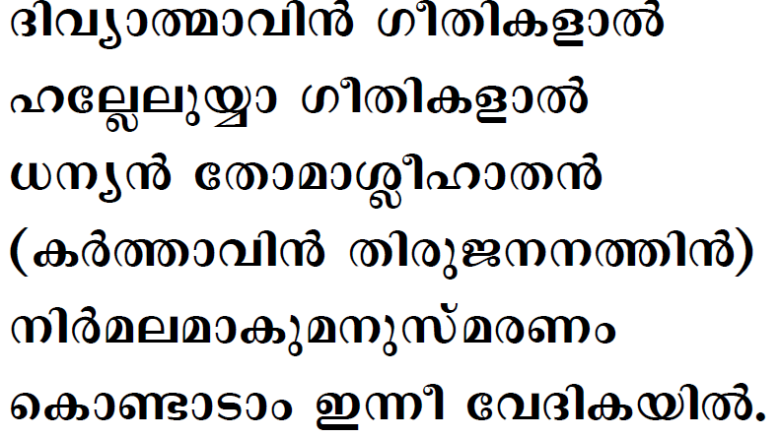

Slide 34

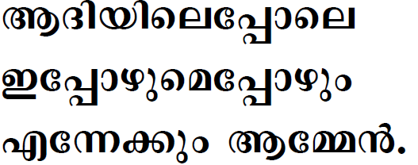

Slide 35
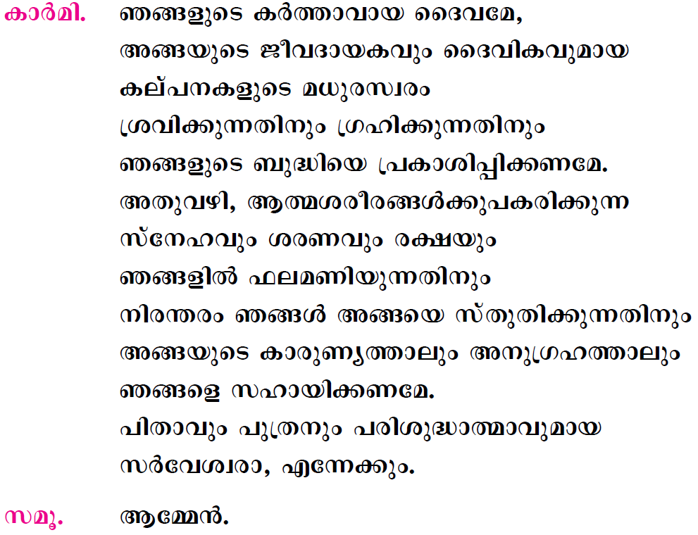

Slide 36
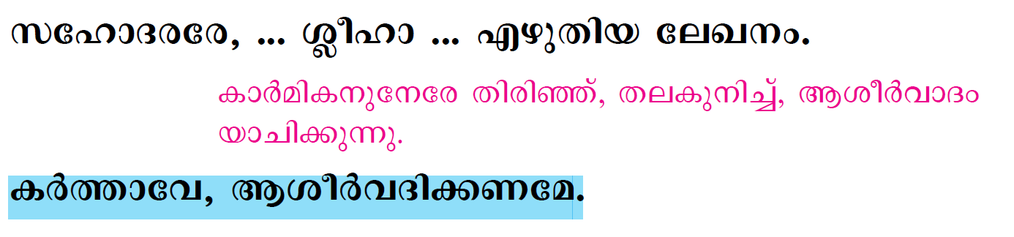
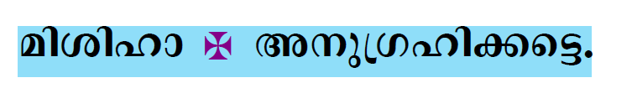


Slide 37
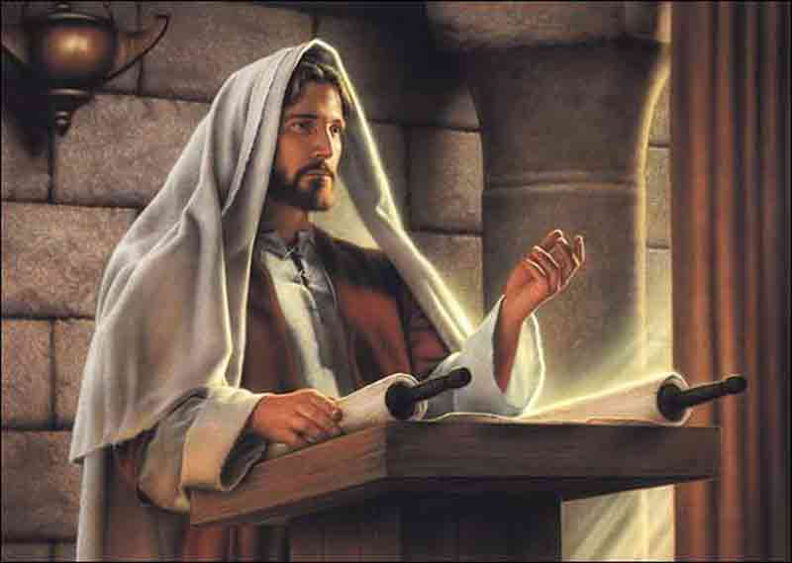
Please Stand…

Slide 38
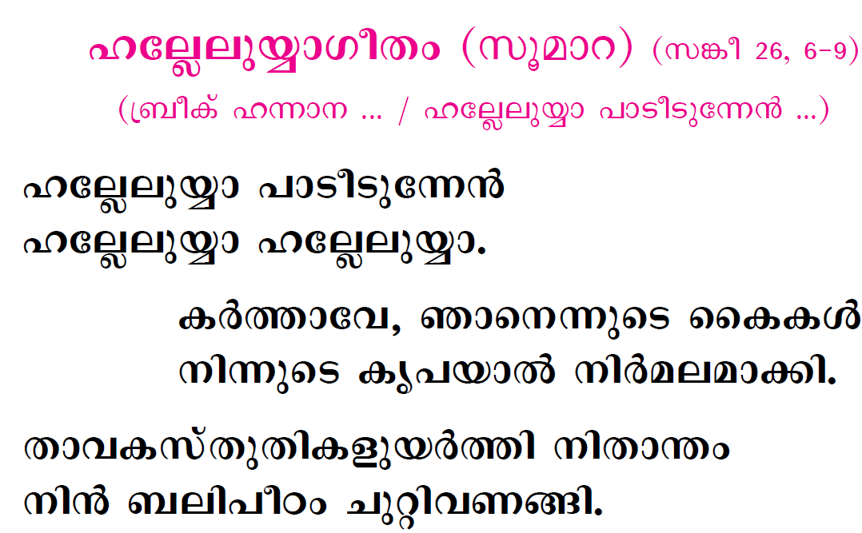

Slide 39
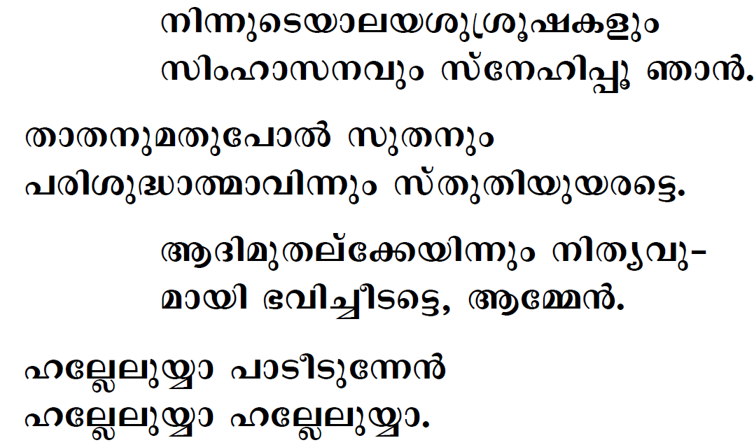

Slide 40
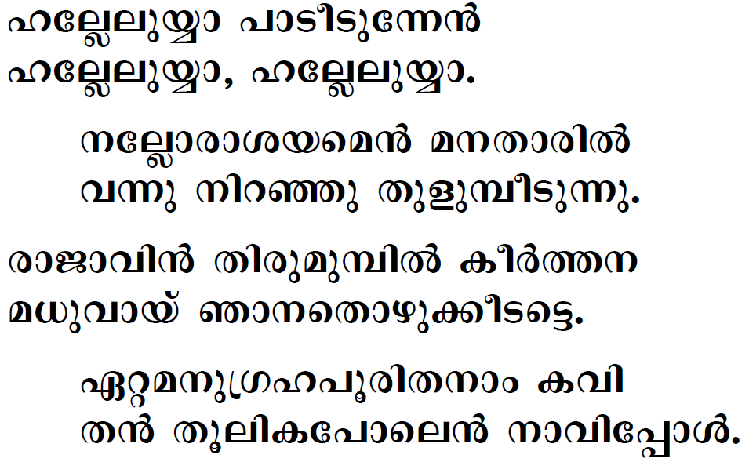

Slide 41


Slide 42


Slide 43




Slide 44
Please be Seated…

Slide 45


Slide 46
Please Stand…

Slide 47



Slide 48





Slide 49





Slide 50




Slide 51



Slide 52





Slide 53





Slide 54





Slide 55



Slide 56



Slide 57


Slide 58


Slide 59


Slide 60


Slide 61




Slide 62


Slide 63


Slide 64


Slide 65





Slide 66


Slide 67



Slide 68


Slide 69



Slide 70




Slide 71



Slide 72



Follow Page 122

Slide 73




Slide 74



Slide 75




Slide 76




Slide 77





Slide 78




Slide 79



Slide 80


Slide 81



Slide 82



Slide 83





Slide 84


Slide 85



Slide 86



Slide 87


Slide 88


Slide 89



Slide 90


Slide 91


Slide 92


Slide 93


Slide 94



Slide 95



Slide 96



Slide 97


Slide 98





Slide 99










Slide 100



Slide 101





Slide 102



Slide 103


Slide 104


Continue from Page 85

Slide 105




Slide 106



Slide 107




Slide 108


Slide 109


Slide 110


Slide 111





Slide 112



Slide 113




Slide 114




Slide 115




Slide 116




Slide 117


Slide 118


Slide 119


Slide 120



Slide 121



Slide 122




Slide 123




Slide 125


Slide 126


Slide 127




Slide 128



Slide 129





Slide 130


Slide 131



Slide 132


Slide 133


Slide 134


Slide 135


