Slide 1

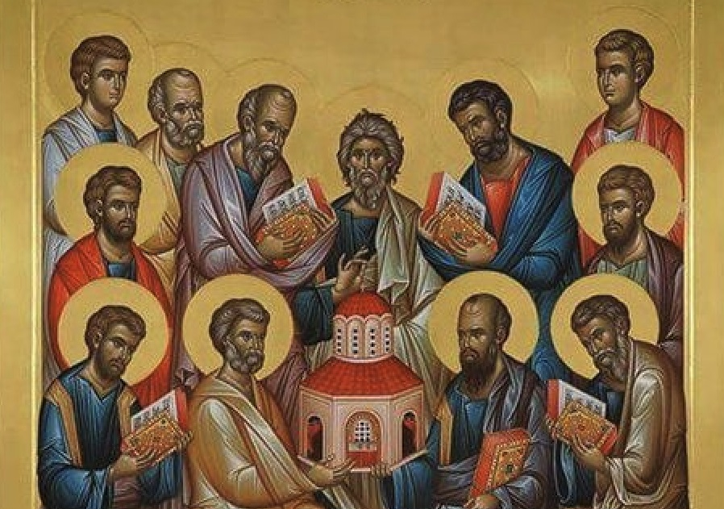


Slide 2
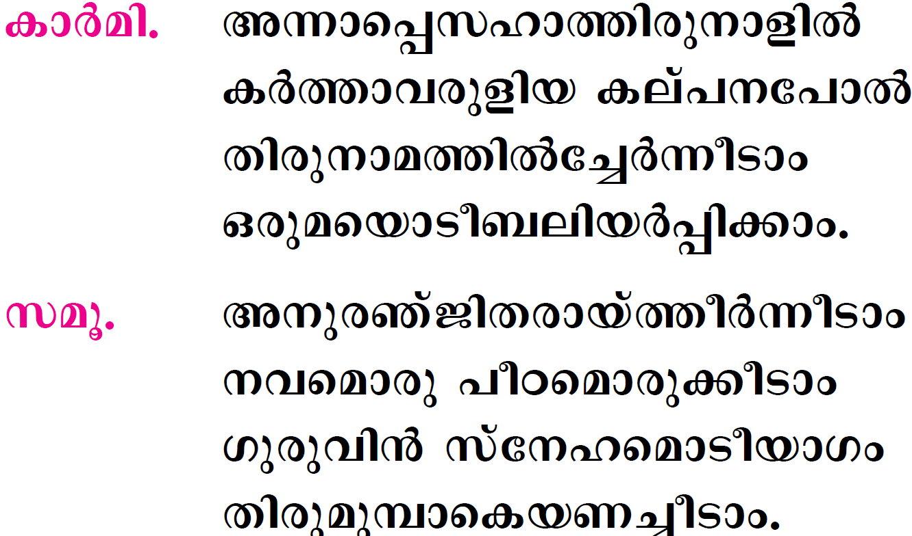

Slide 3
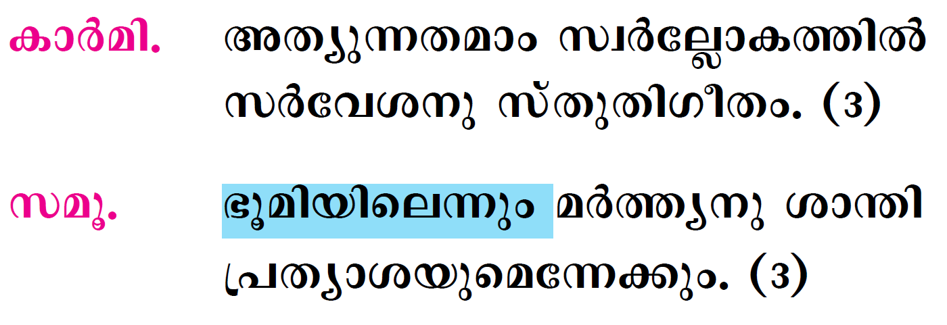

Slide 4
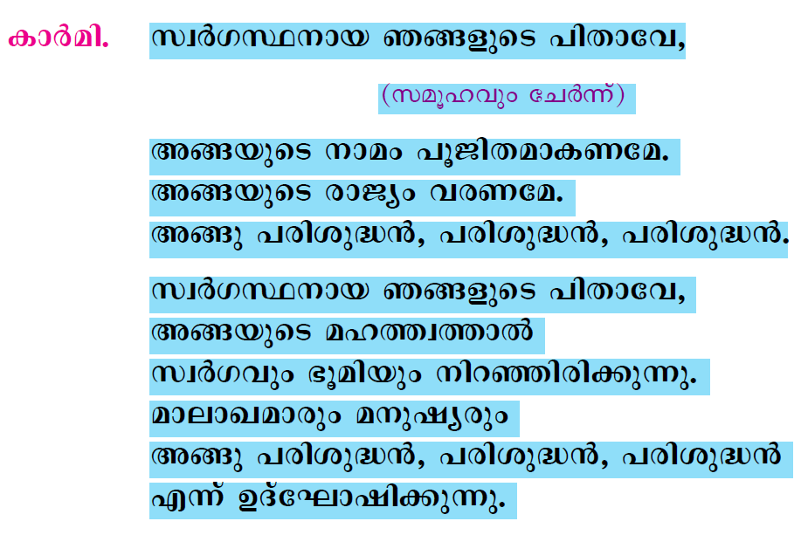

Slide 5
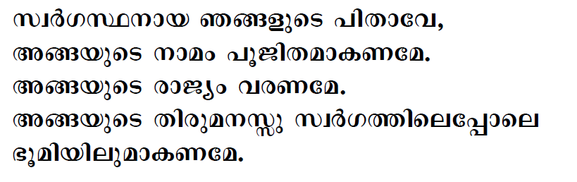
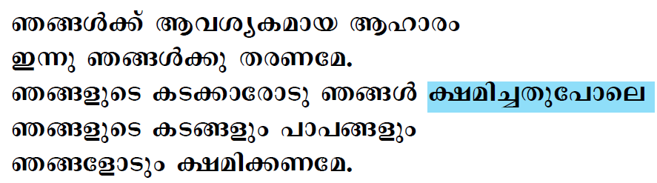

Slide 6
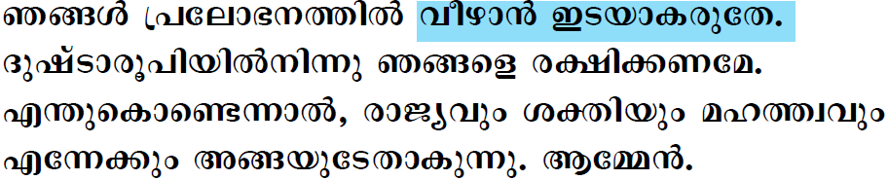

Slide 7

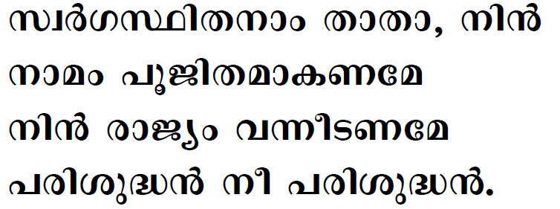

Slide 8

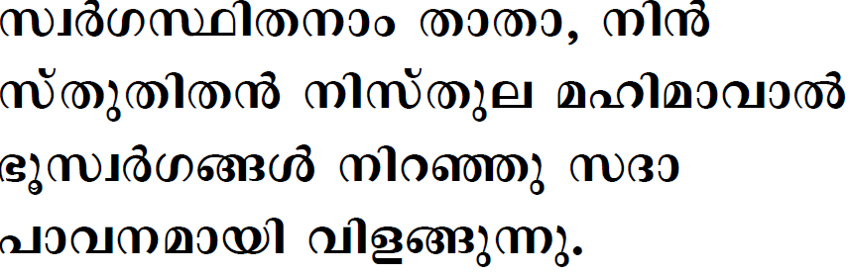
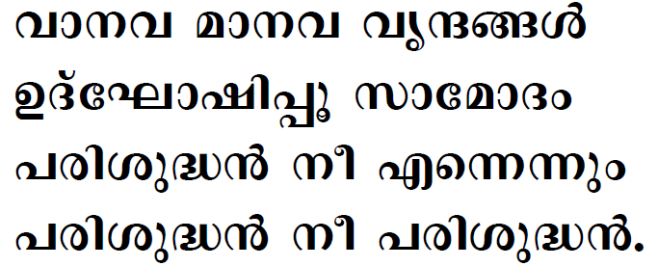

Slide 9
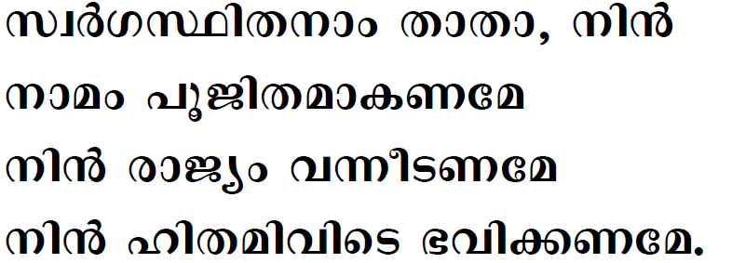
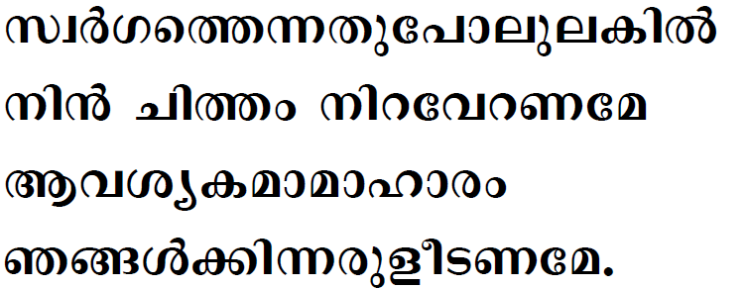

Slide 10
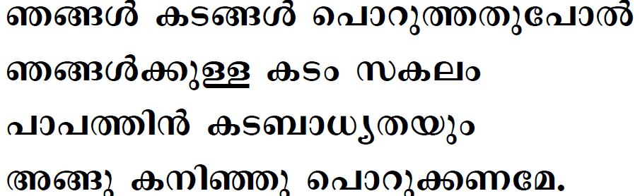
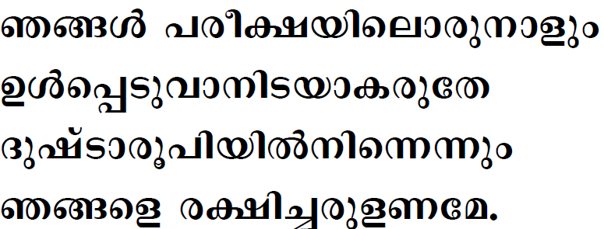

Slide 11
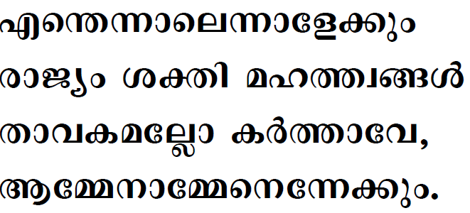

Slide 12

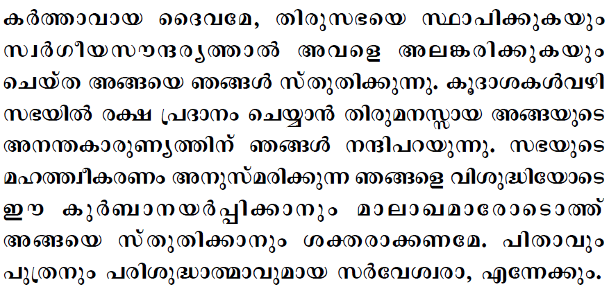


Slide 13

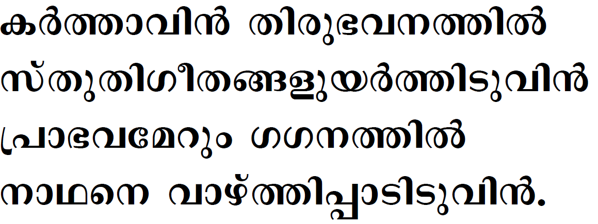

Slide 14

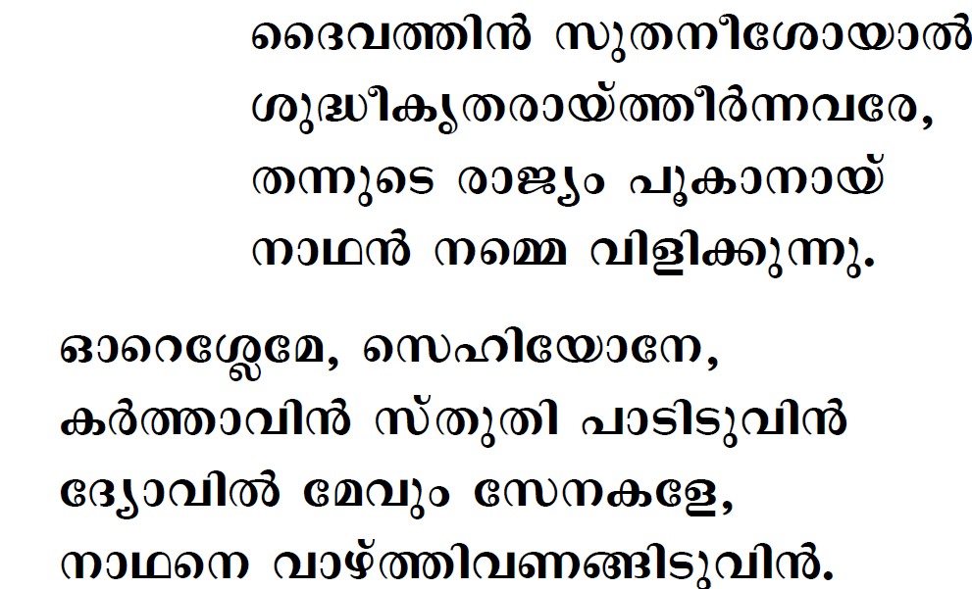

Slide 15
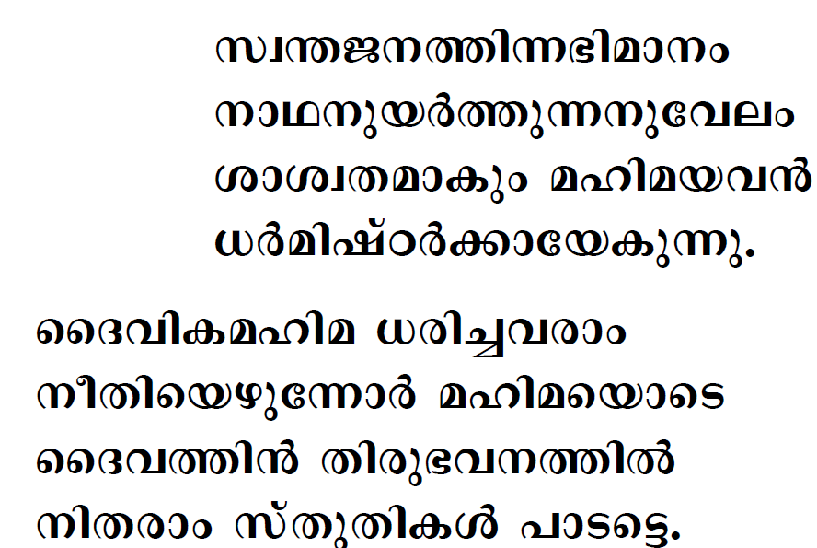

Slide 16
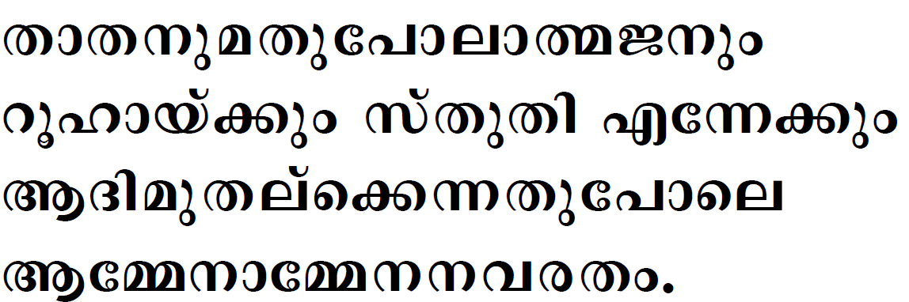

Slide 17

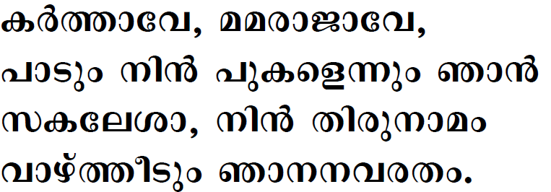

Slide 18

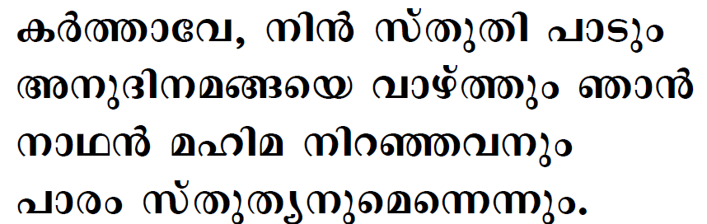
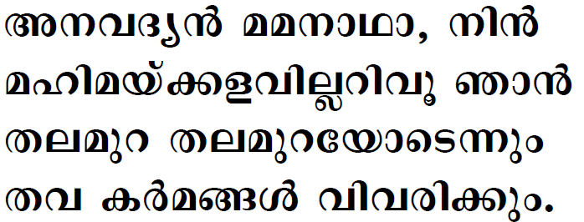

Slide 19
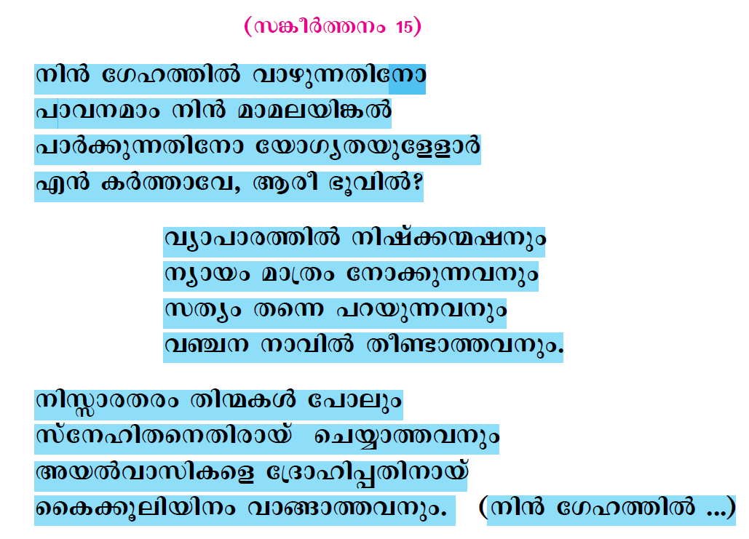

Slide 20
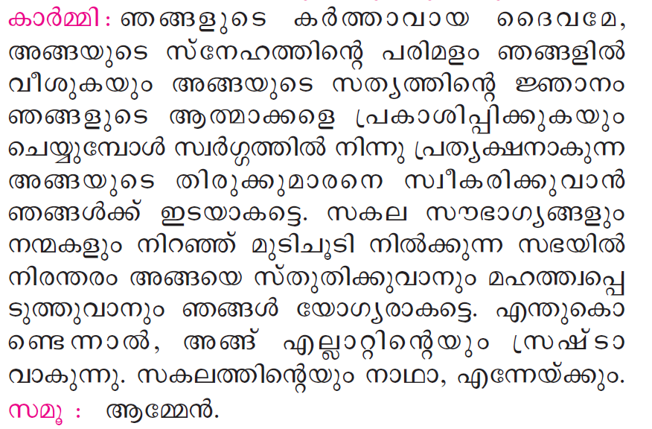

Slide 21
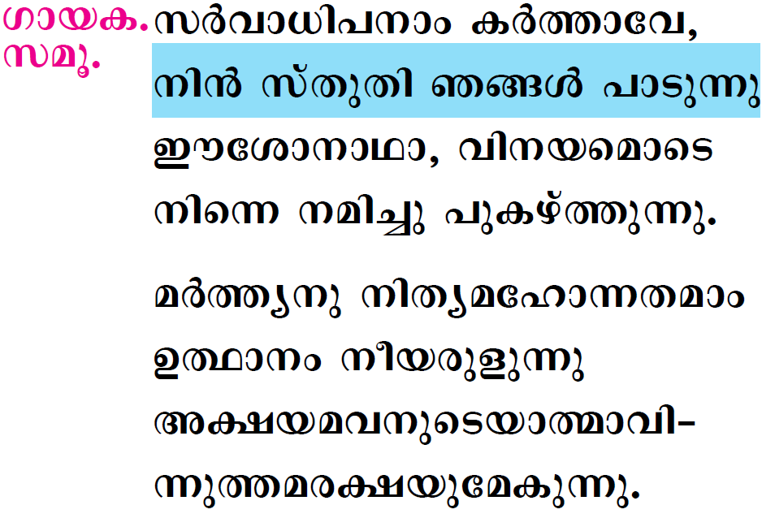

Slide 22

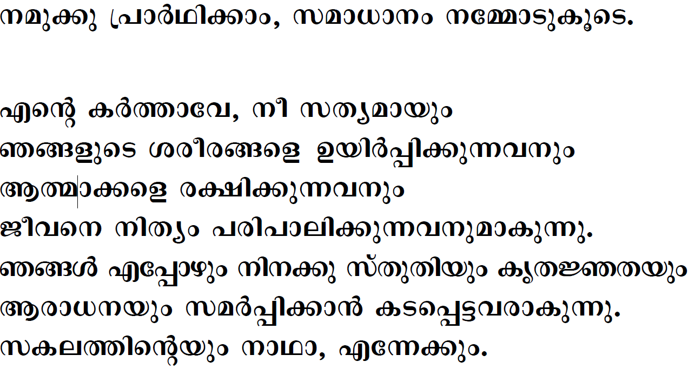



Slide 23
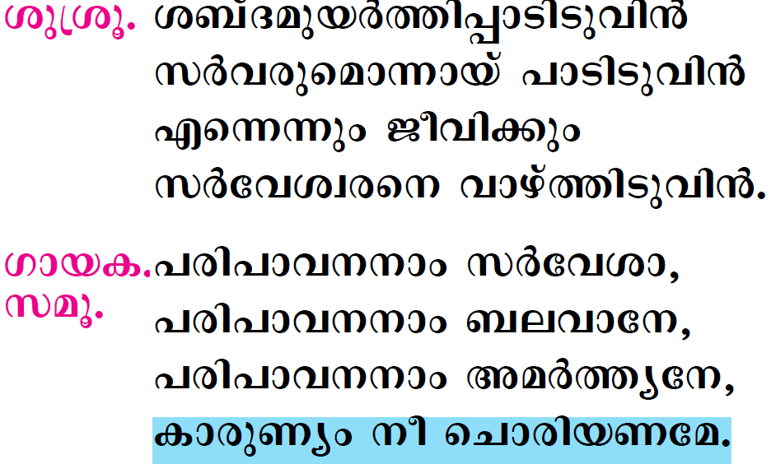

Slide 24

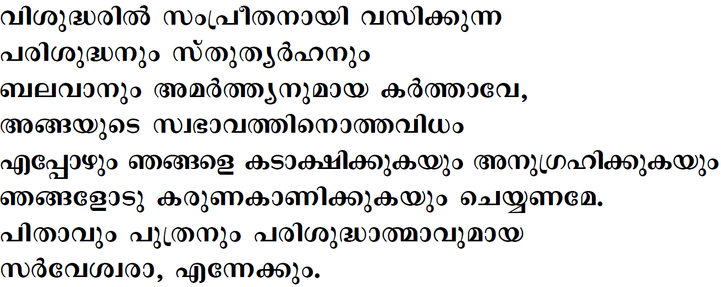


Slide 25
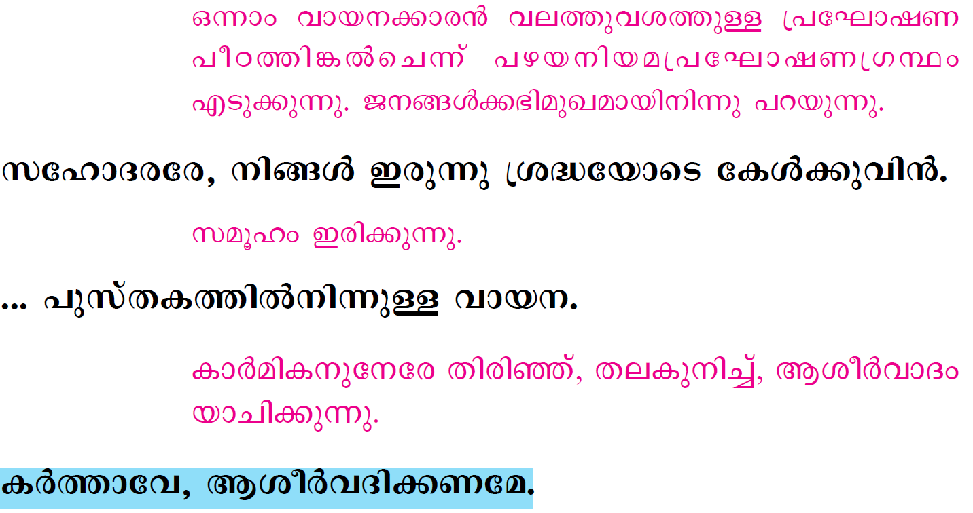

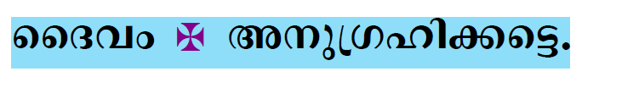

Slide 26
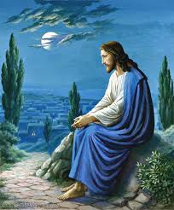
Please be Seated…

Slide 27
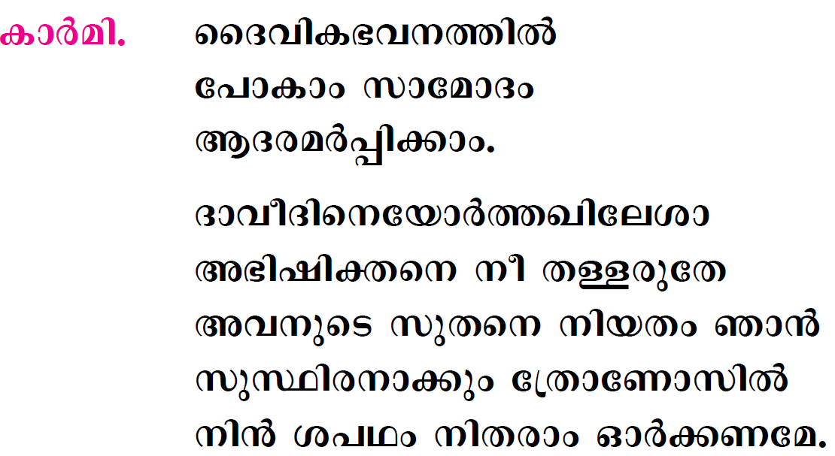

Slide 28
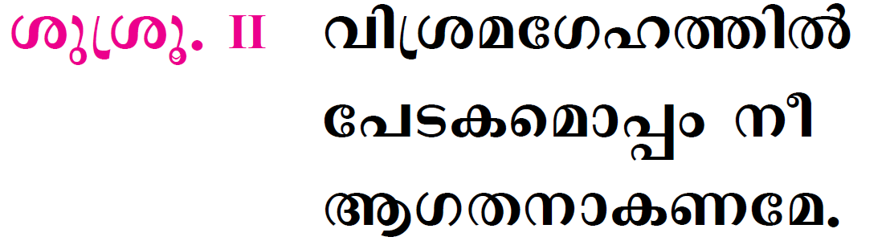
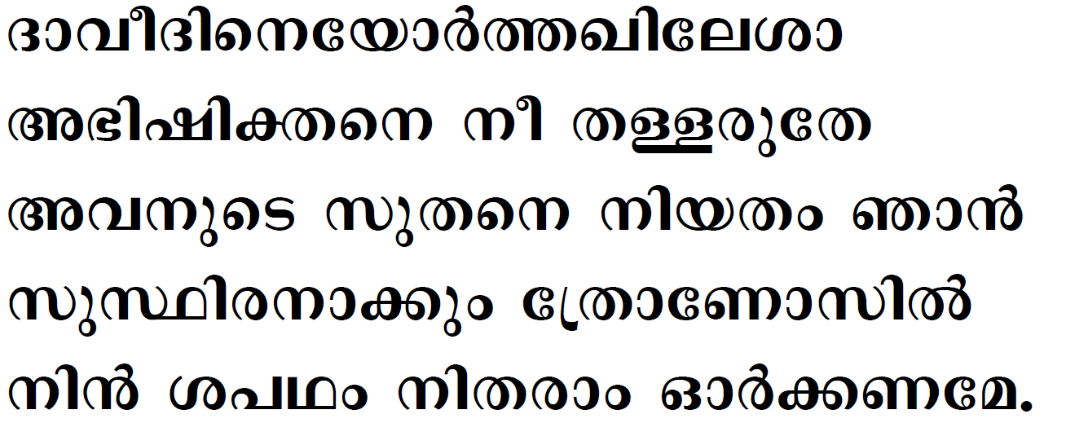

Slide 29
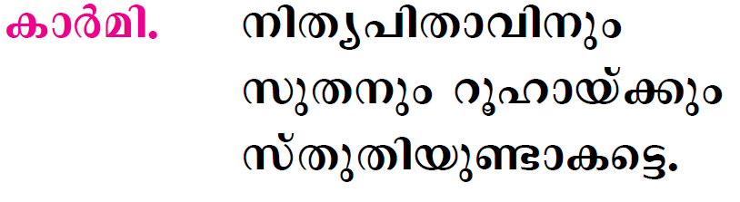

Slide 30
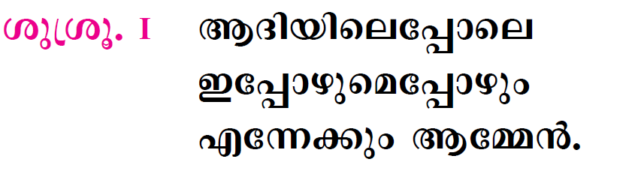

Slide 31

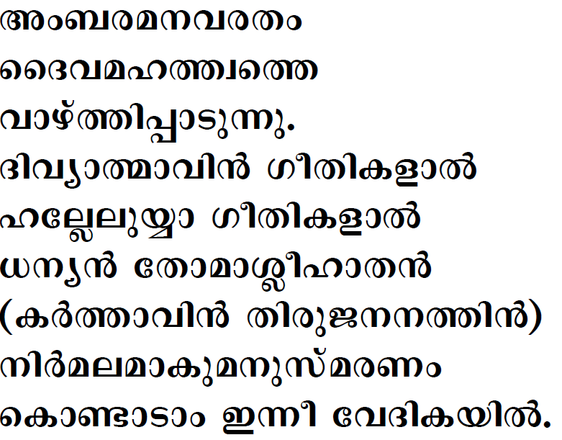

Slide 32

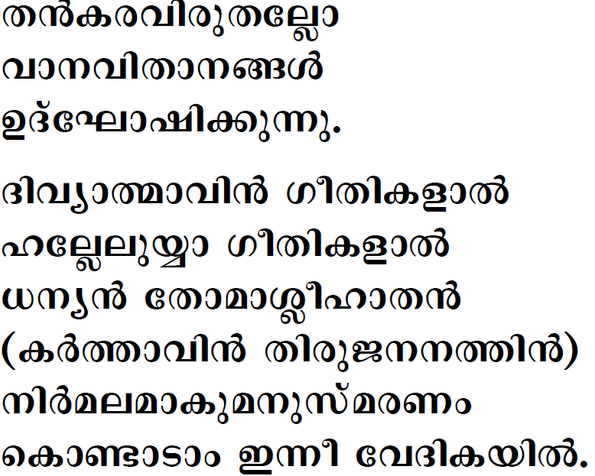


Slide 33

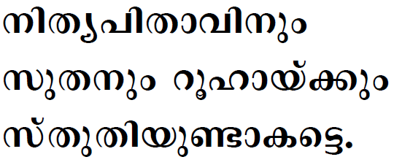

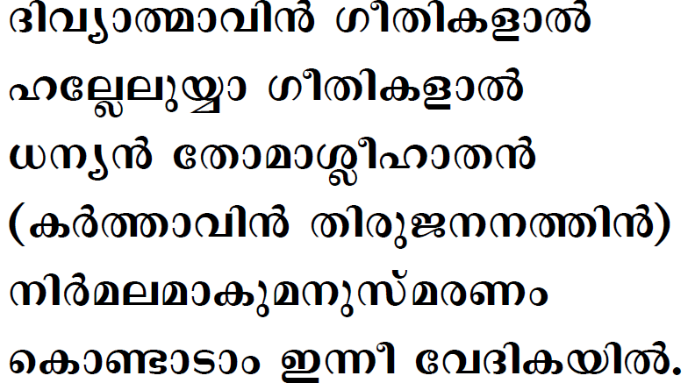

Slide 34

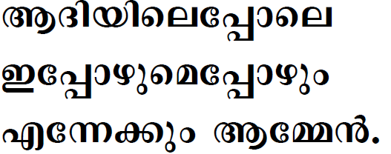

Slide 35
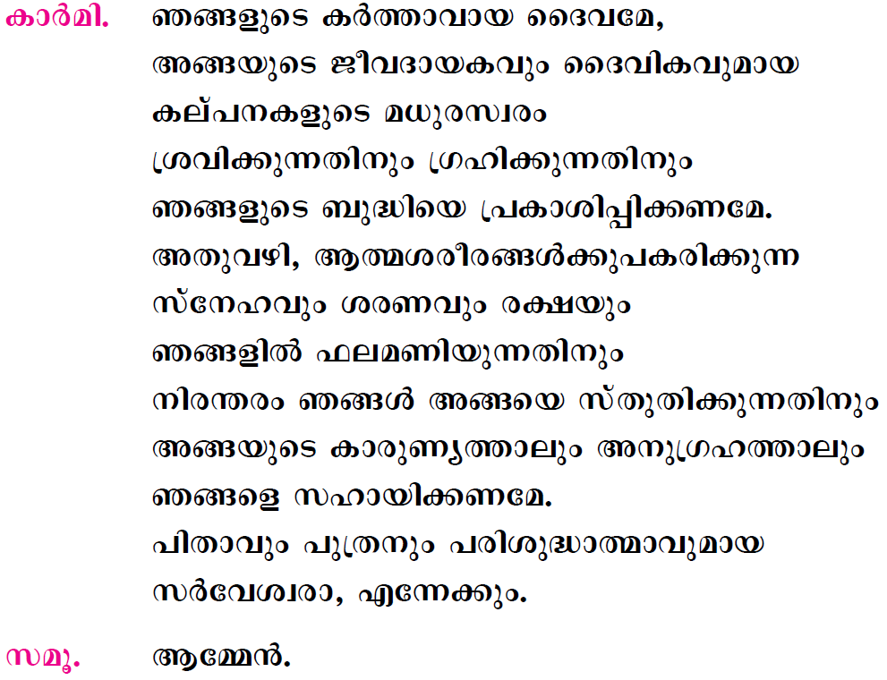

Slide 36
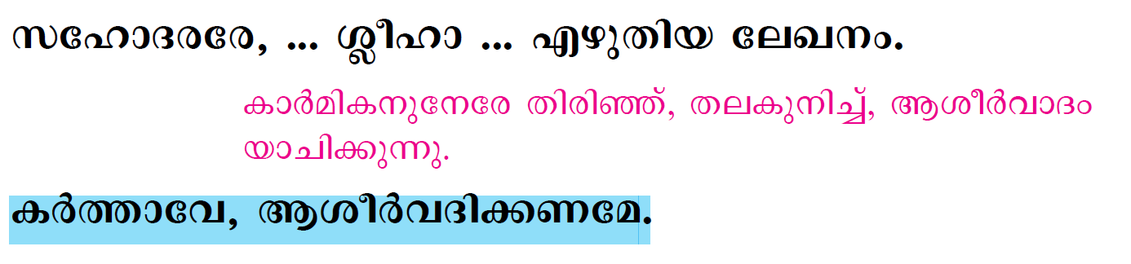
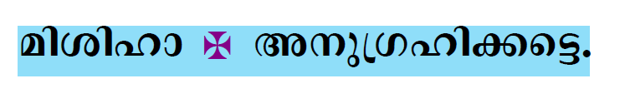


Slide 37
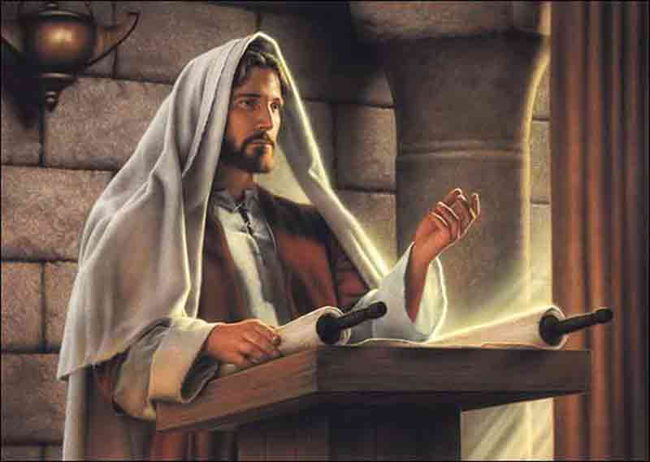
Please Stand…

Slide 38
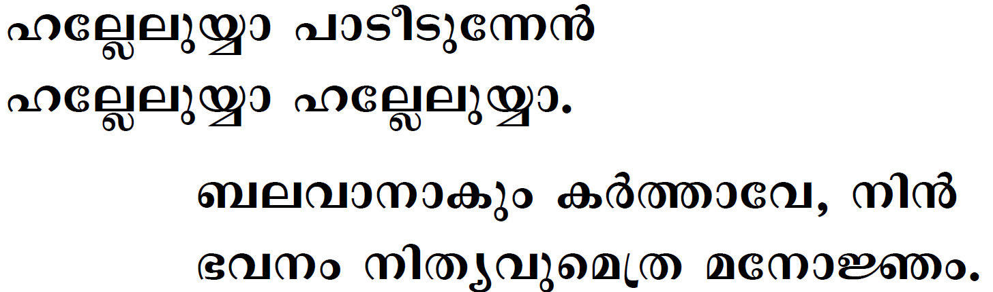
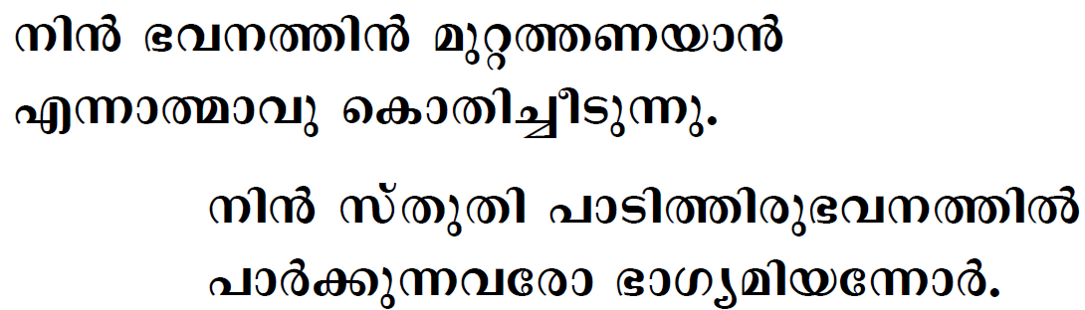

Slide 39
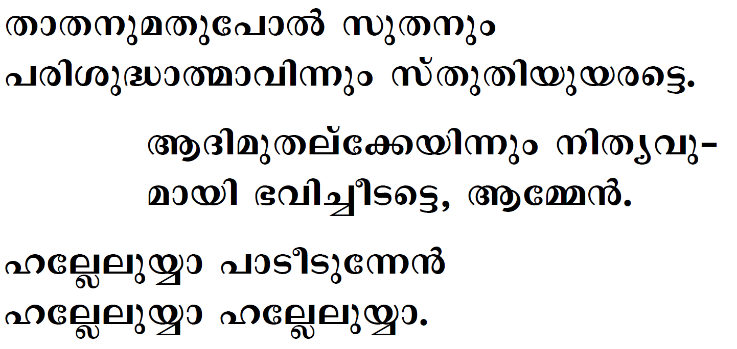

Slide 40
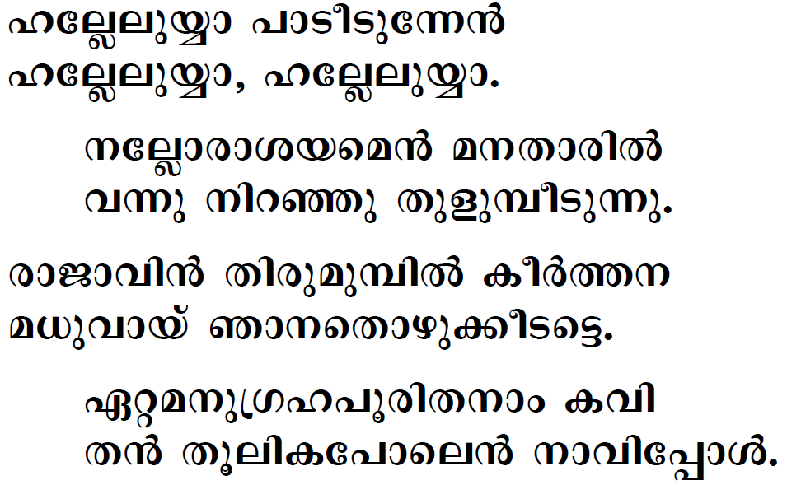

Slide 41


Slide 42


Slide 43




Slide 44
Please be Seated…

Slide 45


Slide 46
Please Stand…

Slide 47




Slide 48




Slide 49





Slide 50





Slide 51



Slide 52





Slide 53





Slide 54





Slide 55



Slide 56



Slide 57


Slide 58


Slide 59


Slide 60


Slide 61




Slide 62


Slide 63


Slide 64


Slide 65





Slide 66


Slide 67



Slide 68


Slide 69



Slide 70




Slide 71



Slide 72




Slide 73



Slide 74




Slide 75



Slide 76




Slide 77





Slide 78




Slide 79



Slide 80


Slide 81




Slide 82


Slide 83





Slide 84


Slide 85


Slide 86



Slide 87



Slide 88


Slide 89


Slide 90


Slide 91



Slide 92



Slide 93



Slide 94



Slide 95


Slide 96



Slide 97



Slide 98




Slide 99


Slide 100





Slide 101



Slide 102


Slide 103


Slide 104


Slide 105





Slide 106





Slide 107



Slide 108




Slide 109




Slide 110




Slide 111




Slide 112


Slide 113


Slide 114


Slide 115



Slide 116



Slide 117




Slide 118




Slide 120


Slide 121


Slide 122




Slide 123



Slide 124





Slide 125


Slide 126



Slide 127


Slide 128


Slide 129


Slide 130


