Slide 1

Resource Pack For Schools
Outdoor Mural Trail

Slide 2
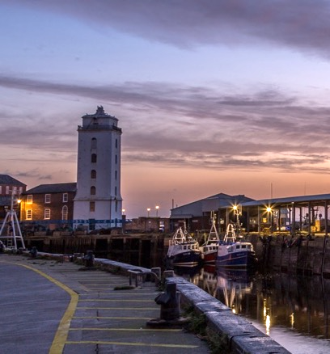
Introduction
In 1225, North Shields began as a handful of fishermen’s huts,
or shiels, serving the monks of nearby Tynemouth Priory.
Eight centuries later, it’s home to over 40,000 people —
a town with a proud fishing heritage, a vibrant arts scene,
and a community looking confidently to the future.
In 2025, North Shields celebrated its 800th birthday with a year-long programme of events marking the town’s past, present, and future. Among concerts, exhibitions, and community gatherings, one project stood out: the Elevation Mural Festival.
Elevation invited local and visiting artists to create large-scale public artworks across the town — each designed to “capture the spirit of North Shields.” These murals now form part of its visual identity, bringing colour and creativity to everyday streets and offering something residents and visitors can enjoy for years to come.

Slide 3
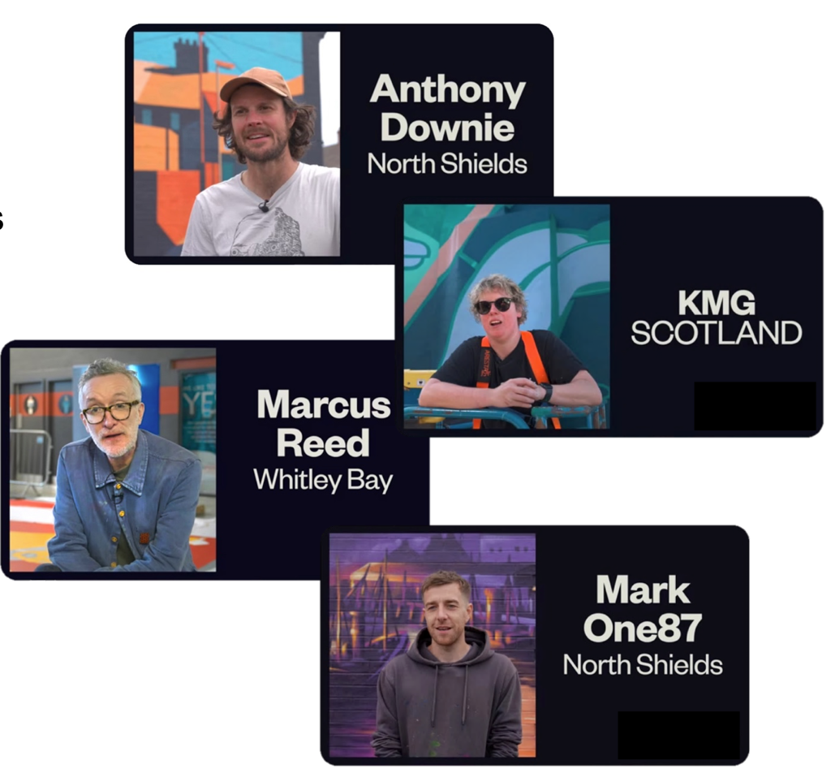
Meet the artists
Anthony Downie – A North Shields painter who finds beauty in ordinary streets and turns familiar places into works of art.
KMG – A Scottish artist who brings myths and legends to life with bold colours and playful, cartoon-like designs.
Marcus Reed – An illustrator known for geometric shapes and featuring people.
Mark One87 – A graffiti artist who works with bright colour and energy, often involving young people in his murals.

Slide 4
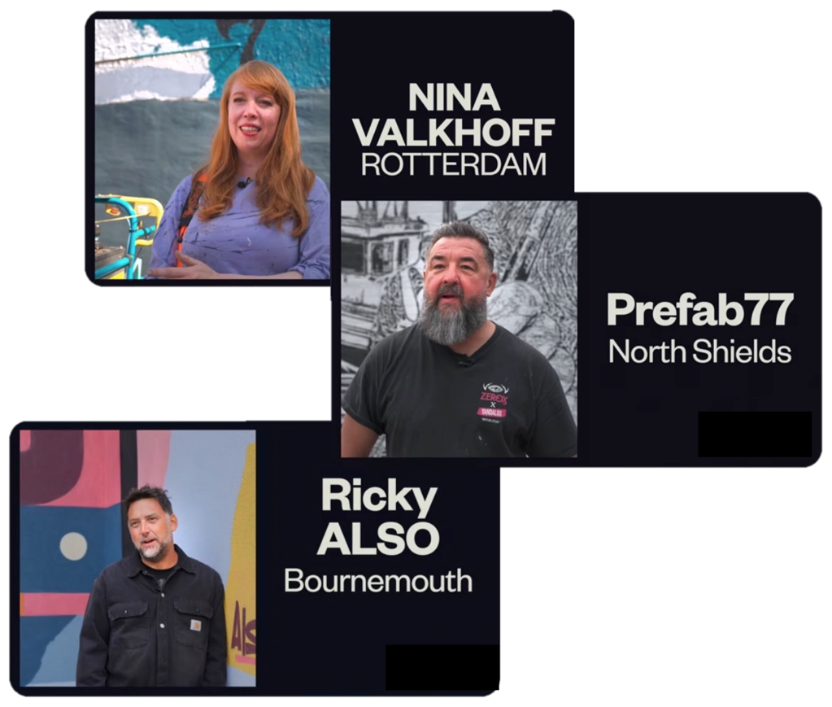
Meet the artists
Nina Valkhoff – A Dutch muralist who paints huge, vibrant pictures of animals and nature, often inspired by local wildlife.
Prefab77 – A North Shields–born stencil artist whose detailed black-and-white murals show strength, character, and humour.
Ricky Also – A graffiti artist and designer who turns words and song lyrics into colourful, geometric wall art.

Slide 5
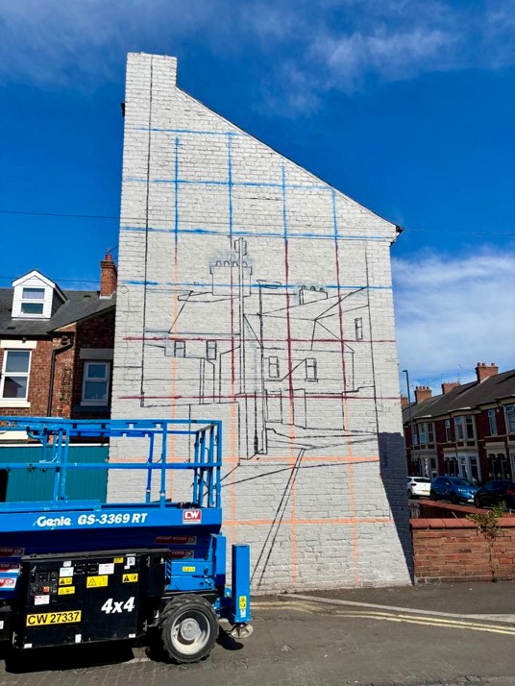
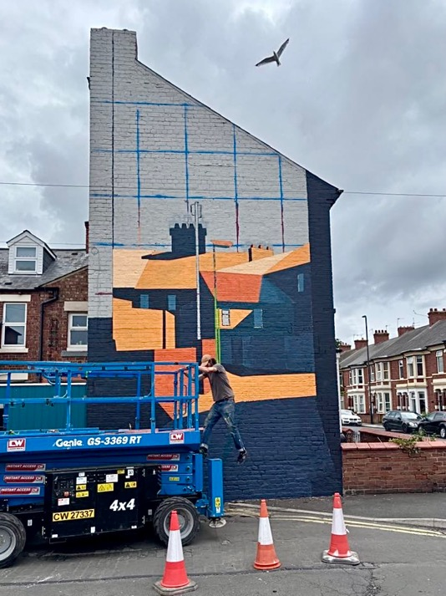
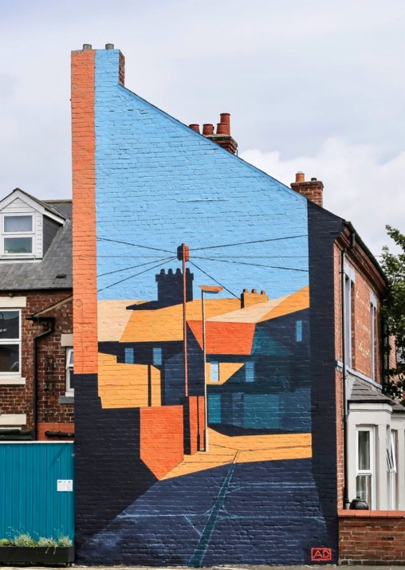
Anthony Downie – North Shields No.4

Slide 6
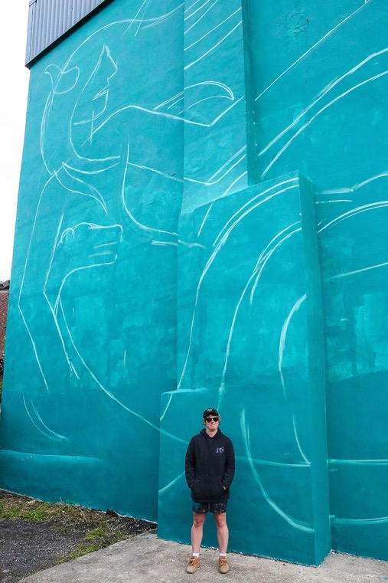
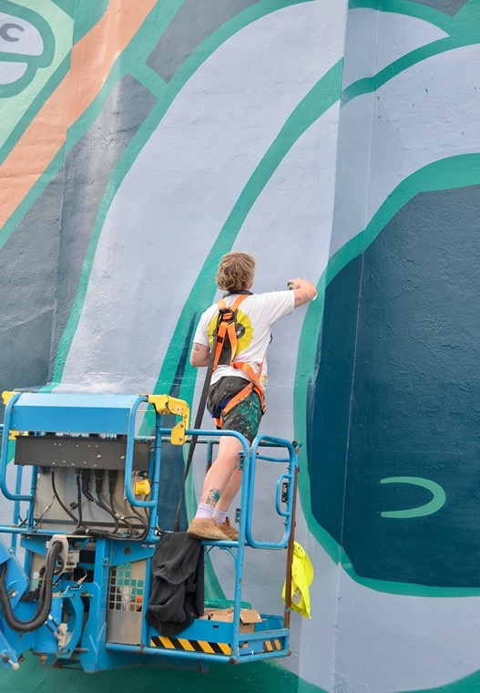
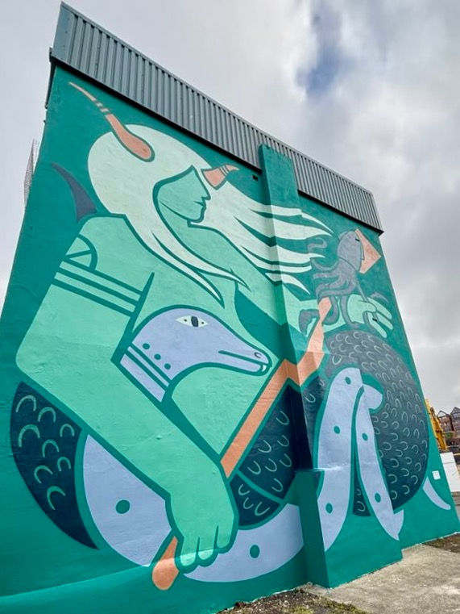
KMG – Oceanus

Slide 7
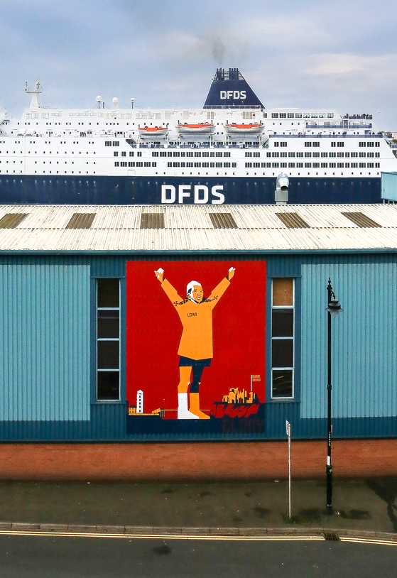
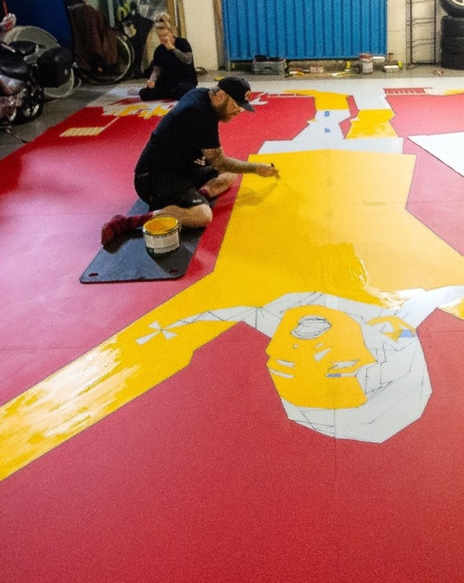
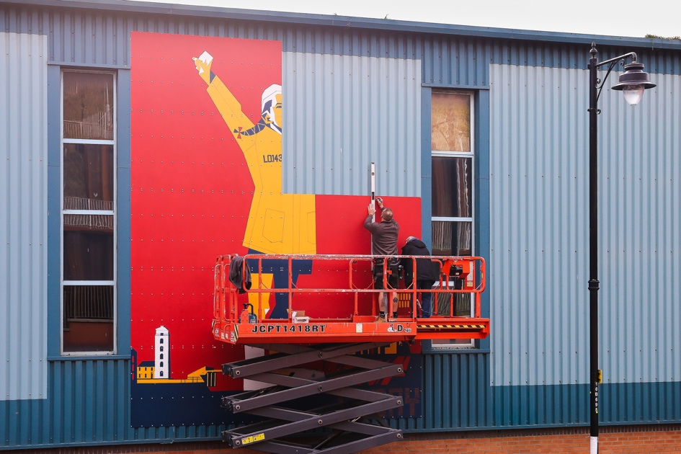
Marcus Reed – Glory

Slide 8
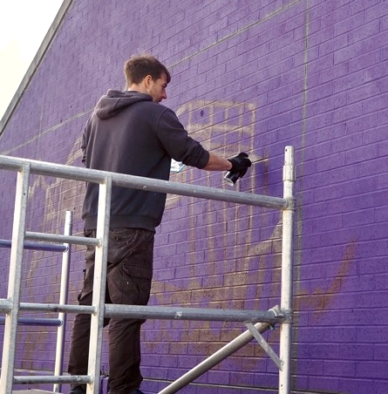
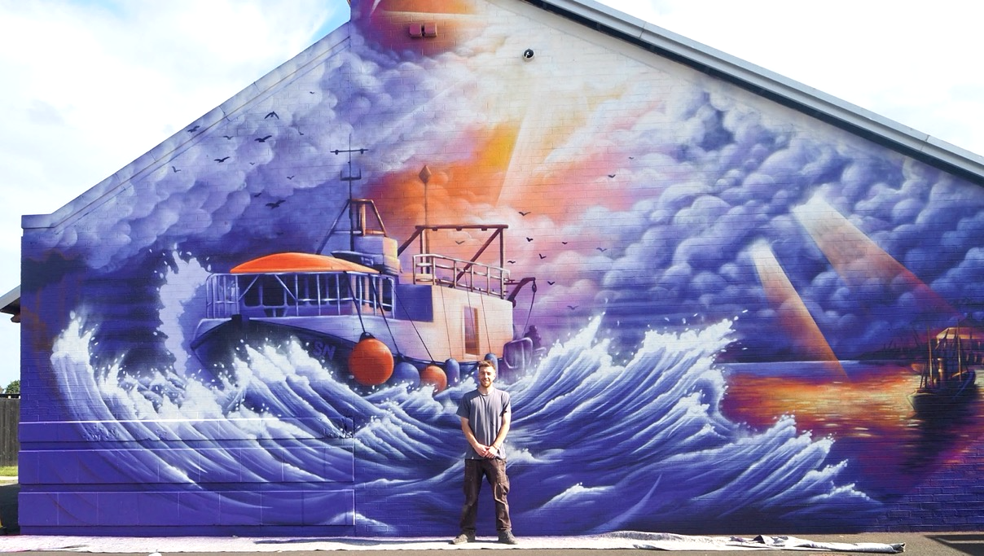
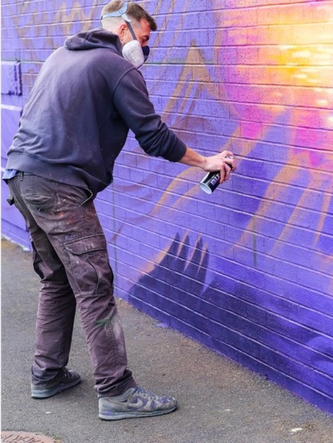
Mark One87 – Spirit of Shields

Slide 9
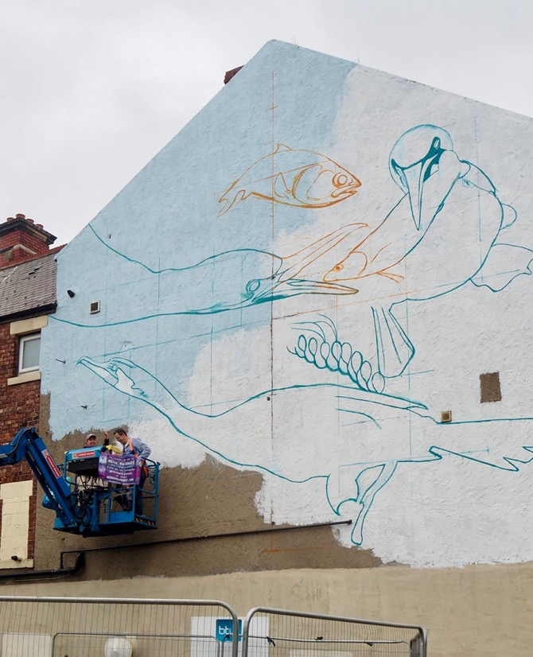
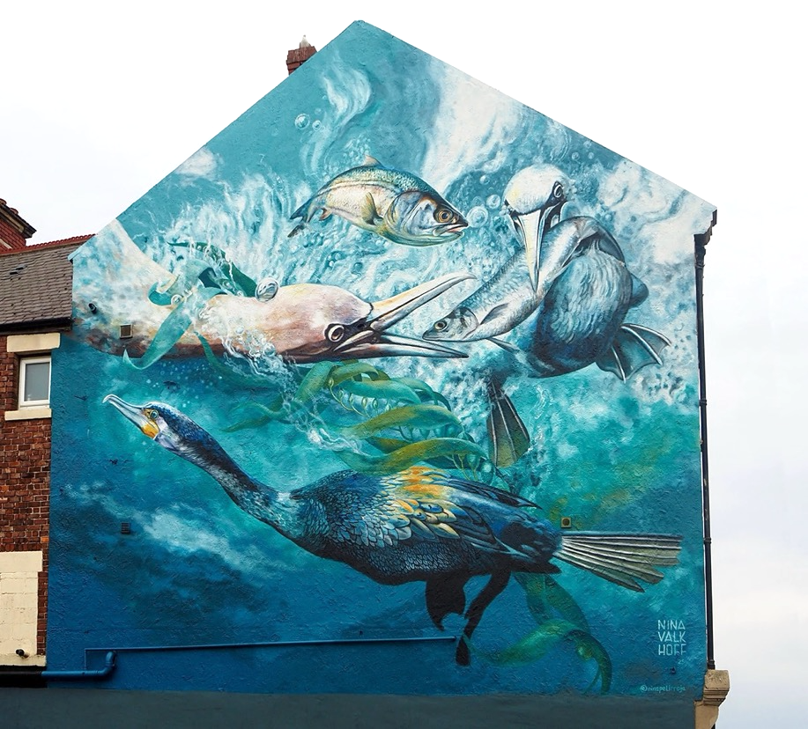
Nina Valkhoff – The Chase

Slide 10
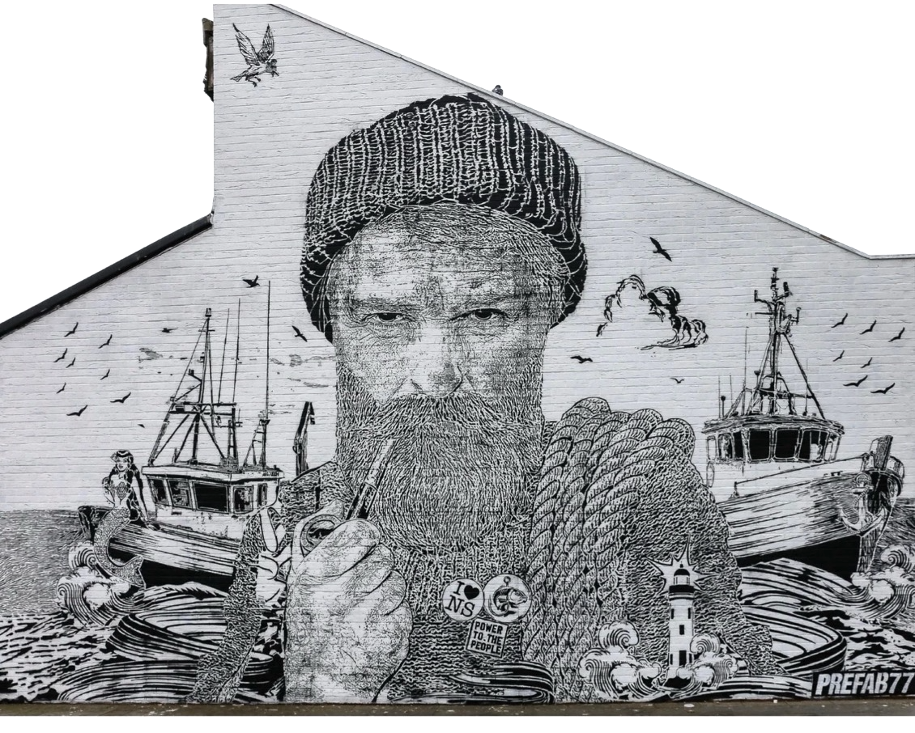
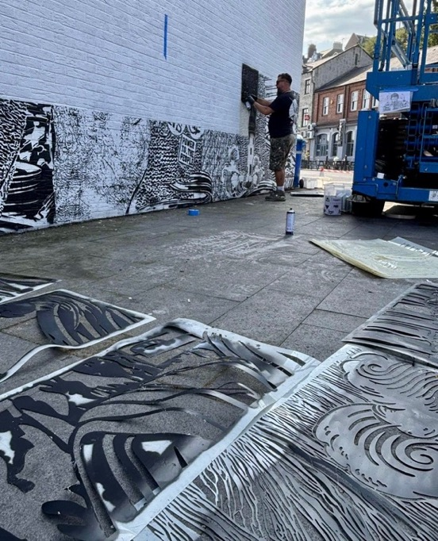
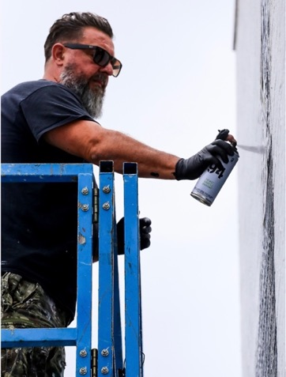
Prefab77 – Net Worth

Slide 11
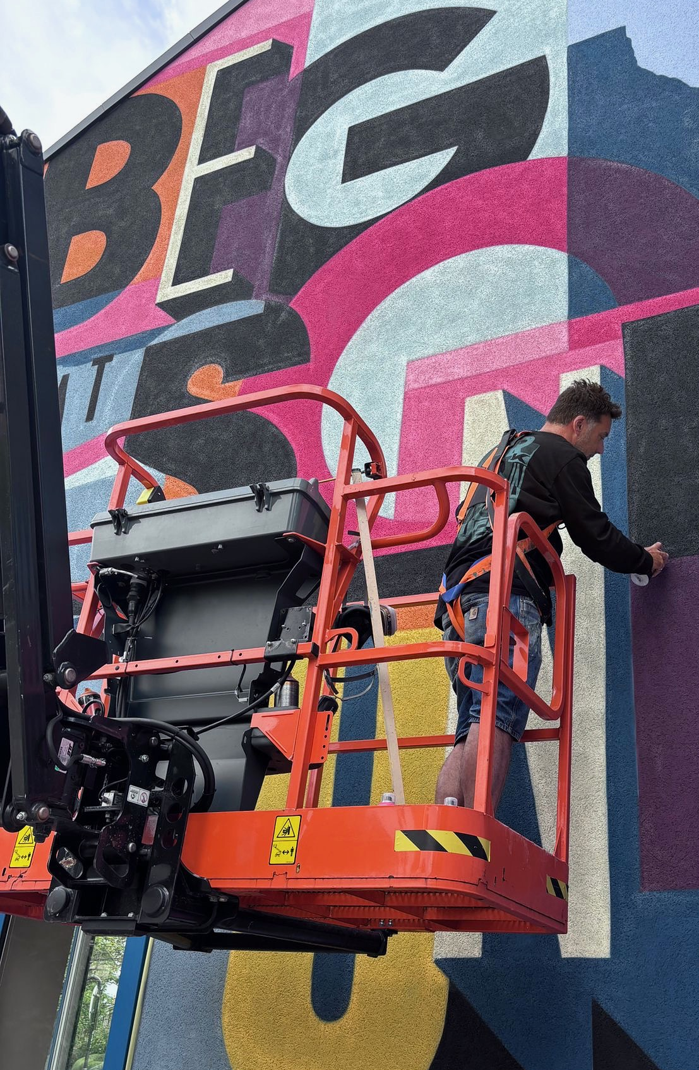
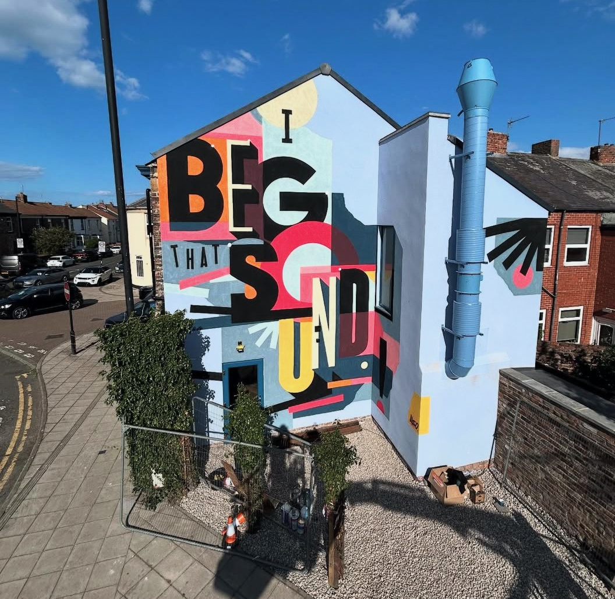
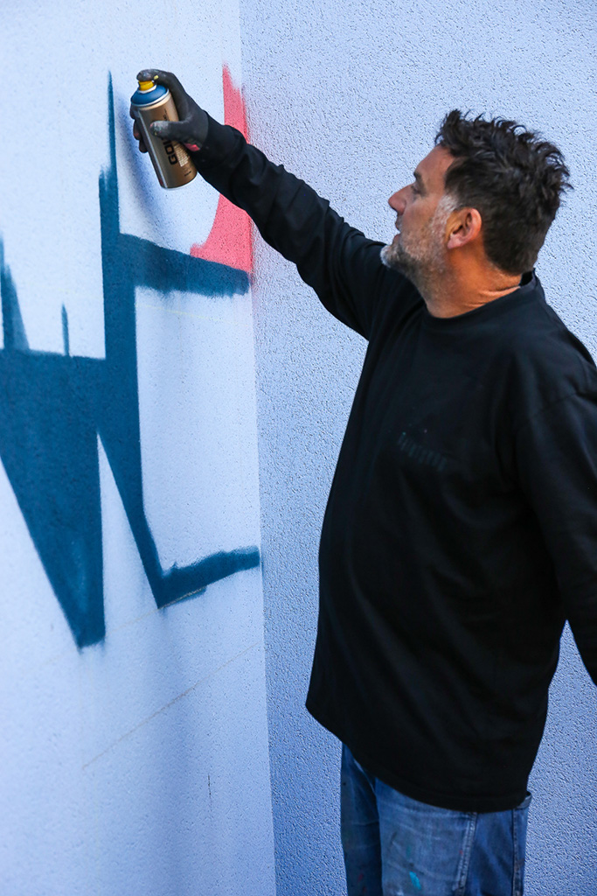
Ricky Also – I Beg That Sound

Slide 12
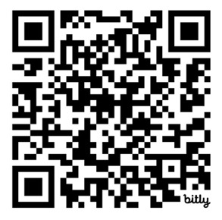
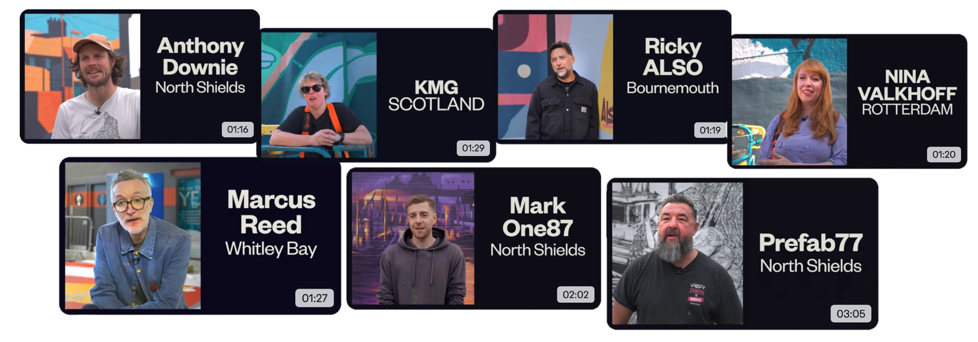
Watch interviews with the artists
https://elevationcio.com/artist-videos

Slide 13
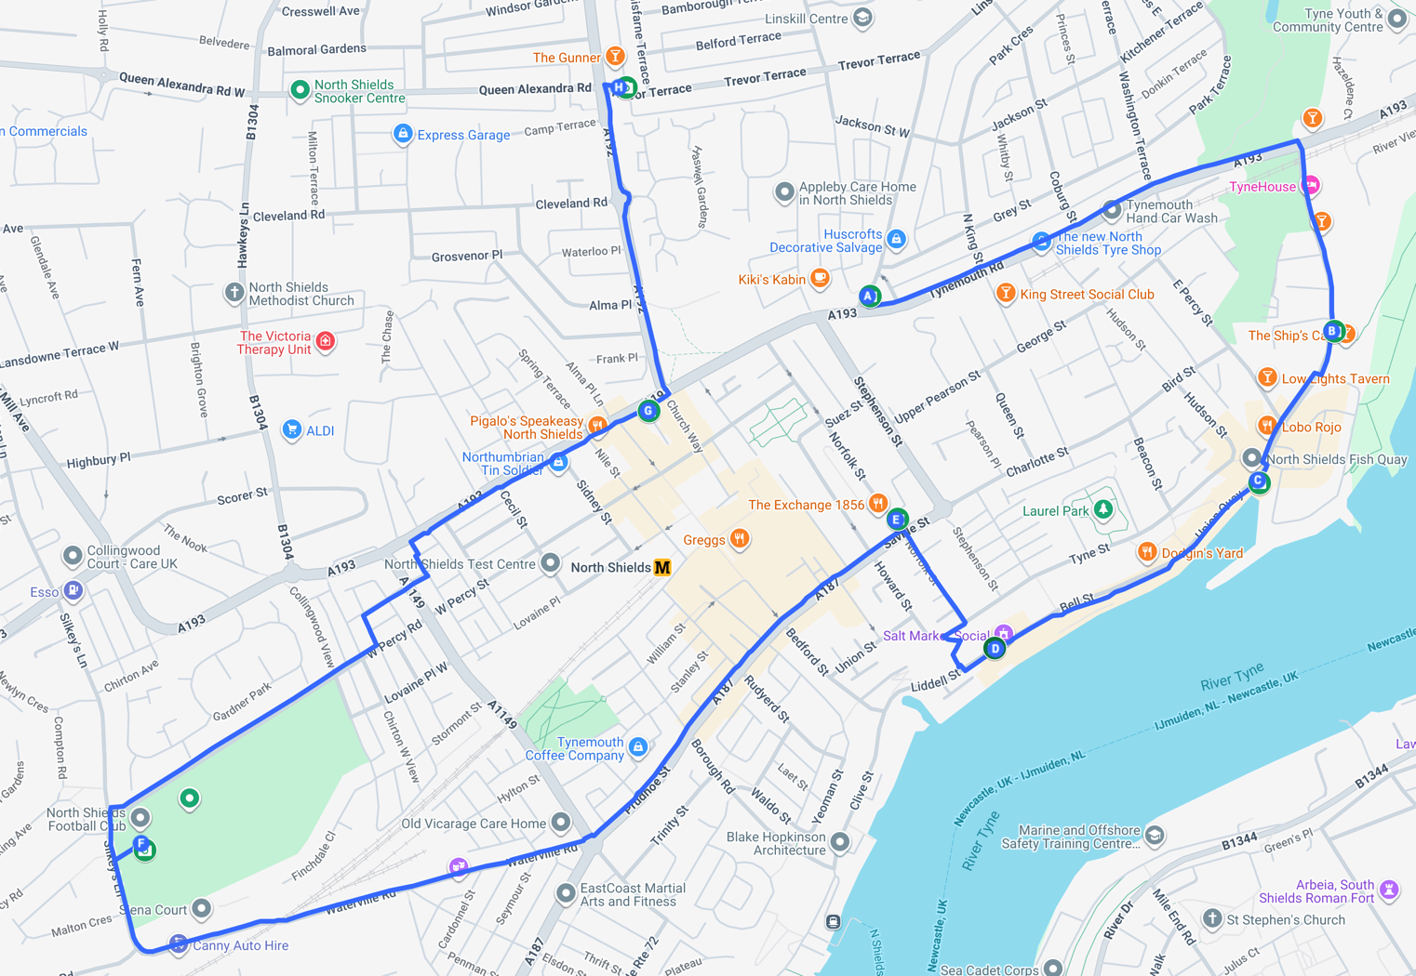

Plan Your Visit
Anthony Downie
Ricky Also
KMG
Prefab77
Nina Valkhoff
Prefab77
Marcus Reed
Mark One87

