Slide 1
ACFT Events Instructions
IAW ATP 7-22.01
ESB B Co

Slide 2
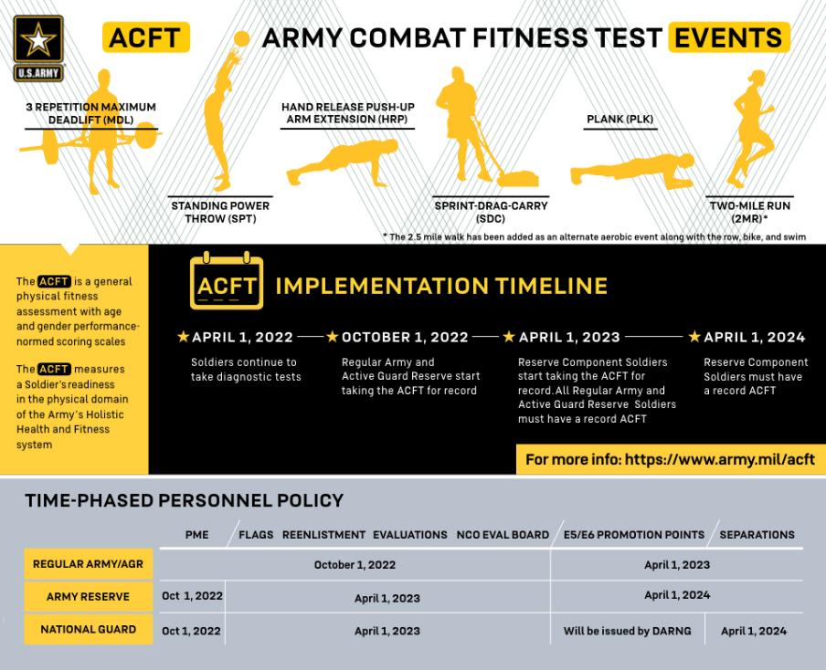
The ACFT is a general six-event fitness assessment, with performance-normed standards based on and age, using the same groups as the APFT.
ACFT OVERVIEW

Slide 3
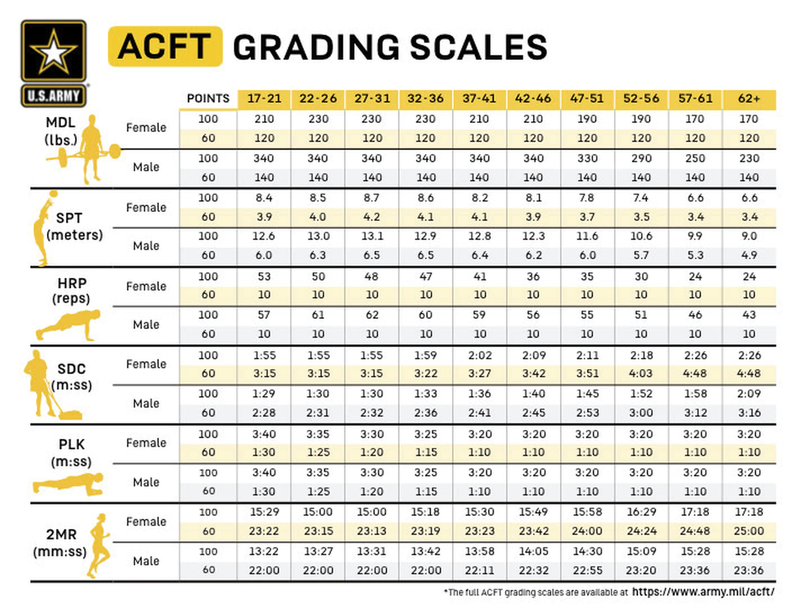
NEW ACFT GRADING SCALES

Slide 4
3 Rep Max Deadlift (MDL)
The following instructions will be available to Soldiers prior to the test:
3 Repetition Maximum Deadlift: You must step inside the hex bar with feet shoulder width apart and locate the midpoint of the hex-bar handles. On the command, “GET SET,” you will bend at the knees and hips, reach down, and grasp the center of the handles using a closed grip. Arms will be fully extended, back flat, head in line with the spinal column, and heels in contact with the ground. All repetitions will begin from this position. On the command, “GO,” you will stand up and lift the bar by straightening the hips and knees. After completing the movement up, you will lower the bar to the floor under control while maintaining a flat back. You must not rest on the ground. A successful attempt is three repetitions to standard. If you fail to perform a successful attempt, you will be allowed one re-attempt at the same weight or a lower weight of your choosing. If you complete three correct repetitions on your first attempt, you will be given the option to attempt a higher weight of your choosing to increase your score. The amount of weight successfully attempted will be your raw score.
Figure 1-7. Touching the plates to the ground
versus not touching the ground

Slide 5
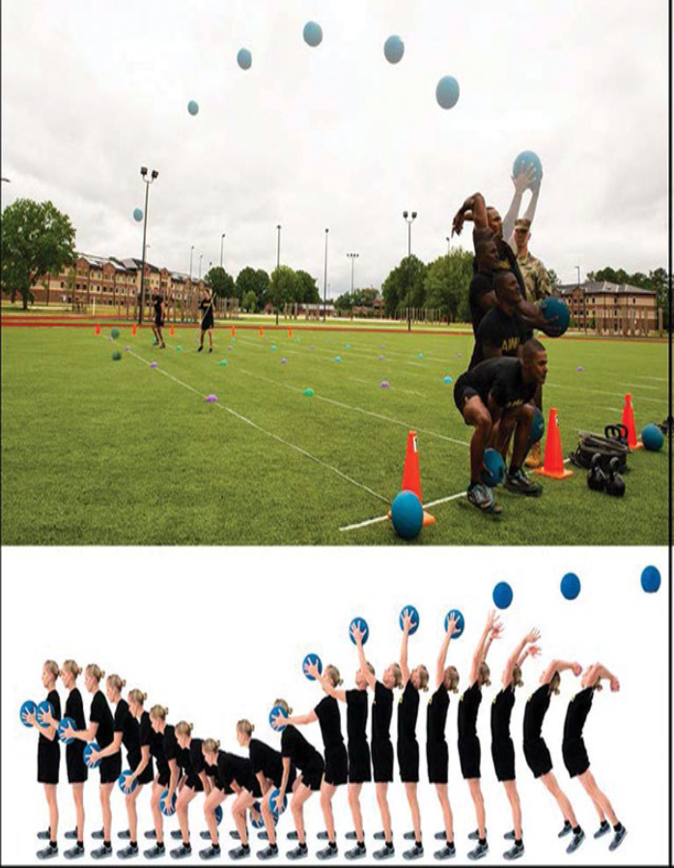
Standing Power Throw (SPT)
Standing Power Throw: You will face away from the throw line and grasp a 10-lb medicine ball with both hands. Stand with the heels at — not on or over — the start line. To avoid having the ball slip, grasp firmly and as far around the sides or beneath the ball as possible. You may make several preparatory movements by bending at the trunk, knees, and hips while lowering the ball toward the ground. Attempt to throw the ball as far as possible. Your feet must be stationary and on the ground prior to the throw. You may jump during the throwing movement to exert more power into the throw, but you must not fall, cross beyond, or touch the throw line with your foot. If you do, the throw will not count. The longer of the two attempts will be the one used for your record score.

Slide 6
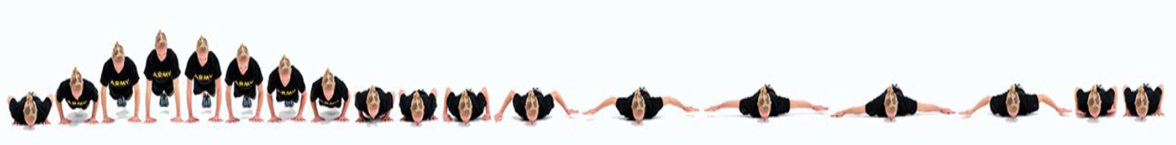
Hand-Release Push-Up (HRP)
The following instructions will be available to Soldiers prior to the test:
Hand-Release Push-Up - On the command, “GET SET,” you will assume the prone position with hands flat on the ground beneath your shoulders. Your chest and the front of your hips and thighs will be on the ground. Toes will be touching the ground, and feet will be together or up to a boot’s width apart as measured by the grader’s boot. Your ankles will be flexed. Your head does not have to be on the ground. With the hands placed flat on the ground, your index fingers will be inside the outer edge of your shoulders. Your feet will remain on the ground throughout the event. On the command, “GO,” you will push the whole body up from the ground as a single unit to fully extend the elbows, moving into the front leaning rest position. You will maintain the same straight body alignment from the top of the head to the ankles. This straight position will be maintained for the duration of the event. Bending or flexing the knees, hips, trunk, or neck during a repetition will cause that repetition to not count. The front leaning rest is the only authorized rest position. If you move from the straight position the event will be terminated. After you reach the up position, your elbows will bend again to lower your body to the ground. Your chest, hips, and thighs will touch the ground. Your head or face does not have to contact the ground. After reaching the ground as a single unit, without moving the head, body, or legs, you will immediately move both arms out to the side, straightening the elbows into the T-position. You will then immediately return your hands to the starting position to complete one repetition. You cannot pause or rest on the ground. If you place a knee on the ground or lift a hand or foot when in the up position, the event will be terminated. You have two minutes to complete as many correct repetitions as possible.

Slide 7
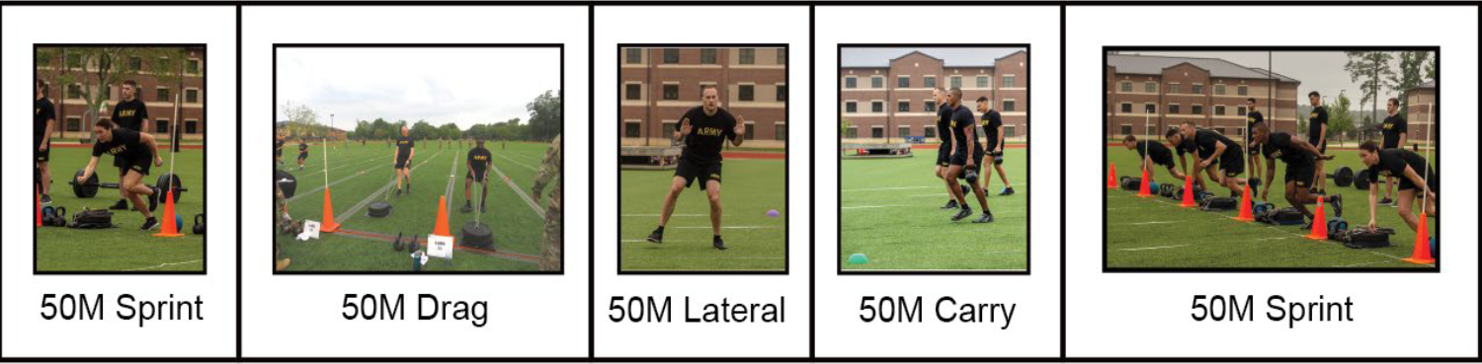
Sprint, Drag, Carry (SDC)
The following instructions will be available to Soldiers prior to the test:
Sprint-Drag-Carry - You must assume the prone position with hands on the ground beneath your shoulders and with the top of your head behind the start line, ready to complete five consecutive and continuous 50-meter shuttles. For the first shuttle, on the command, “GO,” stand up and sprint 25 meters before touching the 25-meter line with your foot and hand, turning at the line and sprinting back to the start. If you fail to touch properly, the scorer will call you back before allowing you to continue. For the second shuttle, grasp each pull-strap handle to pull the sled backwards until the whole sled crosses the 25-meter line. If you fail to cross the line with the sled, the scorer will call you back before allowing you to continue. Turn and drag the sled back to the start line. For the third shuttle, you will perform the lateral for 25 meters, touching the line with the foot and hand before performing the lateral back to the start line. The lateral will be performed to the left in one direction and to the right in the other direction. For the fourth shuttle, grasp the handles of the two 40-lb kettlebells and run 25 meters, touching the line with the foot before returning back to the start line. Place the kettlebells on the ground without dropping them. For the fifth shuttle, sprint 25 meters to the line, touching with the foot and hand, before turning and sprinting back to the start line to complete the event.

Slide 8
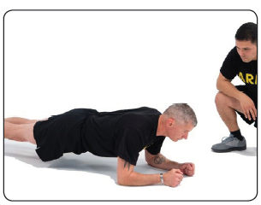
The Plank (PLK)
The Plank: is the fifth event in the ACFT

Slide 9
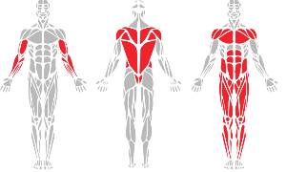
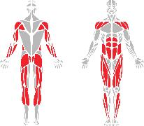
Plank vs. Leg Tuck
RAND observed that the leg tuck was not an accurate predictor of core strength for all Soldiers. The leg tuck requires a minimum pre-requisite upper body strength that made it impossible to measure core strength in all Soldiers.
In response, the Army will now use the plank as the sole exercise to assess core strength, using recognized standards from sister-services as a baseline and modifying the scales based on Army requirements.
Moving to the plank allows the Army to verify that the ACFT properly measures all Soldiers’ core strength equally, and ensures Soldiers have a similar testing experience and opportunity to succeed during every event of the ACFT.
The leg tuck is still a great holistic core exercise and is still encouraged as part of unit training outlined in ATP 7-22.02.
Muscle Groups Used
Leg Tuck
Plank

Slide 10
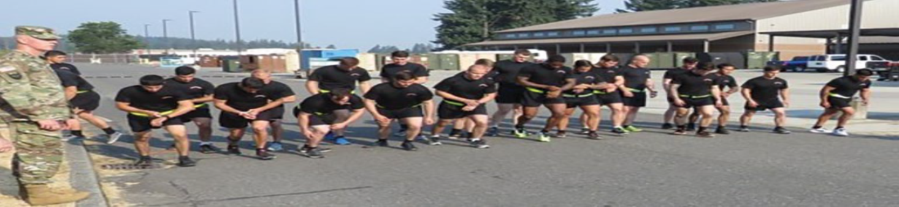
2-Mile Run (2MR)
2-Mile Run - Prior to starting the ACFT event, you will already know the 2-mile course including the start and finish points, turn around points, or number of laps. On the command, “GO,” the clock will start and you will begin running at your own pace, completing the 2- mile distance without receiving any physical help. You may walk or pause, but you cannot be picked up, pulled, or pushed in any way. You may pace another Soldier or be paced by another Soldier. Verbal encouragement is permitted. Leaving the course at any time or at any point during the event will cause the event to be terminated. Your time will be recorded as you cross the finish line at the 2-mile point.

Slide 11
Profiles and Alternate Events
Profiles and Alternate Events. Soldiers will take all events not prohibited by a permanent profile. If a permanent profile prohibits the 2-mile run, permanent-profile-directed alternate aerobic events include:
  5,000-meter row
  12,000 -meter bike
  1,000-meter swim
  2.5-mile walk
Soldiers on temporary profiles will not take the ACFT but will recover and recondition prior to taking the ACFT.

Slide 12
Temporary and Permanent Profiles
Temporary profiles: Soldiers on temporary profiles will not take the ACFT but will recover and recondition prior to taking the ACFT.
Permanent profiles: Soldiers will take all events not prohibited by a permanent profile. The minimum requirement for the ACFT is a single aerobic event.
If a permanent profile prohibits the 2-mile run, profile-directed alternate aerobic events include the 2.5-mile walk,
12k stationary bike, 1k swim, and 5k row.

