Slide 1
BSA CO-OP Muzzleloading Rifle Safety Briefing
NO PERCUSSION CAPS, BLACK POWDER, or BLACK POWDER SUBSTITUTE in the classroom NO EXCEPTIONS!

Slide 2
Orientation Goal
To provide beginning shooters with the knowledge, skills, and attitude necessary to shoot a rifle safely under the direct supervision of a NRA Certified CO-OP ML Rifle Instructor or Certified NRA/NMLRA ML Instructor or a Certified NCS Shooting Sports Director.

Slide 3
NRA Gun Safety Rules
ALWAYS keep your gun pointed in a safe direction
ALWAYS keep your finger off the trigger until ready to shoot
ALWAYS keep your gun unloaded until ready to use

Slide 4
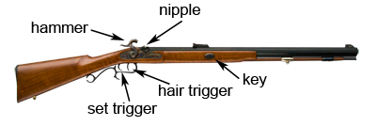
ML Rifle Parts…Percussion Cap Rifle
rear sight
front sight
barrel
muzzle
butt plate
grip
ramrod
trigger
Three Major Parts: Lock, Stock, and Barrel
The Lock contains the hammer and the trigger

Slide 5
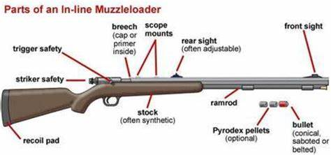
ML Rifle Parts…In-line Rifle
muzzle
grip
An Inline Rifle has the primer in the same line at the breech of the barrel

Slide 6
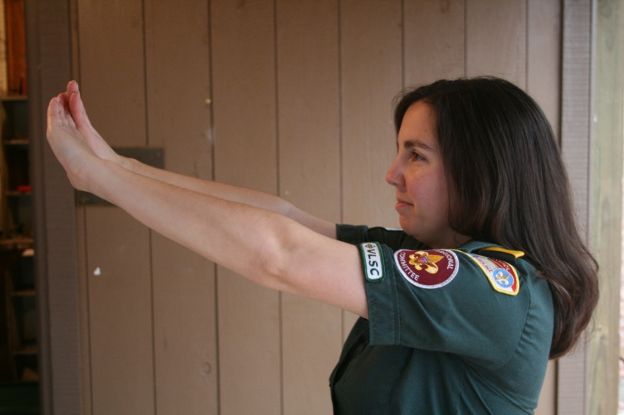
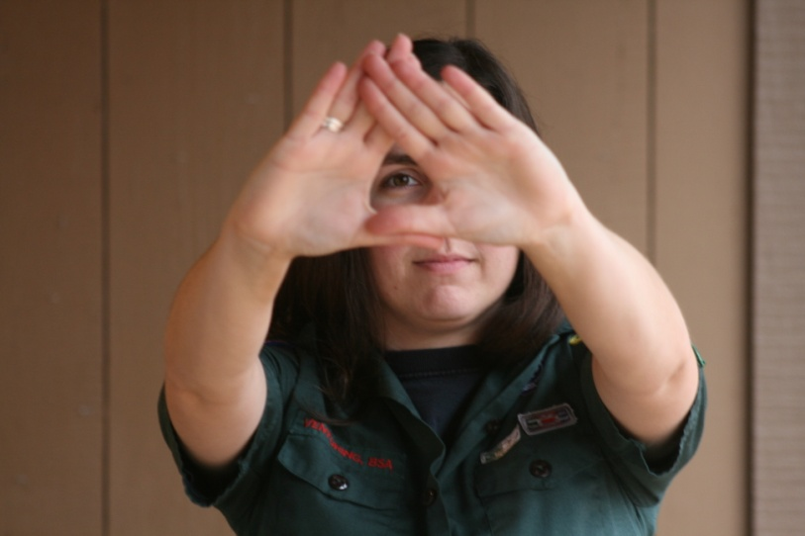
Shooting Fundamentals Determining the Dominant Eye
Extend arms forward and form opening between the hands
With both eyes open, look at a distant object through opening
Bring hands to face while looking at object – Opening will be aligned with the dominant eye
Notes:
6

Slide 7
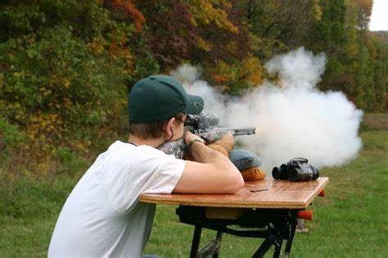
Bench Rest Position
Feet flat on the ground with the legs relaxed.
Seated directly behind the front support with slight lean forward.
Butt of the rifle in the shoulder close to neck.
Elbows on the table to support the rifle.
Support hand under the Forearm.
Trigger hand holding the grip.
Face firmly against the stock with eye looking straight down the sights.
Align the position to target.
Notes:
7

Slide 8
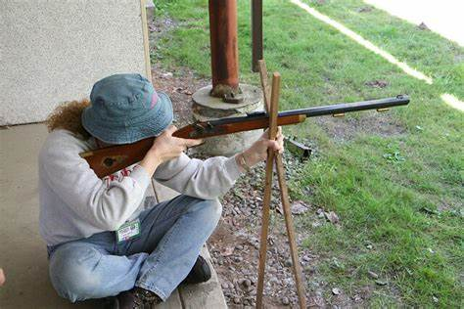
Cross Stick Position
Seated on the ground with the legs crossed at ankles at 10-30 degrees to the target.
Seated directly behind the front support with slight lean forward.
Butt of the rifle in the shoulder close to neck.
Support hand holding the cross-sticks.
Trigger hand holding the grip.
Face firmly against the stock with eye looking straight down the sights.
Align the position to target.
Notes:
8

Slide 9
Rifle Shooting Fundamentals
1. AIMING (sight alignment & sight picture)
2. BREATH CONTROL
3. HOLD CONTROL
4. TRIGGER CONTROL
5. FOLLOW-THROUGH

Slide 10
FUNDAMENTALS “Aiming”
Notch Rear and Post Front Sight
FRONT SIGHT IS IN SHARP FOCUS
Sight Alignment
With Post-and-Notch sights:
The tops of the front and rear sights are even
The front post is centered in the rear notch
Sight Picture
6 O'clock Hold on the Bullseye
Notes:
3 Min. Cumulative Time: 8 Min.
Instructor Notes: (Review Part I in Handbook)
NEW information: The bullseye has replaced the blank target and 6 O’clock hold on bullseye.
Ask What is a fundamental?
Fundamentals are basic building blocks on which we can develop and expand.
Ask what is "Aiming?"
Aiming is the process of positioning the rifle so that the bullet will hit the target.
The process first involves sight alignment and then sight picture.
Ask What makes up sight alignment?
The proper positioning of the shooting eye, rear sight and front sight.
Ask What makes up sight picture?
The alignment of the shooting eye, rear sight, front sight and target or adding the target to aligned sights.
The sight picture varies with the type of sights you are using, but the basic rule is to focus on the front sight (the rear sight and target will be slightly out of focus).
Explain 6 O’clock hold on the bullseye.
Ball on a fence post. The ball is the bullseye and the post is the front sight.

Slide 11
FUNDAMENTALS “Aiming”
Aperture Rear and Post Front Sight
FRONT SIGHT IS IN SHARP FOCUS
Sight Alignment
Aperture Rear and Post Front Sight
The top of the front sight is centered in the rear sight’s aperture
Sight Picture
6 O'clock Hold on the Bullseye
Notes:
3 Min. Cumulative Time: 8 Min.
Instructor Notes: (Review Part I in Handbook)
NEW information: The bullseye has replaced the blank target and 6 O’clock hold on bullseye.
Ask What is a fundamental?
Fundamentals are basic building blocks on which we can develop and expand.
Ask what is "Aiming?"
Aiming is the process of positioning the rifle so that the bullet will hit the target.
The process first involves sight alignment and then sight picture.
Ask What makes up sight alignment?
The proper positioning of the shooting eye, rear sight and front sight.
Ask What makes up sight picture?
The alignment of the shooting eye, rear sight, front sight and target or adding the target to aligned sights.
The sight picture varies with the type of sights you are using, but the basic rule is to focus on the front sight (the rear sight and target will be slightly out of focus).
Explain 6 O’clock hold on the bullseye.
Ball on a fence post. The ball is the bullseye and the post is the front sight.

Slide 12
Shooting Fundamentals Breath Control
Body movement while breathing can produce gun movement that impairs shooting accuracy.
Pause breathing momentarily while firing the shot! (Respiratory pause)

Slide 13
Shooting Fundamentals Hold Control
Body movement affects the shot.
Hold your body still.
Hold control involves you maintaining the proper sight picture and sight alignment during the process of firing the shot.

Slide 14
Shooting Fundamentals Trigger Control
Trigger is pressed straight to the rear in a smooth, continuous manner without disturbing the sight picture.
Gradually and evenly increasing pressure until the mechanism releases.

Slide 15
Shooting Fundamentals Follow-Through
In Rifle Shooting:
Follow through means to continue applying the other fundamentals before, during, and after the shot.
15

Slide 16
Shooting Fundamentals The Fundamentals…A Review
“Maintaining sight alignment and acceptable sight picture.” –
“Pause breathing.” –
“Holding still.” –
“Moving only your trigger finger.” –
“To maintain position, and continue aiming, breath control, hold control, and trigger control until the gun settles back into the aiming area after the shot is fired.” –
AIMING
BREATH CONTROL
HOLD CONTROL
TRIGGER CONTROL
FOLLOW-THROUGH

Slide 17
Most Important Fundamentals!
NOTE –
The TWO most IMPORTANT shooting fundamentals are……..
“Maintaining sight alignment” – AIMING
“Moving only the trigger finger” – TRIGGER CONTROL

Slide 18
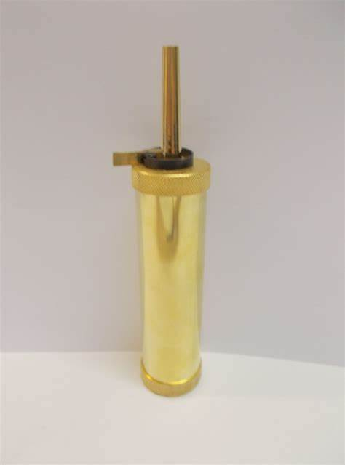
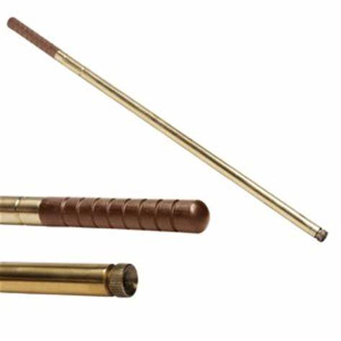
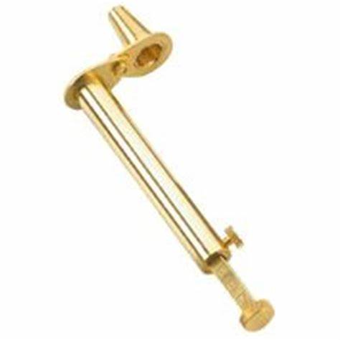
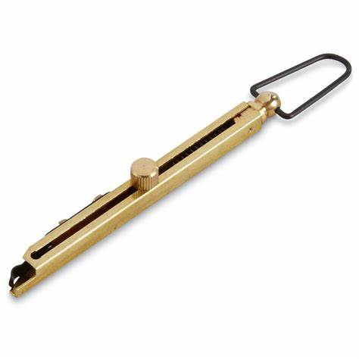
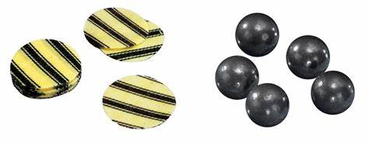
Accoutrements (Tools) needed to load a ML Rifle
short starter
powder flask
powder measure
ramrod
patch and balls
Capper & caps
18

Slide 19
Determining if a Muzzleloader is loaded or unloaded
Instructor demonstration
Position the gun – pointed in a safe direction
Put ramrod into muzzle all the way to bottom of the barrel
Mark rod at muzzle
Pull rod out of barrel
Place rod on side of barrel with mark aligned with the muzzle
Look at the end of the rod to see how it aligns with the nipple.
Unloaded: the end of the rod should be closely aligned with the nipple. Typically, within ½ inch.
Loaded: The end the rod will be above the nipple typically by greater than an ½ inch.
The “sound check” is NOT acceptable for determining if a ML rifle is loaded.
19

Slide 20
Pre-Preparation of a Muzzleloader for loading
Instructor demonstration DO NOT ACTUALLY LOAD
Position rifle for loading – pointed in a safe direction
Check bore for load
Put hammer in half cock position & check nipple for a cap
Swab barrel with wet patch
Swab barrel with a dry patch
Snap 3 caps to dry the flash channel
Fill powder with the proper powder for the firearm
Fill capper with caps
20

Slide 21
Demonstrate Procedure for Loading a ML Rifle (use for every shot)
Instructor demonstration
DO NOT ACTUALLY LOAD
“Smoke nipple” by pushing ramrod down the barrel and look for smoke coming out of the nipple to verify the rifle is clear to load. and/or dry fire with 1 cap to verify the barrel is clear.
Fill powder measure from powder flask (maximum grains of powder not to exceed the caliber of the rifle. i.e. 50 grains for 50 caliber)
Pour powder into muzzle
Center patch over muzzle
Place ball on patch over muzzle
Use short starter “button” to start ball in muzzle (~1/2”)
Tap ball into barrel with short rod of the starter (~6”)
Use ramrod to drive the ball down. (Use short strokes so you don’t bend the rod.) Ball MUST Be Fully Seated on Top of Powder
Once on the firing line, the instructor will place a cap on the nipple
21

Slide 22
Supervision Requirements
NRA Certified Range Safety Officer
1 RSO per 8 participants 1:8 ratio
AND
NRA Certified CO-OP ML Rifle Instructor
OR
NRA/NMLRA Certified ML Instructor or Certified Shooting Sports Director.
1 Instructor per 1 participants 1:1 ratio

Slide 23
Supervision Requirements
O
Loading and Firing MUST be supervised by the qualified instructor a 1 on 1 instructor to participant basis.
RSO ensures the safe operations according to range standard operating procedures. (SOP)

Slide 24
Range Safety Briefing
NRA Safe Gun Handling Rules
ALWAYS keep your gun pointed in a safe direction.
ALWAYS keep your finger off the trigger until ready to shoot.
ALWAYS keep your gun unloaded until ready to use.

Slide 25
Range Safety Briefing
Range layout
Ready Area
Firing Line
Target Area
Back Stop

Slide 26
Range Safety Briefing
Other Safety Rules
Know your target and what is beyond
Wear eye and ear protection as appropriate
Never use alcohol or drugs before or while shooting
Be aware that certain types of guns and many shooting activities require additional safety precautions
Range Commands
“Capping” (participant states just before snapping a cap)
“Commence Firing”
“Fire in the Hole” (participant states just before shot)
“Cease Firing”

Slide 27
Questions
What are your questions before you move to the Ready Area?

