Slide 1
BSA Archery Range Safety Briefing
NO ARROWS in the classroom NO EXCEPTIONS!

Slide 2
Orientation Goal
To provide beginning archers with the knowledge, skills, and attitude necessary to shoot a archery safely under the direct supervision of a BSA archery rangemaster, a USA Archery Level 1 (or higher) instructor or an NCS certified Shooting Sports Director.

Slide 3
Archery Safety Rules
ALWAYS keep your bow pointed in a safe direction
ALWAYS keep your finger off the bow string until ready to shoot
ALWAYS keep your arrow off the string until ready to use

Slide 4
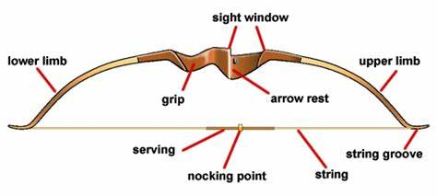
The Recurve Bow

Slide 5
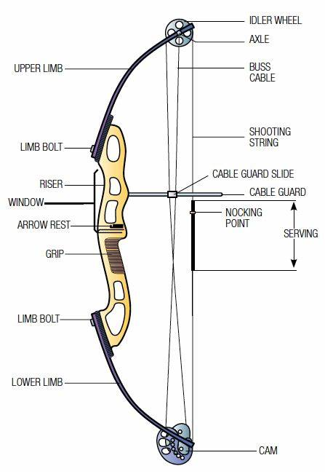
The Compound Bow

Slide 6
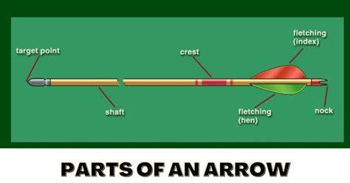
The Parts of an Arrow

Slide 7
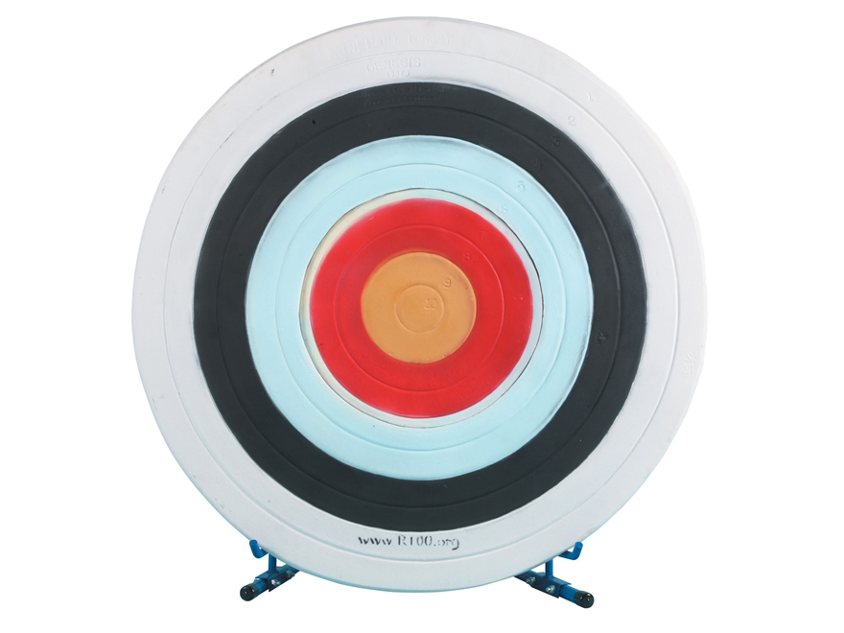
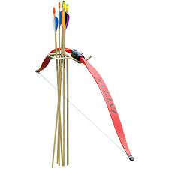
The Archery Range
The Waiting Line: Archers wait behind this line until directed to advance onto the range.
The Shooting Line: Archers advance to the shooting line when they are directed to. This is usually done by the instructor issuing two whistle blasts.
The Target Line: Should be at least 5 ft. in front of the targets. Shooters wait here until given the command to take arrows out of the target. If two individuals are shooting at the same target, this is where one will wait while the other retrieves their arrows.
Target Line
Shooting Line
Waiting Line

Slide 8
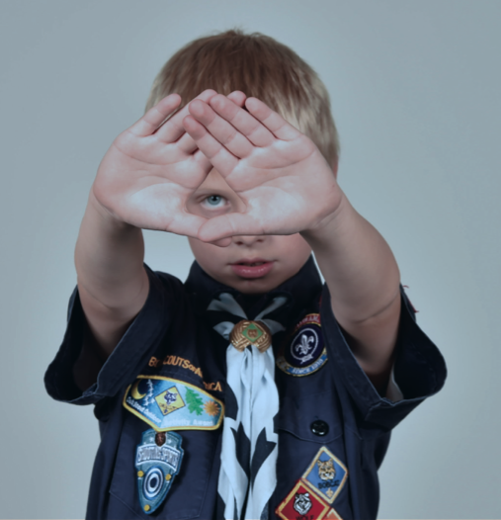
Shooting Fundamentals
Determining Eye Dominance
Extend arms forward and form opening between the hands
With both eyes open, look at a distant object through opening
Bring hands to face while looking at object – Opening will be aligned with the dominant eye

Slide 9
Shooting Fundamentals
Determining Eye Dominance
Archers should usually draw back the bowstring with their dominant hand, even if it does not match up with their dominant eye. If they are cross-dominant, consider closing their dominant eye when shooting.

Slide 10
Archery Shooting Fundamentals
1. STANCE
2. NOCK THE ARROW
3. HOOK AND GRIP
4. RAISE THE BOW
DRAW
ANCHOR
HOLD
AIM
RELEASE/FOLLOW-THROUGH

Slide 11
Archery Shooting Fundamentals
STANCE
Stand with feet STRADDLING the shooting line.
Feet should be about shoulder-width apart.
Move the foot closest to the target back about 3 inches.
Turn the toes of both feet toward the target about 30 degrees.
Shooting Line

Slide 12
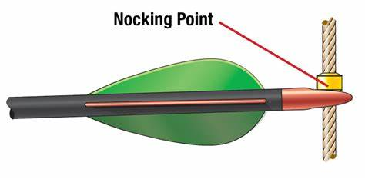
Archery Shooting Fundamentals
Nock the Arrow
Grasp the arrow below the nock.
Bring the arrow up and over the bow and place it on the arrow rest.
Spin the arrow so the index vane (usually a different color) points away from the bow.
Push the nock into place on the bowstring directly below the nocking point. (When the arrow is securely placed on the bow string the archer feels and/or hears the arrow “snap” into place.)

Slide 13
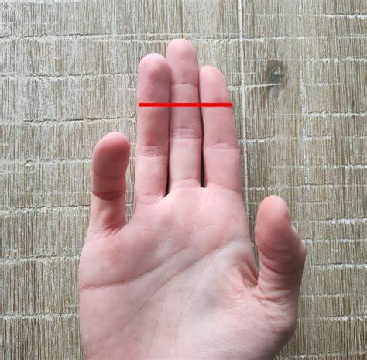
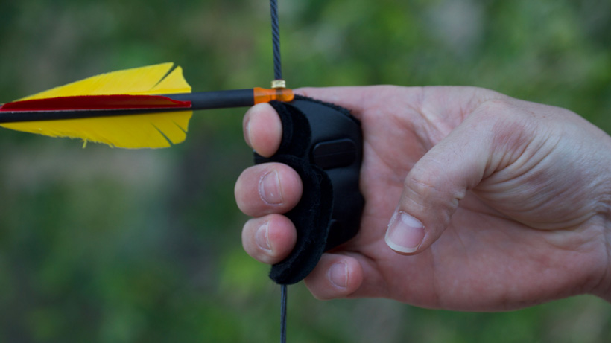
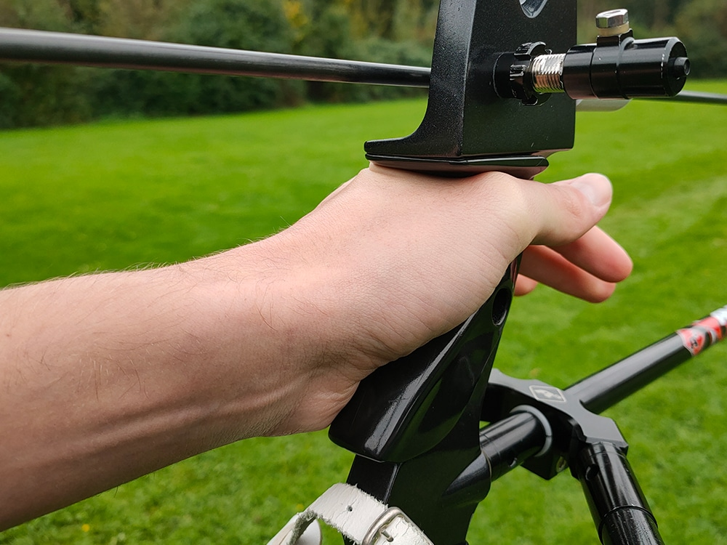
Archery Shooting Fundamentals
Hook and Grip
Curl the bowstring with the fingertips of the index, middle, and ring fingers UNDER the nock of the arrow.
Pull the bowstring back enough to apply a small amount of tension.
Center the meaty part of the grip hand on the bow grip.
Hold the bow grip loosely.

Slide 14
Archery Shooting Fundamentals
Raise the Bow
Turn the head towards the target.
Rotate the elbow of the bow arm away from the bowstring.
Lift both arms to shoulder height.
Extend the bow arm fully, keeping the bow vertical.

Slide 15
Archery Shooting Fundamentals
Draw
Pull the bowstring toward the face.
The draw should be seamless and smooth.

Slide 16
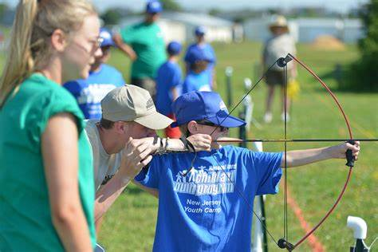
Archery Shooting Fundamentals
Anchor
Settle the index finger of the draw hand into the corner of the mouth.
Keep the draw hand relaxed and against the face.
It is critical that the archer pull the bowstring back to a consistent anchor point every time to maintain accuracy.

Slide 17
Archery Shooting Fundamentals
Aim
Place the point of the arrow on the intended target area.
The eye focus is equally on the arrow point and the target.
You will adjust your point of aim after you see where you initial shots are placed on the target.

Slide 18
Archery Shooting Fundamentals
Release/Follow-Through
Relax the fingertips to allow the bowstring to push the fingers out of the way.
Keep the bow arm up as the arrow leaves the bow.
Finish the shot by allowing the draw hand to fall between the ear and the shoulder.

Slide 19
Archery Shooting Fundamentals The Fundamentals…A Review
1. STANCE
2. NOCK THE ARROW
3. HOOK AND GRIP
4. RAISE THE BOW
DRAW
ANCHOR
HOLD
AIM
RELEASE/FOLLOW-THROUGH
19

Slide 20
Know the Proper Whistle Codes
Two Whistle Blasts: Move to the shooting line
One Whistle Blast: Fire the proper number of arrows.
Three Whistle Blasts: Move to the target line. Retrieve arrows when directed by the instructor.
Five or More Whistle Blasts: Stop shooting. Stay where you are. This is an EMERGENCY. The range officer will tell archers what action to take.

Slide 21
Safety Guidelines
NEVER dry fire a bow.
Always uses arrows that are correct for your draw length.
Remember - STRADDLE the shooting line.
Always keep your arrows pointed down or towards the target.
Always walk on the range.
Shoot only at the target that is in front of you.

Slide 22
Retrieving Arrows
Leave the bow at the shooting line when the command is given to retireve arrows (3 whistle blasts). ALWAYS walk on the range.
When retrieving arrows from a target, place the non-dominant hand against the target face with the arrow shaft between your fingers.
Grasp the arrow shaft close to the target face with your dominant hand.
Pull back while twisting the arrow.
If part of the arrow is still in the target, reposition your dominant hand close to the target face and repeat.
Once the arrow is out of the target, drop it on the ground in front of the target.
Pick up the arrows so they are all facing the same way.
Hold the arrows with both hands, palms facing down. One hand next to the fletchings/vanes, the other, behind the arrow heads.
Walk back holding the arrows horizontally and replace the arrows in the quiver.

Slide 23
BSA Guidelines
Lion and Tiger Cubs must shoot with an adult partner.
Cub Scouts must wear arm guards and finger tabs or gloves. (Unless the bow string has finger savers.)
Scouts, BSA members, Venturers, and Sea Scouts must wear arm guards.

Slide 24
Questions?
What are your questions before you move to the Waiting Area?

