Slide 1




Best Place On The PlanNet
Notes:
FONT Arial

Slide 2



IMAGINE TIME FREEDOM
IMAGINE FINANCIAL FREEDOM

Slide 3

Design your ideal life!
With PlanNet Marketing, we show you how to take control of your future through the power of entrepreneurship, the travel industry and e-commerce.
DISCOVER
HOW
TO
EARN MORE
Through a home-based business
1
2
TRAVEL MORE
Learn secrets of travel professionals
3
SAVE MORE
Save on what you’re doing ANYWAY
4
EXPERIENCE MORE
Enjoy all of the above without an additional job
Notes:
Font Arial Regular

Slide 4
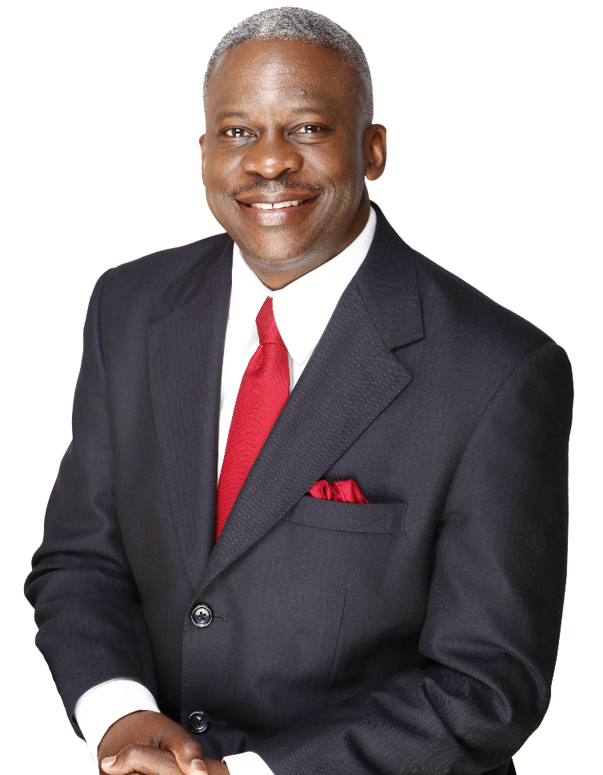

Who ARE We?
DONALD BRADLEY
PLANNET FOUNDER & CHAIRMAN OF BOARD
►Highly decorated seven-figure earner with
20+ years in marketing, sales and product
distribution
A Newly Launched Marketing Company
An Online Business Provider
Based In Atlanta, GA
Solid Company Leadership
A fresh opportunity without the risk of a startup
We supply you with an opportunity to earn from home
International company growing globally
Highly qualified corporate leadership team
“We’re committed to offering a financial opportunity that provides now income, and more importantly, sustained financial security…”
-Donald Bradley

Slide 5

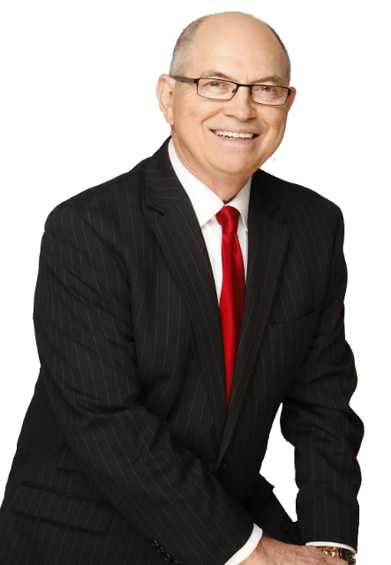
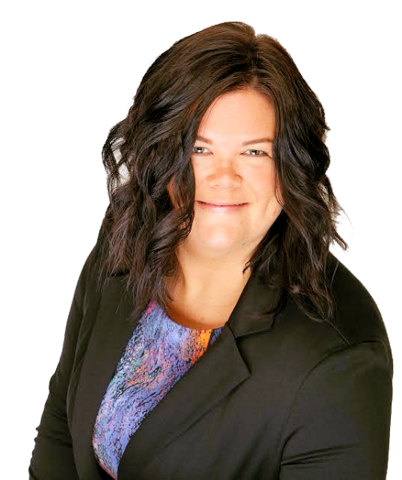
Corporate
LEADERSHIP
“A company that is managed as a
business should be…”
Andy CAUTHEN
PRESIDENT & CEO
A support team that is trained, courteous and professional
Decades of executive
management, corporate
operations, marketing &
sales experience
Managed billion dollar
global business
 International experience
Compliance – managed with the highest principles, practices and standards
LeAnn TROECKLER
COO
Manages the PlanNet
Support Team
Directs field operations
 Team supervision and
management
Recognition, respect and acknowledgement for the Reps in the field
Notes:
Slide 7 note

Slide 6

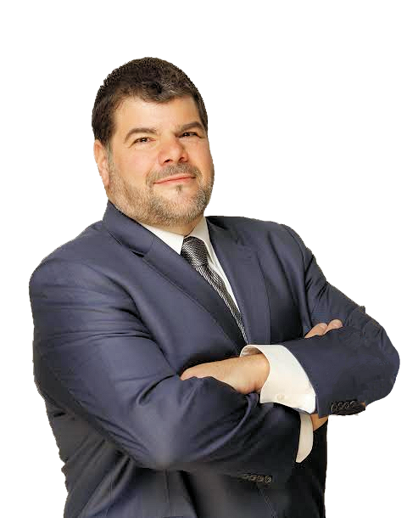
Who ARE We?
JAMES FERRARA
INTELETRAVEL CO-FOUNDER & PRESIDENT
► Industry recognized travel expert with 25+
years in travel training, marketing and sales
Leading Innovator In Travel For 25+ Years
Accreditation & Certification
Based In
Delray Beach, FL
Exclusive Partnership With PlanNet
The originator of home based travel agents
From CLIA to ARC to A+ BBB recognized for excellence
Based in USA, Developing unique travel products
globally
Stellar Partnership: We Sell Travel…
PlanNet Sells Us
“We offer an experience in travel beyond anything you’ve ever had. We bring the fun back and added income!”
-James Ferrara

Slide 7



The Travel Industry
GET
Paid
ON WHAT
BABY
BOOMERS
FUELING
GROWTH
MILLENIALS
SPEND
$200 BILLION
ANNUALLY
PEOPLE ARE DOING
#1 RESEARCHED
CATEGORY ONLINE
$15 TRILLION PROJECTION
IN 10 YRS
anyway
$8 TRILLION
ANNUALLY
ALMOST everyone YOU KNOW is traveling
OR WANTS TO travel.

Slide 8



Infinite possibilities!
Become a travel merchant
Realize the earning power of the largest industry on the planet!
Book Group Cruises:
Family Reunions, Common Interest Groups and more
Wedding Industry!
Honeymoons, Destination Weddings and Anniversaries
Group Travel:
Sports Teams, Corporate & Church Retreats, Fraternities/Sororities etc.
Group Travel:
Sports Teams, Corporate & Church Retreats, Fraternities/Sororities etc.

Slide 9





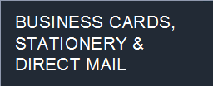
70-80%
OF COMMISSIONS PAID TO ITA!
1
PARTNERED WITH MAJOR VENDORS WORLDWIDE
PERSONALIZED WEBSITE & EMAIL MARKETING PROGRAM
2
NO THIRD PARTY INTERMEDIARIES
3
RESERVED INVENTORY OF GROUP CRUISE BLOCKS
4
BEST IN CUSTOMER SUPPORT AND SERVICE

Slide 10



Earn more!
5 Day Golf Trip
7 Day Honeymoon
Golfing in Scottsdale, AZ
for a group of 4
All-inclusive resort in Cancun complete with butler service
Your commission:
$274.86
Your commission:
$561.79
Golf trip
Honey
moon
Business travel
Group cruise
Frequent Business Traveler
5 Day Group Cruise
How much can I earn?
Three night hotel stay
3 times a month booked
thru your portal
Family reunion books 20 cabins for a Western Caribbean Cruise
Your commission:
$2,240.17
Your commission:
$151.20
*commissions represented here are examples and are not a guarantee of income
**travel rates are subject to change due to date, availability etc.

Slide 11


INTELE-TRIPS
HAVE FUN LEARNING & EARNING!
Educate yourself by experiencing travel from a client perspective…
Become better educated on travel vendors and industry products
Acquire vendor specific certifications
Position yourself to better sell travel as a professional

Slide 12
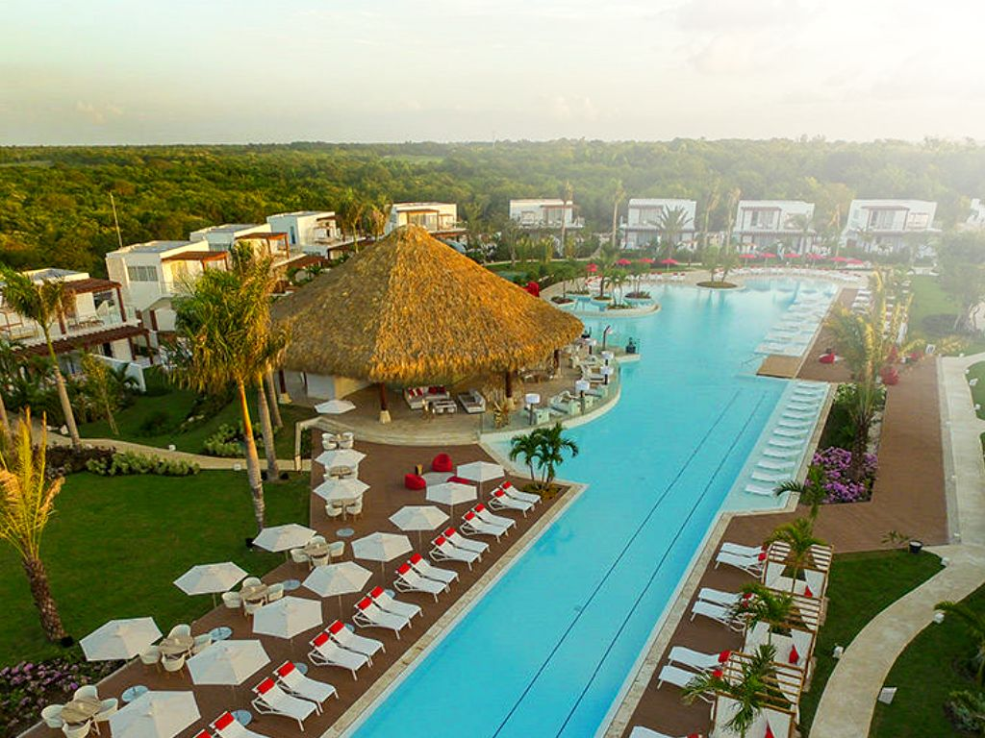
INTELE-TRIPS
2016
4 DAYS
PUNTA CANA
$149

Slide 13


INTELE-TRIPS
2017
2016
4 Day
Bahamas Cruise
$199
Oceanview
$299
Balcony

Slide 14




Intele-Trust Guarantee
BEST TRAVEL PRICE GUARANTEE
NO QUESTIONS ASKED, 100% MONEY BACK GUARANTEE
RISK FREE PROFIT
GUARANTEE

Slide 15



GET STARTED NOW!
Make a quality decision and enroll today!
PLANNET
MARKETING REP
PLANNET
MARKETING REP
& INTELETRAVEL
ITA
INTELETRAVEL
ITA
MOST POPULAR
$19⁹⁵enrollment
$179⁹⁵
$199⁹⁰
enrollment
enrollment
➢ Earn commission on travel sales
➢ InteleTravel guaranteed best
prices and VIP travel benefits
➢ Your very own InteleTravel
ITA personalized website
➢ No product purchase required
➢ Direct commission on ITA sales
➢ Enroll REPS & earn overrides
Personalized PlanNet Marketing
Replicated Website
➢ Maximize both opportunities!
➢ Book travel & sell the ITA
➢ Leverage the benefits and
perks of two great companies
$59.90/MONTHLY
UNLIMITED SUPPORT
$39.95/MONTHLY
UNLIMITED SUPPORT
$19.95/MONTHLY
UNLIMITED SUPPORT

Slide 16

Marketing Compensation Plan
CAPITALIZE ON THE POWER OF LEVERAGE AND RESIDUAL INCOME
“NEVER RELY ON A SINGLE SOURCE OF INCOME. YOU MUST INVEST TO CREATE A SECOND SOURCE”-WARREN BUFFETT

Slide 17


LEVERAGED INCOME
50% Check Match On ALL Personal Referrals!
50% MATCH
Every direct sale one of your personal REPS makes, pays them AND you!
$
$
$
DIRECT SALE
TEAM BONUS
Earn On Every Sale
Earn Additional Bonuses As You Promote
Sell the ITA program and receive a $50 direct sale commission
Team bonuses pay an extra $10 per ITA sale in your team. Earn up to 6 levels of $10 bonuses.
NO LIMIT ON DIRECT SALES, MATCHES OR TEAM BONUSES
UP FRONT COMMISSIONS PAID WEEKLY!

Slide 18




Gold Builder
BUILDER PROGRAM
Advance Through The Builder Program With Personal Active ITAs
3 ACTIVE ITAs
BRONZE BUILDER
RECEIVE FIRST $10 LEVEL
OF TEAM BONUSES.
10% MATCH ON PERSONAL ITAs TRAVEL COMMISSIONS WHEN GOLD BUILDER IS ALSO AN ITA.
6 ACTIVE ITAs
SILVER BUILDER
10% MATCH ON PERSONAL REPS MATRIX COMMISSIONS.
9 ACTIVE ITAs
GOLD BUILDER

Slide 19



RESIDUAL
INCOME
3X9 TEAM BUILD MATRIX
LEVEL |
# OF PERSONAL ACTIVE ITAs
PAYOUT
PER ITA RENEWAL
ITA
RENEWALS
MAX PER LEVEL
POTENTIAL PAYOUT
CUMULATIVE TOTAL
1 | 2
2 | 2
3 | 3
4 | 4
5 | 5
6 | 6
7 | 7
8 | 8
9 | 9
3
9
27
81
243
729
2,187
6,561
19,683
$4
$4
$4
$4
$4
$4
$4
$4
$4
$12
$48
$156
$480
$1,452
$4,368
$13,116
$39,360
$118,092
MATRIX COMMISSIONS ARE PAID OUT MONTHLY
GOLD AND ABOVE RECEIVE 10% MATCH ON PERSONAL REPS’ MATRIX

Slide 20


DIRECTOR PROGRAM
Hit it, you GET IT!
Director bonus paid
in addition to weekly and residual pay!
9
8
DIRECTOR bonuses paid monthly
7
100,000
ITAs
$100k
6
50,000
ITAs
$50k
$
5
25,000
ITAs
$30k
One-Star Directors receive a $1,000 monthly income guarantee from all sources of income.
4
10,000
ITAs
$16k
3
4,000
ITAs
$10k
2
1,500
ITAs
$5,000
1
500
ITAs
$2,000
Directors receive PlanNet Marketing Director Jacket and awards/recognition
300
ITAs
$1,000
100
ITAs
$500
Team Bonus
$10
Team Bonus
$10
Team Bonus
$10
Team Bonus
$10
Team Bonus
$10

Slide 21







Presidential Rings & Rolex
SAPPHIRE RING
$100K ANNUAL EARNING RATE
ROLEX WATCH
RECEIVED AT 5 STAR
DIRECTOR
RUBY RING
$250K ANNUAL EARNING RATE
DIAMOND RING
$500K ANNUAL EARNING RATE
DOUBLE DIAMOND
$1 MILLION ANNUAL EARNING RATE

Slide 22


PlanNet Marketing Pledge
Become a PlanNet Marketing Director.
Feel secure in knowing that in the event of your death, the PlanNet business you’ve built will outlast you.
Your family will still receive your PlanNet Marketing weekly commissions, Director pay, Director Bonuses and monthly residual income.

Slide 23

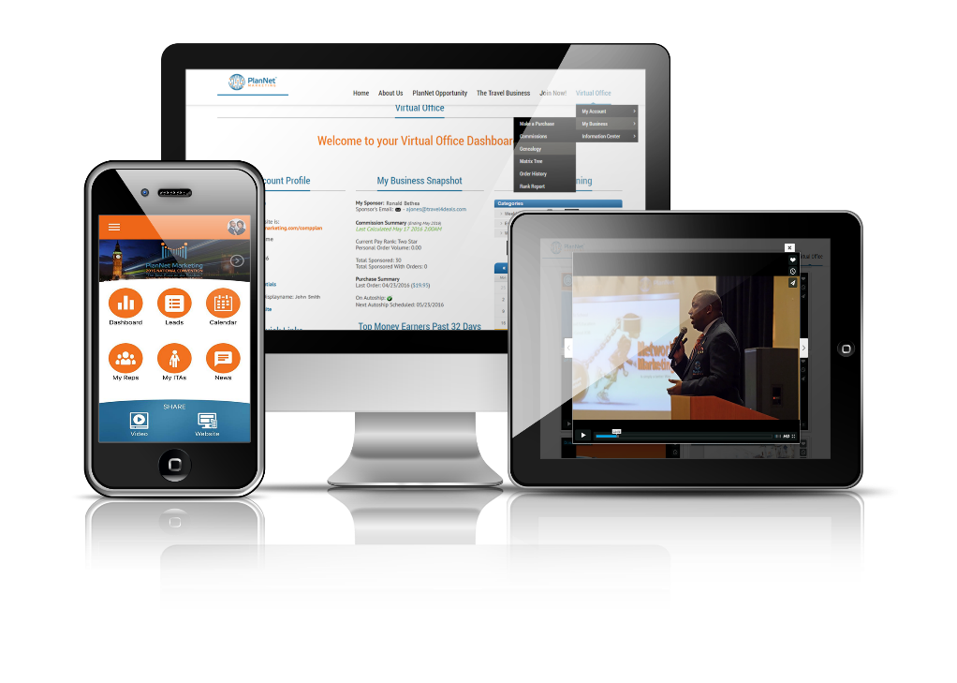


TURNKEY BUSINESS
VALUABLE TOOLS, SYSTEMS & SUPPORT!
1
tools
2
training
3
events
Website to track your business, mobile app to grow your business and more!
On demand and live training via web, calls and live!
Live events, trainings and conventions!

Slide 24



Make A Decision
You are excited and ready to go!
You are very interested, but they have a question?
Thank you, but no thank you.

Slide 25

Start your journey of success!
“THE journey OF A THOUSAND MILES begins WITH one step” -lao tzu

