Slide 1
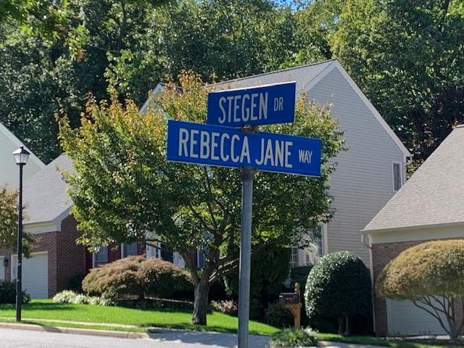
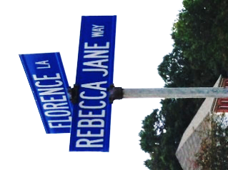
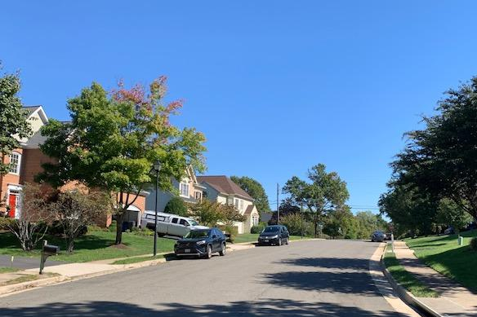
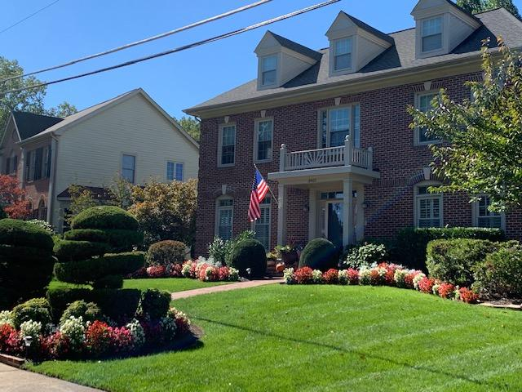
Florence Overlook
Homeowners Association
( FOHOA )
Annual Meeting 2024
Sunday, October 27, 2024

Slide 2
Pre-Meeting Activities
Please fill in the ‘Sign-In’ sheet
Please kindly review your information on the FOHOA roster
Enjoy some wine and visit with your neighbors!

Slide 3


Meeting Agenda
Quorum call to convene meeting
Update of new residents/pending sales in 2024
ARB Report and new ARB Chair
FOHOA document revisions
Common areas
Finances
Social events
Overview of Sentry Management services
Update on Web site – WWW.FOHOA.NET
Community Changes – surrounding area
Election of new board member(s)
Open Forum
Adjournment

Slide 4
Meeting Convenes
Quorum: 10% of members should be present
Call to Order @5:00 pm
Board Members
  President: Carol Joyce
  Vice President: Daniel Elder
  Secretary/Treasurer: Aaron Willey
Architectural Review Chairperson
  Susanna Kavanaugh

Slide 5

New FOHOA Members in 2023
NEW NEIGHBORS:
No new neighbors
FOR SALE:
  None at this moment

Slide 6

ARB Membership/Report
BoD Formalized Appointment of ARB Members in Memo
Current ARB Memberships
  Susanna Kavanaugh (Chair)
  Donna Connor (Member)
  Ann Sturner (Member)
ARB Report
  Next walk-around
Florence Overlook
Architectural Review Board

Slide 7
FOHOA Document Revisions
FOHOA Plat update
  See hard copy
  Will finalize after meeting
FOHOA Roster update
  See hard copy
  Will finalize after meeting

Slide 8
Common Area Parcel A
(Wooded Area/Ravine Behind Stegen Homes)
Late 2022: BoD installed new “Natural Habitat” signs throughout the common area.
Several trees removed, tree pending removal:
    Rear of 6134 Stegen Drive Rear (Lot 18)
      Dead tree appears to require removal.
      Rough order of magnitude - $1,000.
      Board approval required.
Survey Markers – Lost or Overgrown
  Board may hire original surveyor (LPD Inc.) to re-mark area.
  Montessori School Survey completed early 2023.

Slide 9
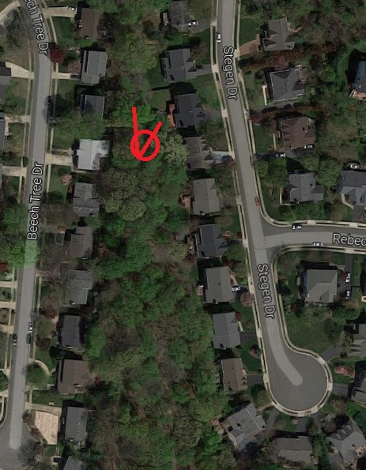
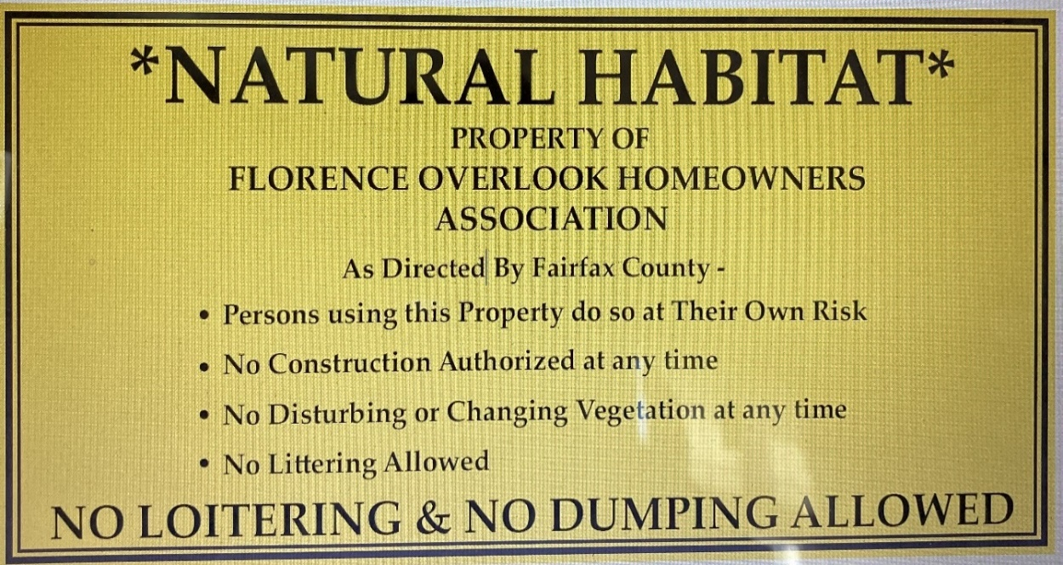
Common Area Parcel A
Indicates dead tree.
Red lines depict approximate boundary

Slide 10
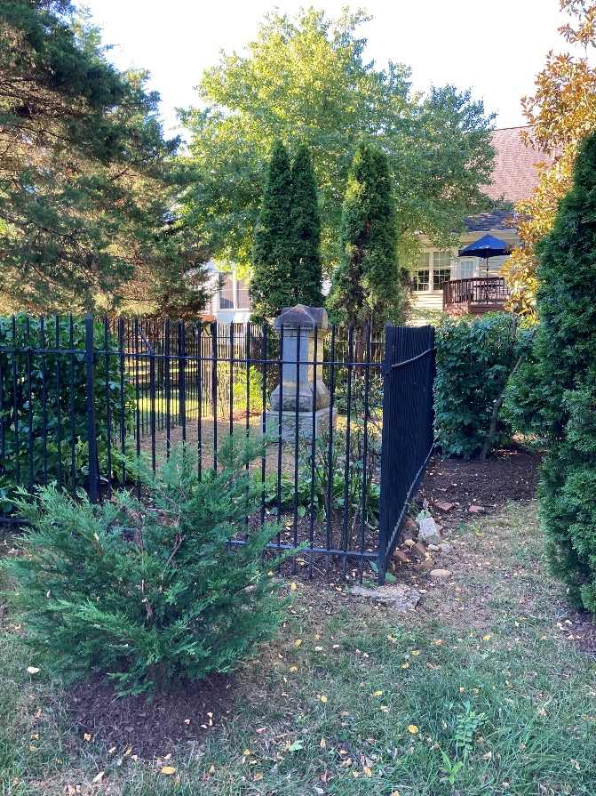
Common Area Parcel B (Cemetery)
Cast Iron Fence – likely 100 years old
  Replacement cost today $10-15,000
  Proper maintenance – fence life many more years
Prior years, Board organized clean
up days on site (vines and fence)
As of 2023 – Contract In-Place
  Using “Lopez Landscaping” services
  $132/month
  Beautifully maintains parcel
May need to Repaint Fence in 2025

Slide 11


Finances: Taxes and Insurance
Current to Date with Taxes
Pending 2024 Fed & State Tax Returns Completed
  Next tax filing date: Spring 2025
Review of Insurance Coverage
  State Farm Insurance Agent: Steve Sandoval
  Contract Valid to 14 September 2025
  Base insurance: $215.00
  Umbrella insurance: $788.00
  TOTAL ANNUAL PREMIUM $1,003.00

Slide 12

Finances: Current Balances
Almost all 2024 homeowner dues paid.
Balances as of 26 October 2024
  Operating checking: $ 10,099.43
  Reserve money market: $ 3,515.41
  Reserve C/D 13-Mo 5.50%: $ 26,379.01
  TOTAL: $ 39,993.85
Remaining 2024 expenses:
  Sentry Management Fee ($326.88/mo.)
  Cemetery maintenance ($132/mo.)
  6134 Stegen tree removal (~$1,000)*
    *Pending Board Approval
  Holiday party ?? (~$300)
  Other/Miscellaneous (~$100)

Slide 13

Reserve Study and Finances
2022–2027, 5-year Master Budget
In 2016, BoD developed a 5-Year master budget
In 2022, BoD documented reserve fund needs
Master budget goals
  ~ $15,000 in Reserve for Cemetery Fence Repair
  ~ $15,000 in Reserve for Tree Maintenance and other authorized expenses (not for legal fees)
Currently at Goal: $29,894.84 in Reserve
  Roughly $1,000 per Home
Board Projected No 2024/2025 Reserve Contribution

Slide 14

Reserve Study and Finances
2020–2025 Annual Dues
Annual dues for homeowners
  2020: $300 (actual)
  2021: $300 (actual)
  2022: $300 (actual)
  2023: $300 (actual)
  2024: $300 (actual)
  2025: $300 (planned)
Subject to annual reevaluation by the BoD
Your Board is holding the line on dues despite soaring inflation!
Inflation
FOHOA

Slide 15

Social Events
Spring and Fall Picnic
Spring Picnic: June 10, 2022
  Successful event with ≈ 20+ attendees and pleasant weather
  Bounce House again a “Big Hit” w/kids
  Picnic featured BBQ Chicken in addition to the usual burgers, sausage, and hot dogs!
Thanks to all who led and helped.
Fall Picnic: Cancelled due to low number of attendees.

Slide 16




Social Events
Upcoming Holiday Party
Aiming for December 7, Saturday Evening
The flyer is to be sent out to the neighborhood via email followed by an Evite invitation
At this time, looking for volunteers to step forward to host the party in their home.
  If no volunteers, we will cancel for 2024.

Slide 17

Sentry Management
Our Community Management Company
Sentry Management acquired Abode Management in 2016
New Account Managers: Carla Coimbra
FOHOA Representative: Alexander “Alex” Ciccarelli
Key Duties
  Handles Resale Disclosure Packages & All Other HOA-Related Real Estate Settlement Issues
  Processes All Financial Transactions & Generates Monthly Financial Reports
  Requires Copies of Annual Federal and State Tax Filings
  Requires Copy of State Farm Insurance Coverage
  Will identify outside Legal Counsel, when requested/necessary
  Retains Documents for 7 Years
  Soon to Handle Corporate Transparency Act (CTA) Requirements for Board (Next Slide)
New 5-Year Management Contract – Signed Dec 31, 2022 – Ends Dec 31, 2027
Annual Contract Cost:
  2018 = $3,624 2020 = $3,699 2022 = $4,037.25 2024 = $3,922.92
  2019 = $3,660 2021 = $3,734 2023 = $3,845.76
New Information
  Any Modification to By-Laws and Declaration “may be amended by a two-thirds vote of the lot owners.” See also 18 Va. Code § 55.1-1829.D, Amendment to declaration and bylaws.

Slide 18
Corporate Transparency Act
115th Congress, H.R. 3089
The Corporate Transparency Act (CTA) is a new regulation requiring community organizations to begin filing Beneficial Owner Information (BOI) with the Financial Crimes Enforcement Network (FinCEN) of the United States Treasury.
The CTA was enacted in 2021 to combat money laundering and terrorism financing by requiring corporations, including community associations, to disclose BOI to FinCEN.
Community Organizations have a duty to file certain BOI with the FinCEN by the filing deadline of January 1, 2025, or face civil or criminal penalties.
Sentry Management has partnered with FinCenFetch, a leading platform for corporate compliance specializing in BOI filings.
Sentry Management will proceed with supporting our association's reporting obligations.
Account SetUp/Profile Prep: $75.00 per association
Annual Fee: $395.00 (Charged in Mar 2025)
Change Fee: $40.00
Key Questions – “Beneficial Ownership” and 1X Requirement (?)

Slide 19
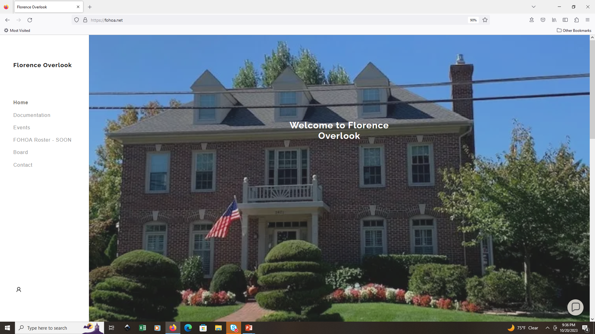
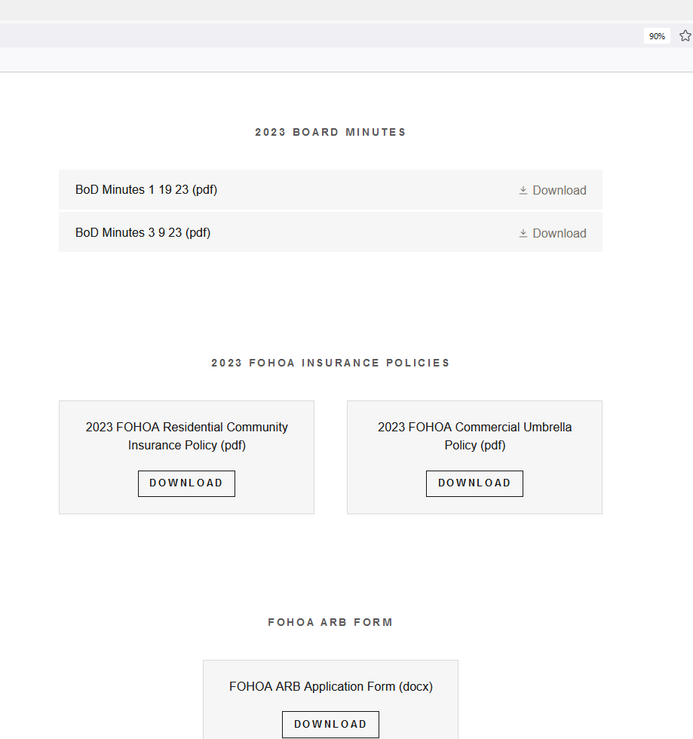
New FOHOA Web Site
WWW.FOHOA.NET
Currently In Service
Now Includes :
  Neighborhood Information
  Board Members & Contact Form
  Meeting Minutes
  OA Documents
  Members Only Section (Possible-Future)

Slide 20

Community Changes
Traffic Calming Initiative Update
  2022: HFHOA and FOHOA began engagement with County.
  Traffic fatality involving neighborhood cat increased urgency.
  Speed control device was temporarily installed Aug-Sep 2023, but unserviceable.
  Task Force formed with J. Bobich, A. Clayton and J. Van Zyl as FOHOA Reps
  Fairfax County proposed 3 locations (top, middle, lower) along Florence Ave – upper, middle, lower areas. Eight homes were adjacent to the recommended locations, marked on the road.
  Just took one resident to Veto the plan. One FOHOA resident vetoed, and one resident (not associated with a HOA) refused to declined to sign. So the PLAN STALLED.
  Options recommended by HFHOA were as follows:
    Press forward with one hump;
    Send more persuasive advocacy to the one resident from the other side to see if we can get a second hump;
    Return to the beginning and ask for a 4-way stop sign at Florence, Gentle, and Rebecca Jane Way;
    Or leave as is, and as the one resident from the other side recommended:
    “Shame speeders by photographing them and putting their pictures on social media.”
South Alex Shopping Center Continuing to Expand and Apartment Leasing Ongoing
  Aldi, PJ’s Coffee, BigPapi’s, K-Pot, Inspire Nail Bar
  Inova Urgent Care
Rose Hill Shopping Center Redevelopment
  Fairfax County Board of Supervisors deferred approval pending more “community engagement.”
  Supervisor Lusk requesting more retail, less residential (8/31/23).
Huntington Club Redevelopment (Huntington Ave. – Near Metro)
  Approved by Board of Supervisors, paused indefinitely due to funding.

Slide 21
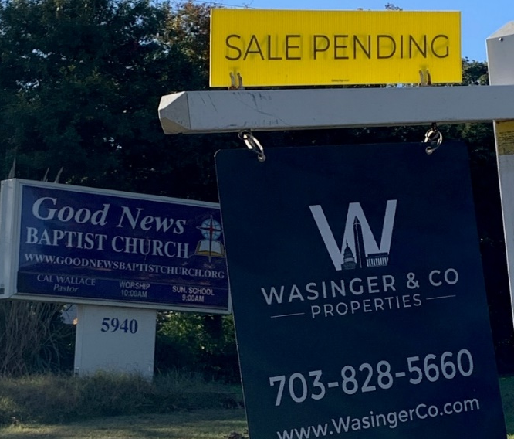
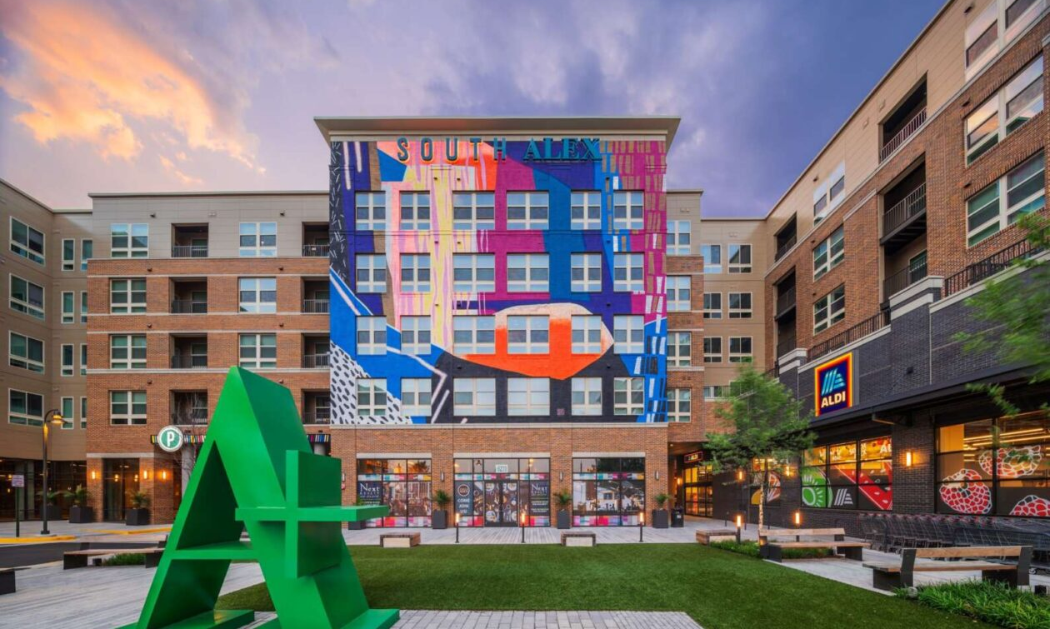
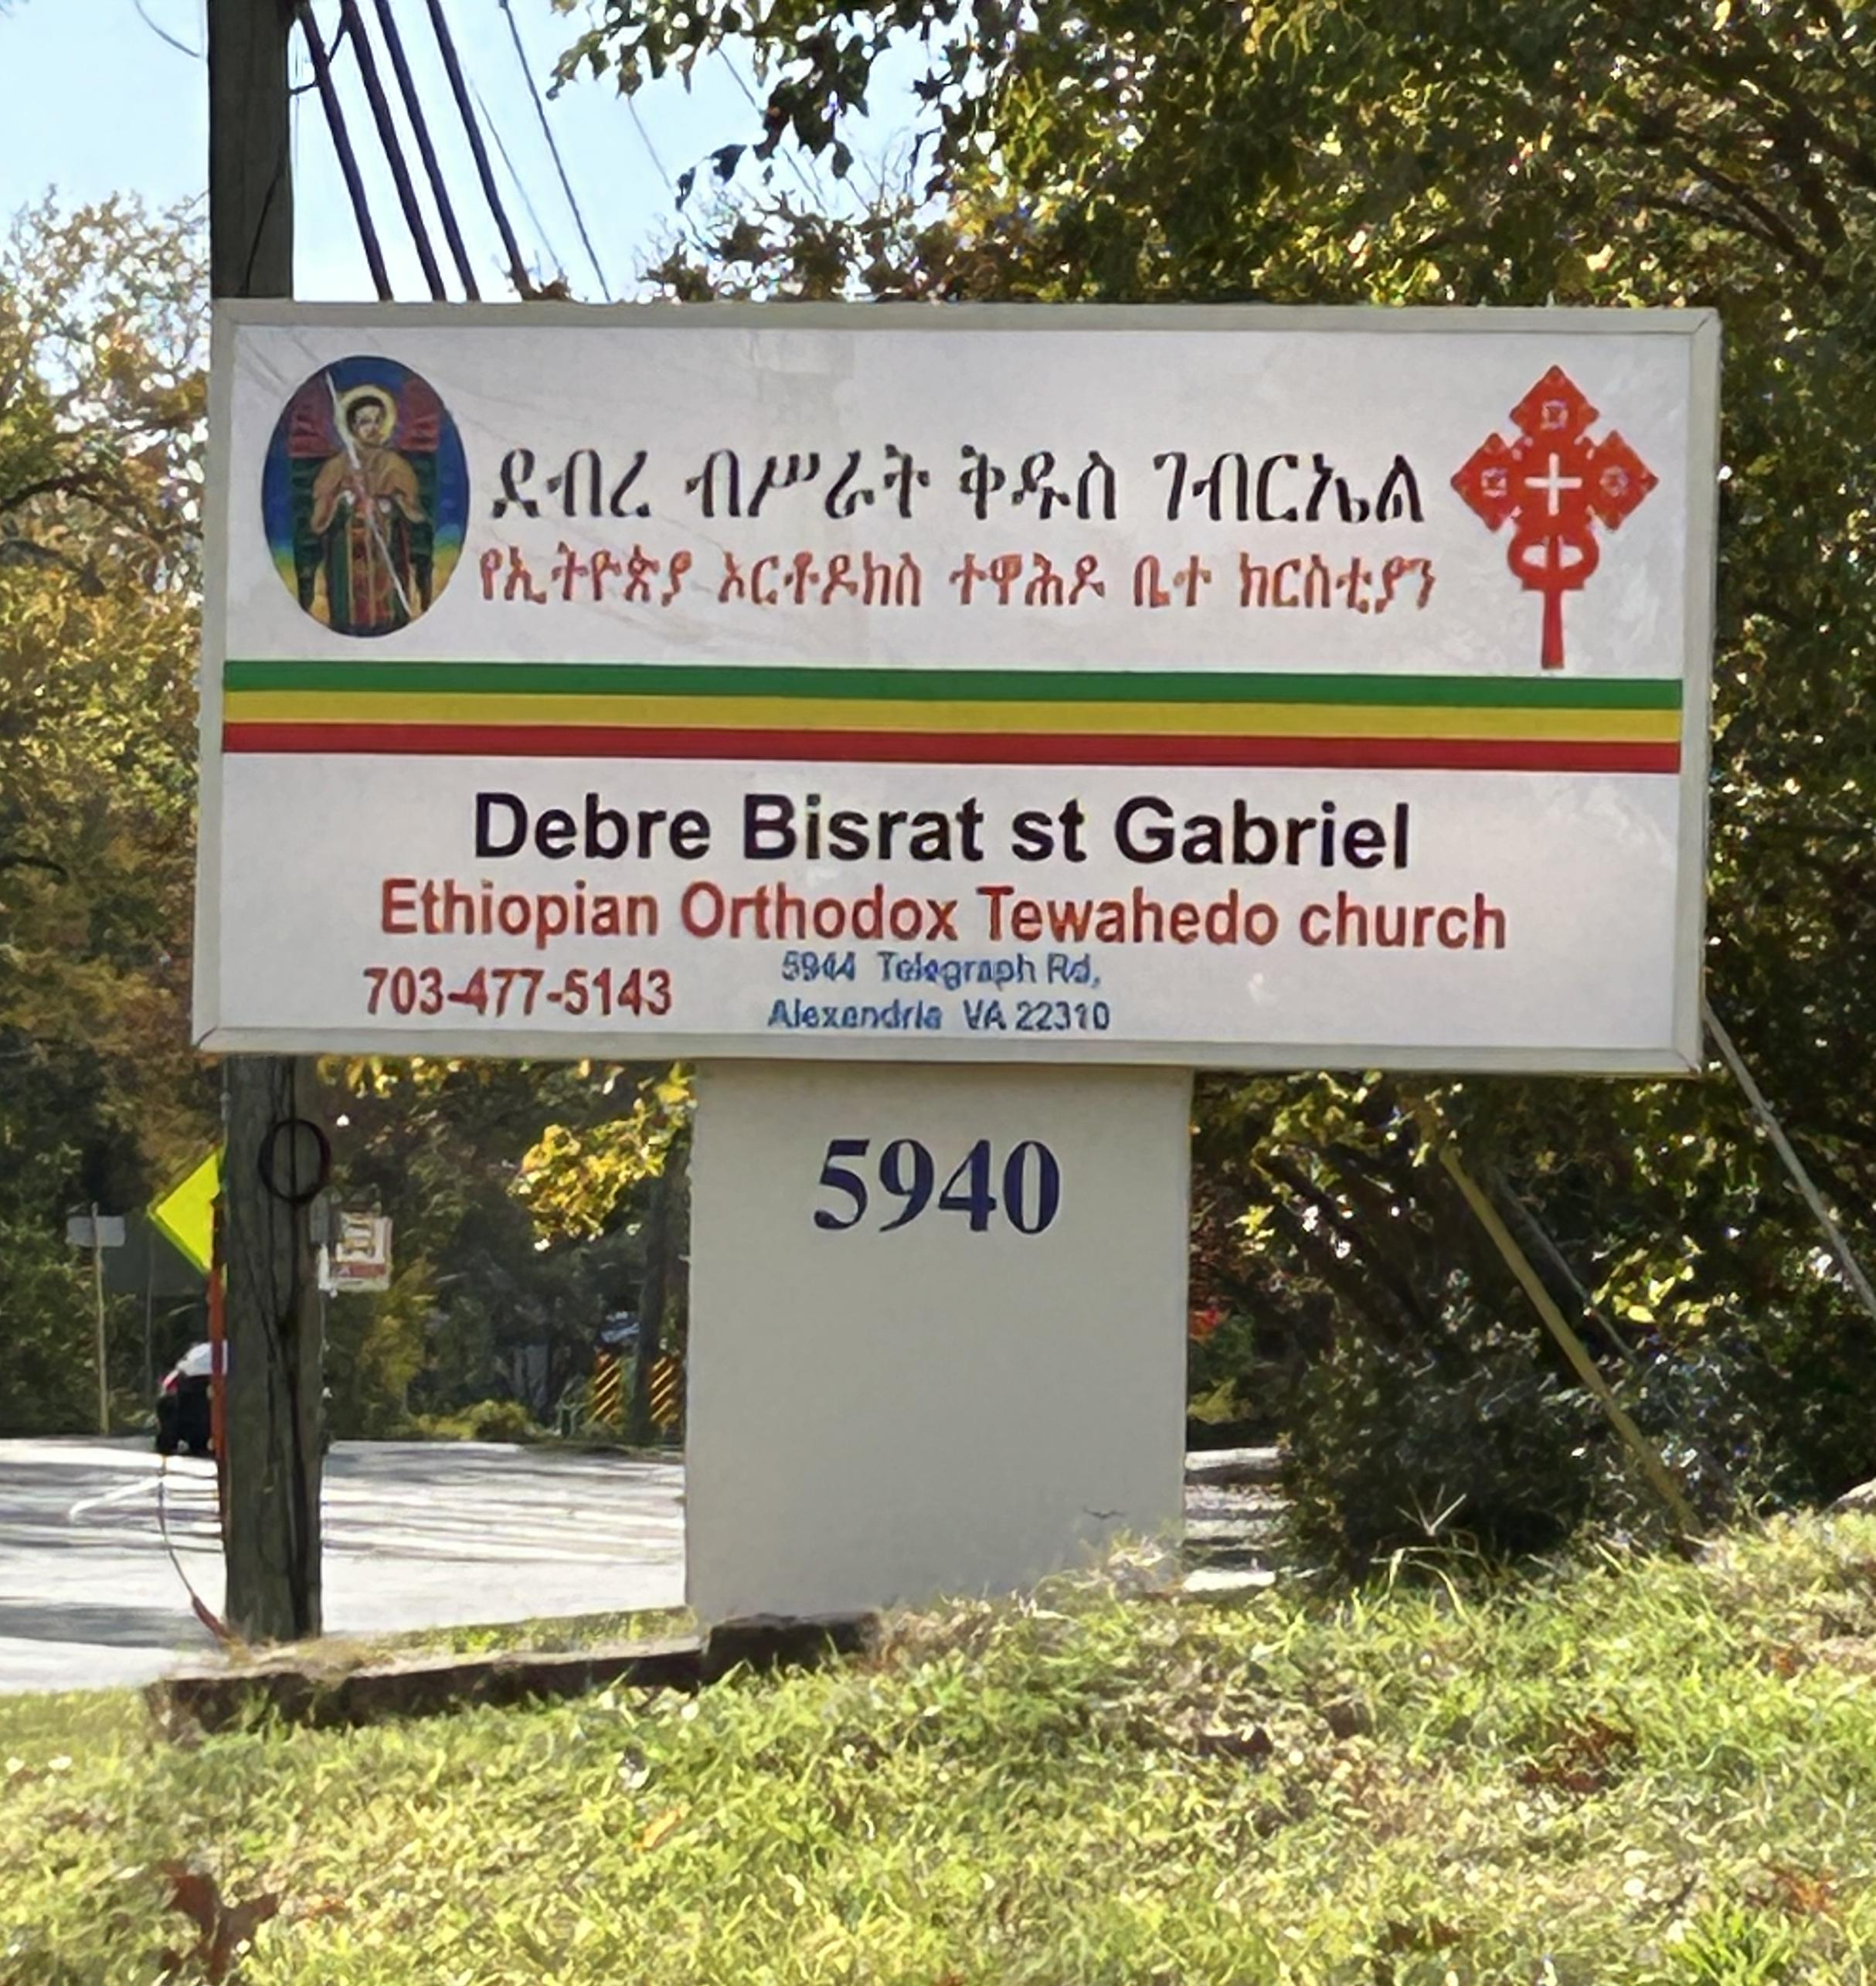
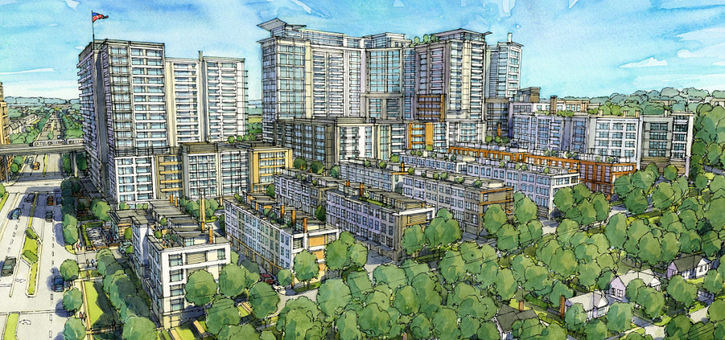
Church Sold on Telegraph Road
South Alex – North Kings Highway
(Aldi/PJs Coffee/BigPapi’s/K-Pot/Inspire Nail Bar/Inova Urgent Care)
Still Leasing Apartments
New Church on Telegraph Road
Huntington Club Condo Redevelopment
(Project paused indefinitely)
Huntington Avenue (Looking East from Telegraph Road)

Slide 22
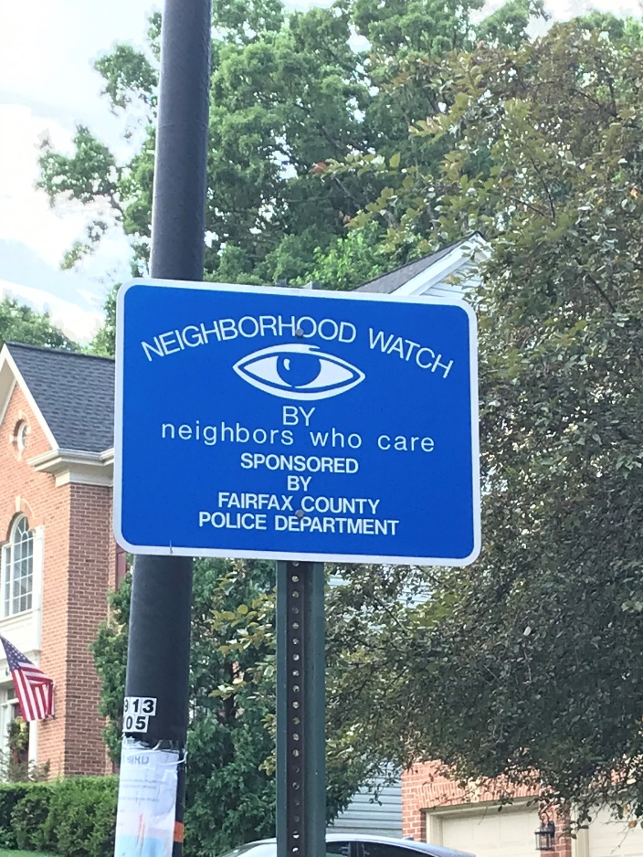
Neighborhood
Watch Program
BACKGROUND:
  Previous Owners Had it Posted
REQUEST:
  Looking for Participants to Develop
  and Implement the Program
HISTORY AND ACTIONS YOU CAN TAKE:
  Lock Doors (car, house, etc.)
  Offer your Time and Ideas to help Develop the Program
  Support the use of our Budget to Develop the Program
  Keep watch for strangers in our neighborhood and note personal characteristics and car model, color, license plate and time.
  Offer your security system footage to the police, if needed.

Slide 23
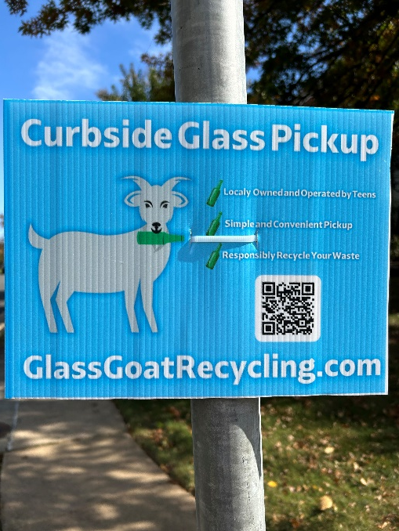
Community Reminder
Recycling – NO Glass in Blue Bins
Glass Goat Recycling
  Locally-Owned and Operated by Teens
  Simple & Convenient Pickup
  Free Bin Dropped Off w/in 24 hrs
  First Pickup $1.00
Addresses for Glass Recyclables:
  4251 Eisenhower Avenue, Alexandria
  2511 Parkers Lane, Mt. Vernon
  6121 Franconia Road, Franconia
  3224 Colvin Street, Alexandria
  Jones Point Park, Old Town Alexandria

Slide 24
Election of New Board Members
Start of 2022: Jeff Bobich, Carol Joyce, and Daniel Elder Stepped to fill vacancies.
Since Nobody Stepped Forward to Volunteer for the Board at the Start of 2023, Jeff Bobich served as President for a second year.
It is Time to Elect TWO New BoD Members for a 3-year Tenure.

Slide 25
Open Forum
Thank you!

Slide 26
Back-Up Materials

Slide 27
Resale Disclosure Package
To obtain a package:
Submit an application to Condocerts through condocerts.com
Condocerts will notify Sentry and send you the following documents
  FOHOA Common Interest Community Board Community Association Registration
  FOHOA Architectural Review Board Guidelines
  FOHOA Articles of Incorporation
  FOHOA By-Laws
  FOHOA Resolution Regarding Delinquent Assessments (1998)
  FOHOA Complaint Procedures (2012)
  FOHOA Cost Schedule for Providing Copies of Books and Records (2012)
  FOHOA Declaration of Covenants
  FOHOA Deed of Subdivision
  FOHOA 5 year Reserve Study (2012-2016) & Reserve Memo (2022)
  FOHOA Commercial Liability Umbrella Insurance Policy
  FOHOA Information Brochure
The fee for this service is around $300.

