Slide 1
Spelling Y3
Mastering spellings: building on the foundations of phonics
Spring 2
Week 1

Slide 2
Year 3 - Spring 2
Week 1 - Monday

Slide 3
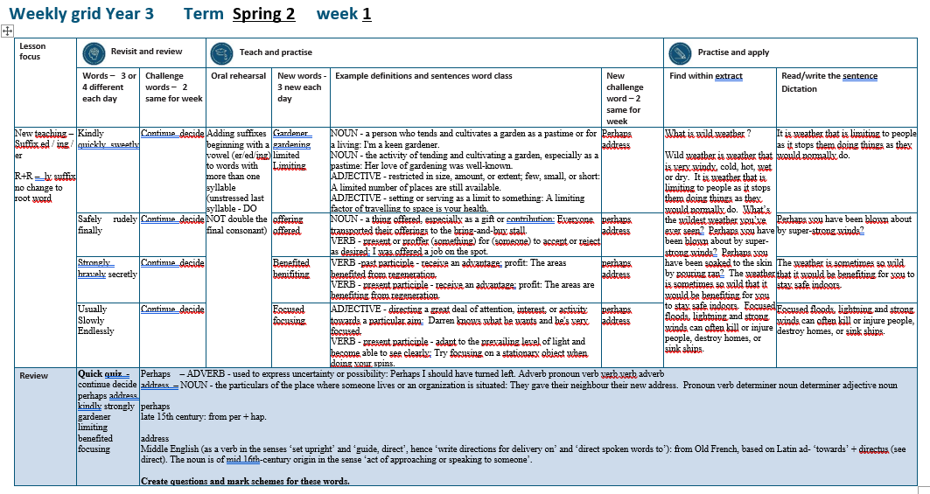

Slide 4
Let’s Revisit and Review…

Slide 5
Do you remember this challenge word?

Slide 6

VERB
continue
Definition -persist in an activity or process

Slide 7
He was unable to continue with his job.
________

Slide 8

VERB
decided
Definition - come or bring to a resolution in the mind as a result of consideration

Slide 9
She decided that she liked him.
_______

Slide 10
The suffix
-ly

Slide 11
-ly

Slide 12
-ly
The suffix –ly is added to an adjective to form an adverb. The rules already learnt still apply.
The suffix –ly starts with a consonant letter, so it is added straight on to most root words

Slide 13
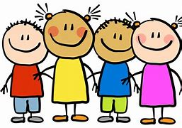
kindly

Slide 14
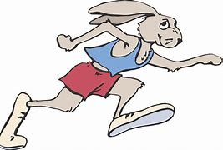
quickly

Slide 15
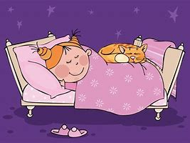
sweetly

Slide 16
Let’s Teach and Practise

Slide 17
Adding suffixes beginning with a vowel (er/ed/ing) to words with more than one syllable

Slide 18
Unstressed last syllable –
DO NOT double the final consonant

Slide 19
-er
-ed
-ing

Slide 20
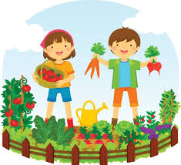
gardener

Slide 21
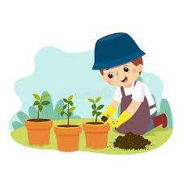
gardening

Slide 22

limited

Slide 23

limiting

Slide 24
gardener
garden + er = gardener
NOUN
Definition - a person who tends and cultivates a garden as a pastime or for a living

Slide 25
gardening
garden + ing = gardening
NOUN
Definition - the activity of tending and cultivating a garden, especially as a pastime

Slide 26
limited
limit +ed = limited
ADJECTIVE
Definition - restricted in size, amount, or extent; few, small, or short

Slide 27
limiting
limit +ing = limiting
ADJECTIVE
Definition - setting or serving as a limit to something

Slide 28
I'm a keen gardener.
________

Slide 29
Her love of gardening was well-known.
_________

Slide 30
A limited number of places are still available.
______

Slide 31
A limiting factor of travelling to space is your health.
________

Slide 32
New CHALLENGE words.

Slide 33
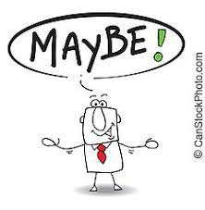
perhaps
ADVERB
Definition - used to express uncertainty or possibility

Slide 34
Perhaps I should have turned left.
_______

Slide 35

address
NOUN
Definition - the particulars of the place where someone lives or an organisation is situated

Slide 36
They gave their neighbour their new address.
_______

Slide 37
Let’s Practise and Apply.

Slide 38
Can you spot the spelling rule words and the challenge words?

Slide 39
What is wild weather ?
Wild weather is weather that is very windy, cold, hot, wet or dry. It is weather that is limiting to people as it stops them doing things as they would normally do. What’s the wildest weather you’ve ever seen? Perhaps you have been blown about by super-strong winds? Perhaps you have been soaked to the skin by pouring ran? The weather is sometimes so wild that it would be benefiting for you to stay safe indoors. Focused floods, lightning and strong winds can often kill or injure people, destroy homes, or sink ships.

Slide 40
What is wild weather ?
Wild weather is weather that is very windy, cold, hot, wet or dry. It is weather that is limiting to people as it stops them doing things as they would normally do. What’s the wildest weather you’ve ever seen? Perhaps you have been blown about by super-strong winds? Perhaps you have been soaked to the skin by pouring ran? The weather is sometimes so wild that it would be benefiting for you to stay safe indoors. Focused floods, lightning and strong winds can often kill or injure people, destroy homes, or sink ships.

Slide 41
Write this sentence as I dictate it to you.
Notes:
Weather is limiting to people.

Slide 42
Weather is limiting to people.
Did you write it correctly?
Edit your work and make sure you have it correct.
Can you underline the spelling word that we have covered in this session?

Slide 43
Year 3 - Spring 2
Week 1 - Tuesday
Notes:
Revisit and review the words from previous teaching and challenge words – I say, we say, you say
Ask children to write words only in their spelling book
Introduce the new spelling rule
Children to write the new spelling rule words and challenge words into books when the sentences are shown with the spelling word missing.
Read the extract with the class as choral reading. Practise model of prosody etc.
Ask children to find the spelling words from the session in the text.
Then read allowed the chosen sentence for children to write fully in their books.
Show the extract and ask children to then edit their work to check they were correct in their dictation.

Slide 45
Let’s Revisit and Review…

Slide 46
Do you remember this challenge word?

Slide 47
VERB
continue
Definition -persist in an activity or process

Slide 48
He was unable to continue with his job.
________

Slide 49
VERB
decided
Definition - come or bring to a resolution in the mind as a result of consideration

Slide 50
She decided that she liked him.
_______

Slide 51
The suffix
-ly

Slide 52
-ly

Slide 53
-ly
The suffix –ly is added to an adjective to form an adverb. The rules already learnt still apply.
The suffix –ly starts with a consonant letter, so it is added straight on to most root words

Slide 54

safely

Slide 55

rudely

Slide 56
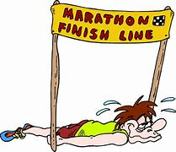
finally

Slide 57
Let’s Teach and Practise

Slide 58
Adding suffixes beginning with a vowel (er/ed/ing) to words with more than one syllable

Slide 59
Unstressed last syllable –
DO NOT double the final consonant

Slide 60
-er
-ed
-ing

Slide 61
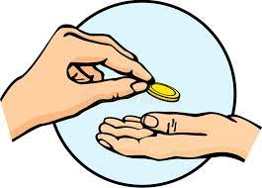
offering

Slide 62

offered

Slide 63
offering
offer + ing = offering
NOUN
Definition - a thing offered, especially as a gift or contribution

Slide 64
offered
offer + er = offered
VERB
Definition - present or proffer (something) for (someone) to accept or reject as desired

Slide 65
Everyone transported their offerings to the bring-and-buy stall.
_________

Slide 66
I was offered a job on the spot.
_______

Slide 67
New CHALLENGE words.

Slide 68
perhaps
ADVERB
Definition - used to express uncertainty or possibility

Slide 69
Perhaps I should have turned left.
_______

Slide 70
address
NOUN
Definition - the particulars of the place where someone lives or an organisation is situated

Slide 71
They gave their neighbour their new address.
_______

Slide 72
Let’s Practise and Apply.

Slide 73
Can you spot the spelling rule words and the challenge words?

Slide 74
What is wild weather ?
Wild weather is weather that is very windy, cold, hot, wet or dry. It is weather that is limiting to people as it stops them doing things as they would normally do. What’s the wildest weather you’ve ever seen? Perhaps you have been blown about by super-strong winds? Perhaps you have been soaked to the skin by pouring ran? The weather is sometimes so wild that it would be benefiting for you to stay safe indoors. Focused floods, lightning and strong winds can often kill or injure people, destroy homes, or sink ships.

Slide 75
What is wild weather ?
Wild weather is weather that is very windy, cold, hot, wet or dry. It is weather that is limiting to people as it stops them doing things as they would normally do. What’s the wildest weather you’ve ever seen? Perhaps you have been blown about by super-strong winds? Perhaps you have been soaked to the skin by pouring ran? The weather is sometimes so wild that it would be benefiting for you to stay safe indoors. Focused floods, lightning and strong winds can often kill or injure people, destroy homes, or sink ships.

Slide 76
Write this sentence as I dictate it to you.
Notes:
Perhaps you have been blown about by super-strong winds?

Slide 77
Perhaps you have been blown about by super-strong winds?
Did you write it correctly?
Edit your work and make sure you have it correct.
Can you underline the spelling word that we have covered in this session?

Slide 78
Year 3 - Spring 2
Week 1 - Wednesday
Notes:
Revisit and review the words from previous teaching and challenge words – I say, we say, you say
Ask children to write words only in their spelling book
Introduce the new spelling rule
Children to write the new spelling rule words and challenge words into books when the sentences are shown with the spelling word missing.
Read the extract with the class as choral reading. Practise model of prosody etc.
Ask children to find the spelling words from the session in the text.
Then read allowed the chosen sentence for children to write fully in their books.
Show the extract and ask children to then edit their work to check they were correct in their dictation.

Slide 80
Let’s Revisit and Review…

Slide 81
Do you remember this challenge word?

Slide 82
VERB
continue
Definition -persist in an activity or process

Slide 83
He was unable to continue with his job.
________

Slide 84
VERB
decided
Definition - come or bring to a resolution in the mind as a result of consideration

Slide 85
She decided that she liked him.
_______

Slide 86
The suffix
-ly

Slide 87
-ly

Slide 88
-ly
The suffix –ly is added to an adjective to form an adverb. The rules already learnt still apply.
The suffix –ly starts with a consonant letter, so it is added straight on to most root words

Slide 89

strongly

Slide 90
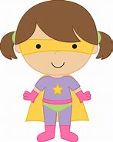
bravely

Slide 91

secretly

Slide 92
Let’s Teach and Practise

Slide 93
Adding suffixes beginning with a vowel (er/ed/ing) to words with more than one syllable

Slide 94
Unstressed last syllable –
DO NOT double the final consonant

Slide 95
-er
-ed
-ing

Slide 96

benefited

Slide 97
benefiting

Slide 98
benefited
benefit + ed = benefited
VERB past tense
Definition - receive an advantage; profit

Slide 99
benefiting
benefit + ing = benefiting
VERB present tense
Definition - receive an advantage; profit

Slide 100
The areas benefited from regeneration.
_________

Slide 101
The areas are benefiting from regeneration.
__________

Slide 102
New CHALLENGE words.

Slide 103
perhaps
ADVERB
Definition - used to express uncertainty or possibility

Slide 104
Perhaps I should have turned left.
_______

Slide 105
address
NOUN
Definition - the particulars of the place where someone lives or an organisation is situated

Slide 106
They gave their neighbour their new address.
_______

Slide 107
Let’s Practise and Apply.

Slide 108
Can you spot the spelling rule words and the challenge words?

Slide 109
What is wild weather ?
Wild weather is weather that is very windy, cold, hot, wet or dry. It is weather that is limiting to people as it stops them doing things as they would normally do. What’s the wildest weather you’ve ever seen? Perhaps you have been blown about by super-strong winds? Perhaps you have been soaked to the skin by pouring ran? The weather is sometimes so wild that it would be benefiting for you to stay safe indoors. Focused floods, lightning and strong winds can often kill or injure people, destroy homes, or sink ships.

Slide 110
What is wild weather ?
Wild weather is weather that is very windy, cold, hot, wet or dry. It is weather that is limiting to people as it stops them doing things as they would normally do. What’s the wildest weather you’ve ever seen? Perhaps you have been blown about by super-strong winds? Perhaps you have been soaked to the skin by pouring ran? The weather is sometimes so wild that it would be benefiting for you to stay safe indoors. Focused floods, lightning and strong winds can often kill or injure people, destroy homes, or sink ships.

Slide 111
Write this sentence as I dictate it to you.
Notes:
It would be benefiting for you to stay safe indoors.

Slide 112
It would be benefiting for you to stay safe indoors.
Did you write it correctly?
Edit your work and make sure you have it correct.
Can you underline the spelling word that we have covered in this session?

Slide 113
Year 3 - Spring 2
Week 1 - Thursday
Notes:
Revisit and review the words from previous teaching and challenge words – I say, we say, you say
Ask children to write words only in their spelling book
Introduce the new spelling rule
Children to write the new spelling rule words and challenge words into books when the sentences are shown with the spelling word missing.
Read the extract with the class as choral reading. Practise model of prosody etc.
Ask children to find the spelling words from the session in the text.
Then read allowed the chosen sentence for children to write fully in their books.
Show the extract and ask children to then edit their work to check they were correct in their dictation.

Slide 115
Let’s Revisit and Review…

Slide 116
Do you remember this challenge word?

Slide 117
VERB
continue
Definition -persist in an activity or process

Slide 118
He was unable to continue with his job.
________

Slide 119
VERB
decided
Definition - come or bring to a resolution in the mind as a result of consideration

Slide 120
She decided that she liked him.
_______

Slide 121
The suffix
-ly

Slide 122
-ly

Slide 123
-ly
The suffix –ly is added to an adjective to form an adverb. The rules already learnt still apply.
The suffix –ly starts with a consonant letter, so it is added straight on to most root words

Slide 124
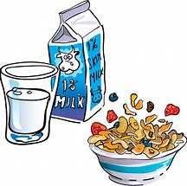
usually

Slide 125
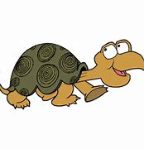
slowly

Slide 126

endlessly

Slide 127
Let’s Teach and Practise

Slide 128
Adding suffixes beginning with a vowel (er/ed/ing) to words with more than one syllable

Slide 129
Unstressed last syllable –
DO NOT double the final consonant

Slide 130
-er
-ed
-ing

Slide 131

focused

Slide 132
focusing

Slide 133
focused
focus + ed = focused
ADJECTIVE
Definition - directing a great deal of attention, interest, or activity towards a particular aim

Slide 134
focusing
focus + ing = focusing
VERB
Definition - adapt to the prevailing level of light and become able to see clearly

Slide 135
Darren knows what he wants and he's very focused.
_______

Slide 136
Try focusing on a stationary object when doing your spins.
________

Slide 137
New CHALLENGE words.

Slide 138
perhaps
ADVERB
Definition - used to express uncertainty or possibility

Slide 139
Perhaps I should have turned left.
_______

Slide 140
address
NOUN
Definition - the particulars of the place where someone lives or an organisation is situated

Slide 141
They gave their neighbour their new address.
_______

Slide 142
Let’s Practise and Apply.

Slide 143
Can you spot the spelling rule words and the challenge words?

Slide 144
What is wild weather ?
Wild weather is weather that is very windy, cold, hot, wet or dry. It is weather that is limiting to people as it stops them doing things as they would normally do. What’s the wildest weather you’ve ever seen? Perhaps you have been blown about by super-strong winds? Perhaps you have been soaked to the skin by pouring ran? The weather is sometimes so wild that it would be benefiting for you to stay safe indoors. Focused floods, lightning and strong winds can often kill or injure people, destroy homes, or sink ships.

Slide 145
What is wild weather ?
Wild weather is weather that is very windy, cold, hot, wet or dry. It is weather that is limiting to people as it stops them doing things as they would normally do. What’s the wildest weather you’ve ever seen? Perhaps you have been blown about by super-strong winds? Perhaps you have been soaked to the skin by pouring ran? The weather is sometimes so wild that it would be benefiting for you to stay safe indoors. Focused floods, lightning and strong winds can often kill or injure people, destroy homes, or sink ships.

Slide 146
Write this sentence as I dictate it to you.
Notes:
Weather is limiting to people.

Slide 147
Weather is limiting to people.
Did you write it correctly?
Edit your work and make sure you have it correct.
Can you underline the spelling word that we have covered in this session?

Slide 148
Year 3 - Spring 2
Week 1 - Friday
Notes:
Click through the slides for all the R+R words for the week (both the focus and the challenge words)
Click through the slides for all the new learning this week

Slide 150
Old challenge words…

Slide 151
continue

Slide 152
decided

Slide 153
Old spelling rule words…

Slide 154
kindly

Slide 155
quickly

Slide 156
sweetly

Slide 157
safely

Slide 158
rudely

Slide 159
finally

Slide 160
strongly

Slide 161
bravely

Slide 162
secretly

Slide 163
usually

Slide 164
slowly

Slide 165
endlessly

Slide 166
New spelling rule words…

Slide 167
gardener

Slide 168
gardening

Slide 169
limited

Slide 170
limiting

Slide 171
offering

Slide 172
offered

Slide 173
benefited

Slide 174
benefiting

Slide 175
focused

Slide 176
focusing

Slide 177
New challenge words…

Slide 178
perhaps

Slide 179
address

Slide 180
Quick Quiz time…
Notes:
Say these words for the quiz
continue decide perhaps address kindly strongly gardener limiting benefited focusing

Slide 181
Did you get them correct?
Edit your work.
continue decide perhaps address kindly strongly gardener limiting benefited focusing

Slide 182
Word class time…

Slide 183
Perhaps I should have turned left.
Adverb pronoun verb verb verb adverb
Notes:
Ask for these words to be classed

Slide 184
They gave their neighbour their new address.
Pronoun verb determiner noun determiner adjective noun
Notes:
Ask for these words to be classed

Slide 185
Etymology
The history of a word….

Slide 186
Perhaps
late 15th century: from per + hap.
Address
Middle English (as a verb in the senses ‘set upright’ and ‘guide, direct’, hence ‘write directions for delivery on’ and ‘direct spoken words to’): from Old French, based on Latin ad- ‘towards’ + directus (see direct). The noun is of mid 16th-century origin in the sense ‘act of approaching or speaking to someone’.

Slide 187
Let’s investigate….
Create questions and mark schemes for these words.

