Slide 1
Spelling Y3
Mastering spellings: building on the foundations of phonics
Spring 2
Week 2

Slide 2
Year 3 - Spring 2
Week 2 - Monday

Slide 3
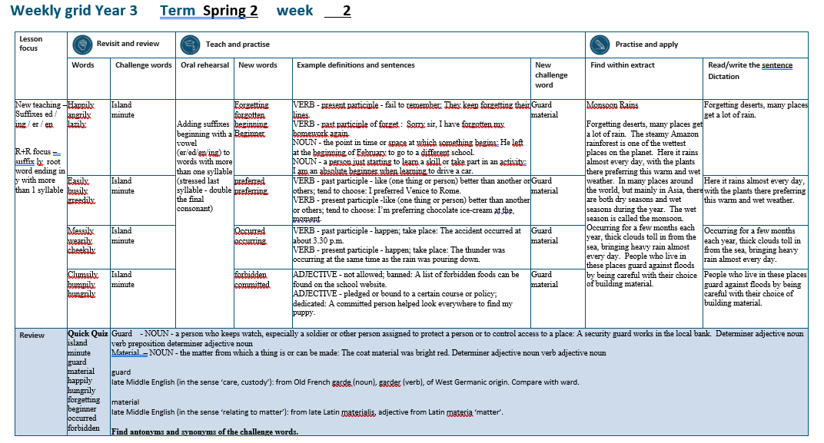

Slide 4
Let’s Revisit and Review…

Slide 5
Do you remember this challenge word?

Slide 6
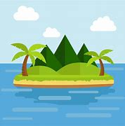
NOUN
island
Definition -a piece of land surrounded by water

Slide 7
The pirates landed on an island in search of treasure.
______

Slide 8

NOUN
minute
Definition - a period of time equal to sixty seconds or a sixtieth of an hour

Slide 9
The minute hand ticked by slowing during exam.
______

Slide 10
The suffix
-ly

Slide 11
-ly

Slide 12
-ly
Creating adverbs using the suffix –ly where the root word ends in ‘y’ with more than one syllable.
Rule – change the ‘y’ to and ‘i’ and add ‘ly’

Slide 13
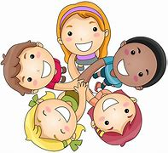
happily

Slide 14
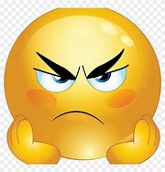
angrily

Slide 15
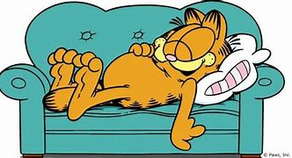
lazily

Slide 16
Let’s Teach and Practise

Slide 17
Adding suffixes beginning with a vowel (er/ed/en/ing) to words with more than one syllable

Slide 18
stressed last syllable – double the final consonant

Slide 19
-er
-ed
-ing
-en

Slide 20
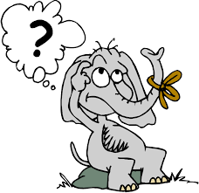
forgetting

Slide 21
forgotten

Slide 22
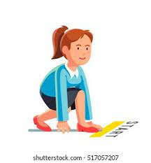
beginning

Slide 23
beginner

Slide 24
forgetting
forget + t + ing = forgetting
VERB
Definition - present participle - fail to remember

Slide 25
forgotten
forgot + t + en = forgotten
VERB
Definition - past participle - fail to remember

Slide 26
beginning
begin +n + ing = beginning
NOUN
Definition - the point in time or space at which something begins

Slide 27
beginner
begin +n +er = beginner
NOUN
Definition - a person just starting to learn a skill or take part in an activity

Slide 28
They keep forgetting their lines.
__________

Slide 29
Sorry sir, I have forgotten my homework again.
_________

Slide 30
He left at the beginning of February to go to a different school.
_________

Slide 31
I am an absolute beginner when learning to drive a car.
________

Slide 32
New CHALLENGE words.

Slide 33
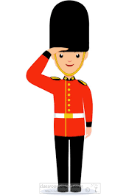
guard
NOUN
Definition - a person who keeps watch, especially a soldier or other person assigned to protect a person or to control access to a place

Slide 34
A security guard works in the local bank.
_____

Slide 35
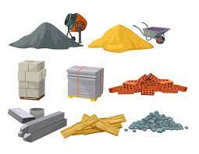
material
NOUN
Definition - the matter from which a thing is or can be made

Slide 36
The coat material was bright red.
________

Slide 37
Let’s Practise and Apply.

Slide 38
Can you spot the spelling rule words and the challenge words?

Slide 39
Monsoon Rains
Forgetting deserts, many places get a lot of rain. The steamy Amazon rainforest is one of the wettest places on the planet. Here it rains almost every day, with the plants there preferring this warm and wet weather. In many places around the world, but mainly in Asia, there are both dry seasons and wet seasons during the year. The wet season is called the monsoon. Occurring for a few months each year, thick clouds toll in from the sea, bringing heavy rain almost every day. People who live in these places guard against floods by being careful with their choice of building material.

Slide 40
Monsoon Rains
Forgetting deserts, many places get a lot of rain. The steamy Amazon rainforest is one of the wettest places on the planet. Here it rains almost every day, with the plants there preferring this warm and wet weather. In many places around the world, but mainly in Asia, there are both dry seasons and wet seasons during the year. The wet season is called the monsoon. Occurring for a few months each year, thick clouds toll in from the sea, bringing heavy rain almost every day. People who live in these places guard against floods by being careful with their choice of building material.

Slide 41
Write this sentence as I dictate it to you.
Notes:
Forgetting deserts, many places get a lot of rain.

Slide 42
Forgetting deserts, many places get a lot of rain.
Did you write it correctly?
Edit your work and make sure you have it correct.
Can you underline the spelling word that we have covered in this session?

Slide 43
Year 3 - Spring 2
Week 2 - Tuesday
Notes:
Revisit and review the words from previous teaching and challenge words – I say, we say, you say
Ask children to write words only in their spelling book
Introduce the new spelling rule
Children to write the new spelling rule words and challenge words into books when the sentences are shown with the spelling word missing.
Read the extract with the class as choral reading. Practise model of prosody etc.
Ask children to find the spelling words from the session in the text.
Then read allowed the chosen sentence for children to write fully in their books.
Show the extract and ask children to then edit their work to check they were correct in their dictation.

Slide 45
Let’s Revisit and Review…

Slide 46
Do you remember this challenge word?

Slide 47
NOUN
island
Definition -a piece of land surrounded by water

Slide 48
The pirates landed on an island in search of treasure.
______

Slide 49
NOUN
minute
Definition - a period of time equal to sixty seconds or a sixtieth of an hour

Slide 50
The minute hand ticked by slowing during exam.
______

Slide 51
The suffix
-ly

Slide 52
-ly

Slide 53
-ly
Creating adverbs using the suffix –ly where the root word ends in ‘y’ with more than one syllable.
Rule – change the ‘y’ to and ‘i’ and add ‘ly’

Slide 54
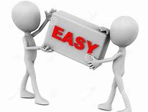
easily

Slide 55

busily

Slide 56
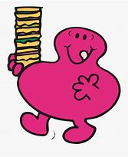
greedily

Slide 57
Let’s Teach and Practise

Slide 58
Adding suffixes beginning with a vowel (er/ed/en/ing) to words with more than one syllable

Slide 59
stressed last syllable – double the final consonant

Slide 60
-er
-ed
-ing
-en

Slide 61

preferred

Slide 62
preferring

Slide 63
preferred
prefer + r + ed = preferred
VERB
Definition - past participle - like (one thing or person) better than another or others; tend to choose

Slide 64
preferred
prefer + r + ing = preferring
VERB
Definition - present participle -like (one thing or person) better than another or others; tend to choose

Slide 65
I preferred Venice to Rome.
_________

Slide 66
I’m preferring chocolate ice-cream at the moment.
__________

Slide 67
New CHALLENGE words.

Slide 68
guard
NOUN
Definition - a person who keeps watch, especially a soldier or other person assigned to protect a person or to control access to a place

Slide 69
A security guard works in the local bank.
_____

Slide 70
material
NOUN
Definition - the matter from which a thing is or can be made

Slide 71
The coat material was bright red.
________

Slide 72
Let’s Practise and Apply.

Slide 73
Can you spot the spelling rule words and the challenge words?

Slide 74
Monsoon Rains
Forgetting deserts, many places get a lot of rain. The steamy Amazon rainforest is one of the wettest places on the planet. Here it rains almost every day, with the plants there preferring this warm and wet weather. In many places around the world, but mainly in Asia, there are both dry seasons and wet seasons during the year. The wet season is called the monsoon. Occurring for a few months each year, thick clouds toll in from the sea, bringing heavy rain almost every day. People who live in these places guard against floods by being careful with their choice of building material.

Slide 75
Monsoon Rains
Forgetting deserts, many places get a lot of rain. The steamy Amazon rainforest is one of the wettest places on the planet. Here it rains almost every day, with the plants there preferring this warm and wet weather. In many places around the world, but mainly in Asia, there are both dry seasons and wet seasons during the year. The wet season is called the monsoon. Occurring for a few months each year, thick clouds toll in from the sea, bringing heavy rain almost every day. People who live in these places guard against floods by being careful with their choice of building material.

Slide 76
Write this sentence as I dictate it to you.
Notes:
The plants there are preferring this warm and wet weather.

Slide 77
The plants there are preferring this warm and wet weather.
Did you write it correctly?
Edit your work and make sure you have it correct.
Can you underline the spelling word that we have covered in this session?

Slide 78
Year 3 - Spring 2
Week 2 - Wednesday
Notes:
Revisit and review the words from previous teaching and challenge words – I say, we say, you say
Ask children to write words only in their spelling book
Introduce the new spelling rule
Children to write the new spelling rule words and challenge words into books when the sentences are shown with the spelling word missing.
Read the extract with the class as choral reading. Practise model of prosody etc.
Ask children to find the spelling words from the session in the text.
Then read allowed the chosen sentence for children to write fully in their books.
Show the extract and ask children to then edit their work to check they were correct in their dictation.

Slide 80
Let’s Revisit and Review…

Slide 81
Do you remember this challenge word?

Slide 82
NOUN
island
Definition -a piece of land surrounded by water

Slide 83
The pirates landed on an island in search of treasure.
______

Slide 84
NOUN
minute
Definition - a period of time equal to sixty seconds or a sixtieth of an hour

Slide 85
The minute hand ticked by slowing during exam.
______

Slide 86
The suffix
-ly

Slide 87
-ly

Slide 88
-ly
Creating adverbs using the suffix –ly where the root word ends in ‘y’ with more than one syllable.
Rule – change the ‘y’ to and ‘i’ and add ‘ly’

Slide 89
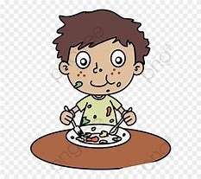
messily

Slide 90
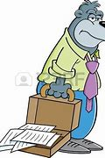
wearily

Slide 91

cheekily

Slide 92
Let’s Teach and Practise

Slide 93
Adding suffixes beginning with a vowel (er/ed/en/ing) to words with more than one syllable

Slide 94
stressed last syllable – double the final consonant

Slide 95
-er
-ed
-ing
-en

Slide 96

occurred

Slide 97
occurring

Slide 98
occurred
occur + r + ed = occurred
VERB
Definition - past participle - happen; take place

Slide 99
occurring
occur + r + ing = occurring
VERB
Definition - present participle - happen; take place

Slide 100
The accident occurred at about 3.30 p.m.
________

Slide 101
The thunder was occurring at the same time as the rain was pouring down.
_________

Slide 102
New CHALLENGE words.

Slide 103
guard
NOUN
Definition - a person who keeps watch, especially a soldier or other person assigned to protect a person or to control access to a place

Slide 104
A security guard works in the local bank.
_____

Slide 105
material
NOUN
Definition - the matter from which a thing is or can be made

Slide 106
The coat material was bright red.
________

Slide 107
Let’s Practise and Apply.

Slide 108
Can you spot the spelling rule words and the challenge words?

Slide 109
Monsoon Rains
Forgetting deserts, many places get a lot of rain. The steamy Amazon rainforest is one of the wettest places on the planet. Here it rains almost every day, with the plants there preferring this warm and wet weather. In many places around the world, but mainly in Asia, there are both dry seasons and wet seasons during the year. The wet season is called the monsoon. Occurring for a few months each year, thick clouds toll in from the sea, bringing heavy rain almost every day. People who live in these places guard against floods by being careful with their choice of building material.

Slide 110
Monsoon Rains
Forgetting deserts, many places get a lot of rain. The steamy Amazon rainforest is one of the wettest places on the planet. Here it rains almost every day, with the plants there preferring this warm and wet weather. In many places around the world, but mainly in Asia, there are both dry seasons and wet seasons during the year. The wet season is called the monsoon. Occurring for a few months each year, thick clouds toll in from the sea, bringing heavy rain almost every day. People who live in these places guard against floods by being careful with their choice of building material.

Slide 111
Write this sentence as I dictate it to you.
Notes:
Occurring for a few months each year, thick clouds start to form.

Slide 112
Occurring for a few months each year, thick clouds start to form.
Did you write it correctly?
Edit your work and make sure you have it correct.
Can you underline the spelling word that we have covered in this session?

Slide 113
Year 3 - Spring 2
Week 2 - Thursday
Notes:
Revisit and review the words from previous teaching and challenge words – I say, we say, you say
Ask children to write words only in their spelling book
Introduce the new spelling rule
Children to write the new spelling rule words and challenge words into books when the sentences are shown with the spelling word missing.
Read the extract with the class as choral reading. Practise model of prosody etc.
Ask children to find the spelling words from the session in the text.
Then read allowed the chosen sentence for children to write fully in their books.
Show the extract and ask children to then edit their work to check they were correct in their dictation.

Slide 115
Let’s Revisit and Review…

Slide 116
Do you remember this challenge word?

Slide 117
NOUN
island
Definition -a piece of land surrounded by water

Slide 118
The pirates landed on an island in search of treasure.
______

Slide 119
NOUN
minute
Definition - a period of time equal to sixty seconds or a sixtieth of an hour

Slide 120
The minute hand ticked by slowing during exam.
______

Slide 121
The suffix
-ly

Slide 122
-ly

Slide 123
-ly
Creating adverbs using the suffix –ly where the root word ends in ‘y’ with more than one syllable.
Rule – change the ‘y’ to and ‘i’ and add ‘ly’

Slide 124
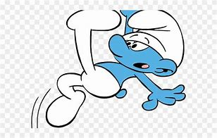
clumsily

Slide 125
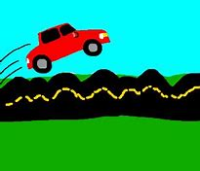
bumpily

Slide 126
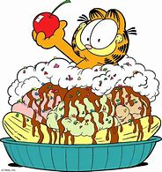
hungrily

Slide 127
Let’s Teach and Practise

Slide 128
Adding suffixes beginning with a vowel (er/ed/en/ing) to words with more than one syllable

Slide 129
stressed last syllable – double the final consonant

Slide 130
-er
-ed
-ing
-en

Slide 131

forbidden

Slide 132

committed

Slide 133
forbidden
forbid + d +en = forbidden
ADJECTIVE
Definition - not allowed; banned

Slide 134
committed
commit + t + ed = committed
ADJECTIVE
Definition - pledged or bound to a certain course or policy

Slide 135
A list of forbidden foods can be found on the school website.
_________

Slide 136
A committed person helped look everywhere to find my puppy.
_________

Slide 137
New CHALLENGE words.

Slide 138
guard
NOUN
Definition - a person who keeps watch, especially a soldier or other person assigned to protect a person or to control access to a place

Slide 139
A security guard works in the local bank.
_____

Slide 140
material
NOUN
Definition - the matter from which a thing is or can be made

Slide 141
The coat material was bright red.
________

Slide 142
Let’s Practise and Apply.

Slide 143
Can you spot the spelling rule words and the challenge words?

Slide 144
Monsoon Rains
Forgetting deserts, many places get a lot of rain. The steamy Amazon rainforest is one of the wettest places on the planet. Here it rains almost every day, with the plants there preferring this warm and wet weather. In many places around the world, but mainly in Asia, there are both dry seasons and wet seasons during the year. The wet season is called the monsoon. Occurring for a few months each year, thick clouds toll in from the sea, bringing heavy rain almost every day. People who live in these places guard against floods by being careful with their choice of building material.

Slide 145
Monsoon Rains
Forgetting deserts, many places get a lot of rain. The steamy Amazon rainforest is one of the wettest places on the planet. Here it rains almost every day, with the plants there preferring this warm and wet weather. In many places around the world, but mainly in Asia, there are both dry seasons and wet seasons during the year. The wet season is called the monsoon. Occurring for a few months each year, thick clouds toll in from the sea, bringing heavy rain almost every day. People who live in these places guard against floods by being careful with their choice of building material.

Slide 146
Write this sentence as I dictate it to you.
Notes:
People who live in these places guard against floods.

Slide 147
People who live in these places guard against floods.
Did you write it correctly?
Edit your work and make sure you have it correct.
Can you underline the spelling word that we have covered in this session?

Slide 148
Year 3 - Spring 2
Week 2 - Friday
Notes:
Click through the slides for all the R+R words for the week (both the focus and the challenge words)
Click through the slides for all the new learning this week

Slide 150
Old challenge words…

Slide 151
island

Slide 152
minute

Slide 153
Old spelling rule words…

Slide 154
happily

Slide 155
angrily

Slide 156
lazily

Slide 157
easily

Slide 158
busily

Slide 159
greedily

Slide 160
messily

Slide 161
wearily

Slide 162
cheekily

Slide 163
clumsily

Slide 164
bumpily

Slide 165
hungrily

Slide 166
New spelling rule words…

Slide 167
forgetting

Slide 168
forgotten

Slide 169
beginning

Slide 170
beginner

Slide 171
preferred

Slide 172
preferring

Slide 173
occurred

Slide 174
occurring

Slide 175
forbidden

Slide 176
committed

Slide 177
New challenge words…

Slide 178
guard

Slide 179
material

Slide 180
Quick Quiz time…
Notes:
Say these words for the quiz
island minute guard material happily hungrily forgetting beginner occurred forbidden

Slide 181
Did you get them correct?
Edit your work.
island minute guard material happily hungrily forgetting beginner occurred forbidden

Slide 182
Word class time…

Slide 183
A security guard works in the local bank.
Determiner adjective noun verb preposition determiner adjective noun
Notes:
Ask for these words to be classed

Slide 184
The coat material was bright red.
Determiner adjective noun verb adjective noun
Notes:
Ask for these words to be classed

Slide 185
Etymology
The history of a word….

Slide 186
Guard
late Middle English (in the sense ‘care, custody’): from Old French garde (noun), garder (verb), of West Germanic origin. Compare with ward.
Material
late Middle English (in the sense ‘relating to matter’): from late Latin materialis, adjective from Latin materia ‘matter’.

Slide 187
Let’s investigate….
Find antonyms and synonyms of the challenge words.

