Slide 1
Spelling Y3
Mastering spellings: building on the foundations of phonics
Spring 2
Week 3

Slide 2
Year 3 - Spring 2
Week 3 - Monday

Slide 3
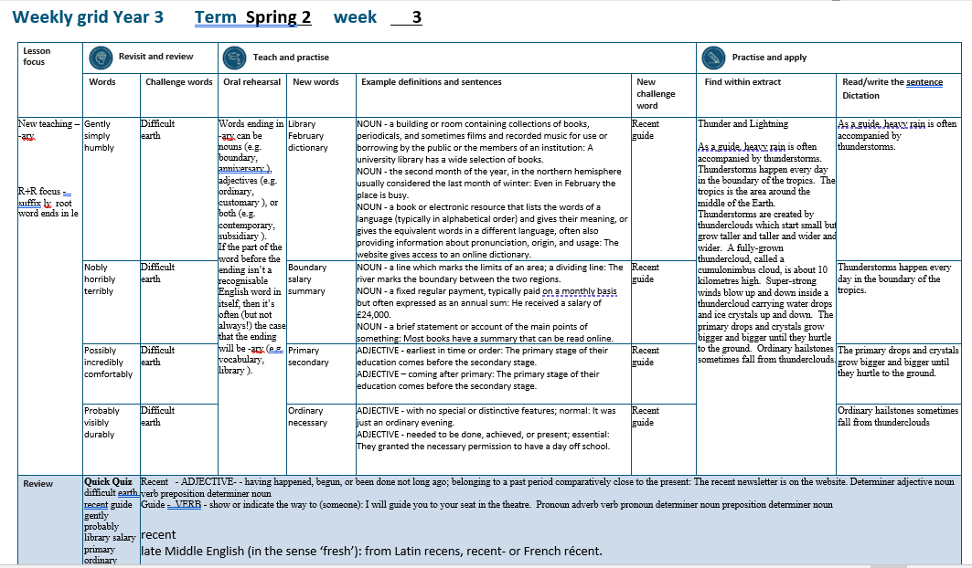

Slide 4
Let’s Revisit and Review…

Slide 5
Do you remember this challenge word?

Slide 6

ADJECTIVE
difficult
Definition -needing much effort or skill to accomplish, deal with, or understand

Slide 7
It is difficult to make decisions.
_________

Slide 8

NOUN
Earth
Definition - the planet on which we live; the world

Slide 9
The earth is the third planet from the sun.
_____

Slide 10
The suffix
-ly

Slide 11
-ly

Slide 12
-ly
Creating adverbs using the suffix –ly where the root word ends in ‘le’.
Rule – take off the ‘le’ and add ‘ly’

Slide 13
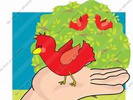
gently

Slide 14

simply

Slide 15
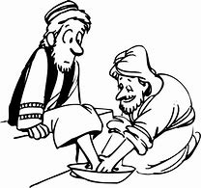
humbly

Slide 16
Let’s Teach and Practise

Slide 17
Words ending in -ary can be nouns, adjectives or both.

Slide 18
If the part of the word before the ending isn’t a recognisable English word in itself, then it’s often the case that the ending will be -ary

Slide 19
-ary

Slide 20
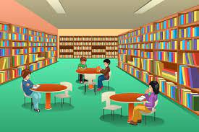
library

Slide 21

February

Slide 22
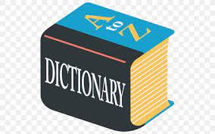
dictionary

Slide 23
library
NOUN
Definition - a building or room containing collections of books, periodicals, and sometimes films and recorded music for use or borrowing by the public or the members of an institution

Slide 24
February
NOUN
Definition - the second month of the year, in the northern hemisphere usually considered the last month of winter

Slide 25
dictionary
NOUN
Definition - a book or electronic resource that lists the words of a language (typically in alphabetical order) and gives their meaning, or gives the equivalent words in a different language, often also providing information about pronunciation, origin, and usage

Slide 26
A university library has a wide selection of books.
_______

Slide 27
Even in February the place is busy.
________

Slide 28
The website gives access to an online dictionary.
__________

Slide 29
New CHALLENGE words.

Slide 30

recent
ADJECTIVE
Definition - having happened, begun, or been done not long ago; belonging to a past period comparatively close to the present

Slide 31
The recent newsletter is on the website.
______

Slide 32
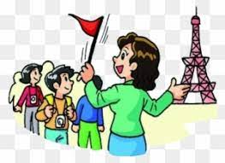
guide
VERB
Definition - show or indicate the way to someone

Slide 33
I will guide you to your seat in the theatre.
_____

Slide 34
Let’s Practise and Apply.

Slide 35
Can you spot the spelling rule words and the challenge words?

Slide 36
Thunder and Lightning
As a guide, heavy rain is often accompanied by thunderstorms. Thunderstorms happen every day in the boundary of the tropics. The tropics is the area around the middle of the Earth. Thunderstorms are created by thunderclouds which start small but grow taller and taller and wider and wider. A fully-grown thundercloud, called a cumulonimbus cloud, is about 10 kilometres high. Super-strong winds blow up and down inside a thundercloud carrying water drops and ice crystals up and down. The primary drops and crystals grow bigger and bigger until they hurtle to the ground. Ordinary hailstones sometimes fall from thunderclouds.

Slide 37
Thunder and Lightning
As a guide, heavy rain is often accompanied by thunderstorms. Thunderstorms happen every day in the boundary of the tropics. The tropics is the area around the middle of the Earth. Thunderstorms are created by thunderclouds which start small but grow taller and taller and wider and wider. A fully-grown thundercloud, called a cumulonimbus cloud, is about 10 kilometres high. Super-strong winds blow up and down inside a thundercloud carrying water drops and ice crystals up and down. The primary drops and crystals grow bigger and bigger until they hurtle to the ground. Ordinary hailstones sometimes fall from thunderclouds.

Slide 38
Write this sentence as I dictate it to you.
Notes:
As a guide, heavy rain is often accompanied by thunderstorms.

Slide 39
As a guide, heavy rain is often accompanied by thunderstorms.
Did you write it correctly?
Edit your work and make sure you have it correct.
Can you underline the spelling word that we have covered in this session?

Slide 40
Year 3 - Spring 2
Week 3 - Tuesday
Notes:
Revisit and review the words from previous teaching and challenge words – I say, we say, you say
Ask children to write words only in their spelling book
Introduce the new spelling rule
Children to write the new spelling rule words and challenge words into books when the sentences are shown with the spelling word missing.
Read the extract with the class as choral reading. Practise model of prosody etc.
Ask children to find the spelling words from the session in the text.
Then read allowed the chosen sentence for children to write fully in their books.
Show the extract and ask children to then edit their work to check they were correct in their dictation.

Slide 42
Let’s Revisit and Review…

Slide 43
Do you remember this challenge word?

Slide 44
ADJECTIVE
difficult
Definition -needing much effort or skill to accomplish, deal with, or understand

Slide 45
It is difficult to make decisions.
_________

Slide 46
NOUN
Earth
Definition - the planet on which we live; the world

Slide 47
The earth is the third planet from the sun.
_____

Slide 48
The suffix
-ly

Slide 49
-ly

Slide 50
-ly
Creating adverbs using the suffix –ly where the root word ends in ‘le’.
Rule – take off the ‘le’ and add ‘ly’

Slide 51
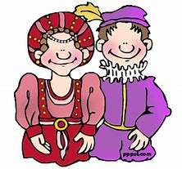
nobly

Slide 52
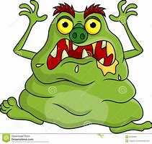
horribly

Slide 53

terribly

Slide 54
Let’s Teach and Practise

Slide 55
Words ending in -ary can be nouns, adjectives or both.

Slide 56
If the part of the word before the ending isn’t a recognisable English word in itself, then it’s often the case that the ending will be -ary

Slide 57
-ary

Slide 58
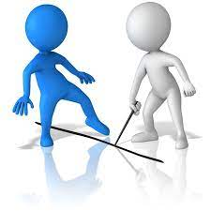
boundary

Slide 59
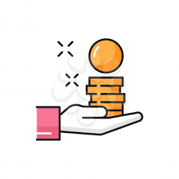
salary

Slide 60
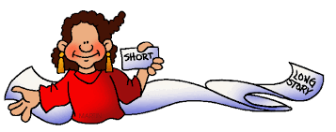
summary

Slide 61
boundary
NOUN
Definition - a line which marks the limits of an area; a dividing line

Slide 62
salary
NOUN
Definition - a fixed regular payment, typically paid on a monthly basis but often expressed as an annual sum

Slide 63
summary
NOUN
Definition - a brief statement or account of the main points of something

Slide 64
The river marks the boundary between the two regions.
_________

Slide 65
He received a salary of £24,000.
______

Slide 66
Most books have a summary that can be read online.
_______

Slide 67
New CHALLENGE words.

Slide 68
recent
ADJECTIVE
Definition - having happened, begun, or been done not long ago; belonging to a past period comparatively close to the present

Slide 69
The recent newsletter is on the website.
______

Slide 70
guide
VERB
Definition - show or indicate the way to someone

Slide 71
I will guide you to your seat in the theatre.
_____

Slide 72
Let’s Practise and Apply.

Slide 73
Can you spot the spelling rule words and the challenge words?

Slide 74
Thunder and Lightning
As a guide, heavy rain is often accompanied by thunderstorms. Thunderstorms happen every day in the boundary of the tropics. The tropics is the area around the middle of the Earth. Thunderstorms are created by thunderclouds which start small but grow taller and taller and wider and wider. A fully-grown thundercloud, called a cumulonimbus cloud, is about 10 kilometres high. Super-strong winds blow up and down inside a thundercloud carrying water drops and ice crystals up and down. The primary drops and crystals grow bigger and bigger until they hurtle to the ground. Ordinary hailstones sometimes fall from thunderclouds.

Slide 75
Thunder and Lightning
As a guide, heavy rain is often accompanied by thunderstorms. Thunderstorms happen every day in the boundary of the tropics. The tropics is the area around the middle of the Earth. Thunderstorms are created by thunderclouds which start small but grow taller and taller and wider and wider. A fully-grown thundercloud, called a cumulonimbus cloud, is about 10 kilometres high. Super-strong winds blow up and down inside a thundercloud carrying water drops and ice crystals up and down. The primary drops and crystals grow bigger and bigger until they hurtle to the ground. Ordinary hailstones sometimes fall from thunderclouds.

Slide 76
Write this sentence as I dictate it to you.
Notes:
Thunderstorms happen every day in the boundary of the tropics.

Slide 77
Thunderstorms happen every day in the boundary of the tropics.
Did you write it correctly?
Edit your work and make sure you have it correct.
Can you underline the spelling word that we have covered in this session?

Slide 78
Year 3 - Spring 2
Week 3 - Wednesday
Notes:
Revisit and review the words from previous teaching and challenge words – I say, we say, you say
Ask children to write words only in their spelling book
Introduce the new spelling rule
Children to write the new spelling rule words and challenge words into books when the sentences are shown with the spelling word missing.
Read the extract with the class as choral reading. Practise model of prosody etc.
Ask children to find the spelling words from the session in the text.
Then read allowed the chosen sentence for children to write fully in their books.
Show the extract and ask children to then edit their work to check they were correct in their dictation.

Slide 80
Let’s Revisit and Review…

Slide 81
Do you remember this challenge word?

Slide 82
ADJECTIVE
difficult
Definition -needing much effort or skill to accomplish, deal with, or understand

Slide 83
It is difficult to make decisions.
_________

Slide 84
NOUN
Earth
Definition - the planet on which we live; the world

Slide 85
The earth is the third planet from the sun.
_____

Slide 86
The suffix
-ly

Slide 87
-ly

Slide 88
-ly
Creating adverbs using the suffix –ly where the root word ends in ‘le’.
Rule – take off the ‘le’ and add ‘ly’

Slide 89
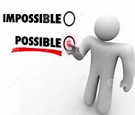
possibly

Slide 90

incredibly

Slide 91
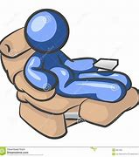
comfortably

Slide 92
Let’s Teach and Practise

Slide 93
Words ending in -ary can be nouns, adjectives or both.

Slide 94
If the part of the word before the ending isn’t a recognisable English word in itself, then it’s often the case that the ending will be -ary

Slide 95
-ary

Slide 96

primary

Slide 97

secondary

Slide 98
primary
ADJECTIVE
Definition - earliest in time or order

Slide 99
secondary
ADJECTIVE
Definition - coming after primary

Slide 100
The primary stage of their education comes before the secondary stage.
_______

Slide 101
The primary stage of their education comes before the secondary stage.
_________

Slide 102
New CHALLENGE words.

Slide 103
recent
ADJECTIVE
Definition - having happened, begun, or been done not long ago; belonging to a past period comparatively close to the present

Slide 104
The recent newsletter is on the website.
______

Slide 105
guide
VERB
Definition - show or indicate the way to someone

Slide 106
I will guide you to your seat in the theatre.
_____

Slide 107
Let’s Practise and Apply.

Slide 108
Can you spot the spelling rule words and the challenge words?

Slide 109
Thunder and Lightning
As a guide, heavy rain is often accompanied by thunderstorms. Thunderstorms happen every day in the boundary of the tropics. The tropics is the area around the middle of the Earth. Thunderstorms are created by thunderclouds which start small but grow taller and taller and wider and wider. A fully-grown thundercloud, called a cumulonimbus cloud, is about 10 kilometres high. Super-strong winds blow up and down inside a thundercloud carrying water drops and ice crystals up and down. The primary drops and crystals grow bigger and bigger until they hurtle to the ground. Ordinary hailstones sometimes fall from thunderclouds.

Slide 110
Thunder and Lightning
As a guide, heavy rain is often accompanied by thunderstorms. Thunderstorms happen every day in the boundary of the tropics. The tropics is the area around the middle of the Earth. Thunderstorms are created by thunderclouds which start small but grow taller and taller and wider and wider. A fully-grown thundercloud, called a cumulonimbus cloud, is about 10 kilometres high. Super-strong winds blow up and down inside a thundercloud carrying water drops and ice crystals up and down. The primary drops and crystals grow bigger and bigger until they hurtle to the ground. Ordinary hailstones sometimes fall from thunderclouds.

Slide 111
Write this sentence as I dictate it to you.
Notes:
The primary drops and crystals grow bigger and bigger until they hurtle to the ground.

Slide 112
The primary drops and crystals grow bigger and bigger until they hurtle to the ground.
Did you write it correctly?
Edit your work and make sure you have it correct.
Can you underline the spelling word that we have covered in this session?

Slide 113
Year 3 - Spring 2
Week 3 - Thursday
Notes:
Revisit and review the words from previous teaching and challenge words – I say, we say, you say
Ask children to write words only in their spelling book
Introduce the new spelling rule
Children to write the new spelling rule words and challenge words into books when the sentences are shown with the spelling word missing.
Read the extract with the class as choral reading. Practise model of prosody etc.
Ask children to find the spelling words from the session in the text.
Then read allowed the chosen sentence for children to write fully in their books.
Show the extract and ask children to then edit their work to check they were correct in their dictation.

Slide 115
Let’s Revisit and Review…

Slide 116
Do you remember this challenge word?

Slide 117
ADJECTIVE
difficult
Definition -needing much effort or skill to accomplish, deal with, or understand

Slide 118
It is difficult to make decisions.
_________

Slide 119
NOUN
Earth
Definition - the planet on which we live; the world

Slide 120
The earth is the third planet from the sun.
_____

Slide 121
The suffix
-ly

Slide 122
-ly

Slide 123
-ly
Creating adverbs using the suffix –ly where the root word ends in ‘le’.
Rule – take off the ‘le’ and add ‘ly’

Slide 124

probably

Slide 125
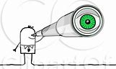
visibly

Slide 126
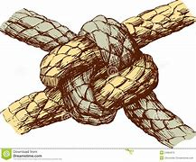
durably

Slide 127
Let’s Teach and Practise

Slide 128
Words ending in -ary can be nouns, adjectives or both.

Slide 129
If the part of the word before the ending isn’t a recognisable English word in itself, then it’s often the case that the ending will be -ary

Slide 130
-ary

Slide 131
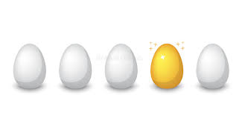
ordinary

Slide 132
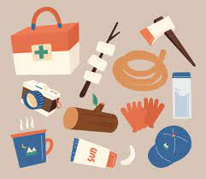
necessary

Slide 133
ordinary
ADJECTIVE
Definition - with no special or distinctive features; normal

Slide 134
necessary
ADJECTIVE
Definition - needed to be done, achieved, or present; essential

Slide 135
It was just an ordinary evening.
________

Slide 136
They granted the necessary permission to have a day off school.
__________

Slide 137
New CHALLENGE words.

Slide 138
recent
ADJECTIVE
Definition - having happened, begun, or been done not long ago; belonging to a past period comparatively close to the present

Slide 139
The recent newsletter is on the website.
______

Slide 140
guide
VERB
Definition - show or indicate the way to someone

Slide 141
I will guide you to your seat in the theatre.
_____

Slide 142
Let’s Practise and Apply.

Slide 143
Can you spot the spelling rule words and the challenge words?

Slide 144
Thunder and Lightning
As a guide, heavy rain is often accompanied by thunderstorms. Thunderstorms happen every day in the boundary of the tropics. The tropics is the area around the middle of the Earth. Thunderstorms are created by thunderclouds which start small but grow taller and taller and wider and wider. A fully-grown thundercloud, called a cumulonimbus cloud, is about 10 kilometres high. Super-strong winds blow up and down inside a thundercloud carrying water drops and ice crystals up and down. The primary drops and crystals grow bigger and bigger until they hurtle to the ground. Ordinary hailstones sometimes fall from thunderclouds.

Slide 145
Thunder and Lightning
As a guide, heavy rain is often accompanied by thunderstorms. Thunderstorms happen every day in the boundary of the tropics. The tropics is the area around the middle of the Earth. Thunderstorms are created by thunderclouds which start small but grow taller and taller and wider and wider. A fully-grown thundercloud, called a cumulonimbus cloud, is about 10 kilometres high. Super-strong winds blow up and down inside a thundercloud carrying water drops and ice crystals up and down. The primary drops and crystals grow bigger and bigger until they hurtle to the ground. Ordinary hailstones sometimes fall from thunderclouds.

Slide 146
Write this sentence as I dictate it to you.
Notes:
Ordinary hailstones sometimes fall from thunderclouds

Slide 147
Ordinary hailstones sometimes fall from thunderclouds.
Did you write it correctly?
Edit your work and make sure you have it correct.
Can you underline the spelling word that we have covered in this session?

Slide 148
Year 3 - Spring 2
Week 3 - Friday
Notes:
Click through the slides for all the R+R words for the week (both the focus and the challenge words)
Click through the slides for all the new learning this week

Slide 150
Old challenge words…

Slide 151
difficult

Slide 152
earth

Slide 153
Old spelling rule words…

Slide 154
gently

Slide 155
simply

Slide 156
humbly

Slide 157
nobly

Slide 158
horribly

Slide 159
terribly

Slide 160
possibly

Slide 161
incredibly

Slide 162
comfortably

Slide 163
probably

Slide 164
visibly

Slide 165
durably

Slide 166
New spelling rule words…

Slide 167
library

Slide 168
dictionary

Slide 169
February

Slide 170
boundary

Slide 171
salary

Slide 172
summary

Slide 173
primary

Slide 174
secondary

Slide 175
ordinary

Slide 176
necessary

Slide 177
New challenge words…

Slide 178
guide

Slide 179
recent

Slide 180
Quick Quiz time…
Notes:
Say these words for the quiz
difficult earth recent guide gently probably library salary primary ordinary

Slide 181
Did you get them correct?
Edit your work.
difficult earth recent guide gently probably library salary primary ordinary

Slide 182
Word class time…

Slide 183
The recent newsletter is on the website.
. Determiner adjective noun verb preposition determiner noun
Notes:
Ask for these words to be classed

Slide 184
I will guide you to your seat in the theatre.
Pronoun adverb verb pronoun determiner noun preposition determiner noun
Notes:
Ask for these words to be classed

Slide 185
Etymology
The history of a word….

Slide 186
Recent
late Middle English (in the sense ‘fresh’): from Latin recens, recent- or French récent.
Guide
late Middle English: from Old French guide (noun), guider (verb), of Germanic origin; related to wit

Slide 187
Let’s investigate….
Look at the word origin of the challenge words and find words that are linked to them.

