Slide 1
Spelling Y3
Mastering spellings: building on the foundations of phonics
Spring 2
Week 4

Slide 2
Year 3 - Spring 2
Week 4 - Monday

Slide 3
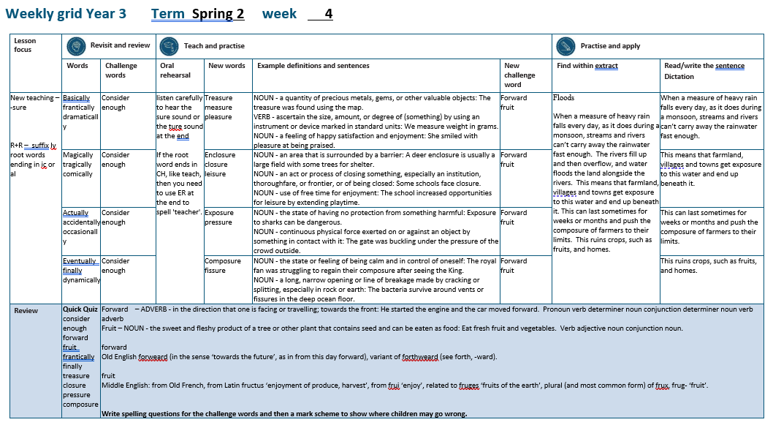

Slide 4
Let’s Revisit and Review…

Slide 5
Do you remember this challenge word?

Slide 6
VERB
consider
Definition -think carefully about (something), typically before making a decision

Slide 7
We need to consider how to move forward.
________

Slide 8
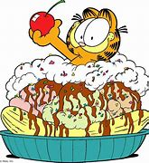
DETERMINER
enough
Definition - as much or as many as required

Slide 9
I have had enough food for lunch.
______

Slide 10
The suffix -ly

Slide 11
-ly

Slide 12
-ly Creating adverbs using the suffix –ly where the root word ends in ‘ic’. Rule – ic + ally

Slide 13
-ly Creating adverbs using the suffix –ly where the root word ends in ‘al’. Rule – al + ly

Slide 14
basically

Slide 15
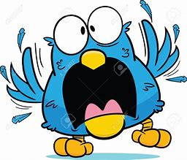
frantically

Slide 16
dramatically

Slide 17
Let’s Teach and Practise

Slide 18
Words ending in -sure

Slide 19
Listen carefully to hear the sure sound or the ture sound at the end. If the root word ends in CH, like teach, then you need to use ER at the end to spell 'teacher'

Slide 20
-sure

Slide 21
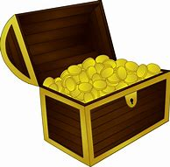
treasure

Slide 22
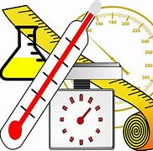
measure

Slide 23
pleasure

Slide 24
treasure
NOUN
Definition - a quantity of precious metals, gems, or other valuable objects

Slide 25
measure
VERB
Definition - ascertain the size, amount, or degree of (something) by using an instrument or device marked in standard units

Slide 26
pleasure
NOUN
Definition - a feeling of happy satisfaction and enjoyment

Slide 27
The treasure was found using the map.
_________

Slide 28
We measure weight in grams.
________

Slide 29
She smiled with pleasure at being praised.
________

Slide 30
New CHALLENGE words.

Slide 31
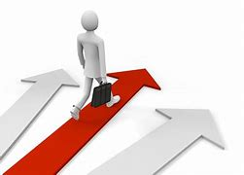
forward
ADVERB
Definition - in the direction that one is facing or travelling; towards the front

Slide 32
He started the engine and the car moved forward.
_______

Slide 33
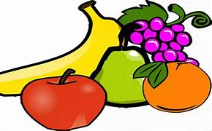
fruit
NOUN
Definition - the sweet and fleshy product of a tree or other plant that contains seed and can be eaten as food

Slide 34
Eat fresh fruit and vegetables.
_____

Slide 35
Let’s Practise and Apply.

Slide 36
Can you spot the spelling rule words and the challenge words?

Slide 37
Floods When a measure of heavy rain falls every day, as it does during a monsoon, streams and rivers can’t carry away the rainwater fast enough. The rivers fill up and then overflow, and water floods the land alongside the rivers. This means that farmland, villages and towns get exposure to this water and end up beneath it. This can last sometimes for weeks or months and push the composure of farmers to their limits. This ruins crops, such as fruits, and homes.

Slide 38
Floods When a measure of heavy rain falls every day, as it does during a monsoon, streams and rivers can’t carry away the rainwater fast enough. The rivers fill up and then overflow, and water floods the land alongside the rivers. This means that farmland, villages and towns get exposure to this water and end up beneath it. This can last sometimes for weeks or months and push the composure of farmers to their limits. This ruins crops, such as fruits, and homes.

Slide 39
Write this sentence as I dictate it to you.
Notes:
A measure of heavy rain can fall every day.

Slide 40
A measure of heavy rain can fall every day.
Did you write it correctly?
Edit your work and make sure you have it correct.
Can you underline the spelling word that we have covered in this session?

Slide 41
Year 3 - Spring 2
Week 4 - Tuesday
Notes:
Revisit and review the words from previous teaching and challenge words – I say, we say, you say
Ask children to write words only in their spelling book
Introduce the new spelling rule
Children to write the new spelling rule words and challenge words into books when the sentences are shown with the spelling word missing.
Read the extract with the class as choral reading. Practise model of prosody etc.
Ask children to find the spelling words from the session in the text.
Then read allowed the chosen sentence for children to write fully in their books.
Show the extract and ask children to then edit their work to check they were correct in their dictation.

Slide 43
Let’s Revisit and Review…

Slide 44
Do you remember this challenge word?

Slide 45
VERB
consider
Definition -think carefully about (something), typically before making a decision

Slide 46
We need to consider how to move forward.
________

Slide 47
DETERMINER
enough
Definition - as much or as many as required

Slide 48
I have had enough food for lunch.
______

Slide 49
The suffix -ly

Slide 50
-ly

Slide 51
-ly Creating adverbs using the suffix –ly where the root word ends in ‘ic’. Rule – ic + ally

Slide 52
-ly Creating adverbs using the suffix –ly where the root word ends in ‘al’. Rule – al + ly

Slide 53
magically

Slide 54
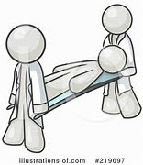
tragically

Slide 55
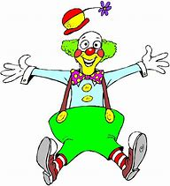
comically

Slide 56
Let’s Teach and Practise

Slide 57
Words ending in -sure

Slide 58
Listen carefully to hear the sure sound or the ture sound at the end. If the root word ends in CH, like teach, then you need to use ER at the end to spell 'teacher'

Slide 59
-sure

Slide 60
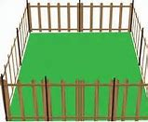
enclosure

Slide 61
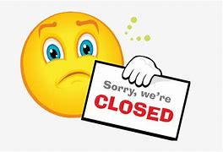
closure

Slide 62
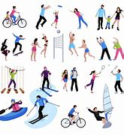
leisure

Slide 63
enclosure
NOUN
Definition - an area that is surrounded by a barrier

Slide 64
closure
NOUN
Definition - an act or process of closing something, especially an institution, thoroughfare, or frontier, or of being closed

Slide 65
leisure
NOUN
Definition - use of free time for enjoyment

Slide 66
A deer enclosure is usually a large field with some trees for shelter.
_________

Slide 67
Some schools face closure.
_______

Slide 68
The school increased opportunities for leisure by extending playtime.
_______

Slide 69
New CHALLENGE words.

Slide 70
forward
ADVERB
Definition - in the direction that one is facing or travelling; towards the front

Slide 71
He started the engine and the car moved forward.
_______

Slide 72
fruit
NOUN
Definition - the sweet and fleshy product of a tree or other plant that contains seed and can be eaten as food

Slide 73
Eat fresh fruit and vegetables.
_____

Slide 74
Let’s Practise and Apply.

Slide 75
Can you spot the spelling rule words and the challenge words?

Slide 76
Floods When a measure of heavy rain falls every day, as it does during a monsoon, streams and rivers can’t carry away the rainwater fast enough. The rivers fill up and then overflow, and water floods the land alongside the rivers. This means that farmland, villages and towns get exposure to this water and end up beneath it. This can last sometimes for weeks or months and push the composure of farmers to their limits. This ruins crops, such as fruits, and homes.

Slide 77
Floods When a measure of heavy rain falls every day, as it does during a monsoon, streams and rivers can’t carry away the rainwater fast enough. The rivers fill up and then overflow, and water floods the land alongside the rivers. This means that farmland, villages and towns get exposure to this water and end up beneath it. This can last sometimes for weeks or months and push the composure of farmers to their limits. This ruins crops, such as fruits, and homes.

Slide 78
Write this sentence as I dictate it to you.
Notes:
Towns get exposure to this rain water.

Slide 79
Towns get exposure to this rain water.
Did you write it correctly?
Edit your work and make sure you have it correct.
Can you underline the spelling word that we have covered in this session?

Slide 80
Year 3 - Spring 2
Week 4 - Wednesday
Notes:
Revisit and review the words from previous teaching and challenge words – I say, we say, you say
Ask children to write words only in their spelling book
Introduce the new spelling rule
Children to write the new spelling rule words and challenge words into books when the sentences are shown with the spelling word missing.
Read the extract with the class as choral reading. Practise model of prosody etc.
Ask children to find the spelling words from the session in the text.
Then read allowed the chosen sentence for children to write fully in their books.
Show the extract and ask children to then edit their work to check they were correct in their dictation.

Slide 82
Let’s Revisit and Review…

Slide 83
Do you remember this challenge word?

Slide 84
VERB
consider
Definition -think carefully about (something), typically before making a decision

Slide 85
We need to consider how to move forward.
________

Slide 86
DETERMINER
enough
Definition - as much or as many as required

Slide 87
I have had enough food for lunch.
______

Slide 88
The suffix -ly

Slide 89
-ly

Slide 90
-ly Creating adverbs using the suffix –ly where the root word ends in ‘ic’. Rule – ic + ally

Slide 91
-ly Creating adverbs using the suffix –ly where the root word ends in ‘al’. Rule – al + ly

Slide 92
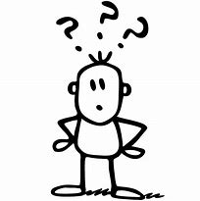
actually

Slide 93
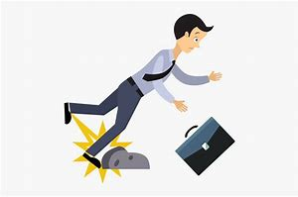
accidentally

Slide 94
occasionally

Slide 95
Let’s Teach and Practise

Slide 96
Words ending in -sure

Slide 97
Listen carefully to hear the sure sound or the ture sound at the end. If the root word ends in CH, like teach, then you need to use ER at the end to spell 'teacher'

Slide 98
-sure

Slide 99
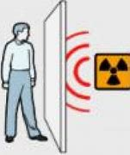
exposure

Slide 100
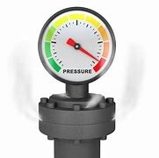
pressure

Slide 101
exposure
NOUN
Definition - the state of having no protection from something harmful

Slide 102
pressure
NOUN
Definition - continuous physical force exerted on or against an object by something in contact with it

Slide 103
Exposure to sharks can be dangerous.
________

Slide 104
The gate was buckling under the pressure of the crowd outside.
________

Slide 105
New CHALLENGE words.

Slide 106
forward
ADVERB
Definition - in the direction that one is facing or travelling; towards the front

Slide 107
He started the engine and the car moved forward.
_______

Slide 108
fruit
NOUN
Definition - the sweet and fleshy product of a tree or other plant that contains seed and can be eaten as food

Slide 109
Eat fresh fruit and vegetables.
_____

Slide 110
Let’s Practise and Apply.

Slide 111
Can you spot the spelling rule words and the challenge words?

Slide 112
Floods When a measure of heavy rain falls every day, as it does during a monsoon, streams and rivers can’t carry away the rainwater fast enough. The rivers fill up and then overflow, and water floods the land alongside the rivers. This means that farmland, villages and towns get exposure to this water and end up beneath it. This can last sometimes for weeks or months and push the composure of farmers to their limits. This ruins crops, such as fruits, and homes.

Slide 113
Floods When a measure of heavy rain falls every day, as it does during a monsoon, streams and rivers can’t carry away the rainwater fast enough. The rivers fill up and then overflow, and water floods the land alongside the rivers. This means that farmland, villages and towns get exposure to this water and end up beneath it. This can last sometimes for weeks or months and push the composure of farmers to their limits. This ruins crops, such as fruits, and homes.

Slide 114
Write this sentence as I dictate it to you.
Notes:
It pushed the composure of farmers to their limits.

Slide 115
It pushed the composure of farmers to their limits.
Did you write it correctly?
Edit your work and make sure you have it correct.
Can you underline the spelling word that we have covered in this session?

Slide 116
Year 3 - Spring 2
Week 4 - Thursday
Notes:
Revisit and review the words from previous teaching and challenge words – I say, we say, you say
Ask children to write words only in their spelling book
Introduce the new spelling rule
Children to write the new spelling rule words and challenge words into books when the sentences are shown with the spelling word missing.
Read the extract with the class as choral reading. Practise model of prosody etc.
Ask children to find the spelling words from the session in the text.
Then read allowed the chosen sentence for children to write fully in their books.
Show the extract and ask children to then edit their work to check they were correct in their dictation.

Slide 118
Let’s Revisit and Review…

Slide 119
Do you remember this challenge word?

Slide 120
VERB
consider
Definition -think carefully about (something), typically before making a decision

Slide 121
We need to consider how to move forward.
________

Slide 122
DETERMINER
enough
Definition - as much or as many as required

Slide 123
I have had enough food for lunch.
______

Slide 124
The suffix -ly

Slide 125
-ly

Slide 126
-ly Creating adverbs using the suffix –ly where the root word ends in ‘ic’. Rule – ic + ally

Slide 127
-ly Creating adverbs using the suffix –ly where the root word ends in ‘al’. Rule – al + ly

Slide 128
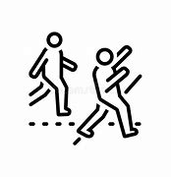
eventually

Slide 129
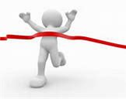
finally

Slide 130
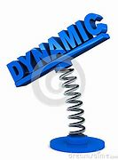
dynamically

Slide 131
Let’s Teach and Practise

Slide 132
Words ending in -sure

Slide 133
Listen carefully to hear the sure sound or the ture sound at the end. If the root word ends in CH, like teach, then you need to use ER at the end to spell 'teacher'

Slide 134
-sure

Slide 135
composure

Slide 136
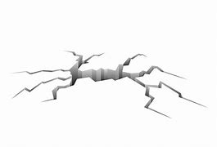
fissure

Slide 137
composure
NOUN
Definition - the state or feeling of being calm and in control of oneself

Slide 138
fissure
NOUN
Definition - - a long, narrow opening or line of breakage made by cracking or splitting, especially in rock or earth

Slide 139
The royal fan was struggling to regain their composure after seeing the King.
_________

Slide 140
The bacteria survive around vents or fissures in the deep ocean floor.
________

Slide 141
New CHALLENGE words.

Slide 142
forward
ADVERB
Definition - in the direction that one is facing or travelling; towards the front

Slide 143
He started the engine and the car moved forward.
_______

Slide 144
fruit
NOUN
Definition - the sweet and fleshy product of a tree or other plant that contains seed and can be eaten as food

Slide 145
Eat fresh fruit and vegetables.
_____

Slide 146
Let’s Practise and Apply.

Slide 147
Can you spot the spelling rule words and the challenge words?

Slide 148
Floods When a measure of heavy rain falls every day, as it does during a monsoon, streams and rivers can’t carry away the rainwater fast enough. The rivers fill up and then overflow, and water floods the land alongside the rivers. This means that farmland, villages and towns get exposure to this water and end up beneath it. This can last sometimes for weeks or months and push the composure of farmers to their limits. This ruins crops, such as fruits, and homes.

Slide 149
Floods When a measure of heavy rain falls every day, as it does during a monsoon, streams and rivers can’t carry away the rainwater fast enough. The rivers fill up and then overflow, and water floods the land alongside the rivers. This means that farmland, villages and towns get exposure to this water and end up beneath it. This can last sometimes for weeks or months and push the composure of farmers to their limits. This ruins crops, such as fruits, and homes.

Slide 150
Write this sentence as I dictate it to you.
Notes:
This ruins crops, such as fruits, and homes.

Slide 151
This ruins crops, such as fruits, and homes.
Did you write it correctly?
Edit your work and make sure you have it correct.
Can you underline the spelling word that we have covered in this session?

Slide 152
Year 3 - Spring 2
Week 4 - Friday
Notes:
Click through the slides for all the R+R words for the week (both the focus and the challenge words)
Click through the slides for all the new learning this week

Slide 154
Old challenge words…

Slide 155
consider

Slide 156
enough

Slide 157
Old spelling rule words…

Slide 158
basically

Slide 159
frantically

Slide 160
dramatically

Slide 161
magically

Slide 162
tragically

Slide 163
comically

Slide 164
actually

Slide 165
accidentally

Slide 166
occasionally

Slide 167
eventually

Slide 168
finally

Slide 169
dynamically

Slide 170
New spelling rule words…

Slide 171
treasure

Slide 172
measure

Slide 173
pleasure

Slide 174
enclosure

Slide 175
closure

Slide 176
leisure

Slide 177
exposure

Slide 178
pressure

Slide 179
composure

Slide 180
fissure

Slide 181
New challenge words…

Slide 182
forward

Slide 183
fruit

Slide 184
Quick Quiz time…
Notes:
Say these words for the quiz
consider enough forward fruit frantically finally treasure closure pressure composure

Slide 185
Did you get them correct?
Edit your work.
consider enough forward fruit frantically finally treasure closure pressure composure

Slide 186
Word class time…

Slide 187
He started the engine and the car moved forward.
Pronoun verb determiner noun conjunction determiner noun verb adverb
Notes:
Ask for these words to be classed

Slide 188
Eat fresh fruit and vegetables.
Verb adjective noun conjunction noun
Notes:
Ask for these words to be classed

Slide 189
Etymology
The history of a word….

Slide 190
Forward
Old English forweard (in the sense ‘towards the future’, as in from this day forward), variant of forthweard (see forth, -ward).
Fruit
Middle English: from Old French, from Latin fructus ‘enjoyment of produce, harvest’, from frui ‘enjoy’, related to fruges ‘fruits of the earth’, plural (and most common form) of frux, frug- ‘fruit’.

Slide 191
Let’s investigate….
Write spelling questions for the challenge words and then a mark scheme to show where children may go wrong.

