Slide 1
Spelling Y3
Mastering spellings: building on the foundations of phonics
Spring 2
Week 5

Slide 2
Year 3 - Spring 2
Week 5 - Monday

Slide 3
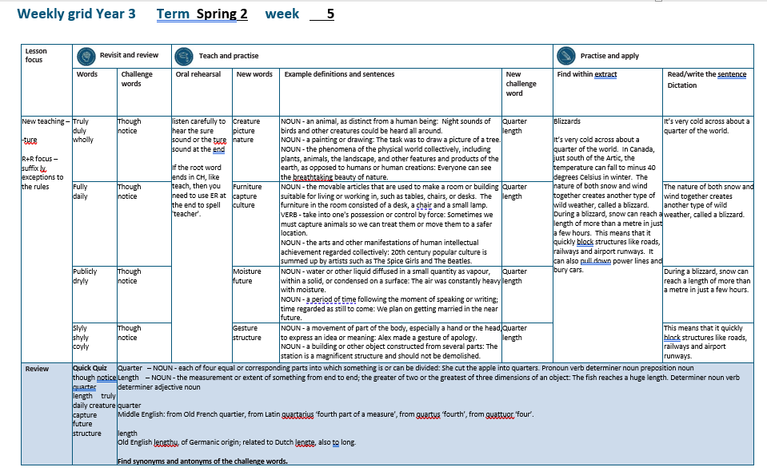

Slide 4
Let’s Revisit and Review…

Slide 5
Do you remember this challenge word?

Slide 6
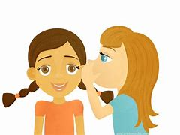
CONJUNCTION
though
Definition -despite the fact that

Slide 7
Though they were speaking quietly, they could still be heard.
______

Slide 8

NOUN
notice
Definition - a displayed sheet or placard giving news or information

Slide 9
The notice was very clear.
______

Slide 10
The suffix
-ly

Slide 11
-ly

Slide 12
-ly exceptions to the previous rules

Slide 13

truly

Slide 14

duly

Slide 15

wholly

Slide 16
Let’s Teach and Practise

Slide 17
Words ending in -ture

Slide 18
Listen carefully to hear the sure sound or the ture sound at the end.
If the root word ends in CH, like teach, then you need to use ER at the end to spell 'teacher'

Slide 19
-ture

Slide 20
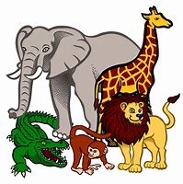
creature

Slide 21

picture

Slide 22

nature

Slide 23
creature
NOUN
Definition - an animal, as distinct from a human being

Slide 24
picture
NOUN
Definition - a painting, photo or drawing

Slide 25
nature
NOUN
Definition - the phenomena of the physical world collectively, including plants, animals, the landscape, and other features and products of the earth, as opposed to humans or human creations

Slide 26
Night sounds of birds and other creatures could be heard all around.
_________

Slide 27
The task was to draw a picture of a tree.
_______

Slide 28
Everyone can see the breath-taking beauty of nature.
______

Slide 29
New CHALLENGE words.

Slide 30
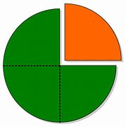
quarter
NOUN
Definition - each of four equal or corresponding parts into which something is or can be divided

Slide 31
She cut the apple into quarters.
________

Slide 32
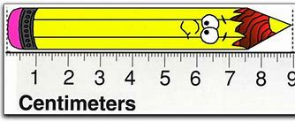
length
NOUN
Definition - the measurement or extent of something from end to end

Slide 33
The fish reaches a huge length.
______

Slide 34
Let’s Practise and Apply.

Slide 35
Can you spot the spelling rule words and the challenge words?

Slide 36
Blizzards
It’s very cold across about a quarter of the world. In Canada, just south of the Artic, the temperature can fall to minus 40 degrees Celsius in winter. The nature of both snow and wind together creates another type of wild weather, called a blizzard. During a blizzard, snow can reach a length of more than a metre in just a few hours. This means that it quickly block structures like roads, railways and airport runways. It can also pull down power lines and bury cars.

Slide 37
Blizzards
It’s very cold across about a quarter of the world. In Canada, just south of the Artic, the temperature can fall to minus 40 degrees Celsius in winter. The nature of both snow and wind together creates another type of wild weather, called a blizzard. During a blizzard, snow can reach a length of more than a metre in just a few hours. This means that it quickly block structures like roads, railways and airport runways. It can also pull down power lines and bury cars.

Slide 38
Write this sentence as I dictate it to you.
Notes:
It’s very cold across about a quarter of the world.

Slide 39
It’s very cold across about a quarter of the world.
Did you write it correctly?
Edit your work and make sure you have it correct.
Can you underline the spelling word that we have covered in this session?

Slide 40
Year 3 - Spring 2
Week 5 - Tuesday
Notes:
Revisit and review the words from previous teaching and challenge words – I say, we say, you say
Ask children to write words only in their spelling book
Introduce the new spelling rule
Children to write the new spelling rule words and challenge words into books when the sentences are shown with the spelling word missing.
Read the extract with the class as choral reading. Practise model of prosody etc.
Ask children to find the spelling words from the session in the text.
Then read allowed the chosen sentence for children to write fully in their books.
Show the extract and ask children to then edit their work to check they were correct in their dictation.

Slide 42
Let’s Revisit and Review…

Slide 43
Do you remember this challenge word?

Slide 44
CONJUNCTION
though
Definition -despite the fact that

Slide 45
Though they were speaking quietly, they could still be heard.
______

Slide 46
NOUN
notice
Definition - a displayed sheet or placard giving news or information

Slide 47
The notice was very clear.
______

Slide 48
The suffix
-ly

Slide 49
-ly

Slide 50
-ly exceptions to the previous rules

Slide 51

fully

Slide 52

daily

Slide 53
Let’s Teach and Practise

Slide 54
Words ending in -ture

Slide 55
Listen carefully to hear the sure sound or the ture sound at the end.
If the root word ends in CH, like teach, then you need to use ER at the end to spell 'teacher'

Slide 56
-ture

Slide 57

furniture

Slide 58
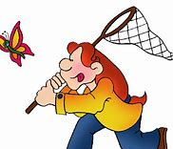
capture

Slide 59
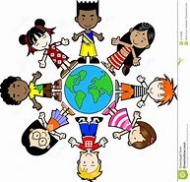
culture

Slide 60
furniture
NOUN
Definition - the movable articles that are used to make a room or building suitable for living or working in, such as tables, chairs, or desks

Slide 61
capture
VERB
Definition - take into one's possession or control by force

Slide 62
culture
NOUN
Definition - the arts and other manifestations of human intellectual achievement regarded collectively

Slide 63
The furniture in the room consisted of a desk, a chair and a small lamp.
_________

Slide 64
Sometimes we must capture animals so we can treat them or move them to a safer location.
_______

Slide 65
20th century popular culture is summed up by artists such as The Spice Girls and The Beatles.
_______

Slide 66
New CHALLENGE words.

Slide 67
quarter
NOUN
Definition - each of four equal or corresponding parts into which something is or can be divided

Slide 68
She cut the apple into quarters.
________

Slide 69
length
NOUN
Definition - the measurement or extent of something from end to end

Slide 70
The fish reaches a huge length.
______

Slide 71
Let’s Practise and Apply.

Slide 72
Can you spot the spelling rule words and the challenge words?

Slide 73
Blizzards
It’s very cold across about a quarter of the world. In Canada, just south of the Artic, the temperature can fall to minus 40 degrees Celsius in winter. The nature of both snow and wind together creates another type of wild weather, called a blizzard. During a blizzard, snow can reach a length of more than a metre in just a few hours. This means that it quickly block structures like roads, railways and airport runways. It can also pull down power lines and bury cars.

Slide 74
Blizzards
It’s very cold across about a quarter of the world. In Canada, just south of the Artic, the temperature can fall to minus 40 degrees Celsius in winter. The nature of both snow and wind together creates another type of wild weather, called a blizzard. During a blizzard, snow can reach a length of more than a metre in just a few hours. This means that it quickly block structures like roads, railways and airport runways. It can also pull down power lines and bury cars.

Slide 75
Write this sentence as I dictate it to you.
Notes:
The nature of both snow and wind together creates another type of wild weather, called a blizzard.

Slide 76
The nature of both snow and wind together creates another type of wild weather, called a blizzard.
Did you write it correctly?
Edit your work and make sure you have it correct.
Can you underline the spelling word that we have covered in this session?

Slide 77
Year 3 - Spring 2
Week 5 - Wednesday
Notes:
Revisit and review the words from previous teaching and challenge words – I say, we say, you say
Ask children to write words only in their spelling book
Introduce the new spelling rule
Children to write the new spelling rule words and challenge words into books when the sentences are shown with the spelling word missing.
Read the extract with the class as choral reading. Practise model of prosody etc.
Ask children to find the spelling words from the session in the text.
Then read allowed the chosen sentence for children to write fully in their books.
Show the extract and ask children to then edit their work to check they were correct in their dictation.

Slide 79
Let’s Revisit and Review…

Slide 80
Do you remember this challenge word?

Slide 81
CONJUNCTION
though
Definition -despite the fact that

Slide 82
Though they were speaking quietly, they could still be heard.
______

Slide 83
NOUN
notice
Definition - a displayed sheet or placard giving news or information

Slide 84
The notice was very clear.
______

Slide 85
The suffix
-ly

Slide 86
-ly

Slide 87
-ly exceptions to the previous rules

Slide 88

publicly

Slide 89

dryly

Slide 90
Let’s Teach and Practise

Slide 91
Words ending in -ture

Slide 92
Listen carefully to hear the sure sound or the ture sound at the end.
If the root word ends in CH, like teach, then you need to use ER at the end to spell 'teacher'

Slide 93
-ture

Slide 94

moisture

Slide 95

future

Slide 96
moisture
NOUN
Definition - water or other liquid diffused in a small quantity as vapour, within a solid, or condensed on a surface

Slide 97
future
NOUN
Definition - - a period of time following the moment of speaking or writing; time regarded as still to come

Slide 98
The air was constantly heavy with moisture.
________

Slide 99
We plan on getting married in the near future.
______

Slide 100
New CHALLENGE words.

Slide 101
quarter
NOUN
Definition - each of four equal or corresponding parts into which something is or can be divided

Slide 102
She cut the apple into quarters.
________

Slide 103
length
NOUN
Definition - the measurement or extent of something from end to end

Slide 104
The fish reaches a huge length.
______

Slide 105
Let’s Practise and Apply.

Slide 106
Can you spot the spelling rule words and the challenge words?

Slide 107
Blizzards
It’s very cold across about a quarter of the world. In Canada, just south of the Artic, the temperature can fall to minus 40 degrees Celsius in winter. The nature of both snow and wind together creates another type of wild weather, called a blizzard. During a blizzard, snow can reach a length of more than a metre in just a few hours. This means that it quickly block structures like roads, railways and airport runways. It can also pull down power lines and bury cars.

Slide 108
Blizzards
It’s very cold across about a quarter of the world. In Canada, just south of the Artic, the temperature can fall to minus 40 degrees Celsius in winter. The nature of both snow and wind together creates another type of wild weather, called a blizzard. During a blizzard, snow can reach a length of more than a metre in just a few hours. This means that it quickly block structures like roads, railways and airport runways. It can also pull down power lines and bury cars.

Slide 109
Write this sentence as I dictate it to you.
Notes:
During a blizzard, snow can reach a length of more than a metre in just a few hours.

Slide 110
During a blizzard, snow can reach a length of more than a metre in just a few hours.
Did you write it correctly?
Edit your work and make sure you have it correct.
Can you underline the spelling word that we have covered in this session?

Slide 111
Year 3 - Spring 2
Week 5 - Thursday
Notes:
Revisit and review the words from previous teaching and challenge words – I say, we say, you say
Ask children to write words only in their spelling book
Introduce the new spelling rule
Children to write the new spelling rule words and challenge words into books when the sentences are shown with the spelling word missing.
Read the extract with the class as choral reading. Practise model of prosody etc.
Ask children to find the spelling words from the session in the text.
Then read allowed the chosen sentence for children to write fully in their books.
Show the extract and ask children to then edit their work to check they were correct in their dictation.

Slide 113
Let’s Revisit and Review…

Slide 114
Do you remember this challenge word?

Slide 115
CONJUNCTION
though
Definition -despite the fact that

Slide 116
Though they were speaking quietly, they could still be heard.
______

Slide 117
NOUN
notice
Definition - a displayed sheet or placard giving news or information

Slide 118
The notice was very clear.
______

Slide 119
The suffix
-ly

Slide 120
-ly

Slide 121
-ly exceptions to the previous rules

Slide 122

slyly

Slide 123

shyly

Slide 124

coyly

Slide 125
Let’s Teach and Practise

Slide 126
Words ending in -ture

Slide 127
Listen carefully to hear the sure sound or the ture sound at the end.
If the root word ends in CH, like teach, then you need to use ER at the end to spell 'teacher'

Slide 128
-ture

Slide 129

gesture

Slide 130
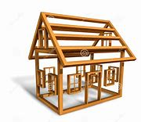
structure

Slide 131
gesture
NOUN
Definition - a movement of part of the body, especially a hand or the head, to express an idea or meaning

Slide 132
structure
NOUN
Definition - a building or other object constructed from several parts

Slide 133
Alex made a gesture of apology.
_______

Slide 134
The station is a magnificent structure and should not be demolished.
_________

Slide 135
New CHALLENGE words.

Slide 136
quarter
NOUN
Definition - each of four equal or corresponding parts into which something is or can be divided

Slide 137
She cut the apple into quarters.
________

Slide 138
length
NOUN
Definition - the measurement or extent of something from end to end

Slide 139
The fish reaches a huge length.
______

Slide 140
Let’s Practise and Apply.

Slide 141
Can you spot the spelling rule words and the challenge words?

Slide 142
Blizzards
It’s very cold across about a quarter of the world. In Canada, just south of the Artic, the temperature can fall to minus 40 degrees Celsius in winter. The nature of both snow and wind together creates another type of wild weather, called a blizzard. During a blizzard, snow can reach a length of more than a metre in just a few hours. This means that it quickly block structures like roads, railways and airport runways. It can also pull down power lines and bury cars.

Slide 143
Blizzards
It’s very cold across about a quarter of the world. In Canada, just south of the Artic, the temperature can fall to minus 40 degrees Celsius in winter. The nature of both snow and wind together creates another type of wild weather, called a blizzard. During a blizzard, snow can reach a length of more than a metre in just a few hours. This means that it quickly block structures like roads, railways and airport runways. It can also pull down power lines and bury cars.

Slide 144
Write this sentence as I dictate it to you.
Notes:
This means that it quickly block structures like roads, railways and airport runways.

Slide 145
This means that it quickly block structures like roads, railways and airport runways.
Did you write it correctly?
Edit your work and make sure you have it correct.
Can you underline the spelling word that we have covered in this session?

Slide 146
Year 3 - Spring 2
Week 5 - Friday
Notes:
Click through the slides for all the R+R words for the week (both the focus and the challenge words)
Click through the slides for all the new learning this week

Slide 148
Old challenge words…

Slide 149
though

Slide 150
notice

Slide 151
Old spelling rule words…

Slide 152
truly

Slide 153
duly

Slide 154
wholly

Slide 155
fully

Slide 156
daily

Slide 157
publicly

Slide 158
dryly

Slide 159
slyly

Slide 160
shyly

Slide 161
coyly

Slide 162
New spelling rule words…

Slide 163
creature

Slide 164
picture

Slide 165
nature

Slide 166
furniture

Slide 167
capture

Slide 168
culture

Slide 169
moisture

Slide 170
future

Slide 171
gesture

Slide 172
structure

Slide 173
New challenge words…

Slide 174
quarter

Slide 175
length

Slide 176
Quick Quiz time…
Notes:
Say these words for the quiz
though notice quarter length truly daily creature capture future structure

Slide 177
Did you get them correct?
Edit your work.
though notice quarter length truly daily creature capture future structure

Slide 178
Word class time…

Slide 179
She cut the apple into quarters.
Pronoun verb determiner noun preposition noun
Notes:
Ask for these words to be classed

Slide 180
The fish reaches a huge length.
Determiner noun verb determiner adjective noun
Notes:
Ask for these words to be classed

Slide 181
Etymology
The history of a word….

Slide 182
Quarter
Middle English: from Old French quartier, from Latin quartarius ‘fourth part of a measure’, from quartus ‘fourth’, from quattuor ‘four’.
Length
Old English lengthu, of Germanic origin; related to Dutch lengte, also to long.

Slide 183
Let’s investigate….
Find synonyms and antonyms of the challenge words.

