Slide 1
Spelling Y2
Mastering spellings: building of the foundations of phonics
Autumn 2
Week 1

Slide 2
Year 2 - Autumn 2
Week 1 - Monday
Notes:
Revisit and review the words from Y2 Aut. 1 The sound /l/ spelt with ‘le’ at the end of words and challenge words move, prove, improve – I say, we say, you say
Ask children to write words only in their spelling book
Introduce the new spelling rule: The ending ‘el’. The sound /l/ spelt with ‘el’ at the end of words.
Children to write the new spelling rule words and challenge words into books when the sentences are shown with the spelling word missing.
Read the extract with the class as choral reading. Practise model of prosody etc.
Ask children to find the spelling words from the session in the text.
Then read aloud the chosen sentence for children to write fully in their books (dictation style).
Show the extract and ask children to then edit their work to check they were correct in their dictation.

Slide 3
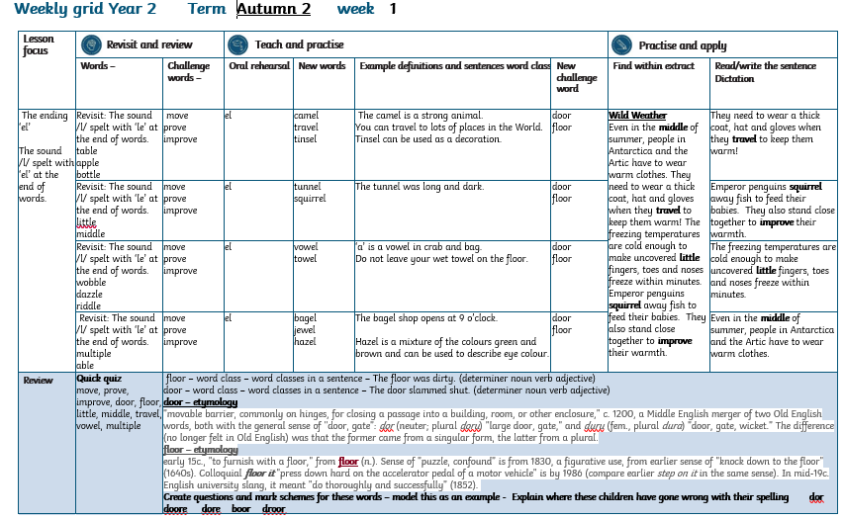

Slide 4
Let’s Revisit and Review…

Slide 5
Do you remember this challenge word?

Slide 6
prove

Slide 7
prove
Definition – to show it is true

Slide 8

prove
I need to prove I didn’t do it.

Slide 9
Do you remember this challenge word?

Slide 10
move

Slide 11
move
Definition - to change position

Slide 12
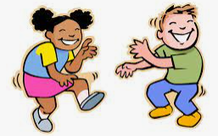
move
I love to move to music.

Slide 13
le

Slide 14
“le” makes the /l/ sound at the end of these words

Slide 15
table

Slide 16
table

Slide 17
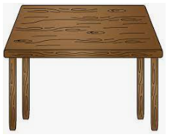
table

Slide 18
apple

Slide 19
apple

Slide 20

apple

Slide 21
bottle

Slide 22
bottle

Slide 23

bottle

Slide 24
Let’s Teach and Practise

Slide 25
-el

Slide 26
The sound /l/ spelt with ‘el’ at the end of words.
Notes:
Just like ‘un’

Slide 27
camel

Slide 28
camel

Slide 29
travel

Slide 30
travel

Slide 31
tinsel

Slide 32
tinsel

Slide 33
camel

Slide 34
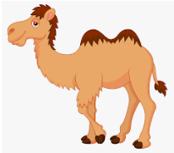
camel cam + el = camel

Slide 35
camel cam + el = camel
Definition – a mammal that can have either 1 or 2 humps.

Slide 36
travel

Slide 37
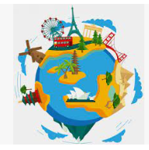
travel trav + el = travel

Slide 38
travel trav + el = travel
Definition – visiting or going to different places

Slide 39
tinsel

Slide 40
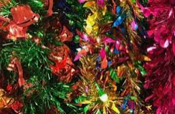
tinsel tins + el = tinsel

Slide 41
tinsel tins + el = tinsel
Definition – you can use tinsel as a decoration

Slide 42
The camel is a strong animal.

Slide 43
The _____ is a strong animal.

Slide 44
The camel is a strong animal.

Slide 45
You can travel to lots of places in the World.

Slide 46
You can ______ to lots of places in the World.

Slide 47
You can travel to lots of places in the World.

Slide 48
Tinsel can be used as a decoration.

Slide 49
______ can be used as a decoration.

Slide 50
Tinsel can be used as a decoration.

Slide 51
New CHALLENGE words.

Slide 52
door

Slide 53
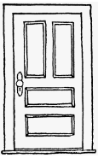
door movable barrier, commonly on hinges, for closing a passage into a building, room, or other enclosure

Slide 54
floor

Slide 55
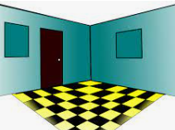
floor lower surface, the bottom of a room

Slide 56
The door slammed shut.

Slide 57

The door slammed shut.

Slide 58
The floor was dirty.

Slide 59

The floor was dirty.

Slide 60
Let’s Practise and Apply.

Slide 61
Can you spot the spelling rule words and the challenge words?

Slide 62
Wild Weather
Even in the middle of summer, people in Antarctica and the Artic have to wear warm clothes. They need to wear a thick coat, hat and gloves when they travel to keep them warm! The freezing temperatures are cold enough to make uncovered little fingers, toes and noses freeze within minutes.
Emperor penguins squirrel away fish to feed their babies. They also stand close together to improve their warmth.

Slide 63
Wild Weather
Even in the middle of summer, people in Antarctica and the Artic have to wear warm clothes. They need to wear a thick coat, hat and gloves when they travel to keep them warm! The freezing temperatures are cold enough to make uncovered little fingers, toes and noses freeze within minutes.
Emperor penguins squirrel away fish to feed their babies. They also stand close together to improve their warmth.

Slide 64
Write this sentence as I dictate it to you.
Notes:
They need to wear a thick coat, hat and gloves when they travel to keep them warm!

Slide 65
They need to wear a thick coat, hat and gloves when they travel to keep them warm!
Did you write it correctly?
Edit your work and make sure you have it correct.
Can you underline the spelling word that we have covered in this session?

Slide 66
Year 2 - Autumn 2
Week 1 - Tuesday
Notes:
Revisit and review the words from Y2 Aut. 1 The sound /l/ spelt with ‘le’ at the end of words and challenge words move, prove, improve – I say, we say, you say
Ask children to write words only in their spelling book
Introduce the new spelling rule: The ending ‘el’. The sound /l/ spelt with ‘el’ at the end of words.
Children to write the new spelling rule words and challenge words into books when the sentences are shown with the spelling word missing.
Read the extract with the class as choral reading. Practise model of prosody etc.
Ask children to find the spelling words from the session in the text.
Then read allowed the chosen sentence for children to write fully in their books.
Show the extract and ask children to then edit their work to check they were correct in their dictation.

Slide 68
Let’s Revisit and Review…

Slide 69
Do you remember this challenge word?

Slide 70
prove

Slide 71

prove definition – to show it is true

Slide 72
Do you remember this challenge word?

Slide 73
move

Slide 74
move definition - to change position

Slide 75
The sound /l/ spelt with ‘le’ at the end of words.

Slide 76
le

Slide 77
“le” makes the /l/ sound at the end of these words’

Slide 78
little

Slide 79
little

Slide 80
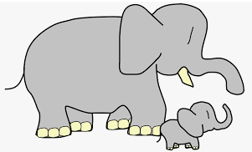
little

Slide 81
middle

Slide 82
middle

Slide 83
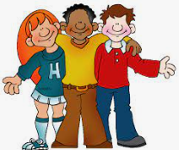
middle

Slide 84
Let’s Teach and Practise

Slide 85
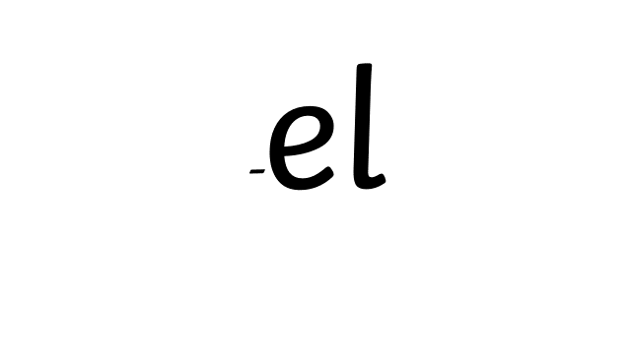
mis-

Slide 86
The sound /l/ spelt with “el” at the end of words.
Notes:
Just like ‘un’

Slide 87
tunnel

Slide 88
tunnel

Slide 89
squirrel

Slide 90
squirrel

Slide 91
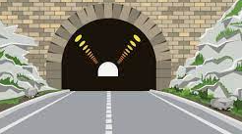
tunnel tunn + el = tunnel

Slide 92
tunnel tunn + el = tunnel
The tunnel was long and dark.

Slide 93
squirrel

Slide 94
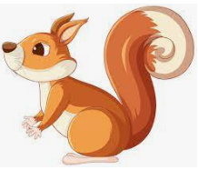
squirrel squirr + el = squirrel

Slide 95
squirrel squirr + el = squirrel
A little mammal that eats nuts.

Slide 96
The tunnel was dark and long.

Slide 97
The ______ was dark and long.

Slide 98
The tunnel was dark and long.

Slide 99
A squirrel is a little mammal that eats nuts.

Slide 100
A ________ is a little mammal that eats nuts.

Slide 101
A squirrel is a little mammal that eats nuts.

Slide 102
New CHALLENGE words.

Slide 103
door

Slide 104
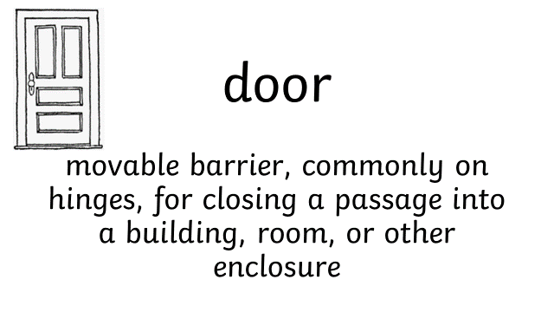

Slide 105
floor

Slide 106
floor lower surface, the bottom of a room

Slide 107
The door slammed shut.

Slide 108
The door slammed shut.

Slide 109
The floor was dirty.

Slide 110
The floor was dirty.

Slide 111
Let’s Practise and Apply.

Slide 112
Can you spot the spelling rule words and the challenge words?

Slide 113
Wild Weather
Even in the middle of summer, people in Antarctica and the Artic have to wear warm clothes. They need to wear a thick coat, hat and gloves when they travel to keep them warm! The freezing temperatures are cold enough to make uncovered little fingers, toes and noses freeze within minutes.
Emperor penguins squirrel away fish to feed their babies. They also stand close together to improve their warmth.

Slide 114
Wild Weather
Even in the middle of summer, people in Antarctica and the Artic have to wear warm clothes. They need to wear a thick coat, hat and gloves when they travel to keep them warm! The freezing temperatures are cold enough to make uncovered little fingers, toes and noses freeze within minutes.
Emperor penguins squirrel away fish to feed their babies. They also stand close together to improve their warmth.

Slide 115
Write this sentence as I dictate it to you.
Notes:
Emperor penguins squirrel away fish to feed their babies.

Slide 116
Emperor penguins squirrel away fish to feed their babies.
Did you write it correctly?
Edit your work and make sure you have it correct.
Can you underline the spelling words that we have covered in this session?

Slide 117
Year 2 - Autumn 2
Week 1 - Wednesday
Notes:
Revisit and review the words from Y2 Aut. 1 The sound /l/ spelt with ‘le’ at the end of words and challenge words move, prove, improve – I say, we say, you say
Ask children to write words only in their spelling book
Introduce the new spelling rule: The ending ‘el’. The sound /l/ spelt with ‘el’ at the end of words.
Children to write the new spelling rule words and challenge words into books when the sentences are shown with the spelling word missing.
Read the extract with the class as choral reading. Practise model of prosody etc.
Ask children to find the spelling words from the session in the text.
Then read aloud the chosen sentence for children to write fully in their books (dictation style).
Show the extract and ask children to then edit their work to check they were correct in their dictation.

Slide 118
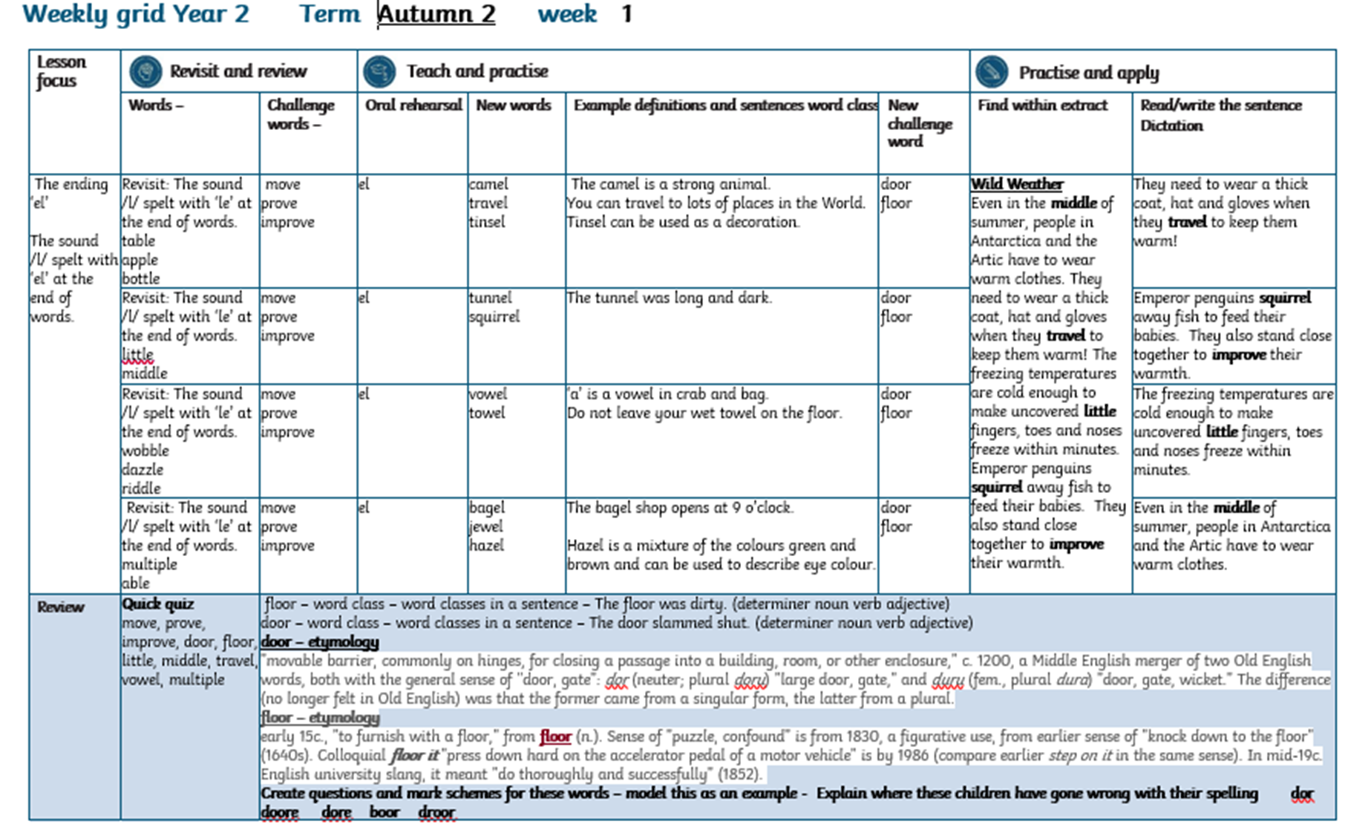

Slide 119
Let’s Revisit and Review…

Slide 120
Do you remember this challenge word?

Slide 121
prove

Slide 122
prove
Definition – to show it is true

Slide 123
prove
I need to prove I didn’t do it.

Slide 124
Do you remember this challenge word?

Slide 125
move

Slide 126
move
Definition - to change position

Slide 127
move
I love to move to music.

Slide 128
The sound /l/ spelt with ‘le’ at the end of words.

Slide 129
le

Slide 130
“le” makes the /l/ sound at the end of these words

Slide 131
wobble

Slide 132

wobble

Slide 133
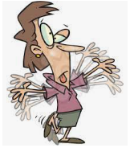
wobble

Slide 134
dazzle

Slide 135
dazzle

Slide 136
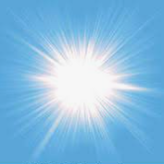
dazzle

Slide 137
riddle

Slide 138
riddle

Slide 139

riddle

Slide 140
Let’s Teach and Practise

Slide 141
The sound /l/ spelt with ‘el’ at the end of words.

Slide 142
el

Slide 143
vowel
Notes:
Just like ‘un’

Slide 144
vowel
Notes:
Just like ‘un’

Slide 145
towel

Slide 146
towel

Slide 147
vowel

Slide 148

Vowel vow + el = vowel

Slide 149
Vowel vow + el = vowel
“a” is a vowel in crab and bag.

Slide 150

towel tow + el = towel

Slide 151
towel tow + el = towel
Do not leave your wet towel on the floor.

Slide 152
“a” is a vowel in crab and bag.

Slide 153
“a” is a _____ in crab and bag.

Slide 154
“a” is a vowel in crab and bag.

Slide 155
Do not leave your wet towel on the floor.

Slide 156
Do not leave your wet _____ on the floor.

Slide 157
Do not leave your wet towel on the floor.

Slide 158
New CHALLENGE words.

Slide 159
door

Slide 160
door movable barrier, commonly on hinges, for closing a passage into a building, room, or other enclosure

Slide 161
floor

Slide 162
floor lower surface, the bottom of a room

Slide 163
Let’s Practise and Apply.

Slide 164
Can you spot the spelling rule words and the challenge words?

Slide 165
Wild Weather
Even in the middle of summer, people in Antarctica and the Artic have to wear warm clothes. They need to wear a thick coat, hat and gloves when they travel to keep them warm! The freezing temperatures are cold enough to make uncovered little fingers, toes and noses freeze within minutes.
Emperor penguins squirrel away fish to feed their babies. They also stand close together to improve their warmth.

Slide 166
Wild Weather
Even in the middle of summer, people in Antarctica and the Artic have to wear warm clothes. They need to wear a thick coat, hat and gloves when they travel to keep them warm! The freezing temperatures are cold enough to make uncovered little fingers, toes and noses freeze within minutes.
Emperor penguins squirrel away fish to feed their babies. They also stand close together to improve their warmth.

Slide 167
Write this sentence as I dictate it to you.
Notes:
The freezing temperatures are cold enough to make uncovered little fingers, toes and noses freeze within minutes.

Slide 168
The freezing temperatures are cold enough to make uncovered little fingers, toes and noses freeze within minutes.
Did you write it correctly?
Edit your work and make sure you have it correct.
Can you underline the spelling word that we have covered in this session?

Slide 169
Year 3 - Autumn 2
Week 1 - Thursday
Notes:
Revisit and review the words from Y2 with the prefix un and challenge words – I say, we say, you say
Ask children to write words only in their spelling book
Introduce the new spelling rule of mis prefix
Children to write the new spelling rule words and challenge words into books when the sentences are shown with the spelling word missing.
Read the extract with the class as choral reading. Practise model of prosody etc.
Ask children to find the spelling words from the session in the text.
Then read allowed the chosen sentence for children to write fully in their books.
Show the extract and ask children to then edit their work to check they were correct in their dictation.

Slide 171
Let’s Revisit and Review…

Slide 172
Do you remember this challenge word?

Slide 173
prove

Slide 174
prove
Definition – to show it is true

Slide 175
prove
I need to prove I didn’t do it.

Slide 176
Do you remember this challenge word?

Slide 177
move

Slide 178
move definition - to change position

Slide 179
move
I love to move to music.

Slide 180
le

Slide 181
“le” makes the /l/ sound at the end of these words

Slide 182
multiple

Slide 183

multiple

Slide 184

multiple

Slide 185
able

Slide 186

able

Slide 187
able

Slide 188
Let’s Teach and Practise

Slide 189
-el

Slide 190
The sound /l/ spelt with ‘el’ at the end of words.
Notes:
Just like ‘un’

Slide 191
bagel

Slide 192
bagel

Slide 193
jewel

Slide 194
jewel

Slide 195
hazel

Slide 196

hazel

Slide 197

bagel bag + el = bagel

Slide 198
bagel bag + el = bagel
The bagel shop opens at 9am.

Slide 199
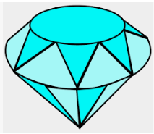
jewel jew + el = jewel

Slide 200

hazel haz + el = hazel

Slide 201
hazel haz + el = hazel
Hazel is a mixture of the colours brown and green.

Slide 202
The bagel shop opens at 9am.

Slide 203
The _____ shop opens at 9am.

Slide 204
The bagel shop opens at 9am.

Slide 205
Hazel is a mixture of the colours brown and green.

Slide 206
_____ is a mixture of the colours brown and green.

Slide 207
Hazel is a mixture of the colours brown and green.

Slide 208
New CHALLENGE words.

Slide 209
door

Slide 211
floor

Slide 212
floor lower surface, the bottom of a room

Slide 213
The door slammed shut.

Slide 214
The door slammed shut.

Slide 215
The floor was dirty.

Slide 216
The floor was dirty.

Slide 217
Let’s Practise and Apply.

Slide 218
Can you spot the spelling rule words and the challenge words?

Slide 219
Wild Weather
Even in the middle of summer, people in Antarctica and the Artic have to wear warm clothes. They need to wear a thick coat, hat and gloves when they travel to keep them warm! The freezing temperatures are cold enough to make uncovered little fingers, toes and noses freeze within minutes.
Emperor penguins squirrel away fish to feed their babies. They also stand close together to improve their warmth.

Slide 220
Wild Weather
Even in the middle of summer, people in Antarctica and the Artic have to wear warm clothes. They need to wear a thick coat, hat and gloves when they travel to keep them warm! The freezing temperatures are cold enough to make uncovered little fingers, toes and noses freeze within minutes.
Emperor penguins squirrel away fish to feed their babies. They also stand close together to improve their warmth.

Slide 221
Write this sentence as I dictate it to you.
Notes:
Even in the middle of summer, people in Antarctica and the Artic have to wear warm clothes.

Slide 222
Even in the middle of summer, people in Antarctica and the Artic have to wear warm clothes.
Did you write it correctly?
Edit your work and make sure you have it correct.
Can you underline the spelling word that we have covered in this session?

Slide 223
Year 2 - Autumn 2
Week 1 - Friday
Notes:
Click through the slides for all the R+R words for the week (both the focus and the challenge words)
Click through the slides for all the new learning this week

Slide 225
Can you read these words…
Notes:
Can you read these words?

Slide 226
move

Slide 227
prove

Slide 228
door

Slide 229
floor

Slide 230
little

Slide 231
middle

Slide 232
multiple

Slide 233
travel

Slide 234
vowel

Slide 235
Quick Quiz time…
Notes:
Say these words for the quiz can the children write these in their spelling books?
move, prove, door, floor,
little, middle, travel, vowel, multiple

Slide 236
Did you get them correct?
Edit your work.
move, prove, door, floor,
little, middle, travel, vowel, multiple
Notes:
Say these words for the quiz
move, prove, door, floor,
little, middle, travel, vowel, multiple

Slide 237
Word class time…

Slide 238
The floor was dirty.
Notes:
Ask for these words to be classed

Slide 239
The floor was dirty.
determiner noun verb adjective
Notes:
Ask for these words to be classed

Slide 240
The floor was dirty.
determiner noun verb adjective
Notes:
Ask for these words to be classed

Slide 241
The floor was dirty.
determiner noun verb adjective
Notes:
Ask for these words to be classed

Slide 242
The door slammed shut.
Notes:
Ask for these words to be classed

Slide 243
The door slammed shut.
determiner noun verb adjective
Notes:
Ask for these words to be classed

Slide 244
The door slammed shut.
determiner noun adjective verb
Notes:
Ask for these words to be classed

Slide 245
Etymology
The history of a word….

Slide 246
door – etymology
"movable barrier, commonly on hinges, for closing a passage into a building, room, or other enclosure," c. 1200, a Middle English merger of two Old English words, both with the general sense of "door, gate": dor (neuter; plural doru) "large door, gate," and duru (fem., plural dura) "door, gate, wicket." The difference (no longer felt in Old English) was that the former came from a singular form, the latter from a plural.

Slide 247
floor – etymology
early 15c., "to furnish with a floor," from floor (n.). Sense of "puzzle, confound" is from 1830, a figurative use, from earlier sense of "knock down to the floor" (1640s). Colloquial floor it "press down hard on the accelerator pedal of a motor vehicle" is by 1986 (compare earlier step on it in the same sense). In mid-19c. English university slang, it meant "do thoroughly and successfully" (1852).

Slide 248
Let’s investigate….
Can you find synonyms?
Can you create questions?

Slide 249
Synonyms of floor…
ground
flooring

Slide 250
Synonyms of door…
exit
gate
entry

Slide 251
Investigate ways of creating questions for other children using the words eight and caught.
Think about a mark scheme to show if they are correct.

Slide 252
Example…
Some children have written down the word floor and misspelled it.
Can you explain where these children have gone wrong with their spelling?
dor
doore
dore
boor
droor

Slide 253
Example…
Some children have written down the word floor and misspelled it.
Can you explain where these children have gone wrong with their spelling?
dor – they have missed out an “o”
doore – they have added an “e” at the end
dore
boor
droor

