Slide 1
Spelling Y2
Mastering spellings: building of the foundations of phonics
Autumn 2
Week 2

Slide 2
Year 2 - Autumn 2
Week 2 - Monday

Slide 3
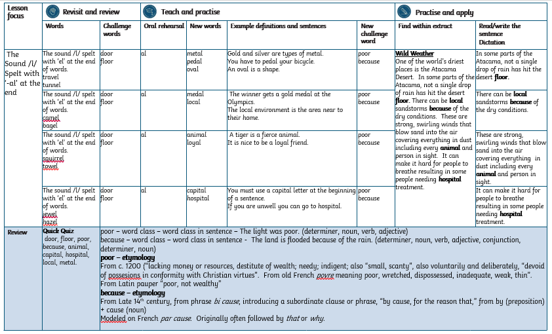

Slide 4
Let’s Revisit and Review…

Slide 5
Do you remember this challenge word?

Slide 6
door

Slide 7
door
Definition – a hinged, sliding or revolving barrier at the entrance to a room, building or vehicle.

Slide 8
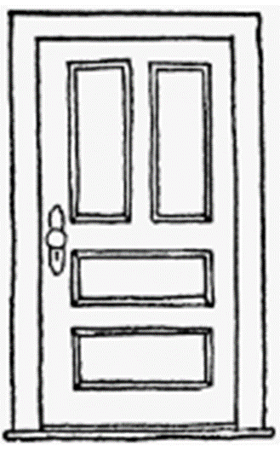
door
Close the door!

Slide 9
Do you remember this challenge word?

Slide 10
floor

Slide 11
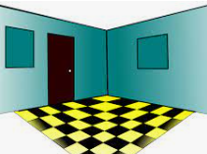
floor lower surface, the bottom of a room

Slide 12

The floor was dirty.

Slide 13
-el

Slide 14
The sound /l/ spelt with ‘el’ at the end of words.
Notes:
Just like ‘un’

Slide 15
tunnel

Slide 16
tunnel

Slide 17
travel

Slide 18
travel

Slide 19
Let’s Teach and Practise

Slide 20
al

Slide 21
“al” makes the /l/ sound at the end of these words

Slide 22
metal

Slide 23
metal

Slide 24
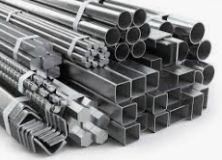
metal

Slide 25
pedal

Slide 26
pedal

Slide 27
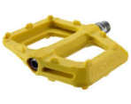
pedal

Slide 28
oval

Slide 29
oval

Slide 30
oval

Slide 31
metal

Slide 32

metal met + al = metal
Gold and silver are types of metal.

Slide 33
pedal

Slide 34
pedal ped + al = pedal

Slide 35
pedal ped + al = pedal
You have to pedal your bicycle.

Slide 36
oval

Slide 37
oval ov + al = oval

Slide 38
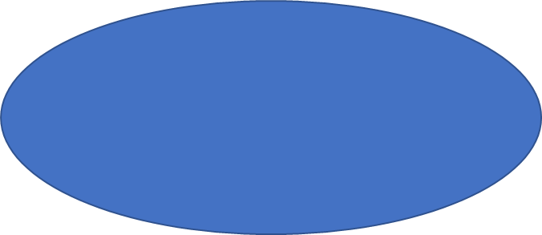
oval ov + al = oval
An oval is a shape.

Slide 39
Gold and silver are types of metal.

Slide 40
Gold and silver are types of _____.

Slide 41
Gold and silver are types of metal.

Slide 42
You have to pedal your bicycle.

Slide 43
You have to _____ your bicycle.

Slide 44
You have to pedal your bicycle.

Slide 45
An oval is a shape.

Slide 46
An ____ is a shape.

Slide 47
An oval is a shape.

Slide 48
New CHALLENGE words.

Slide 49
poor

Slide 50
poor lacking sufficient money to live at a standard considered comfortable or normal in a society

Slide 51
The man was poor.

Slide 52
because

Slide 53
for the reason that; since
because

Slide 54
It was hot because the sun was shining.

Slide 55
Let’s Practise and Apply.

Slide 56
Can you spot the spelling rule words and the challenge words?

Slide 57
Wild Weather
One of the world’s driest places is the Atacama Desert. In some parts of the Atacama, not a single drop of rain has hit the desert floor. There can be local sandstorms because of the dry conditions. These are strong, swirling winds that blow sand into the air covering everything in dust including every animal and person in sight. It can make it hard for people to breathe resulting in some people needing hospital treatment.

Slide 58
Wild Weather
One of the world’s driest places is the Atacama Desert. In some parts of the Atacama, not a single drop of rain has hit the desert floor. There can be local sandstorms because of the dry conditions. These are strong, swirling winds that blow sand into the air covering everything in dust including every animal and person in sight. It can make it hard for people to breathe resulting in some people needing hospital treatment.

Slide 59
Write this sentence as I dictate it to you.
Notes:
In some parts of the Atacama, not a single drop of rain has hit the desert floor.

Slide 60
In some parts of the Atacama, not a single drop of rain has hit the desert floor.
Did you write it correctly?
Edit your work and make sure you have it correct.
Can you underline the spelling word that we have covered in this session?

Slide 61
Year 2 - Autumn 2
Week 2 - Tuesday

Slide 63
Let’s Revisit and Review…

Slide 64
Do you remember this challenge word?

Slide 65
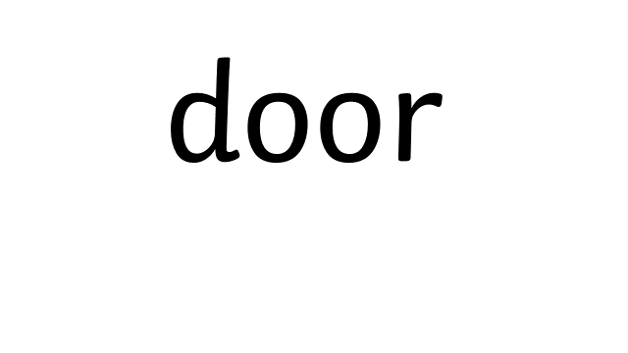

Slide 66
door
Definition – a hinged, sliding or revolving barrier at the entrance to a room, building or vehicle.

Slide 67
door
Close the door!

Slide 68
Do you remember this challenge word?

Slide 69
floor

Slide 70
floor lower surface, the bottom of a room

Slide 71
The floor was dirty.

Slide 72
-el

Slide 73
The sound /l/ spelt with ‘el’ at the end of words.
Notes:
Just like ‘un’

Slide 74
camel

Slide 75
camel

Slide 76
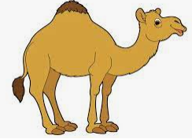
camel

Slide 77
bagel

Slide 78
bagel

Slide 79
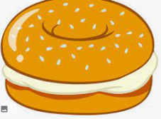
bagel

Slide 80
Let’s Teach and Practise

Slide 81
al

Slide 82
“al” makes the /l/ sound at the end of these words

Slide 83
medal

Slide 84
medal

Slide 85
local

Slide 86
local

Slide 87
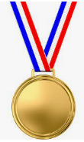
medal med + al = medal

Slide 88

medal med+ al = medal
The winner got a gold medal at the Olympics.

Slide 89
local

Slide 90
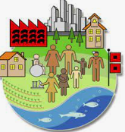
local loc + al =local

Slide 91
local loc + al = local
The local environment is the area near to their home.

Slide 92
The winner got a gold medal at the Olympics.

Slide 93
The winner got a gold _____ at the Olympics.

Slide 94
The winner got a gold medal at the Olympics.

Slide 95
The local environment is the area near to their home.

Slide 96
The _____ environment is the area near to their home.

Slide 97
The local environment is the area near to their home.

Slide 98
New CHALLENGE words.

Slide 99
poor

Slide 100
poor lacking sufficient money to live at a standard considered comfortable or normal in a society

Slide 101
The man was poor.

Slide 102
because

Slide 103
for the reason that; since
because

Slide 104
It was hot because the sun was shining.

Slide 105
Let’s Practise and Apply.

Slide 106
Can you spot the spelling rule words and the challenge words?

Slide 107
Wild Weather
One of the world’s driest places is the Atacama Desert. In some parts of the Atacama, not a single drop of rain has hit the desert floor. There can be local sandstorms because of the dry conditions. These are strong, swirling winds that blow sand into the air covering everything in dust including every animal and person in sight. It can make it hard for people to breathe resulting in some people needing hospital treatment.

Slide 108
Wild Weather
One of the world’s driest places is the Atacama Desert. In some parts of the Atacama, not a single drop of rain has hit the desert floor. There can be local sandstorms because of the dry conditions. These are strong, swirling winds that blow sand into the air covering everything in dust including every animal and person in sight. It can make it hard for people to breathe resulting in some people needing hospital treatment.

Slide 109
Write this sentence as I dictate it to you.
Notes:
There can be local sandstorms because of the dry conditions.

Slide 110
There can be local sandstorms because of the dry conditions.
Did you write it correctly?
Edit your work and make sure you have it correct.
Can you underline the spelling words that we have covered in this session?

Slide 111
Year 2 - Autumn 2
Week 2 - Wednesday

Slide 113
Let’s Revisit and Review…

Slide 114
Do you remember this challenge word?

Slide 115
door

Slide 116
door
Definition – a hinged, sliding or revolving barrier at the entrance to a room, building or vehicle.

Slide 117
door
Close the door!

Slide 118
Do you remember this challenge word?

Slide 119
floor

Slide 120
floor lower surface, the bottom of a room

Slide 121
The floor was dirty.

Slide 122
-el

Slide 123
The sound /l/ spelt with ‘el’ at the end of words.
Notes:
Just like ‘un’

Slide 124
squirrel

Slide 125

squirrel

Slide 126
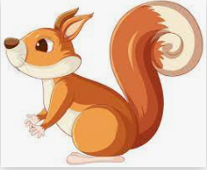
squirrel

Slide 127
towel

Slide 128
towel

Slide 129

towel

Slide 130
Let’s Teach and Practise

Slide 131
al

Slide 132
“al” makes the /l/ sound at the end of these words

Slide 133
animal
Notes:
Just like ‘un’

Slide 134
animal
Notes:
Just like ‘un’

Slide 135
loyal

Slide 136
loyal

Slide 137
animal

Slide 138
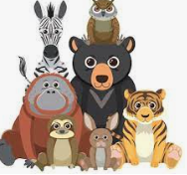
animal anim + al = animal

Slide 139
animal anim + al = animal
A tiger is a fierce animal.

Slide 140
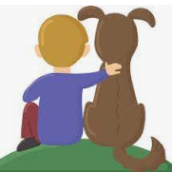
loyal loy + al = loyal

Slide 141
loyal loy + al = loyal
It is nice to be a loyal friend.

Slide 142
A tiger is a fierce animal.

Slide 143
A tiger is a fierce ______.

Slide 144
A tiger is a fierce animal.

Slide 145
It is nice to be a loyal friend.

Slide 146
It is nice to be a _____ friend.

Slide 147
It is nice to be a loyal friend.

Slide 148
New CHALLENGE words.

Slide 149
poor

Slide 150
poor lacking sufficient money to live at a standard considered comfortable or normal in a society

Slide 151
The man was poor.

Slide 152
because

Slide 153
for the reason that; since
because

Slide 154
It was hot because the sun was shining.

Slide 155
Let’s Practise and Apply.

Slide 156
Can you spot the spelling rule words and the challenge words?

Slide 157
Wild Weather
One of the world’s driest places is the Atacama Desert. In some parts of the Atacama, not a single drop of rain has hit the desert floor. There can be local sandstorms because of the dry conditions. These are strong, swirling winds that blow sand into the air covering everything in dust including every animal and person in sight. It can make it hard for people to breathe resulting in some people needing hospital treatment.

Slide 158
Wild Weather
One of the world’s driest places is the Atacama Desert. In some parts of the Atacama, not a single drop of rain has hit the desert floor. There can be local sandstorms because of the dry conditions. These are strong, swirling winds that blow sand into the air covering everything in dust including every animal and person in sight. It can make it hard for people to breathe resulting in some people needing hospital treatment.

Slide 159
Write this sentence as I dictate it to you.
Notes:
These are strong, swirling winds that blow sand into the air covering everything in dust including every animal and person in sight.

Slide 160
These are strong, swirling winds that blow sand into the air covering everything in dust including every animal and person in sight.
Did you write it correctly?
Edit your work and make sure you have it correct.
Can you underline the spelling word that we have covered in this session?

Slide 161
Year 3 - Autumn 2
Week 2 - Thursday

Slide 163
Let’s Revisit and Review…

Slide 164
Do you remember this challenge word?

Slide 165
door

Slide 166
door
Definition – a hinged, sliding or revolving barrier at the entrance to a room, building or vehicle.

Slide 167
door
Close the door!

Slide 168
Do you remember this challenge word?

Slide 169
floor

Slide 170
floor lower surface, the bottom of a room

Slide 171
The floor was dirty.

Slide 172
-el

Slide 173
The sound /l/ spelt with ‘el’ at the end of words.
Notes:
Just like ‘un’

Slide 174
jewel

Slide 175

jewel

Slide 176
hazel

Slide 177
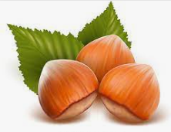
hazel

Slide 178
Let’s Teach and Practise

Slide 179
al

Slide 180
“al” makes the /l/ sound at the end of these words

Slide 181
capital

Slide 182
capital

Slide 183
hospital

Slide 184
hospital

Slide 185

capital capit + al = capital

Slide 186
capital capit+ al = capital
You must use a capital letter at the beginning of a sentence.

Slide 187
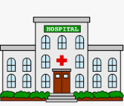
hospital hospit+ al = hospital

Slide 188
hospital hospit+ al = hospital
If you are unwell you can go to hospital.

Slide 189
You must use a capital letter at the beginning of a sentence.

Slide 190
You must use a _______ letter at the beginning of a sentence.

Slide 191
You must use a capital letter at the beginning of a sentence.

Slide 192
If you are unwell you can go to hospital.

Slide 193
If you are unwell you can go to ________.

Slide 194
If you are unwell you can go to hospital.

Slide 195
New CHALLENGE words.

Slide 196
poor

Slide 197
poor lacking sufficient money to live at a standard considered comfortable or normal in a society

Slide 198
The man was poor.

Slide 199
because

Slide 200
for the reason that; since
because

Slide 201
It was hot because the sun was shining.

Slide 202
Let’s Practise and Apply.

Slide 203
Can you spot the spelling rule words and the challenge words?

Slide 204
Wild Weather
One of the world’s driest places is the Atacama Desert. In some parts of the Atacama, not a single drop of rain has hit the desert floor. There can be local sandstorms because of the dry conditions. These are strong, swirling winds that blow sand into the air covering everything in dust including every animal and person in sight. It can make it hard for people to breathe resulting in some people needing hospital treatment.

Slide 205
Wild Weather
One of the world’s driest places is the Atacama Desert. In some parts of the Atacama, not a single drop of rain has hit the desert floor. There can be local sandstorms because of the dry conditions. These are strong, swirling winds that blow sand into the air covering everything in dust including every animal and person in sight. It can make it hard for people to breathe resulting in some people needing hospital treatment.

Slide 206
Write this sentence as I dictate it to you.
Notes:
It can make it hard for people to breathe resulting in some people needing hospital treatment.

Slide 207
It can make it hard for people to breathe resulting in some people needing hospital treatment.
Did you write it correctly?
Edit your work and make sure you have it correct.
Can you underline the spelling word that we have covered in this session?

Slide 208
Year 2 - Autumn 2
Week 2 - Friday

Slide 210
Can you read these words…
Notes:
Can you read these words?

Slide 211
door

Slide 212
floor

Slide 213
poor

Slide 214
because

Slide 215
animal

Slide 216
capital

Slide 217
hospital

Slide 218
local

Slide 219
metal

Slide 220
Quick Quiz time…
Notes:
Say these words for the quiz can the children write these in their spelling books?
door, floor, poor, because, animal, capital, hospital, local, metal.

Slide 221
Did you get them correct?
Edit your work
door, floor, poor, because, animal, capital, hospital, local, metal.
Notes:
Say these words for the quiz
move, prove, door, floor,
little, middle, travel, vowel, multiple

Slide 222
Word class time…

Slide 223
The light was poor.
Notes:
Ask for these words to be classed

Slide 224
The light was poor.
determiner noun verb adjective
Notes:
Ask for these words to be classed

Slide 225
The light was poor
determiner noun verb adjective
Notes:
Ask for these words to be classed

Slide 226
The light was poor.
determiner noun verb adjective
Notes:
Ask for these words to be classed

Slide 227
The land is flooded because of the rain.
Notes:
Ask for these words to be classed

Slide 228
The land is flooded because of the rain.
determiner noun verb adjective conjunction determiner noun
Notes:
Ask for these words to be classed

Slide 229
The land is flooded because of the rain.
determiner noun verb adjective conjunction determiner noun
Notes:
Ask for these words to be classed

Slide 230
The land is flooded because of the rain.
determiner noun verb adjective conjunction determiner noun
Notes:
Ask for these words to be classed

Slide 231
Etymology
The history of a word….

Slide 232
poor – etymology
From c. 1200 (“lacking money or resources, destitute of wealth; needy; indigent; also “small, scanty”, also voluntarily and deliberately, “devoid of possesions in conformity with Christian virtues”. From old French povre meaning poor, wretched, dispossessed, inadequate, weak, thin”. From Latin pauper “poor, not wealthy”

Slide 233
because – etymology
From Late 14th century, from phrase bi cause, introducing a subordinate clause or phrase, “by cause, for the reason that,” from by (preposition) + cause (noun)
Modeled on French par cause. Originally often followed by that or why.

Slide 234
Let’s investigate….
Can you find synonyms?
Can you create questions?

Slide 235
Synonyms of poor…
needy
imperfect
faulty

Slide 236
Synonyms of because…
since
as
for the reason that

Slide 237
Investigate ways of creating questions for other children using the words poor and because.
Think about a mark scheme to show if they are correct.

Slide 238
Example…
Some children have written down the word floor and misspelled it.
Can you explain where these children have gone wrong with their spelling?
por
poore
pore
phoor

Slide 239
Example…
Some children have written down the word floor and misspelled it.
Can you explain where these children have gone wrong with their spelling?
por – they have missed out an “o”
poore – they have added an “e” at the end
pore
poor
phoor

