Slide 1
Spelling Y2
Mastering spellings: building of the foundations of phonics
Autumn 2
Week 3

Slide 2
Year 2 - Autumn 2
Week 3 - Monday

Slide 3
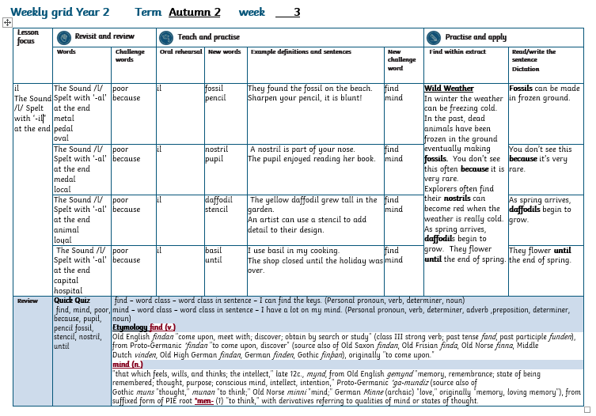

Slide 4
Let’s Revisit and Review…

Slide 5
Do you remember this challenge word?

Slide 6
poor

Slide 7
poor lacking sufficient money to live at a standard considered comfortable or normal in a society

Slide 8
The man was poor.

Slide 9
Do you remember this challenge word?

Slide 10
because

Slide 11
for the reason that; since
because

Slide 12
It was hot because the sun was shining.

Slide 13
-al

Slide 14
The sound /l/ spelt with ‘al’ at the end of words.
Notes:
Just like ‘un’

Slide 15
metal

Slide 16
metal

Slide 17
pedal

Slide 18
pedal

Slide 19
oval

Slide 20
oval

Slide 21
Let’s Teach and Practise

Slide 22
il

Slide 23
“il” makes the /l/ sound at the end of these words

Slide 24
fossil

Slide 25
fossil

Slide 26
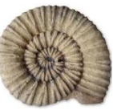
fossil

Slide 27
pencil

Slide 28
pencil

Slide 29

pencil

Slide 30
fossil

Slide 31
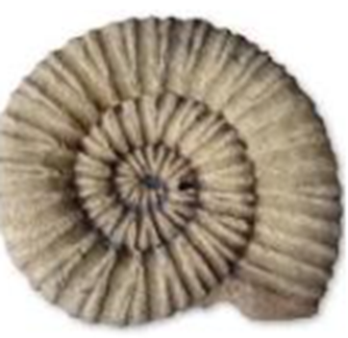
fossil foss + il = fossil

Slide 32
fossil foss + il = fossil
They found a fossil on the beach.

Slide 33
pencil

Slide 34
pencil penc + il = pencil

Slide 35
pencil penc + il = pencil
Sharpen your pencil, it is blunt!

Slide 36
They found a fossil on the beach.

Slide 37
They found a ______ on the beach.

Slide 38
They found a fossil on the beach.

Slide 39
Sharpen your pencil, it is blunt!

Slide 40
Sharpen your ______, it is blunt!

Slide 41
Sharpen your pencil, it is blunt!

Slide 42
New CHALLENGE words.

Slide 43
find

Slide 44
find to discover or identify something

Slide 45
I can’t find my keys!

Slide 46
mind

Slide 47
mind a person’s ability to think and reason

Slide 48
A lot of thoughts ran through my mind.

Slide 49
Let’s Practise and Apply.

Slide 50
Can you spot the spelling rule words and the challenge words?

Slide 51
Wild Weather
In winter the weather can be freezing cold. In the past, dead animals have been frozen in the ground eventually making fossils. You don’t see this often because it is very rare.
Explorers often find their nostrils can become red when the weather is really cold.
As spring arrives, daffodils begin to grow. They flower until the end of spring

Slide 52
Wild Weather
In winter the weather can be freezing cold. In the past, dead animals have been frozen in the ground eventually making fossils. You don’t see this often because it is very rare.
Explorers often find their nostrils can become red when the weather is really cold.
As spring arrives, daffodils begin to grow. They flower until the end of spring

Slide 53
Write this sentence as I dictate it to you.
Notes:
Fossils can be made in frozen ground.

Slide 54
Fossils can be made in frozen ground.
Did you write it correctly?
Edit your work and make sure you have it correct.
Can you underline the spelling word that we have covered in this session?

Slide 55
Year 2 - Autumn 2
Week 3 - Tuesday

Slide 57
Let’s Revisit and Review…

Slide 58
Do you remember this challenge word?

Slide 59
poor

Slide 60
poor lacking sufficient money to live at a standard considered comfortable or normal in a society

Slide 61
The man was poor.

Slide 62
Do you remember this challenge word?

Slide 63
because

Slide 64
for the reason that; since
because

Slide 65
It was hot because the sun was shining.

Slide 66
-al

Slide 67
The sound /l/ spelt with ‘al’ at the end of words.
Notes:
Just like ‘un’

Slide 68
medal

Slide 69
medal

Slide 70

medal

Slide 71
local

Slide 72
local

Slide 73

local

Slide 74
Let’s Teach and Practise

Slide 75
il

Slide 76
“il” makes the /l/ sound at the end of these words

Slide 77
nostril

Slide 78
nostril

Slide 79
pupil

Slide 80
pupil

Slide 81
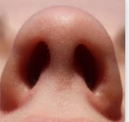
nostril nostr + il = nostril

Slide 82
nostril nostr + il = nostril
A nostril is part of your nose.

Slide 83
pupil

Slide 84

pupil pup + il =pupil

Slide 85
pupil pup + il =pupil
The pupil enjoyed reading her book.

Slide 86
A nostril is part of your nose.

Slide 87
A _______ is part of your nose.

Slide 88
A nostril is part of your nose.

Slide 89
The pupil enjoyed reading her book.

Slide 90
The _____ enjoyed reading her book.

Slide 91
The pupil enjoyed reading her book.

Slide 92
New CHALLENGE words.

Slide 93
find

Slide 94
find to discover or identify something

Slide 95
I can’t find my keys!

Slide 96
mind

Slide 97
mind a person’s ability to think and reason

Slide 98
A lot of thoughts ran through my mind.

Slide 99
Let’s Practise and Apply.

Slide 100
Can you spot the spelling rule words and the challenge words?

Slide 101
Wild Weather
In winter the weather can be freezing cold. In the past, dead animals have been frozen in the ground eventually making fossils. You don’t see this often because it is very rare.
Explorers often find their nostrils can become red when the weather is really cold.
As spring arrives, daffodils begin to grow. They flower until the end of spring.

Slide 102
Wild Weather
In winter the weather can be freezing cold. In the past, dead animals have been frozen in the ground eventually making fossils. You don’t see this often because it is very rare.
Explorers often find their nostrils can become red when the weather is really cold.
As spring arrives, daffodils begin to grow. They flower until the end of spring.

Slide 103
Write this sentence as I dictate it to you.
Notes:
You don’t see this because it’s very rare.

Slide 104
You don’t see this because it’s very rare.
Did you write it correctly?
Edit your work and make sure you have it correct.
Can you underline the spelling words that we have covered in this session?

Slide 105
Year 2 - Autumn 2
Week 3 - Wednesday

Slide 107
Let’s Revisit and Review…

Slide 108
Do you remember this challenge word?

Slide 109
poor

Slide 110
poor lacking sufficient money to live at a standard considered comfortable or normal in a society

Slide 111
The man was poor.

Slide 112
Do you remember this challenge word?

Slide 113
because

Slide 114
for the reason that; since
because

Slide 115
It was hot because the sun was shining.

Slide 116
-al

Slide 117
The sound /l/ spelt with ‘al’ at the end of words.
Notes:
Just like ‘un’

Slide 118
animal

Slide 119

animal

Slide 120
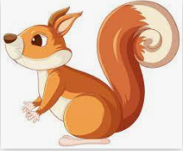
animal

Slide 121
loyal

Slide 122
loyal

Slide 123
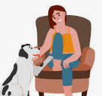
loyal

Slide 124
Let’s Teach and Practise

Slide 125
il

Slide 126
“il” makes the /l/ sound at the end of these words

Slide 127
daffodil
Notes:
Just like ‘un’

Slide 128
daffodil
Notes:
Just like ‘un’

Slide 129
stencil

Slide 130
stencil

Slide 131
daffodil

Slide 132
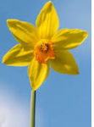
daffodil daffod + il = daffodil

Slide 133
daffodil daffod + il = daffodil
The yellow daffodil grew tall in the garden.

Slide 134
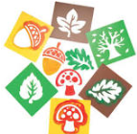
stencil stenc+ il = stencil

Slide 135
stencil stenc+ il = stencil
An artist can use a stencil to add detail to a design.

Slide 136
The yellow daffodil grew tall in the garden.

Slide 137
The yellow ________ grew tall in the garden.

Slide 138
The yellow daffodil grew tall in the garden.

Slide 139
An artist can use a stencil to add detail to a design.

Slide 140
An artist can use a _______ to add detail to a design.

Slide 141
An artist can use a stencil to add detail to a design.

Slide 142
New CHALLENGE words.

Slide 143
find

Slide 144
find to discover or identify something

Slide 145
I can’t find my keys!

Slide 146
mind

Slide 147
mind a person’s ability to think and reason

Slide 148
A lot of thoughts ran through my mind.

Slide 149
Let’s Practise and Apply.

Slide 150
Can you spot the spelling rule words and the challenge words?

Slide 151
Wild Weather
In winter the weather can be freezing cold. In the past, dead animals have been frozen in the ground eventually making fossils. You don’t see this often because it is very rare.
Explorers often find their nostrils can become red when the weather is really cold.
As spring arrives, daffodils begin to grow. They flower until the end of spring.

Slide 152
Wild Weather
In winter the weather can be freezing cold. In the past, dead animals have been frozen in the ground eventually making fossils. You don’t see this often because it is very rare.
Explorers often find their nostrils can become red when the weather is really cold.
As spring arrives, daffodils begin to grow. They flower until the end of spring.

Slide 153
Write this sentence as I dictate it to you.
Notes:
As spring arrives, daffodils begin to grow.

Slide 154
As spring arrives, daffodils begin to grow.
Did you write it correctly?
Edit your work and make sure you have it correct.
Can you underline the spelling word that we have covered in this session?

Slide 155
Year 3 - Autumn 2
Week 3 - Thursday

Slide 157
Let’s Revisit and Review…

Slide 158
Do you remember this challenge word?

Slide 159
poor

Slide 160
poor lacking sufficient money to live at a standard considered comfortable or normal in a society

Slide 161
The man was poor.

Slide 162
Do you remember this challenge word?

Slide 163
because

Slide 164
for the reason that; since
because

Slide 165
It was hot because the sun was shining.

Slide 166
-al

Slide 167
The sound /l/ spelt with ‘al’ at the end of words.
Notes:
Just like ‘un’

Slide 168
capital

Slide 169
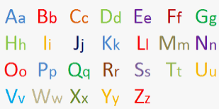
capital

Slide 170
hospital

Slide 171
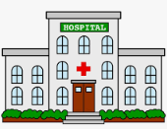
hospital

Slide 172
Let’s Teach and Practise

Slide 173
il

Slide 174
“il” makes the /l/ sound at the end of these words

Slide 175
basil

Slide 176
basil

Slide 177
until

Slide 178
until

Slide 179
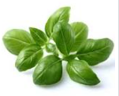
basil bas+ il = basil

Slide 180

basil bas+ il = basil
I use basil in my cooking.

Slide 181
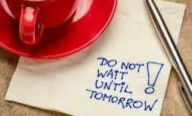
until unt+ il = until

Slide 182
until unt+ il = until
The shop closed until the holiday was over.

Slide 183
I use basil in my cooking.

Slide 184
I use _____ in my cooking.

Slide 185
I use basil in my cooking.

Slide 186
The shop is closed until the holiday is over.

Slide 187
The shop is closed _____ the holiday is over.

Slide 188
The shop is closed until the holiday is over.

Slide 189
New CHALLENGE words.

Slide 190
find

Slide 191
find to discover or identify something

Slide 192
I can’t find my keys!

Slide 193
mind

Slide 194
mind a person’s ability to think and reason

Slide 195
A lot of thoughts ran through my mind.

Slide 196
Let’s Practise and Apply.

Slide 197
Can you spot the spelling rule words and the challenge words?

Slide 198
Wild Weather
In winter the weather can be freezing cold. In the past, dead animals have been frozen in the ground eventually making fossils. You don’t see this often because it is very rare.
Explorers often find their nostrils can become red when the weather is really cold.
As spring arrives, daffodils begin to grow. They flower until the end of spring.

Slide 199
Wild Weather
In winter the weather can be freezing cold. In the past, dead animals have been frozen in the ground eventually making fossils. You don’t see this often because it is very rare.
Explorers often find their nostrils can become red when the weather is really cold.
As spring arrives, daffodils begin to grow. They flower until the end of spring.

Slide 200
Write this sentence as I dictate it to you.
Notes:
They flower until the end of spring.

Slide 201
They flower until the end of spring.
Did you write it correctly?
Edit your work and make sure you have it correct.
Can you underline the spelling word that we have covered in this session?

Slide 202
Year 2 - Autumn 2
Week 3 - Friday

Slide 204
Can you read these words…
Notes:
Can you read these words?

Slide 205
find

Slide 206
mind

Slide 207
poor

Slide 208
because

Slide 209
pupil

Slide 210
fossil

Slide 211
stencil

Slide 212
nostril

Slide 213
until

Slide 214
Quick Quiz time…
Notes:
Say these words for the quiz can the children write these in their spelling books?
find, mind, poor, because, pupil, pencil fossil, stencil, nostril,
until

Slide 215
Did you get them correct?
Edit your work
find, mind, poor, because, pupil, pencil fossil, stencil, nostril, until
Notes:
Say these words for the quiz
move, prove, door, floor,
little, middle, travel, vowel, multiple

Slide 216
Word class time…

Slide 217
I can find the keys.
Notes:
Ask for these words to be classed

Slide 218
I can find the keys.
Personal pronoun verb determiner noun
Notes:
Ask for these words to be classed

Slide 219
I have a lot on my mind.
Notes:
Ask for these words to be classed

Slide 220
I have a lot on my mind.
Personal pronoun verb determiner adverb preposition noun
Notes:
Ask for these words to be classed

Slide 221
Etymology
The history of a word….

Slide 222
find (v.)
Old English findan "come upon, meet with; discover; obtain by search or study" (class III strong verb; past tense fand, past participle funden), from Proto-Germanic *findan "to come upon, discover" (source also of Old Saxon findan, Old Frisian finda, Old Norse finna, Middle Dutch vinden, Old High German findan, German finden, Gothic finþan), originally "to come upon."

Slide 223
mind (n.)
"that which feels, wills, and thinks; the intellect," late 12c., mynd, from Old English gemynd "memory, remembrance; state of being remembered; thought, purpose; conscious mind, intellect, intention," Proto-Germanic *ga-mundiz (source also of Gothic muns "thought," munan "to think;" Old Norse minni "mind;" German Minne (archaic) "love," originally "memory, loving memory"), from suffixed form of PIE root *men- (1) "to think," with derivatives referring to qualities of mind or states of thought.

Slide 224
Let’s investigate….
Can you find synonyms?
Can you create questions?

Slide 225
Synonyms of find…
discover
catch
detect
dig out

Slide 226
Synonyms of mind…
brain
intelligence
wit
intellect

Slide 227
Investigate ways of creating questions for other children using the words find and mind.
Think about a mark scheme to show if they are correct.

Slide 228
Example…
Some children have written down the word floor and misspelled it.
Can you explain where these children have gone wrong with their spelling?
fin
fine
fid
fined

Slide 229
Example…
Some children have written down the word floor and misspelled it.
Can you explain where these children have gone wrong with their spelling?
fin – they’ve missed the “e”
fine – they’ve added an “e” instead of “d” at the end
fid
fined

