Slide 1
Spelling Y2
Mastering spellings: building of the foundations of phonics
Autumn 2
Week 4

Slide 2
Year 2 - Autumn 2
Week 4 - Monday

Slide 3
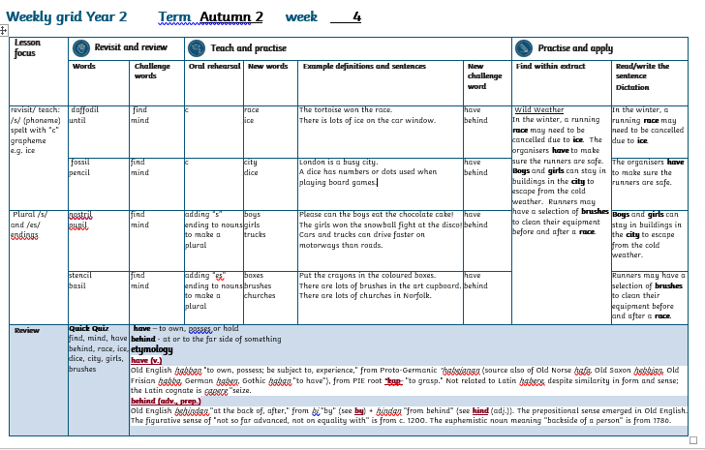

Slide 4
Let’s Revisit and Review…

Slide 5
Do you remember this challenge word?

Slide 6
find

Slide 7
find to discover or identify something

Slide 8
I can’t find my keys!

Slide 9
Do you remember this challenge word?

Slide 10
mind

Slide 11
a person’s ability to think and reason
mind

Slide 12
A lot of thoughts ran through my mind.

Slide 13
-il

Slide 14
The sound /l/ spelt with ‘il’ at the end of words.
Notes:
Just like ‘un’

Slide 15
daffodil

Slide 16
daffodil

Slide 17
until

Slide 18
until

Slide 19
Let’s Teach and Practise

Slide 20
c

Slide 21
c
/s/ (phoneme) spelt with “c” grapheme e.g. ice

Slide 22
race

Slide 23
race

Slide 24
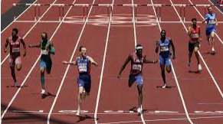
race

Slide 25
ice

Slide 26
ice

Slide 27
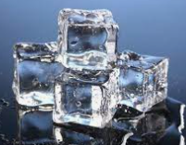
ice

Slide 28
race

Slide 29
race race
The tortoise won the race.

Slide 30
ice

Slide 31

ice ice
There is a lot of ice on the car window!

Slide 32
The tortoise won the race.

Slide 33
The tortoise won the ____.

Slide 34
The tortoise won the race.

Slide 35
There is lots of ice on the car window!

Slide 36
There is lots of ___ on the car window!

Slide 37
There is lots of ice on the car window!

Slide 38
New CHALLENGE words.

Slide 39
have

Slide 40
have to own, posses or hold

Slide 41
I have a headache!

Slide 42
behind

Slide 43
behind at or to the far side of something

Slide 44
There is a rhino behind me!

Slide 45
Let’s Practise and Apply.

Slide 46
Can you spot the spelling rule words and the challenge words?

Slide 47
Wild Weather
In the winter, a running race may need to be cancelled due to ice. The organisers have to make sure the runners are safe.
Boys and girls can stay in buildings in the city to escape from the cold weather. Runners may have a selection of brushes to clean their equipment before and after a race.

Slide 48
Wild Weather
In the winter, a running race may need to be cancelled due to ice. The organisers have to make sure the runners are safe.
Boys and girls can stay in buildings in the city to escape from the cold weather. Runners may have a selection of brushes to clean their equipment before and after a race.

Slide 49
Write this sentence as I dictate it to you.
Notes:
In the winter, a running race may need to be cancelled due to ice.

Slide 50
In the winter, a running race may need to be cancelled due to ice.
Did you write it correctly?
Edit your work and make sure you have it correct.
Can you underline the spelling word that we have covered in this session?

Slide 51
Year 2 - Autumn 2
Week 4 - Tuesday

Slide 53
Let’s Revisit and Review…

Slide 54
Do you remember this challenge word?

Slide 55
find

Slide 56


Slide 57
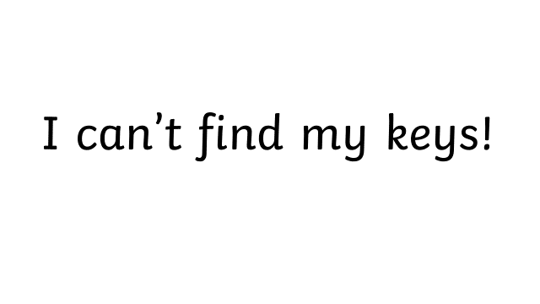

Slide 58
Do you remember this challenge word?

Slide 59
mind

Slide 60
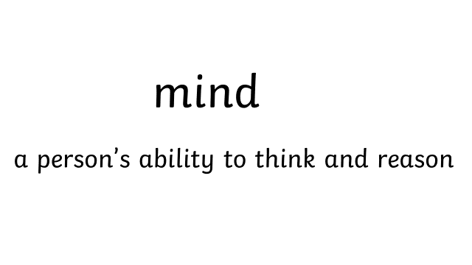

Slide 61
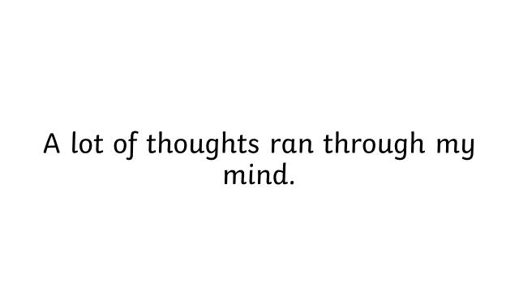
.

Slide 62
-il

Slide 63
The sound /l/ spelt with ‘il’ at the end of words.
Notes:
Just like ‘un’

Slide 64
fossil

Slide 65
fossil

Slide 66
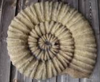
fossil

Slide 67
pencil

Slide 68
pencil

Slide 69

pencil

Slide 70
Let’s Teach and Practise

Slide 71
c

Slide 73
c
/s/ (phoneme) spelt with “c” grapheme e.g. ice

Slide 74
city

Slide 75
city

Slide 76
dice

Slide 77
dice

Slide 78
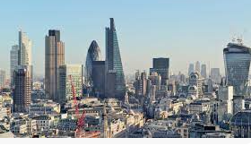
city

Slide 79
City
London is a busy city.

Slide 80
dice

Slide 81
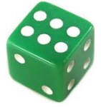
dice

Slide 82
dice
A dice has numbers or dots used when playing board games.

Slide 83
London is a busy city.

Slide 84
London is a busy ____.

Slide 85
London is a busy city.

Slide 86
A dice has numbers or dots used when playing board games.

Slide 87
A ____ has numbers or dots used when playing board games.

Slide 88
A dice has numbers or dots used when playing board games.

Slide 89
New CHALLENGE words.

Slide 90
have

Slide 91
have to own, posses or hold

Slide 92
I have a headache!

Slide 93
behind

Slide 94
behind at or to the far side of something

Slide 95
There is a rhino behind me!

Slide 96
Let’s Practise and Apply.

Slide 97
Can you spot the spelling rule words and the challenge words?

Slide 98
Wild Weather
In the winter, a running race may need to be cancelled due to ice. The organisers have to make sure the runners are safe.
Boys and girls can stay in buildings in the city to escape from the cold weather. Runners may have a selection of brushes to clean their equipment before and after a race.

Slide 99
Wild Weather
In the winter, a running race may need to be cancelled due to ice. The organisers have to make sure the runners are safe.
Boys and girls can stay in buildings in the city to escape from the cold weather. Runners may have a selection of brushes to clean their equipment before and after a race.

Slide 100
Write this sentence as I dictate it to you.
Notes:
The organisers have to make sure the runners are safe.

Slide 101
The organisers have to make sure the runners are safe.
Did you write it correctly?
Edit your work and make sure you have it correct.
Can you underline the spelling words that we have covered in this session?

Slide 102
Year 2 - Autumn 2
Week 4 - Wednesday

Slide 104
Let’s Revisit and Review…

Slide 105
Do you remember this challenge word?

Slide 106
find

Slide 107
find to discover or identify something

Slide 109
Do you remember this challenge word?

Slide 110
mind

Slide 113
-il

Slide 114
The sound /l/ spelt with ‘il’ at the end of words.
Notes:
Just like ‘un’

Slide 115
nostril

Slide 116

nostril

Slide 117
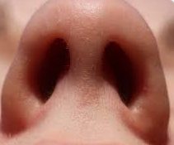
nostril

Slide 118
pupil

Slide 119
pupil

Slide 120
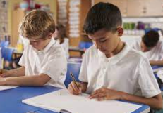
pupil

Slide 121
Let’s Teach and Practise

Slide 123
Plural /s/ and /es/ endings

Slide 124
boys
Notes:
Just like ‘un’

Slide 125
boys
Notes:
Just like ‘un’

Slide 126
girls

Slide 127
girls

Slide 128
trucks

Slide 129
trucks

Slide 130
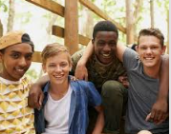
boys boy + s = boys

Slide 131
boys boy + s = boys
Please can the boys eat the chocolate cake!

Slide 132
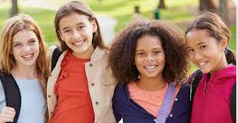
girls girl+ s = girls

Slide 133
girls girl+ s = girls
The girls won the snowball fight at the disco!

Slide 134

trucks truck + s = trucks

Slide 135
trucks truck + s = trucks
Cars and trucks can drive faster on motorways than roads.

Slide 136
Please can the boys eat the chocolate cake!

Slide 137
Please can the ____ eat the chocolate cake!

Slide 138
Please can the boys eat the chocolate cake!

Slide 139
The girls won the snowball fight at the disco!

Slide 140
The _____ won the snowball fight at the disco!

Slide 141
The girls won the snowball fight at the disco!

Slide 142
Cars and trucks can drive faster on motorways than roads.

Slide 143
Cars and ______ can drive faster on motorways than roads.

Slide 144
Cars and trucks can drive faster on motorways than roads.

Slide 145
New CHALLENGE words.

Slide 146
have

Slide 147
have to own, posses or hold

Slide 148
I have a headache!

Slide 149
behind

Slide 150
behind at or to the far side of something

Slide 151
There is a rhino behind me!

Slide 152
Let’s Practise and Apply.

Slide 153
Can you spot the spelling rule words and the challenge words?

Slide 154
Wild Weather
In the winter, a running race may need to be cancelled due to ice. The organisers have to make sure the runners are safe.
Boys and girls can stay in buildings in the city to escape from the cold weather. Runners may have a selection of brushes to clean their equipment before and after a race.

Slide 155
Wild Weather
In the winter, a running race may need to be cancelled due to ice. The organisers have to make sure the runners are safe.
Boys and girls can stay in buildings in the city to escape from the cold weather. Runners may have a selection of brushes to clean their equipment before and after a race.

Slide 156
Write this sentence as I dictate it to you.
Notes:
Boys and girls can stay in buildings in the city to escape from the cold weather.

Slide 157
Boys and girls can stay in buildings in the city to escape from the cold weather.
Did you write it correctly?
Edit your work and make sure you have it correct.
Can you underline the spelling word that we have covered in this session?

Slide 158
Year 3 - Autumn 2
Week 4 - Thursday

Slide 160
Let’s Revisit and Review…

Slide 161
Do you remember this challenge word?

Slide 162
find

Slide 163
find to discover or identify something

Slide 165
Do you remember this challenge word?

Slide 166
mind

Slide 169
-il

Slide 170
The sound /l/ spelt with ‘il’ at the end of words.
Notes:
Just like ‘un’

Slide 171
stencil

Slide 172
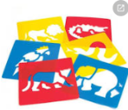
stencil

Slide 173
basil

Slide 174
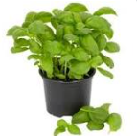
basil

Slide 175
Let’s Teach and Practise

Slide 176
Plural /s/ and /es/ endings

Slide 177
boxes

Slide 178
boxes

Slide 179
brushes

Slide 180
brushes

Slide 181
churches

Slide 182
churches

Slide 183

boxes box+ es = boxes

Slide 184
boxes box+ es = boxes
Put the crayons in the coloured boxes.

Slide 185
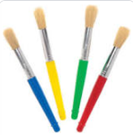
brushes brush+ es = brushes

Slide 186
brushes brush+ es = brushes
There are lots of brushes in the art cupboard.

Slide 187
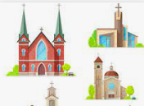
churches church+ es = churches

Slide 188
churches church+ es = churches
There are lots of churches in Norfolk.

Slide 189
Put the crayons in the coloured boxes.

Slide 190
Put the crayons in the coloured _____.

Slide 191
Put the crayons in the coloured boxes.

Slide 192
There are lots of brushes in the art cupboard.

Slide 193
There are lots of _______ in the art cupboard.

Slide 194
There are lots of brushes in the art cupboard.

Slide 195
There are lots of churches in Norfolk.

Slide 196
There are lots of ________ in Norfolk.

Slide 197
There are lots of churches in Norfolk.

Slide 198
New CHALLENGE words.

Slide 199
have

Slide 200
have to own, posses or hold

Slide 201
behind

Slide 202
behind at or to the far side of something

Slide 203
There is a rhino behind me!

Slide 204
Let’s Practise and Apply.

Slide 205
Can you spot the spelling rule words and the challenge words?

Slide 206
Wild Weather
In the winter, a running race may need to be cancelled due to ice. The organisers have to make sure the runners are safe.
Boys and girls can stay in buildings in the city to escape from the cold weather. Runners may have a selection of brushes to clean their equipment before and after a race.

Slide 207
Wild Weather
In the winter, a running race may need to be cancelled due to ice. The organisers have to make sure the runners are safe.
Boys and girls can stay in buildings in the city to escape from the cold weather. Runners may have a selection of brushes to clean their equipment before and after a race.

Slide 208
Write this sentence as I dictate it to you.
Notes:
Runners may have a selection of brushes to clean their equipment before and after a race.

Slide 209
Runners may have a selection of brushes to clean their equipment before and after a race.
Did you write it correctly?
Edit your work and make sure you have it correct.
Can you underline the spelling word that we have covered in this session?

Slide 210
Year 2 - Autumn 2
Week 4 - Friday

Slide 212
Can you read these words…
Notes:
Can you read these words?

Slide 213
find

Slide 214
mind

Slide 215
have

Slide 216
behind

Slide 217
race

Slide 218
ice

Slide 219
dice

Slide 220
city

Slide 221
girls

Slide 222
brushes

Slide 223
Quick Quiz time…
Notes:
Say these words for the quiz can the children write these in their spelling books?
find, mind, have behind, race, ice, dice, city, girls, brushes

Slide 224
Did you get them correct?
Edit your work
find, mind, have behind, race, ice, dice, city, girls, brushes
Notes:
Say these words for the quiz
move, prove, door, floor,
little, middle, travel, vowel, multiple

Slide 225
Word class time…

Slide 226
have – to own, posses or hold
Verb
Notes:
Ask for these words to be classed

Slide 227
I have the keys.
Personal pronoun verb determiner noun
Notes:
Ask for these words to be classed

Slide 228
behind – at or to the far side of something
preposition
Notes:
Ask for these words to be classed

Slide 229

We were stuck behind a tractor.
pronoun verb preposition determiner noun
Notes:
Ask for these words to be classed

Slide 230
Etymology
The history of a word….

Slide 231
have (v.)
Old English habban "to own, possess; be subject to, experience," from Proto-Germanic *habejanan (source also of Old Norse hafa, Old Saxon hebbjan, Old Frisian habba, German haben, Gothic haban "to have"), from PIE root *kap- "to grasp." Not related to Latin habere, despite similarity in form and sense; the Latin cognate is capere "seize.

Slide 232
behind (adv., prep.)
Old English behindan "at the back of, after," from bi "by" (see by) + hindan "from behind" (see hind (adj.)). The prepositional sense emerged in Old English. The figurative sense of "not so far advanced, not on equality with" is from c. 1200. The euphemistic noun meaning "backside of a person" is from 1786.

Slide 233
Let’s investigate….
Can you find synonyms?
Can you create questions?

Slide 234
Synonyms of have…
*posses
*own
*experience

Slide 235
Synonyms of behind…
at the back of
beyond
following
supporting

Slide 236
Investigate ways of creating questions for other children using the words have and behind.
Think about a mark scheme to show if they are correct.

Slide 237
Example…
Some children have written down the word floor and misspelled it.
Can you explain where these children have gone wrong with their spelling?
hav
bhind
behighnd

Slide 238
Example…
Some children have written down the word floor and misspelled it.
Can you explain where these children have gone wrong with their spelling?
Hav – missed the “e”
Bhind – missed “e”
Behighnd – used the incorrect “i” spelling

