Slide 1
Spelling Y2
Mastering spellings: building of the foundations of phonics
Autumn 2
Week 5

Slide 2
Year 2 - Autumn 2
Week 5 - Monday

Slide 3
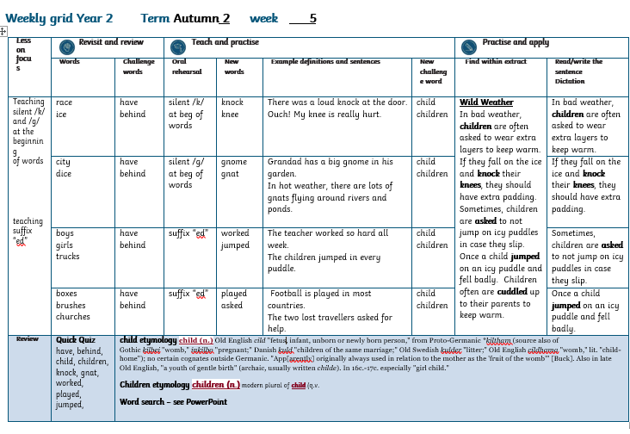

Slide 4
Let’s Revisit and Review…

Slide 5
Do you remember this challenge word?

Slide 6
have

Slide 7
have to own, posses or hold

Slide 8
I have a headache!

Slide 9
Do you remember this challenge word?

Slide 10
behind

Slide 11
behind at or to the far side of something

Slide 12
There is a rhino behind me!

Slide 13
c

Slide 14
c
/s/ (phoneme) spelt with “c” grapheme e.g. ice

Slide 15
race

Slide 16
race

Slide 17
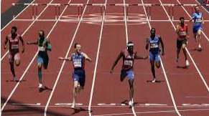
race

Slide 18
ice

Slide 19
ice

Slide 20
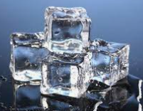
ice

Slide 21
Let’s Teach and Practise

Slide 22
/k/

Slide 23
Words with /k/ grapheme at the beginning of the words which are silent when spoken
Notes:
Just like ‘un’

Slide 24
knock

Slide 25
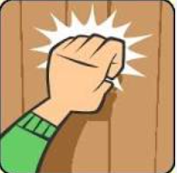
knock

Slide 26
knee

Slide 27
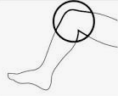
knee

Slide 28
knock k + nock = knock

Slide 29
knock k + nock = knock
There was a loud knock at the door.

Slide 30
knee k + nee = knee

Slide 31
knee k + nee = knee
Ouch! My knee is really hurt!

Slide 32
There was a loud knock at the door.

Slide 33
There was a loud _____ at the door.

Slide 34
There was a loud knock at the door.

Slide 35
Ouch! My knee is really hurt!

Slide 36
Ouch! My ____ is really hurt!

Slide 37
Ouch! My knee is really hurt!

Slide 38
New CHALLENGE words.

Slide 39
child

Slide 40
child a young human being

Slide 41
The child is lost!

Slide 42
children

Slide 43
children more than one young human beings.

Slide 44
The children were playing nicely.

Slide 45
Let’s Practise and Apply.

Slide 46
Can you spot the spelling rule words and the challenge words?

Slide 47
Wild Weather
In bad weather, children are often asked to wear extra layers to keep warm. If they fall on the ice and knock their knees, they should have extra padding. Sometimes, children are asked to not jump on icy puddles in case they slip. Once a child jumped on an icy puddle and fell badly. Children often are cuddled up to their parents to keep warm.

Slide 48
Wild Weather
In bad weather, children are often asked to wear extra layers to keep warm. If they fall on the ice and knock their knees, they should have extra padding. Sometimes, children are asked to not jump on icy puddles in case they slip. Once a child jumped on an icy puddle and fell badly. Children often are cuddled up to their parents to keep warm.

Slide 49
Write this sentence as I dictate it to you.
Notes:
In bad weather, children are often asked to wear extra layers to keep warm.

Slide 50
In bad weather, children are often asked to wear extra layers to keep warm.
Did you write it correctly?
Edit your work and make sure you have it correct.
Can you underline the spelling word that we have covered in this session?

Slide 51
Year 2 - Autumn 2
Week 5 - Tuesday

Slide 53
Let’s Revisit and Review…

Slide 54
Do you remember this challenge word?

Slide 55
have

Slide 56
have to own, posses or hold

Slide 57
I have a headache!

Slide 58
Do you remember this challenge word?

Slide 59
behind

Slide 60
behind at or to the far side of something

Slide 61
There is a rhino behind me!

Slide 62
c

Slide 63
c
/s/ (phoneme) spelt with “c” grapheme e.g. ice

Slide 64
city

Slide 65
city

Slide 66
dice

Slide 67
dice

Slide 68
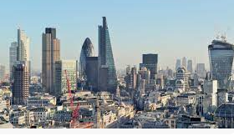
city

Slide 69
City
London is a busy city.

Slide 70
dice

Slide 71
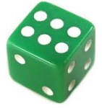
dice

Slide 72
Let’s Teach and Practise

Slide 73
/g/

Slide 74
Words with the grapheme /g/ at the beginning but are silent when spoken

Slide 75
gnome

Slide 76
gnome

Slide 77
gnat

Slide 78
gnat

Slide 79

gnome g + nome = gnome

Slide 80
gnome g + nome = gnome
Grandad has a big gnome in his garden.

Slide 81
gnat

Slide 82
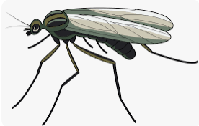
gnat g + nat =gnat

Slide 83
gnat g + nat =gnat
In hot weather, there are lots of gnats flying around rivers and ponds.

Slide 84
Grandad has a big gnome in his garden.

Slide 85
Grandad has a big _____ in his garden.

Slide 86
Grandad has a big gnome in his garden.

Slide 87
In hot weather, there are lots of gnats flying around rivers and ponds.

Slide 88
In hot weather, there are lots of _____ flying around rivers and ponds.

Slide 89
In hot weather, there are lots of gnats flying around rivers and ponds.

Slide 90
New CHALLENGE words.

Slide 91
child

Slide 92
child a young human being

Slide 93
The child is lost!

Slide 94
children

Slide 95
children more than one young human beings.

Slide 96
The children were playing nicely.

Slide 97
Let’s Practise and Apply.

Slide 98
Can you spot the spelling rule words and the challenge words?

Slide 99
Wild Weather
In bad weather, children are often asked to wear extra layers to keep warm. If they fall on the ice and knock their knees, they should have extra padding. Sometimes, children are asked to not jump on icy puddles in case they slip. Once a child jumped on an icy puddle and fell badly. Children often are cuddled up to their parents to keep warm.

Slide 100
Wild Weather
In bad weather, children are often asked to wear extra layers to keep warm. If they fall on the ice and knock their knees, they should have extra padding. Sometimes, children are asked to not jump on icy puddles in case they slip. Once a child jumped on an icy puddle and fell badly. Children often are cuddled up to their parents to keep warm.

Slide 101
Write this sentence as I dictate it to you.
Notes:
If they fall on the ice and knock their knees, they should have extra padding.

Slide 102
If they fall on the ice and knock their knees, they should have extra padding.
Did you write it correctly?
Edit your work and make sure you have it correct.
Can you underline the spelling words that we have covered in this session?

Slide 103
Year 2 - Autumn 2
Week 5 - Wednesday

Slide 105
Let’s Revisit and Review…

Slide 106
Do you remember this challenge word?

Slide 107
have

Slide 108
have to own, posses or hold

Slide 109
I have a headache!

Slide 110
Do you remember this challenge word?

Slide 111
behind

Slide 112
behind at or to the far side of something

Slide 113
There is a rhino behind me!

Slide 114
Plural /s/ and /es/ endings

Slide 115
boys
Notes:
Just like ‘un’

Slide 116

boys
Notes:
Just like ‘un’

Slide 117
girls

Slide 118
girls

Slide 119
trucks

Slide 120
trucks

Slide 121
Let’s Teach and Practise

Slide 122
ed

Slide 123
ed adding the suffix “ed” at the end of words to show the thing happened in the past.

Slide 124
worked
Notes:
Just like ‘un’

Slide 125
worked
Notes:
Just like ‘un’

Slide 126
jumped

Slide 127
jumped

Slide 128
worked

Slide 129

worked work+ ed = worked

Slide 130
worked work + ed = worked
The teacher worked so hard all week.

Slide 131
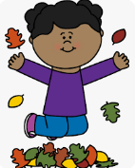
jumped jump+ed = jumped

Slide 132
jumped jump+ ed = jumped
The children jumped in every puddle.

Slide 133
The teacher worked so hard all week.

Slide 134
The teacher ______ so hard all week.

Slide 135
The teacher worked so hard all week.

Slide 136
The children jumped in every puddle.

Slide 137
The children ______ in every puddle.

Slide 138
The children jumped in every puddle.

Slide 139
New CHALLENGE words.

Slide 140
child

Slide 141
child a young human being

Slide 142
The child is lost!

Slide 143
children

Slide 144
children more than one young human beings.

Slide 145
The children were playing nicely.

Slide 146
Let’s Practise and Apply.

Slide 147
Can you spot the spelling rule words and the challenge words?

Slide 148
Wild Weather
In bad weather, children are often asked to wear extra layers to keep warm. If they fall on the ice and knock their knees, they should have extra padding. Sometimes, children are asked to not jump on icy puddles in case they slip. Once a child jumped on an icy puddle and fell badly. Children often are cuddled up to their parents to keep warm.

Slide 149
Wild Weather
In bad weather, children are often asked to wear extra layers to keep warm. If they fall on the ice and knock their knees, they should have extra padding. Sometimes, children are asked to not jump on icy puddles in case they slip. Once a child jumped on an icy puddle and fell badly. Children often are cuddled up to their parents to keep warm.

Slide 150
Write this sentence as I dictate it to you.
Notes:
Sometimes, children are asked to not jump on icy puddles in case they slip.

Slide 151
Sometimes, children are asked to not jump on icy puddles in case they slip.
Did you write it correctly?
Edit your work and make sure you have it correct.
Can you underline the spelling word that we have covered in this session?

Slide 152
Year 3 - Autumn 2
Week 5 - Thursday

Slide 154
Let’s Revisit and Review…

Slide 155
Do you remember this challenge word?

Slide 156
have

Slide 157
have to own, posses or hold

Slide 158
I have a headache!

Slide 159
Do you remember this challenge word?

Slide 160
behind

Slide 161
behind at or to the far side of something

Slide 162
There is a rhino behind me!

Slide 163
Plural /s/ and /es/ endings

Slide 164
boxes

Slide 165
boxes

Slide 166
brushes

Slide 167
brushes

Slide 168
churches

Slide 169
churches

Slide 170
Let’s Teach and Practise

Slide 171
ed

Slide 172
ed adding the suffix “ed” at the end of words to show the thing happened in the past.

Slide 173
played

Slide 174
played

Slide 175
asked

Slide 176
asked

Slide 177
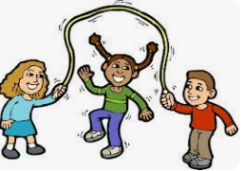
played play+ ed= played

Slide 178
Played play+ ed = played
Football is played in most countries.

Slide 179

asked ask+ ed =asked

Slide 180
asked ask+ ed = asked
The two lost travellers asked for help.

Slide 181
Football is played in most countries.

Slide 182
Football is ______ in most countries.

Slide 183
Football is played in most countries.

Slide 184
The two lost travellers asked for help.

Slide 185
The two lost travellers _____ for help.

Slide 186
The two lost travellers asked for help.

Slide 187
New CHALLENGE words.

Slide 188
child

Slide 189
child a young human being

Slide 190
The child is lost!

Slide 191
children

Slide 192
children more than one young human beings.

Slide 193
The children were playing nicely.

Slide 194
Let’s Practise and Apply.

Slide 195
Can you spot the spelling rule words and the challenge words?

Slide 196
Wild Weather
In bad weather, children are often asked to wear extra layers to keep warm. If they fall on the ice and knock their knees, they should have extra padding. Sometimes, children are asked to not jump on icy puddles in case they slip. Once a child jumped on an icy puddle and fell badly. Children often are cuddled up to their parents to keep warm.

Slide 197
Wild Weather
In bad weather, children are often asked to wear extra layers to keep warm. If they fall on the ice and knock their knees, they should have extra padding. Sometimes, children are asked to not jump on icy puddles in case they slip. Once a child jumped on an icy puddle and fell badly. Children often are cuddled up to their parents to keep warm.

Slide 198
Write this sentence as I dictate it to you.
Notes:
Once a child jumped on an icy puddle and fell badly.

Slide 199
Once a child jumped on an icy puddle and fell badly.
Did you write it correctly?
Edit your work and make sure you have it correct.
Can you underline the spelling word that we have covered in this session?

Slide 200
Year 2 - Autumn 2
Week 5 - Friday

Slide 202
Can you read these words…
Notes:
Can you read these words?

Slide 203
have

Slide 204
behind

Slide 205
child

Slide 206
children

Slide 207
knock

Slide 208
gnat

Slide 209
worked

Slide 210
played

Slide 211
jumped

Slide 212
Quick Quiz time…
Notes:
Say these words for the quiz can the children write these in their spelling books?
have, behind, child, children, knock, gnat, worked, played, jumped,

Slide 213
Did you get them correct?
Edit your work
have, behind, child, children, knock, gnat, worked, played, jumped
Notes:
Say these words for the quiz
move, prove, door, floor,
little, middle, travel, vowel, multiple

Slide 214
Word class time…

Slide 215
I love children.
Notes:
Ask for these words to be classed

Slide 216
I love children.
Personal pronoun verb noun
Notes:
Ask for these words to be classed

Slide 217
The child was cross.
Notes:
Ask for these words to be classed

Slide 218
The child was cross.
determiner noun verb adjective
Notes:
Ask for these words to be classed

Slide 219
Etymology
The history of a word….

Slide 220
child (n.)
Old English cild "fetus, infant, unborn or newly born person," from Proto-Germanic *kiltham (source also of Gothic kilþei "womb," inkilþo "pregnant;" Danish kuld "children of the same marriage;" Old Swedish kulder "litter;" Old English cildhama "womb," lit. "child-home"); no certain cognates outside Germanic. "App[arently] originally always used in relation to the mother as the 'fruit of the womb'" [Buck]. Also in late Old English, "a youth of gentle birth" (archaic, usually written childe). In 16c.-17c. especially "girl child."

Slide 221
children (n.)
modern plural of child (q.v.)

Slide 222
Let’s investigate….
Can you find our words in this wordsearch?

Slide 223
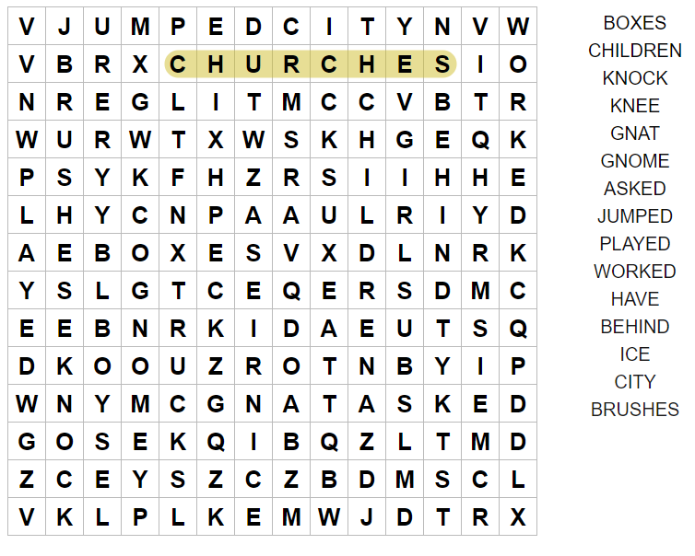

Slide 224
