Slide 1
Spelling Y2
Mastering spellings: building of the foundations of phonics
Autumn 2
Week 6

Slide 2
Year 2 - Autumn 2
Week 6 - Monday

Slide 3
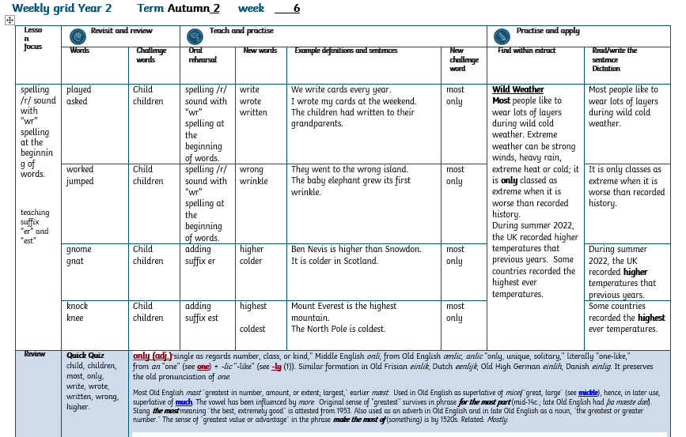

Slide 4
Let’s Revisit and Review…

Slide 5
Do you remember this challenge word?

Slide 6
child

Slide 7
child a young human being

Slide 8
The child is lost!

Slide 9
children

Slide 10
children more than one young human beings.

Slide 11
The children were playing nicely.

Slide 12
ed adding the suffix “ed” at the end of words to show the thing happened in the past.

Slide 13
played

Slide 14
played

Slide 15
asked

Slide 16
asked

Slide 17
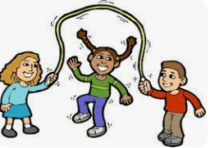
played play+ ed= played

Slide 18
Played play+ ed = played
Football is played in most countries.

Slide 19
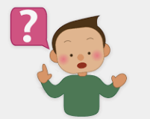
asked ask+ ed =asked

Slide 20
asked ask+ ed = asked
The two lost travellers asked for help.

Slide 21
Let’s Teach and Practise

Slide 22
/r/

Slide 23
The /r/ phoneme spelt with “wr” graphemes.
Notes:
Just like ‘un’

Slide 24
write

Slide 25
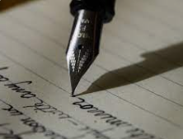
write

Slide 26
wrote

Slide 27
wrote

Slide 28
written

Slide 29
written

Slide 30
knock k + nock = knock

Slide 31
write wr+ ite = write
We write cards every year.

Slide 32
wrote wr + ote = wrote

Slide 33
wrote wr + ote = wrote
I wrote my cards at the weekend.

Slide 34
written wr + itten = written

Slide 35
written wr + itten = written
The children had written to their grandparents.

Slide 36
We write cards every year.

Slide 37
We _____ cards every year.

Slide 38
We write cards every year.

Slide 39
I wrote my cards at the weekend.

Slide 40
I _____ my cards at the weekend.

Slide 41
I wrote my cards at the weekend.

Slide 42
The children had written to their grandparents.

Slide 43
The children had _______ to their grandparents.

Slide 44
The children had written to their grandparents.

Slide 45
New CHALLENGE words.

Slide 46
most

Slide 47
most greatest in amount

Slide 48
We had the most sweets!

Slide 49
only

Slide 50
only solely

Slide 51
There was only one tree left.

Slide 52
Let’s Practise and Apply.

Slide 53
Can you spot the spelling rule words and the challenge words?

Slide 54
Wild Weather
Most people like to wear lots of layers during wild cold weather. Extreme weather can be strong winds, heavy rain, extreme heat or cold; it is only classed as extreme when it is worse than recorded history.
During summer 2022, the UK recorded higher temperatures that previous years. Some countries recorded the highest ever temperatures.

Slide 55
Wild Weather
Most people like to wear lots of layers during wild cold weather. Extreme weather can be strong winds, heavy rain, extreme heat or cold; it is only classed as extreme when it is worse than recorded history.
During summer 2022, the UK recorded higher temperatures that previous years. Some countries recorded the highest ever temperatures.

Slide 56
Write this sentence as I dictate it to you.
Notes:
Most people like to wear lots of layers during wild cold weather.

Slide 57
Most people like to wear lots of layers during wild cold weather.
Did you write it correctly?
Edit your work and make sure you have it correct.
Can you underline the spelling word that we have covered in this session?

Slide 58
Year 2 - Autumn 2
Week 6 - Tuesday

Slide 60
Let’s Revisit and Review…

Slide 61
Do you remember this challenge word?

Slide 62
child

Slide 63
child a young human being

Slide 64
The child is lost!

Slide 65
children

Slide 66
children more than one young human beings.

Slide 67
The children were playing nicely.

Slide 68
worked
Notes:
Just like ‘un’

Slide 69

worked
Notes:
Just like ‘un’

Slide 70
jumped

Slide 71
jumped

Slide 72
Let’s Teach and Practise

Slide 73
/r/

Slide 74
spelling /r/ sound with “wr” spelling at the beginning of words

Slide 75
wrong

Slide 76
wrong

Slide 77
wrinkle

Slide 78
wrinkle

Slide 79

wrong wr + ong = wrong

Slide 80
Wrong wr + ong = wrong
They went to the wrong island.

Slide 81
wrinkle

Slide 82
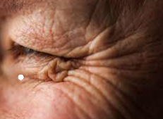
wrinkle wr + inkle =wrinkle

Slide 83
wrinkle wr + inkle = wrinkle
The baby elephant grew it’s first wrinkle.

Slide 84
They went to the wrong island.

Slide 85
They went to the _____ island.

Slide 86
They went to the wrong island.

Slide 87
The baby elephant grew it’s first wrinkle.

Slide 88
The baby elephant grew it’s first _______.

Slide 89
The baby elephant grew it’s first wrinkle.

Slide 90
New CHALLENGE words.

Slide 91
most

Slide 92
most greatest in amount

Slide 93
We had the most sweets!

Slide 94
only

Slide 95
only solely

Slide 96
There was only one tree left.

Slide 97
Let’s Practise and Apply.

Slide 98
Can you spot the spelling rule words and the challenge words?

Slide 99
Wild Weather
Most people like to wear lots of layers during wild cold weather. Extreme weather can be strong winds, heavy rain, extreme heat or cold; it is only classed as extreme when it is worse than recorded history.
During summer 2022, the UK recorded higher temperatures that previous years. Some countries recorded the highest ever temperatures.

Slide 100
Wild Weather
Most people like to wear lots of layers during wild cold weather. Extreme weather can be strong winds, heavy rain, extreme heat or cold; it is only classed as extreme when it is worse than recorded history.
During summer 2022, the UK recorded higher temperatures that previous years. Some countries recorded the highest ever temperatures.

Slide 101
Write this sentence as I dictate it to you.
Notes:
It is only classes as extreme when it is worse than recorded history.

Slide 102
It is only classes as extreme when it is worse than recorded history.
Did you write it correctly?
Edit your work and make sure you have it correct.
Can you underline the spelling words that we have covered in this session?

Slide 103
Year 2 - Autumn 2
Week 6 - Wednesday

Slide 105
Let’s Revisit and Review…

Slide 106
Do you remember this challenge word?

Slide 107
child

Slide 108
child a young human being

Slide 109
The child is lost!

Slide 110
children

Slide 111
children more than one young human beings.

Slide 112
The children were playing nicely.

Slide 113
gnome

Slide 114
gnome

Slide 115
gnat

Slide 116
gnat

Slide 117
Let’s Teach and Practise

Slide 118
er

Slide 119
er adding the suffix “er” at the end of words to compare

Slide 120
higher
Notes:
Just like ‘un’

Slide 121
higher
Notes:
Just like ‘un’

Slide 122
colder

Slide 123
colder

Slide 124
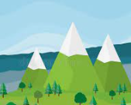
higher high+ er = higher

Slide 125
higher high + er = higher
Ben Nevis is higher than Snowdon.

Slide 126
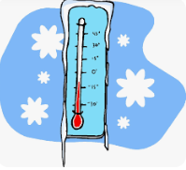
colder cold+er = colder

Slide 127
colder cold+ er = colder
It is colder in Scotland.

Slide 128
Ben Nevis is higher than Snowdon.

Slide 129
Ben Nevis is ______ than Snowdon.

Slide 130
Ben Nevis is higher than Snowdon.

Slide 131
It is colder in Scotland.

Slide 132
It is ______ in Scotland.

Slide 133
It is colder in Scotland.

Slide 134
New CHALLENGE words.

Slide 135
most

Slide 136
most greatest in amount

Slide 137
We had the most sweets!

Slide 138
only

Slide 139
only solely

Slide 140
There was only one tree left.

Slide 141
Let’s Practise and Apply.

Slide 142
Can you spot the spelling rule words and the challenge words?

Slide 143
Wild Weather
Most people like to wear lots of layers during wild cold weather. Extreme weather can be strong winds, heavy rain, extreme heat or cold; it is only classed as extreme when it is worse than recorded history.
During summer 2022, the UK recorded higher temperatures that previous years. Some countries recorded the highest ever temperatures.

Slide 144
Wild Weather
Most people like to wear lots of layers during wild cold weather. Extreme weather can be strong winds, heavy rain, extreme heat or cold; it is only classed as extreme when it is worse than recorded history.
During summer 2022, the UK recorded higher temperatures that previous years. Some countries recorded the highest ever temperatures.

Slide 145
Write this sentence as I dictate it to you.
Notes:
During summer 2022, the UK recorded higher temperatures that previous years

Slide 146
During summer 2022, the UK recorded higher temperatures that previous years.
Did you write it correctly?
Edit your work and make sure you have it correct.
Can you underline the spelling word that we have covered in this session?

Slide 147
Year 3 - Autumn 2
Week -6 Thursday

Slide 149
Let’s Revisit and Review…

Slide 150
Do you remember this challenge word?

Slide 151
child

Slide 152
child a young human being

Slide 153
The child is lost!

Slide 154
children

Slide 155
children more than one young human beings.

Slide 156
The children were playing nicely.

Slide 157
knock

Slide 158
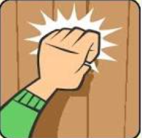
knock

Slide 159
knee

Slide 160
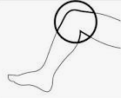
knee

Slide 161
Let’s Teach and Practise

Slide 162
est

Slide 163
Est adding the suffix “est” at the end of words to compare

Slide 164
highest

Slide 165
highest

Slide 166
coldest

Slide 167
coldest

Slide 168
highest high+ est= highest

Slide 169
highest high+ est = highest
Mount Everest is the highest mountain.

Slide 170
coldest cold + est = coldest

Slide 171
coldest cold+ est = coldest
The North Pole is the coldest.

Slide 172
Mount Everest is the highest mountain.

Slide 173
Mount Everest is the _______ mountain.

Slide 174
Mount Everest is the highest mountain.

Slide 175
The North Pole is the coldest.

Slide 176
The North Pole is the _______.

Slide 177
The North Pole is the coldest.

Slide 178
New CHALLENGE words.

Slide 179
most

Slide 180
most greatest in amount

Slide 181
We had the most sweets!

Slide 182
only

Slide 183
only solely

Slide 184
There was only one tree left.

Slide 185
Let’s Practise and Apply.

Slide 186
Can you spot the spelling rule words and the challenge words?

Slide 187
Wild Weather
Most people like to wear lots of layers during wild cold weather. Extreme weather can be strong winds, heavy rain, extreme heat or cold; it is only classed as extreme when it is worse than recorded history.
During summer 2022, the UK recorded higher temperatures that previous years. Some countries recorded the highest ever temperatures.

Slide 188
Wild Weather
Most people like to wear lots of layers during wild cold weather. Extreme weather can be strong winds, heavy rain, extreme heat or cold; it is only classed as extreme when it is worse than recorded history.
During summer 2022, the UK recorded higher temperatures that previous years. Some countries recorded the highest ever temperatures.

Slide 189
Write this sentence as I dictate it to you.
Notes:
Some countries recorded the highest ever temperatures.

Slide 190
Some countries recorded the highest ever temperatures.
Did you write it correctly?
Edit your work and make sure you have it correct.
Can you underline the spelling word that we have covered in this session?

Slide 191
Year 2 - Autumn 2
Week 6 - Friday

Slide 193
Can you read these words…
Notes:
Can you read these words?

Slide 194
child

Slide 195
children

Slide 196
most

Slide 197
only

Slide 198
write

Slide 199
wrote

Slide 200
written

Slide 201
wrong

Slide 202
higher

Slide 203
Quick Quiz time…
Notes:
Say these words for the quiz can the children write these in their spelling books?
child, children, most, only, write, wrote, written, wrong, higher.

Slide 204
Did you get them correct?
Edit your work
child, children, most, only, write, wrote, written, wrong, higher.
Notes:
Say these words for the quiz
move, prove, door, floor,
little, middle, travel, vowel, multiple

Slide 205
Word class time…

Slide 206
We had the most sweets.
Notes:
Ask for these words to be classed

Slide 207
We had the most sweets.
pronoun verb determiner adverb noun
Notes:
Ask for these words to be classed

Slide 208
There was only one tree left.
Notes:
Ask for these words to be classed

Slide 209
There was only one tree left.
Adverb verb adverb adjective noun
Notes:
Ask for these words to be classed

Slide 210
Etymology
The history of a word….

Slide 211
Most
Old English mast "greatest in number, amount, or extent; largest," earlier mæst. Used in Old English as superlative of micel "great, large" (see mickle), hence, in later use, superlative of much. The vowel has been influenced by more. Original sense of "greatest" survives in phrase for the most part (mid-14c.; late Old English had þa mæste dæl). Slang the most meaning "the best, extremely good" is attested from 1953. Also used as an adverb in Old English and in late Old English as a noun, "the greatest or greater number." The sense of "greatest value or advantage" in the phrase make the most of (something) is by 1520s. Related: Mostly.

Slide 212
only (adj.)
"single as regards number, class, or kind," Middle English onli, from Old English ænlic, anlic "only, unique, solitary," literally "one-like," from an "one" (see one) + -lic "-like" (see -ly (1)). Similar formation in Old Frisian einlik, Dutch eenlijk, Old High German einlih, Danish einlig. It preserves the old pronunciation of one.

Slide 213
Let’s investigate….
Can you find our words in this wordsearch?

Slide 214
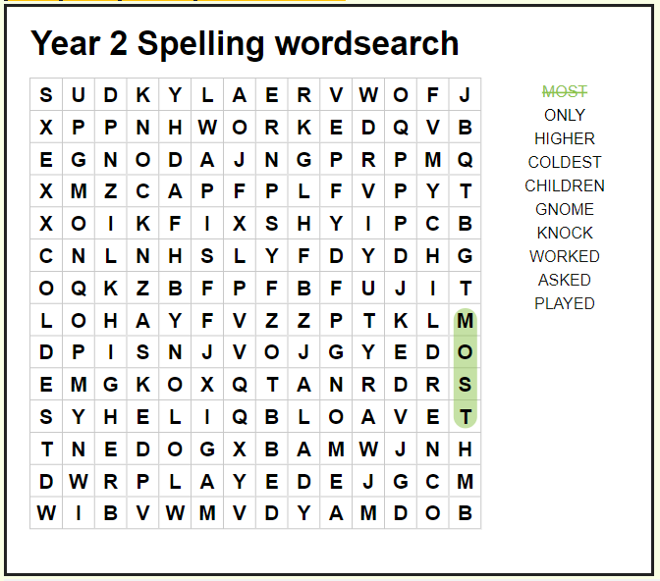

Slide 215
