Slide 1
Spelling Y2
Mastering spellings: building on the foundations of phonics
Spring 1
Week 1

Slide 2
These slides are slightly different - to reduce the number there are now animations used
Please use these slides in full screen slide show mode to ensure they work how they are designed with chunks of information being shown at a time to prevent overload
Thank you

Slide 3
Year 2 - Spring 1
Week 1 - Monday

Slide 4
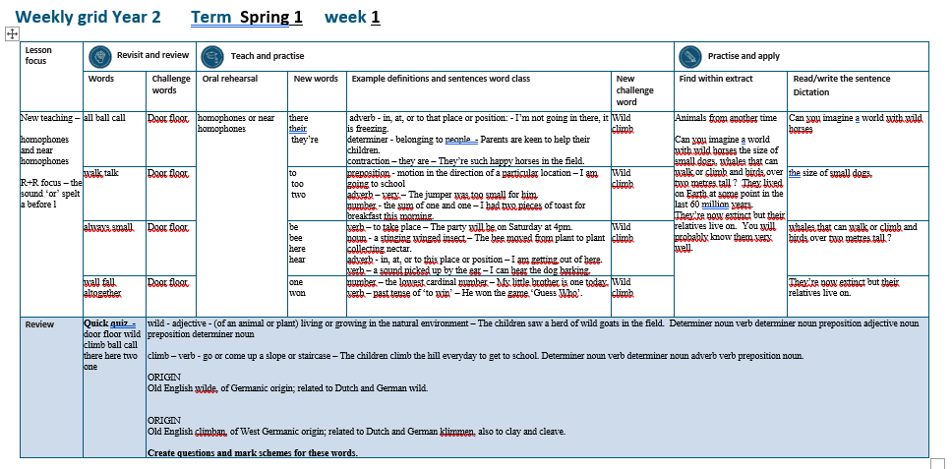

Slide 5
Let’s Revisit and Review…

Slide 6
Do you remember this challenge word?

Slide 7

door
What could be behind the door?
Notes:
View in slide show mode to have each aspect appear separately

Slide 8
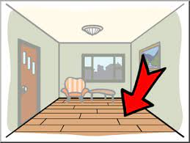
floor
Be careful not to slip on the wet floor.
Notes:
View in slide show mode to have each aspect appear separately

Slide 9
Do you remember the sound ‘or’ spelt ‘a’ before ‘l’

Slide 10
al
Sounds ‘or’

Slide 11
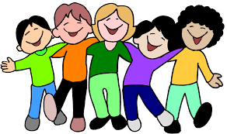
all

Slide 12

ball

Slide 13

call

Slide 14
Let’s Teach and Practise

Slide 15
homophones or near homophones homo = same phone = sound

Slide 16
homophones

Slide 17
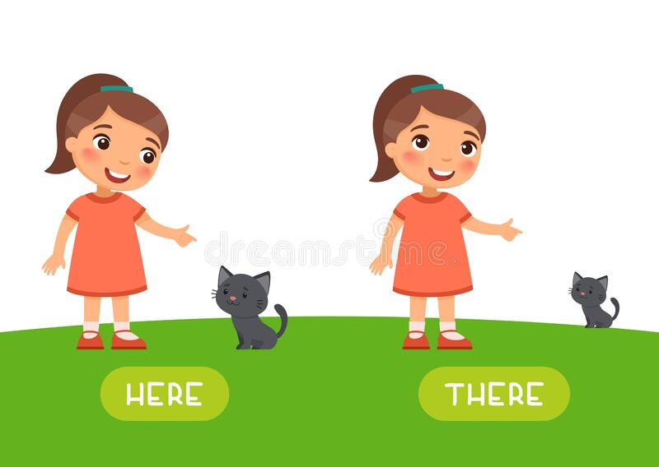
there

Slide 18

their

Slide 19
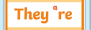
they’re

Slide 20
there
ADVERB
Definition - in, at, or to that place or position

Slide 21
their
DETERMINER
Definition - belonging to people

Slide 22
they’re
CONTRACTION
Definition – they are

Slide 23
I’m not going in there, it is freezing.
_____,

Slide 24
Parents are keen to help their children.
_____

Slide 25
They’re such happy horses in the field.
_______

Slide 26
New CHALLENGE words.

Slide 27
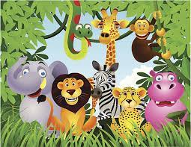
wild
ADJECTIVE
Definition - (of an animal or plant) living or growing in the natural environment

Slide 28
The children saw a herd of wild goats in the field.
____

Slide 29
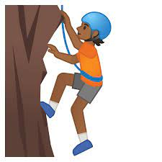
climb
VERB
Definition - go or come up a slope or staircase

Slide 30
The children climb the hill everyday to get to school.
_____

Slide 31
Let’s Practise and Apply.

Slide 32
Can you spot the spelling rule words and the challenge words?

Slide 33
Animals from another time
Can you imagine a world with wild horses the size of small dogs, whales that can walk or climb and birds over two metres tall ? They lived on Earth at some point in the last 60 million years. They’re now extinct but their relatives live on. You will probably know them very well.

Slide 34
Animals from another time
Can you imagine a world with wild horses the size of small dogs, whales that can walk or climb and birds over two metres tall ? They lived on Earth at some point in the last 60 million years. They’re now extinct but their relatives live on. You will probably know them very well.

Slide 35
Write this sentence as I dictate it to you.
Notes:
Can you imagine a world with wild horses… (continue sentence tomorrow)

Slide 36
Can you imagine a world with wild horses…
Did you write it correctly?
Edit your work and make sure you have it correct.
Can you underline the spelling word that we have covered in this session?

Slide 37
Year 2 - Spring 1
Week 1 - Tuesday
Notes:
Revisit and review the words from previous teaching and challenge words – I say, we say, you say
Ask children to write words only in their spelling book
Introduce the new spelling rule
Children to write the new spelling rule words and challenge words into books when the sentences are shown with the spelling word missing.
Read the extract with the class as choral reading. Practise model of prosody etc.
Ask children to find the spelling words from the session in the text.
Then read allowed the chosen sentence for children to write fully in their books.
Show the extract and ask children to then edit their work to check they were correct in their dictation.

Slide 39
Let’s Revisit and Review…

Slide 40
Do you remember this challenge word?

Slide 41
door
What could be behind the door?
Notes:
View in slide show mode to have each aspect appear separately

Slide 42
floor
Be careful not to slip on the wet floor.
Notes:
View in slide show mode to have each aspect appear separately

Slide 43
Do you remember the sound ‘or’ spelt ‘a’ before ‘l’

Slide 44
al
Sounds ‘or’

Slide 45
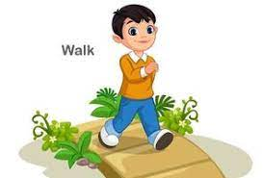
walk

Slide 46
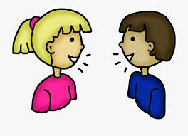
talk

Slide 47
Let’s Teach and Practise

Slide 48
homophones or near homophones homo = same phone = sound

Slide 49
homophones

Slide 50
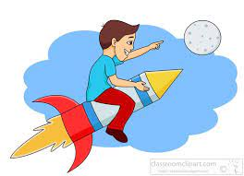
to

Slide 51
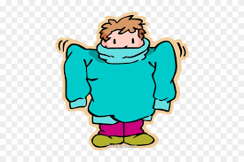
too

Slide 52

two

Slide 53
to
PREPOSITION
Definition - motion in the direction of a particular location

Slide 54
too
ADVERB
Definition - very

Slide 55
two
NUMBER
Definition – the sum of one and one

Slide 56
I am going to school
__

Slide 57
The jumper was too big for him.
___

Slide 58
I had two pieces of toast for breakfast this morning.
___

Slide 59
New CHALLENGE words.

Slide 60
wild
ADJECTIVE
Definition - (of an animal or plant) living or growing in the natural environment

Slide 61
The children saw a herd of wild goats in the field.
____

Slide 62
climb
VERB
Definition - go or come up a slope or staircase

Slide 63
The children climb the hill everyday to get to school.
_____

Slide 64
Let’s Practise and Apply.

Slide 65
Can you spot the spelling rule words and the challenge words?

Slide 66
Animals from another time
Can you imagine a world with wild horses the size of small dogs, whales that can walk or climb and birds over two metres tall ? They lived on Earth at some point in the last 60 million years. They’re now extinct but their relatives live on. You will probably know them very well.

Slide 67
Animals from another time
Can you imagine a world with wild horses the size of small dogs, whales that can walk or climb and birds over two metres tall ? They lived on Earth at some point in the last 60 million years. They’re now extinct but their relatives live on. You will probably know them very well.

Slide 68
Write this sentence as I dictate it to you.
Notes:
…the size of small dogs,… (continue sentence tomorrow)

Slide 69
…the size of small dogs,
Did you write it correctly?
Edit your work and make sure you have it correct.
Can you underline the spelling word that we have covered in this session?

Slide 70
Year 2 - Spring 1
Week 1 - Wednesday
Notes:
Revisit and review the words from previous teaching and challenge words – I say, we say, you say
Ask children to write words only in their spelling book
Introduce the new spelling rule
Children to write the new spelling rule words and challenge words into books when the sentences are shown with the spelling word missing.
Read the extract with the class as choral reading. Practise model of prosody etc.
Ask children to find the spelling words from the session in the text.
Then read allowed the chosen sentence for children to write fully in their books.
Show the extract and ask children to then edit their work to check they were correct in their dictation.

Slide 72
Let’s Revisit and Review…

Slide 73
Do you remember this challenge word?

Slide 74
door
What could be behind the door?
Notes:
View in slide show mode to have each aspect appear separately

Slide 75
floor
Be careful not to slip on the wet floor.
Notes:
View in slide show mode to have each aspect appear separately

Slide 76
Do you remember the sound ‘or’ spelt ‘a’ before ‘l’

Slide 77
al
Sounds ‘or’

Slide 78

always

Slide 79
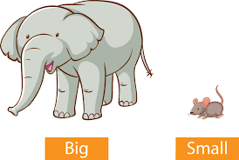
small

Slide 80
Let’s Teach and Practise

Slide 81
homophones or near homophones homo = same phone = sound

Slide 82
homophones

Slide 83
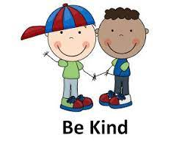
be

Slide 84

bee

Slide 85
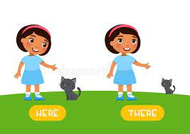
here

Slide 86
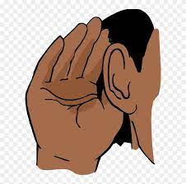
hear

Slide 87
be
VERB
Definition – to take place

Slide 88
bee
NOUN
Definition - a stinging winged insect

Slide 89
here
ADVERB
Definition – in, at, or to this place or position

Slide 90
hear
VERB
Definition – a sound picked up by the ear

Slide 91
The party will be on Saturday at 4pm.
__

Slide 92
The bee moved from plant to plant collecting nectar.
___

Slide 93
I am getting out of here.
____.

Slide 94
I can hear the dog barking.
____

Slide 95
New CHALLENGE words.

Slide 96
wild
ADJECTIVE
Definition - (of an animal or plant) living or growing in the natural environment

Slide 97
The children saw a herd of wild goats in the field.
____

Slide 98
climb
VERB
Definition - go or come up a slope or staircase

Slide 99
The children climb the hill everyday to get to school.
_____

Slide 100
Let’s Practise and Apply.

Slide 101
Can you spot the spelling rule words and the challenge words?

Slide 102
Animals from another time
Can you imagine a world with wild horses the size of small dogs, whales that can walk or climb and birds over two metres tall ? They lived on Earth at some point in the last 60 million years. They’re now extinct but their relatives live on. You will probably know them very well.

Slide 103
Animals from another time
Can you imagine a world with wild horses the size of small dogs, whales that can walk or climb and birds over two metres tall ? They lived on Earth at some point in the last 60 million years. They’re now extinct but their relatives live on. You will probably know them very well.

Slide 104
Write this sentence as I dictate it to you.
Notes:
… whales that can walk or climb and birds over two metres tall ?

Slide 105
…whales that can walk or climb and birds over two metres tall ?
Did you write it correctly?
Edit your work and make sure you have it correct.
Can you underline the spelling word that we have covered in this session?

Slide 106
Year 2 - Spring 1
Week 1 - Thursday
Notes:
Revisit and review the words from previous teaching and challenge words – I say, we say, you say
Ask children to write words only in their spelling book
Introduce the new spelling rule
Children to write the new spelling rule words and challenge words into books when the sentences are shown with the spelling word missing.
Read the extract with the class as choral reading. Practise model of prosody etc.
Ask children to find the spelling words from the session in the text.
Then read allowed the chosen sentence for children to write fully in their books.
Show the extract and ask children to then edit their work to check they were correct in their dictation.

Slide 108
Let’s Revisit and Review…

Slide 109
Do you remember this challenge word?

Slide 110
door
What could be behind the door?
Notes:
View in slide show mode to have each aspect appear separately

Slide 111
floor
Be careful not to slip on the wet floor.
Notes:
View in slide show mode to have each aspect appear separately

Slide 112
Do you remember the sound ‘or’ spelt ‘a’ before ‘l’

Slide 113
al
Sounds ‘or’

Slide 114
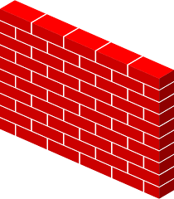
wall

Slide 115
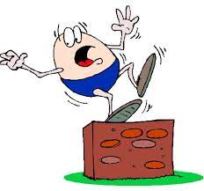
fall

Slide 116
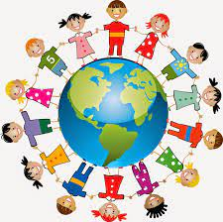
altogether

Slide 117
Let’s Teach and Practise

Slide 118
homophones or near homophones homo = same phone = sound

Slide 119
homophones

Slide 120

one

Slide 121
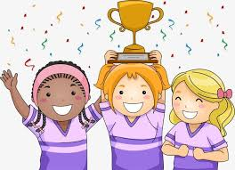
won

Slide 122
one
NUMBER
Definition – the lowest cardinal number

Slide 123
won
VERB
Definition - past tense of ‘to win’

Slide 124
My little brother is one today
___

Slide 125
He won the game ‘Guess Who’.
___

Slide 126
New CHALLENGE words.

Slide 127
wild
ADJECTIVE
Definition - (of an animal or plant) living or growing in the natural environment

Slide 128
The children saw a herd of wild goats in the field.
____

Slide 129
climb
VERB
Definition - go or come up a slope or staircase

Slide 130
The children climb the hill everyday to get to school.
_____

Slide 131
Let’s Practise and Apply.

Slide 132
Can you spot the spelling rule words and the challenge words?

Slide 133
Animals from another time
Can you imagine a world with wild horses the size of small dogs, whales that can walk or climb and birds over two metres tall ? They lived on Earth at some point in the last 60 million years. They’re now extinct but their relatives live on. You will probably know them very well.

Slide 134
Animals from another time
Can you imagine a world with wild horses the size of small dogs, whales that can walk or climb and birds over two metres tall ? They lived on Earth at some point in the last 60 million years. They’re now extinct but their relatives live on. You will probably know them very well.

Slide 135
Write this sentence as I dictate it to you.
Notes:
They’re now extinct but their relatives live on.

Slide 136
They’re now extinct but their relatives live on.
Did you write it correctly?
Edit your work and make sure you have it correct.
Can you underline the spelling word that we have covered in this session?

Slide 137
Year 2 - Spring 1
Week 1 - Friday
Notes:
Click through the slides for all the R+R words for the week (both the focus and the challenge words)
Click through the slides for all the new learning this week

Slide 139
Old challenge words…

Slide 140
door

Slide 141
floor

Slide 142
Old spelling rule words…

Slide 143
all

Slide 144
ball

Slide 145
call

Slide 146
walk

Slide 147
talk

Slide 148
always

Slide 149
small

Slide 150
wall

Slide 151
fall

Slide 152
together

Slide 153
New spelling rule words…

Slide 154
there

Slide 155
their

Slide 156
they’re

Slide 157
to

Slide 158
too

Slide 159
two

Slide 160
be

Slide 161
bee

Slide 162
here

Slide 163
hear

Slide 164
one

Slide 165
won

Slide 166
New challenge words…

Slide 167
wild

Slide 168
climb

Slide 169
Quick Quiz time…
Notes:
Say these words for the quiz
door floor wild climb ball call there here two one

Slide 170
Did you get them correct?
Edit your work.
door floor wild climb ball call there here two one

Slide 171
Word class time…

Slide 172
The children saw a herd of wild goats in the field.
Determiner noun verb determiner noun preposition adjective noun preposition determiner noun
Notes:
Ask for these words to be classed

Slide 173
The children climb the hill everyday to get to school.
Determiner noun verb determiner noun adverb verb preposition noun.
Notes:
Ask for these words to be classed

Slide 174
Etymology
The history of a word….

Slide 175
Wild
Old English wilde, of Germanic origin; related to Dutch and German wild.
Climb
Old English climban, of West Germanic origin; related to Dutch and German klimmen, also to clay and cleave.

Slide 176
Let’s investigate….
Create questions and mark schemes for these words.

