Slide 1
Spelling Y2
Mastering spellings: building on the foundations of phonics
Spring 1
Week 2

Slide 2
These slides are slightly different - to reduce the number there are now animations used
Please use these slides in full screen slide show mode to ensure they work how they are designed with chunks of information being shown at a time to prevent overload
Thank you

Slide 3
Year 2 - Spring 1
Week 2 - Monday

Slide 4
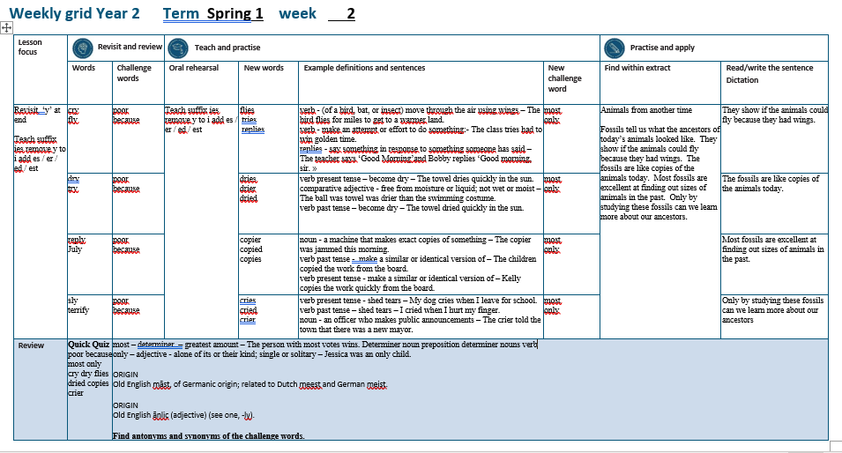

Slide 5
Let’s Revisit and Review…

Slide 6
Do you remember this challenge word?

Slide 7
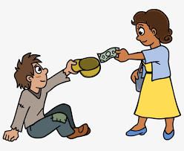
poor
Christians give money to poor people.
Notes:
View in slide show mode to have each aspect appear separately

Slide 8
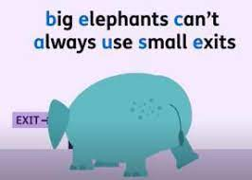
because
Remember to eat fruit and vegetables because it keeps you healthy.
Notes:
View in slide show mode to have each aspect appear separately

Slide 9
Do you remember the sound ‘igh’ spelt ‘y’ at the end of words?

Slide 10
y
Sounds ‘igh’

Slide 11
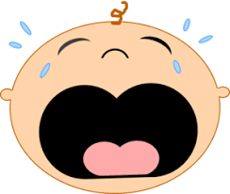
cry

Slide 12
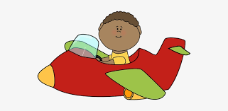
fly

Slide 13
Let’s Teach and Practise

Slide 14
Suffixes es / er / ed / est
change y to i
then add…
es / er / ed / est

Slide 15
es

Slide 16
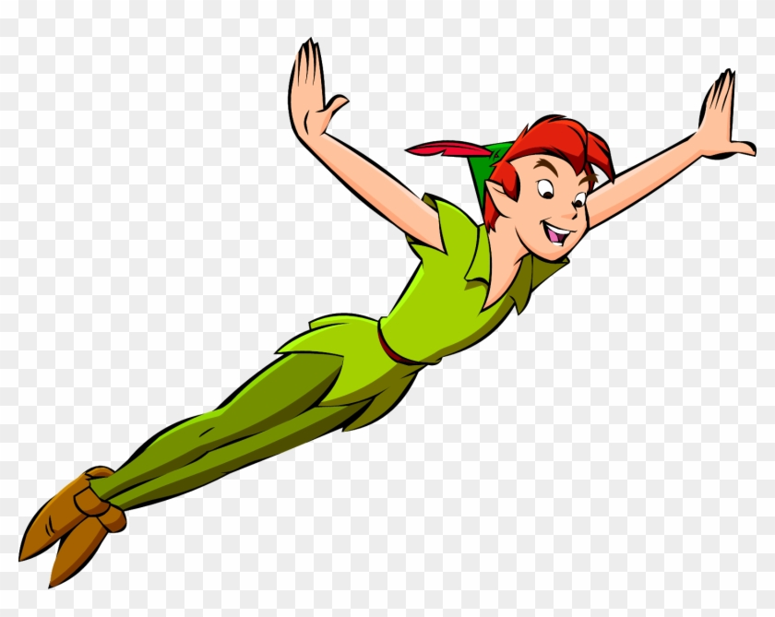
flies

Slide 17
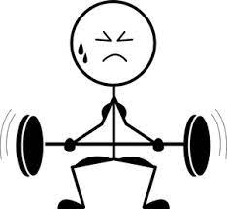
tries

Slide 18

replies

Slide 19
flies
fly (-y +i) + es = flies
VERB
Definition - (of a bird, bat, or insect) move through the air using wings

Slide 20
tries
try (-y +i) + es = tries
VERB
Definition - make an attempt or effort to do something

Slide 21
replies
reply (-y +i) + es = replies
VERB
Definition - say something or write something in response to something someone has said or written

Slide 22
The bird flies for miles to get to a warmer land.
_____

Slide 23
The class tries hard to win golden time.
_____

Slide 24
The teacher says ‘Good Morning’ and Bobby replies ‘Good morning, sir.’
_______

Slide 25
New CHALLENGE words.

Slide 26
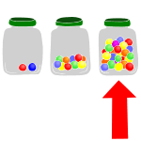
most
DETERMINER
Definition - greatest amount

Slide 27
The person with most votes wins.
____

Slide 28

only
ADJECTIVE
Definition - alone of its or their kind; single or solitary

Slide 29
Jessica was an only child.
____

Slide 30
Let’s Practise and Apply.

Slide 31
Can you spot the spelling rule words and the challenge words?

Slide 32
Animals from another time
Fossils tell us what the ancestors of today’s animals looked like. They show if the animals could fly because they had wings. The fossils are like copies of the animals today. Most fossils are excellent at finding out sizes of animals in the past. Only by studying these fossils can we learn more about our ancestors.

Slide 33
Animals from another time
Fossils tell us what the ancestors of today’s animals looked like. They show if the animals could fly because they had wings. The fossils are like copies of the animals today. Most fossils are excellent at finding out sizes of animals in the past. Only by studying these fossils can we learn more about our ancestors.

Slide 34
Write this sentence as I dictate it to you.
Notes:
They show if the animals could fly because they had wings.

Slide 35
They show if the animals could fly because they had wings.
Did you write it correctly?
Edit your work and make sure you have it correct.
Can you underline the spelling word that we have covered in this session?

Slide 36
Year 2 - Spring 1
Week 2 - Tuesday
Notes:
Revisit and review the words from previous teaching and challenge words – I say, we say, you say
Ask children to write words only in their spelling book
Introduce the new spelling rule
Children to write the new spelling rule words and challenge words into books when the sentences are shown with the spelling word missing.
Read the extract with the class as choral reading. Practise model of prosody etc.
Ask children to find the spelling words from the session in the text.
Then read allowed the chosen sentence for children to write fully in their books.
Show the extract and ask children to then edit their work to check they were correct in their dictation.

Slide 38
Let’s Revisit and Review…

Slide 39
Do you remember this challenge word?

Slide 40
poor
Christians give money to poor people.
Notes:
View in slide show mode to have each aspect appear separately

Slide 41
because
Remember to eat fruit and vegetables because it keeps you healthy.
Notes:
View in slide show mode to have each aspect appear separately

Slide 42
Do you remember the sound ‘igh’ spelt ‘y’ at the end of words?

Slide 43
y
Sounds ‘igh’

Slide 44
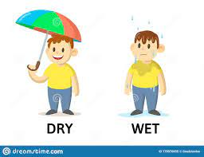
dry

Slide 45
try

Slide 46
Let’s Teach and Practise

Slide 47
Suffixes es / er / ed / est
change y to i
then add…
es / er / ed / est

Slide 48
es / er / ed

Slide 49
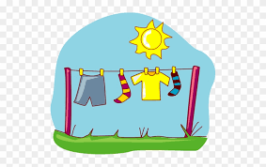
dries

Slide 50
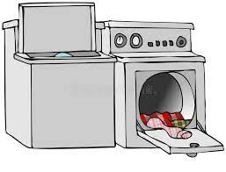
drier

Slide 51
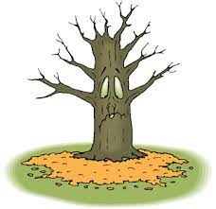
dried

Slide 52
dries
dry (-y +i) + es = dries
VERB
Definition - become dry

Slide 53
drier
dry (-y +i) + er = drier
COMPARATIVE ADJECTIVE
Definition - free from moisture or liquid

Slide 54
dried
dry (-y +i) + ed = dried
VERB
Definition – (past tense) become dry

Slide 55
The towel dries quickly in the sun.
_____

Slide 56
The towel was drier than the swimming costume.
_____

Slide 57
The towel dried quickly in the sun.
_____

Slide 58
New CHALLENGE words.

Slide 59
most
DETERMINER
Definition - greatest amount

Slide 60
The person with most votes wins.
____

Slide 61
only
ADJECTIVE
Definition - alone of its or their kind; single or solitary

Slide 62
Jessica was an only child.
____

Slide 63
Let’s Practise and Apply.

Slide 64
Can you spot the spelling rule words and the challenge words?

Slide 65
Animals from another time
Fossils tell us what the ancestors of today’s animals looked like. They show if the animals could fly because they had wings. The fossils are like copies of the animals today. Most fossils are excellent at finding out sizes of animals in the past. Only by studying these fossils can we learn more about our ancestors.

Slide 66
Animals from another time
Fossils tell us what the ancestors of today’s animals looked like. They show if the animals could fly because they had wings. The fossils are like copies of the animals today. Most fossils are excellent at finding out sizes of animals in the past. Only by studying these fossils can we learn more about our ancestors.

Slide 67
Write this sentence as I dictate it to you.
Notes:
The fossils are like copies of the animals today.

Slide 68
The fossils are like copies of the animals today.
Did you write it correctly?
Edit your work and make sure you have it correct.
Can you underline the spelling word that we have covered in this session?

Slide 69
Year 2 - Spring 1
Week 2 - Wednesday
Notes:
Revisit and review the words from previous teaching and challenge words – I say, we say, you say
Ask children to write words only in their spelling book
Introduce the new spelling rule
Children to write the new spelling rule words and challenge words into books when the sentences are shown with the spelling word missing.
Read the extract with the class as choral reading. Practise model of prosody etc.
Ask children to find the spelling words from the session in the text.
Then read allowed the chosen sentence for children to write fully in their books.
Show the extract and ask children to then edit their work to check they were correct in their dictation.

Slide 71
Let’s Revisit and Review…

Slide 72
Do you remember this challenge word?

Slide 73
poor
Christians give money to poor people.
Notes:
View in slide show mode to have each aspect appear separately

Slide 74
because
Remember to eat fruit and vegetables because it keeps you healthy.
Notes:
View in slide show mode to have each aspect appear separately

Slide 75
Do you remember the sound ‘igh’ spelt ‘y’ at the end of words?

Slide 76
y
Sounds ‘igh’

Slide 77
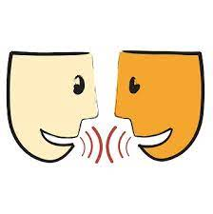
reply

Slide 78
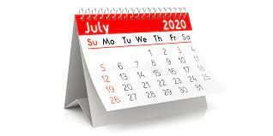
July

Slide 79
Let’s Teach and Practise

Slide 80
Suffixes es / er / ed / est
change y to i
then add…
es / er / ed / est

Slide 81
es / er / ed

Slide 82
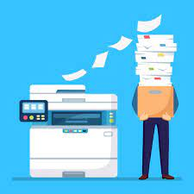
copier

Slide 83
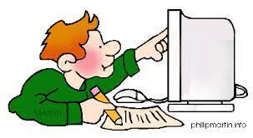
copied

Slide 84
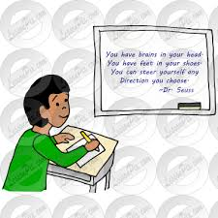
copies

Slide 85
copier
copy (-y +i) + er = copier
NOUN
Definition - a machine that makes exact copies of something

Slide 86
copied
copy (-y +i) + ed = copied
VERB
Definition - make a similar or identical version of

Slide 87
copies
copy (-y +i) + es = copies
VERB
Definition - - make a similar or identical version of

Slide 88
The copier was jammed this morning.
______

Slide 89
The children copied the work from the board.
______

Slide 90
Kelly copies the work quickly from the board.
______

Slide 91
New CHALLENGE words.

Slide 92
most
DETERMINER
Definition - greatest amount

Slide 93
The person with most votes wins.
____

Slide 94
only
ADJECTIVE
Definition - alone of its or their kind; single or solitary

Slide 95
Jessica was an only child.
____

Slide 96
Let’s Practise and Apply.

Slide 97
Can you spot the spelling rule words and the challenge words?

Slide 98
Animals from another time
Fossils tell us what the ancestors of today’s animals looked like. They show if the animals could fly because they had wings. The fossils are like copies of the animals today. Most fossils are excellent at finding out sizes of animals in the past. Only by studying these fossils can we learn more about our ancestors.

Slide 99
Animals from another time
Fossils tell us what the ancestors of today’s animals looked like. They show if the animals could fly because they had wings. The fossils are like copies of the animals today. Most fossils are excellent at finding out sizes of animals in the past. Only by studying these fossils can we learn more about our ancestors.

Slide 100
Write this sentence as I dictate it to you.
Notes:
Most fossils are excellent at finding out sizes of animals in the past.

Slide 101
Most fossils are excellent at finding out sizes of animals in the past.
Did you write it correctly?
Edit your work and make sure you have it correct.
Can you underline the spelling word that we have covered in this session?

Slide 102
Year 2 - Spring 1
Week 2 - Thursday
Notes:
Revisit and review the words from previous teaching and challenge words – I say, we say, you say
Ask children to write words only in their spelling book
Introduce the new spelling rule
Children to write the new spelling rule words and challenge words into books when the sentences are shown with the spelling word missing.
Read the extract with the class as choral reading. Practise model of prosody etc.
Ask children to find the spelling words from the session in the text.
Then read allowed the chosen sentence for children to write fully in their books.
Show the extract and ask children to then edit their work to check they were correct in their dictation.

Slide 104
Let’s Revisit and Review…

Slide 105
Do you remember this challenge word?

Slide 106
poor
Christians give money to poor people.
Notes:
View in slide show mode to have each aspect appear separately

Slide 107
because
Remember to eat fruit and vegetables because it keeps you healthy.
Notes:
View in slide show mode to have each aspect appear separately

Slide 108
Do you remember the sound ‘igh’ spelt ‘y’ at the end of words?

Slide 109
y
Sounds ‘igh’

Slide 110

sly

Slide 111
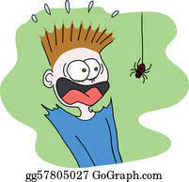
terrify

Slide 112
Let’s Teach and Practise

Slide 113
Suffixes es / er / ed / est
change y to i
then add…
es / er / ed / est

Slide 114
es / ed / er

Slide 115
cries

Slide 116
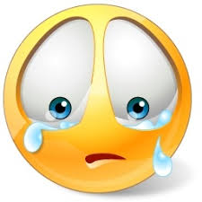
cried

Slide 117
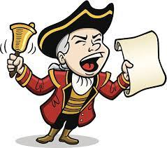
crier

Slide 118
cries
cry (-y +i) + es = cries
VERB
Definition – (present tense) shed tears

Slide 119
cried
cry (-y +i) + ed = cried
VERB
Definition – (past tense) shed tears

Slide 120
crier
cry (-y +i) + er = crier
NOUN
Definition - an officer who makes public announcements

Slide 121
My dog cries when I leave for school.
_____

Slide 122
I cried when I hurt my finger.
_____

Slide 123
The crier told the town that there was a new mayor.
_____

Slide 124
New CHALLENGE words.

Slide 125
most
DETERMINER
Definition - greatest amount

Slide 126
The person with most votes wins.
____

Slide 127
only
ADJECTIVE
Definition - alone of its or their kind; single or solitary

Slide 128
Jessica was an only child.
____

Slide 129
Let’s Practise and Apply.

Slide 130
Can you spot the spelling rule words and the challenge words?

Slide 131
Animals from another time
Fossils tell us what the ancestors of today’s animals looked like. They show if the animals could fly because they had wings. The fossils are like copies of the animals today. Most fossils are excellent at finding out sizes of animals in the past. Only by studying these fossils can we learn more about our ancestors.

Slide 132
Animals from another time
Fossils tell us what the ancestors of today’s animals looked like. They show if the animals could fly because they had wings. The fossils are like copies of the animals today. Most fossils are excellent at finding out sizes of animals in the past. Only by studying these fossils can we learn more about our ancestors.

Slide 133
Write this sentence as I dictate it to you.
Notes:
Only by studying these fossils can we learn more about our ancestors

Slide 134
Only by studying these fossils can we learn more about our ancestors
Did you write it correctly?
Edit your work and make sure you have it correct.
Can you underline the spelling word that we have covered in this session?

Slide 135
Year 2 - Spring 1
Week 2 - Friday
Notes:
Click through the slides for all the R+R words for the week (both the focus and the challenge words)
Click through the slides for all the new learning this week

Slide 137
Old challenge words…

Slide 138
poor

Slide 139
because

Slide 140
Old spelling rule words…

Slide 141
cry

Slide 142
fly

Slide 143
dry

Slide 144
try

Slide 145
reply

Slide 146
July

Slide 147
shy

Slide 148
terrify

Slide 149
New spelling rule words…

Slide 150
flies

Slide 151
tries

Slide 152
replies

Slide 153
dries

Slide 154
drier

Slide 155
dried

Slide 156
copier

Slide 157
copies

Slide 158
copied

Slide 159
cries

Slide 160
cried

Slide 161
crier

Slide 162
New challenge words…

Slide 163
most

Slide 164
only

Slide 165
Quick Quiz time…
Notes:
Say these words for the quiz
poor because most only cry dry flies dried copies crier

Slide 166
Did you get them correct?
Edit your work.
poor because most only cry dry flies dried copies crier

Slide 167
Word class time…

Slide 168
The person with most votes wins.
Determiner noun preposition determiner nouns verb
Notes:
Ask for these words to be classed

Slide 169
Jessica was an only child.
Noun verb determiner adjective noun
Notes:
Ask for these words to be classed

Slide 170
Etymology
The history of a word….

Slide 171
Most
Old English māst, of Germanic origin; related to Dutch meest and German meist.
Only
Old English ānlic (adjective) (see one, -ly).

Slide 172
Let’s investigate….
Find antonyms and synonyms of the challenge words.

