Slide 1
Spelling Y2
Mastering spellings: building on the foundations of phonics
Spring 1
Week 3

Slide 2
These slides are slightly different - to reduce the number there are now animations used
Please use these slides in full screen slide show mode to ensure they work how they are designed with chunks of information being shown at a time to prevent overload
Thank you

Slide 3
Year 2 - Spring 1
Week 3 - Monday

Slide 4
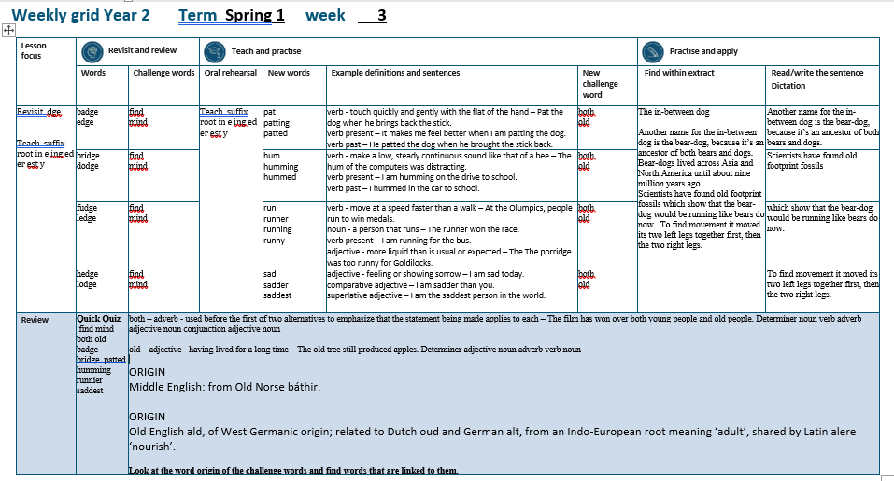

Slide 5
Let’s Revisit and Review…

Slide 6
Do you remember this challenge word?

Slide 7
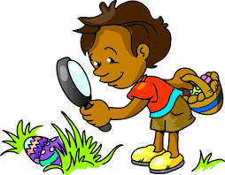
find
At Easter we find eggs on our hunt.
Notes:
View in slide show mode to have each aspect appear separately

Slide 8

mind
Our minds are incredible and control our bodies all the time.
Notes:
View in slide show mode to have each aspect appear separately

Slide 9
Do you remember the sound ‘ze’ spelt ‘dge’ at the end of words?

Slide 10
dge
Sounds ‘ze’

Slide 11

badge

Slide 12
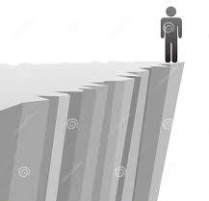
edge

Slide 13
Let’s Teach and Practise

Slide 14
Suffixes ing / er / ed / est / y
When a vowel is followed by a consonant in a one-syllable word, double the consonant and then add the suffix.

Slide 15
ing / er / est / ed / y

Slide 16
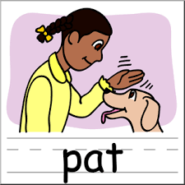
pat

Slide 17
patting

Slide 18
patted

Slide 19
pat
(a = vowel) (one syllable)
VERB
Definition - touch quickly and gently with the flat of the hand

Slide 20
patting
pat (+t) + ing = patting
VERB
Definition – (present tense) touch quickly and gently with the flat of the hand

Slide 21
patted
pat (+t) + ed = patted
VERB
Definition – (past tense) touch quickly and gently with the flat of the hand

Slide 22
Pat the dog when he brings back the stick.
___

Slide 23
It makes me feel better when I am patting the dog.
_______

Slide 24
He patted the dog when he brought the stick back.
______

Slide 25
New CHALLENGE words.

Slide 26
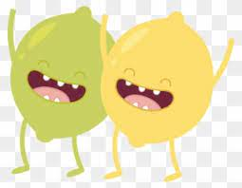
both
ADVERB
Definition - used before the first of two alternatives to emphasise that the statement being made applies to each

Slide 27
The film has won over both young people and old people.
____

Slide 28
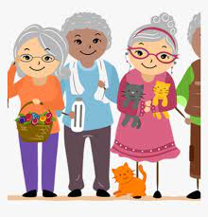
old
ADJECTIVE
Definition - having lived for a long time

Slide 29
The old tree still produced apples.
___

Slide 30
Let’s Practise and Apply.

Slide 31
Can you spot the spelling rule words and the challenge words?

Slide 32
The in-between dog
Another name for the in-between dog is the bear-dog, because it’s an ancestor of both bears and dogs. Bear-dogs lived across Asia and North America until about nine million years ago.
Scientists have found old footprint fossils which show that the bear-dog would be running like bears do now. To find movement it moved its two left legs together first, then the two right legs.

Slide 33
The in-between dog
Another name for the in-between dog is the bear-dog, because it’s an ancestor of both bears and dogs. Bear-dogs lived across Asia and North America until about nine million years ago.
Scientists have found old footprint fossils which show that the bear-dog would be running like bears do now. To find movement it moved its two left legs together first, then the two right legs.

Slide 34
Write this sentence as I dictate it to you.
Notes:
Another name for the in-between dog is the bear-dog, because it’s an ancestor of both bears and dogs.

Slide 35
Another name for the in-between dog is the bear-dog, because it’s an ancestor of both bears and dogs.
Did you write it correctly?
Edit your work and make sure you have it correct.
Can you underline the spelling word that we have covered in this session?

Slide 36
Year 2 - Spring 1
Week 3 - Tuesday
Notes:
Revisit and review the words from previous teaching and challenge words – I say, we say, you say
Ask children to write words only in their spelling book
Introduce the new spelling rule
Children to write the new spelling rule words and challenge words into books when the sentences are shown with the spelling word missing.
Read the extract with the class as choral reading. Practise model of prosody etc.
Ask children to find the spelling words from the session in the text.
Then read allowed the chosen sentence for children to write fully in their books.
Show the extract and ask children to then edit their work to check they were correct in their dictation.

Slide 38
Let’s Revisit and Review…

Slide 39
Do you remember this challenge word?

Slide 40
find
At Easter we find eggs on our hunt.
Notes:
View in slide show mode to have each aspect appear separately

Slide 41
mind
Our minds are incredible and control our bodies all the time.
Notes:
View in slide show mode to have each aspect appear separately

Slide 42
Do you remember the sound ‘ze’ spelt ‘dge’ at the end of words?

Slide 43
dge
Sounds ‘ze’

Slide 44

bridge

Slide 45
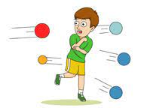
dodge

Slide 46
Let’s Teach and Practise

Slide 47
Suffixes ing / er / ed / est / y
When a vowel is followed by a consonant in a one-syllable word, double the consonant and then add the suffix.

Slide 48
ing / er / est / ed / y

Slide 49

hum

Slide 50
humming

Slide 51
hummed

Slide 52
hum
(u = vowel) (one syllable)
VERB
Definition - make a low, steady continuous sound like that of a bee

Slide 53
hum
hum (+m) + ing = humming
VERB
Definition – (present tense) make a low, steady continuous sound like that of a bee

Slide 54
hum
hum (+m) + ed = hummed
VERB
Definition – (past tense) make a low, steady continuous sound like that of a bee

Slide 55
The hum of the computers was distracting.
___

Slide 56
I am humming on the drive to school.
_______

Slide 57
I hummed in the car to school.
______

Slide 58
New CHALLENGE words.

Slide 59
both
ADVERB
Definition - used before the first of two alternatives to emphasise that the statement being made applies to each

Slide 60
The film has won over both young people and old people.
____

Slide 61
old
ADJECTIVE
Definition - having lived for a long time

Slide 62
The old tree still produced apples.
___

Slide 63
Let’s Practise and Apply.

Slide 64
Can you spot the spelling rule words and the challenge words?

Slide 65
The in-between dog
Another name for the in-between dog is the bear-dog, because it’s an ancestor of both bears and dogs. Bear-dogs lived across Asia and North America until about nine million years ago.
Scientists have found old footprint fossils which show that the bear-dog would be running like bears do now. To find movement it moved its two left legs together first, then the two right legs.

Slide 66
The in-between dog
Another name for the in-between dog is the bear-dog, because it’s an ancestor of both bears and dogs. Bear-dogs lived across Asia and North America until about nine million years ago.
Scientists have found old footprint fossils which show that the bear-dog would be running like bears do now. To find movement it moved its two left legs together first, then the two right legs.

Slide 67
Write this sentence as I dictate it to you.
Notes:
Scientists have found old footprint fossils

Slide 68
Scientists have found old footprint fossils
Did you write it correctly?
Edit your work and make sure you have it correct.
Can you underline the spelling word that we have covered in this session?

Slide 69
Year 2 - Spring 1
Week 3 - Wednesday
Notes:
Revisit and review the words from previous teaching and challenge words – I say, we say, you say
Ask children to write words only in their spelling book
Introduce the new spelling rule
Children to write the new spelling rule words and challenge words into books when the sentences are shown with the spelling word missing.
Read the extract with the class as choral reading. Practise model of prosody etc.
Ask children to find the spelling words from the session in the text.
Then read allowed the chosen sentence for children to write fully in their books.
Show the extract and ask children to then edit their work to check they were correct in their dictation.

Slide 71
Let’s Revisit and Review…

Slide 72
Do you remember this challenge word?

Slide 73
find
At Easter we find eggs on our hunt.
Notes:
View in slide show mode to have each aspect appear separately

Slide 74
mind
Our minds are incredible and control our bodies all the time.
Notes:
View in slide show mode to have each aspect appear separately

Slide 75
Do you remember the sound ‘ze’ spelt ‘dge’ at the end of words?

Slide 76
dge
Sounds ‘ze’

Slide 77
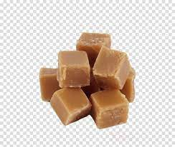
fudge

Slide 78
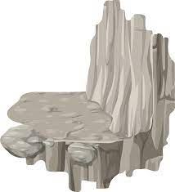
ledge

Slide 79
Let’s Teach and Practise

Slide 80
Suffixes ing / er / ed / est / y
When a vowel is followed by a consonant in a one-syllable word, double the consonant and then add the suffix.

Slide 81
ing / er / est / ed / y

Slide 82

run

Slide 83
runner

Slide 84
running

Slide 85

runny

Slide 86
run
(u = vowel) (one syllable)
VERB
Definition - move at a speed faster than a walk

Slide 87
runner
run (+n) + er = runner
NOUN
Definition - a person that runs

Slide 88
running
run (+n) + ing = running
VERB
Definition – (present tense) move at a speed faster than a walk

Slide 89
runny
run (+n) + y = runny
ADJECTIVE
Definition – more liquid than is usual or expected

Slide 90
At the Olympics, people run to win medals.
___

Slide 91
The runner won the race.
______

Slide 92
I am running for the bus.
_______

Slide 93
The porridge was too runny for Goldilocks.
_____

Slide 94
New CHALLENGE words.

Slide 95
both
ADVERB
Definition - used before the first of two alternatives to emphasise that the statement being made applies to each

Slide 96
The film has won over both young people and old people.
____

Slide 97
old
ADJECTIVE
Definition - having lived for a long time

Slide 98
The old tree still produced apples.
___

Slide 99
Let’s Practise and Apply.

Slide 100
Can you spot the spelling rule words and the challenge words?

Slide 101
The in-between dog
Another name for the in-between dog is the bear-dog, because it’s an ancestor of both bears and dogs. Bear-dogs lived across Asia and North America until about nine million years ago.
Scientists have found old footprint fossils which show that the bear-dog would be running like bears do now. To find movement it moved its two left legs together first, then the two right legs.

Slide 102
The in-between dog
Another name for the in-between dog is the bear-dog, because it’s an ancestor of both bears and dogs. Bear-dogs lived across Asia and North America until about nine million years ago.
Scientists have found old footprint fossils which show that the bear-dog would be running like bears do now. To find movement it moved its two left legs together first, then the two right legs.

Slide 103
Write this sentence as I dictate it to you.
Notes:
…which show that the bear-dog would be running like bears do now.

Slide 104
…which show that the bear-dog would be running like bears do now.
Did you write it correctly?
Edit your work and make sure you have it correct.
Can you underline the spelling word that we have covered in this session?

Slide 105
Year 2 - Spring 1
Week 3 - Thursday
Notes:
Revisit and review the words from previous teaching and challenge words – I say, we say, you say
Ask children to write words only in their spelling book
Introduce the new spelling rule
Children to write the new spelling rule words and challenge words into books when the sentences are shown with the spelling word missing.
Read the extract with the class as choral reading. Practise model of prosody etc.
Ask children to find the spelling words from the session in the text.
Then read allowed the chosen sentence for children to write fully in their books.
Show the extract and ask children to then edit their work to check they were correct in their dictation.

Slide 107
Let’s Revisit and Review…

Slide 108
Do you remember this challenge word?

Slide 109
find
At Easter we find eggs on our hunt.
Notes:
View in slide show mode to have each aspect appear separately

Slide 110
mind
Our minds are incredible and control our bodies all the time.
Notes:
View in slide show mode to have each aspect appear separately

Slide 111
Do you remember the sound ‘ze’ spelt ‘dge’ at the end of words?

Slide 112
dge
Sounds ‘ze’

Slide 113
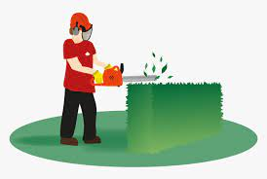
hedge

Slide 114
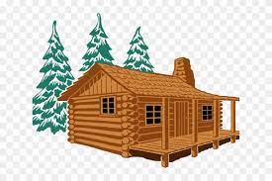
lodge

Slide 115
Let’s Teach and Practise

Slide 116
Suffixes ing / er / ed / est / y
When a vowel is followed by a consonant in a one-syllable word, double the consonant and then add the suffix.

Slide 117
ing / er / est / ed / y

Slide 118

sad

Slide 119
sadder

Slide 120
saddest

Slide 121
sad
(a = vowel) (one syllable)
ADJECTIVE
Definition - feeling or showing sorrow

Slide 122
sad
sad (+ d) + er = sadder
COMPARATIVE ADJECTIVE
Definition - feeling or showing sorrow

Slide 123
sad
sad (+ d) + est = saddest
SUPERLATIVE ADJECTIVE
Definition - feeling or showing sorrow

Slide 124
I am sad today.
___

Slide 125
I am sadder than you.
______

Slide 126
I am the saddest person in the world.
_______

Slide 127
New CHALLENGE words.

Slide 128
both
ADVERB
Definition - used before the first of two alternatives to emphasise that the statement being made applies to each

Slide 129
The film has won over both young people and old people.
____

Slide 130
old
ADJECTIVE
Definition - having lived for a long time

Slide 131
The old tree still produced apples.
___

Slide 132
Let’s Practise and Apply.

Slide 133
Can you spot the spelling rule words and the challenge words?

Slide 134
The in-between dog
Another name for the in-between dog is the bear-dog, because it’s an ancestor of both bears and dogs. Bear-dogs lived across Asia and North America until about nine million years ago.
Scientists have found old footprint fossils which show that the bear-dog would be running like bears do now. To find movement it moved its two left legs together first, then the two right legs.

Slide 135
The in-between dog
Another name for the in-between dog is the bear-dog, because it’s an ancestor of both bears and dogs. Bear-dogs lived across Asia and North America until about nine million years ago.
Scientists have found old footprint fossils which show that the bear-dog would be running like bears do now. To find movement it moved its two left legs together first, then the two right legs.

Slide 136
Write this sentence as I dictate it to you.
Notes:
To find movement it moved its two left legs together first, then the two right legs.

Slide 137
To find movement it moved its two left legs together first, then the two right legs.
Did you write it correctly?
Edit your work and make sure you have it correct.
Can you underline the spelling word that we have covered in this session?

Slide 138
Year 2 - Spring 1
Week 3 - Friday
Notes:
Click through the slides for all the R+R words for the week (both the focus and the challenge words)
Click through the slides for all the new learning this week

Slide 140
Old challenge words…

Slide 141
find

Slide 142
mind

Slide 143
Old spelling rule words…

Slide 144
badge

Slide 145
edge

Slide 146
bridge

Slide 147
dogde

Slide 148
fudge

Slide 149
ledge

Slide 150
hedge

Slide 151
lodge

Slide 152
New spelling rule words…

Slide 153
pat

Slide 154
patting

Slide 155
patted

Slide 156
hum

Slide 157
humming

Slide 158
hummed

Slide 159
run

Slide 160
runner

Slide 161
running

Slide 162
runny

Slide 163
sad

Slide 164
sadder

Slide 165
saddest

Slide 166
New challenge words…

Slide 167
both

Slide 168
old

Slide 169
Quick Quiz time…
Notes:
Say these words for the quiz
find mind both old badge
bridge patted humming runnier saddest

Slide 170
Did you get them correct?
Edit your work.
find mind both old badge
bridge patted humming runnier saddest

Slide 171
Word class time…

Slide 172
The film has won over both young people and old people.
Determiner noun verb adverb adjective noun conjunction adjective noun
Notes:
Ask for these words to be classed

Slide 173
The old tree still produced apples.
Determiner adjective noun adverb verb noun
Notes:
Ask for these words to be classed

Slide 174
Etymology
The history of a word….

Slide 175
Both
Middle English: from Old Norse báthir.
Old
Middle English: from Old Norse báthir.

Slide 176
Let’s investigate….
Look at the word origin of the challenge words and find words that are linked to them.

