Slide 1
Spelling Y2
Mastering spellings: building on the foundations of phonics
Spring 1
Week 4

Slide 2
These slides are slightly different - to reduce the number there are now animations used
Please use these slides in full screen slide show mode to ensure they work how they are designed with chunks of information being shown at a time to prevent overload
Thank you

Slide 3
Year 2 - Spring 1
Week 4 - Monday

Slide 4
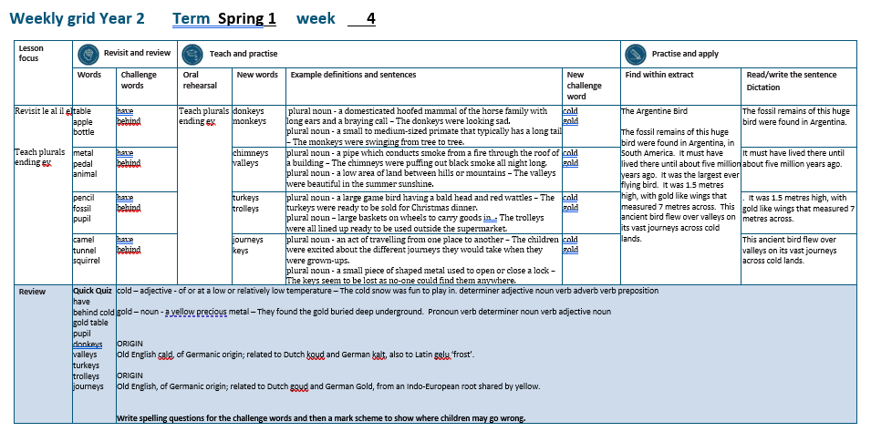

Slide 5
Let’s Revisit and Review…

Slide 6
Do you remember this challenge word?

Slide 7
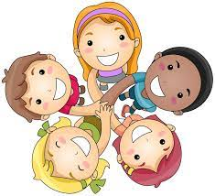
have
We have lots of friends.
Notes:
View in slide show mode to have each aspect appear separately

Slide 8
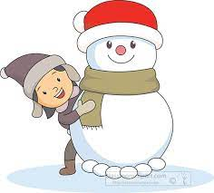
behind
The little girl was behind the snowman.
Notes:
View in slide show mode to have each aspect appear separately

Slide 9
Do you remember the sound ‘al’ spelt ‘in different ways at the end of words?

Slide 10
le al il el

Slide 11
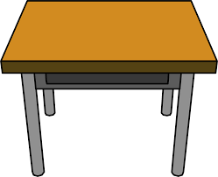
table

Slide 12
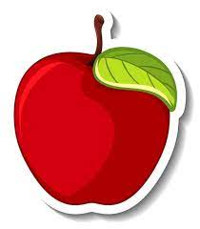
apple

Slide 13
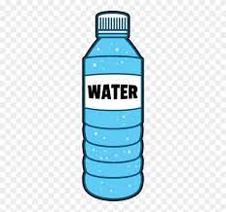
bottle

Slide 14
Let’s Teach and Practise

Slide 15
Plurals roots ending in ‘ey’
Plural is more than one

Slide 16
ey + s eys

Slide 17
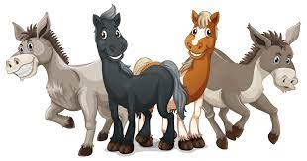
donkeys

Slide 18
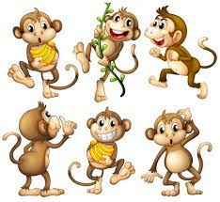
monkeys

Slide 19
donkeys
donkey + s = donkeys
PLURAL NOUN
Definition - a domesticated hoofed mammal of the horse family with long ears and a braying call

Slide 20
monkeys
monkey + s = monkeys
PLURAL NOUN
Definition - a small to medium-sized primate that typically has a long tail

Slide 21
The donkeys were looking sad.
_______

Slide 22
The monkeys were swinging from tree to tree.
_______

Slide 23
New CHALLENGE words.

Slide 24
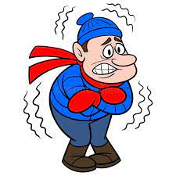
cold
ADJECTIVE
Definition - of or at a low or relatively low temperature

Slide 25
The cold snow was fun to play in.
____

Slide 26
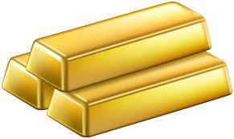
gold
NOUN
Definition - a yellow precious metal

Slide 27
They found the gold buried deep underground.
____

Slide 28
Let’s Practise and Apply.

Slide 29
Can you spot the spelling rule words and the challenge words?

Slide 30
The Argentine Bird
The fossil remains of this huge bird were found in Argentina, in South America. It must have lived there until about five million years ago. It was the largest ever flying bird. It was 1.5 metres high, with gold like wings that measured 7 metres across. This ancient bird flew over valleys on its vast journeys across cold lands.

Slide 31
The Argentine Bird
The fossil remains of this huge bird were found in Argentina, in South America. It must have lived there until about five million years ago. It was the largest ever flying bird. It was 1.5 metres high, with gold like wings that measured 7 metres across. This ancient bird flew over valleys on its vast journeys across cold lands.

Slide 32
Write this sentence as I dictate it to you.
Notes:
The fossil remains of this huge bird were found in Argentina.

Slide 33
The fossil remains of this huge bird were found in Argentina.
Did you write it correctly?
Edit your work and make sure you have it correct.
Can you underline the spelling word that we have covered in this session?

Slide 34
Year 2 - Spring 1
Week 4 - Tuesday
Notes:
Revisit and review the words from previous teaching and challenge words – I say, we say, you say
Ask children to write words only in their spelling book
Introduce the new spelling rule
Children to write the new spelling rule words and challenge words into books when the sentences are shown with the spelling word missing.
Read the extract with the class as choral reading. Practise model of prosody etc.
Ask children to find the spelling words from the session in the text.
Then read allowed the chosen sentence for children to write fully in their books.
Show the extract and ask children to then edit their work to check they were correct in their dictation.

Slide 36
Let’s Revisit and Review…

Slide 37
Do you remember this challenge word?

Slide 38
have
We have lots of friends.
Notes:
View in slide show mode to have each aspect appear separately

Slide 39
behind
The little girl was behind the snowman.
Notes:
View in slide show mode to have each aspect appear separately

Slide 40
Do you remember the sound ‘al’ spelt ‘in different ways at the end of words?

Slide 41
le al il el

Slide 42
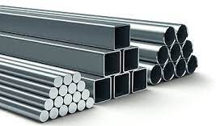
metal

Slide 43

pedal

Slide 44
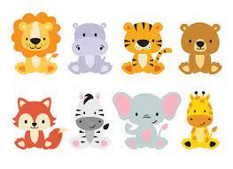
animal

Slide 45
Let’s Teach and Practise

Slide 46
Plurals roots ending in ‘ey’
Plural is more than one

Slide 47
ey + s eys

Slide 48
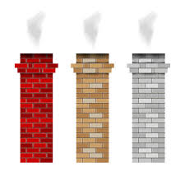
chimneys

Slide 49
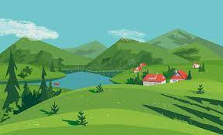
valleys

Slide 50
chimneys
chimney + s = chimneys
PLURAL NOUN
Definition - a pipe which conducts smoke from a fire through the roof of a building

Slide 51
valleys
valley + s = valleys
PLURAL NOUN
Definition - a low area of land between hills or mountains

Slide 52
The chimneys were puffing out black smoke all night long.
________

Slide 53
The valleys were beautiful in the summer sunshine.
_______

Slide 54
New CHALLENGE words.

Slide 55
cold
ADJECTIVE
Definition - of or at a low or relatively low temperature

Slide 56
The cold snow was fun to play in.
____

Slide 57
gold
NOUN
Definition - a yellow precious metal

Slide 58
They found the gold buried deep underground.
____

Slide 59
Let’s Practise and Apply.

Slide 60
Can you spot the spelling rule words and the challenge words?

Slide 61
The Argentine Bird
The fossil remains of this huge bird were found in Argentina, in South America. It must have lived there until about five million years ago. It was the largest ever flying bird. It was 1.5 metres high, with gold like wings that measured 7 metres across. This ancient bird flew over valleys on its vast journeys across cold lands.

Slide 62
The Argentine Bird
The fossil remains of this huge bird were found in Argentina, in South America. It must have lived there until about five million years ago. It was the largest ever flying bird. It was 1.5 metres high, with gold like wings that measured 7 metres across. This ancient bird flew over valleys on its vast journeys across cold lands.

Slide 63
Write this sentence as I dictate it to you.
Notes:
It must have lived there until about five million years ago.

Slide 64
It must have lived there until about five million years ago.
Did you write it correctly?
Edit your work and make sure you have it correct.
Can you underline the spelling word that we have covered in this session?

Slide 65
Year 2 - Spring 1
Week 4 - Wednesday
Notes:
Revisit and review the words from previous teaching and challenge words – I say, we say, you say
Ask children to write words only in their spelling book
Introduce the new spelling rule
Children to write the new spelling rule words and challenge words into books when the sentences are shown with the spelling word missing.
Read the extract with the class as choral reading. Practise model of prosody etc.
Ask children to find the spelling words from the session in the text.
Then read allowed the chosen sentence for children to write fully in their books.
Show the extract and ask children to then edit their work to check they were correct in their dictation.

Slide 67
Let’s Revisit and Review…

Slide 68
Do you remember this challenge word?

Slide 69
have
We have lots of friends.
Notes:
View in slide show mode to have each aspect appear separately

Slide 70
behind
The little girl was behind the snowman.
Notes:
View in slide show mode to have each aspect appear separately

Slide 71
Do you remember the sound ‘al’ spelt ‘in different ways at the end of words?

Slide 72
le al il el

Slide 73
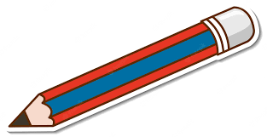
pencil

Slide 74
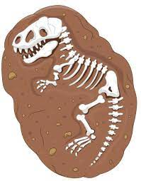
fossil

Slide 75

pupil

Slide 76
Let’s Teach and Practise

Slide 77
Plurals roots ending in ‘ey’
Plural is more than one

Slide 78
ey + s eys

Slide 79
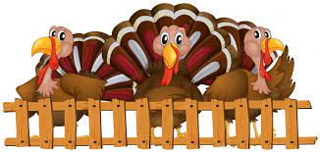
turkeys

Slide 80
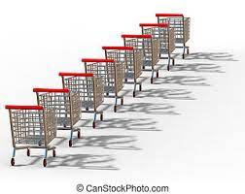
trolleys

Slide 81
turkeys
turkey + s = turkeys
PLURAL NOUN
Definition - a large game bird having a bald head and red wattles

Slide 82
trolleys
trolley + s = trolleys
PLURAL NOUN
Definition - large baskets on wheels to carry goods in

Slide 83
The turkeys were ready to be sold for Christmas dinner.
_______

Slide 84
The trolleys were all lined up ready to be used outside the supermarket.
________

Slide 85
New CHALLENGE words.

Slide 86
cold
ADJECTIVE
Definition - of or at a low or relatively low temperature

Slide 87
The cold snow was fun to play in.
____

Slide 88
gold
NOUN
Definition - a yellow precious metal

Slide 89
They found the gold buried deep underground.
____

Slide 90
Let’s Practise and Apply.

Slide 91
Can you spot the spelling rule words and the challenge words?

Slide 92
The Argentine Bird
The fossil remains of this huge bird were found in Argentina, in South America. It must have lived there until about five million years ago. It was the largest ever flying bird. It was 1.5 metres high, with gold like wings that measured 7 metres across. This ancient bird flew over valleys on its vast journeys across cold lands.

Slide 93
The Argentine Bird
The fossil remains of this huge bird were found in Argentina, in South America. It must have lived there until about five million years ago. It was the largest ever flying bird. It was 1.5 metres high, with gold like wings that measured 7 metres across. This ancient bird flew over valleys on its vast journeys across cold lands.

Slide 94
Write this sentence as I dictate it to you.
Notes:
It was 1.5 metres high, with gold like wings that measured 7 metres across.

Slide 95
It was 1.5 metres high, with gold like wings that measured 7 metres across.
Did you write it correctly?
Edit your work and make sure you have it correct.
Can you underline the spelling word that we have covered in this session?

Slide 96
Year 2 - Spring 1
Week 4 - Thursday
Notes:
Revisit and review the words from previous teaching and challenge words – I say, we say, you say
Ask children to write words only in their spelling book
Introduce the new spelling rule
Children to write the new spelling rule words and challenge words into books when the sentences are shown with the spelling word missing.
Read the extract with the class as choral reading. Practise model of prosody etc.
Ask children to find the spelling words from the session in the text.
Then read allowed the chosen sentence for children to write fully in their books.
Show the extract and ask children to then edit their work to check they were correct in their dictation.

Slide 98
Let’s Revisit and Review…

Slide 99
Do you remember this challenge word?

Slide 100
have
We have lots of friends.
Notes:
View in slide show mode to have each aspect appear separately

Slide 101
behind
The little girl was behind the snowman.
Notes:
View in slide show mode to have each aspect appear separately

Slide 102
Do you remember the sound ‘al’ spelt ‘in different ways at the end of words?

Slide 103
le al il el

Slide 104
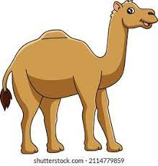
camel

Slide 105
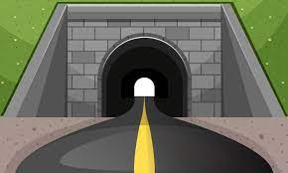
tunnel

Slide 106
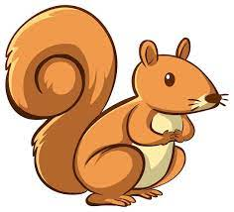
squirrel

Slide 107
Let’s Teach and Practise

Slide 108
Plurals roots ending in ‘ey’
Plural is more than one

Slide 109
ey + s eys

Slide 110
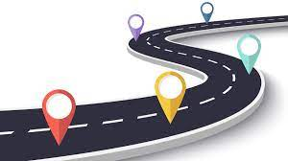
journeys

Slide 111

keys

Slide 112
journeys
journey + s = journeys
PLURAL NOUN
Definition - an act of travelling from one place to another

Slide 113
keys
key + s = keys
PLURAL NOUN
Definition - a small piece of shaped metal used to open or close a lock

Slide 114
The children were excited about the different journeys they would take when they were grown-ups.
________

Slide 115
The keys seem to be lost as no-one could find them anywhere.
____

Slide 116
New CHALLENGE words.

Slide 117
cold
ADJECTIVE
Definition - of or at a low or relatively low temperature

Slide 118
The cold snow was fun to play in.
____

Slide 119
gold
NOUN
Definition - a yellow precious metal

Slide 120
They found the gold buried deep underground.
____

Slide 121
Let’s Practise and Apply.

Slide 122
Can you spot the spelling rule words and the challenge words?

Slide 123
The Argentine Bird
The fossil remains of this huge bird were found in Argentina, in South America. It must have lived there until about five million years ago. It was the largest ever flying bird. It was 1.5 metres high, with gold like wings that measured 7 metres across. This ancient bird flew over valleys on its vast journeys across cold lands.

Slide 124
The Argentine Bird
The fossil remains of this huge bird were found in Argentina, in South America. It must have lived there until about five million years ago. It was the largest ever flying bird. It was 1.5 metres high, with gold like wings that measured 7 metres across. This ancient bird flew over valleys on its vast journeys across cold lands.

Slide 125
Write this sentence as I dictate it to you.
Notes:
This ancient bird flew over valleys on its vast journeys across cold lands.

Slide 126
This ancient bird flew over valleys on its vast journeys across cold lands.
Did you write it correctly?
Edit your work and make sure you have it correct.
Can you underline the spelling word that we have covered in this session?

Slide 127
Year 2 - Spring 1
Week 4 - Friday
Notes:
Click through the slides for all the R+R words for the week (both the focus and the challenge words)
Click through the slides for all the new learning this week

Slide 129
Old challenge words…

Slide 130
have

Slide 131
behind

Slide 132
Old spelling rule words…

Slide 133
table

Slide 134
apple

Slide 135
bottle

Slide 136
metal

Slide 137
pedal

Slide 138
animal

Slide 139
pencil

Slide 140
fossil

Slide 141
pupil

Slide 142
camel

Slide 143
tunnel

Slide 144
squirrel

Slide 145
New spelling rule words…

Slide 146
donkeys

Slide 147
monkeys

Slide 148
chimneys

Slide 149
valleys

Slide 150
turkeys

Slide 151
trolleys

Slide 152
journeys

Slide 153
keys

Slide 154
New challenge words…

Slide 155
cold

Slide 156
gold

Slide 157
Quick Quiz time…
Notes:
Say these words for the quiz
have behind cold gold table pupil donkeys valleys turkeys trolleys journeys

Slide 158
Did you get them correct?
Edit your work.
have behind cold gold table pupil donkeys valleys turkeys trolleys journeys

Slide 159
Word class time…

Slide 160
The cold snow was fun to play in.
determiner adjective noun verb adverb verb preposition
Notes:
Ask for these words to be classed

Slide 161
They found the gold buried deep underground.
Pronoun verb determiner noun verb adjective noun
Notes:
Ask for these words to be classed

Slide 162
Etymology
The history of a word….

Slide 163
Cold
Old English cald, of Germanic origin; related to Dutch koud and German kalt, also to Latin gelu ‘frost’.
Gold
Old English, of Germanic origin; related to Dutch goud and German Gold, from an Indo-European root shared by yellow.

Slide 164
Let’s investigate….
Write spelling questions for the challenge words and then a mark scheme to show where children may go wrong.

