Slide 1
Spelling Y2
Mastering spellings: building on the foundations of phonics
Spring 1
Week 5

Slide 2
These slides are slightly different - to reduce the number there are now animations used
Please use these slides in full screen slide show mode to ensure they work how they are designed with chunks of information being shown at a time to prevent overload
Thank you

Slide 3
Year 2 - Spring 1
Week 5 - Monday

Slide 5
Let’s Revisit and Review…

Slide 6
Do you remember this challenge word?

Slide 7
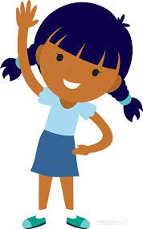
child
Everyone loves being a child.
Notes:
View in slide show mode to have each aspect appear separately

Slide 8
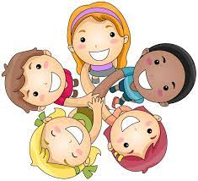
children
The children loved to play.
Notes:
View in slide show mode to have each aspect appear separately

Slide 9
Do you remember the sound ‘/zh/’ spelt in different ways?

Slide 10
si sure su

Slide 11
television

Slide 12
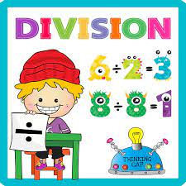
division

Slide 13
occasion

Slide 14
Let’s Teach and Practise

Slide 15
‘a’
Sound ‘o’ spelt ‘a’ after w and q

Slide 16
‘a’

Slide 17
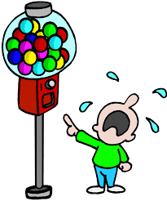
want

Slide 18
watch

Slide 19
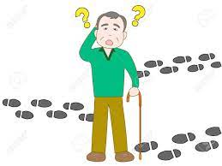
wander

Slide 20
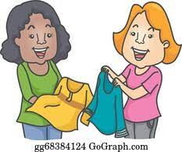
swap

Slide 21
want
VERB
Definition - have a desire to possess or do (something)

Slide 22
watch
VERB
Definition - look at or observe attentively over a period of time

Slide 23
wander
VERB
Definition - walk or move in a leisurely or aimless way

Slide 24
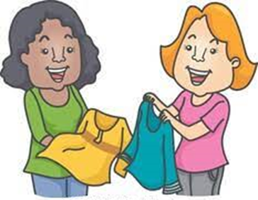
swap
VERB
Definition - take part in an exchange of

Slide 25
I want a big present for Christmas.
____

Slide 26
Lucy, watch the kettle and let me know when it has boiled.
_____

Slide 27
People wander over the footpaths to get fresh air and exercise.
______

Slide 28
Will you swap your crisps with mine?
____

Slide 29
New CHALLENGE words.

Slide 30
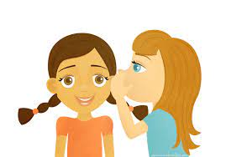
told
VERB
Definition - communicate information to someone in spoken or written words

Slide 31
Our teacher told us to write the sum down.
____

Slide 32
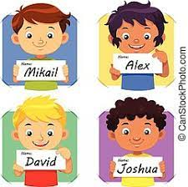
called
VERB
Definition - give (a baby or animal) a specified name

Slide 33
They called their daughter Susan.
______

Slide 34
Let’s Practise and Apply.

Slide 35
Can you spot the spelling rule words and the challenge words?

Slide 36
The Indrik Beast This animal, called the Indrik Beast, lived in Asia about 30 million years ago. It was the largest ever mammal to wander on land. It was usual to measure about 4.5 metres high. A squad of beasts could reach leaves high up in tall trees.

Slide 37
The Indrik Beast This animal, called the Indrik Beast, lived in Asia about 30 million years ago. It was the largest ever mammal to wander on land. It was usual to measure about 4.5 metres high. A squad of beasts could reach leaves high up in tall trees.

Slide 38
Write this sentence as I dictate it to you.
Notes:
This animal, called the Indrik Beast, lived in Asia about 30 million years ago.

Slide 39
This animal, called the Indrik Beast, lived in Asia about 30 million years ago.
Did you write it correctly?
Edit your work and make sure you have it correct.
Can you underline the spelling word that we have covered in this session?

Slide 40
Year 2 - Spring 1
Week 5 - Tuesday
Notes:
Revisit and review the words from previous teaching and challenge words – I say, we say, you say
Ask children to write words only in their spelling book
Introduce the new spelling rule
Children to write the new spelling rule words and challenge words into books when the sentences are shown with the spelling word missing.
Read the extract with the class as choral reading. Practise model of prosody etc.
Ask children to find the spelling words from the session in the text.
Then read allowed the chosen sentence for children to write fully in their books.
Show the extract and ask children to then edit their work to check they were correct in their dictation.

Slide 42
Let’s Revisit and Review…

Slide 43
Do you remember this challenge word?

Slide 44
child
Everyone loves being a child.
Notes:
View in slide show mode to have each aspect appear separately

Slide 45
children
The children loved to play.
Notes:
View in slide show mode to have each aspect appear separately

Slide 46
Do you remember the sound ‘/zh/’ spelt in different ways?

Slide 47
si sure su

Slide 48
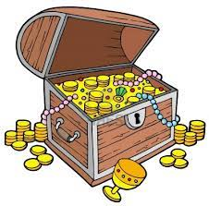
treasure

Slide 49
pleasure

Slide 50
Let’s Teach and Practise

Slide 51
‘a’
Sound ‘o’ spelt ‘a’ after w and q

Slide 52
‘a’

Slide 53
squash

Slide 54
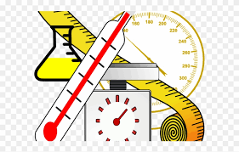
quantify

Slide 55
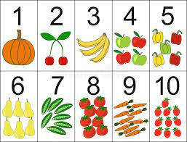
quantity

Slide 56
squash
VERB
Definition - crush or squeeze (something) with force so that it becomes flat, soft, or out of shape

Slide 57
quantify
VERB
Definition - express or measure the quantity of

Slide 58
quantity
NOUN
Definition - the amount or number of a material

Slide 59
Be careful not to squash your sandwiches in your bookbag.
______

Slide 60
I must quantify the number of sweets so I can share them with my friends.
_______

Slide 61
We will need a large quantity of chairs in the hall for the parents when they watch the children perform.
________

Slide 62
New CHALLENGE words.

Slide 63
told
VERB
Definition - communicate information to someone in spoken or written words

Slide 64
Our teacher told us to write the sum down.
____

Slide 65
called
VERB
Definition - give (a baby or animal) a specified name

Slide 66
They called their daughter Susan.
______

Slide 67
Let’s Practise and Apply.

Slide 68
Can you spot the spelling rule words and the challenge words?

Slide 69
The Indrik Beast This animal, called the Indrik Beast, lived in Asia about 30 million years ago. It was the largest ever mammal to wander on land. It was usual to measure about 4.5 metres high. A squad of beasts could reach leaves high up in tall trees.

Slide 70
The Indrik Beast This animal, called the Indrik Beast, lived in Asia about 30 million years ago. It was the largest ever mammal to wander on land. It was usual to measure about 4.5 metres high. A squad of beasts could reach leaves high up in tall trees.

Slide 71
Write this sentence as I dictate it to you.
Notes:
It was the largest ever mammal to wander on land.

Slide 72
It was the largest ever mammal to wander on land.
Did you write it correctly?
Edit your work and make sure you have it correct.
Can you underline the spelling word that we have covered in this session?

Slide 73
Year 2 - Spring 1
Week 5 - Wednesday
Notes:
Revisit and review the words from previous teaching and challenge words – I say, we say, you say
Ask children to write words only in their spelling book
Introduce the new spelling rule
Children to write the new spelling rule words and challenge words into books when the sentences are shown with the spelling word missing.
Read the extract with the class as choral reading. Practise model of prosody etc.
Ask children to find the spelling words from the session in the text.
Then read allowed the chosen sentence for children to write fully in their books.
Show the extract and ask children to then edit their work to check they were correct in their dictation.

Slide 75
Let’s Revisit and Review…

Slide 76
Do you remember this challenge word?

Slide 77
child
Everyone loves being a child.
Notes:
View in slide show mode to have each aspect appear separately

Slide 78
children
The children loved to play.
Notes:
View in slide show mode to have each aspect appear separately

Slide 79
Do you remember the sound ‘/zh/’ spelt in different ways?

Slide 80
si sure su

Slide 81
measure

Slide 82
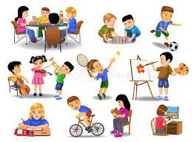
leisure

Slide 83
Let’s Teach and Practise

Slide 84
‘a’
Sound ‘o’ spelt ‘a’ after w and q

Slide 85
‘a’

Slide 86
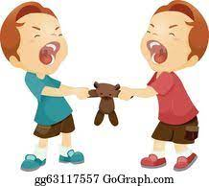
squabble

Slide 87
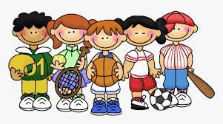
squad

Slide 88
squabble
VERB
Definition - quarrel noisily over a trivial matter

Slide 89
squad
NOUN
Definition - a small group of people having a particular task

Slide 90
– Will you children stop, there is no need to squabble over the `bikes.
________

Slide 91
The football squad warmed up ready for their match.
_____

Slide 92
New CHALLENGE words.

Slide 93
told
VERB
Definition - communicate information to someone in spoken or written words

Slide 94
Our teacher told us to write the sum down.
____

Slide 95
called
VERB
Definition - give (a baby or animal) a specified name

Slide 96
They called their daughter Susan.
______

Slide 97
Let’s Practise and Apply.

Slide 98
Can you spot the spelling rule words and the challenge words?

Slide 99
The Indrik Beast This animal, called the Indrik Beast, lived in Asia about 30 million years ago. It was the largest ever mammal to wander on land. It was usual to measure about 4.5 metres high. A squad of beasts could reach leaves high up in tall trees.

Slide 100
The Indrik Beast This animal, called the Indrik Beast, lived in Asia about 30 million years ago. It was the largest ever mammal to wander on land. It was usual to measure about 4.5 metres high. A squad of beasts could reach leaves high up in tall trees.

Slide 101
Write this sentence as I dictate it to you.
Notes:
It was usual to measure about 4.5 metres high.

Slide 102
It was usual to measure about 4.5 metres high.
Did you write it correctly?
Edit your work and make sure you have it correct.
Can you underline the spelling word that we have covered in this session?

Slide 103
Year 2 - Spring 1
Week 5 - Thursday
Notes:
Revisit and review the words from previous teaching and challenge words – I say, we say, you say
Ask children to write words only in their spelling book
Introduce the new spelling rule
Children to write the new spelling rule words and challenge words into books when the sentences are shown with the spelling word missing.
Read the extract with the class as choral reading. Practise model of prosody etc.
Ask children to find the spelling words from the session in the text.
Then read allowed the chosen sentence for children to write fully in their books.
Show the extract and ask children to then edit their work to check they were correct in their dictation.

Slide 105
Let’s Revisit and Review…

Slide 106
Do you remember this challenge word?

Slide 107
child
Everyone loves being a child.
Notes:
View in slide show mode to have each aspect appear separately

Slide 108
children
The children loved to play.
Notes:
View in slide show mode to have each aspect appear separately

Slide 109
Do you remember the sound ‘/zh/’ spelt in different ways?

Slide 110
si sure su

Slide 111
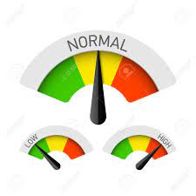
usual

Slide 112
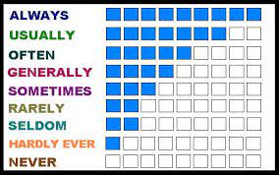
usually

Slide 113
Let’s Teach and Practise

Slide 114
‘a’
Sound ‘o’ spelt ‘a’ after w and q

Slide 115
‘a’

Slide 116
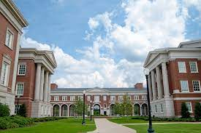
quad

Slide 117
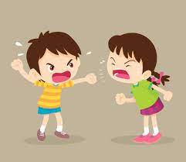
quarrel

Slide 118
quad
NOUN
Definition - a four sided space or shape

Slide 119
quarrel
VERB
Definition - a heated argument or disagreement

Slide 120
The children met in the quad and sat on the grass eating lunch.
____

Slide 121
The quarrel was over who ate the last biscuit in the barrel.
_______

Slide 122
New CHALLENGE words.

Slide 123
told
VERB
Definition - communicate information to someone in spoken or written words

Slide 124
Our teacher told us to write the sum down.
____

Slide 125
called
VERB
Definition - give (a baby or animal) a specified name

Slide 126
They called their daughter Susan.
______

Slide 127
Let’s Practise and Apply.

Slide 128
Can you spot the spelling rule words and the challenge words?

Slide 129
The Indrik Beast This animal, called the Indrik Beast, lived in Asia about 30 million years ago. It was the largest ever mammal to wander on land. It was usual to measure about 4.5 metres high. A squad of beasts could reach leaves high up in tall trees.

Slide 130
The Indrik Beast This animal, called the Indrik Beast, lived in Asia about 30 million years ago. It was the largest ever mammal to wander on land. It was usual to measure about 4.5 metres high. A squad of beasts could reach leaves high up in tall trees.

Slide 131
Write this sentence as I dictate it to you.
Notes:
A squad of beasts could reach leaves high up in tall trees.

Slide 132
A squad of beasts could reach leaves high up in tall trees.
Did you write it correctly?
Edit your work and make sure you have it correct.
Can you underline the spelling word that we have covered in this session?

Slide 133
Year 2 - Spring 1
Week 5 - Friday
Notes:
Click through the slides for all the R+R words for the week (both the focus and the challenge words)
Click through the slides for all the new learning this week

Slide 135
Old challenge words…

Slide 136
child

Slide 137
children

Slide 138
Old spelling rule words…

Slide 139
television

Slide 140
division

Slide 141
occasion

Slide 142
treasure

Slide 143
pleasure

Slide 144
measure

Slide 145
leisure

Slide 146
usual

Slide 147
usually

Slide 148
New spelling rule words…

Slide 149
want

Slide 150
watch

Slide 151
wander

Slide 152
swap

Slide 153
squash

Slide 154
quantify

Slide 155
quantity

Slide 156
squabble

Slide 157
squad

Slide 158
quad

Slide 159
quarrel

Slide 160
New challenge words…

Slide 161
told

Slide 162
called

Slide 163
Quick Quiz time…
Notes:
Say these words for the quiz
child children told called television measure want swap squash quarrel

Slide 164
Did you get them correct?
Edit your work.
child children told called television measure want swap squash quarrel

Slide 165
Word class time…

Slide 166
Our teacher told us to write the sum down.
Determiner noun verb pronoun verb determiner noun preposition
Notes:
Ask for these words to be classed

Slide 167
They called their daughter Susan.
Pronoun verb determiner noun adjective
Notes:
Ask for these words to be classed

Slide 168
Etymology
The history of a word….

Slide 169
Told
Old English tellan ‘relate, count, estimate’, of Germanic origin; related to German zählen ‘reckon, count’, erzählen ‘recount, relate’, also to tale.
Called
ate Old English ceallian, from Old Norse kalla ‘summon loudly’.

Slide 170
Let’s investigate….
Find synonyms and antonyms of the challenge words.

