Slide 1
Spelling Y2
Mastering spellings: building on the foundations of phonics
Spring 1
Week 6

Slide 2
Year 2 - Spring 1
Week 6 - Monday

Slide 3
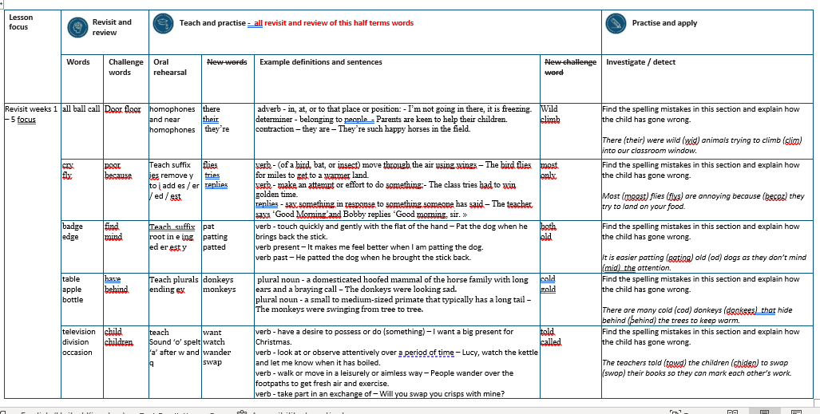

Slide 4
Let’s Revisit and Review…

Slide 5
Do you remember this challenge word?

Slide 6
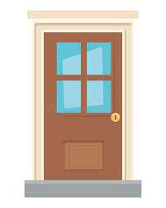
door
What could be behind the door?
Notes:
View in slide show mode to have each aspect appear separately

Slide 7
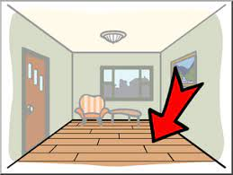
floor
Be careful not to slip on the wet floor.
Notes:
View in slide show mode to have each aspect appear separately

Slide 8
Do you remember the sound ‘or’ spelt ‘a’ before ‘l’

Slide 9
al
Sounds ‘or’

Slide 10
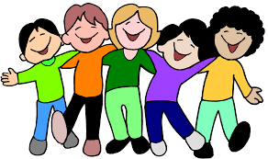
all

Slide 11

ball

Slide 12

call

Slide 13
Let’s Teach and Practise

Slide 14
homophones or near homophones homo = same phone = sound

Slide 15
homophones

Slide 16
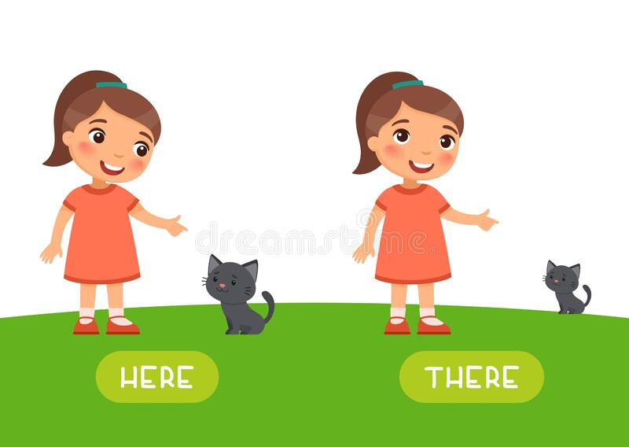
there

Slide 17

their

Slide 18
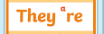
they’re

Slide 19
there
ADVERB
Definition - in, at, or to that place or position

Slide 20
their
DETERMINER
Definition - belonging to people

Slide 21
they’re
CONTRACTION
Definition – they are

Slide 22
I’m not going in there, it is freezing.
_____,

Slide 23
Parents are keen to help their children.
_____

Slide 24
They’re such happy horses in the field.
_______

Slide 25
New CHALLENGE words.

Slide 26
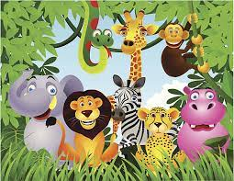
wild
ADJECTIVE
Definition - (of an animal or plant) living or growing in the natural environment

Slide 27
The children saw a herd of wild goats in the field.
____

Slide 28
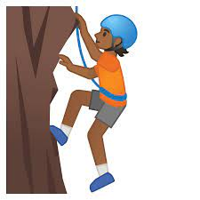
climb
VERB
Definition - go or come up a slope or staircase

Slide 29
The children climb the hill everyday to get to school.
_____

Slide 30
Let’s investigate.

Slide 31
Can you spot the spelling errors in these sentences?
Write the correct spelling and explain where they went wrong.

Slide 32
their were wid animals trying to clim into our classroom window.

Slide 33
their were wid animals trying to clim into our classroom window.

Slide 34
their were wid animals trying to clim into our classroom window. there – incorrect homophone

Slide 35
their were wid animals trying to clim into our classroom window. wild – missing the l

Slide 36
their were wid animals trying to clim into our classroom window. climb – silent letter b at the end

Slide 37
There were wild animals trying to climb into our classroom window.

Slide 38
Year 2 - Spring 1
Week 6 - Tuesday

Slide 40
Let’s Revisit and Review…

Slide 41
Do you remember this challenge word?

Slide 42
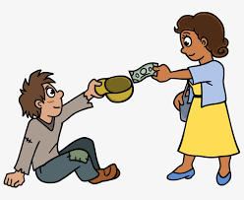
poor
Christians give money to poor people.
Notes:
View in slide show mode to have each aspect appear separately

Slide 43
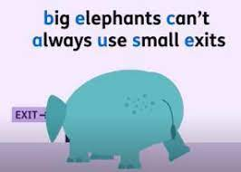
because
Remember to eat fruit and vegetables because it keeps you healthy.
Notes:
View in slide show mode to have each aspect appear separately

Slide 44
Do you remember the sound ‘igh’ spelt ‘y’ at the end of words?

Slide 45
y
Sounds ‘igh’

Slide 46
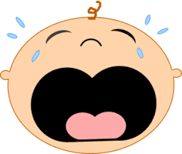
cry

Slide 47
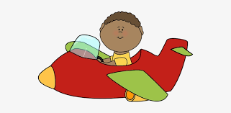
fly

Slide 48
Let’s Teach and Practise

Slide 49
Suffixes es / er / ed / est
change y to i
then add…
es / er / ed / est

Slide 50
es

Slide 51
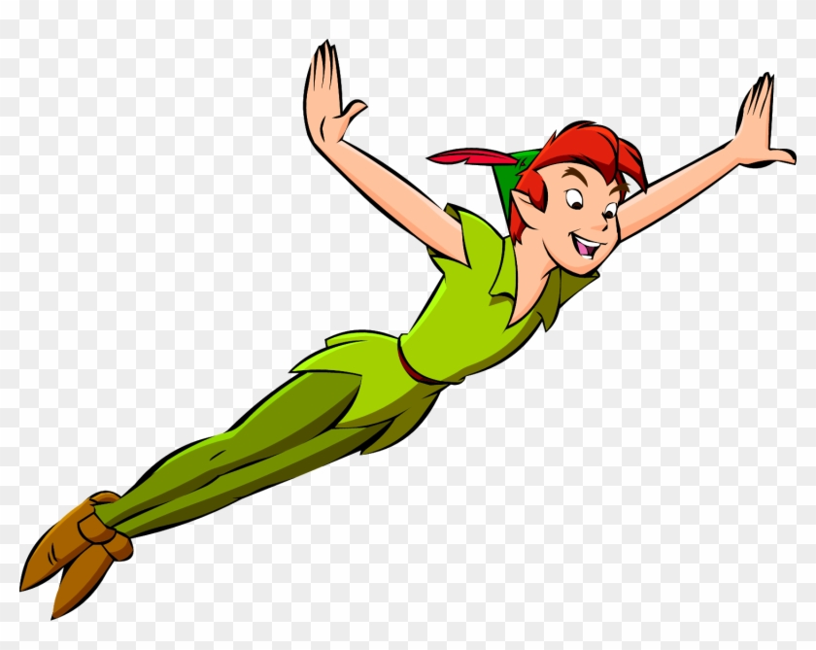
flies

Slide 52

tries

Slide 53

replies

Slide 54
flies
fly (-y +i) + es = flies
VERB
Definition - (of a bird, bat, or insect) move through the air using wings

Slide 55
tries
try (-y +i) + es = tries
VERB
Definition - make an attempt or effort to do something

Slide 56
replies
reply (-y +i) + es = replies
VERB
Definition - say something or write something in response to something someone has said or written

Slide 57
The bird flies for miles to get to a warmer land.
_____

Slide 58
The class tries hard to win golden time.
_____

Slide 59
The teacher says ‘Good Morning’ and Bobby replies ‘Good morning, sir.’
_______

Slide 60
New CHALLENGE words.

Slide 61
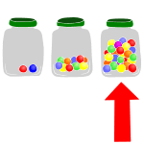
most
DETERMINER
Definition - greatest amount

Slide 62
The person with most votes wins.
____

Slide 63

only
ADJECTIVE
Definition - alone of its or their kind; single or solitary

Slide 64
Jessica was an only child.
____

Slide 65
Let’s investigate.

Slide 66
Can you spot the spelling errors in these sentences?
Write the correct spelling and explain where they went wrong.

Slide 67
moast flys are annoying because becoz they try to land on your food.

Slide 68
moast flys are annoying because becoz they try to land on your food.

Slide 69
moast flys are annoying because becoz they try to land on your food. most – no a

Slide 70
moast flys are annoying because becoz they try to land on your food. flies – fly (-y +i) + es

Slide 71
moast flys are annoying because becoz they try to land on your food. because – big elephants can’t always use small exits

Slide 72
Most flies are annoying because they try to land on your food.

Slide 73
Year 2 - Spring 1
Week 6 - Wednesday

Slide 75
Let’s Revisit and Review…

Slide 76
Let’s investigate.

Slide 77
Do you remember this challenge word?

Slide 78
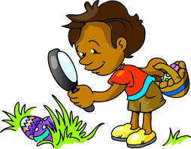
find
At Easter we find eggs on our hunt.
Notes:
View in slide show mode to have each aspect appear separately

Slide 79

mind
Our minds are incredible and control our bodies all the time.
Notes:
View in slide show mode to have each aspect appear separately

Slide 80
Do you remember the sound ‘ze’ spelt ‘dge’ at the end of words?

Slide 81
dge
Sounds ‘ze’

Slide 82

badge

Slide 83
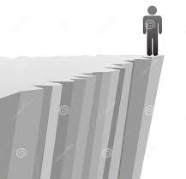
edge

Slide 84
Let’s Teach and Practise

Slide 85
Suffixes ing / er / ed / est / y
When a vowel is followed by a consonant in a one-syllable word, double the consonant and then add the suffix.

Slide 86
ing / er / est / ed / y

Slide 87
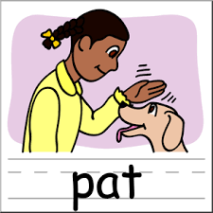
pat

Slide 88
patting

Slide 89
patted

Slide 90
pat
(a = vowel) (one syllable)
VERB
Definition - touch quickly and gently with the flat of the hand

Slide 91
patting
pat (+t) + ing = patting
VERB
Definition – (present tense) touch quickly and gently with the flat of the hand

Slide 92
patted
pat (+t) + ed = patted
VERB
Definition – (past tense) touch quickly and gently with the flat of the hand

Slide 93
Pat the dog when he brings back the stick.
___

Slide 94
It makes me feel better when I am patting the dog.
_______

Slide 95
He patted the dog when he brought the stick back.
______

Slide 96
New CHALLENGE words.

Slide 97
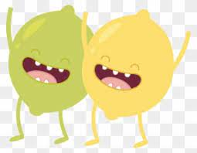
both
ADVERB
Definition - used before the first of two alternatives to emphasise that the statement being made applies to each

Slide 98
The film has won over both young people and old people.
____

Slide 99
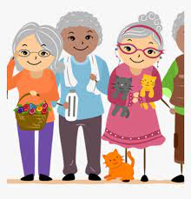
old
ADJECTIVE
Definition - having lived for a long time

Slide 100
The old tree still produced apples.
___

Slide 101
Can you spot the spelling errors in these sentences?
Write the correct spelling and explain where they went wrong.

Slide 102
It is easier pating od dogs as they don’t mid the attention.

Slide 103
It is easier pating od dogs as they don’t mid the attention.

Slide 104
It is easier pating od dogs as they don’t mid the attention.
Patting – pat (o vowel and one syllable so double the consonant before adding the suffix) pat +t + ing

Slide 105
It is easier pating od dogs as they don’t mid the attention. old – missing the l

Slide 106
It is easier pating od dogs as they don’t mid the attention. mind – missing the n

Slide 107
It is easier patting old dogs as they don’t mind the attention.

Slide 108
Year 2 - Spring 1
Week 6 - Thursday

Slide 110
Let’s Revisit and Review…

Slide 111
Do you remember this challenge word?

Slide 112
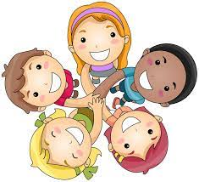
have
We have lots of friends.
Notes:
View in slide show mode to have each aspect appear separately

Slide 113
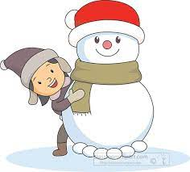
behind
The little girl was behind the snowman.
Notes:
View in slide show mode to have each aspect appear separately

Slide 114
Do you remember the sound ‘al’ spelt ‘in different ways at the end of words?

Slide 115
le al il el

Slide 116
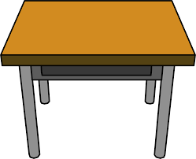
table

Slide 117
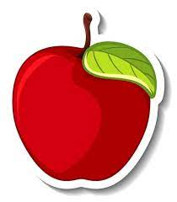
apple

Slide 118

bottle

Slide 119
Let’s Teach and Practise

Slide 120
Plurals roots ending in ‘ey’
Plural is more than one

Slide 121
ey + s eys

Slide 122
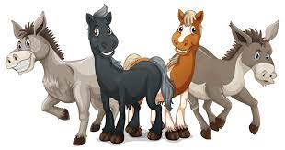
donkeys

Slide 123
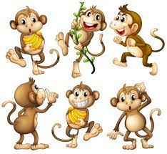
monkeys

Slide 124
donkeys
donkey + s = donkeys
PLURAL NOUN
Definition - a domesticated hoofed mammal of the horse family with long ears and a braying call

Slide 125
monkeys
monkey + s = monkeys
PLURAL NOUN
Definition - a small to medium-sized primate that typically has a long tail

Slide 126
The donkeys were looking sad.
_______

Slide 127
The monkeys were swinging from tree to tree.
_______

Slide 128
New CHALLENGE words.

Slide 129
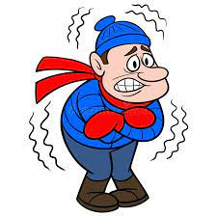
cold
ADJECTIVE
Definition - of or at a low or relatively low temperature

Slide 130
The cold snow was fun to play in.
____

Slide 131

gold
NOUN
Definition - a yellow precious metal

Slide 132
They found the gold buried deep underground.
____

Slide 133
Let’s investigate.

Slide 134
Can you spot the spelling errors in these sentences?
Write the correct spelling and explain where they went wrong.

Slide 135
There are many cod donkees that hide behid the trees to keep warm.

Slide 136
There are many cod donkees that hide behid the trees to keep warm.

Slide 137
There are many cod donkees that hide behid the trees to keep warm. cold – missing the l

Slide 138
There are many cod donkees that hide behid the trees to keep warm. donkeys – ey endings add an s for plural

Slide 139
There are many cod donkees that hide behid the trees to keep warm. behind – missing the n

Slide 140
There are many cold donkeys that hide behind the trees to keep warm.

Slide 141
Year 2 - Spring 1
Week 6 - Friday

Slide 143
Let’s Revisit and Review…

Slide 144
Do you remember this challenge word?

Slide 145
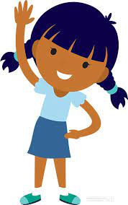
child
Everyone loves being a child.
Notes:
View in slide show mode to have each aspect appear separately

Slide 146
children
The children loved to play.
Notes:
View in slide show mode to have each aspect appear separately

Slide 147
Do you remember the sound ‘/zh/’ spelt in different ways?

Slide 148
si sure su

Slide 149

television

Slide 150
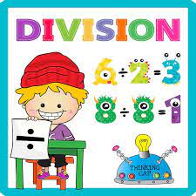
division

Slide 151

occasion

Slide 152
Let’s Teach and Practise

Slide 153
‘a’
Sound ‘o’ spelt ‘a’ after w and q

Slide 154
‘a’

Slide 155
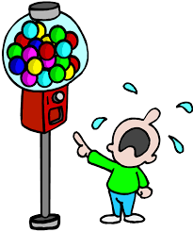
want

Slide 156

watch

Slide 157
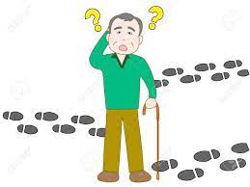
wander

Slide 158
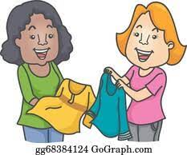
swap

Slide 159
want
VERB
Definition - have a desire to possess or do (something)

Slide 160
watch
VERB
Definition - look at or observe attentively over a period of time

Slide 161
wander
VERB
Definition - walk or move in a leisurely or aimless way

Slide 162
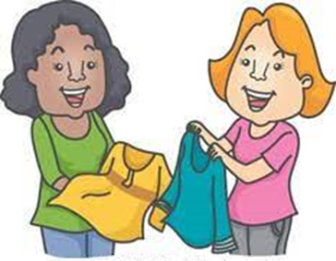
swap
VERB
Definition - take part in an exchange of

Slide 163
I want a big present for Christmas.
____

Slide 164
Lucy, watch the kettle and let me know when it has boiled.
_____

Slide 165
People wander over the footpaths to get fresh air and exercise.
______

Slide 166
Will you swap your crisps with mine?
____

Slide 167
New CHALLENGE words.

Slide 168
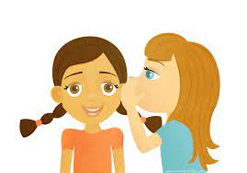
told
VERB
Definition - communicate information to someone in spoken or written words

Slide 169
Our teacher told us to write the sum down.
____

Slide 170
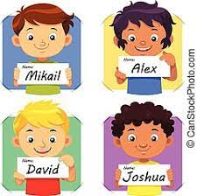
called
VERB
Definition - give (a baby or animal) a specified name

Slide 171
They called their daughter Susan.
______

Slide 172
Let’s investigate.

Slide 173
Can you spot the spelling errors in these sentences?
Write the correct spelling and explain where they went wrong.

Slide 174
The teachers towd the chiden to swop their books so they can mark each other’s work.

Slide 175
The teachers towd the chiden to swop their books so they can mark each other’s work.

Slide 176
The teachers towd the chiden to swop their books so they can mark each other’s work. told – l not w

Slide 177
The teachers towd the chiden to swop their books so they can mark each other’s work. children – missing the l and r

Slide 178
The teachers towd the chiden to swop their books so they can mark each other’s work. swap – ‘o’ sound is a after a ‘w’

Slide 179
The teachers told the children to swap their books so they can mark each other’s work.

