Slide 1
Spelling Y2
Mastering spellings: building on the foundations of phonics
Spring 2
Week 1

Slide 2
Year 2 - Spring 2
Week 1 - Monday

Slide 3
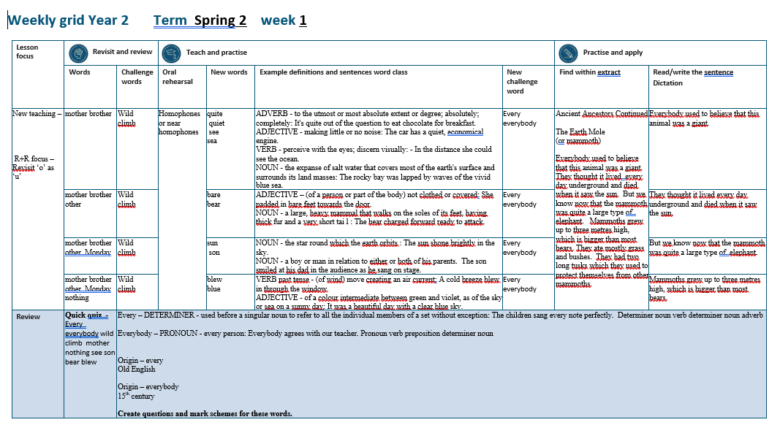

Slide 4
Let’s Revisit and Review…

Slide 5
Do you remember this challenge word?

Slide 6
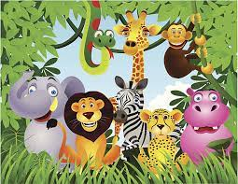
wild
ADJECTIVE
Definition - (of an animal or plant) living or growing in the natural environment

Slide 7
The children saw a herd of wild goats in the field.
____

Slide 8
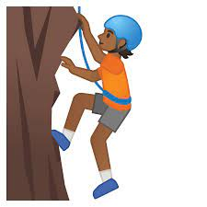
climb
VERB
Definition - go or come up a slope or staircase

Slide 9
The children climb the hill everyday to get to school.
_____

Slide 10
‘U’ sound as ‘O’

Slide 11
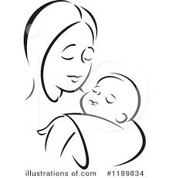
mother

Slide 12
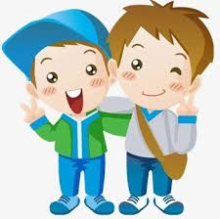
brother

Slide 13
Let’s Teach and Practise

Slide 14
homophones or near homophones homo = same phone = sound

Slide 15
homophones

Slide 16
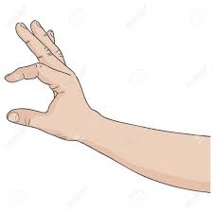
quite

Slide 17

quiet

Slide 18

see

Slide 19

sea

Slide 20
quite
ADVERB
Definition - to a certain or fairly significant extent or degree

Slide 21
quiet
ADJECTIVE
Definition - making little or no noise

Slide 22
see
VERB
Definition – perceive with the eyes; discern visually

Slide 23
sea
NOUN
Definition – the expanse of salt water that covers most of the earth's surface and surrounds its land masses

Slide 24
It's quite warm outside.
_____

Slide 25
I was as quiet as I could be, but she knew I was there.
_____

Slide 26
In the distance she could see the ocean.
___

Slide 27
The rocky bay was lapped by waves of the vivid blue sea.
___

Slide 28
New CHALLENGE words.

Slide 29
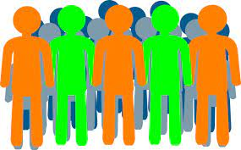
every
DETERMINER
Definition - used before a singular noun to refer to all the individual members of a set without exception

Slide 30
The children sang every note perfectly.
_____

Slide 31
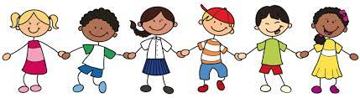
everybody
PRONOUN
Definition – every person

Slide 32
Everybody agrees with our teacher.
_________

Slide 33
Let’s Practise and Apply.

Slide 34
Can you spot the spelling rule words and the challenge words?

Slide 35
Ancient Ancestors continued…
The Earth Mole (or mammoth)
Everybody used to believe that this animal was a giant. They thought it lived every day underground and died when it saw the sun. But we know now that the mammoth was quite a large type of elephant. Mammoths grew up to three metres high, which is bigger than most bears. They ate mostly grass and bushes. They had two long tusks which they used to protect themselves from other mammoths.

Slide 36
Ancient Ancestors continued…
The Earth Mole (or mammoth)
Everybody used to believe that this animal was a giant. They thought it lived every day underground and died when it saw the sun. But we know now that the mammoth was quite a large type of elephant. Mammoths grew up to three metres high, which is bigger than most bears. They ate mostly grass and bushes. They had two long tusks which they used to protect themselves from other mammoths.

Slide 37
Write this sentence as I dictate it to you.
Notes:
Everybody used to believe that this animal was a giant.

Slide 38
Everybody used to believe that this animal was a giant.
Did you write it correctly?
Edit your work and make sure you have it correct.
Can you underline the spelling word that we have covered in this session?

Slide 39
Year 2 - Spring 2
Week 1 - Tuesday
Notes:
Revisit and review the words from previous teaching and challenge words – I say, we say, you say
Ask children to write words only in their spelling book
Introduce the new spelling rule
Children to write the new spelling rule words and challenge words into books when the sentences are shown with the spelling word missing.
Read the extract with the class as choral reading. Practise model of prosody etc.
Ask children to find the spelling words from the session in the text.
Then read allowed the chosen sentence for children to write fully in their books.
Show the extract and ask children to then edit their work to check they were correct in their dictation.

Slide 41
Let’s Revisit and Review…

Slide 42
Do you remember this challenge word?

Slide 43
wild
ADJECTIVE
Definition - (of an animal or plant) living or growing in the natural environment

Slide 44
The children saw a herd of wild goats in the field.
____

Slide 45
climb
VERB
Definition - go or come up a slope or staircase

Slide 46
The children climb the hill everyday to get to school.
_____

Slide 47
‘U’ sound as ‘O’

Slide 48
mother

Slide 49
brother

Slide 50
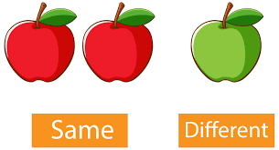
other

Slide 51
Let’s Teach and Practise

Slide 52
homophones or near homophones homo = same phone = sound

Slide 53
homophones

Slide 54
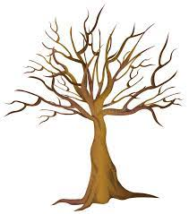
bare

Slide 55
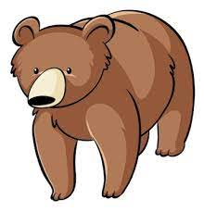
bear

Slide 56
bare
ADJECTIVE
Definition - not clothed or covered

Slide 57
bear
NOUN
Definition - a large, heavy mammal that walks on the soles of its feet, having thick fur and a very short tail

Slide 58
She padded in bare feet towards the door.
____

Slide 59
The bear charged forward ready to attack.
____

Slide 60
New CHALLENGE words.

Slide 61
every
DETERMINER
Definition - used before a singular noun to refer to all the individual members of a set without exception

Slide 62
The children sang every note perfectly.
_____

Slide 63
everybody
PRONOUN
Definition – every person

Slide 64
Everybody agrees with our teacher.
_________

Slide 65
Let’s Practise and Apply.

Slide 66
Can you spot the spelling rule words and the challenge words?

Slide 67
Ancient Ancestors continued…
The Earth Mole (or mammoth)
Everybody used to believe that this animal was a giant. They thought it lived every day underground and died when it saw the sun. But we know now that the mammoth was quite a large type of elephant. Mammoths grew up to three metres high, which is bigger than most bears. They ate mostly grass and bushes. They had two long tusks which they used to protect themselves from other mammoths.

Slide 68
Ancient Ancestors continued…
The Earth Mole (or mammoth)
Everybody used to believe that this animal was a giant. They thought it lived every day underground and died when it saw the sun. But we know now that the mammoth was quite a large type of elephant. Mammoths grew up to three metres high, which is bigger than most bears. They ate mostly grass and bushes. They had two long tusks which they used to protect themselves from other mammoths.

Slide 69
Write this sentence as I dictate it to you.
Notes:
They thought it lived every day underground.

Slide 70
They thought it lived every day underground.
Did you write it correctly?
Edit your work and make sure you have it correct.
Can you underline the spelling word that we have covered in this session?

Slide 71
Year 2 - Spring 2
Week 1 - Wednesday
Notes:
Revisit and review the words from previous teaching and challenge words – I say, we say, you say
Ask children to write words only in their spelling book
Introduce the new spelling rule
Children to write the new spelling rule words and challenge words into books when the sentences are shown with the spelling word missing.
Read the extract with the class as choral reading. Practise model of prosody etc.
Ask children to find the spelling words from the session in the text.
Then read allowed the chosen sentence for children to write fully in their books.
Show the extract and ask children to then edit their work to check they were correct in their dictation.

Slide 73
Let’s Revisit and Review…

Slide 74
Do you remember this challenge word?

Slide 75
wild
ADJECTIVE
Definition - (of an animal or plant) living or growing in the natural environment

Slide 76
The children saw a herd of wild goats in the field.
____

Slide 77
climb
VERB
Definition - go or come up a slope or staircase

Slide 78
The children climb the hill everyday to get to school.
_____

Slide 79
‘U’ sound as ‘O’

Slide 80
mother

Slide 81
brother

Slide 82
other

Slide 83

Monday

Slide 84
Let’s Teach and Practise

Slide 85
homophones or near homophones homo = same phone = sound

Slide 86
homophones

Slide 87

sun

Slide 88
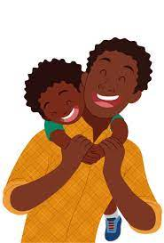
son

Slide 89
sun
NOUN
Definition - the star round which the earth orbits

Slide 90
son
NOUN
Definition - a boy or man in relation to either or both of his parents.

Slide 91
The sun shone brightly in the sky.
___

Slide 92
The son smiled at his dad in the audience as he sang on stage.
___

Slide 93
New CHALLENGE words.

Slide 94
every
DETERMINER
Definition - used before a singular noun to refer to all the individual members of a set without exception

Slide 95
The children sang every note perfectly.
_____

Slide 96
everybody
PRONOUN
Definition – every person

Slide 97
Everybody agrees with our teacher.
_________

Slide 98
Let’s Practise and Apply.

Slide 99
Can you spot the spelling rule words and the challenge words?

Slide 100
Ancient Ancestors continued…
The Earth Mole (or mammoth)
Everybody used to believe that this animal was a giant. They thought it lived every day underground and died when it saw the sun. But we know now that the mammoth was quite a large type of elephant. Mammoths grew up to three metres high, which is bigger than most bears. They ate mostly grass and bushes. They had two long tusks which they used to protect themselves from other mammoths.

Slide 101
Ancient Ancestors continued…
The Earth Mole (or mammoth)
Everybody used to believe that this animal was a giant. They thought it lived every day underground and died when it saw the sun. But we know now that the mammoth was quite a large type of elephant. Mammoths grew up to three metres high, which is bigger than most bears. They ate mostly grass and bushes. They had two long tusks which they used to protect themselves from other mammoths.

Slide 102
Write this sentence as I dictate it to you.
Notes:
But we know now that the mammoth was quite a large type of elephant.

Slide 103
But we know now that the mammoth was quite a large type of elephant.
Did you write it correctly?
Edit your work and make sure you have it correct.
Can you underline the spelling word that we have covered in this session?

Slide 104
Year 2 - Spring 2
Week 1 - Thursday
Notes:
Revisit and review the words from previous teaching and challenge words – I say, we say, you say
Ask children to write words only in their spelling book
Introduce the new spelling rule
Children to write the new spelling rule words and challenge words into books when the sentences are shown with the spelling word missing.
Read the extract with the class as choral reading. Practise model of prosody etc.
Ask children to find the spelling words from the session in the text.
Then read allowed the chosen sentence for children to write fully in their books.
Show the extract and ask children to then edit their work to check they were correct in their dictation.

Slide 106
Let’s Revisit and Review…

Slide 107
Do you remember this challenge word?

Slide 108
wild
ADJECTIVE
Definition - (of an animal or plant) living or growing in the natural environment

Slide 109
The children saw a herd of wild goats in the field.
____

Slide 110
climb
VERB
Definition - go or come up a slope or staircase

Slide 111
The children climb the hill everyday to get to school.
_____

Slide 112
‘U’ sound as ‘O’

Slide 113
mother

Slide 114
brother

Slide 115
other

Slide 116
Monday

Slide 117

nothing

Slide 118
Let’s Teach and Practise

Slide 119
homophones or near homophones homo = same phone = sound

Slide 120
homophones

Slide 121
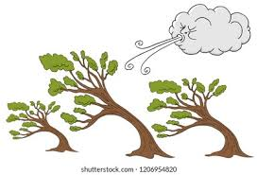
blew

Slide 122

blue

Slide 123
blew
VERB – past tense
Definition - (of wind) move creating an air current

Slide 124
blue
ADJECTIVE
Definition - of a colour intermediate between green and violet, as of the sky or sea on a sunny day

Slide 125
A cold breeze blew in through the window.
____

Slide 126
It was a beautiful day with a clear blue sky
____

Slide 127
New CHALLENGE words.

Slide 128
every
DETERMINER
Definition - used before a singular noun to refer to all the individual members of a set without exception

Slide 129
The children sang every note perfectly.
_____

Slide 130
everybody
PRONOUN
Definition – every person

Slide 131
Everybody agrees with our teacher.
_________

Slide 132
Let’s Practise and Apply.

Slide 133
Can you spot the spelling rule words and the challenge words?

Slide 134
Ancient Ancestors continued…
The Earth Mole (or mammoth)
Everybody used to believe that this animal was a giant. They thought it lived every day underground and died when it saw the sun. But we know now that the mammoth was quite a large type of elephant. Mammoths grew up to three metres high, which is bigger than most bears. They ate mostly grass and bushes. They had two long tusks which they used to protect themselves from other mammoths.

Slide 135
Ancient Ancestors continued…
The Earth Mole (or mammoth)
Everybody used to believe that this animal was a giant. They thought it lived every day underground and died when it saw the sun. But we know now that the mammoth was quite a large type of elephant. Mammoths grew up to three metres high, which is bigger than most bears. They ate mostly grass and bushes. They had two long tusks which they used to protect themselves from other mammoths.

Slide 136
Write this sentence as I dictate it to you.
Notes:
Mammoths grew bigger than most bears.

Slide 137
Mammoths grew bigger than most bears.
Did you write it correctly?
Edit your work and make sure you have it correct.
Can you underline the spelling word that we have covered in this session?

Slide 138
Year 2 - Spring 2
Week 1 - Friday
Notes:
Click through the slides for all the R+R words for the week (both the focus and the challenge words)
Click through the slides for all the new learning this week

Slide 140
Old challenge words…

Slide 141
wild

Slide 142
climb

Slide 143
Old spelling rule words…

Slide 144
mother

Slide 145
brother

Slide 146
other

Slide 147
Monday

Slide 148
nothing

Slide 149
New spelling rule words…

Slide 150
quite

Slide 151
quiet

Slide 152
see

Slide 153
see

Slide 154
bare

Slide 155
bear

Slide 156
son

Slide 157
sun

Slide 158
blew

Slide 159
blue

Slide 160
New challenge words…

Slide 161
every

Slide 162
everybody

Slide 163
Quick Quiz time…
Notes:
Say these words for the quiz
every everybody wild climb mother nothing see son bear blew

Slide 164
Did you get them correct?
Edit your work.
every everybody wild climb mother nothing see son bear blew

Slide 165
Word class time…

Slide 166
The children sang every note perfectly
Determiner noun verb determiner noun adverb
Notes:
Ask for these words to be classed

Slide 167
Everybody agrees with our teacher.
Pronoun verb preposition determiner noun
Notes:
Ask for these words to be classed

Slide 168
Etymology
The history of a word….

Slide 169
every
Old English
Everybody
Old English 15th century

Slide 170
Let’s investigate….
Create questions and mark schemes for these words.

