Slide 1
Spelling Y2
Mastering spellings: building on the foundations of phonics
Spring 2
Week 2

Slide 2
Year 2 - Spring 2
Week 2 - Monday

Slide 3
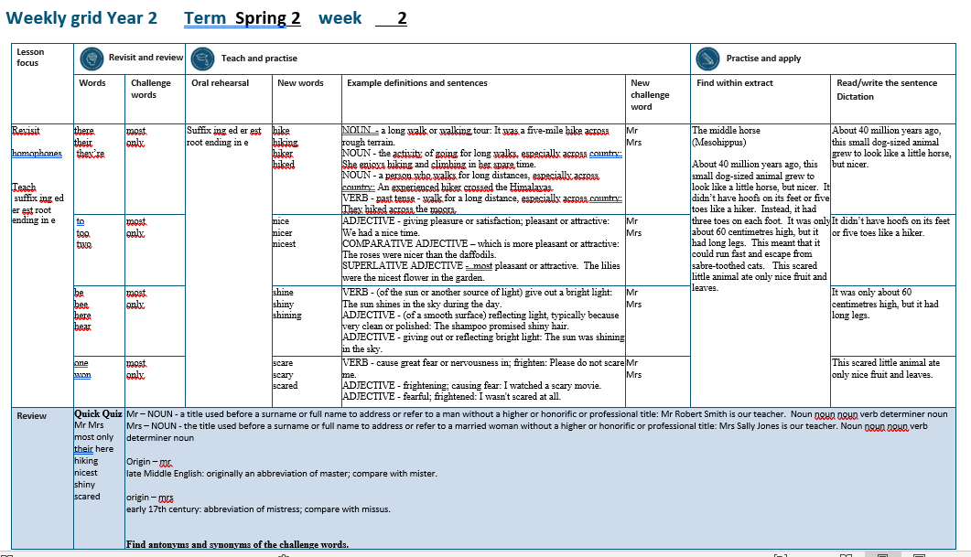

Slide 4
Let’s Revisit and Review…

Slide 5
Do you remember this challenge word?

Slide 6
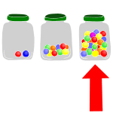
most
DETERMINER
Definition - greatest amount

Slide 7
The person with most votes wins.
____

Slide 8

only
ADJECTIVE
Definition - alone of its or their kind; single or solitary

Slide 9
Jessica was an only child.
____

Slide 10
homophones or near homophones homo = same phone = sound

Slide 11
homophones

Slide 12
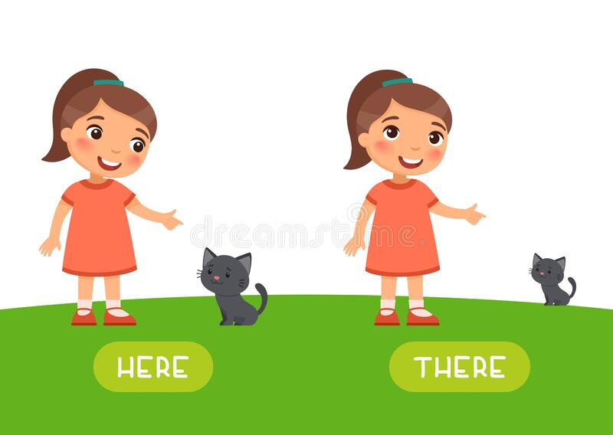
there

Slide 13

their

Slide 14
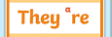
they’re

Slide 15
Let’s Teach and Practise

Slide 16
suffixes ing ed er est root ending in e

Slide 17
suffixes

Slide 18
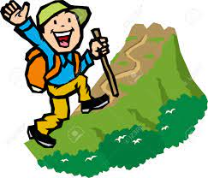
hike

Slide 19
hiking

Slide 20
hiker

Slide 21
hiked

Slide 22
hike
hike – ends in e
NOUN
Definition - a long walk or walking tour

Slide 23
hiking
hike (-e) + ing = hiking
NOUN
Definition - the activity of going for long walks, especially across country

Slide 24
hiker
hike (-e) + er = hiker
NOUN
Definition - a person who walks for long distances, especially across country

Slide 25
hiked
hike (-e) + ed = hiked
VERB
Definition - past tense - walk for a long distance, especially across country

Slide 26
It was a five-mile hike across rough terrain.
____

Slide 27
She enjoys hiking and climbing in her spare time.
______

Slide 28
An experienced hiker crossed the Himalayas.
_____

Slide 29
They hiked across the moors.
_____

Slide 30
New CHALLENGE words.

Slide 31

Mr.
NOUN
Definition - a title used before a surname or full name to address or refer to a man without a higher or honorific or professional title

Slide 32
Mr. Robert Smith is our teacher.
__

Slide 33
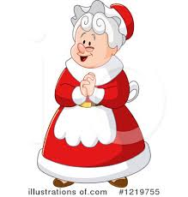
Mrs.
NOUN
Definition – the title used before a surname or full name to address or refer to a married woman without a higher or honorific or professional title

Slide 34
Mrs Sally Jones is our teacher.
___

Slide 35
Let’s Practise and Apply.

Slide 36
Can you spot the spelling rule words and the challenge words?

Slide 37
Ancient Ancestors continued…
The middle horse
(Mesohippus)
About 40 million years ago, this small dog-sized animal grew to look like a little horse, but nicer. It didn’t have hoofs on its feet or five toes like a hiker. Instead, it had three toes on each foot. It was only about 60 centimetres high, but it had long legs. This meant that it could run fast and escape from sabre-toothed cats. This scared little animal ate only nice fruit and leaves.

Slide 38
Ancient Ancestors continued…
The middle horse
(Mesohippus)
About 40 million years ago, this small dog-sized animal grew to look like a little horse, but nicer. It didn’t have hoofs on its feet or five toes like a hiker. Instead, it had three toes on each foot. It was only about 60 centimetres high, but it had long legs. This meant that it could run fast and escape from sabre-toothed cats. This scared little animal ate only nice fruit and leaves.

Slide 39
Write this sentence as I dictate it to you.
Notes:
This small animal grew to look like a little horse, but nicer.

Slide 40
This small animal grew to look like a little horse, but nicer.
Did you write it correctly?
Edit your work and make sure you have it correct.
Can you underline the spelling word that we have covered in this session?

Slide 41
Year 2 - Spring 2
Week 2 - Tuesday
Notes:
Revisit and review the words from previous teaching and challenge words – I say, we say, you say
Ask children to write words only in their spelling book
Introduce the new spelling rule
Children to write the new spelling rule words and challenge words into books when the sentences are shown with the spelling word missing.
Read the extract with the class as choral reading. Practise model of prosody etc.
Ask children to find the spelling words from the session in the text.
Then read allowed the chosen sentence for children to write fully in their books.
Show the extract and ask children to then edit their work to check they were correct in their dictation.

Slide 43
Let’s Revisit and Review…

Slide 44
Do you remember this challenge word?

Slide 45
most
DETERMINER
Definition - greatest amount

Slide 46
The person with most votes wins.
____

Slide 47
only
ADJECTIVE
Definition - alone of its or their kind; single or solitary

Slide 48
Jessica was an only child.
____

Slide 49
homophones or near homophones homo = same phone = sound

Slide 50
homophones

Slide 51
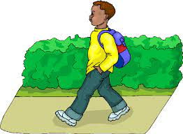
to

Slide 52
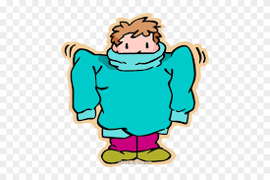
too

Slide 53

two

Slide 54
Let’s Teach and Practise

Slide 55
suffixes ing ed er est root ending in e

Slide 56
suffixes

Slide 57

nice

Slide 58
nicer

Slide 59
nicest

Slide 60
nice
nice – ends in e
ADJECTIVE
Definition - giving pleasure or satisfaction; pleasant or attractive

Slide 61
nicer
nice (-i) + er = nicer
COMPARATIVE ADJECTIVE
Definition - which is more pleasant or attractive

Slide 62
nicer
nice (-i) + est = nicest
SUPERLATIVE ADJECTIVE
Definition - most pleasant or attractive

Slide 63
We had a nice time.
____

Slide 64
The roses were nicer than the daffodils.
_____

Slide 65
The lilies were the nicest flower in the garden.
______

Slide 66
New CHALLENGE words.

Slide 67
Mr.
NOUN
Definition - a title used before a surname or full name to address or refer to a man without a higher or honorific or professional title

Slide 68
Mr. Robert Smith is our teacher.
__

Slide 69
Mrs.
NOUN
Definition – the title used before a surname or full name to address or refer to a married woman without a higher or honorific or professional title

Slide 70
Mrs Sally Jones is our teacher.
___

Slide 71
Let’s Practise and Apply.

Slide 72
Can you spot the spelling rule words and the challenge words?

Slide 73
Ancient Ancestors continued…
The middle horse
(Mesohippus)
About 40 million years ago, this small dog-sized animal grew to look like a little horse, but nicer. It didn’t have hoofs on its feet or five toes like a hiker. Instead, it had three toes on each foot. It was only about 60 centimetres high, but it had long legs. This meant that it could run fast and escape from sabre-toothed cats. This scared little animal ate only nice fruit and leaves.

Slide 74
Ancient Ancestors continued…
The middle horse
(Mesohippus)
About 40 million years ago, this small dog-sized animal grew to look like a little horse, but nicer. It didn’t have hoofs on its feet or five toes like a hiker. Instead, it had three toes on each foot. It was only about 60 centimetres high, but it had long legs. This meant that it could run fast and escape from sabre-toothed cats. This scared little animal ate only nice fruit and leaves.

Slide 75
Write this sentence as I dictate it to you.
Notes:
It didn’t have hoofs on its feet or five toes like a hiker.

Slide 76
It didn’t have hoofs on its feet or five toes like a hiker.
Did you write it correctly?
Edit your work and make sure you have it correct.
Can you underline the spelling word that we have covered in this session?

Slide 77
Year 2 - Spring 2
Week 2 - Wednesday
Notes:
Revisit and review the words from previous teaching and challenge words – I say, we say, you say
Ask children to write words only in their spelling book
Introduce the new spelling rule
Children to write the new spelling rule words and challenge words into books when the sentences are shown with the spelling word missing.
Read the extract with the class as choral reading. Practise model of prosody etc.
Ask children to find the spelling words from the session in the text.
Then read allowed the chosen sentence for children to write fully in their books.
Show the extract and ask children to then edit their work to check they were correct in their dictation.

Slide 79
Let’s Revisit and Review…

Slide 80
Do you remember this challenge word?

Slide 81
most
DETERMINER
Definition - greatest amount

Slide 82
The person with most votes wins.
____

Slide 83
only
ADJECTIVE
Definition - alone of its or their kind; single or solitary

Slide 84
Jessica was an only child.
____

Slide 85
homophones or near homophones homo = same phone = sound

Slide 86
homophones

Slide 87

be

Slide 88

bee

Slide 89
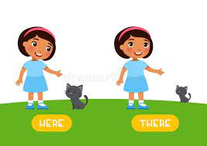
here

Slide 90
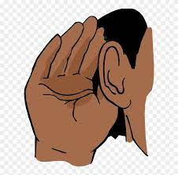
hear

Slide 91
Let’s Teach and Practise

Slide 92
suffixes ing ed er est root ending in e

Slide 93
suffixes

Slide 94

shine

Slide 95
shiny

Slide 96
shining

Slide 97
shine
shine – ends in e
VERB
Definition - (of the sun or another source of light) give out a bright light

Slide 98
shiny
shine (-e) + y = shiny
ADJECTIVE
Definition - (of a smooth surface) reflecting light, typically because very clean or polished

Slide 99
shining
shine (-e) + ing = shining
ADJECTIVE
Definition - giving out or reflecting bright light

Slide 100
The sun shines in the sky during the day.
______

Slide 101
The shampoo promised shiny hair.
_____

Slide 102
The sun was shining in the sky.
_______

Slide 103
New CHALLENGE words.

Slide 104
Mr.
NOUN
Definition - a title used before a surname or full name to address or refer to a man without a higher or honorific or professional title

Slide 105
Mr. Robert Smith is our teacher.
__

Slide 106
Mrs.
NOUN
Definition – the title used before a surname or full name to address or refer to a married woman without a higher or honorific or professional title

Slide 107
Mrs Sally Jones is our teacher.
___

Slide 108
Let’s Practise and Apply.

Slide 109
Can you spot the spelling rule words and the challenge words?

Slide 110
Ancient Ancestors continued…
The middle horse
(Mesohippus)
About 40 million years ago, this small dog-sized animal grew to look like a little horse, but nicer. It didn’t have hoofs on its feet or five toes like a hiker. Instead, it had three toes on each foot. It was only about 60 centimetres high, but it had long legs. This meant that it could run fast and escape from sabre-toothed cats. This scared little animal ate only nice fruit and leaves.

Slide 111
Ancient Ancestors continued…
The middle horse
(Mesohippus)
About 40 million years ago, this small dog-sized animal grew to look like a little horse, but nicer. It didn’t have hoofs on its feet or five toes like a hiker. Instead, it had three toes on each foot. It was only about 60 centimetres high, but it had long legs. This meant that it could run fast and escape from sabre-toothed cats. This scared little animal ate only nice fruit and leaves.

Slide 112
Write this sentence as I dictate it to you.
Notes:
It was only about 60 centimetres high.

Slide 113
It was only about 60 centimetres high.
Did you write it correctly?
Edit your work and make sure you have it correct.
Can you underline the spelling word that we have covered in this session?

Slide 114
Year 2 - Spring 2
Week 2 - Thursday
Notes:
Revisit and review the words from previous teaching and challenge words – I say, we say, you say
Ask children to write words only in their spelling book
Introduce the new spelling rule
Children to write the new spelling rule words and challenge words into books when the sentences are shown with the spelling word missing.
Read the extract with the class as choral reading. Practise model of prosody etc.
Ask children to find the spelling words from the session in the text.
Then read allowed the chosen sentence for children to write fully in their books.
Show the extract and ask children to then edit their work to check they were correct in their dictation.

Slide 116
Let’s Revisit and Review…

Slide 117
Do you remember this challenge word?

Slide 118
most
DETERMINER
Definition - greatest amount

Slide 119
The person with most votes wins.
____

Slide 120
only
ADJECTIVE
Definition - alone of its or their kind; single or solitary

Slide 121
Jessica was an only child.
____

Slide 122
homophones or near homophones homo = same phone = sound

Slide 123
homophones

Slide 124

one

Slide 125
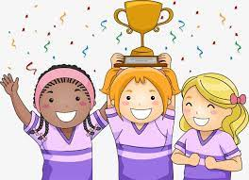
won

Slide 126
Let’s Teach and Practise

Slide 127
suffixes ing ed er est root ending in e

Slide 128
suffixes

Slide 129

scare

Slide 130
scary

Slide 131
scared

Slide 132
scare
scare – ends in e
VERB
Definition - cause great fear or nervousness in; frighten

Slide 133
scary
scare (-e) +y = scary
ADJECTIVE
Definition - frightening; causing fear

Slide 134
scared
scare (-e) +ed = scared
ADJECTIVE
Definition - fearful; frightened

Slide 135
Please do not scare me.
_____

Slide 136
I watched a scary movie.
_____

Slide 137
I wasn't scared at all.
______

Slide 138
New CHALLENGE words.

Slide 139
Mr.
NOUN
Definition - a title used before a surname or full name to address or refer to a man without a higher or honorific or professional title

Slide 140
Mr. Robert Smith is our teacher.
__

Slide 141
Mrs.
NOUN
Definition – the title used before a surname or full name to address or refer to a married woman without a higher or honorific or professional title

Slide 142
Mrs Sally Jones is our teacher.
___

Slide 143
Let’s Practise and Apply.

Slide 144
Can you spot the spelling rule words and the challenge words?

Slide 145
Ancient Ancestors continued…
The middle horse
(Mesohippus)
About 40 million years ago, this small dog-sized animal grew to look like a little horse, but nicer. It didn’t have hoofs on its feet or five toes like a hiker. Instead, it had three toes on each foot. It was only about 60 centimetres high, but it had long legs. This meant that it could run fast and escape from sabre-toothed cats. This scared little animal ate only nice fruit and leaves.

Slide 146
Ancient Ancestors continued…
The middle horse
(Mesohippus)
About 40 million years ago, this small dog-sized animal grew to look like a little horse, but nicer. It didn’t have hoofs on its feet or five toes like a hiker. Instead, it had three toes on each foot. It was only about 60 centimetres high, but it had long legs. This meant that it could run fast and escape from sabre-toothed cats. This scared little animal ate only nice fruit and leaves.

Slide 147
Write this sentence as I dictate it to you.
Notes:
This scared little animal ate only nice fruit and leaves.

Slide 148
This scared little animal ate only nice fruit and leaves.
Did you write it correctly?
Edit your work and make sure you have it correct.
Can you underline the spelling word that we have covered in this session?

Slide 149
Year 2 - Spring 2
Week 1 - Friday
Notes:
Click through the slides for all the R+R words for the week (both the focus and the challenge words)
Click through the slides for all the new learning this week

Slide 151
Old challenge words…

Slide 152
most

Slide 153
only

Slide 154
Old spelling rule words…

Slide 155
there

Slide 156
their

Slide 157
they’re

Slide 158
to

Slide 159
too

Slide 160
two

Slide 161
be

Slide 162
bee

Slide 163
hear

Slide 164
here

Slide 165
one

Slide 166
won

Slide 167
New spelling rule words…

Slide 168
hike

Slide 169
hiking

Slide 170
hiker

Slide 171
hiked

Slide 172
nice

Slide 173
nicer

Slide 174
nicest

Slide 175
shine

Slide 176
shiny

Slide 177
shining

Slide 178
scare

Slide 179
scary

Slide 180
scared

Slide 181
New challenge words…

Slide 182
Mr.

Slide 183
Mrs.

Slide 184
Quick Quiz time…
Notes:
Say these words for the quiz
Mr Mrs most only
their here hiking
nicest
shiny
scared

Slide 185
Did you get them correct?
Edit your work.
Mr. Mrs. most only their here hiking
nicest shiny scared

Slide 186
Word class time…

Slide 187
Mr. Robert Smith is our teacher.
Noun noun noun verb determiner noun
Notes:
Ask for these words to be classed

Slide 188
Mrs Sally Jones is our teacher.
Noun noun noun verb determiner noun
Notes:
Ask for these words to be classed

Slide 189
Etymology
The history of a word….

Slide 190
Mr.
late Middle English: originally an abbreviation of master; compare with mister
Mrs.
early 17th century: abbreviation of mistress; compare with missus

Slide 191
Let’s investigate….
Find antonyms and synonyms of the challenge words.

