Slide 1
Spelling Y2
Mastering spellings: building on the foundations of phonics
Spring 2
Week 3

Slide 2
Year 2 - Spring 2
Week 3 - Monday

Slide 3
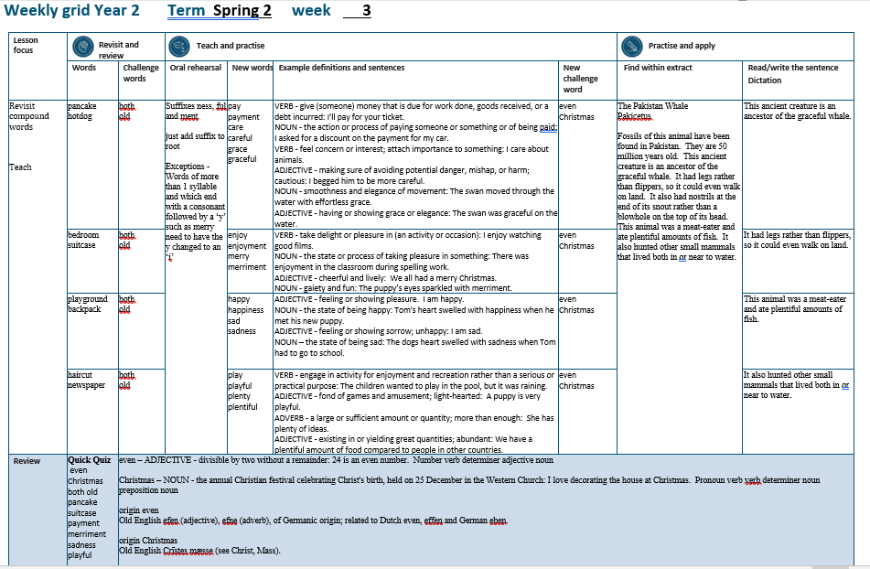

Slide 4
Let’s Revisit and Review…

Slide 5
Do you remember this challenge word?

Slide 6
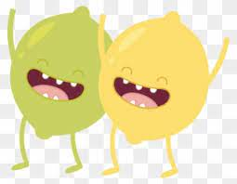
both
ADVERB
Definition - used before the first of two alternatives to emphasise that the statement being made applies to each

Slide 7
The film has won over both young people and old people.
____

Slide 8
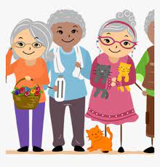
old
ADJECTIVE
Definition - having lived for a long time

Slide 9
The old tree still produced apples.
___

Slide 10
compound words two words ‘compounded’ together

Slide 11
compound words

Slide 12
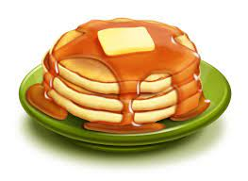

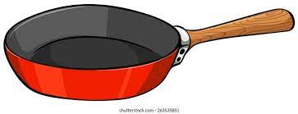
pancake

Slide 13
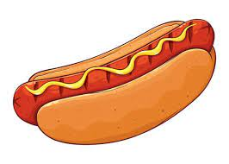
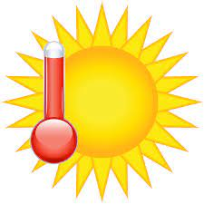
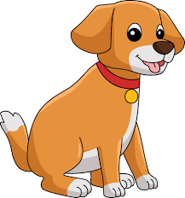
hotdog

Slide 14
Let’s Teach and Practise

Slide 15
suffixes ness, ful and ment just add suffix to root

Slide 16
Exceptions -
Words of more than 1 syllable and which end with a consonant followed by a ‘y’ such as merry need to have the y changed to an ‘i’

Slide 17
suffixes

Slide 18
-ness

Slide 19
-ful

Slide 20
-ment

Slide 21
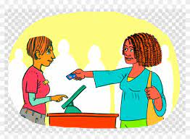
pay

Slide 22

payment

Slide 23

care

Slide 24

careful

Slide 25

grace

Slide 26

graceful

Slide 27
payment
pay + ment = payment
NOUN
Definition - the action or process of paying someone or something or of being paid

Slide 28
careful
care + ful = careful
ADJECTIVE
Definition - making sure of avoiding potential danger, mishap, or harm; cautious

Slide 29
graceful
grace + ful = graceful
ADJECTIVE
Definition - having or showing grace or elegance

Slide 30
I asked for a discount on the payment for my car.
_______

Slide 31
I begged him to be more careful.
_______

Slide 32
The swan was graceful on the water.
________

Slide 33
New CHALLENGE words.

Slide 34
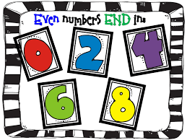
even
ADJECTIVE
Definition - divisible by two without a remainder

Slide 35
24 is an even number.
____

Slide 36
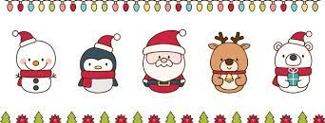
Christmas
NOUN
Definition – the annual Christian festival celebrating Christ's birth, held on 25 December in the Western Church

Slide 37
I love decorating the house at Christmas.
_________

Slide 38
Let’s Practise and Apply.

Slide 39
Can you spot the spelling rule words and the challenge words?

Slide 40
Ancient Ancestors continued…
The Pakistan Whale (Pakicetus)
Fossils of this animal have been found in Pakistan. They are 50 million years old. This ancient creature is an ancestor of the graceful whale. It had legs rather than flippers, so it could even walk on land. It also had nostrils at the end of its snout rather than a blowhole on the top of its head.
This animal was a meat-eater and ate plentiful amounts of fish. It also hunted other small mammals that lived both in or near to water.

Slide 41
Ancient Ancestors continued…
The Pakistan Whale (Pakicetus)
Fossils of this animal have been found in Pakistan. They are 50 million years old. This ancient creature is an ancestor of the graceful whale. It had legs rather than flippers, so it could even walk on land. It also had nostrils at the end of its snout rather than a blowhole on the top of its head.
This animal was a meat-eater and ate plentiful amounts of fish. It also hunted other small mammals that lived both in or near to water.

Slide 42
Write this sentence as I dictate it to you.
Notes:
This ancient creature is an ancestor of the graceful whale.

Slide 43
This ancient creature is an ancestor of the graceful whale.
Did you write it correctly?
Edit your work and make sure you have it correct.
Can you underline the spelling word that we have covered in this session?

Slide 44
Year 2 - Spring 2
Week 3 - Tuesday
Notes:
Revisit and review the words from previous teaching and challenge words – I say, we say, you say
Ask children to write words only in their spelling book
Introduce the new spelling rule
Children to write the new spelling rule words and challenge words into books when the sentences are shown with the spelling word missing.
Read the extract with the class as choral reading. Practise model of prosody etc.
Ask children to find the spelling words from the session in the text.
Then read allowed the chosen sentence for children to write fully in their books.
Show the extract and ask children to then edit their work to check they were correct in their dictation.

Slide 46
Let’s Revisit and Review…

Slide 47
Do you remember this challenge word?

Slide 48
both
ADVERB
Definition - used before the first of two alternatives to emphasise that the statement being made applies to each

Slide 49
The film has won over both young people and old people.
____

Slide 50
old
ADJECTIVE
Definition - having lived for a long time

Slide 51
The old tree still produced apples.
___

Slide 52
compound words two words ‘compounded’ together

Slide 53
compound words

Slide 54
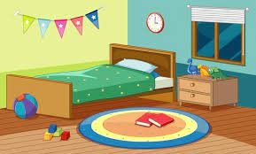
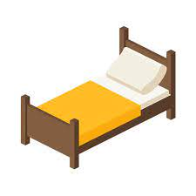

bedroom

Slide 55
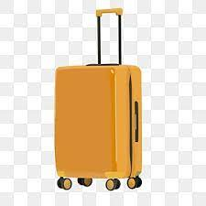


suitcase

Slide 56
Let’s Teach and Practise

Slide 57
suffixes ness, ful and ment just add suffix to root

Slide 58
Exceptions -
Words of more than 1 syllable and which end with a consonant followed by a ‘y’ such as merry need to have the y changed to an ‘i’

Slide 59
suffixes

Slide 60
-ness

Slide 61
-ful

Slide 62
-ment

Slide 63

enjoy

Slide 64
enjoyment

Slide 65

merry

Slide 66
merriment

Slide 67
enjoyment
enjoy + ment = enjoyment
NOUN
Definition - the state or process of taking pleasure in something

Slide 68
merriment
merry (-y +i) + ment = merriment
NOUN
Definition - gaiety and fun

Slide 69
There was enjoyment in the classroom during spelling work.
_________

Slide 70
The puppy’s eyes sparkled with merriment.
_________

Slide 71
New CHALLENGE words.

Slide 72
even
ADJECTIVE
Definition - divisible by two without a remainder

Slide 73
24 is an even number.
____

Slide 74
Christmas
NOUN
Definition – the annual Christian festival celebrating Christ's birth, held on 25 December in the Western Church

Slide 75
I love decorating the house at Christmas.
_________

Slide 76
Let’s Practise and Apply.

Slide 77
Can you spot the spelling rule words and the challenge words?

Slide 78
Ancient Ancestors continued…
The Pakistan Whale (Pakicetus)
Fossils of this animal have been found in Pakistan. They are 50 million years old. This ancient creature is an ancestor of the graceful whale. It had legs rather than flippers, so it could even walk on land. It also had nostrils at the end of its snout rather than a blowhole on the top of its head.
This animal was a meat-eater and ate plentiful amounts of fish. It also hunted other small mammals that lived both in or near to water.

Slide 79
Ancient Ancestors continued…
The Pakistan Whale (Pakicetus)
Fossils of this animal have been found in Pakistan. They are 50 million years old. This ancient creature is an ancestor of the graceful whale. It had legs rather than flippers, so it could even walk on land. It also had nostrils at the end of its snout rather than a blowhole on the top of its head.
This animal was a meat-eater and ate plentiful amounts of fish. It also hunted other small mammals that lived both in or near to water.

Slide 80
Write this sentence as I dictate it to you.
Notes:
It had legs rather than flippers, so it could even walk on land.

Slide 81
It had legs rather than flippers, so it could even walk on land.
Did you write it correctly?
Edit your work and make sure you have it correct.
Can you underline the spelling word that we have covered in this session?

Slide 82
Year 2 - Spring 2
Week 3 - Wednesday
Notes:
Revisit and review the words from previous teaching and challenge words – I say, we say, you say
Ask children to write words only in their spelling book
Introduce the new spelling rule
Children to write the new spelling rule words and challenge words into books when the sentences are shown with the spelling word missing.
Read the extract with the class as choral reading. Practise model of prosody etc.
Ask children to find the spelling words from the session in the text.
Then read allowed the chosen sentence for children to write fully in their books.
Show the extract and ask children to then edit their work to check they were correct in their dictation.

Slide 84
Let’s Revisit and Review…

Slide 85
Do you remember this challenge word?

Slide 86
both
ADVERB
Definition - used before the first of two alternatives to emphasise that the statement being made applies to each

Slide 87
The film has won over both young people and old people.
____

Slide 88
old
ADJECTIVE
Definition - having lived for a long time

Slide 89
The old tree still produced apples.
___

Slide 90
compound words two words ‘compounded’ together

Slide 91
compound words

Slide 92
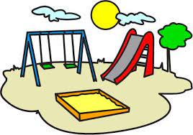
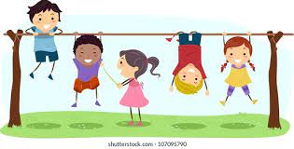
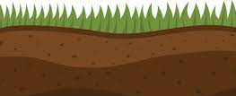
playground

Slide 93
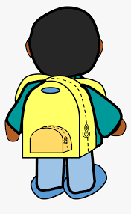

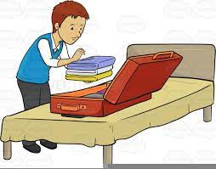
backpack

Slide 94
Let’s Teach and Practise

Slide 95
suffixes ness, ful and ment just add suffix to root

Slide 96
Exceptions -
Words of more than 1 syllable and which end with a consonant followed by a ‘y’ such as merry need to have the y changed to an ‘i’

Slide 97
suffixes

Slide 98
-ness

Slide 99
-ful

Slide 100
-ment

Slide 101
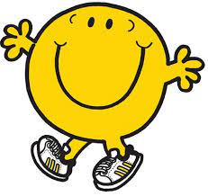
happy

Slide 102
happiness

Slide 103
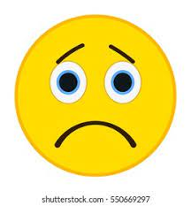
sad

Slide 104
sadness

Slide 105
happiness
happy (-y +i) + ness = happiness
NOUN
Definition - the state of being happy

Slide 106
sadness
sad + ness = sadness
NOUN
Definition - the state of being sad

Slide 107
Tom's heart swelled with happiness when he met his new puppy.
_________

Slide 108
The dogs heart swelled with sadness when Tom had to go to school.
_______

Slide 109
New CHALLENGE words.

Slide 110
even
ADJECTIVE
Definition - divisible by two without a remainder

Slide 111
24 is an even number.
____

Slide 112
Christmas
NOUN
Definition – the annual Christian festival celebrating Christ's birth, held on 25 December in the Western Church

Slide 113
I love decorating the house at Christmas.
_________

Slide 114
Let’s Practise and Apply.

Slide 115
Can you spot the spelling rule words and the challenge words?

Slide 116
Ancient Ancestors continued…
The Pakistan Whale (Pakicetus)
Fossils of this animal have been found in Pakistan. They are 50 million years old. This ancient creature is an ancestor of the graceful whale. It had legs rather than flippers, so it could even walk on land. It also had nostrils at the end of its snout rather than a blowhole on the top of its head.
This animal was a meat-eater and ate plentiful amounts of fish. It also hunted other small mammals that lived both in or near to water.

Slide 117
Ancient Ancestors continued…
The Pakistan Whale (Pakicetus)
Fossils of this animal have been found in Pakistan. They are 50 million years old. This ancient creature is an ancestor of the graceful whale. It had legs rather than flippers, so it could even walk on land. It also had nostrils at the end of its snout rather than a blowhole on the top of its head.
This animal was a meat-eater and ate plentiful amounts of fish. It also hunted other small mammals that lived both in or near to water.

Slide 118
Write this sentence as I dictate it to you.
Notes:
This animal was a meat-eater and ate plentiful amounts of fish.

Slide 119
This animal was a meat-eater and ate plentiful amounts of fish.
Did you write it correctly?
Edit your work and make sure you have it correct.
Can you underline the spelling word that we have covered in this session?

Slide 120
Year 2 - Spring 2
Week 3 - Thursday
Notes:
Revisit and review the words from previous teaching and challenge words – I say, we say, you say
Ask children to write words only in their spelling book
Introduce the new spelling rule
Children to write the new spelling rule words and challenge words into books when the sentences are shown with the spelling word missing.
Read the extract with the class as choral reading. Practise model of prosody etc.
Ask children to find the spelling words from the session in the text.
Then read allowed the chosen sentence for children to write fully in their books.
Show the extract and ask children to then edit their work to check they were correct in their dictation.

Slide 122
Let’s Revisit and Review…

Slide 123
Do you remember this challenge word?

Slide 124
both
ADVERB
Definition - used before the first of two alternatives to emphasise that the statement being made applies to each

Slide 125
The film has won over both young people and old people.
____

Slide 126
old
ADJECTIVE
Definition - having lived for a long time

Slide 127
The old tree still produced apples.
___

Slide 128
compound words two words ‘compounded’ together

Slide 129
compound words

Slide 130
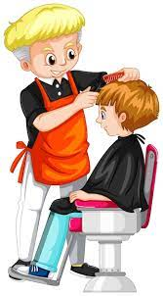
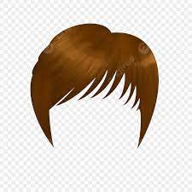

haircut

Slide 131



newspaper

Slide 132
Let’s Teach and Practise

Slide 133
suffixes ness, ful and ment just add suffix to root

Slide 134
Exceptions -
Words of more than 1 syllable and which end with a consonant followed by a ‘y’ such as merry need to have the y changed to an ‘i’

Slide 135
suffixes

Slide 136
-ness

Slide 137
-ful

Slide 138
-ment

Slide 139
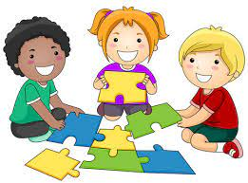
play

Slide 140
playful

Slide 141
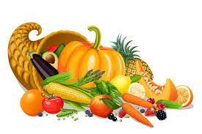
plenty

Slide 142
plentiful

Slide 143
playful
play + ful = playful
ADJECTIVE
Definition - fond of games and amusement; light-hearted

Slide 144
plentiful
plenty (-y +i) + ful = plentiful
ADJECTIVE
Definition - existing in or yielding great quantities; abundant

Slide 145
A puppy is very playful.
_______

Slide 146
We have a plentiful amount of food compared to people in other countries.
_________

Slide 147
New CHALLENGE words.

Slide 148
even
ADJECTIVE
Definition - divisible by two without a remainder

Slide 149
24 is an even number.
____

Slide 150
Christmas
NOUN
Definition – the annual Christian festival celebrating Christ's birth, held on 25 December in the Western Church

Slide 151
I love decorating the house at Christmas.
_________

Slide 152
Let’s Practise and Apply.

Slide 153
Can you spot the spelling rule words and the challenge words?

Slide 154
Ancient Ancestors continued…
The Pakistan Whale (Pakicetus)
Fossils of this animal have been found in Pakistan. They are 50 million years old. This ancient creature is an ancestor of the graceful whale. It had legs rather than flippers, so it could even walk on land. It also had nostrils at the end of its snout rather than a blowhole on the top of its head.
This animal was a meat-eater and ate plentiful amounts of fish. It also hunted other small mammals that lived both in or near to water.

Slide 155
Ancient Ancestors continued…
The Pakistan Whale (Pakicetus)
Fossils of this animal have been found in Pakistan. They are 50 million years old. This ancient creature is an ancestor of the graceful whale. It had legs rather than flippers, so it could even walk on land. It also had nostrils at the end of its snout rather than a blowhole on the top of its head.
This animal was a meat-eater and ate plentiful amounts of fish. It also hunted other small mammals that lived both in or near to water.

Slide 156
Write this sentence as I dictate it to you.
Notes:
It also hunted both in or near to water.

Slide 157
It also hunted both in or near to water.
Did you write it correctly?
Edit your work and make sure you have it correct.
Can you underline the spelling word that we have covered in this session?

Slide 158
Year 2 - Spring 2
Week 3 - Friday
Notes:
Click through the slides for all the R+R words for the week (both the focus and the challenge words)
Click through the slides for all the new learning this week

Slide 160
Old challenge words…

Slide 161
both

Slide 162
old

Slide 163
Old spelling rule words…

Slide 164
pancake

Slide 165
hotdog

Slide 166
bedroom

Slide 167
suitcase

Slide 168
playground

Slide 169
backpack

Slide 170
haircut

Slide 171
newspaper

Slide 172
New spelling rule words…

Slide 173
payment

Slide 174
careful

Slide 175
graceful

Slide 176
enjoyment

Slide 177
merriment

Slide 178
happiness

Slide 179
sadness

Slide 180
playful

Slide 181
plentiful

Slide 182
New challenge words…

Slide 183
even

Slide 184
Christmas

Slide 185
Quick Quiz time…
Notes:
Say these words for the quiz
even
Christmas both old pancake suitcase
payment
merriment sadness playful

Slide 186
Did you get them correct?
Edit your work.
even Christmas both old pancake suitcase payment
merriment sadness playful

Slide 187
Word class time…

Slide 188
24 is an even number.
Number verb determiner adjective noun
Notes:
Ask for these words to be classed

Slide 189
I love decorating the house at Christmas.
Pronoun verb verb determiner noun preposition noun
Notes:
Ask for these words to be classed

Slide 190
Etymology
The history of a word….

Slide 191
Even
Old English efen (adjective), efne (adverb), of Germanic origin; related to Dutch even, effen and German eben.
Christmas
Old English Crīstes mæsse (see Christ, Mass).

Slide 192
Let’s investigate….
Look at the word origin of the challenge words and find words that are linked to them.

