Slide 1
Spelling Y2
Mastering spellings: building on the foundations of phonics
Spring 2
Week 4

Slide 2
Year 2 - Spring 2
Week 4 - Monday

Slide 3
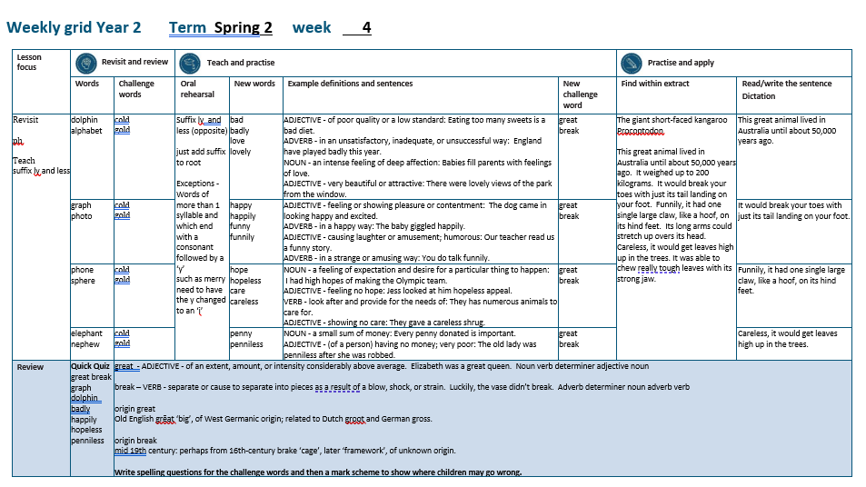

Slide 4
Let’s Revisit and Review…

Slide 5
Do you remember this challenge word?

Slide 6
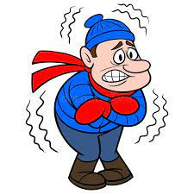
cold
ADJECTIVE
Definition - of or at a low or relatively low temperature

Slide 7
The cold snow was fun to play in.
____

Slide 8
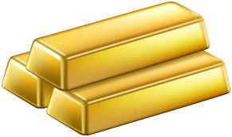
gold
NOUN
Definition - a yellow precious metal

Slide 9
They found the gold buried deep underground.
____

Slide 10
ph

Slide 11
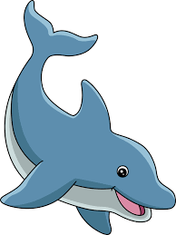
dolphin

Slide 12
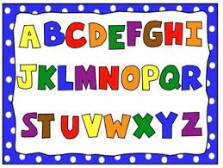
alphabet

Slide 13
Let’s Teach and Practise

Slide 14
suffixes ly and less just add suffix to root

Slide 15
Exceptions -
Words of more than 1 syllable and which end with a consonant followed by a ‘y’ such as merry need to have the y changed to an ‘i’

Slide 16
suffixes

Slide 17
-ly

Slide 18
-less

Slide 19
-less opposite

Slide 20
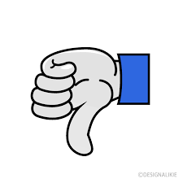
bad

Slide 21
badly

Slide 22

love

Slide 23
lovely

Slide 24
badly
bad + ly = badly
ADVERB
Definition - in an unsatisfactory, inadequate, or unsuccessful way

Slide 25
lovely
love + ly = lovely
ADVERB
Definition - very beautiful or attractive

Slide 26
England have played badly this year.
_____

Slide 27
The dancing was lovely at the show.
______

Slide 28
New CHALLENGE words.

Slide 29

great
ADJECTIVE
Definition - of an extent, amount, or intensity considerably above average

Slide 30
Elizabeth was a great queen.
_____

Slide 31
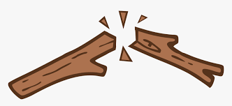
break
VERB
Definition – separate or cause to separate into pieces as a result of a blow, shock, or strain

Slide 32
Luckily, the vase didn’t break.
_____

Slide 33
Let’s Practise and Apply.

Slide 34
Can you spot the spelling rule words and the challenge words?

Slide 35
Ancient Ancestors continued…
The giant short-faced kangaroo (Procoptodon)
This great animal lived in Australia until about 50,000 years ago. It weighed up to 200 kilograms. It would break your toes with just its tail landing on your foot. Funnily, it had one single large claw, like a hoof, on its hind feet. Its long arms could stretch up over its head. Careless, it would get leaves high up in the trees. It was able to chew really tough leaves with its strong jaw.

Slide 36
Ancient Ancestors continued…
The giant short-faced kangaroo (Procoptodon)
This great animal lived in Australia until about 50,000 years ago. It weighed up to 200 kilograms. It would break your toes with just its tail landing on your foot. Funnily, it had one single large claw, like a hoof, on its hind feet. Its long arms could stretch up over its head. Careless, it would get leaves high up in the trees. It was able to chew really tough leaves with its strong jaw.

Slide 37
Write this sentence as I dictate it to you.
Notes:
This great animal lived in Australia.

Slide 38
This great animal lived in Australia.
Did you write it correctly?
Edit your work and make sure you have it correct.
Can you underline the spelling word that we have covered in this session?

Slide 39
Year 2 - Spring 2
Week 4 - Tuesday
Notes:
Revisit and review the words from previous teaching and challenge words – I say, we say, you say
Ask children to write words only in their spelling book
Introduce the new spelling rule
Children to write the new spelling rule words and challenge words into books when the sentences are shown with the spelling word missing.
Read the extract with the class as choral reading. Practise model of prosody etc.
Ask children to find the spelling words from the session in the text.
Then read allowed the chosen sentence for children to write fully in their books.
Show the extract and ask children to then edit their work to check they were correct in their dictation.

Slide 41
Let’s Revisit and Review…

Slide 42
Do you remember this challenge word?

Slide 43
cold
ADJECTIVE
Definition - of or at a low or relatively low temperature

Slide 44
The cold snow was fun to play in.
____

Slide 45
gold
NOUN
Definition - a yellow precious metal

Slide 46
They found the gold buried deep underground.
____

Slide 47
ph

Slide 48
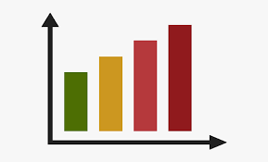
graph

Slide 49

photo

Slide 50
Let’s Teach and Practise

Slide 51
suffixes ly and less just add suffix to root

Slide 52
Exceptions -
Words of more than 1 syllable and which end with a consonant followed by a ‘y’ such as merry need to have the y changed to an ‘i’

Slide 53
suffixes

Slide 54
-ly

Slide 55
-less

Slide 56
-less opposite

Slide 57
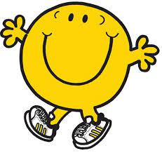
happy

Slide 58
happily

Slide 59
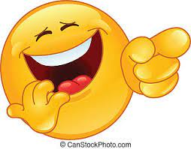
funny

Slide 60
funnily

Slide 61
happily
happy (-y +i) + ly = happily
ADVERB
Definition - in a happy way

Slide 62
funnily
funny (-y +i) + ly = funnily
ADVERB
Definition - in a strange or amusing way

Slide 63
The baby giggled happily.
_______

Slide 64
You do talk funnily.
_______

Slide 65
New CHALLENGE words.

Slide 66
great
ADJECTIVE
Definition - of an extent, amount, or intensity considerably above average

Slide 67
Elizabeth was a great queen.
_____

Slide 68
break
VERB
Definition – separate or cause to separate into pieces as a result of a blow, shock, or strain

Slide 69
Luckily, the vase didn’t break.
_____

Slide 70
Let’s Practise and Apply.

Slide 71
Can you spot the spelling rule words and the challenge words?

Slide 72
Ancient Ancestors continued…
The giant short-faced kangaroo (Procoptodon)
This great animal lived in Australia until about 50,000 years ago. It weighed up to 200 kilograms. It would break your toes with just its tail landing on your foot. Funnily, it had one single large claw, like a hoof, on its hind feet. Its long arms could stretch up over its head. Careless, it would get leaves high up in the trees. It was able to chew really tough leaves with its strong jaw.

Slide 73
Ancient Ancestors continued…
The giant short-faced kangaroo (Procoptodon)
This great animal lived in Australia until about 50,000 years ago. It weighed up to 200 kilograms. It would break your toes with just its tail landing on your foot. Funnily, it had one single large claw, like a hoof, on its hind feet. Its long arms could stretch up over its head. Careless, it would get leaves high up in the trees. It was able to chew really tough leaves with its strong jaw.

Slide 74
Write this sentence as I dictate it to you.
Notes:
It would break your toes.

Slide 75
It would break your toes.
Did you write it correctly?
Edit your work and make sure you have it correct.
Can you underline the spelling word that we have covered in this session?

Slide 76
Year 2 - Spring 2
Week 4 - Wednesday
Notes:
Revisit and review the words from previous teaching and challenge words – I say, we say, you say
Ask children to write words only in their spelling book
Introduce the new spelling rule
Children to write the new spelling rule words and challenge words into books when the sentences are shown with the spelling word missing.
Read the extract with the class as choral reading. Practise model of prosody etc.
Ask children to find the spelling words from the session in the text.
Then read allowed the chosen sentence for children to write fully in their books.
Show the extract and ask children to then edit their work to check they were correct in their dictation.

Slide 78
Let’s Revisit and Review…

Slide 79
Do you remember this challenge word?

Slide 80
cold
ADJECTIVE
Definition - of or at a low or relatively low temperature

Slide 81
The cold snow was fun to play in.
____

Slide 82
gold
NOUN
Definition - a yellow precious metal

Slide 83
They found the gold buried deep underground.
____

Slide 84
ph

Slide 85
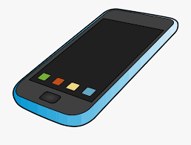
phone

Slide 86
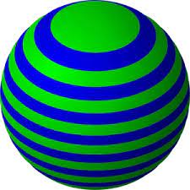
sphere

Slide 87
Let’s Teach and Practise

Slide 88
suffixes ly and less just add suffix to root

Slide 89
Exceptions -
Words of more than 1 syllable and which end with a consonant followed by a ‘y’ such as merry need to have the y changed to an ‘i’

Slide 90
suffixes

Slide 91
-ly

Slide 92
-less

Slide 93
-less opposite

Slide 94
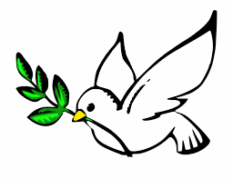
hope

Slide 95
hopeless
x

Slide 96
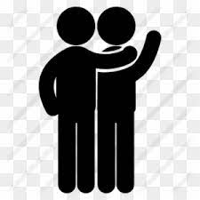
care

Slide 97
careless
x

Slide 98
hopeless
x
hope + less = hopeless
ADJECTIVE
Definition - feeling no hope

Slide 99
careless
x
care + less = careless
ADJECTIVE
Definition - showing no care

Slide 100
Jess looked at his hopeless appeal.
________

Slide 101
They gave a careless shrug.
________

Slide 102
New CHALLENGE words.

Slide 103
great
ADJECTIVE
Definition - of an extent, amount, or intensity considerably above average

Slide 104
Elizabeth was a great queen.
_____

Slide 105
break
VERB
Definition – separate or cause to separate into pieces as a result of a blow, shock, or strain

Slide 106
Luckily, the vase didn’t break.
_____

Slide 107
Let’s Practise and Apply.

Slide 108
Can you spot the spelling rule words and the challenge words?

Slide 109
Ancient Ancestors continued…
The giant short-faced kangaroo (Procoptodon)
This great animal lived in Australia until about 50,000 years ago. It weighed up to 200 kilograms. It would break your toes with just its tail landing on your foot. Funnily, it had one single large claw, like a hoof, on its hind feet. Its long arms could stretch up over its head. Careless, it would get leaves high up in the trees. It was able to chew really tough leaves with its strong jaw.

Slide 110
Ancient Ancestors continued…
The giant short-faced kangaroo (Procoptodon)
This great animal lived in Australia until about 50,000 years ago. It weighed up to 200 kilograms. It would break your toes with just its tail landing on your foot. Funnily, it had one single large claw, like a hoof, on its hind feet. Its long arms could stretch up over its head. Careless, it would get leaves high up in the trees. It was able to chew really tough leaves with its strong jaw.

Slide 111
Write this sentence as I dictate it to you.
Notes:
Funnily, it had one single large claw.

Slide 112
Funnily, it had one single large claw.
Did you write it correctly?
Edit your work and make sure you have it correct.
Can you underline the spelling word that we have covered in this session?

Slide 113
Year 2 - Spring 2
Week 4 - Thursday
Notes:
Revisit and review the words from previous teaching and challenge words – I say, we say, you say
Ask children to write words only in their spelling book
Introduce the new spelling rule
Children to write the new spelling rule words and challenge words into books when the sentences are shown with the spelling word missing.
Read the extract with the class as choral reading. Practise model of prosody etc.
Ask children to find the spelling words from the session in the text.
Then read allowed the chosen sentence for children to write fully in their books.
Show the extract and ask children to then edit their work to check they were correct in their dictation.

Slide 115
Let’s Revisit and Review…

Slide 116
Do you remember this challenge word?

Slide 117
cold
ADJECTIVE
Definition - of or at a low or relatively low temperature

Slide 118
The cold snow was fun to play in.
____

Slide 119
gold
NOUN
Definition - a yellow precious metal

Slide 120
They found the gold buried deep underground.
____

Slide 121
ph

Slide 122
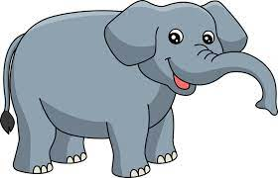
elephant

Slide 123
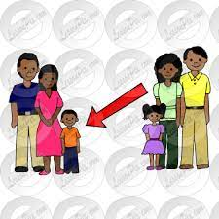
nephew

Slide 124
Let’s Teach and Practise

Slide 125
suffixes ly and less just add suffix to root

Slide 126
Exceptions -
Words of more than 1 syllable and which end with a consonant followed by a ‘y’ such as merry need to have the y changed to an ‘i’

Slide 127
suffixes

Slide 128
-ly

Slide 129
-less

Slide 130
-less opposite

Slide 131
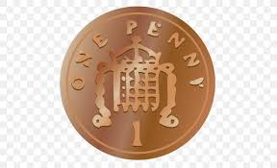
penny

Slide 132
penniless
x

Slide 133
penniless
x
penny (-y +i) + less = penniless
ADJECTIVE
Definition - having no money; very poor:

Slide 134
The old lady was penniless after she was robbed.
_________

Slide 135
New CHALLENGE words.

Slide 136
great
ADJECTIVE
Definition - of an extent, amount, or intensity considerably above average

Slide 137
Elizabeth was a great queen.
_____

Slide 138
break
VERB
Definition – separate or cause to separate into pieces as a result of a blow, shock, or strain

Slide 139
Luckily, the vase didn’t break.
_____

Slide 140
Let’s Practise and Apply.

Slide 141
Can you spot the spelling rule words and the challenge words?

Slide 142
Ancient Ancestors continued…
The giant short-faced kangaroo (Procoptodon)
This great animal lived in Australia until about 50,000 years ago. It weighed up to 200 kilograms. It would break your toes with just its tail landing on your foot. Funnily, it had one single large claw, like a hoof, on its hind feet. Its long arms could stretch up over its head. Careless, it would get leaves high up in the trees. It was able to chew really tough leaves with its strong jaw.

Slide 143
Ancient Ancestors continued…
The giant short-faced kangaroo (Procoptodon)
This great animal lived in Australia until about 50,000 years ago. It weighed up to 200 kilograms. It would break your toes with just its tail landing on your foot. Funnily, it had one single large claw, like a hoof, on its hind feet. Its long arms could stretch up over its head. Careless, it would get leaves high up in the trees. It was able to chew really tough leaves with its strong jaw.

Slide 144
Write this sentence as I dictate it to you.
Notes:
Careless, it would get leaves high up in the trees.

Slide 145
Careless, it would get leaves high up in the trees.
Did you write it correctly?
Edit your work and make sure you have it correct.
Can you underline the spelling word that we have covered in this session?

Slide 146
Year 2 - Spring 2
Week 4 - Friday
Notes:
Click through the slides for all the R+R words for the week (both the focus and the challenge words)
Click through the slides for all the new learning this week

Slide 148
Old challenge words…

Slide 149
cold

Slide 150
gold

Slide 151
Old spelling rule words…

Slide 152
dolphin

Slide 153
alphabet

Slide 154
graph

Slide 155
photo

Slide 156
phone

Slide 157
sphere

Slide 158
elephant

Slide 159
nephew

Slide 160
New spelling rule words…

Slide 161
bad

Slide 162
badly

Slide 163
love

Slide 164
lovely

Slide 165
happy

Slide 166
happily

Slide 167
funny

Slide 168
funnily

Slide 169
hope

Slide 170
hopeless

Slide 171
care

Slide 172
careless

Slide 173
penny

Slide 174
penniless

Slide 175
New challenge words…

Slide 176
great

Slide 177
break

Slide 178
Quick Quiz time…
Notes:
Say these words for the quiz
great break graph dolphin badly happily hopeless penniless

Slide 179
Did you get them correct?
Edit your work.
great break graph dolphin badly happily hopeless penniless

Slide 180
Word class time…

Slide 181
Elizabeth was a great queen.
Noun verb determiner adjective noun
Notes:
Ask for these words to be classed

Slide 182
Luckily, the vase didn’t break.
Adverb determiner noun adverb verb
Notes:
Ask for these words to be classed

Slide 183
Etymology
The history of a word….

Slide 184
Great
Old English grēat ‘big’, of West Germanic origin; related to Dutch groot and German gross.
Break
Mid 19th century: perhaps from 16th-century brake ‘cage’, later ‘framework’, of unknown origin.

Slide 185
Let’s investigate….
Write spelling questions for the challenge words and then a mark scheme to show where children may go wrong.

