Slide 1
Spelling Y2
Mastering spellings: building on the foundations of phonics
Spring 2
Week 4

Slide 2
Year 2 - Spring 2
Week 5 - Monday

Slide 3
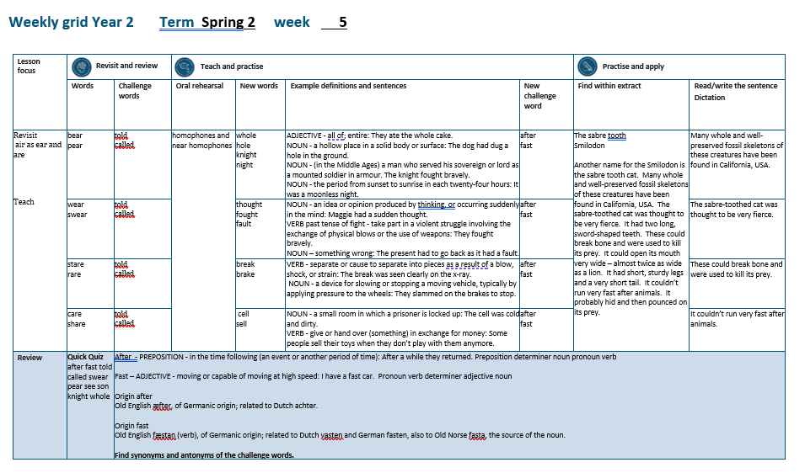

Slide 4
Let’s Revisit and Review…

Slide 5
Do you remember this challenge word?

Slide 6
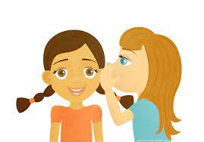
told
VERB
Definition - communicate information to someone in spoken or written words

Slide 7
Our teacher told us to write the sum down.
____

Slide 8
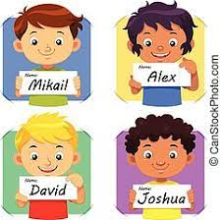
called
VERB
Definition - give (a baby or animal) a specified name

Slide 9
They called their daughter Susan.
______

Slide 10
‘air’ as ‘ear’ and ‘are’

Slide 11
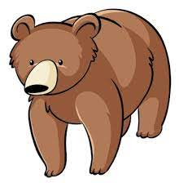
bear

Slide 12

pear

Slide 13
Let’s Teach and Practise

Slide 14
homophones and near homophones

Slide 15
homophones homo = same phone = sound

Slide 16
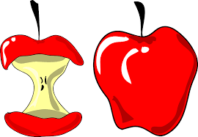
whole

Slide 17
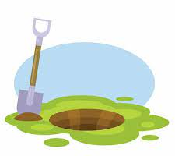
hole

Slide 18
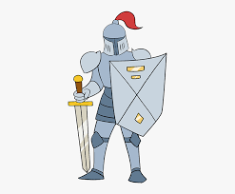
knight

Slide 19

night

Slide 20
whole
ADJECTIVE
Definition - all of; entire

Slide 21
hole
NOUN
Definition - a hollow place in a solid body or surface

Slide 22
knight
NOUN
Definition - (in the Middle Ages) a man who served his sovereign or lord as a mounted soldier in armour

Slide 23
night
NOUN
Definition - the period from sunset to sunrise in each twenty-four hours

Slide 24
They ate the whole cake.
_____

Slide 25
The dog had dug a hole in the ground.
____

Slide 26
The knight fought bravely.
______

Slide 27
It was a moonless night.
_____

Slide 28
New CHALLENGE words.

Slide 29
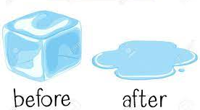
after
PREPOSITION
Definition - in the time following (an event or another period of time)

Slide 30
After a while they returned.
_____

Slide 31
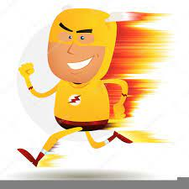
fast
ADJECTIVE
Definition - moving or capable of moving at high speed

Slide 32
I have a fast car
____

Slide 33
Let’s Practise and Apply.

Slide 34
Can you spot the spelling rule words and the challenge words?

Slide 35
Ancient Ancestors continued…
The sabre tooth (Smilodon)
Another name for the Smilodon is the sabre tooth cat. Many whole and well-preserved fossil skeletons of these creatures have been found in California, USA. The sabre-toothed cat was thought to be very fierce. It had two long, sword-shaped teeth. These could break bone and were used to kill its prey. It could open its mouth very wide – almost twice as wide as a lion. It had short, sturdy legs and a very short tail. It couldn’t run very fast after animals. It probably hid and then pounced on its prey.

Slide 36
Ancient Ancestors continued…
The sabre tooth (Smilodon)
Another name for the Smilodon is the sabre tooth cat. Many whole and well-preserved fossil skeletons of these creatures have been found in California, USA. The sabre-toothed cat was thought to be very fierce. It had two long, sword-shaped teeth. These could break bone and were used to kill its prey. It could open its mouth very wide – almost twice as wide as a lion. It had short, sturdy legs and a very short tail. It couldn’t run very fast after animals. It probably hid and then pounced on its prey.

Slide 37
Write this sentence as I dictate it to you.
Notes:
Many whole fossils have been found.

Slide 38
Many whole fossils have been found.
Did you write it correctly?
Edit your work and make sure you have it correct.
Can you underline the spelling word that we have covered in this session?

Slide 39
Year 2 - Spring 2
Week 5 - Tuesday
Notes:
Revisit and review the words from previous teaching and challenge words – I say, we say, you say
Ask children to write words only in their spelling book
Introduce the new spelling rule
Children to write the new spelling rule words and challenge words into books when the sentences are shown with the spelling word missing.
Read the extract with the class as choral reading. Practise model of prosody etc.
Ask children to find the spelling words from the session in the text.
Then read allowed the chosen sentence for children to write fully in their books.
Show the extract and ask children to then edit their work to check they were correct in their dictation.

Slide 41
Let’s Revisit and Review…

Slide 42
Do you remember this challenge word?

Slide 43
told
VERB
Definition - communicate information to someone in spoken or written words

Slide 44
Our teacher told us to write the sum down.
____

Slide 45
called
VERB
Definition - give (a baby or animal) a specified name

Slide 46
They called their daughter Susan.
______

Slide 47
‘air’ as ‘ear’ and ‘are’

Slide 48
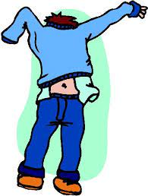
wear

Slide 49

swear

Slide 50
Let’s Teach and Practise

Slide 51
homophones and near homophones

Slide 52
homophones homo = same phone = sound

Slide 53

thought

Slide 54
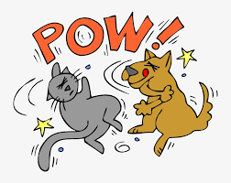
fought

Slide 55
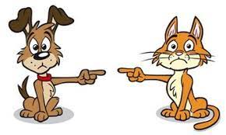
fault

Slide 56
thought
NOUN
Definition - an idea or opinion produced by thinking, or occurring suddenly in the mind

Slide 57
fought
VERB
Definition - past tense of fight

Slide 58
fault
NOUN
Definition - something wrong

Slide 59
Maggie had a sudden thought.
_______

Slide 60
They fought bravely.
______

Slide 61
The present had to go back as it had a fault.
_____

Slide 62
New CHALLENGE words.

Slide 63
after
PREPOSITION
Definition - in the time following (an event or another period of time)

Slide 64
After a while they returned.
_____

Slide 65
fast
ADJECTIVE
Definition - moving or capable of moving at high speed

Slide 66
I have a fast car
____

Slide 67
Let’s Practise and Apply.

Slide 68
Can you spot the spelling rule words and the challenge words?

Slide 69
Ancient Ancestors continued…
The sabre tooth (Smilodon)
Another name for the Smilodon is the sabre tooth cat. Many whole and well-preserved fossil skeletons of these creatures have been found in California, USA. The sabre-toothed cat was thought to be very fierce. It had two long, sword-shaped teeth. These could break bone and were used to kill its prey. It could open its mouth very wide – almost twice as wide as a lion. It had short, sturdy legs and a very short tail. It couldn’t run very fast after animals. It probably hid and then pounced on its prey.

Slide 70
Ancient Ancestors continued…
The sabre tooth (Smilodon)
Another name for the Smilodon is the sabre tooth cat. Many whole and well-preserved fossil skeletons of these creatures have been found in California, USA. The sabre-toothed cat was thought to be very fierce. It had two long, sword-shaped teeth. These could break bone and were used to kill its prey. It could open its mouth very wide – almost twice as wide as a lion. It had short, sturdy legs and a very short tail. It couldn’t run very fast after animals. It probably hid and then pounced on its prey.

Slide 71
Write this sentence as I dictate it to you.
Notes:
The cat was thought to be fierce.

Slide 72
The cat was thought to be fierce.
Did you write it correctly?
Edit your work and make sure you have it correct.
Can you underline the spelling word that we have covered in this session?

Slide 73
Year 2 - Spring 2
Week 5 - Wednesday
Notes:
Revisit and review the words from previous teaching and challenge words – I say, we say, you say
Ask children to write words only in their spelling book
Introduce the new spelling rule
Children to write the new spelling rule words and challenge words into books when the sentences are shown with the spelling word missing.
Read the extract with the class as choral reading. Practise model of prosody etc.
Ask children to find the spelling words from the session in the text.
Then read allowed the chosen sentence for children to write fully in their books.
Show the extract and ask children to then edit their work to check they were correct in their dictation.

Slide 75
Let’s Revisit and Review…

Slide 76
Do you remember this challenge word?

Slide 77
told
VERB
Definition - communicate information to someone in spoken or written words

Slide 78
Our teacher told us to write the sum down.
____

Slide 79
called
VERB
Definition - give (a baby or animal) a specified name

Slide 80
They called their daughter Susan.
______

Slide 81
‘air’ as ‘ear’ and ‘are’

Slide 82
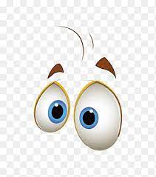
stare

Slide 83
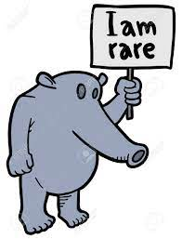
rare

Slide 84
Let’s Teach and Practise

Slide 85
homophones and near homophones

Slide 86
homophones homo = same phone = sound

Slide 87
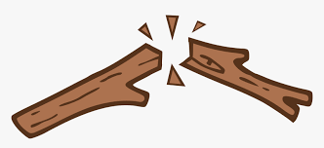
break

Slide 88

brake

Slide 89
break
VERB
Definition - separate or cause to separate into pieces as a result of a blow, shock, or strain

Slide 90
brake
NOUN
Definition - a device for slowing or stopping a moving vehicle, typically by applying pressure to the wheels

Slide 91
The break was seen clearly on the x-ray.
_____

Slide 92
They slammed on the brakes to stop.
______

Slide 93
New CHALLENGE words.

Slide 94
after
PREPOSITION
Definition - in the time following (an event or another period of time)

Slide 95
After a while they returned.
_____

Slide 96
fast
ADJECTIVE
Definition - moving or capable of moving at high speed

Slide 97
I have a fast car
____

Slide 98
Let’s Practise and Apply.

Slide 99
Can you spot the spelling rule words and the challenge words?

Slide 100
Ancient Ancestors continued…
The sabre tooth (Smilodon)
Another name for the Smilodon is the sabre tooth cat. Many whole and well-preserved fossil skeletons of these creatures have been found in California, USA. The sabre-toothed cat was thought to be very fierce. It had two long, sword-shaped teeth. These could break bone and were used to kill its prey. It could open its mouth very wide – almost twice as wide as a lion. It had short, sturdy legs and a very short tail. It couldn’t run very fast after animals. It probably hid and then pounced on its prey.

Slide 101
Ancient Ancestors continued…
The sabre tooth (Smilodon)
Another name for the Smilodon is the sabre tooth cat. Many whole and well-preserved fossil skeletons of these creatures have been found in California, USA. The sabre-toothed cat was thought to be very fierce. It had two long, sword-shaped teeth. These could break bone and were used to kill its prey. It could open its mouth very wide – almost twice as wide as a lion. It had short, sturdy legs and a very short tail. It couldn’t run very fast after animals. It probably hid and then pounced on its prey.

Slide 102
Write this sentence as I dictate it to you.
Notes:
These could break bone.

Slide 103
These could break bone.
Did you write it correctly?
Edit your work and make sure you have it correct.
Can you underline the spelling word that we have covered in this session?

Slide 104
Year 2 - Spring 2
Week 5 - Thursday
Notes:
Revisit and review the words from previous teaching and challenge words – I say, we say, you say
Ask children to write words only in their spelling book
Introduce the new spelling rule
Children to write the new spelling rule words and challenge words into books when the sentences are shown with the spelling word missing.
Read the extract with the class as choral reading. Practise model of prosody etc.
Ask children to find the spelling words from the session in the text.
Then read allowed the chosen sentence for children to write fully in their books.
Show the extract and ask children to then edit their work to check they were correct in their dictation.

Slide 106
Let’s Revisit and Review…

Slide 107
Do you remember this challenge word?

Slide 108
told
VERB
Definition - communicate information to someone in spoken or written words

Slide 109
Our teacher told us to write the sum down.
____

Slide 110
called
VERB
Definition - give (a baby or animal) a specified name

Slide 111
They called their daughter Susan.
______

Slide 112
‘air’ as ‘ear’ and ‘are’

Slide 113
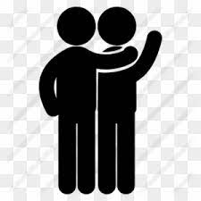
care

Slide 114
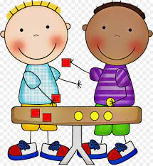
share

Slide 115
Let’s Teach and Practise

Slide 116
homophones and near homophones

Slide 117
homophones homo = same phone = sound

Slide 118

cell

Slide 119
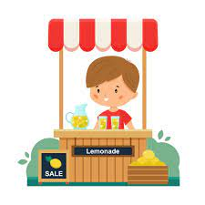
sell

Slide 120
cell
NOUN
Definition - a small room in which a prisoner is locked up

Slide 121
sell
VERB
Definition - give or hand over (something) in exchange for money

Slide 122
The cell was cold and dirty.
____

Slide 123
Some people sell their toys when they don’t play with them anymore.
____

Slide 124
New CHALLENGE words.

Slide 125
after
PREPOSITION
Definition - in the time following (an event or another period of time)

Slide 126
After a while they returned.
_____

Slide 127
fast
ADJECTIVE
Definition - moving or capable of moving at high speed

Slide 128
I have a fast car
____

Slide 129
Let’s Practise and Apply.

Slide 130
Can you spot the spelling rule words and the challenge words?

Slide 131
Ancient Ancestors continued…
The sabre tooth (Smilodon)
Another name for the Smilodon is the sabre tooth cat. Many whole and well-preserved fossil skeletons of these creatures have been found in California, USA. The sabre-toothed cat was thought to be very fierce. It had two long, sword-shaped teeth. These could break bone and were used to kill its prey. It could open its mouth very wide – almost twice as wide as a lion. It had short, sturdy legs and a very short tail. It couldn’t run very fast after animals. It probably hid and then pounced on its prey.

Slide 132
Ancient Ancestors continued…
The sabre tooth (Smilodon)
Another name for the Smilodon is the sabre tooth cat. Many whole and well-preserved fossil skeletons of these creatures have been found in California, USA. The sabre-toothed cat was thought to be very fierce. It had two long, sword-shaped teeth. These could break bone and were used to kill its prey. It could open its mouth very wide – almost twice as wide as a lion. It had short, sturdy legs and a very short tail. It couldn’t run very fast after animals. It probably hid and then pounced on its prey.

Slide 133
Write this sentence as I dictate it to you.
Notes:
It couldn’t run very fast after animals.

Slide 134
It couldn’t run very fast after animals.
Did you write it correctly?
Edit your work and make sure you have it correct.
Can you underline the spelling word that we have covered in this session?

Slide 135
Year 2 - Spring 2
Week 5 - Friday
Notes:
Click through the slides for all the R+R words for the week (both the focus and the challenge words)
Click through the slides for all the new learning this week

Slide 137
Old challenge words…

Slide 138
told

Slide 139
called

Slide 140
Old spelling rule words…

Slide 141
bear

Slide 142
pear

Slide 143
wear

Slide 144
swear

Slide 145
stare

Slide 146
rare

Slide 147
care

Slide 148
share

Slide 149
New spelling rule words…

Slide 150
whole

Slide 151
hole

Slide 152
knight

Slide 153
night

Slide 154
thought

Slide 155
fought

Slide 156
fault

Slide 157
break

Slide 158
brake

Slide 159
cell

Slide 160
sell

Slide 161
New challenge words…

Slide 162
after

Slide 163
fast

Slide 164
Quick Quiz time…
Notes:
Say these words for the quiz
after fast told called swear pear see son knight whole

Slide 165
Did you get them correct?
Edit your work.
after fast told called swear pear see son knight whole

Slide 166
Word class time…

Slide 167
After a while they returned.
Preposition determiner noun pronoun verb
Notes:
Ask for these words to be classed

Slide 168
I have a fast car.
Pronoun verb determiner adjective noun
Notes:
Ask for these words to be classed

Slide 169
Etymology
The history of a word….

Slide 170
After
Old English æfter, of Germanic origin; related to Dutch achter.
Fast
Old English fæstan (verb), of Germanic origin; related to Dutch vasten and German fasten, also to Old Norse fasta, the source of the noun.

Slide 171
Let’s investigate….
Find synonyms and antonyms of the challenge words.

