Slide 1
Spelling Y2
Mastering spellings: building on the foundations of phonics
Spring 2
Week 6

Slide 2
Year 2 - Spring 2
Week 6 - Monday

Slide 3
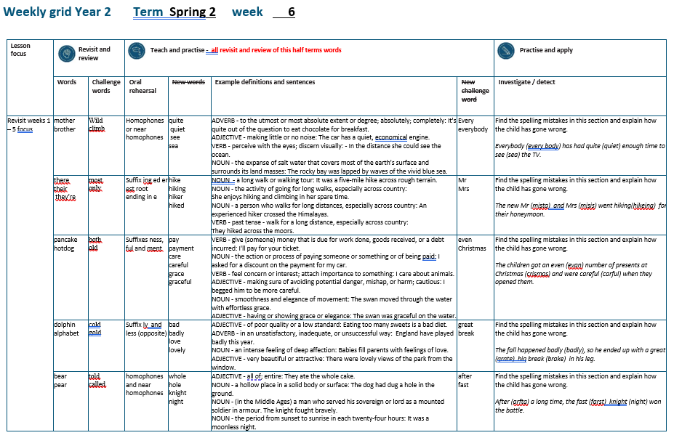

Slide 4
Let’s Revisit and Review…

Slide 5
Do you remember this challenge word?

Slide 6
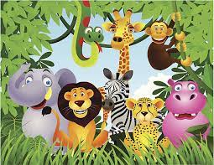
wild
ADJECTIVE
Definition - (of an animal or plant) living or growing in the natural environment

Slide 7
The children saw a herd of wild goats in the field.
____

Slide 8
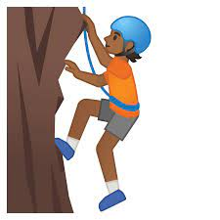
climb
VERB
Definition - go or come up a slope or staircase

Slide 9
The children climb the hill everyday to get to school.
_____

Slide 10
‘U’ sound as ‘O’

Slide 11
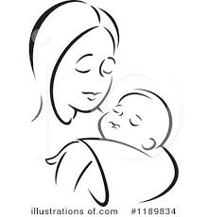
mother

Slide 12
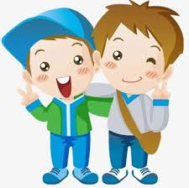
brother

Slide 13
Let’s Teach and Practise

Slide 14
homophones or near homophones homo = same phone = sound

Slide 15
homophones

Slide 16
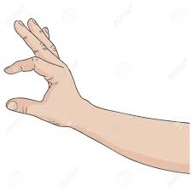
quite

Slide 17
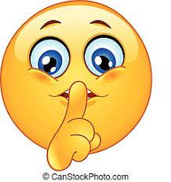
quiet

Slide 18

see

Slide 19

sea

Slide 20
quite
ADVERB
Definition - to a certain or fairly significant extent or degree

Slide 21
quiet
ADJECTIVE
Definition - making little or no noise

Slide 22
see
VERB
Definition – perceive with the eyes; discern visually

Slide 23
sea
NOUN
Definition – the expanse of salt water that covers most of the earth's surface and surrounds its land masses

Slide 24
It's quite warm outside.
_____

Slide 25
I was as quiet as I could be, but she knew I was there.
_____

Slide 26
In the distance she could see the ocean.
___

Slide 27
The rocky bay was lapped by waves of the vivid blue sea.
___

Slide 28
New CHALLENGE words.

Slide 29
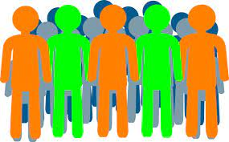
every
DETERMINER
Definition - used before a singular noun to refer to all the individual members of a set without exception

Slide 30
The children sang every note perfectly.
_____

Slide 31
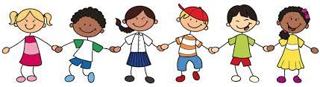
everybody
PRONOUN
Definition – every person

Slide 32
Everybody agrees with our teacher.
_________

Slide 33
Let’s investigate.

Slide 34
Can you spot the spelling errors in these sentences?
Write the correct spelling and explain where they went wrong.

Slide 35
every body has had quiet enough time to sea the TV.

Slide 36
every body has had quiet enough time to sea the TV.

Slide 37
every body has had quiet enough time to sea the TV. everybody – one word

Slide 38
every body has had quiet enough time to sea the TV. quite – near homophone used

Slide 39
every body has had quiet enough time to sea the TV. see – incorrect homophone

Slide 40
Everybody has had quite enough time to see the TV.

Slide 41
Year 2 - Spring 2
Week 6 - Tuesday

Slide 43
Let’s Revisit and Review…

Slide 44
Do you remember this challenge word?

Slide 45
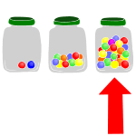
most
DETERMINER
Definition - greatest amount

Slide 46
The person with most votes wins.
____

Slide 47

only
ADJECTIVE
Definition - alone of its or their kind; single or solitary

Slide 48
Jessica was an only child.
____

Slide 49
homophones or near homophones homo = same phone = sound

Slide 50
homophones

Slide 51
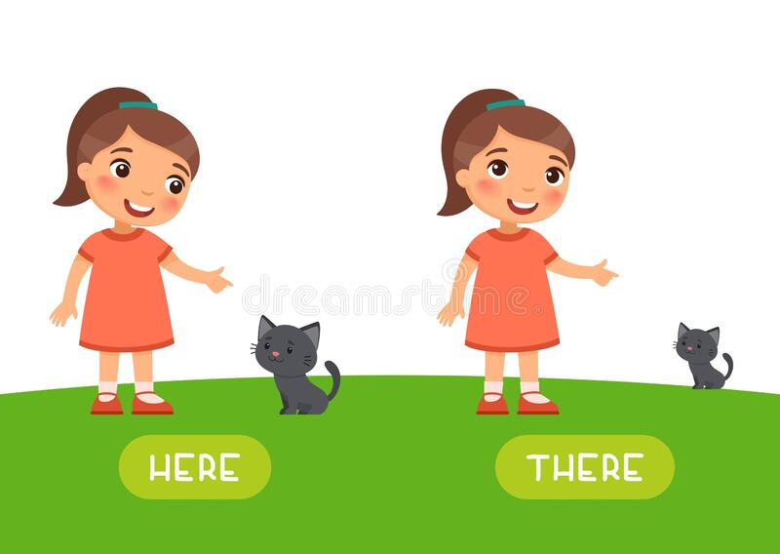
there

Slide 52
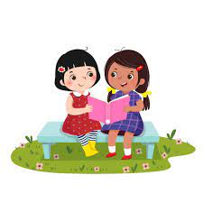
their

Slide 53
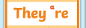
they’re

Slide 54
Let’s Teach and Practise

Slide 55
suffixes ing ed er est root ending in e

Slide 56
suffixes

Slide 57
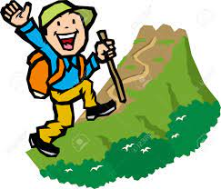
hike

Slide 58
hiking

Slide 59
hiker

Slide 60
hiked

Slide 61
hike
hike – ends in e
NOUN
Definition - a long walk or walking tour

Slide 62
hiking
hike (-e) + ing = hiking
NOUN
Definition - the activity of going for long walks, especially across country

Slide 63
hiker
hike (-e) + er = hiker
NOUN
Definition - a person who walks for long distances, especially across country

Slide 64
hiked
hike (-e) + ed = hiked
VERB
Definition - past tense - walk for a long distance, especially across country

Slide 65
It was a five-mile hike across rough terrain.
____

Slide 66
She enjoys hiking and climbing in her spare time.
______

Slide 67
An experienced hiker crossed the Himalayas.
_____

Slide 68
They hiked across the moors.
_____

Slide 69
New CHALLENGE words.

Slide 70

Mr.
NOUN
Definition - a title used before a surname or full name to address or refer to a man without a higher or honorific or professional title

Slide 71
Mr. Robert Smith is our teacher.
__

Slide 72
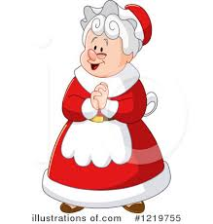
Mrs.
NOUN
Definition – the title used before a surname or full name to address or refer to a married woman without a higher or honorific or professional title

Slide 73
Mrs Sally Jones is our teacher.
___

Slide 74
Let’s investigate.

Slide 75
Can you spot the spelling errors in these sentences?
Write the correct spelling and explain where they went wrong.

Slide 76
The new mista and misis went hikeing for their honeymoon.

Slide 77
The new mista and misis went hikeing for their honeymoon.

Slide 78
The new mista and misis went hikeing for their honeymoon.
Mr.

Slide 79
The new mista and misis went hikeing for their honeymoon.
Mrs.

Slide 80
The new mista and misis went hikeing for their honeymoon. hiking – remove the ‘e’ on root words before adding suffix ‘ing’

Slide 81
The new Mr. and Mrs. went hiking for their honeymoon.

Slide 82
Year 2 - Spring 2
Week 6 - Wednesday

Slide 84
Let’s Revisit and Review…

Slide 85
Do you remember this challenge word?

Slide 86
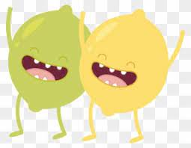
both
ADVERB
Definition - used before the first of two alternatives to emphasise that the statement being made applies to each

Slide 87
The film has won over both young people and old people.
____

Slide 88
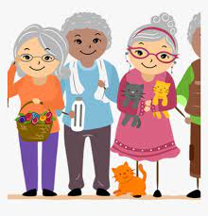
old
ADJECTIVE
Definition - having lived for a long time

Slide 89
The old tree still produced apples.
___

Slide 90
compound words two words ‘compounded’ together

Slide 91
compound words

Slide 92
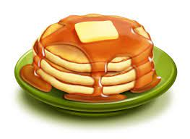

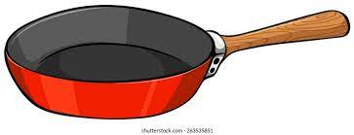
pancake

Slide 93
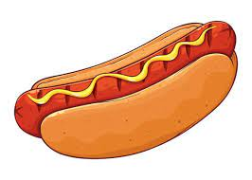

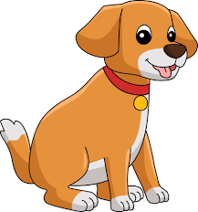
hotdog

Slide 94
Let’s Teach and Practise

Slide 95
suffixes ness, ful and ment just add suffix to root

Slide 96
Exceptions -
Words of more than 1 syllable and which end with a consonant followed by a ‘y’ such as merry need to have the y changed to an ‘i’

Slide 97
suffixes

Slide 98
-ness

Slide 99
-ful

Slide 100
-ment

Slide 101
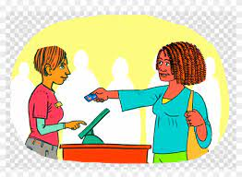
pay

Slide 102
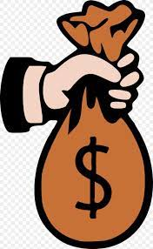
payment

Slide 103

care

Slide 104

careful

Slide 105

grace

Slide 106
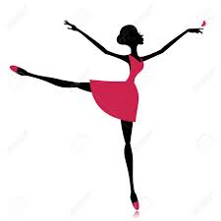
graceful

Slide 107
payment
pay + ment = payment
NOUN
Definition - the action or process of paying someone or something or of being paid

Slide 108
careful
care + ful = careful
ADJECTIVE
Definition - making sure of avoiding potential danger, mishap, or harm; cautious

Slide 109
graceful
grace + ful = graceful
ADJECTIVE
Definition - having or showing grace or elegance

Slide 110
I asked for a discount on the payment for my car.
_______

Slide 111
I begged him to be more careful.
_______

Slide 112
The swan was graceful on the water.
________

Slide 113
New CHALLENGE words.

Slide 114
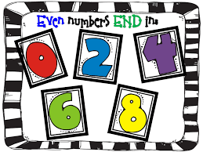
even
ADJECTIVE
Definition - divisible by two without a remainder

Slide 115
24 is an even number.
____

Slide 116
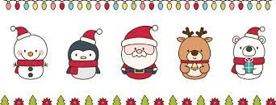
Christmas
NOUN
Definition – the annual Christian festival celebrating Christ's birth, held on 25 December in the Western Church

Slide 117
I love decorating the house at Christmas.
_________

Slide 118
Let’s investigate.

Slide 119
Can you spot the spelling errors in these sentences?
Write the correct spelling and explain where they went wrong.

Slide 120
The children got an evan number of presents at crismas and were carful when they opened them.

Slide 121
The children got an evan number of presents at crismas and were carful when they opened them.

Slide 122
The children got an evan number of presents at crismas and were carful when they opened them. even – ‘e’ not ‘a’

Slide 123
The children got an evan number of presents at crismas and were carful when they opened them.
Christmas – Christ’s mass

Slide 124
The children got an evan number of presents at crismas and were carful when they opened them. careful – suffix ‘ful’ just add to roots

Slide 125
The children got an even number of presents at Christmas and were careful when they opened them.

Slide 126
Year 2 - Spring 2
Week 6 - Thursday

Slide 128
Let’s Revisit and Review…

Slide 129
Do you remember this challenge word?

Slide 130
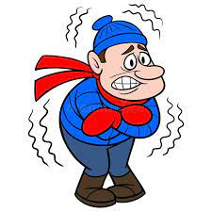
cold
ADJECTIVE
Definition - of or at a low or relatively low temperature

Slide 131
The cold snow was fun to play in.
____

Slide 132

gold
NOUN
Definition - a yellow precious metal

Slide 133
They found the gold buried deep underground.
____

Slide 134
ph

Slide 135

dolphin

Slide 136
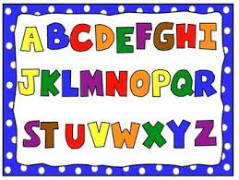
alphabet

Slide 137
Let’s Teach and Practise

Slide 138
suffixes ly and less just add suffix to root

Slide 139
Exceptions -
Words of more than 1 syllable and which end with a consonant followed by a ‘y’ such as merry need to have the y changed to an ‘i’

Slide 140
suffixes

Slide 141
-ly

Slide 142
-less

Slide 143
-less opposite

Slide 144

bad

Slide 145
badly

Slide 146
love

Slide 147
lovely

Slide 148
badly
bad + ly = badly
ADVERB
Definition - in an unsatisfactory, inadequate, or unsuccessful way

Slide 149
lovely
love + ly = lovely
ADVERB
Definition - very beautiful or attractive

Slide 150
England have played badly this year.
_____

Slide 151
The dancing was lovely at the show.
______

Slide 152
New CHALLENGE words.

Slide 153

great
ADJECTIVE
Definition - of an extent, amount, or intensity considerably above average

Slide 154
Elizabeth was a great queen.
_____

Slide 155

break
VERB
Definition – separate or cause to separate into pieces as a result of a blow, shock, or strain

Slide 156
Luckily, the vase didn’t break.
_____

Slide 157
Let’s investigate.

Slide 158
Can you spot the spelling errors in these sentences?
Write the correct spelling and explain where they went wrong.

Slide 159
The fall happened baddly, so he ended up with a grate big brake in his leg.

Slide 160
The fall happened baddly, so he ended up with a grate big brake in his leg.

Slide 161
The fall happened baddly, so he ended up with a grate big brake in his leg. badly – suffix ‘ly’ just add to roots

Slide 162
The fall happened baddly, so he ended up with a grate big brake in his leg. great – wrong homophone

Slide 163
The fall happened baddly, so he ended up with a grate big brake in his leg. break – wrong homophone

Slide 164
The fall happened badly, so he ended up with a great big break in his leg.

Slide 165
Year 2 - Spring 2
Week 6 - Friday

Slide 167
Let’s Revisit and Review…

Slide 168
Do you remember this challenge word?

Slide 169
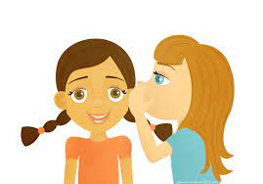
told
VERB
Definition - communicate information to someone in spoken or written words

Slide 170
Our teacher told us to write the sum down.
____

Slide 171
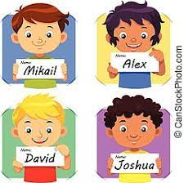
called
VERB
Definition - give (a baby or animal) a specified name

Slide 172
They called their daughter Susan.
______

Slide 173
‘air’ as ‘ear’ and ‘are’

Slide 174
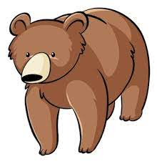
bear

Slide 175

pear

Slide 176
Let’s Teach and Practise

Slide 177
homophones and near homophones

Slide 178
homophones homo = same phone = sound

Slide 179
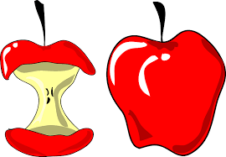
whole

Slide 180
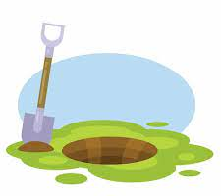
hole

Slide 181
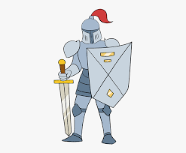
knight

Slide 182
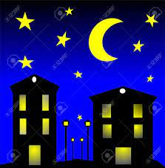
night

Slide 183
whole
ADJECTIVE
Definition - all of; entire

Slide 184
hole
NOUN
Definition - a hollow place in a solid body or surface

Slide 185
knight
NOUN
Definition - (in the Middle Ages) a man who served his sovereign or lord as a mounted soldier in armour

Slide 186
night
NOUN
Definition - the period from sunset to sunrise in each twenty-four hours

Slide 187
They ate the whole cake.
_____

Slide 188
The dog had dug a hole in the ground.
____

Slide 189
The knight fought bravely.
______

Slide 190
It was a moonless night.
_____

Slide 191
New CHALLENGE words.

Slide 192
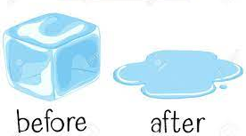
after
PREPOSITION
Definition - in the time following (an event or another period of time)

Slide 193
After a while they returned.
_____

Slide 194
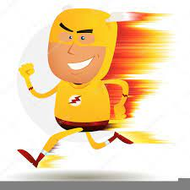
fast
ADJECTIVE
Definition - moving or capable of moving at high speed

Slide 195
I have a fast car
____

Slide 196
Let’s investigate.

Slide 197
Can you spot the spelling errors in these sentences?
Write the correct spelling and explain where they went wrong.

Slide 198
arfta a long time, the farst night won the battle.

Slide 199
arfta a long time, the farst night won the battle.

Slide 200
arfta a long time, the farst night won the battle. after – no ‘f’ and ‘er’ not ‘a’

Slide 201
arfta a long time, the farst night won the battle. fast – no ‘r’

Slide 202
arfta a long time, the farst night won the battle. knight – wrong homophone

Slide 203
After a long time, the fast knight won the battle.

