Slide 1
Spelling Y2
Mastering spellings: building on the foundations of phonics
Summer 2
Week 5
Notes:
These slides are the same as Y2 Summer 2 as this is a revisit and review half term

Slide 2
Year 2 - Summer 2
Week 5 - Monday
Notes:
Revisit and review the words from Y2 and challenge words – I say, we say, you say
Ask children to write words only in their spelling book
Introduce the new spelling rule
Children to write the new spelling rule words and challenge words into books when the sentences are shown with the spelling word missing.
Read the extract with the class as choral reading. Practise model of prosody etc.
Ask children to find the spelling words from the session in the text.
Then read allowed the chosen sentence for children to write fully in their books.
Show the extract and ask children to then edit their work to check they were correct in their dictation.

Slide 3
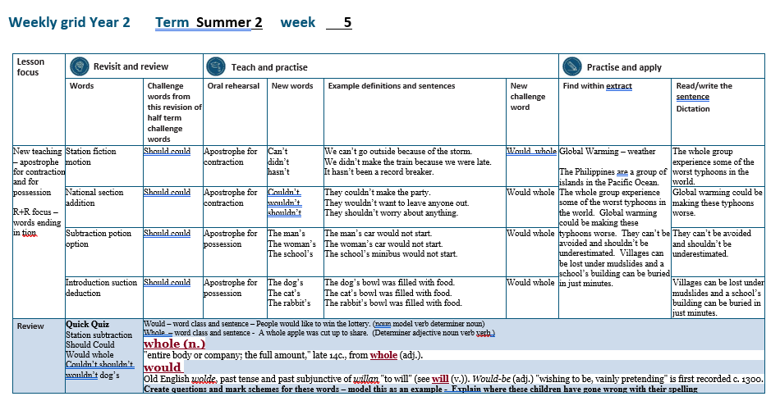

Slide 4
Let’s Revisit and Review…

Slide 5
Do you remember this challenge word?

Slide 6

Definition – shows possibility
should
(modal verb)

Slide 7
People should clean their teeth.
______

Slide 8
Do you remember this challenge word?

Slide 9

Definition – shows possibility
could
(modal verb)

Slide 10
We could go swimming if it is hot enough.
______

Slide 11
Can you remember this spelling rule?

Slide 12
Words ending
-tion

Slide 13
-tion
Notes:
Sound of aI

Slide 14
-tion
This is the most common spelling for this sound at the end of words.

Slide 15
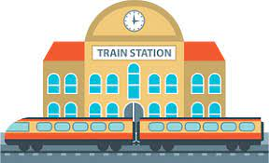
station

Slide 16

fiction

Slide 17

motion

Slide 18
Let’s Teach and Practise

Slide 19
Apostrophe - contraction

Slide 20
_____’____ apostrophe

Slide 21
Apostrophe a punctuation mark (')

Slide 22
Contraction becoming smaller

Slide 23
Contraction becoming smaller
Joining two words together with an apostrophe to show the missing letters
Apostrophe
a punctuation mark (')

Slide 24
can’t

Slide 25
didn’t

Slide 26
hasn’t

Slide 27

Definition – can not
can’t
can + not -> cannot = can’t
(modal verb)

Slide 28
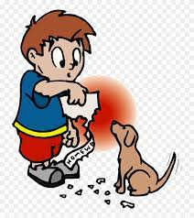
Definition – did not
didn’t
did + not -> didnot = didn’t
(modal verb)

Slide 29
hasn’t has + not -> hasnot = hasn’t
(modal verb)
Definition – has not

Slide 30
We can’t go outside because of the storm.
_____

Slide 31
We didn’t make the train because we were late.
______

Slide 32
It hasn’t been a record breaker.
_____

Slide 33
New CHALLENGE words.

Slide 34
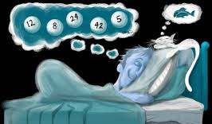
Definition - past of will, in various senses
would
VERB

Slide 35
People would like to win the lottery.
_____

Slide 36
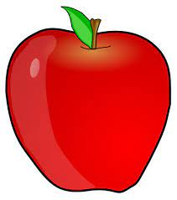
Definition - all of; entire
whole
ADJECTIVE

Slide 37
A whole apple was cut up to share.
_____

Slide 38
Let’s Practise and Apply.

Slide 39
Can you spot the spelling rule words and the challenge words?

Slide 40
Global Warming – weather
The Philippines are a group of islands in the Pacific Ocean. The whole group experience some of the worst typhoons in the world. Global warming could be making these typhoons worse. They can’t be avoided and shouldn’t be underestimated. Villages can be lost under mudslides and a school’s building can be buried in just minutes.

Slide 41
Global Warming – weather
The Philippines are a group of islands in the Pacific Ocean. The whole group experience some of the worst typhoons in the world. Global warming could be making these typhoons worse. They can’t be avoided and shouldn’t be underestimated. Villages can be lost under mudslides and a school’s building can be buried in just minutes.

Slide 42
Write this sentence as I dictate it to you.
Notes:
The whole group experience some of the worst typhoons in the world.

Slide 43
The whole group experience some of the worst typhoons in the world.
Did you write it correctly?
Edit your work and make sure you have it correct.
Can you underline the spelling word that we have covered in this session?

Slide 44
Year 2 - Summer 2
Week 5 - Tuesday
Notes:
Revisit and review the words from Y2 and challenge words – I say, we say, you say
Ask children to write words only in their spelling book
Introduce the new spelling rule
Children to write the new spelling rule words and challenge words into books when the sentences are shown with the spelling word missing.
Read the extract with the class as choral reading. Practise model of prosody etc.
Ask children to find the spelling words from the session in the text.
Then read allowed the chosen sentence for children to write fully in their books.
Show the extract and ask children to then edit their work to check they were correct in their dictation.

Slide 46
Let’s Revisit and Review…

Slide 47
Do you remember this challenge word?

Slide 48
Definition – shows possibility
should
(modal verb)

Slide 49
People should clean their teeth.
______

Slide 50
Do you remember this challenge word?

Slide 51
Definition – shows possibility
could
(modal verb)

Slide 52
We could go swimming if it is hot enough.
______

Slide 53
Can you remember this spelling rule?
Words ending in -tion

Slide 54
Words ending
-tion

Slide 55
-tion
Notes:
Sound of aI

Slide 56
-tion
This is the most common spelling for this sound at the end of words.

Slide 57

nation

Slide 58
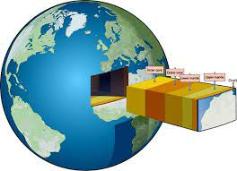
section

Slide 59
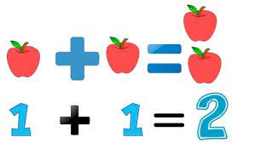
addition

Slide 60
Let’s Teach and Practise

Slide 61
Apostrophe - contraction

Slide 62
_____’____ apostrophe

Slide 63
Apostrophe a punctuation mark (')

Slide 64
Contraction becoming smaller

Slide 65
Contraction becoming smaller
Joining two words together with an apostrophe to show the missing letters
Apostrophe
a punctuation mark (')

Slide 66
couldn’t

Slide 67
wouldn’t

Slide 68
shouldn’t

Slide 69

Definition – could not
couldn’t
could + not -> couldnot = couldn’t
(modal verb)

Slide 70

Definition – would not
wouldn’t
would + not -> wouldnot = wouldn’t
(modal verb)

Slide 71

Definition – should not
shouldn’t
should + not -> shouldnot = shouldn’t
(modal verb)

Slide 72
They couldn’t make the party.
________

Slide 73
They wouldn’t want to leave anyone out.
________

Slide 74
They shouldn’t worry about anything.
_________

Slide 75
New CHALLENGE words.

Slide 76
Definition - past of will, in various senses
would
VERB

Slide 77
People would like to win the lottery.
_____

Slide 78
Definition - all of; entire
whole
ADJECTIVE

Slide 79
A whole apple was cut up to share.
_____

Slide 80
Let’s Practise and Apply.

Slide 81
Can you spot the spelling rule words and the challenge words?

Slide 82
Global Warming – weather
The Philippines are a group of islands in the Pacific Ocean. The whole group experience some of the worst typhoons in the world. Global warming could be making these typhoons worse. They can’t be avoided and shouldn’t be underestimated. Villages can be lost under mudslides and a school’s building can be buried in just minutes.

Slide 83
Global Warming – weather
The Philippines are a group of islands in the Pacific Ocean. The whole group experience some of the worst typhoons in the world. Global warming could be making these typhoons worse. They can’t be avoided and shouldn’t be underestimated. Villages can be lost under mudslides and a school’s building can be buried in just minutes.

Slide 84
Write this sentence as I dictate it to you.
Notes:
Global warming could be making these typhoons worse.

Slide 85
Global warming could be making these typhoons worse.
Did you write it correctly?
Edit your work and make sure you have it correct.
Can you underline the spelling word that we have covered in this session?

Slide 86
Year 2 - Summer 2
Week 5 - Wednesday
Notes:
Revisit and review the words from Y2 and challenge words – I say, we say, you say
Ask children to write words only in their spelling book
Introduce the new spelling rule
Children to write the new spelling rule words and challenge words into books when the sentences are shown with the spelling word missing.
Read the extract with the class as choral reading. Practise model of prosody etc.
Ask children to find the spelling words from the session in the text.
Then read allowed the chosen sentence for children to write fully in their books.
Show the extract and ask children to then edit their work to check they were correct in their dictation.

Slide 88
Let’s Revisit and Review…

Slide 89
Do you remember this challenge word?

Slide 90
Definition – shows possibility
should
(modal verb)

Slide 91
People should clean their teeth.
______

Slide 92
Do you remember this challenge word?

Slide 93
Definition – shows possibility
could
(modal verb)

Slide 94
We could go swimming if it is hot enough.
______

Slide 95
Can you remember this spelling rule?
Words ending in -tion

Slide 96
Words ending
-tion

Slide 97
-tion
Notes:
Sound of aI

Slide 98
-tion
This is the most common spelling for this sound at the end of words.

Slide 99
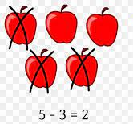
subtraction

Slide 100

potion

Slide 101

option

Slide 102
Let’s Teach and Practise

Slide 103
Apostrophe – possession

Slide 104
_____’_ apostrophe

Slide 105
Apostrophe a punctuation mark (')

Slide 106
Possession something belonging to someone

Slide 107
Possession something belonging to someone
Using an apostrophe to show who something belongs to.
Apostrophe
a punctuation mark (')

Slide 108
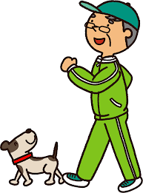
The man’s dog.

Slide 109
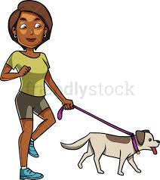
The woman’s dog.

Slide 110
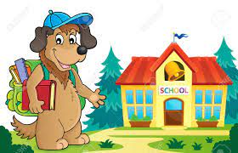
The school’s dog.

Slide 111
dog belongs to the man = man’s dog
The man’s dog
(noun showing possession)
Definition – an adult male human being

Slide 112
dog belongs to the woman = woman’s dog
The woman’s dog
(noun showing possession)
Definition – an adult female human being

Slide 113
Definition – a place to learn
The school’s dog
dog belongs to the school = school’s dog
(noun showing possession)

Slide 114
The man’s car would not start.
_____

Slide 115
The woman’s car would not start.
_______

Slide 116
The school’s minibus would not start.
________

Slide 117
New CHALLENGE words.

Slide 118
Definition - past of will, in various senses
would
VERB

Slide 119
People would like to win the lottery.
_____

Slide 120
Definition - all of; entire
whole
ADJECTIVE

Slide 121
A whole apple was cut up to share.
_____

Slide 122
Let’s Practise and Apply.

Slide 123
Can you spot the spelling rule words and the challenge words?

Slide 124
Global Warming – weather
The Philippines are a group of islands in the Pacific Ocean. The whole group experience some of the worst typhoons in the world. Global warming could be making these typhoons worse. They can’t be avoided and shouldn’t be underestimated. Villages can be lost under mudslides and a school’s building can be buried in just minutes.

Slide 125
Global Warming – weather
The Philippines are a group of islands in the Pacific Ocean. The whole group experience some of the worst typhoons in the world. Global warming could be making these typhoons worse. They can’t be avoided and shouldn’t be underestimated. Villages can be lost under mudslides and a school’s building can be buried in just minutes.

Slide 126
Write this sentence as I dictate it to you.
Notes:
They can’t be avoided and shouldn’t be underestimated.

Slide 127
They can’t be avoided and shouldn’t be underestimated.
Did you write it correctly?
Edit your work and make sure you have it correct.
Can you underline the spelling word that we have covered in this session?

Slide 128
Year 2 - Summer 2
Week 5 - Thursday
Notes:
Revisit and review the words from Y2 and challenge words – I say, we say, you say
Ask children to write words only in their spelling book
Introduce the new spelling rule
Children to write the new spelling rule words and challenge words into books when the sentences are shown with the spelling word missing.
Read the extract with the class as choral reading. Practise model of prosody etc.
Ask children to find the spelling words from the session in the text.
Then read allowed the chosen sentence for children to write fully in their books.
Show the extract and ask children to then edit their work to check they were correct in their dictation.

Slide 130
Let’s Revisit and Review…

Slide 131
Do you remember this challenge word?

Slide 132
Definition – shows possibility
should
(modal verb)

Slide 133
People should clean their teeth.
______

Slide 134
Do you remember this challenge word?

Slide 135
Definition – shows possibility
could
(modal verb)

Slide 136
We could go swimming if it is hot enough.
______

Slide 137
Can you remember this spelling rule?
Words ending in -tion

Slide 138
Words ending
-tion

Slide 139
-tion
Notes:
Sound of aI

Slide 140
-tion
This is the most common spelling for this sound at the end of words.

Slide 141
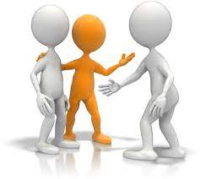
introduction

Slide 142
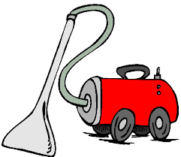
suction

Slide 143

deduction

Slide 144
Let’s Teach and Practise

Slide 145
Apostrophe - contraction

Slide 146
_____’_ apostrophe

Slide 147
Apostrophe a punctuation mark (')

Slide 148
Possession showing something belonging to someone

Slide 149
Possession something belonging to someone
= using an apostrophe to show someone possesses something.
Apostrophe
a punctuation mark (')

Slide 150
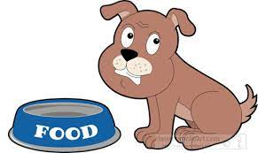
The dog’s bowl.

Slide 151
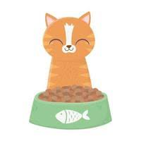
The cat’s bowl.

Slide 152
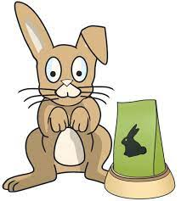
The rabbit’s bowl.

Slide 153
bowl belongs to the dog = dog’s bowl
The dog’s bowl
(noun showing possession)

Slide 154
bowl belongs to the cat = cat’s bowl
The cat’s bowl
(noun showing possession)

Slide 155
bowl belongs to the rabbit = rabbit’s bowl
The rabbit’s bowl
(noun showing possession)

Slide 156
The dog’s bowl was filled with food.
_____

Slide 157
The cat’s bowl was filled with food.
_____

Slide 158
The rabbit’s bowl was filled with food.
________

Slide 159
New CHALLENGE words.

Slide 160
Definition - past of will, in various senses
would
VERB

Slide 161
People would like to win the lottery.
_____

Slide 162
Definition - all of; entire
whole
ADJECTIVE

Slide 163
A whole apple was cut up to share.
_____

Slide 164
Let’s Practise and Apply.

Slide 165
Can you spot the spelling rule words and the challenge words?

Slide 166
Global Warming – weather
The Philippines are a group of islands in the Pacific Ocean. The whole group experience some of the worst typhoons in the world. Global warming could be making these typhoons worse. They can’t be avoided and shouldn’t be underestimated. Villages can be lost under mudslides and a school’s building can be buried in just minutes.

Slide 167
Global Warming – weather
The Philippines are a group of islands in the Pacific Ocean. The whole group experience some of the worst typhoons in the world. Global warming could be making these typhoons worse. They can’t be avoided and shouldn’t be underestimated. Villages can be lost under mudslides and a school’s building can be buried in just minutes.

Slide 168
Write this sentence as I dictate it to you.
Notes:
Villages can be lost under mudslides and a school’s building can be buried in just minutes.

Slide 169
Villages can be lost under mudslides and a school’s building can be buried in just minutes.
Did you write it correctly?
Edit your work and make sure you have it correct.
Can you underline the spelling word that we have covered in this session?

Slide 170
Year 2 - Summer 2
Week 5 - Friday
Notes:
Click through the slides for all the R+R words for the week (both the focus and the challenge words)
Click through the slides for all the new learning this week

Slide 172
Old challenge words…

Slide 173
should

Slide 174
could

Slide 175
Old spelling rule words…

Slide 176
station

Slide 177
fiction

Slide 178
motion

Slide 179
nation

Slide 180
section

Slide 181
addition

Slide 182
subtraction

Slide 183
potion

Slide 184
option

Slide 185
introduction

Slide 186
suction

Slide 187
deduction

Slide 188
New spelling rule words…

Slide 189
can’t

Slide 190
didn’t

Slide 191
hasn’t

Slide 192
couldn’t

Slide 193
wouldn’t

Slide 194
shouldn’t

Slide 195
man’s

Slide 196
woman’s

Slide 197
school’s

Slide 198
dog’s

Slide 199
cat’s

Slide 200
rabbit’s

Slide 201
New challenge words…

Slide 202
would

Slide 203
whole

Slide 204
Quick Quiz time…
Notes:
Say these words for the quiz
Station subtraction should could would whole couldn’t shouldn’t wouldn’t dog’s

Slide 205
Did you get them correct?
Edit your work.
station subtraction should could would whole couldn’t shouldn’t wouldn’t dog’s

Slide 206
Word class time…

Slide 207
People would like to win the lottery.
Notes:
Ask for these words to be classed

Slide 208
People would like to win the lottery.
noun modal verb verb noun phrase
Notes:
Ask for these words to be classed

Slide 209
The whole apple was cut up to share.
Notes:
Ask for these words to be classed

Slide 210
The whole apple was cut up to share.
determiner adjective noun verb adverbial

Slide 211
The whole apple was cut up to share.
determiner adjective noun verb adverbial

Slide 212
Etymology
The history of a word….

Slide 213
would
Old English wolde, past tense and past subjunctive of willan "to will" (see will (v.)). Would-be (adj.) "wishing to be, vainly pretending" is first recorded c. 1300.

Slide 214
whole (n.)
"entire body or company; the full amount," late 14c., from whole (adj.).
whole (adj.)
Old English hal "entire, whole; unhurt, uninjured, safe; healthy, sound; genuine, straightforward," from Proto-Germanic *haila- "undamaged" (source also of Old Saxon hel, Old Norse heill, Old Frisian hal, Middle Dutch hiel, Dutch heel, Old High German, German heil "salvation, welfare"), from PIE *kailo- "whole, uninjured, of good omen" (source also of Old Church Slavonic celu "whole, complete;" see health).
The spelling with wh- developed early 15c. The sense in whole number is from early 14c. Whole milk is from 1782. On the whole "considering all facts or circumstances" is from 1690s. For phrase whole hog, see hog (n.).

Slide 215
Let’s investigate….
Can you find words linked to would and whole?

Slide 216
Words linked to would…
Modal verbs to show possibility
Would could should can will won’t shall wouldn’t couldn’t shouldn’t can’t

Slide 217
Words linked to whole…
Wholehearted
Wholeness
Wholistic
Wholesale
Wholesome
Whole nine yards

