Slide 1
Spelling Y2
Mastering spellings: building on the foundations of phonics
Summer 1
Week 1

Slide 2
Year 2 - Summer 1
Week 1 - Monday

Slide 3
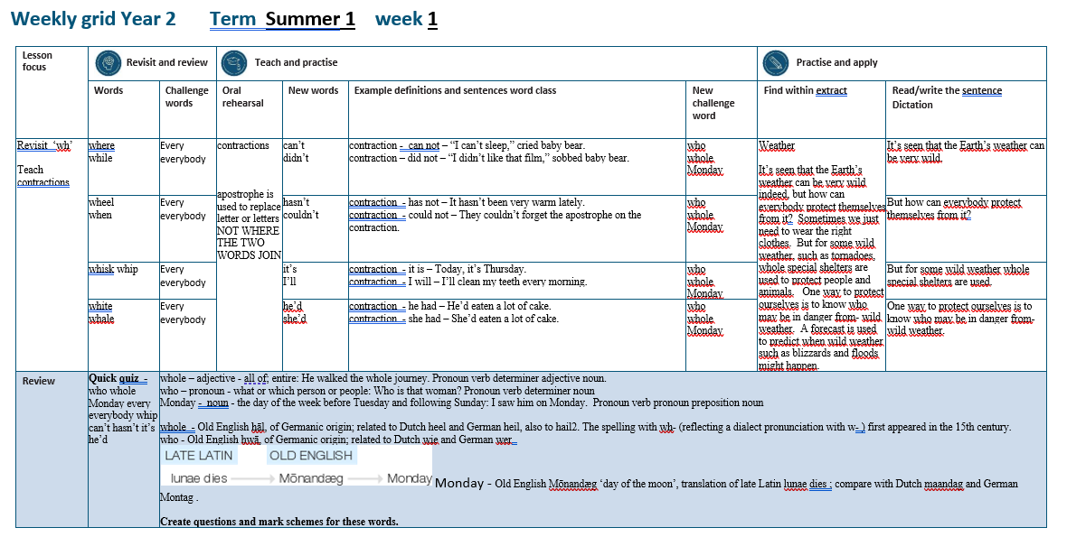

Slide 4
Let’s Revisit and Review…

Slide 5
Do you remember this challenge word?

Slide 6
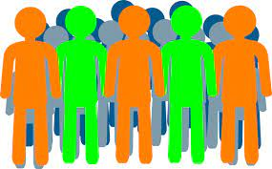
every
DETERMINER
Definition - used before a singular noun to refer to all the individual members of a set without exception

Slide 7
The children sang every note perfectly.
_____

Slide 8
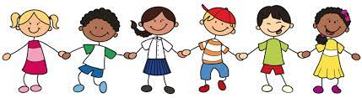
everybody
PRONOUN
Definition – every person

Slide 9
Everybody agrees with our teacher.
_________

Slide 10
homophones or near homophones homo = same phone = sound

Slide 11
homophones

Slide 12
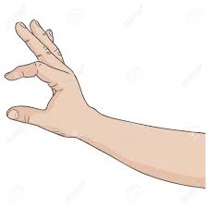
quite

Slide 13

quiet

Slide 14

see

Slide 15

sea

Slide 16
Let’s Teach and Practise

Slide 17
contractions

Slide 18
contractions
___’____ apostrophe is used to replace letter or letters
NOT WHERE THE TWO WORDS JOIN

Slide 19
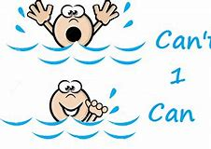
can’t

Slide 20

didn’t

Slide 21
can’t
can not = cannot = can’t
CONTRACTION
Definition – can not

Slide 22
didn’t
did not = didnot = didn’t
CONTRACTION
Definition – did not

Slide 23
“I can’t sleep,” cried baby bear.
_____

Slide 24
“I didn’t like that film,” sobbed baby bear
_____

Slide 25
New CHALLENGE words.

Slide 26

whole
ADJECTIVE
Definition - all of; entire

Slide 27
He walked the whole journey.
_____

Slide 28

who
PRONOUN
Definition - what or which person or people

Slide 29
Who is that woman?
___

Slide 30

Monday
PRONOUN
Definition - the day of the week before Tuesday and following Sunday

Slide 31
I saw him on Monday.
______

Slide 32
Let’s Practise and Apply.

Slide 33
Can you spot the spelling rule words and the challenge words?

Slide 34
Weather
It’s seen that the Earth’s weather can be very wild indeed, but how can everybody protect themselves from it? Sometimes we just need to wear the right clothes. But for some wild weather, such as tornadoes, whole special shelters are used to protect people and animals. One way to protect ourselves is to know who may be in danger from wild weather. A forecast is used to predict when wild weather such as blizzards and floods might happen.

Slide 35
Weather
It’s seen that the Earth’s weather can be very wild indeed, but how can everybody protect themselves from it? Sometimes we just need to wear the right clothes. But for some wild weather, such as tornadoes, whole special shelters are used to protect people and animals. One way to protect ourselves is to know who may be in danger from wild weather. A forecast is used to predict when wild weather such as blizzards and floods might happen.

Slide 36
Write this sentence as I dictate it to you.
Notes:
It’s seen that the Earth’s weather can be very wild.

Slide 37
It’s seen that the Earth’s weather can be very wild.
Did you write it correctly?
Edit your work and make sure you have it correct.
Can you underline the spelling word that we have covered in this session?

Slide 38
Year 2 - Summer 1
Week 1 - Tuesday
Notes:
Revisit and review the words from previous teaching and challenge words – I say, we say, you say
Ask children to write words only in their spelling book
Introduce the new spelling rule
Children to write the new spelling rule words and challenge words into books when the sentences are shown with the spelling word missing.
Read the extract with the class as choral reading. Practise model of prosody etc.
Ask children to find the spelling words from the session in the text.
Then read allowed the chosen sentence for children to write fully in their books.
Show the extract and ask children to then edit their work to check they were correct in their dictation.

Slide 40
Let’s Revisit and Review…

Slide 41
Do you remember this challenge word?

Slide 42
every
DETERMINER
Definition - used before a singular noun to refer to all the individual members of a set without exception

Slide 43
The children sang every note perfectly.
_____

Slide 44
everybody
PRONOUN
Definition – every person

Slide 45
Everybody agrees with our teacher.
_________

Slide 46
homophones or near homophones homo = same phone = sound

Slide 47
homophones

Slide 48
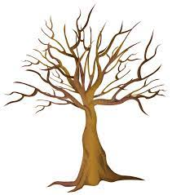
bare

Slide 49
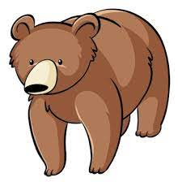
bear

Slide 50
Let’s Teach and Practise

Slide 51
contractions

Slide 52
contractions
___’____ apostrophe is used to replace letter or letters
NOT WHERE THE TWO WORDS JOIN

Slide 53

hasn’t

Slide 54
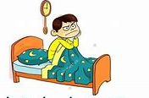
couldn’t

Slide 55
hasn’t
has not = hasnot = hasn’t
CONTRACTION
Definition – has not

Slide 56
couldn’t
could not = couldnot = couldn’t
CONTRACTION
Definition – could not

Slide 57
It hasn’t been very warm lately.
______

Slide 58
They couldn’t forget the apostrophe on the contraction.
________

Slide 59
New CHALLENGE words.

Slide 60
whole
ADJECTIVE
Definition - all of; entire

Slide 61
He walked the whole journey.
_____

Slide 62
who
PRONOUN
Definition - what or which person or people

Slide 63
Who is that woman?
___

Slide 64
Monday
PRONOUN
Definition - the day of the week before Tuesday and following Sunday

Slide 65
I saw him on Monday.
______

Slide 66
Let’s Practise and Apply.

Slide 67
Can you spot the spelling rule words and the challenge words?

Slide 68
Weather
It’s seen that the Earth’s weather can be very wild indeed, but how can everybody protect themselves from it? Sometimes we just need to wear the right clothes. But for some wild weather, such as tornadoes, whole special shelters are used to protect people and animals. One way to protect ourselves is to know who may be in danger from wild weather. A forecast is used to predict when wild weather such as blizzards and floods might happen.

Slide 69
Weather
It’s seen that the Earth’s weather can be very wild indeed, but how can everybody protect themselves from it? Sometimes we just need to wear the right clothes. But for some wild weather, such as tornadoes, whole special shelters are used to protect people and animals. One way to protect ourselves is to know who may be in danger from wild weather. A forecast is used to predict when wild weather such as blizzards and floods might happen.

Slide 70
Write this sentence as I dictate it to you.
Notes:
But how can everybody protect themselves from it?

Slide 71
But how can everybody protect themselves from it?
Did you write it correctly?
Edit your work and make sure you have it correct.
Can you underline the spelling word that we have covered in this session?

Slide 72
Year 2 - Summer 1
Week 1 - Wednesday
Notes:
Revisit and review the words from previous teaching and challenge words – I say, we say, you say
Ask children to write words only in their spelling book
Introduce the new spelling rule
Children to write the new spelling rule words and challenge words into books when the sentences are shown with the spelling word missing.
Read the extract with the class as choral reading. Practise model of prosody etc.
Ask children to find the spelling words from the session in the text.
Then read allowed the chosen sentence for children to write fully in their books.
Show the extract and ask children to then edit their work to check they were correct in their dictation.

Slide 74
Let’s Revisit and Review…

Slide 75
Do you remember this challenge word?

Slide 76
every
DETERMINER
Definition - used before a singular noun to refer to all the individual members of a set without exception

Slide 77
The children sang every note perfectly.
_____

Slide 78
everybody
PRONOUN
Definition – every person

Slide 79
Everybody agrees with our teacher.
_________

Slide 80
homophones or near homophones homo = same phone = sound

Slide 81
homophones

Slide 82

sun

Slide 83
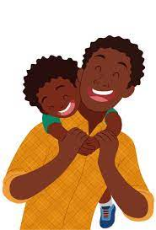
son

Slide 84
Let’s Teach and Practise

Slide 85
contractions

Slide 86
contractions
___’____ apostrophe is used to replace letter or letters
NOT WHERE THE TWO WORDS JOIN

Slide 87


it’s

Slide 88

I’ll

Slide 89
it’s
it is = itis = it’s
CONTRACTION
Definition – it is

Slide 90
I’ll
I will = Iwill = I’ll
CONTRACTION
Definition – I will

Slide 91
Today, it’s Thursday.
____

Slide 92
I’ll clean my teeth every morning.
____

Slide 93
New CHALLENGE words.

Slide 94
whole
ADJECTIVE
Definition - all of; entire

Slide 95
He walked the whole journey.
_____

Slide 96
who
PRONOUN
Definition - what or which person or people

Slide 97
Who is that woman?
___

Slide 98
Monday
PRONOUN
Definition - the day of the week before Tuesday and following Sunday

Slide 99
I saw him on Monday.
______

Slide 100
Let’s Practise and Apply.

Slide 101
Can you spot the spelling rule words and the challenge words?

Slide 102
Weather
It’s seen that the Earth’s weather can be very wild indeed, but how can everybody protect themselves from it? Sometimes we just need to wear the right clothes. But for some wild weather, such as tornadoes, whole special shelters are used to protect people and animals. One way to protect ourselves is to know who may be in danger from wild weather. A forecast is used to predict when wild weather such as blizzards and floods might happen.

Slide 103
Weather
It’s seen that the Earth’s weather can be very wild indeed, but how can everybody protect themselves from it? Sometimes we just need to wear the right clothes. But for some wild weather, such as tornadoes, whole special shelters are used to protect people and animals. One way to protect ourselves is to know who may be in danger from wild weather. A forecast is used to predict when wild weather such as blizzards and floods might happen.

Slide 104
Write this sentence as I dictate it to you.
Notes:
But for some wild weather whole special shelters are used.

Slide 105
But for some wild weather whole special shelters are used.
Did you write it correctly?
Edit your work and make sure you have it correct.
Can you underline the spelling word that we have covered in this session?

Slide 106
Year 2 - Summer 1
Week 1 - Thursday
Notes:
Revisit and review the words from previous teaching and challenge words – I say, we say, you say
Ask children to write words only in their spelling book
Introduce the new spelling rule
Children to write the new spelling rule words and challenge words into books when the sentences are shown with the spelling word missing.
Read the extract with the class as choral reading. Practise model of prosody etc.
Ask children to find the spelling words from the session in the text.
Then read allowed the chosen sentence for children to write fully in their books.
Show the extract and ask children to then edit their work to check they were correct in their dictation.

Slide 108
Let’s Revisit and Review…

Slide 109
Do you remember this challenge word?

Slide 110
every
DETERMINER
Definition - used before a singular noun to refer to all the individual members of a set without exception

Slide 111
The children sang every note perfectly.
_____

Slide 112
everybody
PRONOUN
Definition – every person

Slide 113
Everybody agrees with our teacher.
_________

Slide 114
homophones or near homophones homo = same phone = sound

Slide 115
homophones

Slide 116
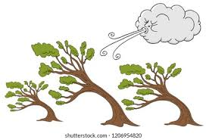
blew

Slide 117

blue

Slide 118
Let’s Teach and Practise

Slide 119
contractions

Slide 120
contractions
___’____ apostrophe is used to replace letter or letters
NOT WHERE THE TWO WORDS JOIN

Slide 121

he’d

Slide 122
she’d
s

Slide 123
he’d
he had = hehad = he’d
CONTRACTION
Definition – he had

Slide 124
she’d
s
she had = shehad = she’d
CONTRACTION
Definition – she had

Slide 125
He’d eaten a lot of cake.
____

Slide 126
She’d eaten a lot of cake.
_____

Slide 127
New CHALLENGE words.

Slide 128
whole
ADJECTIVE
Definition - all of; entire

Slide 129
He walked the whole journey.
_____

Slide 130
who
PRONOUN
Definition - what or which person or people

Slide 131
Who is that woman?
___

Slide 132
Monday
PRONOUN
Definition - the day of the week before Tuesday and following Sunday

Slide 133
I saw him on Monday.
______

Slide 134
Let’s Practise and Apply.

Slide 135
Can you spot the spelling rule words and the challenge words?

Slide 136
Weather
It’s seen that the Earth’s weather can be very wild indeed, but how can everybody protect themselves from it? Sometimes we just need to wear the right clothes. But for some wild weather, such as tornadoes, whole special shelters are used to protect people and animals. One way to protect ourselves is to know who may be in danger from wild weather. A forecast is used to predict when wild weather such as blizzards and floods might happen.

Slide 137
Weather
It’s seen that the Earth’s weather can be very wild indeed, but how can everybody protect themselves from it? Sometimes we just need to wear the right clothes. But for some wild weather, such as tornadoes, whole special shelters are used to protect people and animals. One way to protect ourselves is to know who may be in danger from wild weather. A forecast is used to predict when wild weather such as blizzards and floods might happen.

Slide 138
Write this sentence as I dictate it to you.
Notes:
One way to protect ourselves is to know who may be in danger from wild weather.

Slide 139
One way to protect ourselves is to know who may be in danger from wild weather.
Did you write it correctly?
Edit your work and make sure you have it correct.
Can you underline the spelling word that we have covered in this session?

Slide 140
Year 2 - Summer 1
Week 1 - Friday
Notes:
Click through the slides for all the R+R words for the week (both the focus and the challenge words)
Click through the slides for all the new learning this week

Slide 142
Old challenge words…

Slide 143
every

Slide 144
everybody

Slide 145
Old spelling rule words…

Slide 146
quite

Slide 147
quiet

Slide 148
see

Slide 149
see

Slide 150
bare

Slide 151
bear

Slide 152
son

Slide 153
sun

Slide 154
blew

Slide 155
blue

Slide 156
New spelling rule words…

Slide 157
can’t

Slide 158
didn’t

Slide 159
hasn’t

Slide 160
couldn’t

Slide 161
it’s

Slide 162
it’ll

Slide 163
he’d

Slide 164
she’d

Slide 165
New challenge words…

Slide 166
whole

Slide 167
who

Slide 168
Monday

Slide 169
Quick Quiz time…
Notes:
Say these words for the quiz
who whole Monday every everybody whip can’t hasn’t it’s he’d

Slide 170
Did you get them correct?
Edit your work.
who whole Monday every everybody whip can’t hasn’t it’s he’d

Slide 171
Word class time…

Slide 172
He walked the whole journey.
Pronoun verb determiner adjective noun.
Notes:
Ask for these words to be classed

Slide 173
Who is that woman?
Pronoun verb determiner noun
Notes:
Ask for these words to be classed

Slide 174
I saw him on Monday.
Pronoun verb pronoun preposition noun
Notes:
Ask for these words to be classed

Slide 175
Etymology
The history of a word….

Slide 176
Whole
Old English hāl, of Germanic origin; related to Dutch heel and German heil, also to hail2. The spelling with wh- (reflecting a dialect pronunciation with w- ) first appeared in the 15th century.
Who
Old English hwā, of Germanic origin; related to Dutch wie and German wer

Slide 177

Monday
Old English Mōnandæg ‘day of the moon’, translation of late Latin lunae dies ; compare with Dutch maandag and German Montag

Slide 178
Let’s investigate….
Create questions and mark schemes for these words.

