Slide 1
Spelling Y2
Mastering spellings: building on the foundations of phonics
Summer 1
Week 2

Slide 2
Year 2 - Summer 1
Week 2 - Monday

Slide 3
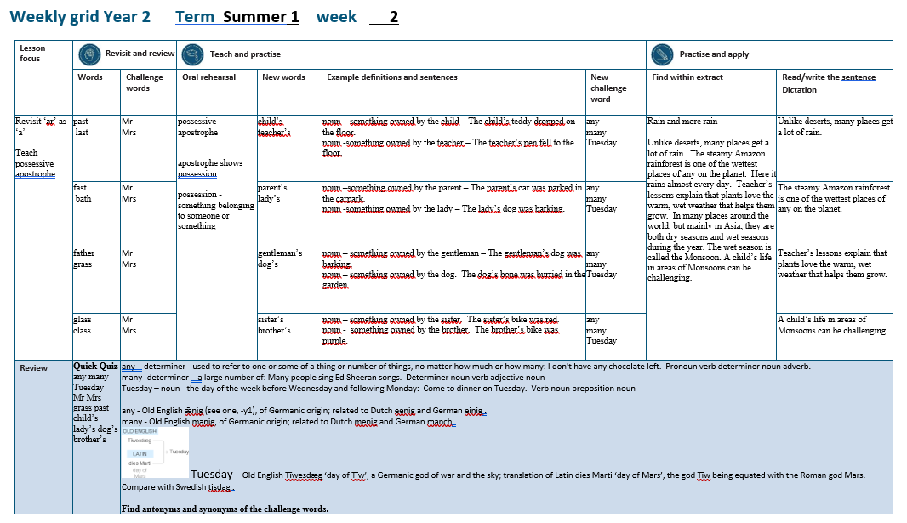

Slide 4
Let’s Revisit and Review…

Slide 5
Do you remember this challenge word?

Slide 6

Mr.
NOUN
Definition - a title used before a surname or full name to address or refer to a man without a higher or honorific or professional title

Slide 7
Mr. Robert Smith is our teacher.
__

Slide 8
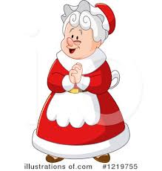
Mrs.
NOUN
Definition – the title used before a surname or full name to address or refer to a married woman without a higher or honorific or professional title

Slide 9
Mrs Sally Jones is our teacher.
___

Slide 10
suffixes ing ed er est root ending in e

Slide 11
suffixes

Slide 12
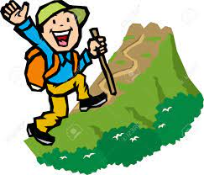
hike

Slide 13
hiking

Slide 14
hiker

Slide 15
hiked

Slide 16
Let’s Teach and Practise

Slide 17
Possessive apostrophe

Slide 18
possessive apostrophe
___’__ apostrophe shows possession possession - something belonging to someone or something

Slide 19
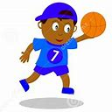
child’s

Slide 20

teacher’s

Slide 21
child’s
child possessing ball = child’s ball
NOUN
Definition – something owned by the child

Slide 22
teacher’s
teacher possessing desk = teacher’s desk
NOUN
Definition – something owned by the teacher

Slide 23
The child’s teddy dropped on the floor.
_______

Slide 24
The teacher’s pen fell to the floor.
_________

Slide 25
New CHALLENGE words.

Slide 26

any
DETERMINER
Definition - used to refer to one or some of a thing or number of things, no matter how much or how many

Slide 27
I don't have any chocolate left.
___

Slide 28
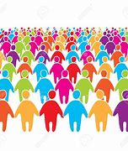
many
DETERMINER
Definition - a large number of

Slide 29
Many people sing Ed Sheeran songs.
____

Slide 30

Tuesday
PRONOUN
Definition - the day of the week before Wednesday and following Monday

Slide 31
Come to dinner on Tuesday.
_______

Slide 32
Let’s Practise and Apply.

Slide 33
Can you spot the spelling rule words and the challenge words?

Slide 34
Rain and more rain
Unlike deserts, many places get a lot of rain. The steamy Amazon rainforest is one of the wettest places of any on the planet. Here it rains almost every day. Teacher’s lessons explain that plants love the warm, wet weather that helps them grow. In many places around the world, but mainly in Asia, they are both dry seasons and wet seasons during the year. The wet season is called the Monsoon. A child’s life in areas of Monsoons can be challenging.

Slide 35
Rain and more rain
Unlike deserts, many places get a lot of rain. The steamy Amazon rainforest is one of the wettest places of any on the planet. Here it rains almost every day. Teacher’s lessons explain that plants love the warm, wet weather that helps them grow. In many places around the world, but mainly in Asia, they are both dry seasons and wet seasons during the year. The wet season is called the Monsoon. A child’s life in areas of Monsoons can be challenging.

Slide 36
Write this sentence as I dictate it to you.
Notes:
Unlike deserts, many places get a lot of rain.

Slide 37
Unlike deserts, many places get a lot of rain.
Did you write it correctly?
Edit your work and make sure you have it correct.
Can you underline the spelling word that we have covered in this session?

Slide 38
Year 2 - Summer 1
Week 2 - Tuesday
Notes:
Revisit and review the words from previous teaching and challenge words – I say, we say, you say
Ask children to write words only in their spelling book
Introduce the new spelling rule
Children to write the new spelling rule words and challenge words into books when the sentences are shown with the spelling word missing.
Read the extract with the class as choral reading. Practise model of prosody etc.
Ask children to find the spelling words from the session in the text.
Then read allowed the chosen sentence for children to write fully in their books.
Show the extract and ask children to then edit their work to check they were correct in their dictation.

Slide 40
Let’s Revisit and Review…

Slide 41
Do you remember this challenge word?

Slide 42
Mr.
NOUN
Definition - a title used before a surname or full name to address or refer to a man without a higher or honorific or professional title

Slide 43
Mr. Robert Smith is our teacher.
__

Slide 44
Mrs.
NOUN
Definition – the title used before a surname or full name to address or refer to a married woman without a higher or honorific or professional title

Slide 45
Mrs Sally Jones is our teacher.
___

Slide 46
suffixes ing ed er est root ending in e

Slide 47
suffixes

Slide 48

nice

Slide 49
nicer

Slide 50
nicest

Slide 51
Let’s Teach and Practise

Slide 52
Possessive apostrophe

Slide 53
possessive apostrophe
___’__ apostrophe shows possession possession - something belonging to someone or something

Slide 54
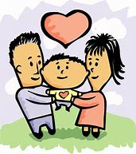
parent’s

Slide 55
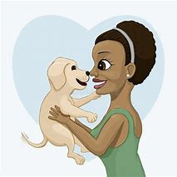
lady’s

Slide 56
parent’s
parent possessing child = parent’s child
NOUN
Definition – something owned by the parent

Slide 57
lady’s
lady possessing dog = lady’s dog
NOUN
Definition – something owned by the lady

Slide 58
The parent’s car was parked in the carpark.
________

Slide 59
The lady’s dog was barking.
______

Slide 60
New CHALLENGE words.

Slide 61
any
DETERMINER
Definition - used to refer to one or some of a thing or number of things, no matter how much or how many

Slide 62
I don't have any chocolate left.
___

Slide 63
many
DETERMINER
Definition - a large number of

Slide 64
Many people sing Ed Sheeran songs.
____

Slide 65
Tuesday
PRONOUN
Definition - the day of the week before Wednesday and following Monday

Slide 66
Come to dinner on Tuesday.
_______

Slide 67
Let’s Practise and Apply.

Slide 68
Can you spot the spelling rule words and the challenge words?

Slide 69
Rain and more rain
Unlike deserts, many places get a lot of rain. The steamy Amazon rainforest is one of the wettest places of any on the planet. Here it rains almost every day. Teacher’s lessons explain that plants love the warm, wet weather that helps them grow. In many places around the world, but mainly in Asia, they are both dry seasons and wet seasons during the year. The wet season is called the Monsoon. A child’s life in areas of Monsoons can be challenging.

Slide 70
Rain and more rain
Unlike deserts, many places get a lot of rain. The steamy Amazon rainforest is one of the wettest places of any on the planet. Here it rains almost every day. Teacher’s lessons explain that plants love the warm, wet weather that helps them grow. In many places around the world, but mainly in Asia, they are both dry seasons and wet seasons during the year. The wet season is called the Monsoon. A child’s life in areas of Monsoons can be challenging.

Slide 71
Write this sentence as I dictate it to you.
Notes:
The steamy Amazon rainforest is one of the wettest places of any on the planet.

Slide 72
The steamy Amazon rainforest is one of the wettest places of any on the planet.
Did you write it correctly?
Edit your work and make sure you have it correct.
Can you underline the spelling word that we have covered in this session?

Slide 73
Year 2 - Summer 1
Week 2 - Wednesday
Notes:
Revisit and review the words from previous teaching and challenge words – I say, we say, you say
Ask children to write words only in their spelling book
Introduce the new spelling rule
Children to write the new spelling rule words and challenge words into books when the sentences are shown with the spelling word missing.
Read the extract with the class as choral reading. Practise model of prosody etc.
Ask children to find the spelling words from the session in the text.
Then read allowed the chosen sentence for children to write fully in their books.
Show the extract and ask children to then edit their work to check they were correct in their dictation.

Slide 75
Let’s Revisit and Review…

Slide 76
Do you remember this challenge word?

Slide 77
Mr.
NOUN
Definition - a title used before a surname or full name to address or refer to a man without a higher or honorific or professional title

Slide 78
Mr. Robert Smith is our teacher.
__

Slide 79
Mrs.
NOUN
Definition – the title used before a surname or full name to address or refer to a married woman without a higher or honorific or professional title

Slide 80
Mrs Sally Jones is our teacher.
___

Slide 81
suffixes ing ed er est root ending in e

Slide 82
suffixes

Slide 83

shine

Slide 84
shiny

Slide 85
shining

Slide 86
Let’s Teach and Practise

Slide 87
Possessive apostrophe

Slide 88
possessive apostrophe
___’__ apostrophe shows possession possession - something belonging to someone or something

Slide 89
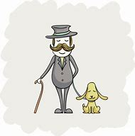
gentleman’s

Slide 90

dog’s

Slide 91
gentleman’s
gentleman possessing dog = gentleman’s dog
NOUN
Definition – something owned by the gentleman

Slide 92
dog’s
dog possessing bone = dog’s bone
NOUN
Definition – something owned by the dog

Slide 93
The gentleman’s dog was barking.
___________

Slide 94
The dog’s bone was buried in the garden.
_____

Slide 95
New CHALLENGE words.

Slide 96
any
DETERMINER
Definition - used to refer to one or some of a thing or number of things, no matter how much or how many

Slide 97
I don't have any chocolate left.
___

Slide 98
many
DETERMINER
Definition - a large number of

Slide 99
Many people sing Ed Sheeran songs.
____

Slide 100
Tuesday
PRONOUN
Definition - the day of the week before Wednesday and following Monday

Slide 101
Come to dinner on Tuesday.
_______

Slide 102
Let’s Practise and Apply.

Slide 103
Can you spot the spelling rule words and the challenge words?

Slide 104
Rain and more rain
Unlike deserts, many places get a lot of rain. The steamy Amazon rainforest is one of the wettest places of any on the planet. Here it rains almost every day. Teacher’s lessons explain that plants love the warm, wet weather that helps them grow. In many places around the world, but mainly in Asia, they are both dry seasons and wet seasons during the year. The wet season is called the Monsoon. A child’s life in areas of Monsoons can be challenging.

Slide 105
Rain and more rain
Unlike deserts, many places get a lot of rain. The steamy Amazon rainforest is one of the wettest places of any on the planet. Here it rains almost every day. Teacher’s lessons explain that plants love the warm, wet weather that helps them grow. In many places around the world, but mainly in Asia, they are both dry seasons and wet seasons during the year. The wet season is called the Monsoon. A child’s life in areas of Monsoons can be challenging.

Slide 106
Write this sentence as I dictate it to you.
Notes:
Teacher’s lessons explain that plants love the warm, wet weather that helps them grow.

Slide 107
Teacher’s lessons explain that plants love the warm, wet weather that helps them grow.
Did you write it correctly?
Edit your work and make sure you have it correct.
Can you underline the spelling word that we have covered in this session?

Slide 108
Year 2 - Summer 1
Week 2 - Thursday
Notes:
Revisit and review the words from previous teaching and challenge words – I say, we say, you say
Ask children to write words only in their spelling book
Introduce the new spelling rule
Children to write the new spelling rule words and challenge words into books when the sentences are shown with the spelling word missing.
Read the extract with the class as choral reading. Practise model of prosody etc.
Ask children to find the spelling words from the session in the text.
Then read allowed the chosen sentence for children to write fully in their books.
Show the extract and ask children to then edit their work to check they were correct in their dictation.

Slide 110
Let’s Revisit and Review…

Slide 111
Do you remember this challenge word?

Slide 112
Mr.
NOUN
Definition - a title used before a surname or full name to address or refer to a man without a higher or honorific or professional title

Slide 113
Mr. Robert Smith is our teacher.
__

Slide 114
Mrs.
NOUN
Definition – the title used before a surname or full name to address or refer to a married woman without a higher or honorific or professional title

Slide 115
Mrs Sally Jones is our teacher.
___

Slide 116
suffixes ing ed er est root ending in e

Slide 117
suffixes

Slide 118
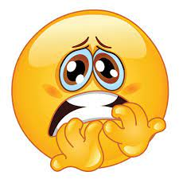
scare

Slide 119
scary

Slide 120
scared

Slide 121
Let’s Teach and Practise

Slide 122
Possessive apostrophe

Slide 123
possessive apostrophe
___’__ apostrophe shows possession possession - something belonging to someone or something

Slide 124
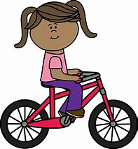
sister’s

Slide 125
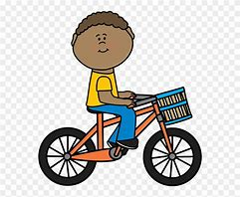
brother’s

Slide 126
sister’s
sister possessing bike = sister’s bike
NOUN
Definition – something owned by the sister

Slide 127
brother’s
brother possessing bike = brother’s bike
NOUN
Definition – something owned by the brother

Slide 128
My sister’s bike is red.
________

Slide 129
My brother’s bike is red.
_________

Slide 130
New CHALLENGE words.

Slide 131
any
DETERMINER
Definition - used to refer to one or some of a thing or number of things, no matter how much or how many

Slide 132
I don't have any chocolate left.
___

Slide 133
many
DETERMINER
Definition - a large number of

Slide 134
Many people sing Ed Sheeran songs.
____

Slide 135
Tuesday
PRONOUN
Definition - the day of the week before Wednesday and following Monday

Slide 136
Come to dinner on Tuesday.
_______

Slide 137
Let’s Practise and Apply.

Slide 138
Can you spot the spelling rule words and the challenge words?

Slide 139
Rain and more rain
Unlike deserts, many places get a lot of rain. The steamy Amazon rainforest is one of the wettest places of any on the planet. Here it rains almost every day. Teacher’s lessons explain that plants love the warm, wet weather that helps them grow. In many places around the world, but mainly in Asia, they are both dry seasons and wet seasons during the year. The wet season is called the Monsoon. A child’s life in areas of Monsoons can be challenging.

Slide 140
Rain and more rain
Unlike deserts, many places get a lot of rain. The steamy Amazon rainforest is one of the wettest places of any on the planet. Here it rains almost every day. Teacher’s lessons explain that plants love the warm, wet weather that helps them grow. In many places around the world, but mainly in Asia, they are both dry seasons and wet seasons during the year. The wet season is called the Monsoon. A child’s life in areas of Monsoons can be challenging.

Slide 141
Write this sentence as I dictate it to you.
Notes:
A child’s life in areas of Monsoons can be challenging.

Slide 142
A child’s life in areas of Monsoons can be challenging.
Did you write it correctly?
Edit your work and make sure you have it correct.
Can you underline the spelling word that we have covered in this session?

Slide 143
Year 2 - Summer 1
Week 2 - Friday
Notes:
Click through the slides for all the R+R words for the week (both the focus and the challenge words)
Click through the slides for all the new learning this week

Slide 145
Old challenge words…

Slide 146
Mr.

Slide 147
Mrs.

Slide 148
Old spelling rule words…

Slide 149
hike

Slide 150
hiking

Slide 151
hiker

Slide 152
hiked

Slide 153
nice

Slide 154
nicer

Slide 155
nicest

Slide 156
shine

Slide 157
shiny

Slide 158
shining

Slide 159
scare

Slide 160
scary

Slide 161
scared

Slide 162
New spelling rule words…

Slide 163
child’s

Slide 164
teacher’s

Slide 165
parent’s

Slide 166
lady’s

Slide 167
gentleman’s

Slide 168
dog’s

Slide 169
sister’s

Slide 170
brother’s

Slide 171
New challenge words…

Slide 172
any

Slide 173
many

Slide 174
Tuesday

Slide 175
Quick Quiz time…
Notes:
Say these words for the quiz
any many Tuesday
Mr Mrs grass past
child’s lady’s dog’s brother’s

Slide 176
Did you get them correct?
Edit your work.
any many Tuesday
Mr Mrs grass past
child’s lady’s dog’s brother’s

Slide 177
Word class time…

Slide 178
I don't have any chocolate left
Pronoun verb determiner noun adverb
Notes:
Ask for these words to be classed

Slide 179
Many people sing Ed Sheeran songs.
Determiner noun verb adjective noun
Notes:
Ask for these words to be classed

Slide 180
Come to dinner on Tuesday.
Verb noun preposition noun
Notes:
Ask for these words to be classed

Slide 181
Etymology
The history of a word….

Slide 182
Any
Old English ǣnig (see one, -y1), of Germanic origin; related to Dutch eenig and German einig .
Many
Old English manig, of Germanic origin; related to Dutch menig and German manch .

Slide 183
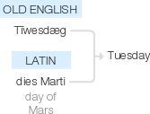
Tuesday
Old English Tīwesdæg ‘day of Tīw’, a Germanic god of war and the sky; translation of Latin dies Marti ‘day of Mars’, the god Tīw being equated with the Roman god Mars. Compare with Swedish tisdag .

Slide 184
Let’s investigate….
Find antonyms and synonyms of the challenge words.

