Slide 1
Spelling Y2
Mastering spellings: building on the foundations of phonics
Summer 1
Week 3

Slide 2
Year 2 - Summer 1
Week 3 - Monday

Slide 3
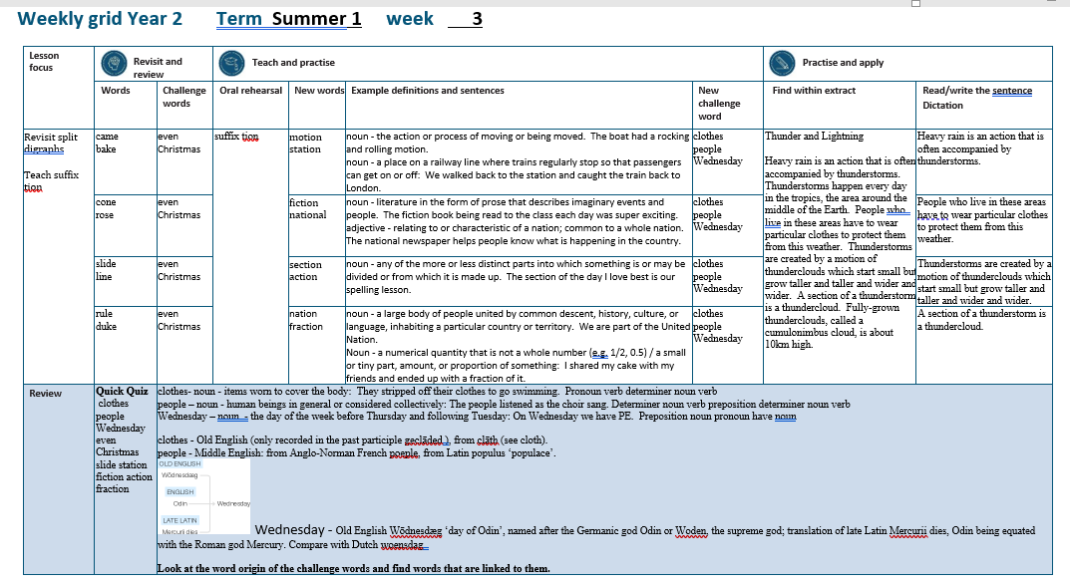

Slide 4
Let’s Revisit and Review…

Slide 5
Do you remember this challenge word?

Slide 6
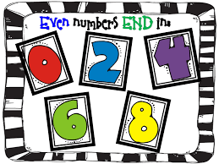
even
ADJECTIVE
Definition - divisible by two without a remainder

Slide 7
24 is an even number.
____

Slide 8
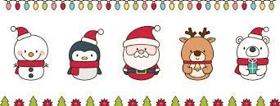
Christmas
NOUN
Definition – the annual Christian festival celebrating Christ's birth, held on 25 December in the Western Church

Slide 9
I love decorating the house at Christmas.
_________

Slide 10
suffixes ness, ful and ment just add suffix to root

Slide 11
Exceptions -
Words of more than 1 syllable and which end with a consonant followed by a ‘y’ such as merry need to have the y changed to an ‘i’

Slide 12
suffixes

Slide 13
-ness

Slide 14
-ful

Slide 15
-ment

Slide 16
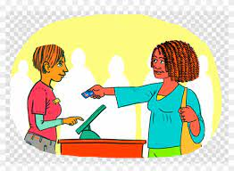
pay

Slide 17

payment

Slide 18

care

Slide 19

careful

Slide 20

grace

Slide 21
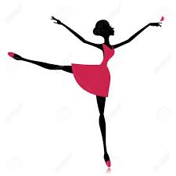
graceful

Slide 22
Let’s Teach and Practise

Slide 23
Suffix
-tion

Slide 24
-tion

Slide 25

motion

Slide 26
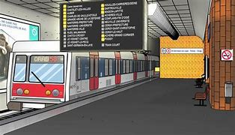
station

Slide 27
motion
NOUN
Definition – the action or process of moving or being moved

Slide 28
station
NOUN
Definition – a place on a railway line where trains regularly stop so that passengers can get on or off

Slide 29
The boat had a rocking and rolling motion.
______

Slide 30
We walked back to the station and caught the train back to London.
_______

Slide 31
New CHALLENGE words.

Slide 32
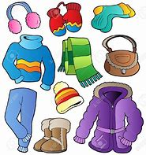
clothes
NOUN
Definition - items worn to cover the body

Slide 33
They stripped off their clothes to go swimming.
_______

Slide 34

people
NOUN
Definition - human beings in general or considered collectively

Slide 35
The people listened as the choir sang.
______

Slide 36

Wednesday
NOUN
Definition - the day of the week before Thursday and following Wednesday

Slide 37
On Wednesday we have PE.
_________

Slide 38
Let’s Practise and Apply.

Slide 39
Can you spot the spelling rule words and the challenge words?

Slide 40
Thunder and Lightning
Heavy rain is an action that is often accompanied by thunderstorms. Thunderstorms happen every day in the tropics, the area around the middle of the Earth. People who live in these areas have to wear particular clothes to protect them from this weather. Thunderstorms are created by a motion of thunderclouds which start small but grow taller and taller and wider and wider. A section of a thunderstorm is a thundercloud. A fully-grown thundercloud, called a cumulonimbus cloud, is about 10km high.

Slide 41
Thunder and Lightning
Heavy rain is an action that is often accompanied by thunderstorms. Thunderstorms happen every day in the tropics, the area around the middle of the Earth. People who live in these areas have to wear particular clothes to protect them from this weather. Thunderstorms are created by a motion of thunderclouds which start small but grow taller and taller and wider and wider. A section of a thunderstorm is a thundercloud. A fully-grown thundercloud, called a cumulonimbus cloud, is about 10km high.

Slide 42
Write this sentence as I dictate it to you.
Notes:
Heavy rain is an action that is often accompanied by thunderstorms.

Slide 43
Heavy rain is an action that is often accompanied by thunderstorms.
Did you write it correctly?
Edit your work and make sure you have it correct.
Can you underline the spelling word that we have covered in this session?

Slide 44
Year 2 - Summer 1
Week 3 - Tuesday
Notes:
Revisit and review the words from previous teaching and challenge words – I say, we say, you say
Ask children to write words only in their spelling book
Introduce the new spelling rule
Children to write the new spelling rule words and challenge words into books when the sentences are shown with the spelling word missing.
Read the extract with the class as choral reading. Practise model of prosody etc.
Ask children to find the spelling words from the session in the text.
Then read allowed the chosen sentence for children to write fully in their books.
Show the extract and ask children to then edit their work to check they were correct in their dictation.

Slide 46
Let’s Revisit and Review…

Slide 47
Do you remember this challenge word?

Slide 48
even
ADJECTIVE
Definition - divisible by two without a remainder

Slide 49
24 is an even number.
____

Slide 50
Christmas
NOUN
Definition – the annual Christian festival celebrating Christ's birth, held on 25 December in the Western Church

Slide 51
I love decorating the house at Christmas.
_________

Slide 52
suffixes ness, ful and ment just add suffix to root

Slide 53
Exceptions -
Words of more than 1 syllable and which end with a consonant followed by a ‘y’ such as merry need to have the y changed to an ‘i’

Slide 54
suffixes

Slide 55
-ness

Slide 56
-ful

Slide 57
-ment

Slide 58

enjoy

Slide 59
enjoyment

Slide 60

merry

Slide 61
merriment

Slide 62
Let’s Teach and Practise

Slide 63
Suffix
-tion

Slide 64
-tion

Slide 65

fiction

Slide 66

national

Slide 67
fiction
NOUN
Definition – literature in the form of prose that describes imaginary events and people

Slide 68
national
ADJECTIVE
Definition – relating to or characteristic of a nation

Slide 69
The fiction book being read to the class each day was super exciting.
_______

Slide 70
The national newspaper helps people know what is happening in the country.
________

Slide 71
New CHALLENGE words.

Slide 72
clothes
NOUN
Definition - items worn to cover the body

Slide 73
They stripped off their clothes to go swimming.
_______

Slide 74
people
NOUN
Definition - human beings in general or considered collectively

Slide 75
The people listened as the choir sang.
______

Slide 76
Wednesday
NOUN
Definition - the day of the week before Thursday and following Wednesday

Slide 77
On Wednesday we have PE.
_________

Slide 78
Let’s Practise and Apply.

Slide 79
Can you spot the spelling rule words and the challenge words?

Slide 80
Thunder and Lightning
Heavy rain is an action that is often accompanied by thunderstorms. Thunderstorms happen every day in the tropics, the area around the middle of the Earth. People who live in these areas have to wear particular clothes to protect them from this weather. Thunderstorms are created by a motion of thunderclouds which start small but grow taller and taller and wider and wider. A section of a thunderstorm is a thundercloud. A fully-grown thundercloud, called a cumulonimbus cloud, is about 10km high.

Slide 81
Thunder and Lightning
Heavy rain is an action that is often accompanied by thunderstorms. Thunderstorms happen every day in the tropics, the area around the middle of the Earth. People who live in these areas have to wear particular clothes to protect them from this weather. Thunderstorms are created by a motion of thunderclouds which start small but grow taller and taller and wider and wider. A section of a thunderstorm is a thundercloud. A fully-grown thundercloud, called a cumulonimbus cloud, is about 10km high.

Slide 82
Write this sentence as I dictate it to you.
Notes:
People wear clothes to protect them from weather.

Slide 83
People wear clothes to protect them from weather.
Did you write it correctly?
Edit your work and make sure you have it correct.
Can you underline the spelling word that we have covered in this session?

Slide 84
Year 2 - Summer 1
Week 3 - Wednesday
Notes:
Revisit and review the words from previous teaching and challenge words – I say, we say, you say
Ask children to write words only in their spelling book
Introduce the new spelling rule
Children to write the new spelling rule words and challenge words into books when the sentences are shown with the spelling word missing.
Read the extract with the class as choral reading. Practise model of prosody etc.
Ask children to find the spelling words from the session in the text.
Then read allowed the chosen sentence for children to write fully in their books.
Show the extract and ask children to then edit their work to check they were correct in their dictation.

Slide 86
Let’s Revisit and Review…

Slide 87
Do you remember this challenge word?

Slide 88
even
ADJECTIVE
Definition - divisible by two without a remainder

Slide 89
24 is an even number.
____

Slide 90
Christmas
NOUN
Definition – the annual Christian festival celebrating Christ's birth, held on 25 December in the Western Church

Slide 91
I love decorating the house at Christmas.
_________

Slide 92
suffixes ness, ful and ment just add suffix to root

Slide 93
Exceptions -
Words of more than 1 syllable and which end with a consonant followed by a ‘y’ such as merry need to have the y changed to an ‘i’

Slide 94
suffixes

Slide 95
-ness

Slide 96
-ful

Slide 97
-ment

Slide 98

happy

Slide 99
happiness

Slide 100
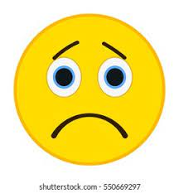
sad

Slide 101
sadness

Slide 102
Let’s Teach and Practise

Slide 103
Suffix
-tion

Slide 104
-tion

Slide 105
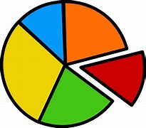
section

Slide 106

action

Slide 107
section
NOUN
Definition – any of the more or less distinct parts into which something is or may be divided or from which it is made up

Slide 108
action
NOUN
Definition – the fact or process of doing something

Slide 109
The section of the day I love best is our spelling lesson.
_______

Slide 110
The action on the pitch was thrilling.
______

Slide 111
New CHALLENGE words.

Slide 112
clothes
NOUN
Definition - items worn to cover the body

Slide 113
They stripped off their clothes to go swimming.
_______

Slide 114
people
NOUN
Definition - human beings in general or considered collectively

Slide 115
The people listened as the choir sang.
______

Slide 116
Wednesday
NOUN
Definition - the day of the week before Thursday and following Wednesday

Slide 117
On Wednesday we have PE.
_________

Slide 118
Let’s Practise and Apply.

Slide 119
Can you spot the spelling rule words and the challenge words?

Slide 120
Thunder and Lightning
Heavy rain is an action that is often accompanied by thunderstorms. Thunderstorms happen every day in the tropics, the area around the middle of the Earth. People who live in these areas have to wear particular clothes to protect them from this weather. Thunderstorms are created by a motion of thunderclouds which start small but grow taller and taller and wider and wider. A section of a thunderstorm is a thundercloud. A fully-grown thundercloud, called a cumulonimbus cloud, is about 10km high.

Slide 121
Thunder and Lightning
Heavy rain is an action that is often accompanied by thunderstorms. Thunderstorms happen every day in the tropics, the area around the middle of the Earth. People who live in these areas have to wear particular clothes to protect them from this weather. Thunderstorms are created by a motion of thunderclouds which start small but grow taller and taller and wider and wider. A section of a thunderstorm is a thundercloud. A fully-grown thundercloud, called a cumulonimbus cloud, is about 10km high.

Slide 122
Write this sentence as I dictate it to you.
Notes:
Thunderstorms are created by a motion of thunderclouds .

Slide 123
Thunderstorms are created by a motion of thunderclouds.
Did you write it correctly?
Edit your work and make sure you have it correct.
Can you underline the spelling word that we have covered in this session?

Slide 124
Year 2 - Summer 1
Week 3 - Thursday
Notes:
Revisit and review the words from previous teaching and challenge words – I say, we say, you say
Ask children to write words only in their spelling book
Introduce the new spelling rule
Children to write the new spelling rule words and challenge words into books when the sentences are shown with the spelling word missing.
Read the extract with the class as choral reading. Practise model of prosody etc.
Ask children to find the spelling words from the session in the text.
Then read allowed the chosen sentence for children to write fully in their books.
Show the extract and ask children to then edit their work to check they were correct in their dictation.

Slide 126
Let’s Revisit and Review…

Slide 127
Do you remember this challenge word?

Slide 128
even
ADJECTIVE
Definition - divisible by two without a remainder

Slide 129
24 is an even number.
____

Slide 130
Christmas
NOUN
Definition – the annual Christian festival celebrating Christ's birth, held on 25 December in the Western Church

Slide 131
I love decorating the house at Christmas.
_________

Slide 132
suffixes ness, ful and ment just add suffix to root

Slide 133
Exceptions -
Words of more than 1 syllable and which end with a consonant followed by a ‘y’ such as merry need to have the y changed to an ‘i’

Slide 134
suffixes

Slide 135
-ness

Slide 136
-ful

Slide 137
-ment

Slide 138

play

Slide 139
playful

Slide 140
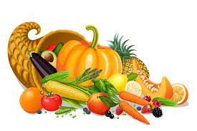
plenty

Slide 141
plentiful

Slide 142
Let’s Teach and Practise

Slide 143
Suffix
-tion

Slide 144
-tion

Slide 145

nation

Slide 146
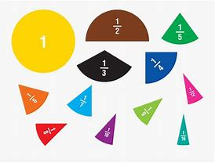
fraction

Slide 147
nation
NOUN
Definition – a large body of people united by common descent, history, culture, or language, inhabiting a particular country or territory

Slide 148
fraction
NOUN
Definition – a numerical quantity that is not a whole number / a small or tiny part, amount, or proportion of something

Slide 149
We are part of the United Nation.
______

Slide 150
I shared my cake with my friends and ended up with a fraction of it.
________

Slide 151
New CHALLENGE words.

Slide 152
clothes
NOUN
Definition - items worn to cover the body

Slide 153
They stripped off their clothes to go swimming.
_______

Slide 154
people
NOUN
Definition - human beings in general or considered collectively

Slide 155
The people listened as the choir sang.
______

Slide 156
Wednesday
NOUN
Definition - the day of the week before Thursday and following Wednesday

Slide 157
On Wednesday we have PE.
_________

Slide 158
Let’s Practise and Apply.

Slide 159
Can you spot the spelling rule words and the challenge words?

Slide 160
Thunder and Lightning
Heavy rain is an action that is often accompanied by thunderstorms. Thunderstorms happen every day in the tropics, the area around the middle of the Earth. People who live in these areas have to wear particular clothes to protect them from this weather. Thunderstorms are created by a motion of thunderclouds which start small but grow taller and taller and wider and wider. A section of a thunderstorm is a thundercloud. A fully-grown thundercloud, called a cumulonimbus cloud, is about 10km high.

Slide 161
Thunder and Lightning
Heavy rain is an action that is often accompanied by thunderstorms. Thunderstorms happen every day in the tropics, the area around the middle of the Earth. People who live in these areas have to wear particular clothes to protect them from this weather. Thunderstorms are created by a motion of thunderclouds which start small but grow taller and taller and wider and wider. A section of a thunderstorm is a thundercloud. A fully-grown thundercloud, called a cumulonimbus cloud, is about 10km high.

Slide 162
Write this sentence as I dictate it to you.
Notes:
A section of a thunderstorm is a thundercloud.

Slide 163
A section of a thunderstorm is a thundercloud.
Did you write it correctly?
Edit your work and make sure you have it correct.
Can you underline the spelling word that we have covered in this session?

Slide 164
Year 2 - Summer 1
Week 3 - Friday
Notes:
Click through the slides for all the R+R words for the week (both the focus and the challenge words)
Click through the slides for all the new learning this week

Slide 166
Old challenge words…

Slide 167
even

Slide 168
Christmas

Slide 169
Old spelling rule words…

Slide 170
payment

Slide 171
careful

Slide 172
graceful

Slide 173
enjoyment

Slide 174
merriment

Slide 175
happiness

Slide 176
sadness

Slide 177
playful

Slide 178
plentiful

Slide 179
New spelling rule words…

Slide 180
motion

Slide 181
station

Slide 182
fiction

Slide 183
national

Slide 184
section

Slide 185
action

Slide 186
nation

Slide 187
fraction

Slide 188
New challenge words…

Slide 189
people

Slide 190
clothes

Slide 191
Wednesday

Slide 192
Quick Quiz time…
Notes:
Say these words for the quiz
clothes people Wednesday even Christmas slide station fiction action fraction

Slide 193
Did you get them correct?
Edit your work.
clothes people Wednesday even Christmas slide station fiction action fraction

Slide 194
Word class time…

Slide 195
They stripped off their clothes to go swimming.
Pronoun verb determiner noun verb
Notes:
Ask for these words to be classed

Slide 196
The people listened as the choir sang.
Determiner noun verb preposition determiner noun verb
Notes:
Ask for these words to be classed

Slide 197
On Wednesday we have PE.
Preposition noun pronoun have noun
Notes:
Ask for these words to be classed

Slide 198
Etymology
The history of a word….

Slide 199
Clothes
Old English (only recorded in the past participle geclāded ), from clāth (see cloth)
People
Middle English: from Anglo-Norman French poeple, from Latin populus ‘populace’

Slide 200
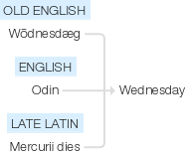
Wednesday
Old English Wōdnesdæg ‘day of Odin’, named after the Germanic god Odin or Woden, the supreme god; translation of late Latin Mercurii dies, Odin being equated with the Roman god Mercury. Compare with Dutch woensdag .

Slide 201
Let’s investigate….
Look at the word origin of the challenge words and find words that are linked to them.

