Slide 1
Spelling Y2
Mastering spellings: building on the foundations of phonics
Summer 1
Week 4

Slide 2
Year 2 - Summer 1
Week 4 - Monday

Slide 3
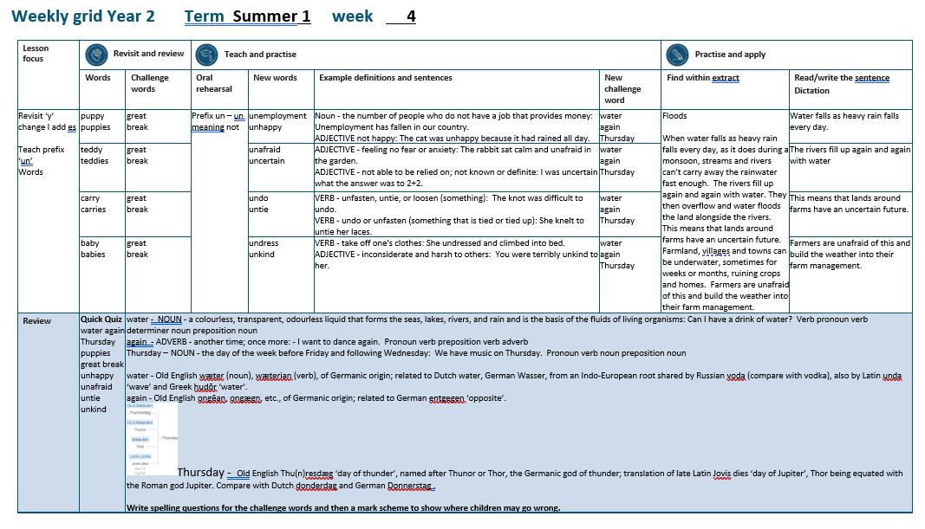

Slide 4
Let’s Revisit and Review…

Slide 5
Do you remember this challenge word?

Slide 6

great
ADJECTIVE
Definition - of an extent, amount, or intensity considerably above average

Slide 7
Elizabeth was a great queen.
_____

Slide 8

break
VERB
Definition – separate or cause to separate into pieces as a result of a blow, shock, or strain

Slide 9
Luckily, the vase didn’t break.
_____

Slide 10
suffixes ly and less just add suffix to root

Slide 11
Exceptions -
Words of more than 1 syllable and which end with a consonant followed by a ‘y’ such as merry need to have the y changed to an ‘i’

Slide 12
suffixes

Slide 13
-ly

Slide 14
-less

Slide 15
-less opposite

Slide 16

bad

Slide 17
badly

Slide 18

love

Slide 19
lovely

Slide 20
Let’s Teach and Practise

Slide 21
Prefix un- meaning NOT

Slide 22
un-

Slide 23

unemployment

Slide 24
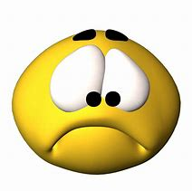
unhappy

Slide 25
unemployment
NOUN
Definition – not employed

Slide 26
unhappy
ADJECTIVE
Definition – not happy

Slide 27
Unemployment has fallen in our country.
____________

Slide 28
The cat was unhappy because it had rained all day.
_______

Slide 29
New CHALLENGE words.

Slide 30

water
NOUN
Definition - a colourless liquid that forms the seas, lakes, rivers, and rain and is the basis of the fluids of living organisms

Slide 31
May I have a drink of water?
_____

Slide 32

again
ADVERB
Definition - another time; once more

Slide 33
I want to dance again.
_____

Slide 34

Thursday
NOUN
Definition - the day of the week before Friday and following Thursday

Slide 35
We have music on Thursday.
________

Slide 36
Let’s Practise and Apply.

Slide 37
Can you spot the spelling rule words and the challenge words?

Slide 38
Floods
When water falls as heavy rain falls every day, as it does during a monsoon, streams and rivers can’t carry away the rainwater fast enough. The rivers fill up again and again with water. They then overflow and water floods the land alongside the rivers. This means that lands around farms have an uncertain future. Farmland, villages and towns can be underwater, sometimes for weeks or months, ruining crops and homes. Farmers are unafraid of this and build the weather into their farm management.

Slide 39
Floods
When water falls as heavy rain falls every day, as it does during a monsoon, streams and rivers can’t carry away the rainwater fast enough. The rivers fill up again and again with water. They then overflow and water floods the land alongside the rivers. This means that lands around farms have an uncertain future. Farmland, villages and towns can be underwater, sometimes for weeks or months, ruining crops and homes. Farmers are unafraid of this and build the weather into their farm management.

Slide 40
Write this sentence as I dictate it to you.
Notes:
Water falls as heavy rain almost every day.

Slide 41
Water falls as heavy rain almost every day.
Did you write it correctly?
Edit your work and make sure you have it correct.
Can you underline the spelling word that we have covered in this session?

Slide 42
Year 2 - Summer 1
Week 4 - Tuesday
Notes:
Revisit and review the words from previous teaching and challenge words – I say, we say, you say
Ask children to write words only in their spelling book
Introduce the new spelling rule
Children to write the new spelling rule words and challenge words into books when the sentences are shown with the spelling word missing.
Read the extract with the class as choral reading. Practise model of prosody etc.
Ask children to find the spelling words from the session in the text.
Then read allowed the chosen sentence for children to write fully in their books.
Show the extract and ask children to then edit their work to check they were correct in their dictation.

Slide 44
Let’s Revisit and Review…

Slide 45
Do you remember this challenge word?

Slide 46
great
ADJECTIVE
Definition - of an extent, amount, or intensity considerably above average

Slide 47
Elizabeth was a great queen.
_____

Slide 48
break
VERB
Definition – separate or cause to separate into pieces as a result of a blow, shock, or strain

Slide 49
Luckily, the vase didn’t break.
_____

Slide 50
suffixes ly and less just add suffix to root

Slide 51
Exceptions -
Words of more than 1 syllable and which end with a consonant followed by a ‘y’ such as merry need to have the y changed to an ‘i’

Slide 52
suffixes

Slide 53
-ly

Slide 54
-less

Slide 55
-less opposite

Slide 56

happy

Slide 57
happily

Slide 58

funny

Slide 59
funnily

Slide 60
Let’s Teach and Practise

Slide 61
Prefix un- meaning NOT

Slide 62
un-

Slide 63
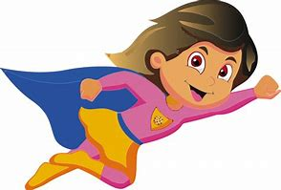
unafraid

Slide 64
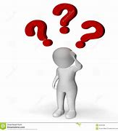
uncertain

Slide 65
unafraid
ADJECTIVE
Definition – not afraid

Slide 66
uncertain
ADJECTIVE
Definition – not certain

Slide 67
The rabbit sat calm and unafraid in the garden.
________

Slide 68
I was uncertain what the answer was to 2+2.
_________

Slide 69
New CHALLENGE words.

Slide 70
water
NOUN
Definition - a colourless liquid that forms the seas, lakes, rivers, and rain and is the basis of the fluids of living organisms

Slide 71
May I have a drink of water?
_____

Slide 72
again
ADVERB
Definition - another time; once more

Slide 73
I want to dance again.
_____

Slide 74
Thursday
NOUN
Definition - the day of the week before Friday and following Thursday

Slide 75
We have music on Thursday.
________

Slide 76
Let’s Practise and Apply.

Slide 77
Can you spot the spelling rule words and the challenge words?

Slide 78
Floods
When water falls as heavy rain falls every day, as it does during a monsoon, streams and rivers can’t carry away the rainwater fast enough. The rivers fill up again and again with water. They then overflow and water floods the land alongside the rivers. This means that lands around farms have an uncertain future. Farmland, villages and towns can be underwater, sometimes for weeks or months, ruining crops and homes. Farmers are unafraid of this and build the weather into their farm management.

Slide 79
Floods
When water falls as heavy rain falls every day, as it does during a monsoon, streams and rivers can’t carry away the rainwater fast enough. The rivers fill up again and again with water. They then overflow and water floods the land alongside the rivers. This means that lands around farms have an uncertain future. Farmland, villages and towns can be underwater, sometimes for weeks or months, ruining crops and homes. Farmers are unafraid of this and build the weather into their farm management.

Slide 80
Write this sentence as I dictate it to you.
Notes:
The rivers fill up again and again with water.

Slide 81
The rivers fill up again and again with water.
Did you write it correctly?
Edit your work and make sure you have it correct.
Can you underline the spelling word that we have covered in this session?

Slide 82
Year 2 - Summer 1
Week 4 - Wednesday
Notes:
Revisit and review the words from previous teaching and challenge words – I say, we say, you say
Ask children to write words only in their spelling book
Introduce the new spelling rule
Children to write the new spelling rule words and challenge words into books when the sentences are shown with the spelling word missing.
Read the extract with the class as choral reading. Practise model of prosody etc.
Ask children to find the spelling words from the session in the text.
Then read allowed the chosen sentence for children to write fully in their books.
Show the extract and ask children to then edit their work to check they were correct in their dictation.

Slide 84
Let’s Revisit and Review…

Slide 85
Do you remember this challenge word?

Slide 86
great
ADJECTIVE
Definition - of an extent, amount, or intensity considerably above average

Slide 87
Elizabeth was a great queen.
_____

Slide 88
break
VERB
Definition – separate or cause to separate into pieces as a result of a blow, shock, or strain

Slide 89
Luckily, the vase didn’t break.
_____

Slide 90
suffixes ly and less just add suffix to root

Slide 91
Exceptions -
Words of more than 1 syllable and which end with a consonant followed by a ‘y’ such as merry need to have the y changed to an ‘i’

Slide 92
suffixes

Slide 93
-ly

Slide 94
-less

Slide 95
-less opposite

Slide 96
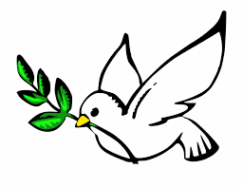
hope

Slide 97
hopeless
x

Slide 98
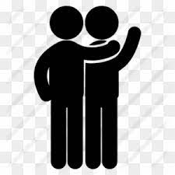
care

Slide 99
careless
x

Slide 100
Let’s Teach and Practise

Slide 101
Prefix un- meaning NOT

Slide 102
un-

Slide 103

undo

Slide 104
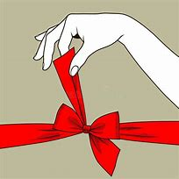
untie

Slide 105
undo
VERB
Definition – not don

Slide 106
untie
VERB
Definition – not tied

Slide 107
The knot was difficult to undo.
____

Slide 108
She knelt to untie her laces.
_____

Slide 109
New CHALLENGE words.

Slide 110
water
NOUN
Definition - a colourless liquid that forms the seas, lakes, rivers, and rain and is the basis of the fluids of living organisms

Slide 111
May I have a drink of water?
_____

Slide 112
again
ADVERB
Definition - another time; once more

Slide 113
I want to dance again.
_____

Slide 114
Thursday
NOUN
Definition - the day of the week before Friday and following Thursday

Slide 115
We have music on Thursday.
________

Slide 116
Let’s Practise and Apply.

Slide 117
Can you spot the spelling rule words and the challenge words?

Slide 118
Floods
When water falls as heavy rain falls every day, as it does during a monsoon, streams and rivers can’t carry away the rainwater fast enough. The rivers fill up again and again with water. They then overflow and water floods the land alongside the rivers. This means that lands around farms have an uncertain future. Farmland, villages and towns can be underwater, sometimes for weeks or months, ruining crops and homes. Farmers are unafraid of this and build the weather into their farm management.

Slide 119
Floods
When water falls as heavy rain falls every day, as it does during a monsoon, streams and rivers can’t carry away the rainwater fast enough. The rivers fill up again and again with water. They then overflow and water floods the land alongside the rivers. This means that lands around farms have an uncertain future. Farmland, villages and towns can be underwater, sometimes for weeks or months, ruining crops and homes. Farmers are unafraid of this and build the weather into their farm management.

Slide 120
Write this sentence as I dictate it to you.
Notes:
This means that lands around farms have an uncertain future.

Slide 121
This means that lands around farms have an uncertain future.
Did you write it correctly?
Edit your work and make sure you have it correct.
Can you underline the spelling word that we have covered in this session?

Slide 122
Year 2 - Summer 1
Week 4 - Thursday
Notes:
Revisit and review the words from previous teaching and challenge words – I say, we say, you say
Ask children to write words only in their spelling book
Introduce the new spelling rule
Children to write the new spelling rule words and challenge words into books when the sentences are shown with the spelling word missing.
Read the extract with the class as choral reading. Practise model of prosody etc.
Ask children to find the spelling words from the session in the text.
Then read allowed the chosen sentence for children to write fully in their books.
Show the extract and ask children to then edit their work to check they were correct in their dictation.

Slide 124
Let’s Revisit and Review…

Slide 125
Do you remember this challenge word?

Slide 126
great
ADJECTIVE
Definition - of an extent, amount, or intensity considerably above average

Slide 127
Elizabeth was a great queen.
_____

Slide 128
break
VERB
Definition – separate or cause to separate into pieces as a result of a blow, shock, or strain

Slide 129
Luckily, the vase didn’t break.
_____

Slide 130
suffixes ly and less just add suffix to root

Slide 131
Exceptions -
Words of more than 1 syllable and which end with a consonant followed by a ‘y’ such as merry need to have the y changed to an ‘i’

Slide 132
suffixes

Slide 133
-ly

Slide 134
-less

Slide 135
-less opposite

Slide 136

penny

Slide 137
penniless
x

Slide 138
Let’s Teach and Practise

Slide 139
Prefix un- meaning NOT

Slide 140
un-

Slide 141
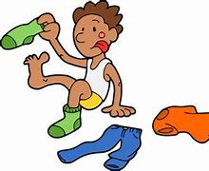
undress

Slide 142
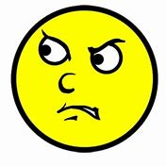
unkind

Slide 143
undress
VERB
Definition – take off one's clothes

Slide 144
unkind
ADJECTIVE
Definition – not kind

Slide 145
She undressed and climbed into bed.
_________

Slide 146
You were terribly unkind to her.
______

Slide 147
New CHALLENGE words.

Slide 148
water
NOUN
Definition - a colourless liquid that forms the seas, lakes, rivers, and rain and is the basis of the fluids of living organisms

Slide 149
May I have a drink of water?
_____

Slide 150
again
ADVERB
Definition - another time; once more

Slide 151
I want to dance again.
_____

Slide 152
Thursday
NOUN
Definition - the day of the week before Friday and following Thursday

Slide 153
We have music on Thursday.
________

Slide 154
Let’s Practise and Apply.

Slide 155
Can you spot the spelling rule words and the challenge words?

Slide 156
Floods
When water falls as heavy rain falls every day, as it does during a monsoon, streams and rivers can’t carry away the rainwater fast enough. The rivers fill up again and again with water. They then overflow and water floods the land alongside the rivers. This means that lands around farms have an uncertain future. Farmland, villages and towns can be underwater, sometimes for weeks or months, ruining crops and homes. Farmers are unafraid of this and build the weather into their farm management.

Slide 157
Floods
When water falls as heavy rain falls every day, as it does during a monsoon, streams and rivers can’t carry away the rainwater fast enough. The rivers fill up again and again with water. They then overflow and water floods the land alongside the rivers. This means that lands around farms have an uncertain future. Farmland, villages and towns can be underwater, sometimes for weeks or months, ruining crops and homes. Farmers are unafraid of this and build the weather into their farm management.

Slide 158
Write this sentence as I dictate it to you.
Notes:
Farmers are unafraid of this.

Slide 159
Farmers are unafraid of this.
Did you write it correctly?
Edit your work and make sure you have it correct.
Can you underline the spelling word that we have covered in this session?

Slide 160
Year 2 - Summer 1
Week 4 - Friday
Notes:
Click through the slides for all the R+R words for the week (both the focus and the challenge words)
Click through the slides for all the new learning this week

Slide 162
Old challenge words…

Slide 163
great

Slide 164
break

Slide 165
Old spelling rule words…

Slide 166
bad

Slide 167
badly

Slide 168
love

Slide 169
lovely

Slide 170
happy

Slide 171
happily

Slide 172
funny

Slide 173
funnily

Slide 174
hope

Slide 175
hopeless

Slide 176
care

Slide 177
careless

Slide 178
penny

Slide 179
penniless

Slide 180
New spelling rule words…

Slide 181
unemployment

Slide 182
unhappy

Slide 183
unafraid

Slide 184
uncertain

Slide 185
undo

Slide 186
untie

Slide 187
undress

Slide 188
unkind

Slide 189
New challenge words…

Slide 190
water

Slide 191
again

Slide 192
Thursday

Slide 193
Quick Quiz time…
Notes:
Say these words for the quiz
water again Thursday puppies great break unhappy unafraid untie unkind

Slide 194
Did you get them correct?
Edit your work.
water again Thursday puppies great break unhappy unafraid untie unkind

Slide 195
Word class time…

Slide 196
May I have a drink of water?
Verb pronoun verb determiner noun preposition noun
Notes:
Ask for these words to be classed

Slide 197
I want to dance again.
Pronoun verb preposition verb adverb
Notes:
Ask for these words to be classed

Slide 198
We have music on Thursday.
Pronoun verb noun preposition noun
Notes:
Ask for these words to be classed

Slide 199
Etymology
The history of a word….

Slide 200
Water
Old English wæter (noun), wæterian (verb), of Germanic origin; related to Dutch water, German Wasser, from an Indo-European root shared by Russian voda (compare with vodka), also by Latin unda ‘wave’ and Greek hudōr ‘water’
Again
Old English ongēan, ongægn, etc., of Germanic origin; related to German entgegen ‘opposite’

Slide 201
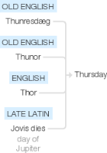
Thursday
Old English Thu(n)resdæg ‘day of thunder’, named after Thunor or Thor, the Germanic god of thunder; translation of late Latin Jovis dies ‘day of Jupiter’, Thor being equated with the Roman god Jupiter. Compare with Dutch donderdag and German Donnerstag .

Slide 202
Let’s investigate….
Write spelling questions for the challenge words and then a mark scheme to show where children may go wrong.

