Slide 1
Spelling Y2
Mastering spellings: building on the foundations of phonics
Summer 1
Week 5

Slide 2
Year 2 - Summer 1
Week 5 - Monday

Slide 3
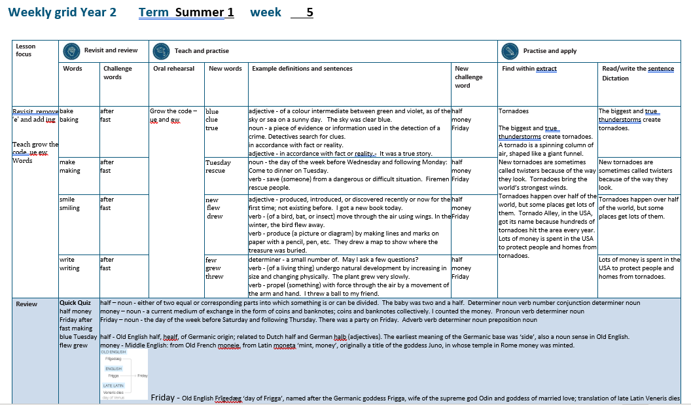

Slide 4
Let’s Revisit and Review…

Slide 5
Do you remember this challenge word?

Slide 6
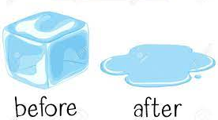
after
PREPOSITION
Definition - in the time following (an event or another period of time)

Slide 7
After a while they returned.
_____

Slide 8
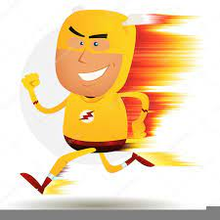
fast
ADJECTIVE
Definition - moving or capable of moving at high speed

Slide 9
I have a fast car
____

Slide 10
homophones and near homophones

Slide 11
homophones homo = same phone = sound

Slide 12
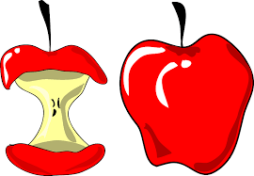
whole

Slide 13
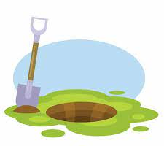
hole

Slide 14
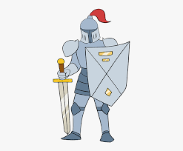
knight

Slide 15
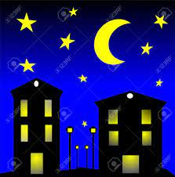
night

Slide 16
Let’s Teach and Practise

Slide 17
Grow the Code
‘ue’ and ‘ew’

Slide 18
ue ew

Slide 19
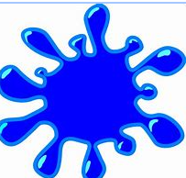
blue

Slide 20
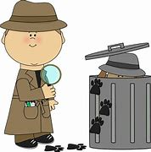
clue

Slide 21

true

Slide 22
blue
ADJECTIVE
Definition – of a colour intermediate between green and violet, as of the sky or sea on a sunny day

Slide 23
clue
NOUN
Definition – a piece of evidence or information used in the detection of a crime

Slide 24
true
ADJECTIVE
Definition – in accordance with fact or reality

Slide 25
The sky was clear blue.
____

Slide 26
Detectives search for clues.
_____

Slide 27
It was a true story.
____

Slide 28
New CHALLENGE words.

Slide 29
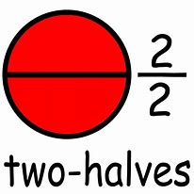
half
NOUN
Definition - either of two equal or corresponding parts into which something is or can be divided.

Slide 30
The baby was two and a half.
____

Slide 31

money
NOUN
Definition - a current medium of exchange in the form of coins and banknotes

Slide 32
I counted the money.
_____

Slide 33
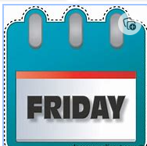
Friday
NOUN
Definition - the day of the week before Saturday and following Thursday

Slide 34
There was a party on Friday.
______

Slide 35
Let’s Practise and Apply.

Slide 36
Can you spot the spelling rule words and the challenge words?

Slide 37
Tornadoes
The biggest and true thunderstorms create tornadoes. A tornado is a spinning column of air, shaped like a giant funnel. New tornadoes are sometimes called twisters because of the way they look. Tornadoes bring the world’s strongest winds. Tornadoes happen over half of the world, but some places get lots of them. Tornado Alley, in the USA, got its name because hundreds of tornadoes hit the area every year. Lots of money is spent in the USA to protect people and homes from tornadoes.

Slide 38
Tornadoes
The biggest and true thunderstorms create tornadoes. A tornado is a spinning column of air, shaped like a giant funnel. New tornadoes are sometimes called twisters because of the way they look. Tornadoes bring the world’s strongest winds. Tornadoes happen over half of the world, but some places get lots of them. Tornado Alley, in the USA, got its name because hundreds of tornadoes hit the area every year. Lots of money is spent in the USA to protect people and homes from tornadoes.

Slide 39
Write this sentence as I dictate it to you.
Notes:
The biggest and true thunderstorms create tornadoes.

Slide 40
The biggest and true thunderstorms create tornadoes.
Did you write it correctly?
Edit your work and make sure you have it correct.
Can you underline the spelling word that we have covered in this session?

Slide 41
Year 2 - Summer 1
Week 5 - Tuesday
Notes:
Revisit and review the words from previous teaching and challenge words – I say, we say, you say
Ask children to write words only in their spelling book
Introduce the new spelling rule
Children to write the new spelling rule words and challenge words into books when the sentences are shown with the spelling word missing.
Read the extract with the class as choral reading. Practise model of prosody etc.
Ask children to find the spelling words from the session in the text.
Then read allowed the chosen sentence for children to write fully in their books.
Show the extract and ask children to then edit their work to check they were correct in their dictation.

Slide 43
Let’s Revisit and Review…

Slide 44
Do you remember this challenge word?

Slide 45
after
PREPOSITION
Definition - in the time following (an event or another period of time)

Slide 46
After a while they returned.
_____

Slide 47
fast
ADJECTIVE
Definition - moving or capable of moving at high speed

Slide 48
I have a fast car
____

Slide 49
homophones and near homophones

Slide 50
homophones homo = same phone = sound

Slide 51

thought

Slide 52
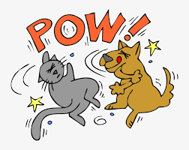
fought

Slide 53
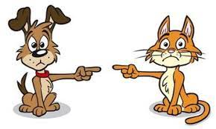
fault

Slide 54
Let’s Teach and Practise

Slide 55
Grow the Code
‘ue’ and ‘ew’

Slide 56
ue ew

Slide 57

Tuesday

Slide 58
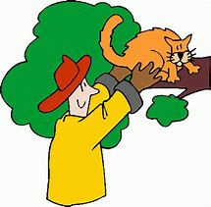
rescue

Slide 59
Tuesday
NOUN
Definition – the day of the week before Wednesday and following Monday

Slide 60
rescue
VERB
Definition – save (someone) from a dangerous or difficult situation

Slide 61
Come to dinner on Tuesday.
_______

Slide 62
Firemen rescue people.
______

Slide 63
New CHALLENGE words.

Slide 64
half
NOUN
Definition - either of two equal or corresponding parts into which something is or can be divided.

Slide 65
The baby was two and a half.
____

Slide 66
money
NOUN
Definition - a current medium of exchange in the form of coins and banknotes

Slide 67
I counted the money.
_____

Slide 68
Friday
NOUN
Definition - the day of the week before Saturday and following Thursday

Slide 69
There was a party on Friday.
______

Slide 70
Let’s Practise and Apply.

Slide 71
Can you spot the spelling rule words and the challenge words?

Slide 72
Tornadoes
The biggest and true thunderstorms create tornadoes. A tornado is a spinning column of air, shaped like a giant funnel. New tornadoes are sometimes called twisters because of the way they look. Tornadoes bring the world’s strongest winds. Tornadoes happen over half of the world, but some places get lots of them. Tornado Alley, in the USA, got its name because hundreds of tornadoes hit the area every year. Lots of money is spent in the USA to protect people and homes from tornadoes.

Slide 73
Tornadoes
The biggest and true thunderstorms create tornadoes. A tornado is a spinning column of air, shaped like a giant funnel. New tornadoes are sometimes called twisters because of the way they look. Tornadoes bring the world’s strongest winds. Tornadoes happen over half of the world, but some places get lots of them. Tornado Alley, in the USA, got its name because hundreds of tornadoes hit the area every year. Lots of money is spent in the USA to protect people and homes from tornadoes.

Slide 74
Write this sentence as I dictate it to you.
Notes:
New tornadoes are sometimes called twisters.

Slide 75
New tornadoes are sometimes called twisters.
Did you write it correctly?
Edit your work and make sure you have it correct.
Can you underline the spelling word that we have covered in this session?

Slide 76
Year 2 - Summer 1
Week 5 - Wednesday
Notes:
Revisit and review the words from previous teaching and challenge words – I say, we say, you say
Ask children to write words only in their spelling book
Introduce the new spelling rule
Children to write the new spelling rule words and challenge words into books when the sentences are shown with the spelling word missing.
Read the extract with the class as choral reading. Practise model of prosody etc.
Ask children to find the spelling words from the session in the text.
Then read allowed the chosen sentence for children to write fully in their books.
Show the extract and ask children to then edit their work to check they were correct in their dictation.

Slide 78
Let’s Revisit and Review…

Slide 79
Do you remember this challenge word?

Slide 80
after
PREPOSITION
Definition - in the time following (an event or another period of time)

Slide 81
After a while they returned.
_____

Slide 82
fast
ADJECTIVE
Definition - moving or capable of moving at high speed

Slide 83
I have a fast car
____

Slide 84
homophones and near homophones

Slide 85
homophones homo = same phone = sound

Slide 86

break

Slide 87

brake

Slide 88
Let’s Teach and Practise

Slide 89
Grow the Code
‘ue’ and ‘ew’

Slide 90
ue ew

Slide 91
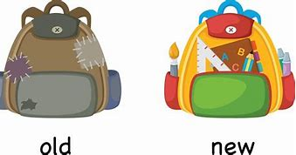
new

Slide 92

flew

Slide 93
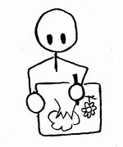
drew

Slide 94
new
ADJECTIVE
Definition – produced, introduced, or discovered recently or now for the first time; not existing before

Slide 95
flew
VERB
Definition – (of a bird, bat, or insect) move through the air using wings

Slide 96
drew
VERB
Definition – produce (a picture or diagram) by making lines and marks on paper with a pencil, pen, etc.

Slide 97
I got a new book today.
___

Slide 98
In the winter, the bird flew away.
____

Slide 99
They drew a map to show where the treasure was buried.
____

Slide 100
New CHALLENGE words.

Slide 101
half
NOUN
Definition - either of two equal or corresponding parts into which something is or can be divided.

Slide 102
The baby was two and a half.
____

Slide 103
money
NOUN
Definition - a current medium of exchange in the form of coins and banknotes

Slide 104
I counted the money.
_____

Slide 105
Friday
NOUN
Definition - the day of the week before Saturday and following Thursday

Slide 106
There was a party on Friday.
______

Slide 107
Let’s Practise and Apply.

Slide 108
Can you spot the spelling rule words and the challenge words?

Slide 109
Tornadoes
The biggest and true thunderstorms create tornadoes. A tornado is a spinning column of air, shaped like a giant funnel. New tornadoes are sometimes called twisters because of the way they look. Tornadoes bring the world’s strongest winds. Tornadoes happen over half of the world, but some places get lots of them. Tornado Alley, in the USA, got its name because hundreds of tornadoes hit the area every year. Lots of money is spent in the USA to protect people and homes from tornadoes.

Slide 110
Tornadoes
The biggest and true thunderstorms create tornadoes. A tornado is a spinning column of air, shaped like a giant funnel. New tornadoes are sometimes called twisters because of the way they look. Tornadoes bring the world’s strongest winds. Tornadoes happen over half of the world, but some places get lots of them. Tornado Alley, in the USA, got its name because hundreds of tornadoes hit the area every year. Lots of money is spent in the USA to protect people and homes from tornadoes.

Slide 111
Write this sentence as I dictate it to you.
Notes:
Tornadoes happen over half of the world,

Slide 112
Tornadoes happen over half of the world.
Did you write it correctly?
Edit your work and make sure you have it correct.
Can you underline the spelling word that we have covered in this session?

Slide 113
Year 2 - Summer 1
Week 5 - Thursday
Notes:
Revisit and review the words from previous teaching and challenge words – I say, we say, you say
Ask children to write words only in their spelling book
Introduce the new spelling rule
Children to write the new spelling rule words and challenge words into books when the sentences are shown with the spelling word missing.
Read the extract with the class as choral reading. Practise model of prosody etc.
Ask children to find the spelling words from the session in the text.
Then read allowed the chosen sentence for children to write fully in their books.
Show the extract and ask children to then edit their work to check they were correct in their dictation.

Slide 115
Let’s Revisit and Review…

Slide 116
Do you remember this challenge word?

Slide 117
after
PREPOSITION
Definition - in the time following (an event or another period of time)

Slide 118
After a while they returned.
_____

Slide 119
fast
ADJECTIVE
Definition - moving or capable of moving at high speed

Slide 120
I have a fast car
____

Slide 121
homophones and near homophones

Slide 122
homophones homo = same phone = sound

Slide 123

cell

Slide 124
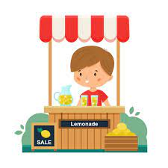
sell

Slide 125
Let’s Teach and Practise

Slide 126
Grow the Code
‘ue’ and ‘ew’

Slide 127
ue ew

Slide 128
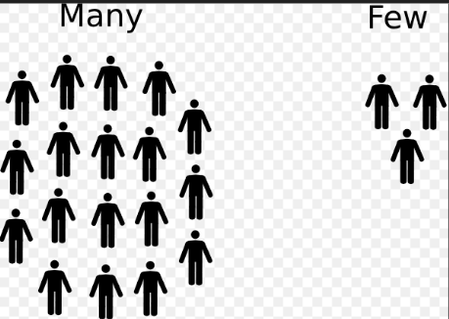
few

Slide 129
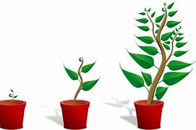
grew

Slide 130
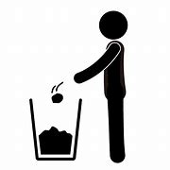
threw

Slide 131
few
DETERMINER
Definition – a small number of

Slide 132
grew
VERB
Definition – (of a living thing) undergo natural development by increasing in size and changing physically

Slide 133
threw
VERB
Definition – propel (something) with force through the air by a movement of the arm and hand

Slide 134
May I ask a few questions?
___

Slide 135
The plant grew very slowly.
____

Slide 136
I threw a ball to my friend.
_____

Slide 137
New CHALLENGE words.

Slide 138
half
NOUN
Definition - either of two equal or corresponding parts into which something is or can be divided.

Slide 139
The baby was two and a half.
____

Slide 140
money
NOUN
Definition - a current medium of exchange in the form of coins and banknotes

Slide 141
I counted the money.
_____

Slide 142
Friday
NOUN
Definition - the day of the week before Saturday and following Thursday

Slide 143
There was a party on Friday.
______

Slide 144
Let’s Practise and Apply.

Slide 145
Can you spot the spelling rule words and the challenge words?

Slide 146
Tornadoes
The biggest and true thunderstorms create tornadoes. A tornado is a spinning column of air, shaped like a giant funnel. New tornadoes are sometimes called twisters because of the way they look. Tornadoes bring the world’s strongest winds. Tornadoes happen over half of the world, but some places get lots of them. Tornado Alley, in the USA, got its name because hundreds of tornadoes hit the area every year. Lots of money is spent in the USA to protect people and homes from tornadoes.

Slide 147
Tornadoes
The biggest and true thunderstorms create tornadoes. A tornado is a spinning column of air, shaped like a giant funnel. New tornadoes are sometimes called twisters because of the way they look. Tornadoes bring the world’s strongest winds. Tornadoes happen over half of the world, but some places get lots of them. Tornado Alley, in the USA, got its name because hundreds of tornadoes hit the area every year. Lots of money is spent in the USA to protect people and homes from tornadoes.

Slide 148
Write this sentence as I dictate it to you.
Notes:
Lots of money is spent in the USA.

Slide 149
Lots of money is spent in the USA.
Did you write it correctly?
Edit your work and make sure you have it correct.
Can you underline the spelling word that we have covered in this session?

Slide 150
Year 2 - Summer 1
Week 5 - Friday
Notes:
Click through the slides for all the R+R words for the week (both the focus and the challenge words)
Click through the slides for all the new learning this week

Slide 152
Old challenge words…

Slide 153
after

Slide 154
fast

Slide 155
Old spelling rule words…

Slide 156
whole

Slide 157
hole

Slide 158
knight

Slide 159
night

Slide 160
thought

Slide 161
fought

Slide 162
fault

Slide 163
break

Slide 164
brake

Slide 165
cell

Slide 166
sell

Slide 167
New spelling rule words…

Slide 168
blue

Slide 169
clue

Slide 170
true

Slide 171
Tuesday

Slide 172
rescue

Slide 173
new

Slide 174
flew

Slide 175
drew

Slide 176
few

Slide 177
grew

Slide 178
threw

Slide 179
New challenge words…

Slide 180
half

Slide 181
money

Slide 182
Friday

Slide 183
Quick Quiz time…
Notes:
Say these words for the quiz
half money Friday after fast making blue Tuesday flew grew

Slide 184
Did you get them correct?
Edit your work.
half money Friday after fast making blue Tuesday flew grew

Slide 185
Word class time…

Slide 186
The baby was two and a half.
Determiner noun verb number conjunction determiner noun
Notes:
Ask for these words to be classed

Slide 187
I counted the money.
Pronoun verb determiner noun
Notes:
Ask for these words to be classed

Slide 188
There was a party on Friday
Adverb verb determiner noun preposition noun
Notes:
Ask for these words to be classed

Slide 189
Etymology
The history of a word….

Slide 190
Half
Old English half, healf, of Germanic origin; related to Dutch half and German halb (adjectives). The earliest meaning of the Germanic base was ‘side’, also a noun sense in Old English
Money
Middle English: from Old French moneie, from Latin moneta ‘mint, money’, originally a title of the goddess Juno, in whose temple in Rome money was minted

Slide 191
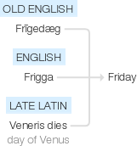
Friday
Old English Frīgedæg ‘day of Frigga’, named after the Germanic goddess Frigga, wife of the supreme god Odin and goddess of married love; translation of late Latin Veneris dies ‘day of Venus’, Frigga being equated with the Roman goddess of love, Venus. Compare with Dutch vrijdag and German Freitag .

Slide 192
Let’s investigate….
Find synonyms and antonyms of the challenge words.

