Slide 1
Spelling Y2
Mastering spellings: building on the foundations of phonics
Summer 1
Week 6

Slide 2
Year 2 - Summer 1
Week 6 - Monday

Slide 3
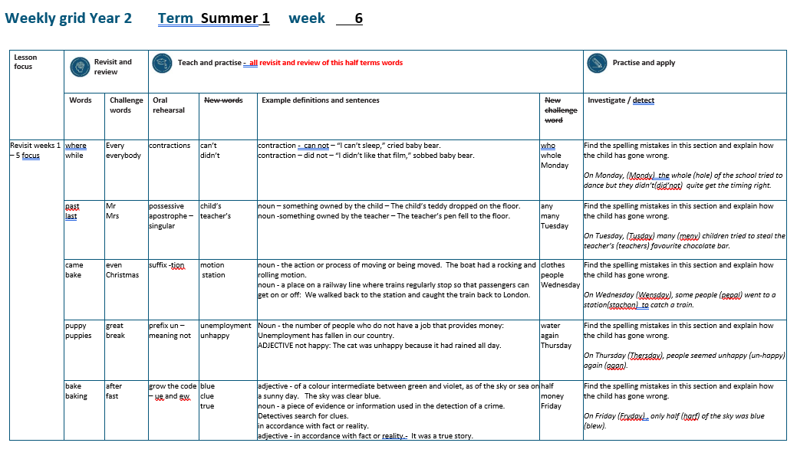

Slide 4
Let’s Revisit and Review…

Slide 5
Do you remember this challenge word?

Slide 6
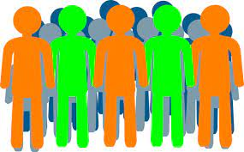
every
DETERMINER
Definition - used before a singular noun to refer to all the individual members of a set without exception

Slide 7
The children sang every note perfectly.
_____

Slide 8
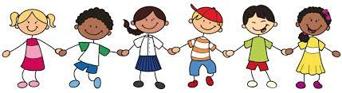
everybody
PRONOUN
Definition – every person

Slide 9
Everybody agrees with our teacher.
_________

Slide 10
homophones or near homophones homo = same phone = sound

Slide 11
homophones

Slide 12
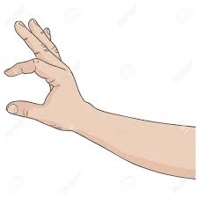
quite

Slide 13

quiet

Slide 14

see

Slide 15

sea

Slide 16
Let’s Teach and Practise

Slide 17
contractions

Slide 18
contractions
___’____ apostrophe is used to replace letter or letters
NOT WHERE THE TWO WORDS JOIN

Slide 19
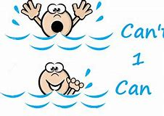
can’t

Slide 20
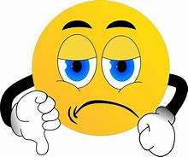
didn’t

Slide 21
can’t
can not = cannot = can’t
CONTRACTION
Definition – can not

Slide 22
didn’t
did not = didnot = didn’t
CONTRACTION
Definition – did not

Slide 23
“I can’t sleep,” cried baby bear.
_____

Slide 24
“I didn’t like that film,” sobbed baby bear
_____

Slide 25
New CHALLENGE words.

Slide 26
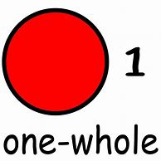
whole
ADJECTIVE
Definition - all of; entire

Slide 27
He walked the whole journey.
_____

Slide 28

who
PRONOUN
Definition - what or which person or people

Slide 29
Who is that woman?
___

Slide 30
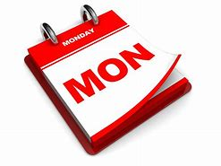
Monday
PRONOUN
Definition - the day of the week before Tuesday and following Sunday

Slide 31
I saw him on Monday.
______

Slide 32
Let’s investigate.

Slide 33
Can you spot the spelling errors in these sentences?
Write the correct spelling and explain where they went wrong.

Slide 34
On Mondy the hole of the school tried to dance but they did’nt quite get the timing right.

Slide 35
On Mondy the hole of the school tried to dance but they did’nt quite get the timing right.

Slide 36
On Mondy the hole of the school tried to dance but they did’nt quite get the timing right.
Monday – ‘ay’ at the end

Slide 37
On Mondy the hole of the school tried to dance but they did’nt quite get the timing right. whole – incorrect homophone

Slide 38
On Mondy the hole of the school tried to dance but they did’nt quite get the timing right. didn’t – apostrophe shows where the letters are missing not where the words join

Slide 39
On Monday, the whole of the school tried to dance but they didn’t quite get the timing right.

Slide 40
Year 2 - Summer 1
Week 6 - Tuesday

Slide 42
Let’s Revisit and Review…

Slide 43
Do you remember this challenge word?

Slide 44

Mr.
NOUN
Definition - a title used before a surname or full name to address or refer to a man without a higher or honorific or professional title

Slide 45
Mr. Robert Smith is our teacher.
__

Slide 46
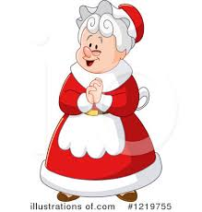
Mrs.
NOUN
Definition – the title used before a surname or full name to address or refer to a married woman without a higher or honorific or professional title

Slide 47
Mrs Sally Jones is our teacher.
___

Slide 48
suffixes ing ed er est root ending in e

Slide 49
suffixes

Slide 50

hike

Slide 51
hiking

Slide 52
hiker

Slide 53
hiked

Slide 54
Let’s Teach and Practise

Slide 55
Possessive apostrophe

Slide 56
possessive apostrophe
___’__ apostrophe shows possession possession - something belonging to someone or something

Slide 57
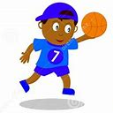
child’s

Slide 58
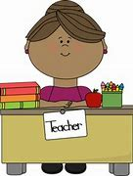
teacher’s

Slide 59
child’s
child possessing ball = child’s ball
NOUN
Definition – something owned by the child

Slide 60
teacher’s
teacher possessing desk = teacher’s desk
NOUN
Definition – something owned by the teacher

Slide 61
The child’s teddy dropped on the floor.
_______

Slide 62
The teacher’s pen fell to the floor.
_________

Slide 63
New CHALLENGE words.

Slide 64

any
DETERMINER
Definition - used to refer to one or some of a thing or number of things, no matter how much or how many

Slide 65
I don't have any chocolate left.
___

Slide 66
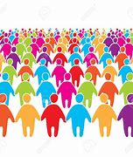
many
DETERMINER
Definition - a large number of

Slide 67
Many people sing Ed Sheeran songs.
____

Slide 68

Tuesday
PRONOUN
Definition - the day of the week before Wednesday and following Monday

Slide 69
Come to dinner on Tuesday.
_______

Slide 70
Let’s investigate.

Slide 71
Can you spot the spelling errors in these sentences?
Write the correct spelling and explain where they went wrong.

Slide 72
On Tusday meny children tried to steal the teachers favourite chocolate bar.

Slide 73
On Tusday meny children tried to steal the teachers favourite chocolate bar.

Slide 74
On Tusday meny children tried to steal the teachers favourite chocolate bar.
Tuesday – ‘ue’ not just ‘u’

Slide 75
On Tusday meny children tried to steal the teachers favourite chocolate bar. many – ‘a’ not ‘e’

Slide 76
On Tusday meny children tried to steal the teachers favourite chocolate bar. teacher’s - possessive apostrophe needed to show the teacher owns the chocolate bar

Slide 77
On Tuesday, many children tried to steal the teacher’s favourite chocolate bar.

Slide 78
Year 2 - Summer 1
Week 6 - Wednesday

Slide 80
Let’s Revisit and Review…

Slide 81
Do you remember this challenge word?

Slide 82
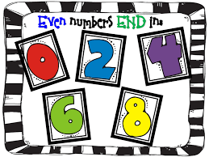
even
ADJECTIVE
Definition - divisible by two without a remainder

Slide 83
24 is an even number.
____

Slide 84
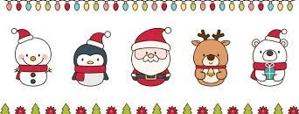
Christmas
NOUN
Definition – the annual Christian festival celebrating Christ's birth, held on 25 December in the Western Church

Slide 85
I love decorating the house at Christmas.
_________

Slide 86
suffixes ness, ful and ment just add suffix to root

Slide 87
Exceptions -
Words of more than 1 syllable and which end with a consonant followed by a ‘y’ such as merry need to have the y changed to an ‘i’

Slide 88
suffixes

Slide 89
-ness

Slide 90
-ful

Slide 91
-ment

Slide 92
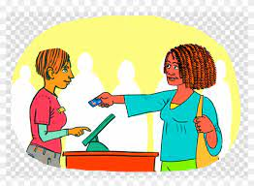
pay

Slide 93
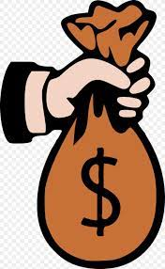
payment

Slide 94

care

Slide 95

careful

Slide 96

grace

Slide 97
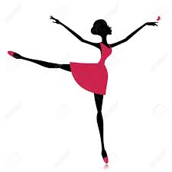
graceful

Slide 98
Let’s Teach and Practise

Slide 99
Suffix
-tion

Slide 100
-tion

Slide 101

motion

Slide 102
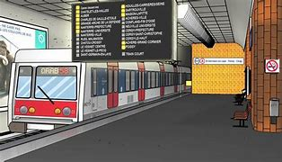
station

Slide 103
motion
NOUN
Definition – the action or process of moving or being moved

Slide 104
station
NOUN
Definition – a place on a railway line where trains regularly stop so that passengers can get on or off

Slide 105
The boat had a rocking and rolling motion.
______

Slide 106
We walked back to the station and caught the train back to London.
_______

Slide 107
New CHALLENGE words.

Slide 108
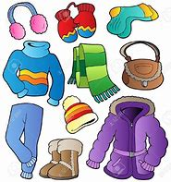
clothes
NOUN
Definition - items worn to cover the body

Slide 109
They stripped off their clothes to go swimming.
_______

Slide 110
people
NOUN
Definition - human beings in general or considered collectively

Slide 111
The people listened as the choir sang.
______

Slide 112

Wednesday
NOUN
Definition - the day of the week before Thursday and following Wednesday

Slide 113
On Wednesday we have PE.
_________

Slide 114
Let’s investigate.

Slide 115
Can you spot the spelling errors in these sentences?
Write the correct spelling and explain where they went wrong.

Slide 116
On Wensday, some pepal went to a stachon to catch a train.

Slide 117
On Wensday, some pepal went to a stachon to catch a train.

Slide 118
On Wensday, some pepal went to a stachon to catch a train.
Wednesday – ‘dnes’ not ‘ns’

Slide 119
On Wensday, some pepal went to a stachon to catch a train. people – ‘le’ not ‘al’

Slide 120
On Wensday, some pepal went to a stachon to catch a train. station – ‘tion’ not ‘chon’

Slide 121
On Wednesday, some people went to a station to catch a train.

Slide 122
Year 2 - Summer 1
Week 6 - Thursday

Slide 124
Let’s Revisit and Review…

Slide 125
Do you remember this challenge word?

Slide 126

great
ADJECTIVE
Definition - of an extent, amount, or intensity considerably above average

Slide 127
Elizabeth was a great queen.
_____

Slide 128

break
VERB
Definition – separate or cause to separate into pieces as a result of a blow, shock, or strain

Slide 129
Luckily, the vase didn’t break.
_____

Slide 130
suffixes ly and less just add suffix to root

Slide 131
Exceptions -
Words of more than 1 syllable and which end with a consonant followed by a ‘y’ such as merry need to have the y changed to an ‘i’

Slide 132
suffixes

Slide 133
-ly

Slide 134
-less

Slide 135
-less opposite

Slide 136

bad

Slide 137
badly

Slide 138
love

Slide 139
lovely

Slide 140
Let’s Teach and Practise

Slide 141
Prefix un- meaning NOT

Slide 142
un-

Slide 143

unemployment

Slide 144
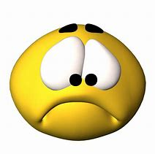
unhappy

Slide 145
unemployment
NOUN
Definition – not employed

Slide 146
unhappy
ADJECTIVE
Definition – not happy

Slide 147
Unemployment has fallen in our country.
____________

Slide 148
The cat was unhappy because it had rained all day.
_______

Slide 149
New CHALLENGE words.

Slide 150

water
NOUN
Definition - a colourless liquid that forms the seas, lakes, rivers, and rain and is the basis of the fluids of living organisms

Slide 151
May I have a drink of water?
_____

Slide 152

again
ADVERB
Definition - another time; once more

Slide 153
I want to dance again.
_____

Slide 154

Thursday
NOUN
Definition - the day of the week before Friday and following Thursday

Slide 155
We have music on Thursday.
________

Slide 156
Let’s investigate.

Slide 157
Can you spot the spelling errors in these sentences?
Write the correct spelling and explain where they went wrong.

Slide 158
On Thersday, people seemed un happy agane.

Slide 159
On Thersday, people seemed un happy agane.

Slide 160
On Thersday, people seemed un happy agane.
Thursday – ‘ur’ not ‘er’

Slide 161
On Thersday, people seemed un happy agane. unhappy – one word not two

Slide 162
On Thersday, people seemed un happy agane. again – ‘ai’ not a_e’

Slide 163
On Thursday, people seemed unhappy again.

Slide 164
Year 2 - Summer 1
Week 6 - Friday

Slide 166
Let’s Revisit and Review…

Slide 167
Do you remember this challenge word?

Slide 168
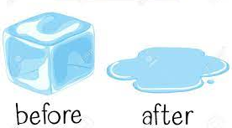
after
PREPOSITION
Definition - in the time following (an event or another period of time)

Slide 169
After a while they returned.
_____

Slide 170
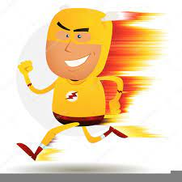
fast
ADJECTIVE
Definition - moving or capable of moving at high speed

Slide 171
I have a fast car
____

Slide 172
homophones and near homophones

Slide 173
homophones homo = same phone = sound

Slide 174
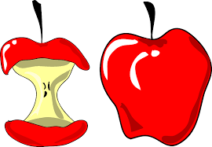
whole

Slide 175

hole

Slide 176
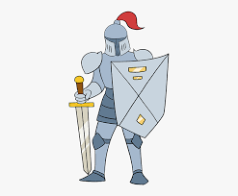
knight

Slide 177
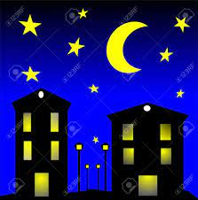
night

Slide 178
Let’s Teach and Practise

Slide 179
Grow the Code
‘ue’ and ‘ew’

Slide 180
ue ew

Slide 181
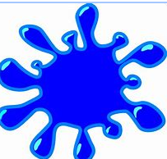
blue

Slide 182
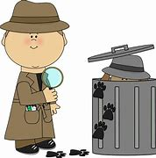
clue

Slide 183

true

Slide 184
blue
ADJECTIVE
Definition – of a colour intermediate between green and violet, as of the sky or sea on a sunny day

Slide 185
clue
NOUN
Definition – a piece of evidence or information used in the detection of a crime

Slide 186
true
ADJECTIVE
Definition – in accordance with fact or reality

Slide 187
The sky was clear blue.
____

Slide 188
Detectives search for clues.
_____

Slide 189
It was a true story.
____

Slide 190
New CHALLENGE words.

Slide 191
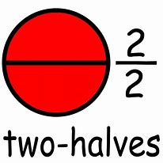
half
NOUN
Definition - either of two equal or corresponding parts into which something is or can be divided.

Slide 192
The baby was two and a half.
____

Slide 193

money
NOUN
Definition - a current medium of exchange in the form of coins and banknotes

Slide 194
I counted the money.
_____

Slide 195
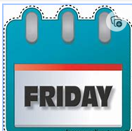
Friday
NOUN
Definition - the day of the week before Saturday and following Thursday

Slide 196
There was a party on Friday.
______

Slide 197
Let’s investigate.

Slide 198
Can you spot the spelling errors in these sentences?
Write the correct spelling and explain where they went wrong.

Slide 199
On Fryday, only harf of the sky was blew.

Slide 200
On Fryday, only harf of the sky was blew.

Slide 201
On Fryday, only harf of the sky was blew.
Friday – ‘i’ not ‘y’

Slide 202
On Fryday, only harf of the sky was blew. half – ‘l’ not ‘r’

Slide 203
On Fryday, only harf of the sky was blew. blue – ‘ue’ not ‘ew’ incorrect homophone

Slide 204
On Friday, only half of the sky was blue.

