Slide 1
Spelling Y2
Mastering spellings: building on the foundations of phonics
Summer 2
Week 4
Notes:
These slides are the same as Y2 Summer 2 as this is a revisit and review half term

Slide 2
Year 2 - Summer 2
Week 4 - Monday
Notes:
Revisit and review the words from Y2 and challenge words – I say, we say, you say
Ask children to write words only in their spelling book
Introduce the new spelling rule
Children to write the new spelling rule words and challenge words into books when the sentences are shown with the spelling word missing.
Read the extract with the class as choral reading. Practise model of prosody etc.
Ask children to find the spelling words from the session in the text.
Then read allowed the chosen sentence for children to write fully in their books.
Show the extract and ask children to then edit their work to check they were correct in their dictation.

Slide 3
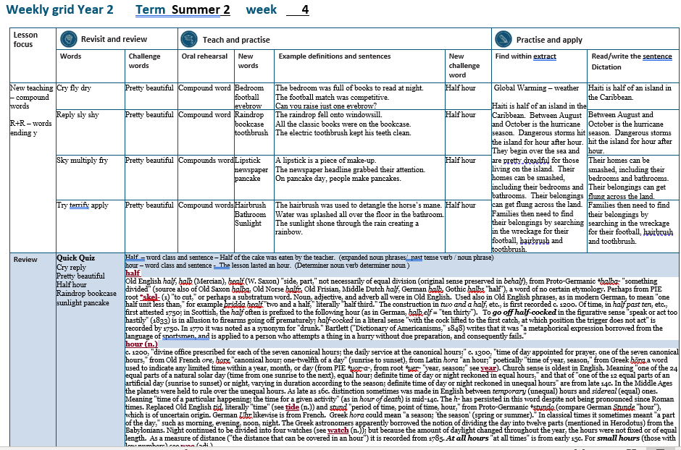

Slide 4
Let’s Revisit and Review…

Slide 5
Do you remember this challenge word?

Slide 6

Definition – attractive in a delicate way
pretty
adjective

Slide 7
The flower was pretty.
______

Slide 8
Do you remember this challenge word?

Slide 9

Definition – pleasing to the eye
beautiful
adjective

Slide 10
The butterfly was beautiful.
_________

Slide 11
Words ending
-y

Slide 12
-y
Notes:
Sound of aI

Slide 13
-y
This is by far the most common spelling for this sound at the end of words.

Slide 14

cry

Slide 15


fly
verb
noun

Slide 16
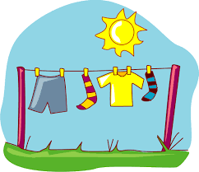
dry

Slide 17
Let’s Teach and Practise

Slide 18
Compound Words

Slide 19
Compound Words

Slide 20
Compound Words
Two or more words that have been grouped together to create a new word that has a different, individual meaning.

Slide 21
bedroom

Slide 22
football n

Slide 23
eyebrow

Slide 24
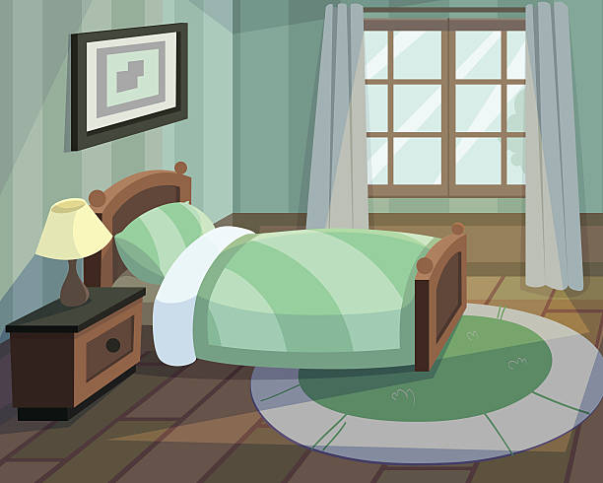

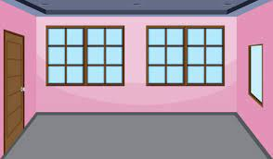
Definition – a room for sleeping in
+ =
bedroom
bed + room = bedroom
(noun)

Slide 25

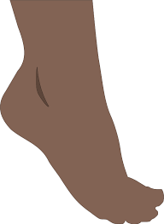

Definition – any game involving kicking a ball
+ =
football
foot + ball = football
(noun)

Slide 26



Definition – a strip of hair above the eye
+ =
eyebrow
eye + brow = eyebrow
(noun)
Notes:
Brow being forehead

Slide 27
The bedroom was full of books to read at night.
_______

Slide 28
The football match was competitive.
________

Slide 29
Can you raise just one eyebrow?
_______

Slide 30
New CHALLENGE words.

Slide 31
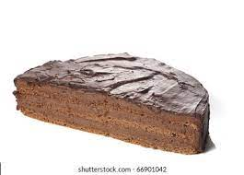
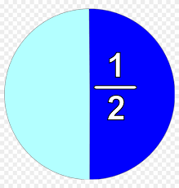
Definition - either of two equal or corresponding parts into which something is or can be divided
half
NOUN

Slide 32
Half of the cake was eaten by the teacher.
____

Slide 33
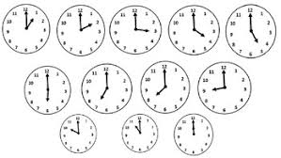
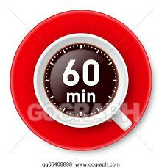
Definition - a period of time equal to a twenty-fourth part of a day and night and divided into 60 minutes
hour
NOUN

Slide 34
The lesson lasted an hour.
____

Slide 35
Let’s Practise and Apply.

Slide 36
Can you spot the spelling rule words and the challenge words?

Slide 37
Global Warming – weather
Haiti is half of a beautiful island in the Caribbean. Between August and October is the hurricane season. Dangerous storms hit the island for hour after hour. They begin over the sea and are pretty dreadful for those living on the island. Their homes can be smashed, including their bedrooms and bathrooms. Their belongings can get flung across the land. Families then need to find their belongings by searching in the wreckage for their football, hairbrush and toothbrush.

Slide 38
Global Warming – weather
Haiti is half of a beautiful island in the Caribbean. Between August and October is the hurricane season. Dangerous storms hit the island for hour after hour. They begin over the sea and are pretty dreadful for those living on the island. Their homes can be smashed, including their bedrooms and bathrooms. Their belongings can get flung across the land. Families then need to find their belongings by searching in the wreckage for their football, hairbrush and toothbrush.

Slide 39
Write this sentence as I dictate it to you.
Notes:
Haiti is half of a beautiful island in the Caribbean.

Slide 40
Haiti is half of a beautiful island in the Caribbean.
Did you write it correctly?
Edit your work and make sure you have it correct.
Can you underline the spelling word that we have covered in this session?

Slide 41
Year 2 - Summer 2
Week 4 - Tuesday
Notes:
Revisit and review the words from Y2 and challenge words – I say, we say, you say
Ask children to write words only in their spelling book
Introduce the new spelling rule
Children to write the new spelling rule words and challenge words into books when the sentences are shown with the spelling word missing.
Read the extract with the class as choral reading. Practise model of prosody etc.
Ask children to find the spelling words from the session in the text.
Then read allowed the chosen sentence for children to write fully in their books.
Show the extract and ask children to then edit their work to check they were correct in their dictation.

Slide 43
Let’s Revisit and Review…

Slide 44
Do you remember this challenge word?

Slide 45
Definition – attractive in a delicate way
pretty
adjective

Slide 46
The flower was pretty.
______

Slide 47
Do you remember this challenge word?

Slide 48
Definition – pleasing to the eye
beautiful
adjective

Slide 49
The butterfly was beautiful.
_________

Slide 50
Words ending
-y

Slide 51
-y
Notes:
Sound of aI

Slide 52
-y
This is by far the most common spelling for this sound at the end of words.

Slide 53

reply

Slide 54
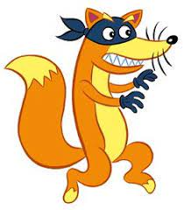
sly

Slide 55
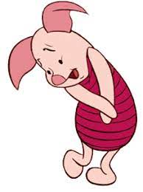
shy

Slide 56
Let’s Teach and Practise

Slide 57
Compound Words

Slide 58
Compound Words

Slide 59
Compound Words
Two or more words that have been grouped together to create a new word that has a different, individual meaning.

Slide 60
raindrop

Slide 61
bookcase n

Slide 62
toothbrush

Slide 63
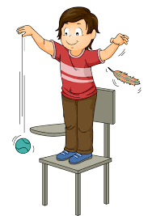

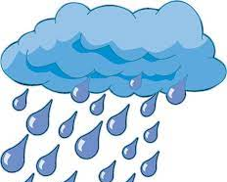
Definition – a single drop of rain
+ =
raindrop
rain + drop = raindrop
(noun)

Slide 64



Definition – shelves for books
+ =
bookcase
book + case = bookcase
(noun)

Slide 65

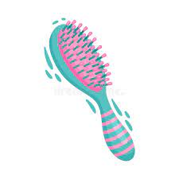

Definition – a small brush to clean teeth
+ =
toothbrush
tooth + brush = toothbrush
(noun)
Notes:
Brow being forehead

Slide 66
The raindrop fell onto the windowsill.
________

Slide 67
All the classic books were on the bookcase.
________

Slide 68
The electric toothbrush kept his teeth clean.
__________

Slide 69
New CHALLENGE words.

Slide 70
Definition - either of two equal or corresponding parts into which something is or can be divided
half
NOUN

Slide 71
Half of the cake was eaten by the teacher.
____

Slide 72
Definition - a period of time equal to a twenty-fourth part of a day and night and divided into 60 minutes
hour
NOUN

Slide 73
The lesson lasted an hour.
____

Slide 74
Let’s Practise and Apply.

Slide 75
Can you spot the spelling rule words and the challenge words?

Slide 76
Global Warming – weather
Haiti is half of a beautiful island in the Caribbean. Between August and October is the hurricane season. Dangerous storms hit the island for hour after hour. They begin over the sea and are pretty dreadful for those living on the island. Their homes can be smashed, including their bedrooms and bathrooms. Their belongings can get flung across the land. Families then need to find their belongings by searching in the wreckage for their football, hairbrush and toothbrush.

Slide 77
Global Warming – weather
Haiti is half of a beautiful island in the Caribbean. Between August and October is the hurricane season. Dangerous storms hit the island for hour after hour. They begin over the sea and are pretty dreadful for those living on the island. Their homes can be smashed, including their bedrooms and bathrooms. Their belongings can get flung across the land. Families then need to find their belongings by searching in the wreckage for their football, hairbrush and toothbrush.

Slide 78
Write this sentence as I dictate it to you.
Notes:
Dangerous storms hit the island for hour after hour.

Slide 79
Dangerous storms hit the island for hour after hour.
Did you write it correctly?
Edit your work and make sure you have it correct.
Can you underline the spelling word that we have covered in this session?

Slide 80
Year 2 - Summer 2
Week 4 - Wednesday
Notes:
Revisit and review the words from Y2 and challenge words – I say, we say, you say
Ask children to write words only in their spelling book
Introduce the new spelling rule
Children to write the new spelling rule words and challenge words into books when the sentences are shown with the spelling word missing.
Read the extract with the class as choral reading. Practise model of prosody etc.
Ask children to find the spelling words from the session in the text.
Then read allowed the chosen sentence for children to write fully in their books.
Show the extract and ask children to then edit their work to check they were correct in their dictation.

Slide 82
Let’s Revisit and Review…

Slide 83
Do you remember this challenge word?

Slide 84
Definition – attractive in a delicate way
pretty
adjective

Slide 85
The flower was pretty.
______

Slide 86
Do you remember this challenge word?

Slide 87
Definition – pleasing to the eye
beautiful
adjective

Slide 88
The butterfly was beautiful.
_________

Slide 89
Words ending
-y

Slide 90
-y
Notes:
Sound of aI

Slide 91
-y
This is by far the most common spelling for this sound at the end of words.

Slide 92

sky

Slide 93

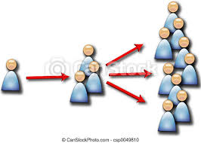
multiply

Slide 94
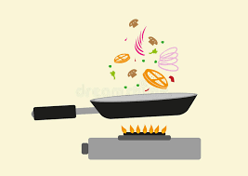
fry

Slide 95
Let’s Teach and Practise

Slide 96
Compound Words

Slide 97
Compound Words

Slide 98
Compound Words
Two or more words that have been grouped together to create a new word that has a different, individual meaning.

Slide 99
lipstick

Slide 100
newspaper n

Slide 101
pancake

Slide 102



Definition – coloured make up for lips
+ =
lipstick
lip + stick = lipstick
(noun)

Slide 103



Definition – a printed paper containing news
+ =
newspaper
news + paper = newspaper
(noun)

Slide 104

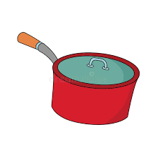

Definition – a thin, flat cake of batter, fried on both sides in a pan and typically rolled up with a sweet or savoury filling
+ =
pancake
pan + cake = pancake
(noun)
Notes:
Brow being forehead

Slide 105
A lipstick is a piece of make-up.
________

Slide 106
The newspaper headline grabbed their attention.
_________

Slide 107
On pancake day, people make pancakes.
_______

Slide 108
New CHALLENGE words.

Slide 109
Definition - either of two equal or corresponding parts into which something is or can be divided
half
NOUN

Slide 110
Half of the cake was eaten by the teacher.
____

Slide 111
Definition - a period of time equal to a twenty-fourth part of a day and night and divided into 60 minutes
hour
NOUN

Slide 112
The lesson lasted an hour.
____

Slide 113
Let’s Practise and Apply.

Slide 114
Can you spot the spelling rule words and the challenge words?

Slide 115
Global Warming – weather
Haiti is half of a beautiful island in the Caribbean. Between August and October is the hurricane season. Dangerous storms hit the island for hour after hour. They begin over the sea and are pretty dreadful for those living on the island. Their homes can be smashed, including their bedrooms and bathrooms. Their belongings can get flung across the land. Families then need to find their belongings by searching in the wreckage for their football, hairbrush and toothbrush.

Slide 116
Global Warming – weather
Haiti is half of a beautiful island in the Caribbean. Between August and October is the hurricane season. Dangerous storms hit the island for hour after hour. They begin over the sea and are pretty dreadful for those living on the island. Their homes can be smashed, including their bedrooms and bathrooms. Their belongings can get flung across the land. Families then need to find their belongings by searching in the wreckage for their football, hairbrush and toothbrush.

Slide 117
Write this sentence as I dictate it to you.
Notes:
Their homes can be smashed, including their bedrooms and bathrooms.

Slide 118
Their homes can be smashed, including their bedrooms and bathrooms.
Did you write it correctly?
Edit your work and make sure you have it correct.
Can you underline the spelling word that we have covered in this session?

Slide 119
Year 2 - Summer 2
Week 4 - Thursday
Notes:
Revisit and review the words from Y2 and challenge words – I say, we say, you say
Ask children to write words only in their spelling book
Introduce the new spelling rule
Children to write the new spelling rule words and challenge words into books when the sentences are shown with the spelling word missing.
Read the extract with the class as choral reading. Practise model of prosody etc.
Ask children to find the spelling words from the session in the text.
Then read allowed the chosen sentence for children to write fully in their books.
Show the extract and ask children to then edit their work to check they were correct in their dictation.

Slide 121
Let’s Revisit and Review…

Slide 122
Do you remember this challenge word?

Slide 123
Definition – attractive in a delicate way
pretty
adjective

Slide 124
The flower was pretty.
______

Slide 125
Do you remember this challenge word?

Slide 126
Definition – pleasing to the eye
beautiful
adjective

Slide 127
The butterfly was beautiful.
_________

Slide 128
Words ending
-y

Slide 129
-y
Notes:
Sound of aI

Slide 130
-y
This is by far the most common spelling for this sound at the end of words.

Slide 131

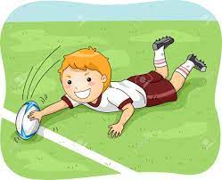
try
noun
verb

Slide 132

terrify

Slide 133

apply

Slide 134
Let’s Teach and Practise

Slide 135
Compound Words

Slide 136
Compound Words

Slide 137
Compound Words
Two or more words that have been grouped together to create a new word that has a different, individual meaning.

Slide 138
hairbrush

Slide 139
bathroom n

Slide 140
sunlight

Slide 141
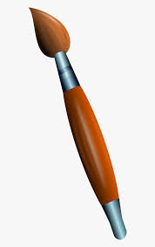
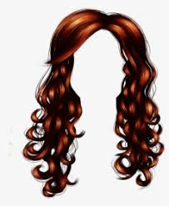
Definition – a brush for smoothing hair
+ =
hairbrush
hair + brush = hairbrush
(noun)

Slide 142
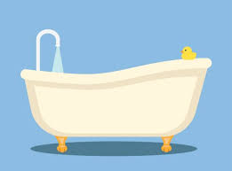
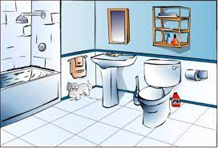
Definition – a room containing a bath or shower with a toilet
+ =
bathroom
bath + room = bathroom
(noun)

Slide 143


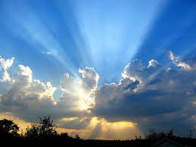
Definition – light from the sun
+ =
sunlight
sun + light = sunlight
(noun)
Notes:
Brow being forehead

Slide 144
The hairbrush was used to detangle the horse’s mane.
_________

Slide 145
Water was splashed all over the floor of the bathroom.
________

Slide 146
The sunlight shone through the rain creating a rainbow.
________

Slide 147
New CHALLENGE words.

Slide 148
Definition - either of two equal or corresponding parts into which something is or can be divided
half
NOUN

Slide 149
Half of the cake was eaten by the teacher.
____

Slide 150
Definition - a period of time equal to a twenty-fourth part of a day and night and divided into 60 minutes
hour
NOUN

Slide 151
The lesson lasted an hour.
____

Slide 152
Let’s Practise and Apply.

Slide 153
Can you spot the spelling rule words and the challenge words?

Slide 154
Global Warming – weather
Haiti is half of a beautiful island in the Caribbean. Between August and October is the hurricane season. Dangerous storms hit the island for hour after hour. They begin over the sea and are pretty dreadful for those living on the island. Their homes can be smashed, including their bedrooms and bathrooms. Their belongings can get flung across the land. Families then need to find their belongings by searching in the wreckage for their football, hairbrush and toothbrush.

Slide 155
Global Warming – weather
Haiti is half of a beautiful island in the Caribbean. Between August and October is the hurricane season. Dangerous storms hit the island for hour after hour. They begin over the sea and are pretty dreadful for those living on the island. Their homes can be smashed, including their bedrooms and bathrooms. Their belongings can get flung across the land. Families then need to find their belongings by searching in the wreckage for their football, hairbrush and toothbrush.

Slide 156
Write this sentence as I dictate it to you.
Notes:
Families then need to find their belongings by searching in the wreckage for their football, hairbrush and toothbrush.

Slide 157
Families then need to find their belongings by searching in the wreckage for their football, hairbrush and toothbrush.
Did you write it correctly?
Edit your work and make sure you have it correct.
Can you underline the spelling word that we have covered in this session?

Slide 158
Year 2 - Summer 2
Week 4 - Friday
Notes:
Click through the slides for all the R+R words for the week (both the focus and the challenge words)
Click through the slides for all the new learning this week

Slide 160
Old challenge words…

Slide 161
pretty

Slide 162
beautiful

Slide 163
Old spelling rule words…

Slide 164
cry

Slide 165
fly

Slide 166
dry

Slide 167
reply

Slide 168
sly

Slide 169
shy

Slide 170
sky

Slide 171
multiply

Slide 172
fry

Slide 173
try

Slide 174
terrify

Slide 175
apply

Slide 176
New spelling rule words…

Slide 177
bedroom

Slide 178
football

Slide 179
eyebrow

Slide 180
raindrop

Slide 181
bookcase

Slide 182
toothbrush

Slide 183
lipstick

Slide 184
newspaper

Slide 185
pancake

Slide 186
hairbrush

Slide 187
bathroom

Slide 188
sunlight

Slide 189
New challenge words…

Slide 190
half

Slide 191
hour

Slide 192
Quick Quiz time…
Notes:
Say these words for the quiz
Cry reply pretty beautiful half hour raindrop bookcase sunlight pancake

Slide 193
Did you get them correct?
Edit your work.
cry reply pretty beautiful half hour raindrop bookcase sunlight pancake

Slide 194
Word class time…

Slide 195
Half of the cake was eaten by the teacher.
Notes:
Ask for these words to be classed

Slide 196
Half of the cake was eaten by the teacher.
expanded noun phrase verb noun phrase
Notes:
Ask for these words to be classed

Slide 197
Half of the cake was eaten by the teacher.
expanded noun phrase verb noun phrase
Notes:
Ask for these words to be classed

Slide 198
The lesson lasted an hour.
Notes:
Ask for these words to be classed

Slide 199
The lesson lasted an hour.
determiner noun verb adverbial

Slide 200
The lesson lasted an hour.
determiner noun verb adverbial

Slide 201
Etymology
The history of a word….

Slide 202
half
Old English half, halb (Mercian), healf (W. Saxon) "side, part," not necessarily of equal division (original sense preserved in behalf), from Proto-Germanic *halba- "something divided" (source also of Old Saxon halba, Old Norse halfr, Old Frisian, Middle Dutch half, German halb, Gothic halbs "half"), a word of no certain etymology. Perhaps from PIE root *skel- (1) "to cut," or perhaps a substratum word. Noun, adjective, and adverb all were in Old English.
Used also in Old English phrases, as in modern German, to mean "one half unit less than," for example þridda healf "two and a half," literally "half third." The construction in two and a half, etc., is first recorded c. 1200. Of time, in half past ten, etc., first attested 1750; in Scottish, the half often is prefixed to the following hour (as in German, halb elf = "ten thirty").
To go off half-cocked in the figurative sense "speak or act too hastily" (1833) is in allusion to firearms going off prematurely; half-cocked in a literal sense "with the cock lifted to the first catch, at which position the trigger does not act" is recorded by 1750. In 1770 it was noted as a synonym for "drunk." Bartlett ("Dictionary of Americanisms," 1848) writes that it was "a metaphorical expression borrowed from the language of sportsmen, and is applied to a person who attempts a thing in a hurry without due preparation, and consequently fails."

Slide 203
hour (n.)
c. 1200, "divine office prescribed for each of the seven canonical hours; the daily service at the canonical hours;" c. 1300, "time of day appointed for prayer, one of the seven canonical hours," from Old French ore, hore "canonical hour; one-twelfth of a day" (sunrise to sunset), from Latin hora "an hour;" poetically "time of year, season," from Greek hōra a word used to indicate any limited time within a year, month, or day (from PIE *yor-a-, from root *yer- "year, season;" see year).
Church sense is oldest in English. Meaning "one of the 24 equal parts of a natural solar day (time from one sunrise to the next), equal hour; definite time of day or night reckoned in equal hours," and that of "one of the 12 equal parts of an artificial day (sunrise to sunset) or night, varying in duration according to the season; definite time of day or night reckoned in unequal hours" are from late 14c. In the Middle Ages the planets were held to rule over the unequal hours. As late as 16c. distinction sometimes was made in English between temporary (unequal) hours and sidereal (equal) ones. Meaning "time of a particular happening; the time for a given activity" (as in hour of death) is mid-14c.
The h- has persisted in this word despite not being pronounced since Roman times. Replaced Old English tid, literally "time" (see tide (n.)) and stund "period of time, point of time, hour," from Proto-Germanic *stundo (compare German Stunde "hour"), which is of uncertain origin. German Uhr likewise is from French.
Greek hora could mean "a season; 'the season' (spring or summer)." In classical times it sometimes meant "a part of the day," such as morning, evening, noon, night. The Greek astronomers apparently borrowed the notion of dividing the day into twelve parts (mentioned in Herodotus) from the Babylonians. Night continued to be divided into four watches (see watch (n.)); but because the amount of daylight changed throughout the year, the hours were not fixed or of equal length.
As a measure of distance ("the distance that can be covered in an hour") it is recorded from 1785. At all hours "at all times" is from early 15c. For small hours (those with low numbers) see wee (adj.).

Slide 204
Let’s investigate….
Can you find words linked to half and hour?

Slide 205
Words linked to half…
Half-measure
Half-moon
Half-mast
Half-price
Half-truth
Half-brother

Slide 206
Words linked to hour…
Hourly
Hourlong
Hourglass
Horometry (art of the measurement of time)
Horologer (clockmaker)

